Slide 1
Session 9
Dense vs Convolutional Neural Networks
Advanced Data Science · NYU Paris · 2026
Paul Dubois

Slide 2
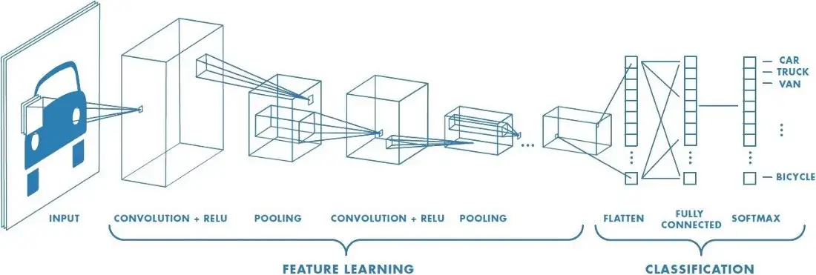
Convolutional layer
Image credit for this section: “A Comprehensive Guide to Convolutional Neural Networks“
https://towardsdatascience.com/a-comprehensive-guide-to-convolutional-neural-networks-the-eli5-way-3bd2b1164a53

Slide 3
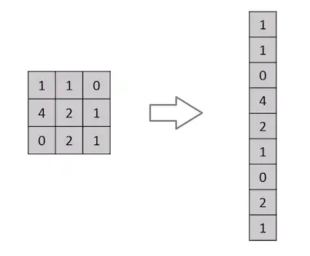
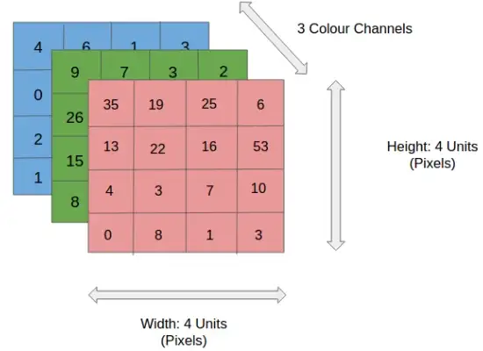
What is wrong with dense layers?

Slide 4

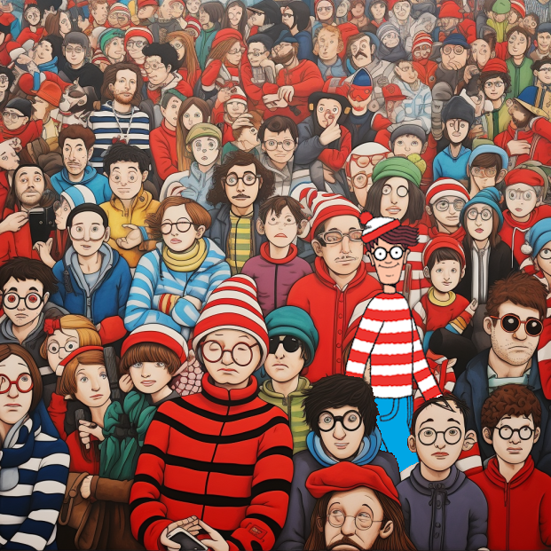
Where is Wally?
Found!

Slide 5

What is a convolution?
1 | 0 | 1
0 | 1 | 0
1 | 0 | 1
“Kernel”

Slide 6
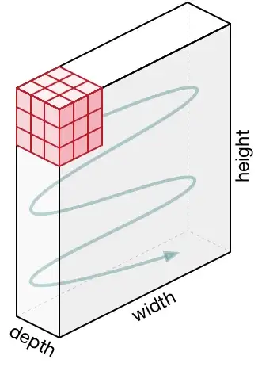
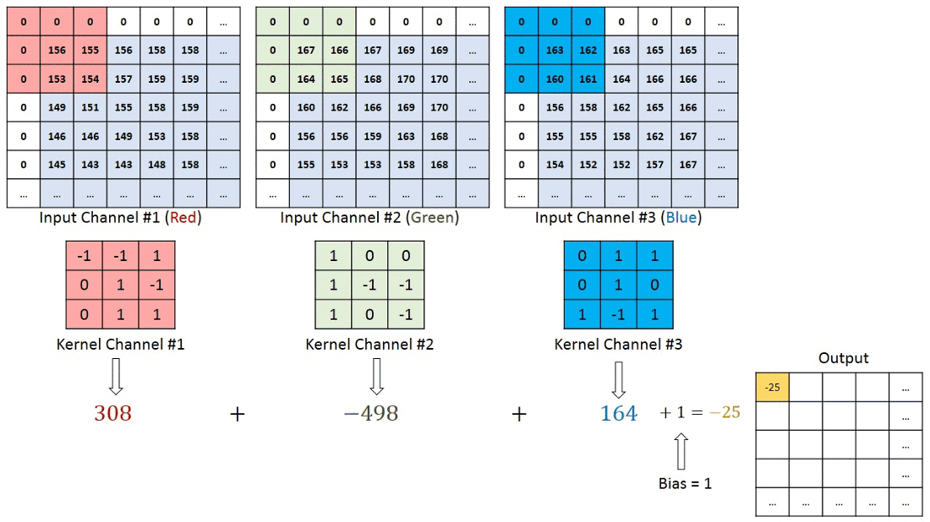
What if image is RGB?

Slide 7

Plain Convolution
Animations credits for this section: https://github.com/vdumoulin/conv_arithmetic/blob/master/README.md
Notes:
Now that we understand the general principle of convolutions, let’s look at addons.
First, we see that the output is smaller than the input (unless the kernel is 1x1); can we try to have an output image that is the same size as the input image?

Slide 8

Padding
Padding
Notes:
Yes! By adding some padding. NB: we can add different type of padding: zeros; specific values; torus; reflection; edges…
This also enables us to better capture what is happening near the edges.
NB: this padding technique is not always used, as not much Is happening on the edges, and we usually want to reduce the size of images.
Now, the images are usually very big, we would like to reduce their dimension, how can we do that?

Slide 9

Striding
Striding
Notes:
Striding manages to reduce the dimension
Can we try to produce better kernels?

Slide 10
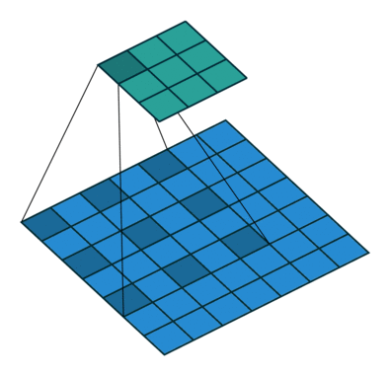
Dilation
1 | 0 | 1
0 | 1 | 0
1 | 0 | 1
Dilation
1 |  | 0 |  | 1
0 |  | 1 |  | 0
1 |  | 0 |  | 1
Notes:
Dilation enables us to have larger kernels without increasing the number of parameters.
NB: this dilation technique is not commonly used.

Slide 11
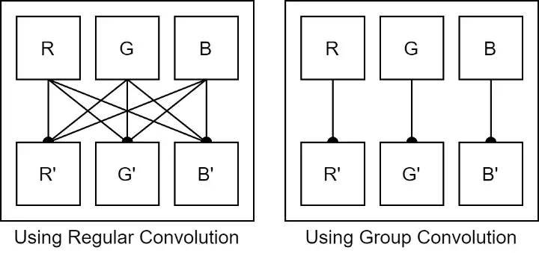
Group convolution
Notes:
Group Convolution enables us to have smaller kernels thus reducing the number of parameters.
NB: this grouping technique is not commonly used, as convolutions have few parameters (compared to dense, for example)

Slide 12
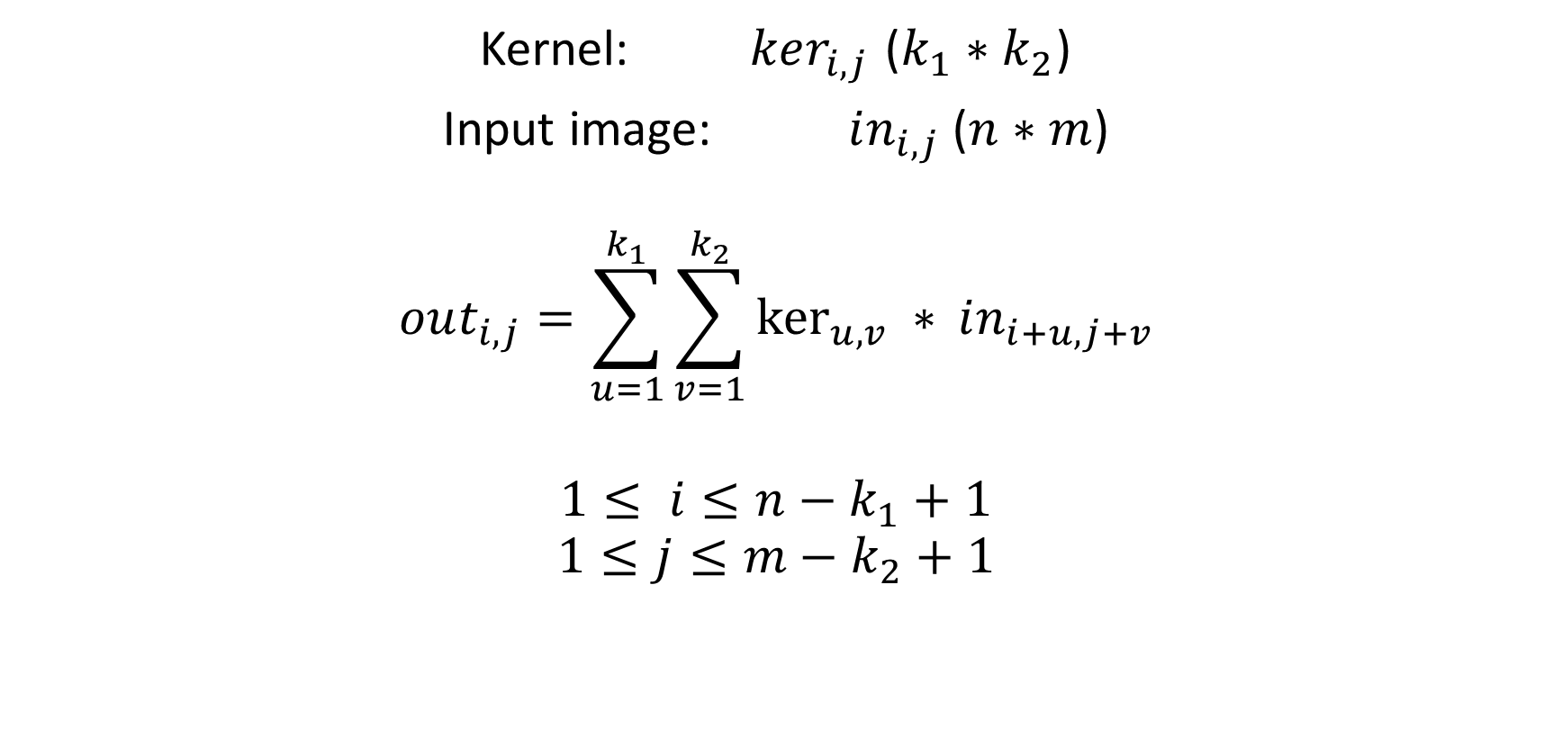
Convolution output formula: plain

Slide 13
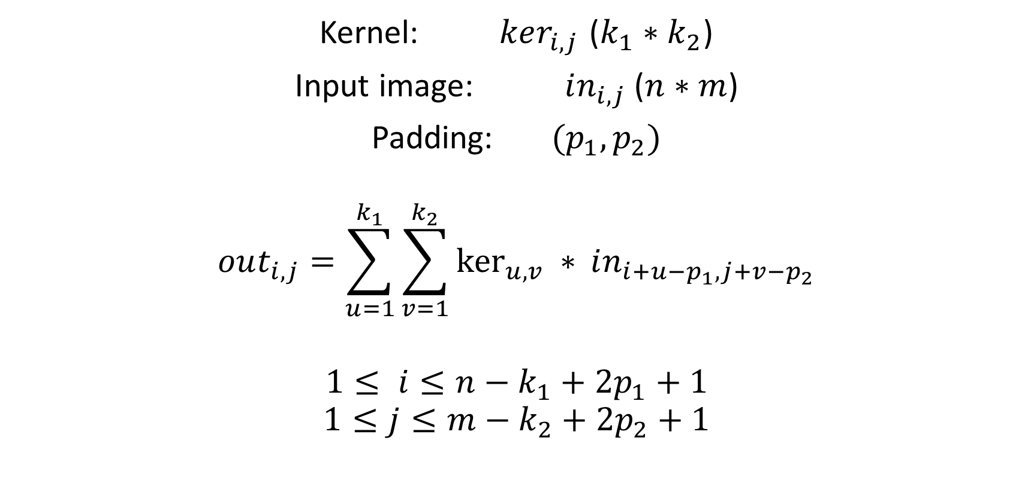
Convolution output formula: padding

Slide 14
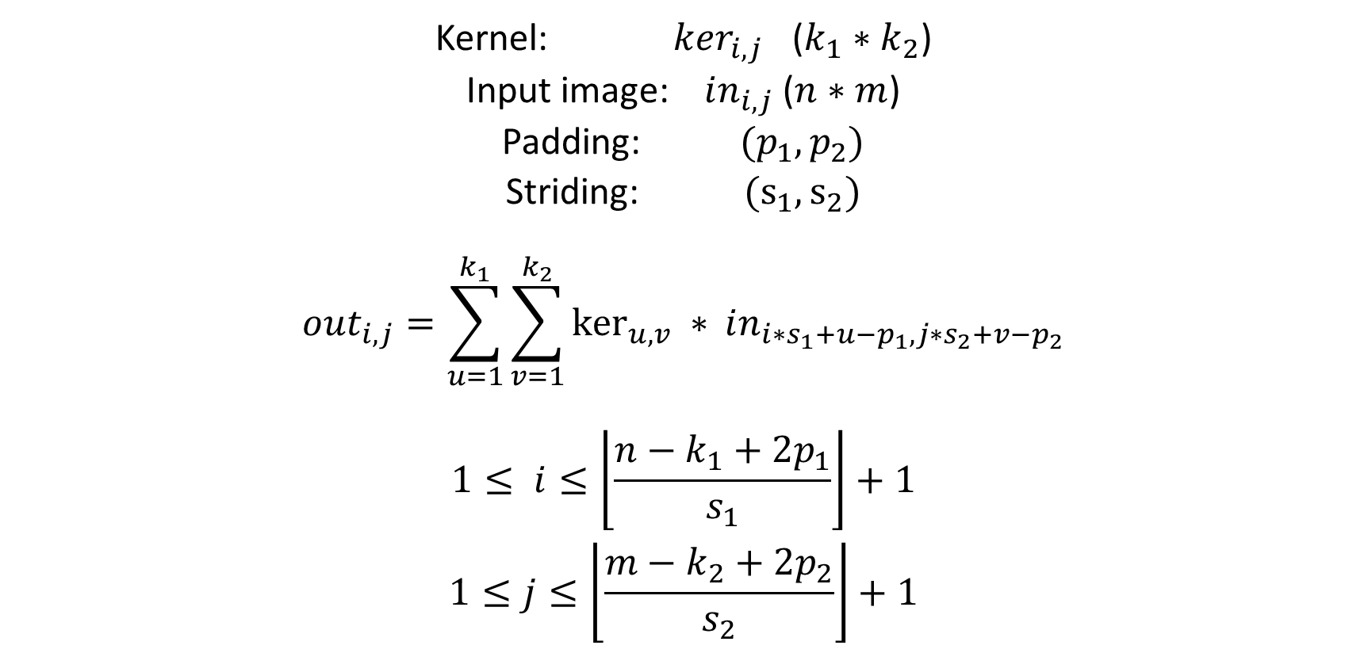
Convolution output formula: striding

Slide 15
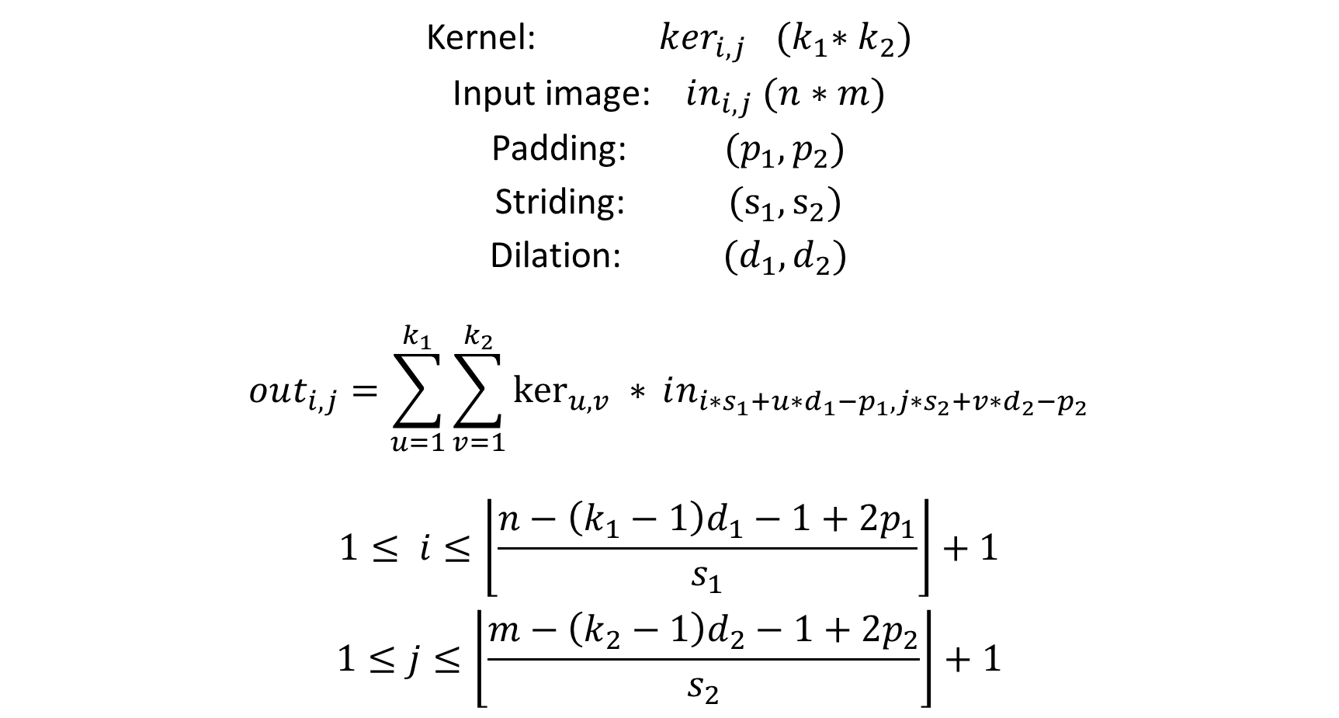
Convolution output formula: dilation

Slide 16
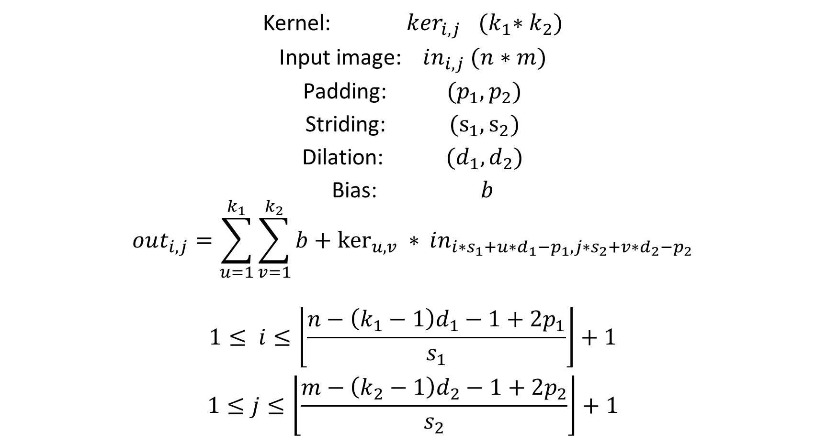
Convolution output formula: bias

Slide 17
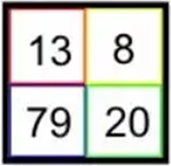
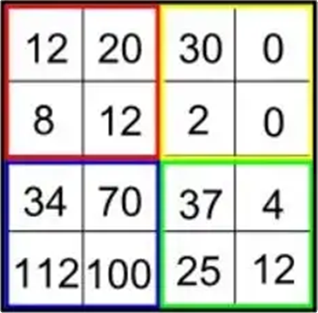
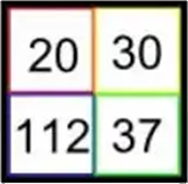
Pooling layer
Average pooling
Max pooling
Notes:
Another technique to reduce the images dimension is to add pooling layers: divide the images to rectangles, and either take the average value, or the maximum.
Note that max pooling is much more popular than the average.
In fact, average pooling is a convolution, with a uniform kernel, while max pooling introduces non-linearity.

Slide 18
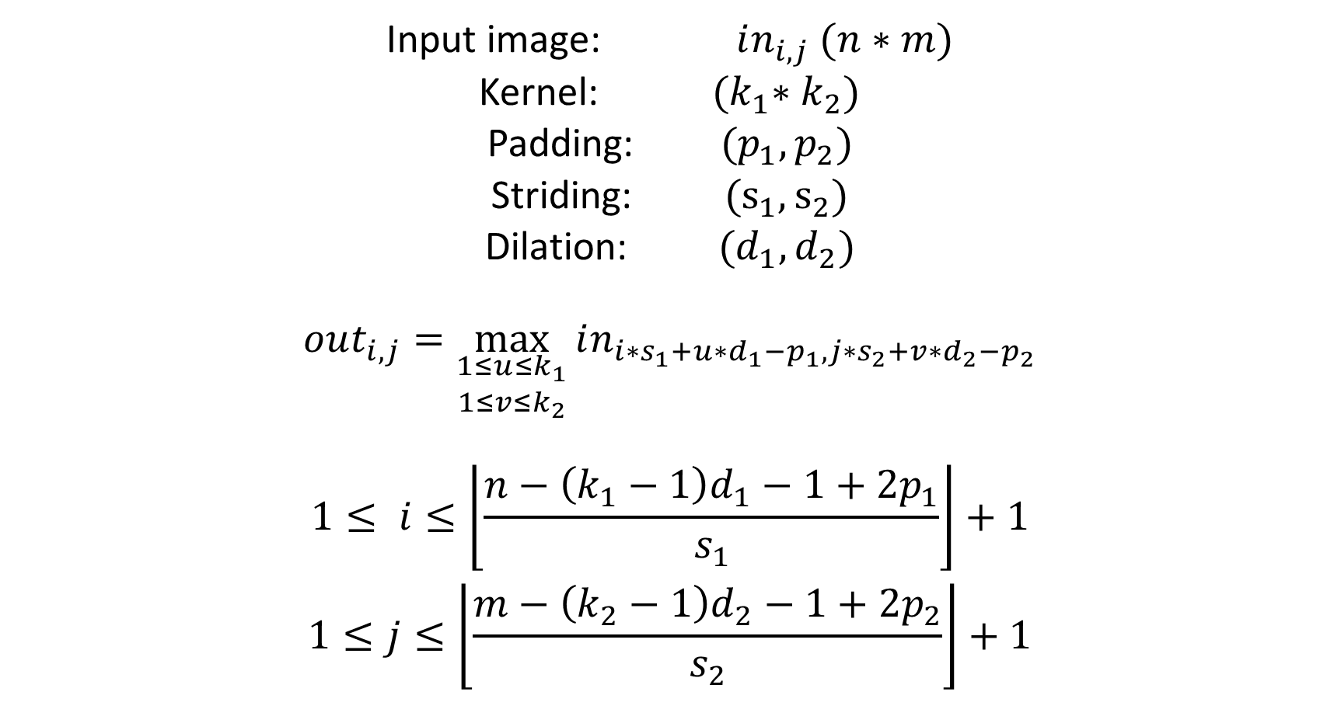
Max pooling output formula

Slide 19
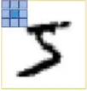

Comparison with dense
Convolution
Dense equivalent

Slide 20
SoftMax Layer
2
0.5
3.2
9.8
1.7
4.2
0.09345794
0.02336449
0.14953271
0.45794393
0.07943925
0.19626168
Normalize
(divide by the norm)

Slide 21
SoftMax Layer
-2
0.5
3.2
9.8
1.7
4.2
-0.11494253
0.02873563
0.18390805
0.56321839
0.09770115
0.24137931
Normalize
(divide by the norm)

Slide 22
SoftMax Layer
-2
0.5
3.2
9.8
1.7
4.2
0.135335283
1.64872127
24.5325302
18033.7449
5.47394739
66.6863310
0.0000746380034
0.0000909277026
0.00135297982
0.994568958
0.000301890604
0.00367778046
Take Exponential
Normalize

Slide 23
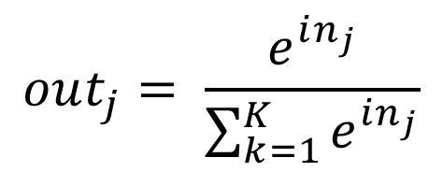
SoftMax Layer
-2
0.5
3.2
9.8
1.7
4.2
-0.11494253
0.02873563
0.18390805
0.56321839
0.09770115
0.24137931
Take SoftMax
(take exponential, then
divide by the norm)

Slide 24
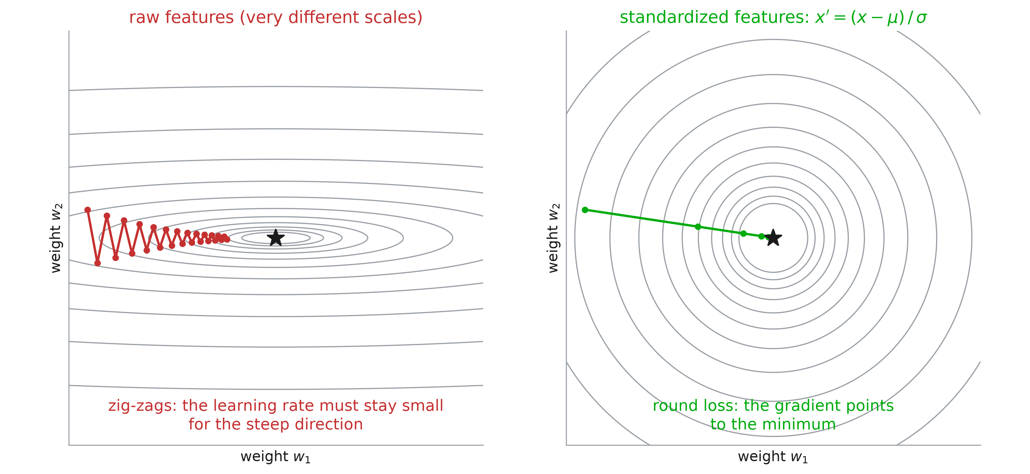
Normalization: why?

Slide 25
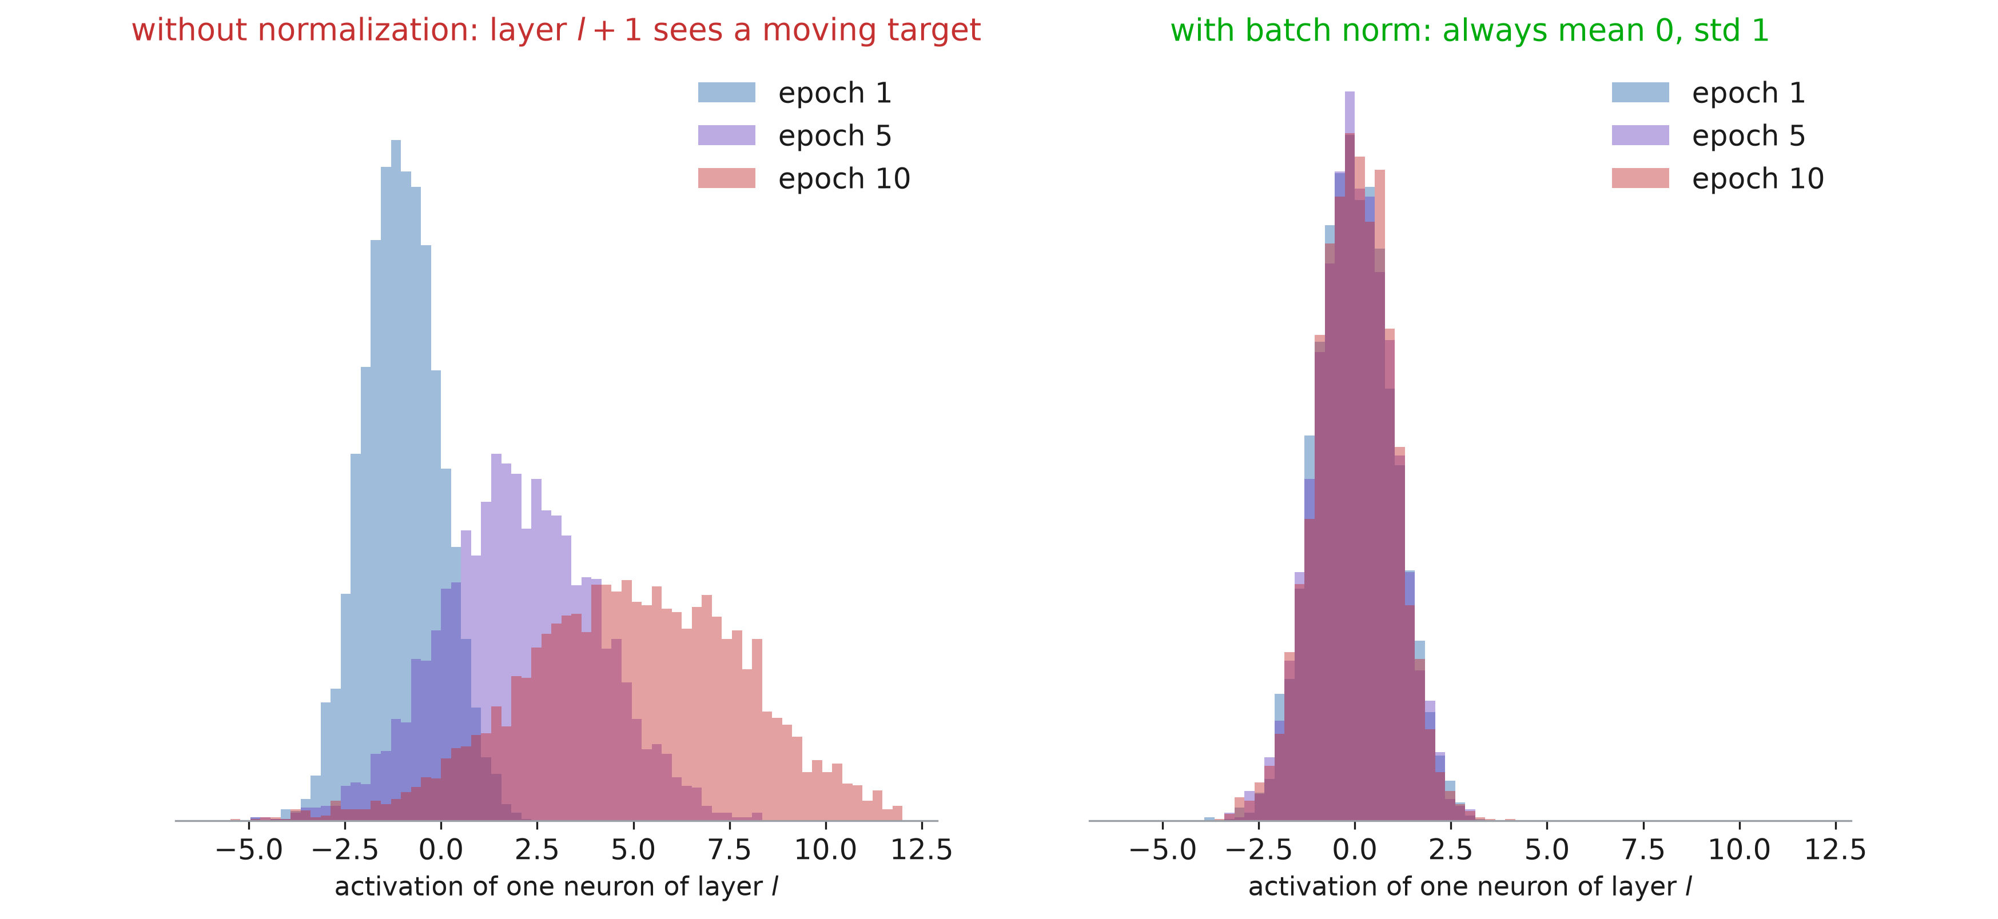
Normalization inside the network

Slide 26
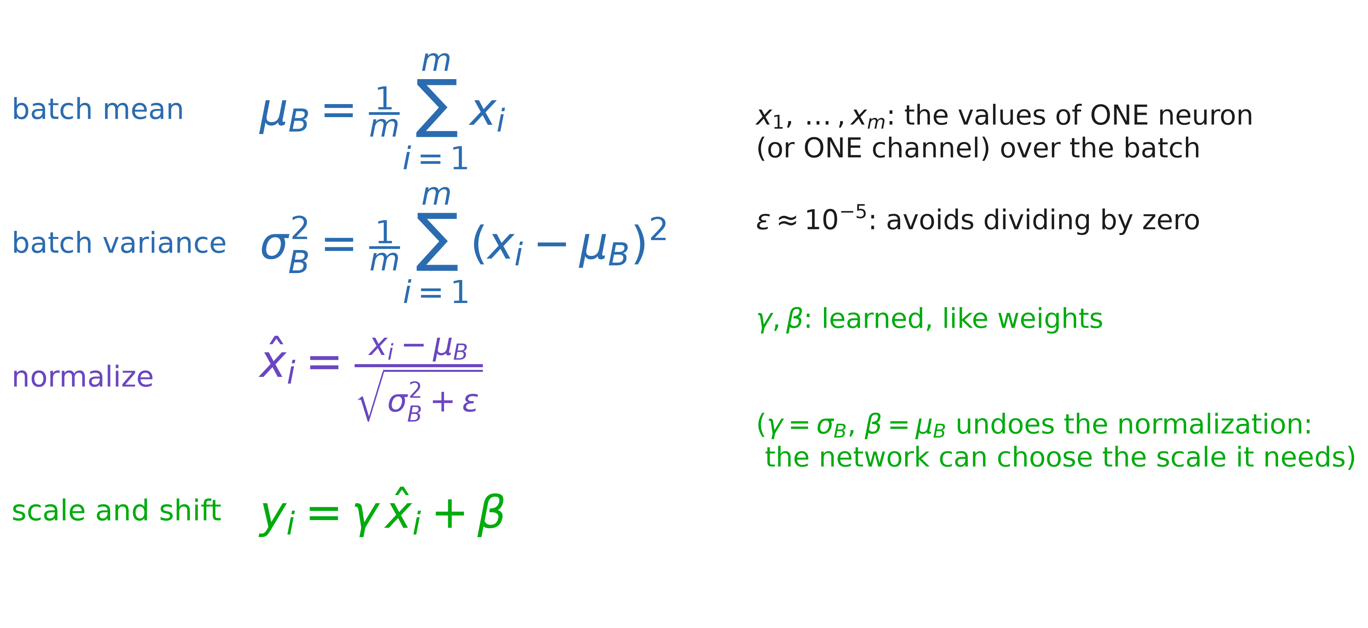
Batch Normalization

Slide 27
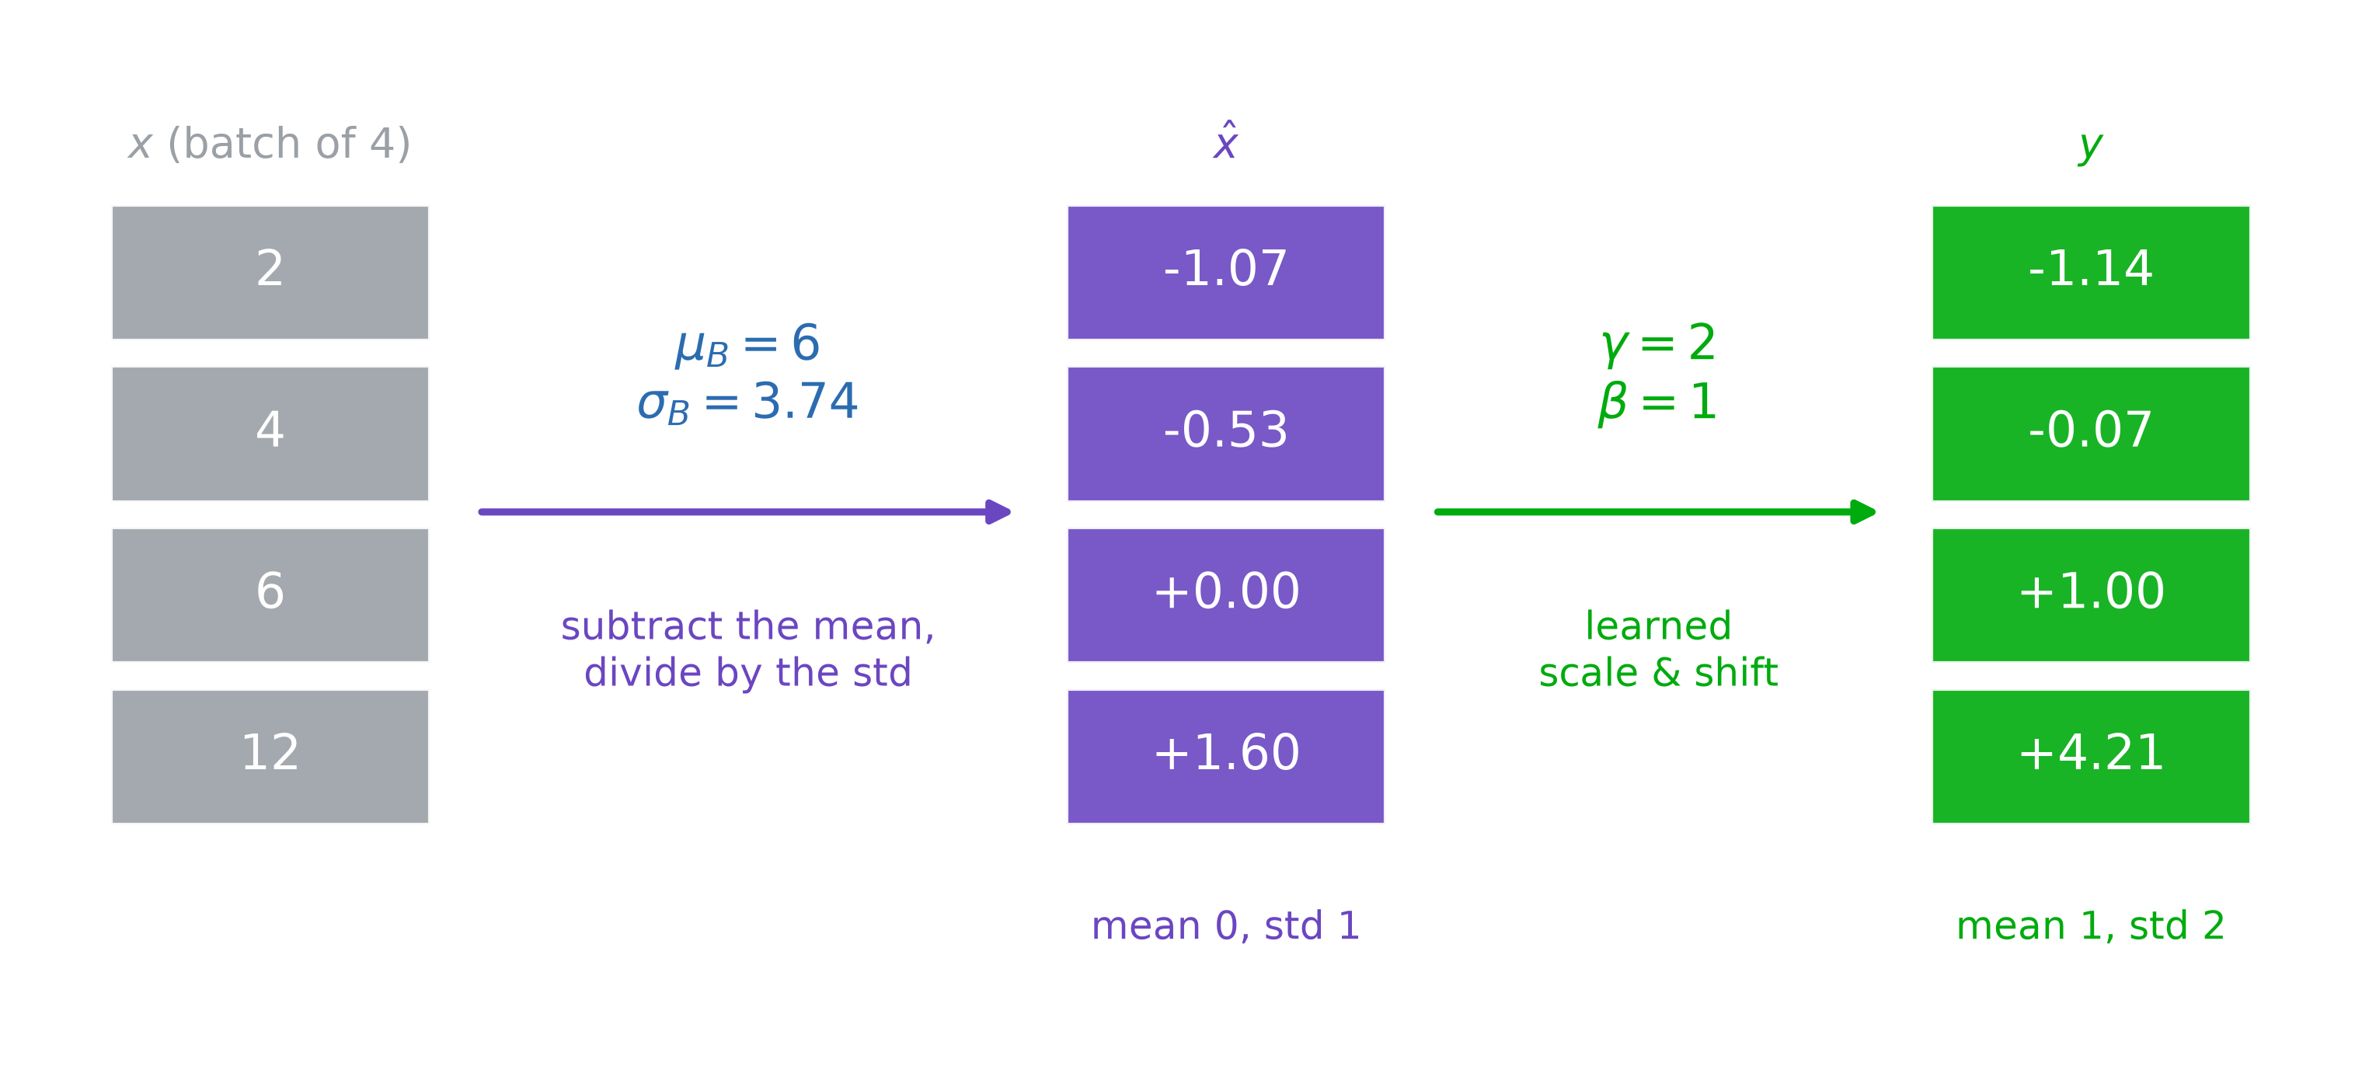
Batch Normalization: example

Slide 28
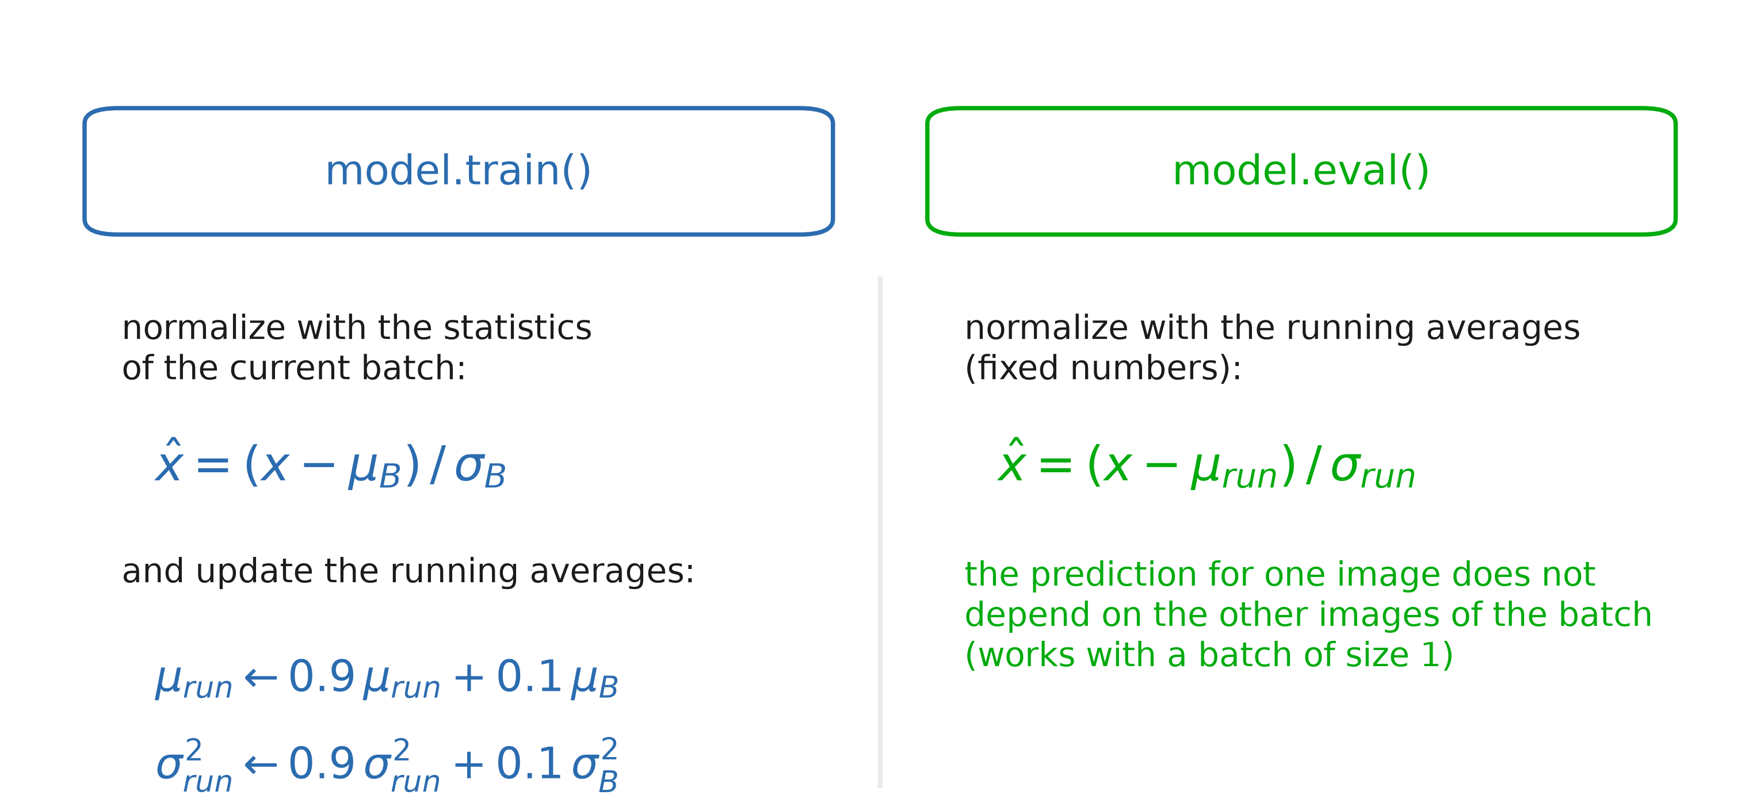
Batch Normalization: train vs eval

Slide 29
Batch Normalization in PyTorch
class SkinConvNet(nn.Module):
def __init__(self, hidden_size=64):
super().__init__()
self.conv1 = nn.Conv2d(3, 8, 5, stride=2)
self.bn1 = nn.BatchNorm2d(8) # per channel
...
self.fc1 = nn.Linear(14 * 14 * 32, hidden_size)
self.bn_fc1 = nn.BatchNorm1d(hidden_size) # one per neuron
def forward(self, x):
x = self.relu(self.bn1(self.conv1(x))) # conv -> BN -> ReLU
...
x = self.relu(self.bn_fc1(self.fc1(x)))
model.train() # before training
model.eval() # before testing

Slide 30
Batch Normalization: pros & cons
Why it helps:
Faster training: larger learning rates, fewer epochs
Less sensitive to the weight initialization
Slight regularization: the batch statistics add noise
Limits:
Needs large enough batches (≥ 16-32), otherwise the statistics are noisy
Behaves differently in train and eval: do not forget model.eval()
Not suited to sequences (RNNs, Transformers): use Layer Norm instead
Where: Linear / Conv → BatchNorm → ReLU (the bias of the layer before is then useless: bias=False)

Slide 31
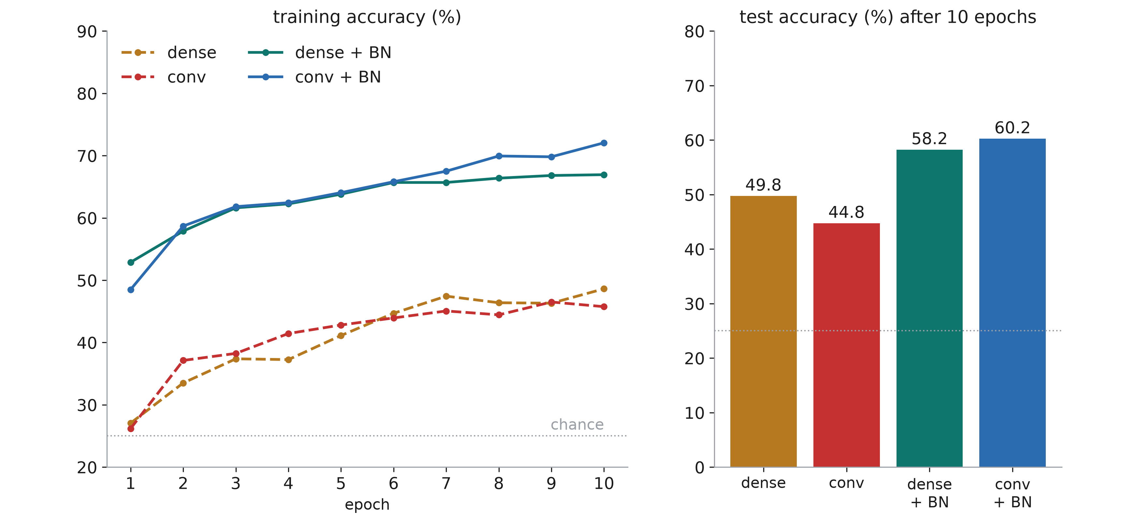
Batch Normalization: results

Slide 32
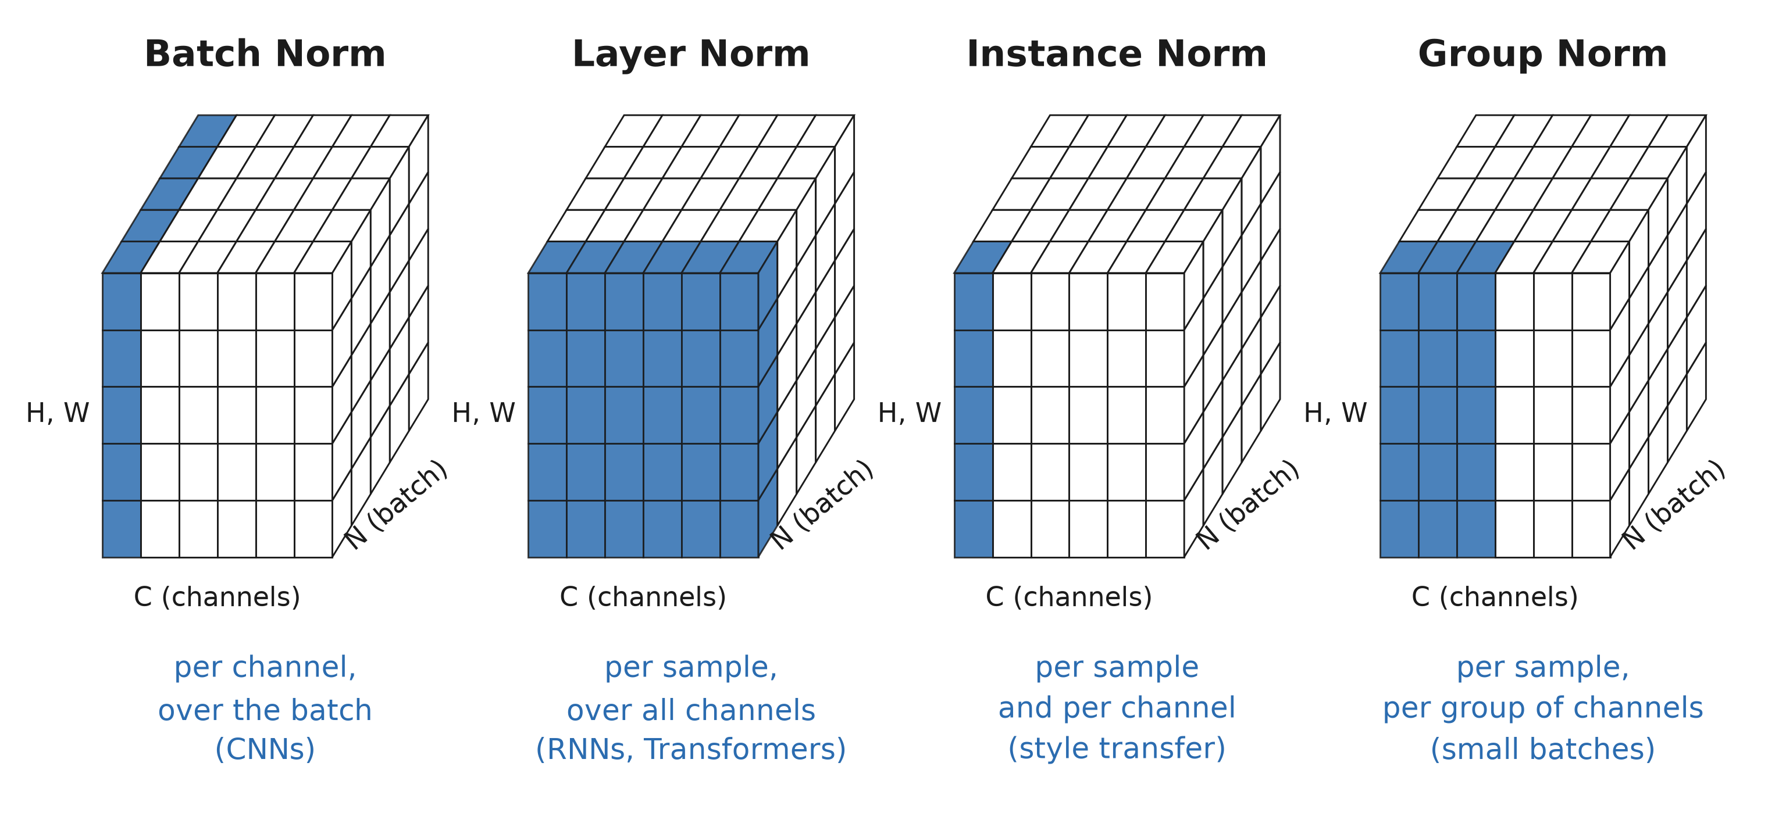
Other normalizations

Slide 33

Data

Slide 34
Data Augmentation: Images
Flip horizontal / vertical
Rotate
Rescale
Crop
Dilate/shrink
Add white noise
Add salt/pepper noise
Add white/black boxes
+ anything that you can think of!

Slide 35
Data Augmentation: Audio
Add white noise
Shifting tone
Vary speed
Filter frequencies (drop/add low/high frequencies)

Slide 36
Data Augmentation: Text
Synonym substitute
Random insertion

Slide 37
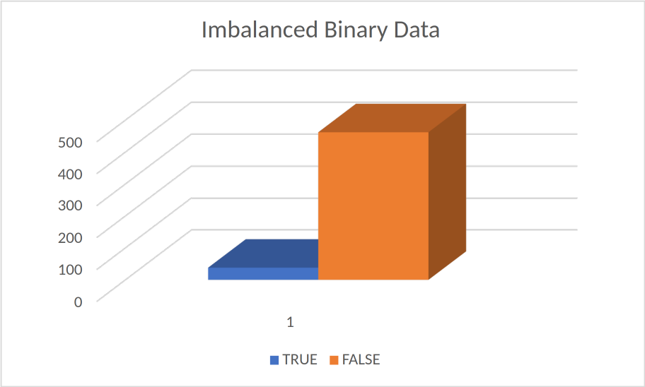
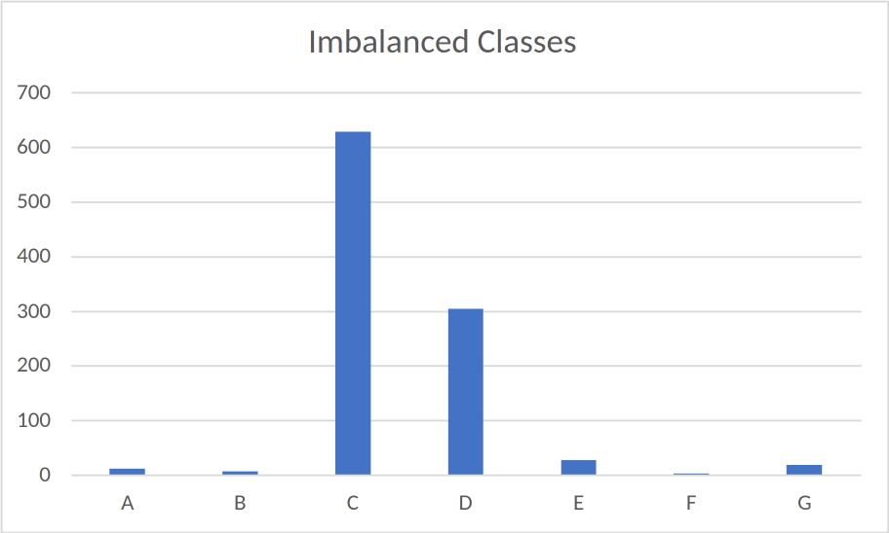
Imbalanced Data: Definition
Binary
Non-Binary

Slide 38
Imbalanced Data: Compensation Techniques
Data-level:
Over sampling / Under sampling
Synthetic data generation
Algorithm-level
Cost-sensitive learning / Class weight adjustment

