Slide 1
Session 7
Width vs Depth
Advanced Data Science · NYU Paris · 2026
Paul Dubois

Slide 2
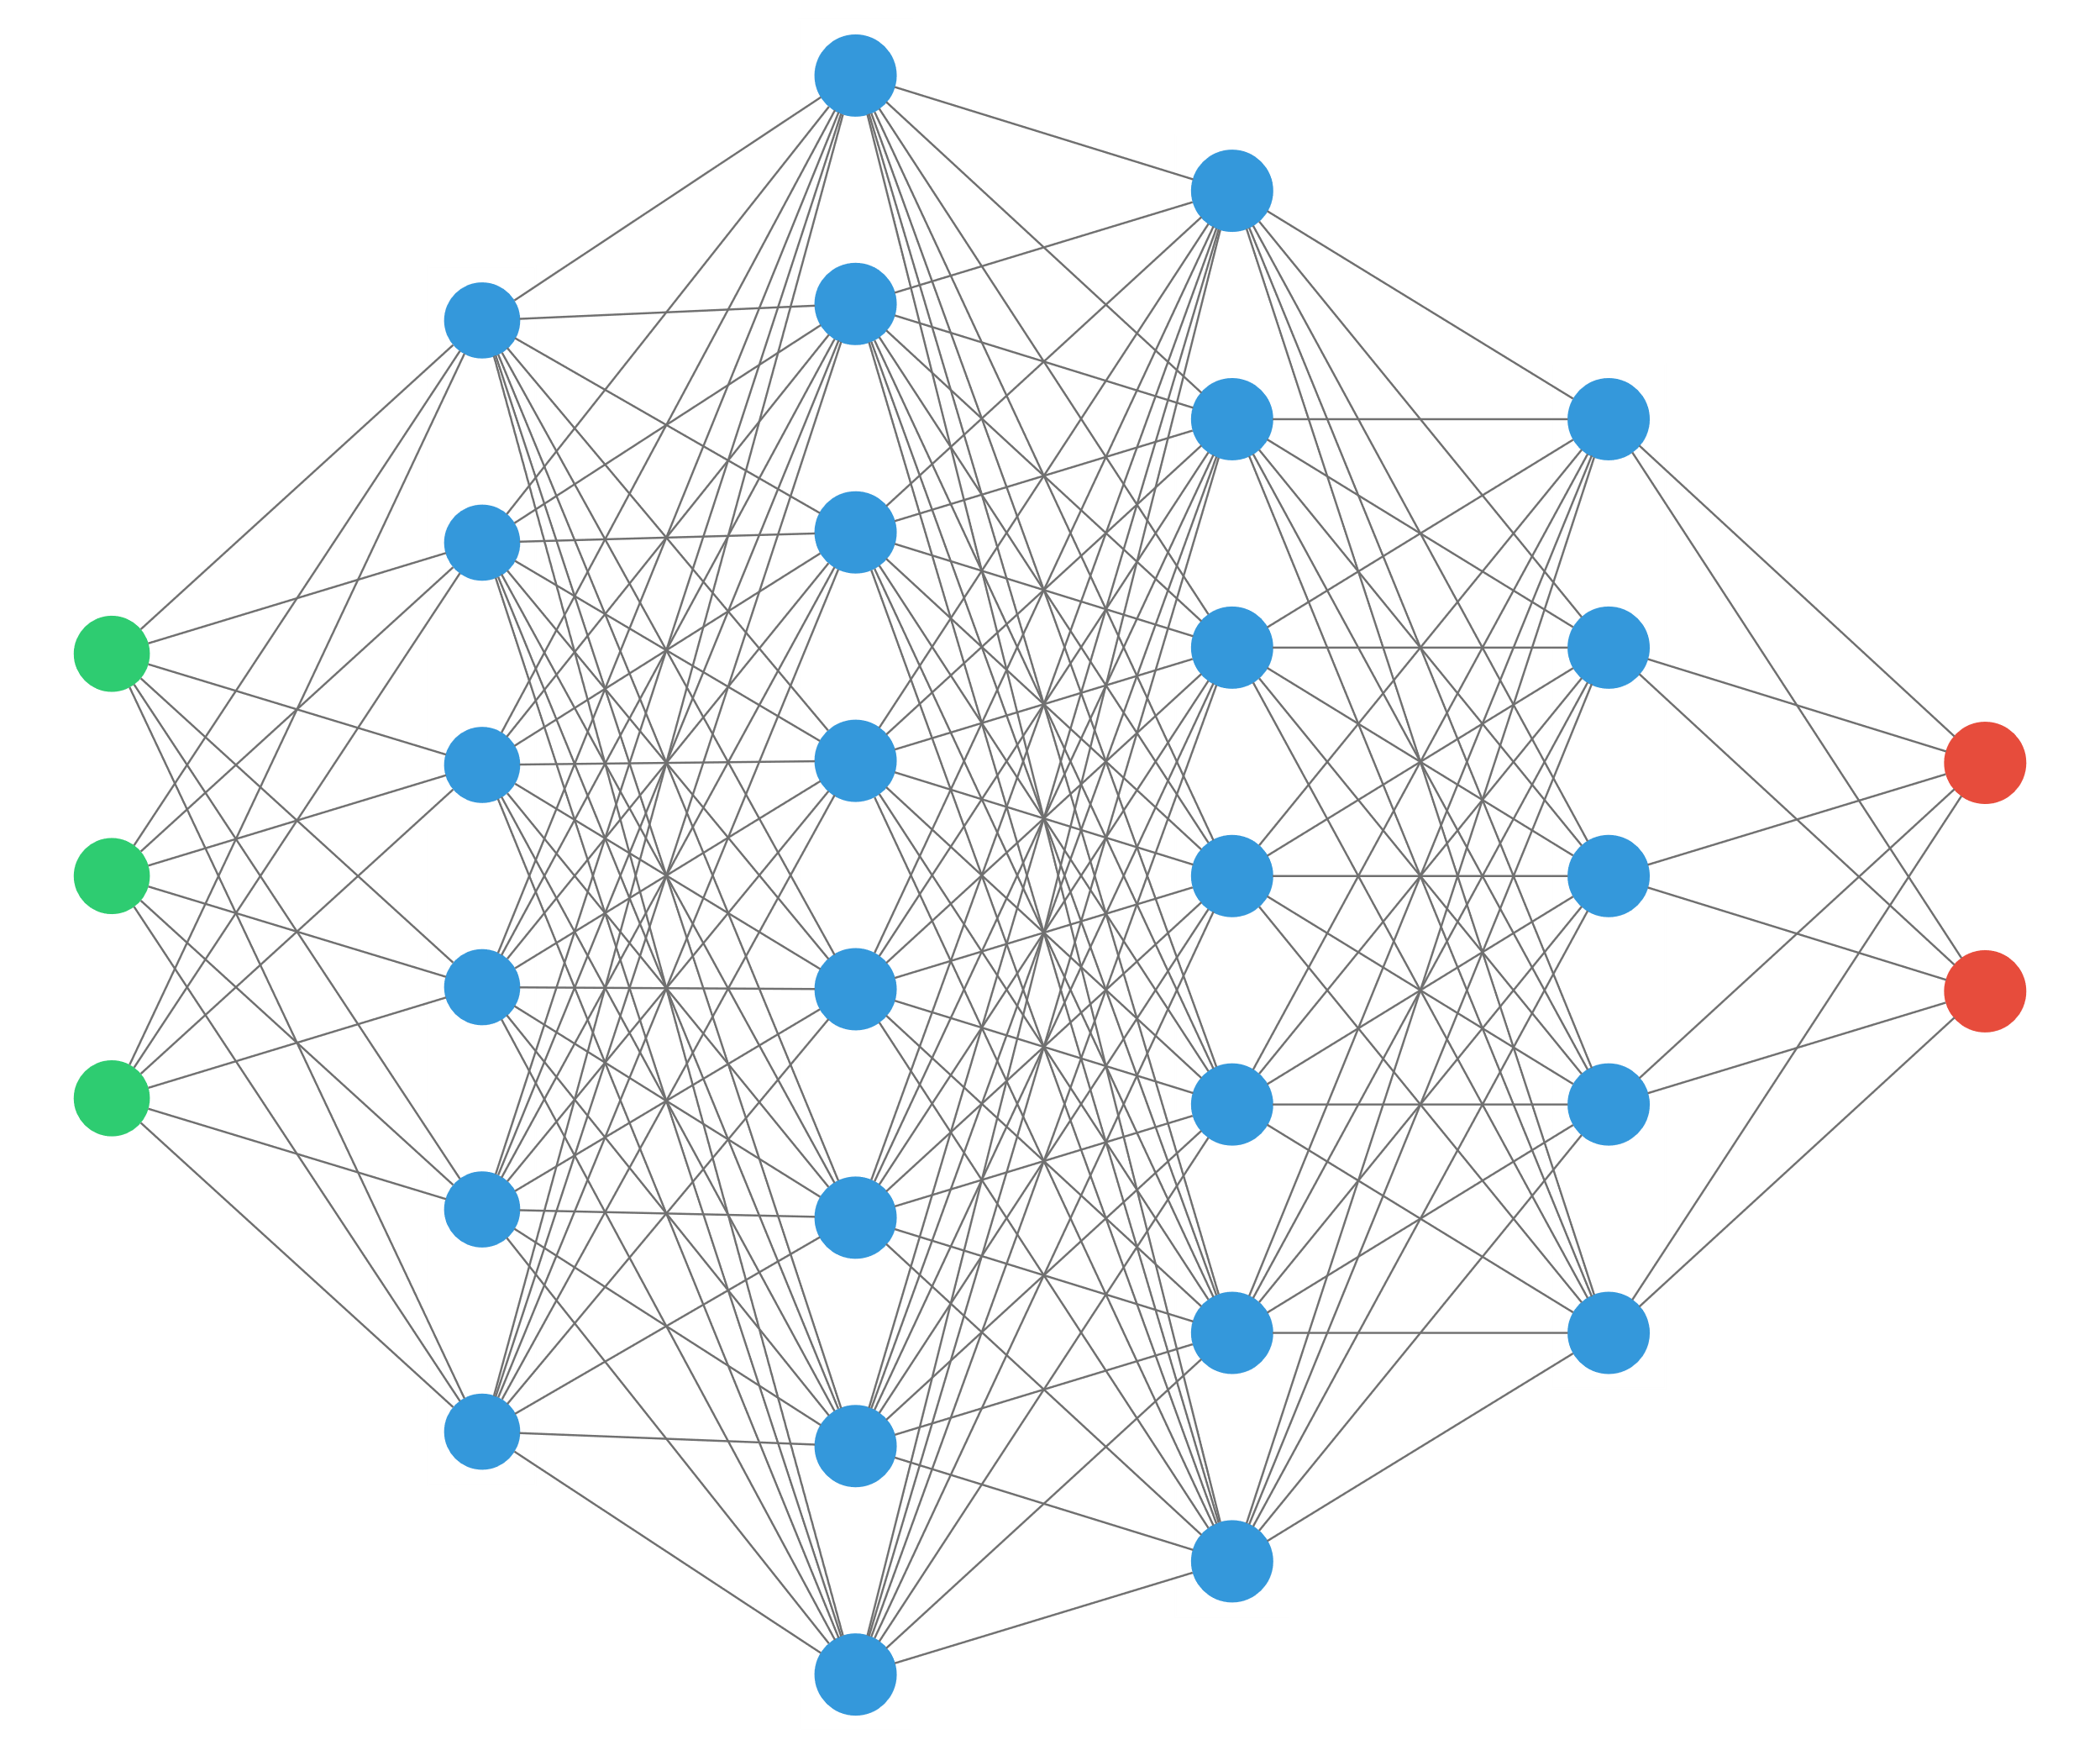
Preceptrons

Slide 3
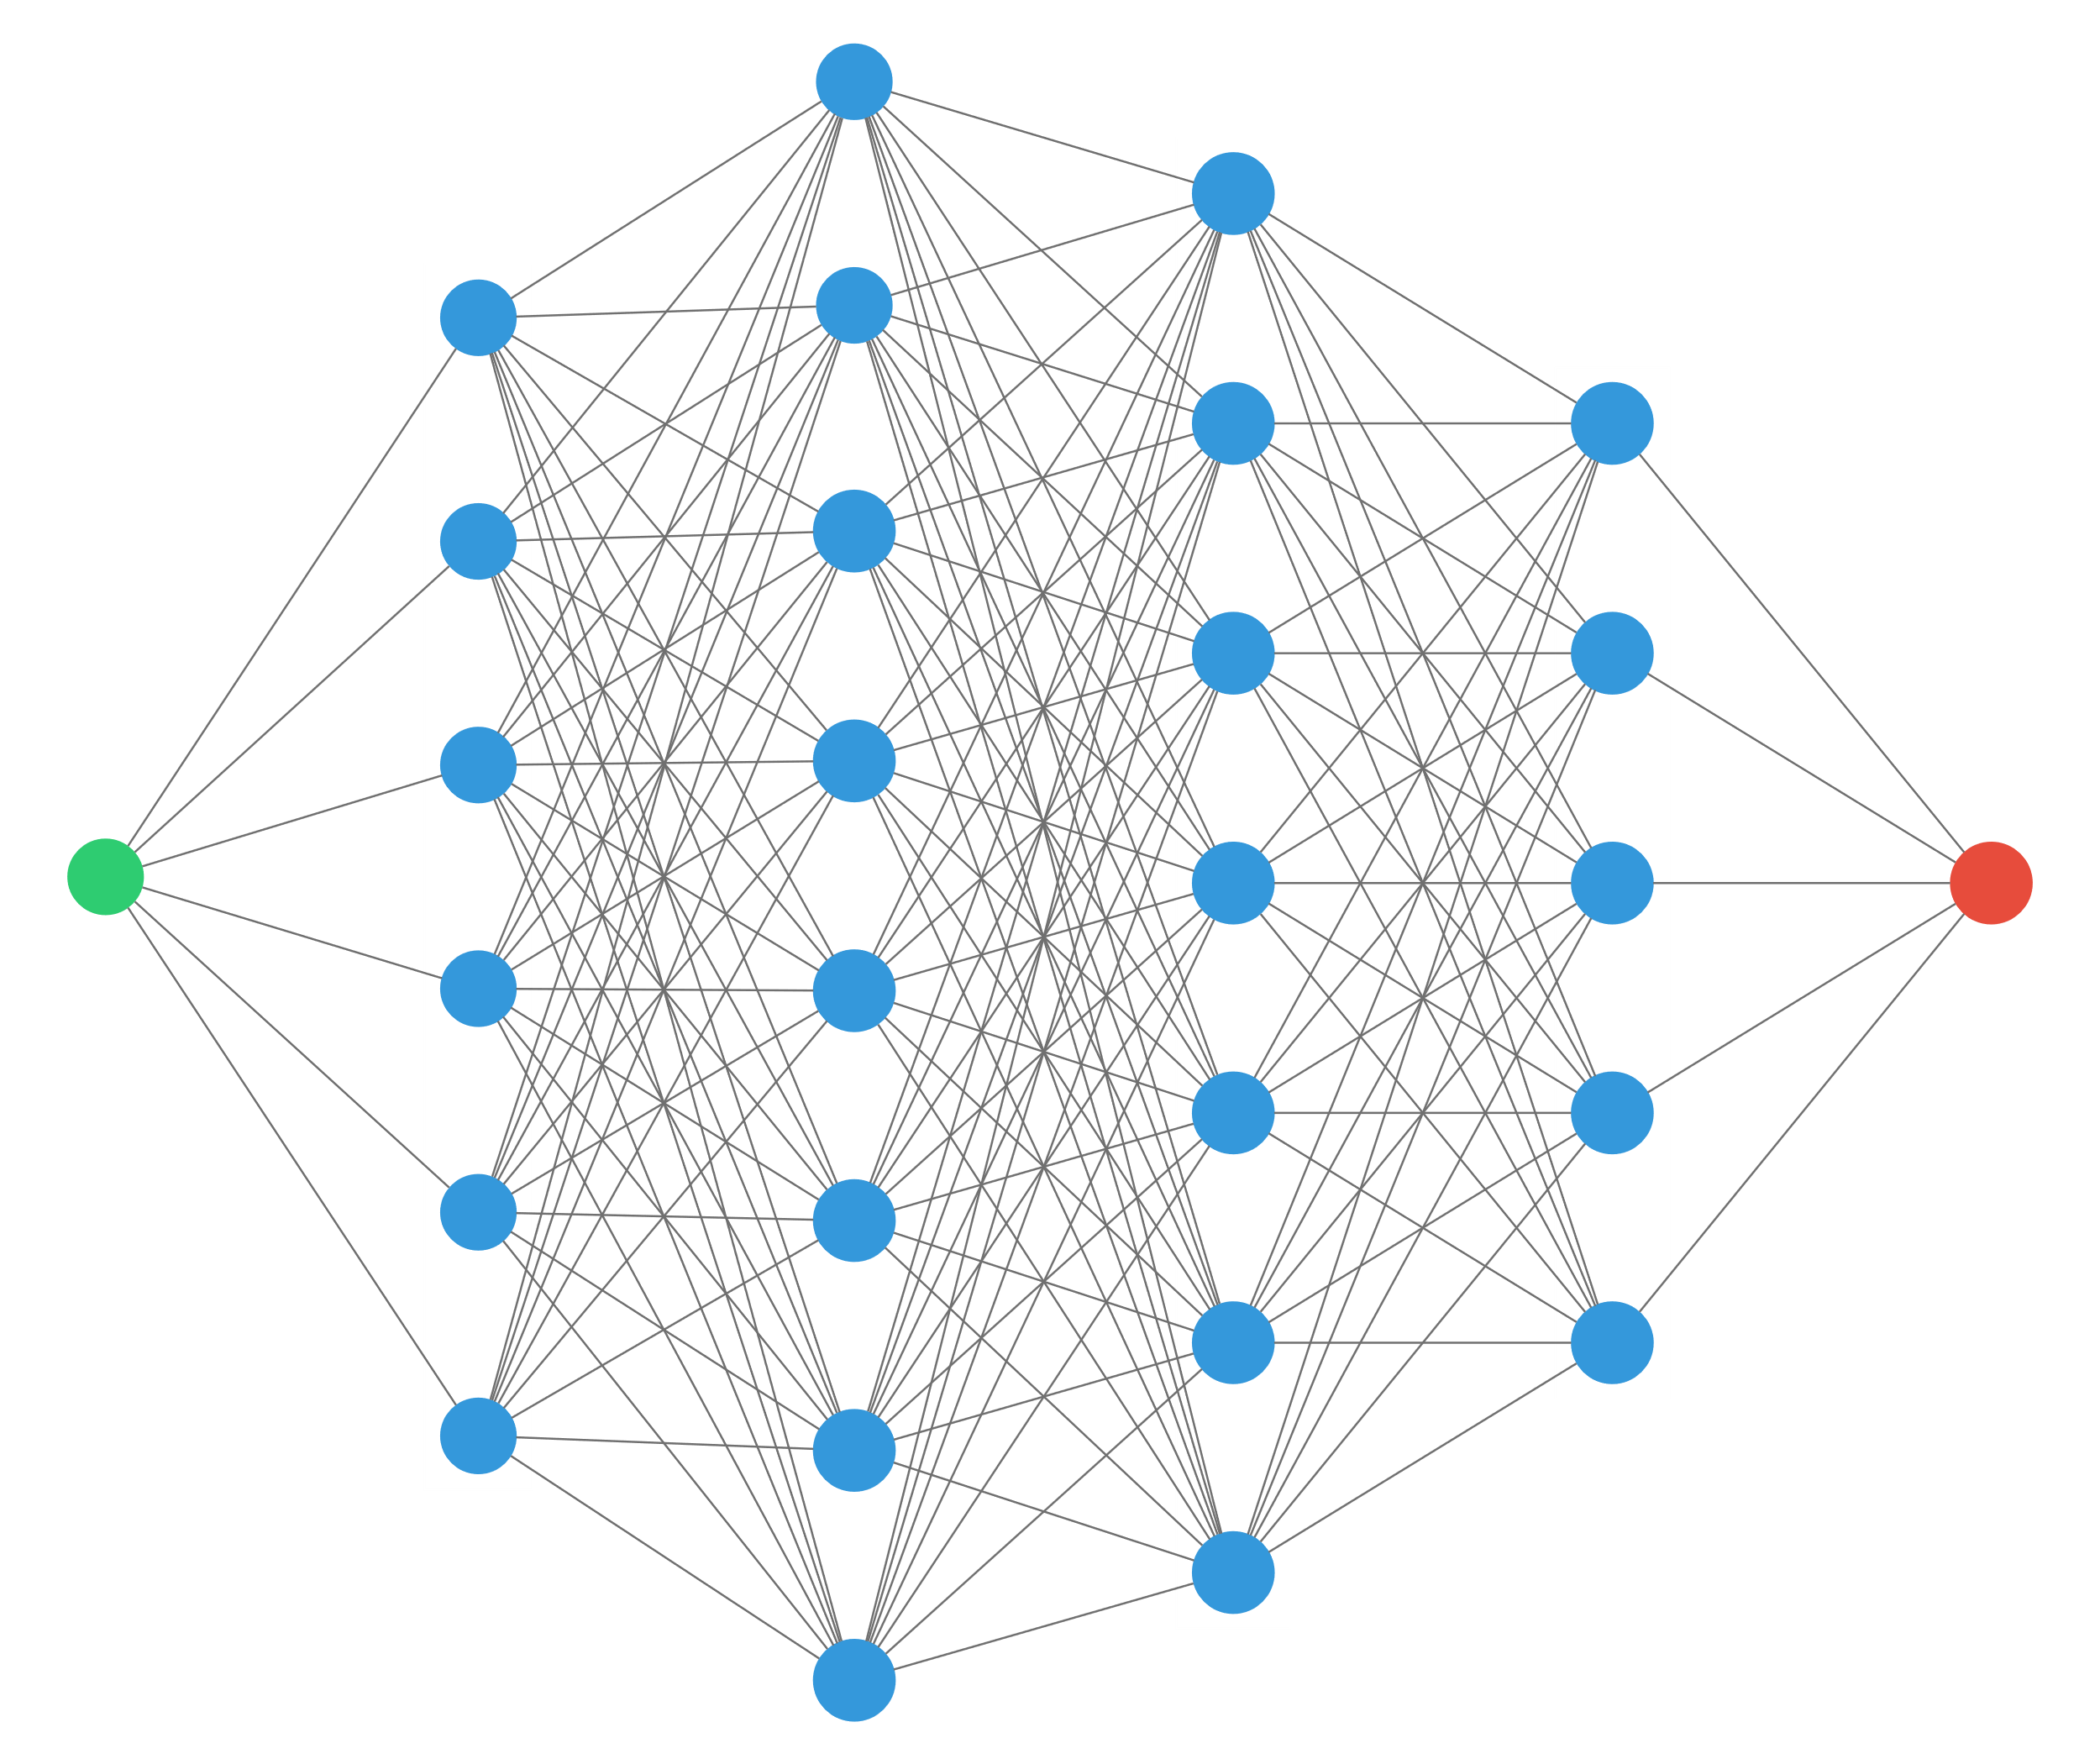


1D perceptron
$$x$$
$$y$$
“any continuous function can be approximated by a 2 layers perceptron” (with ReLU activation)

Slide 4
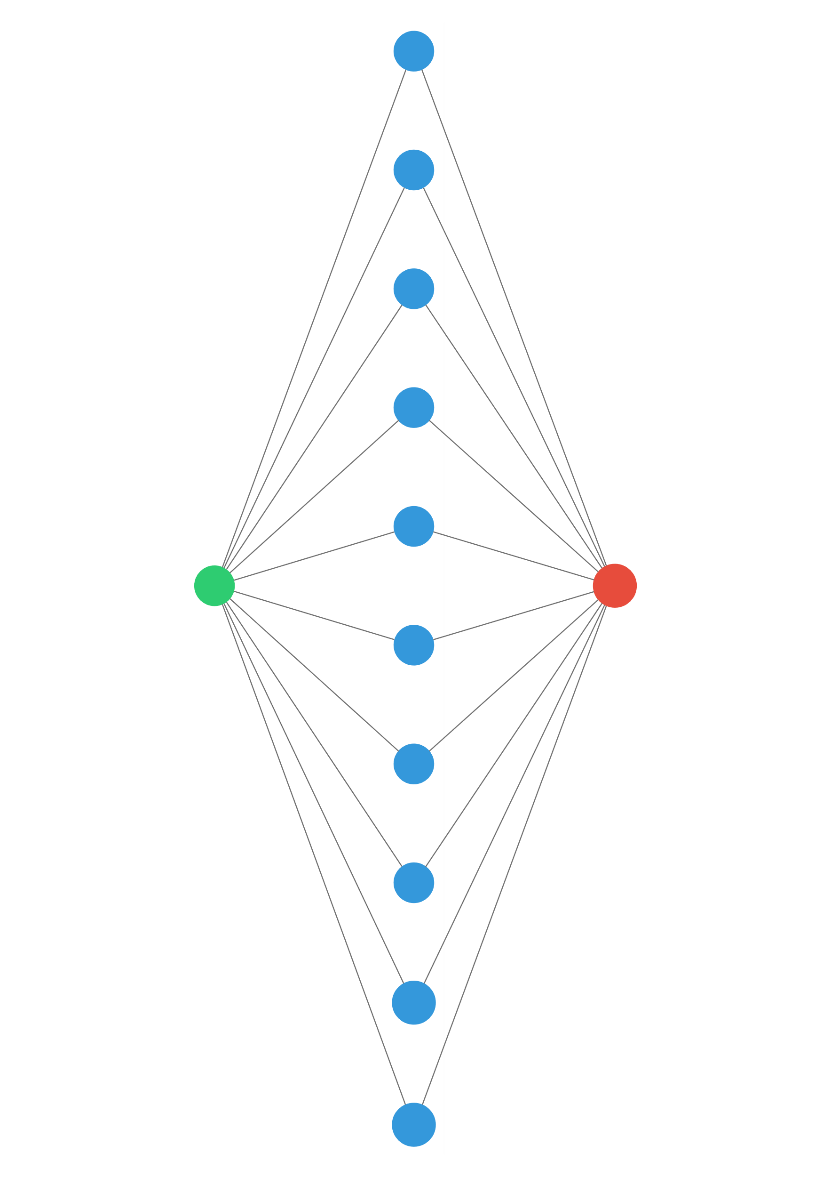
1D perceptron
$$x$$
$$y$$
“any continuous function can be approximated by a 1 hidden layer perceptron” (with ReLU activation)
… provided there are enough neurons in the middle layer!

Slide 5
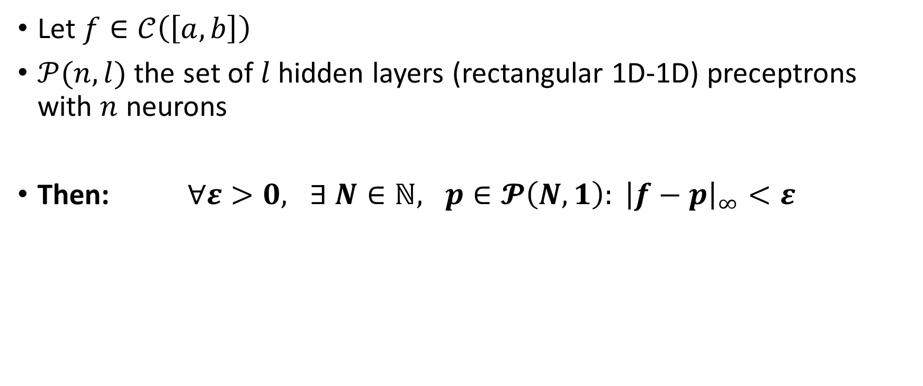
Theorem
Let $f∈𝒞\left(\left[a,b\right]\right)$
$𝒫(n, l)$ the set of $l$ hidden layers (rectangular 1D-1D) preceptrons with $n$ neurons
Then: $∀ε>0, ∃ N∈ℕ, p∈𝓟\left(N,1\right): {\left|f−p\right|}_{∞}<ε$

Slide 6
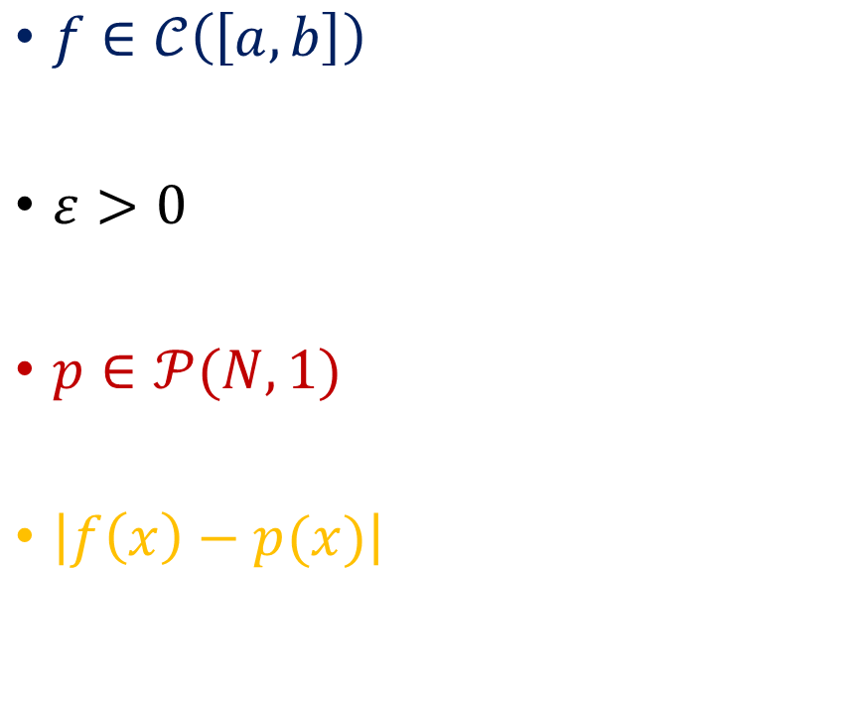


Proof
$f∈𝒞\left(\left[a,b\right]\right)$
$ε>0$
$p∈𝒫(N,1)$
$\left|f\left(x\right)−p(x)\right|$
$$a$$
$$b$$

Slide 7
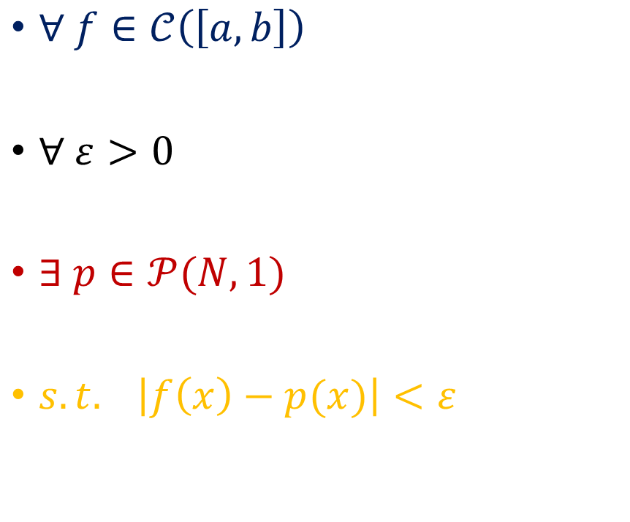
Goal
$∀ f∈𝒞\left(\left[a,b\right]\right)$
$∀ ε>0$
$∃ p∈𝒫(N,1)$
$s.t. \left|f\left(x\right)−p(x)\right|<ε$
$$a$$
$$b$$

Slide 8
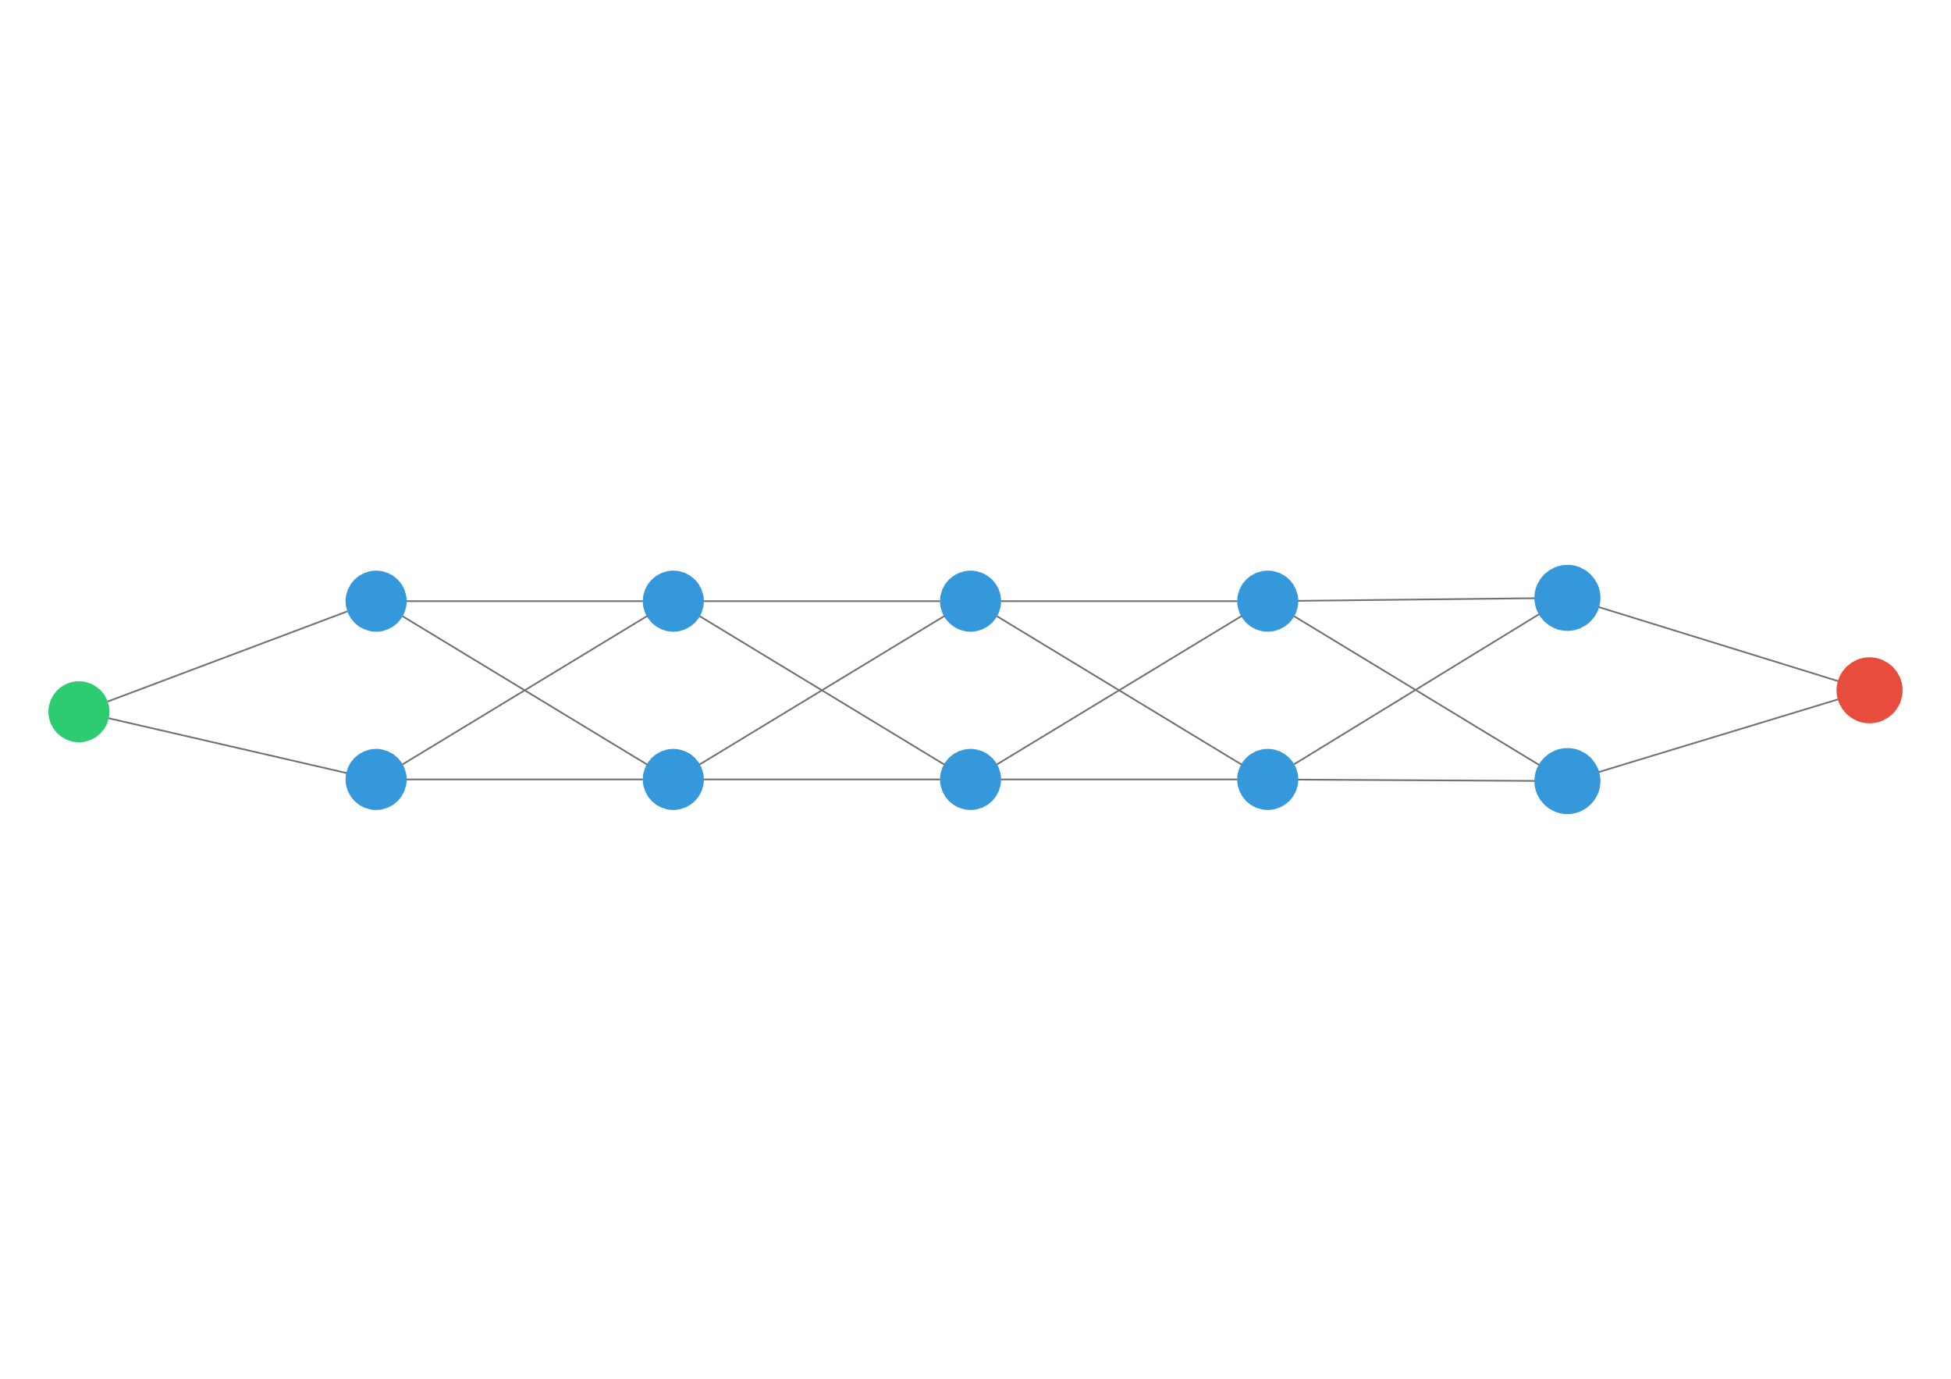
So… wide networks are better?
?
>

Slide 9
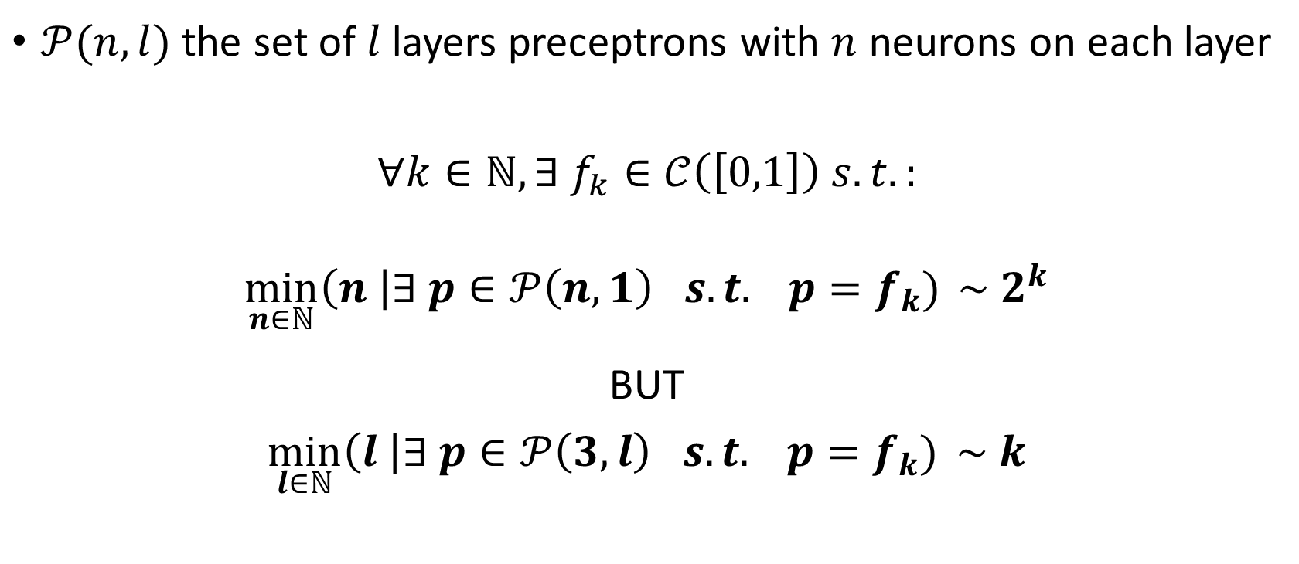
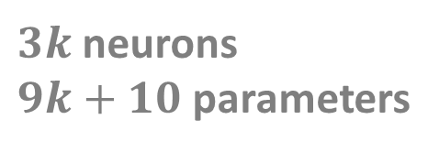
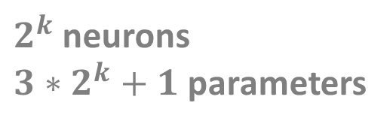
Theorem
$𝒫(n,l)$ the set of $l$ layers preceptrons with $n$ neurons on each layer
$∀k∈ℕ, ∃ f_{k}∈𝒞\left(\left[0,1\right]\right) s.t.:$
$$\min_{n∈ℕ}\left(n \right|∃ p∈𝒫\left(n,1\right) s.t. p=f_{k}) \sim 2^{k}$$
BUT
$$\min_{l∈ℕ}\left(l \right|∃ p∈𝒫\left(3,l\right) s.t. p=f_{k}) \sim k$$
$2^{k}$ neurons
$3∗2^{k}+1$ parameters
$3k$ neurons
$9k+10$ parameters
Notes:
This example will be extensively discussed in the TD4.

Slide 10
So… deep networks are better?
?
<

