Slide 1
Session 4
Clustering
Advanced Machine Learning · MSc DSBA · 2026
Paul Dubois

Slide 2
What is clustering?

Slide 3
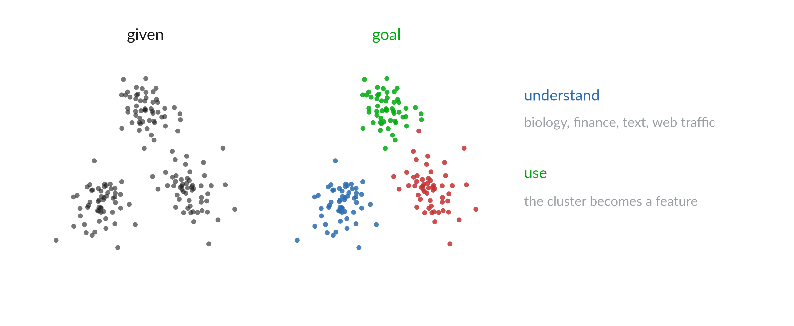
No labels

Slide 4
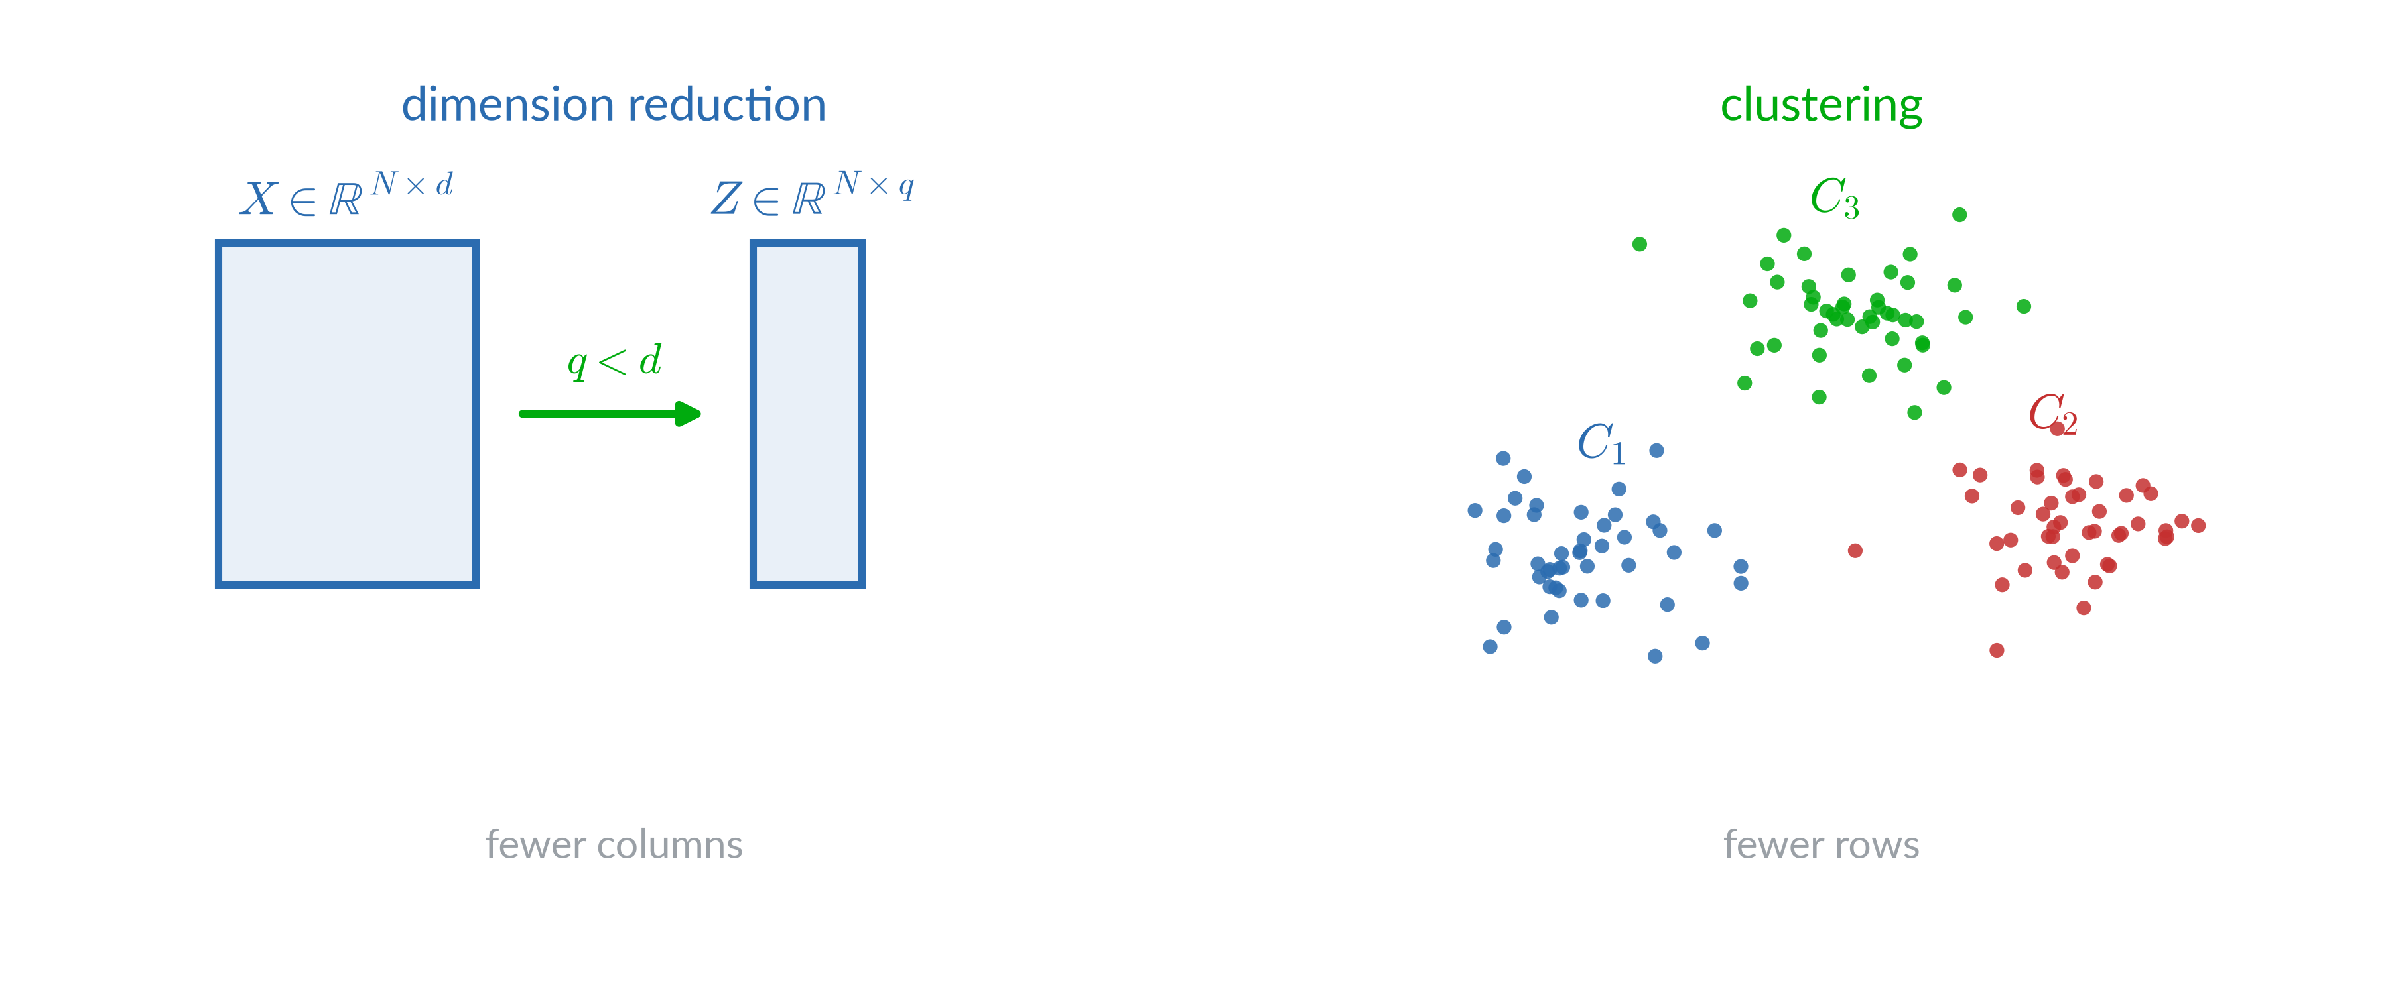
Two ways to simplify a table

Slide 5
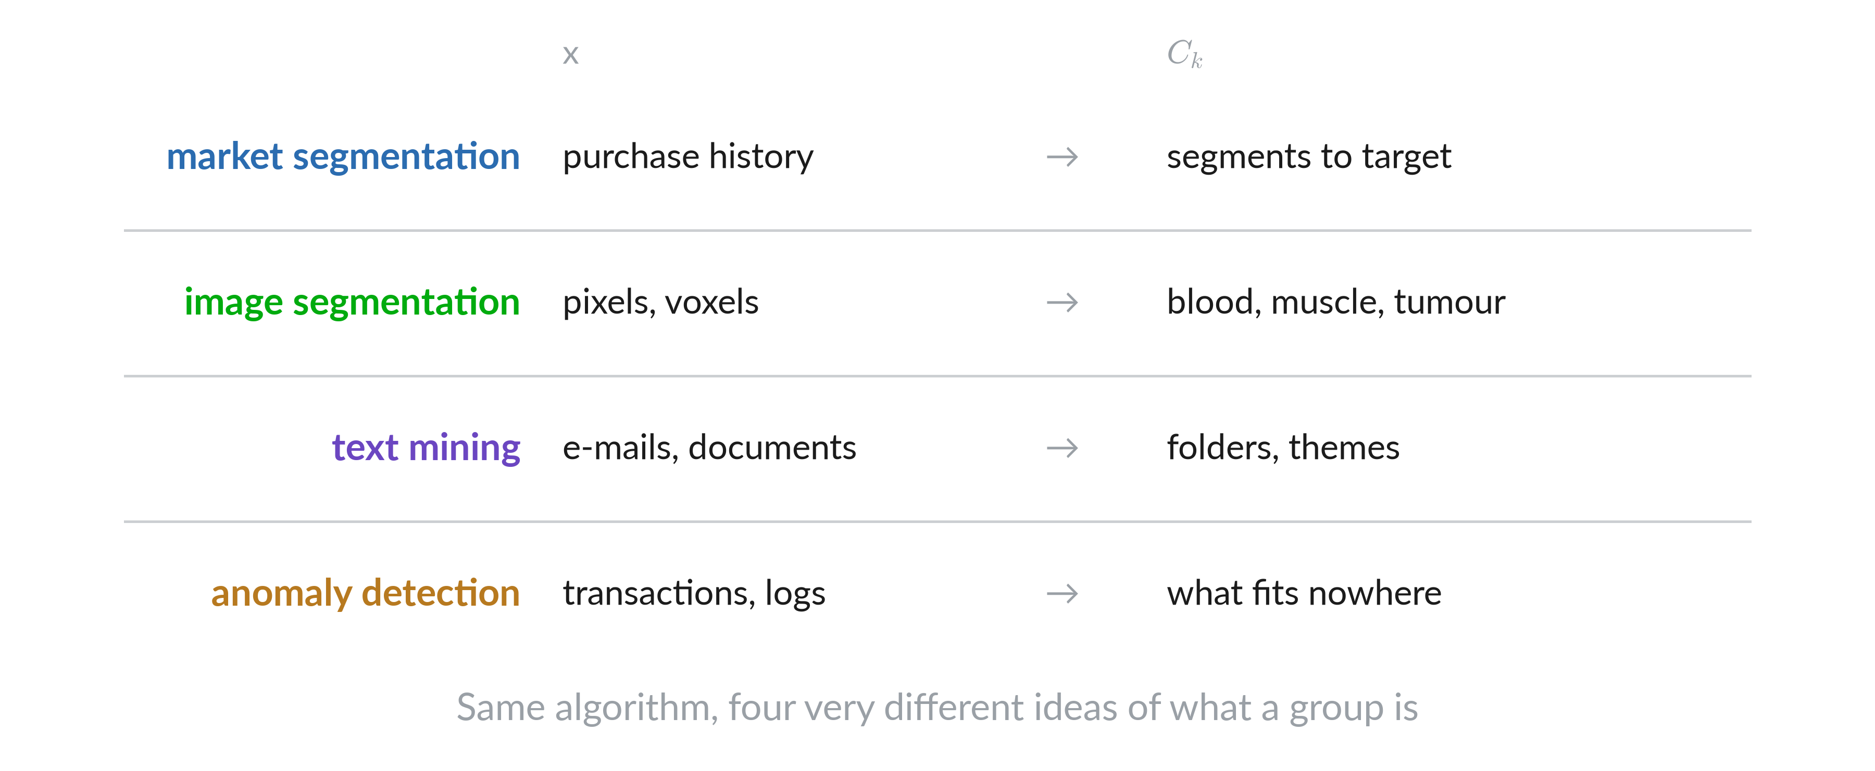
Use cases

Slide 6
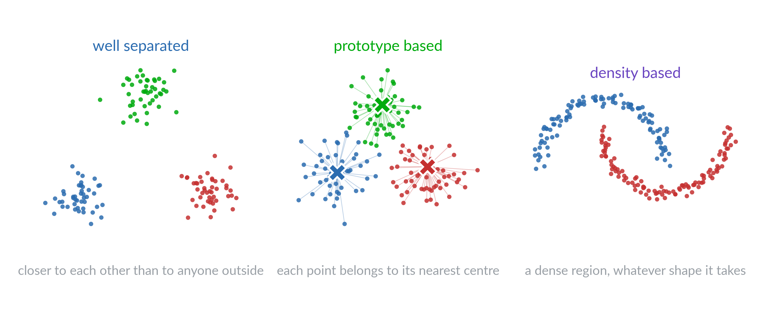
What a cluster can mean

Slide 7
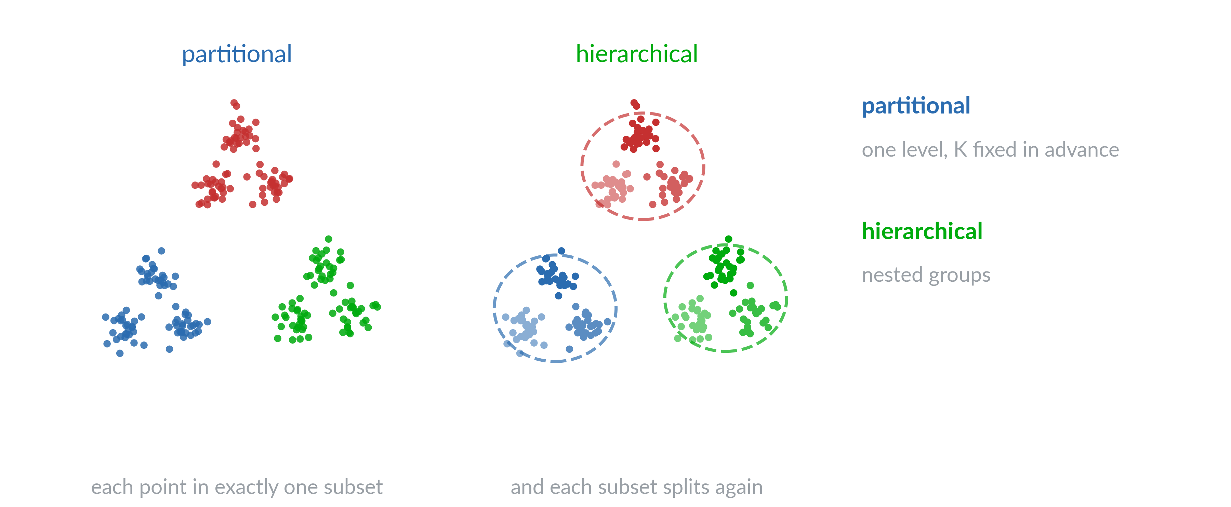
Partitional or hierarchical

Slide 8
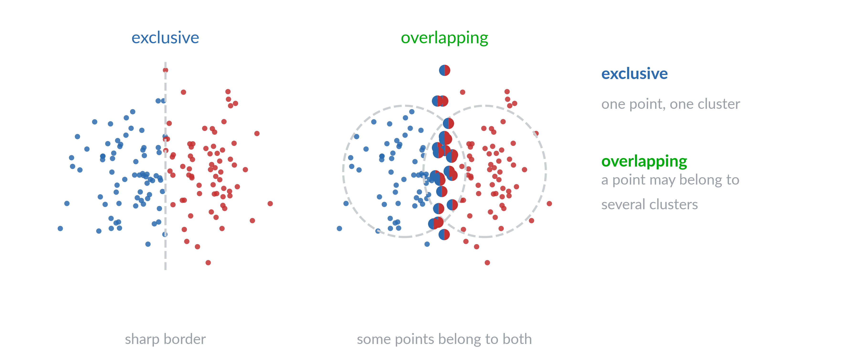
Exclusive or overlapping

Slide 9
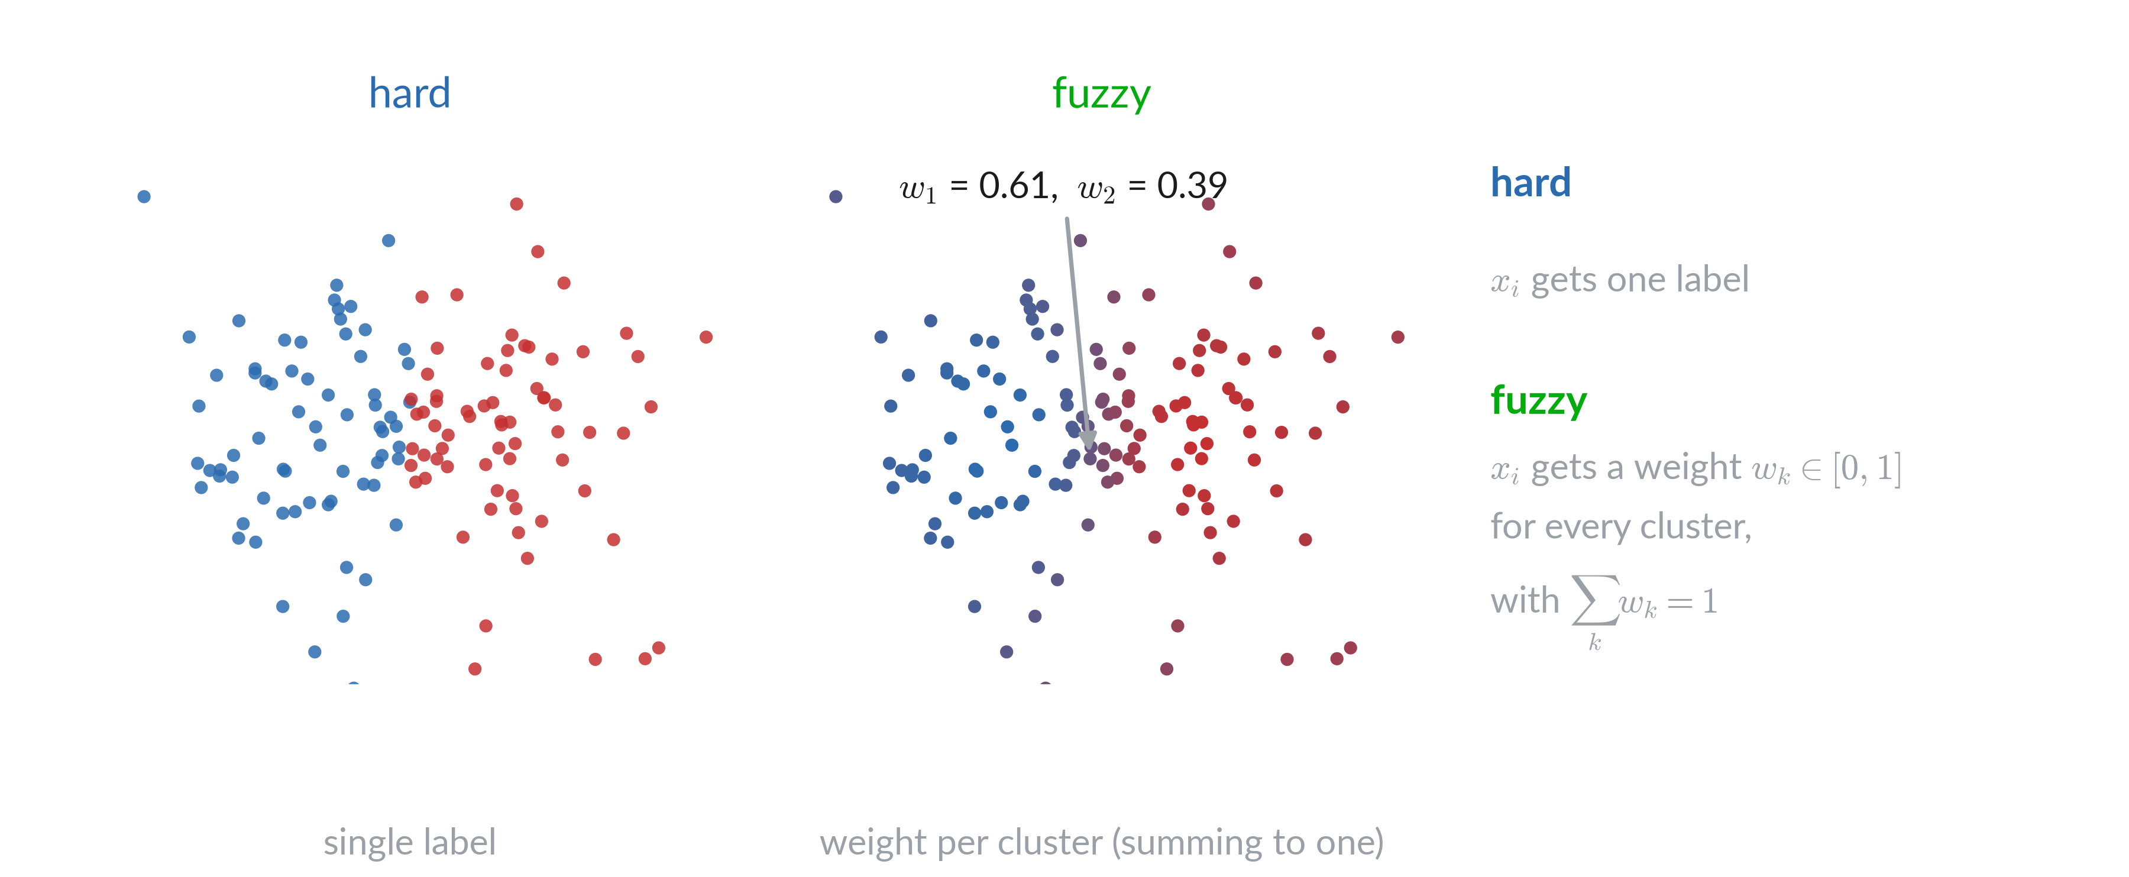
Hard or fuzzy

Slide 10
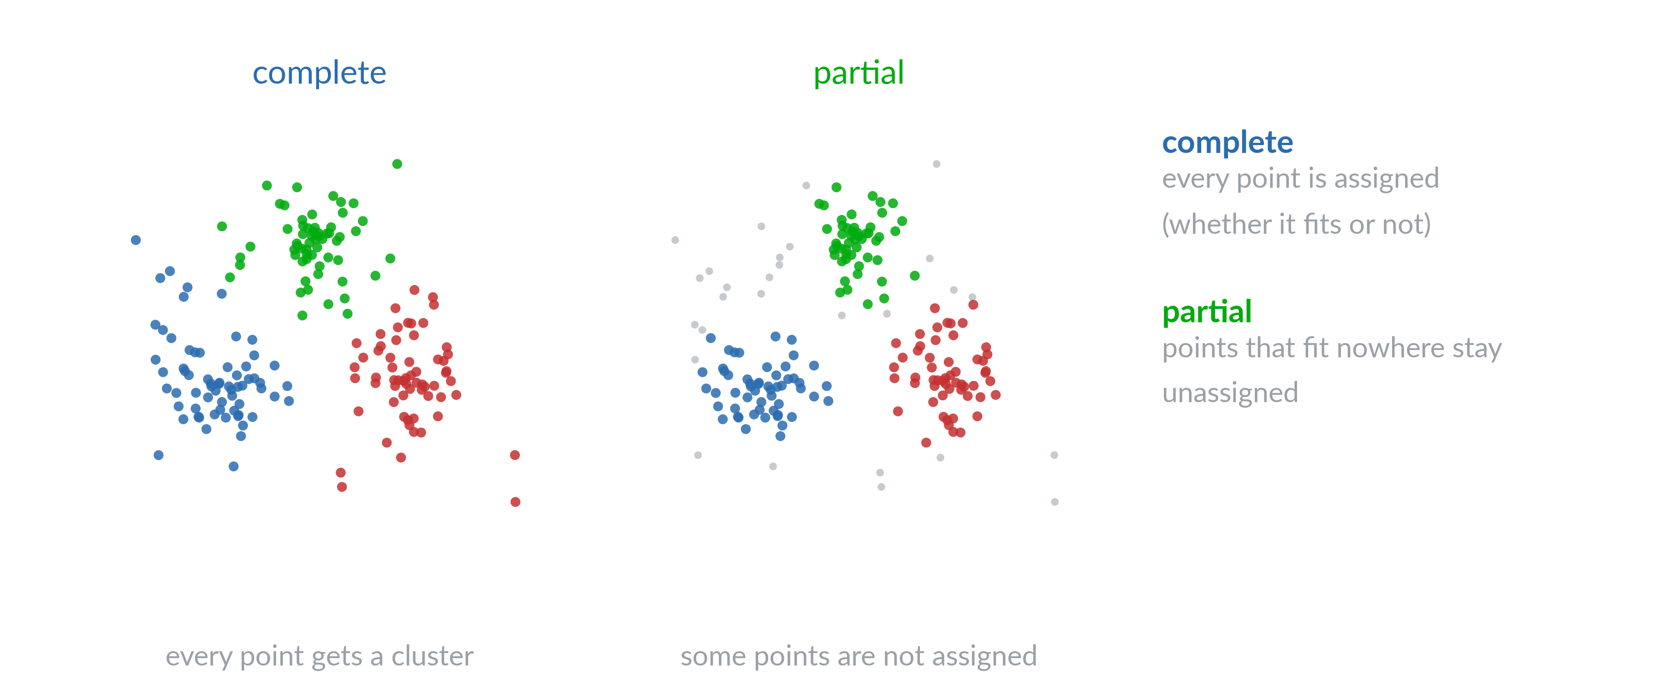
Complete or partial

Slide 11
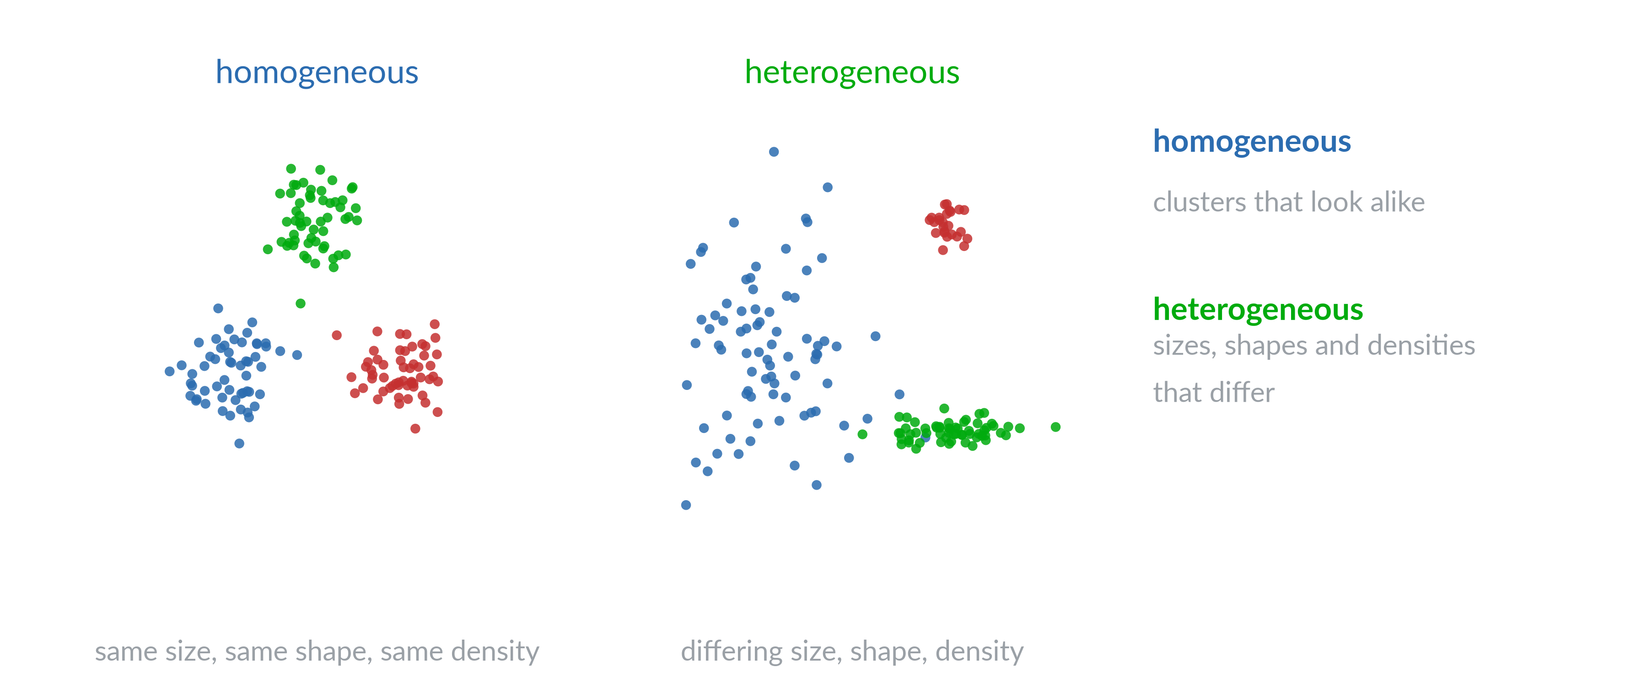
Homogeneous or heterogeneous

Slide 12
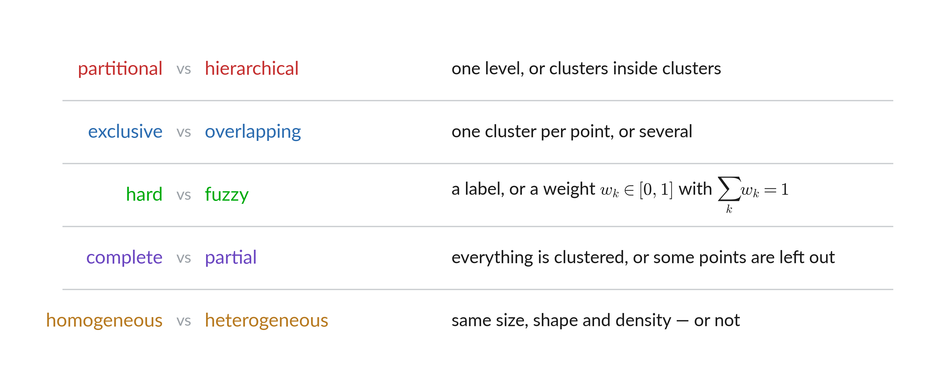
Choice of algorithm assumes

Slide 13
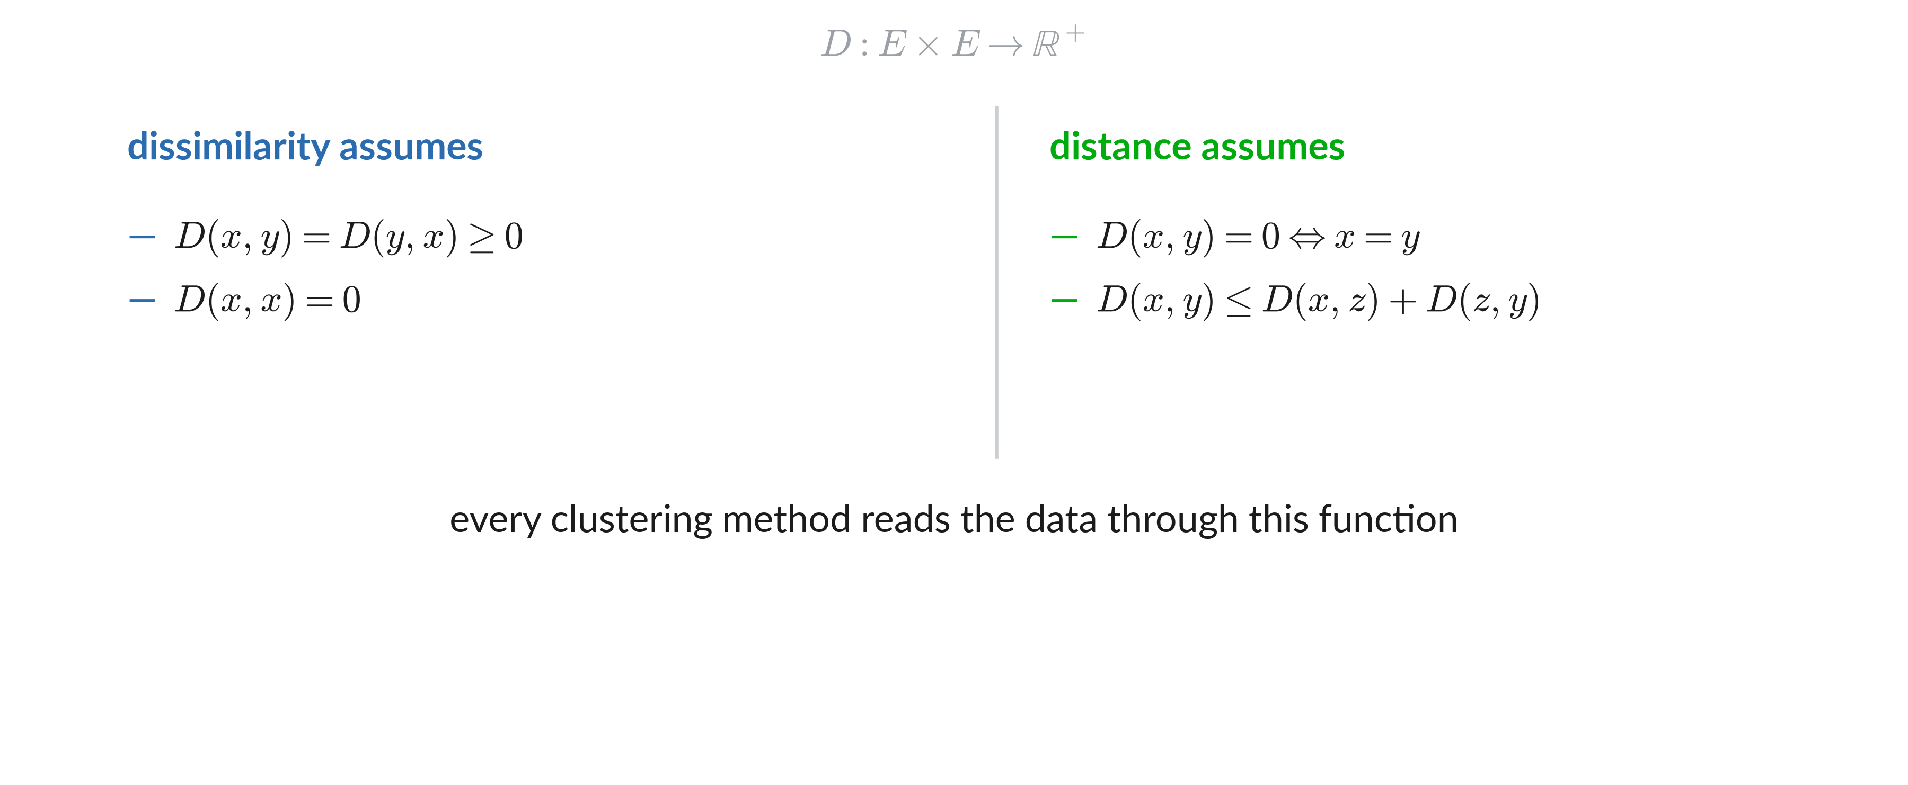
Distance and dissimilarity

Slide 14
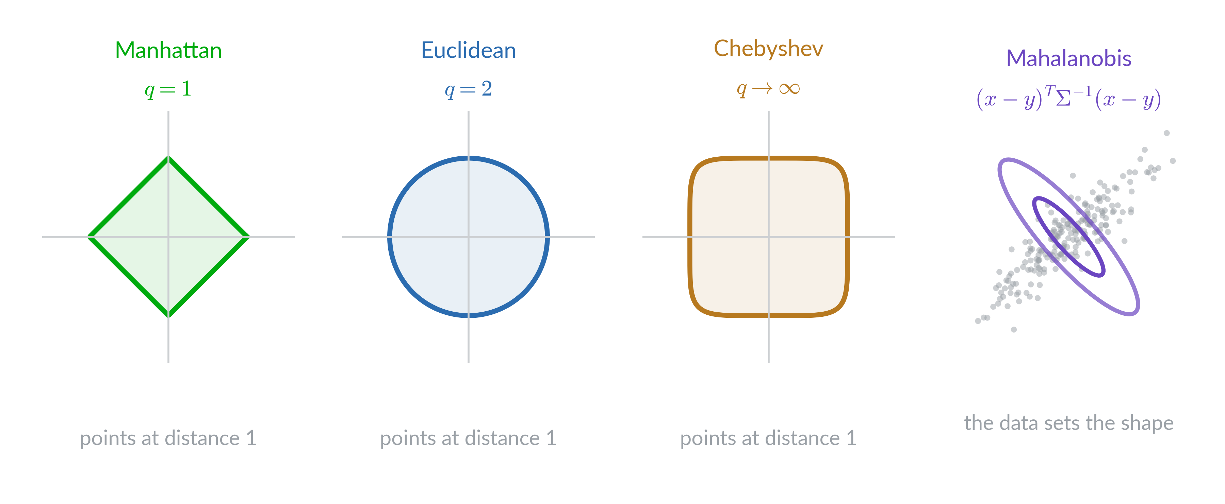
Distances examples

Slide 15
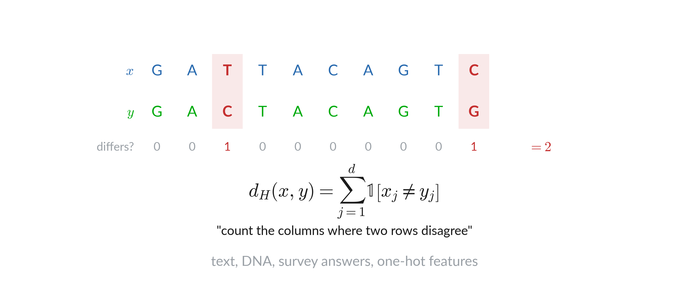
Hamming: a distance for categories

Slide 16
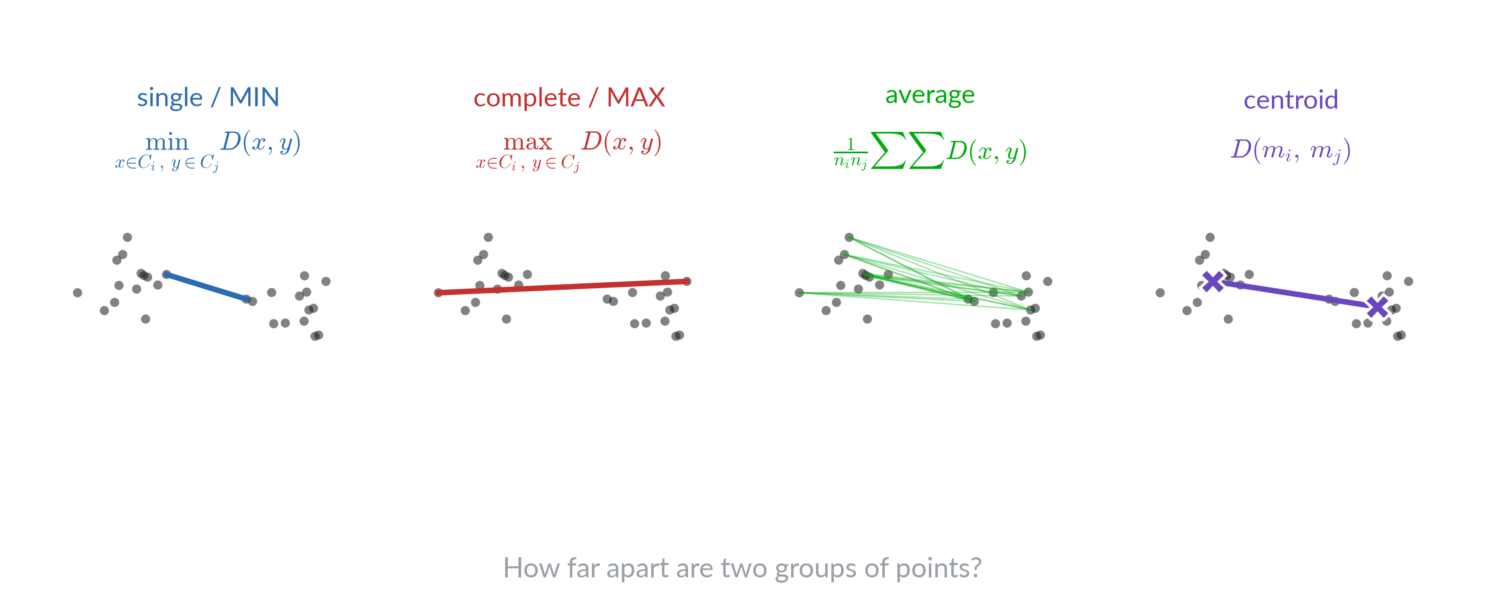
Distances between groups

Slide 17
Clustering quality

Slide 18
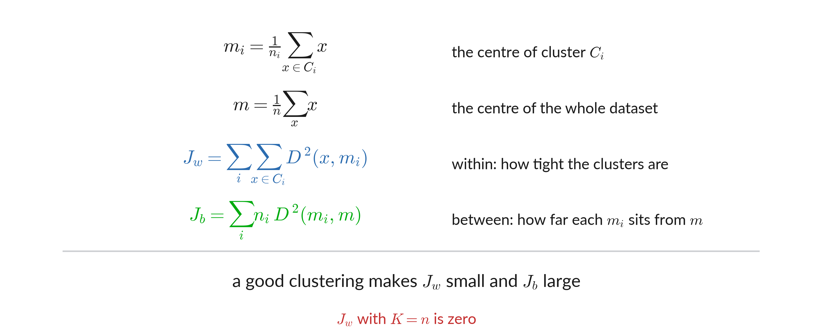
Within and between

Slide 19
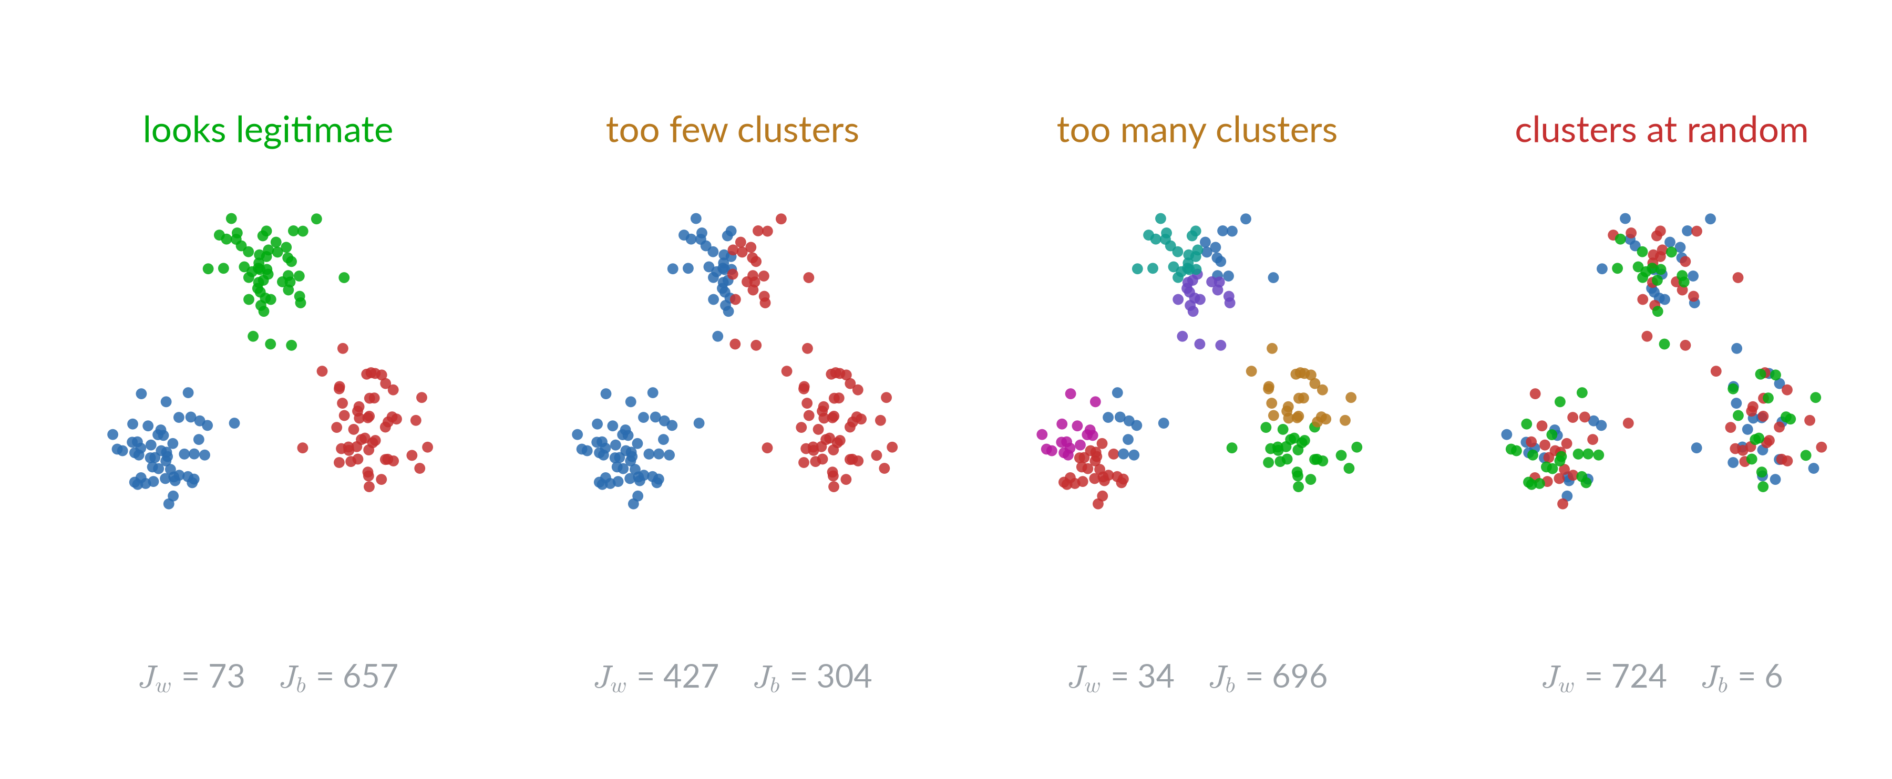
What a good clustering looks like

Slide 20
K-means

Slide 21
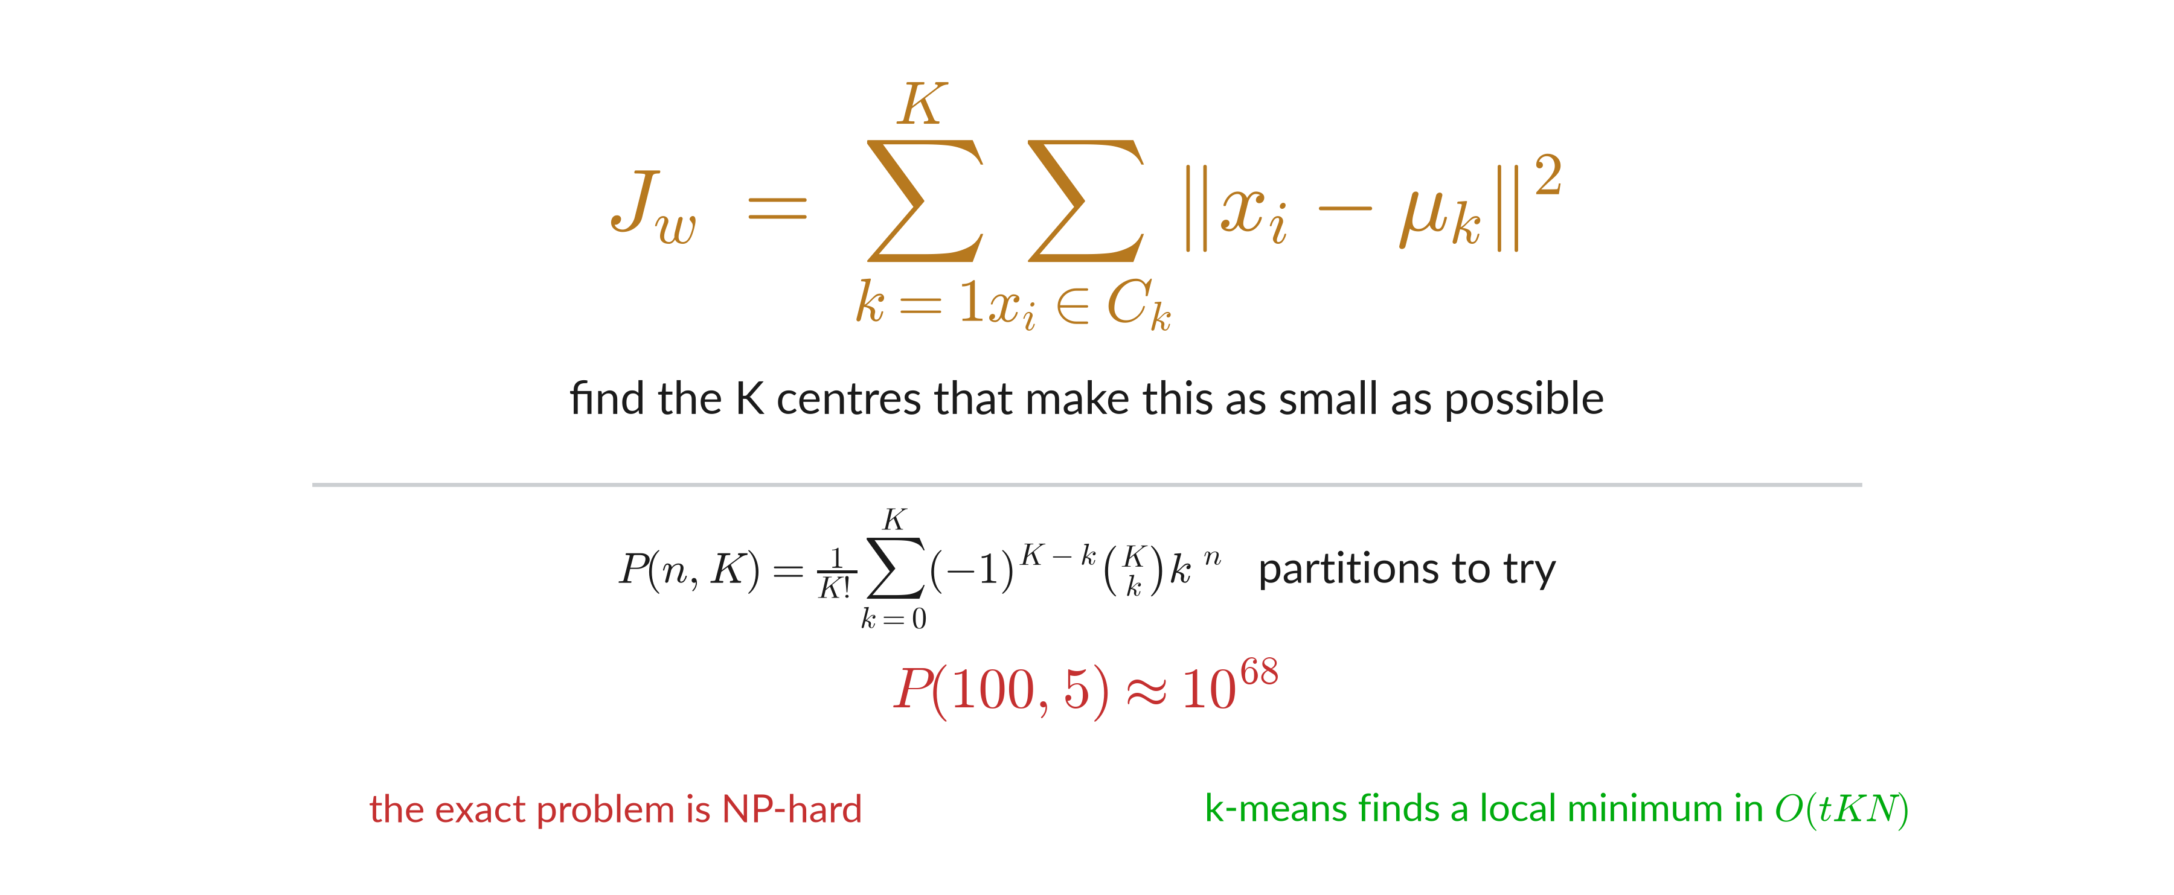
The objective

Slide 22
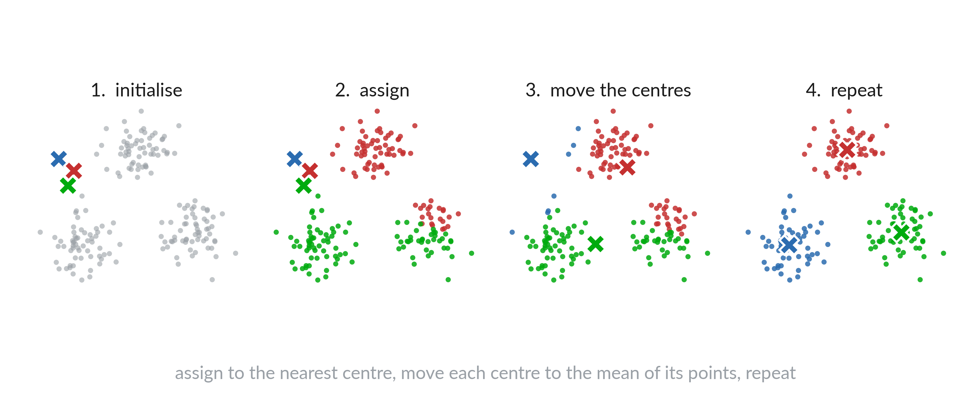
Lloyd’s algorithm

Slide 23
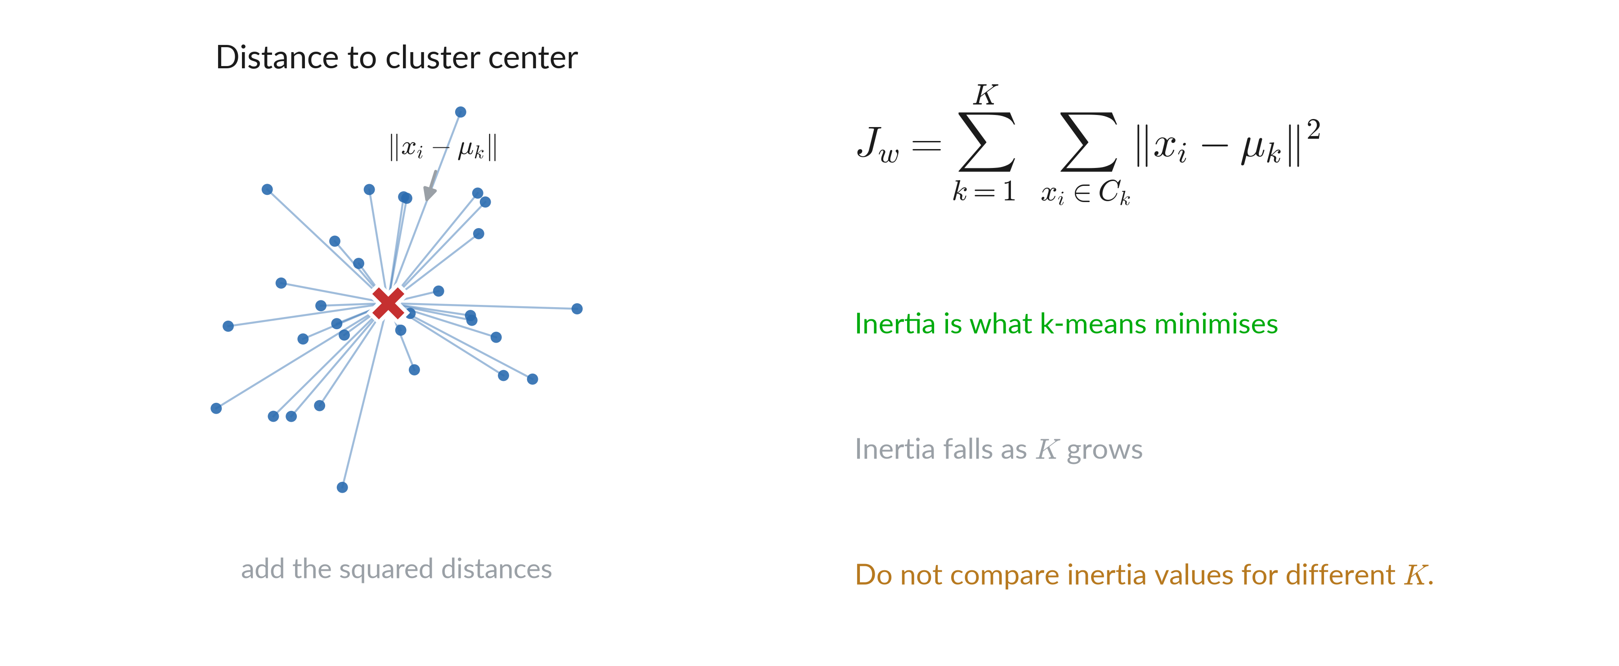
Inertia

Slide 24
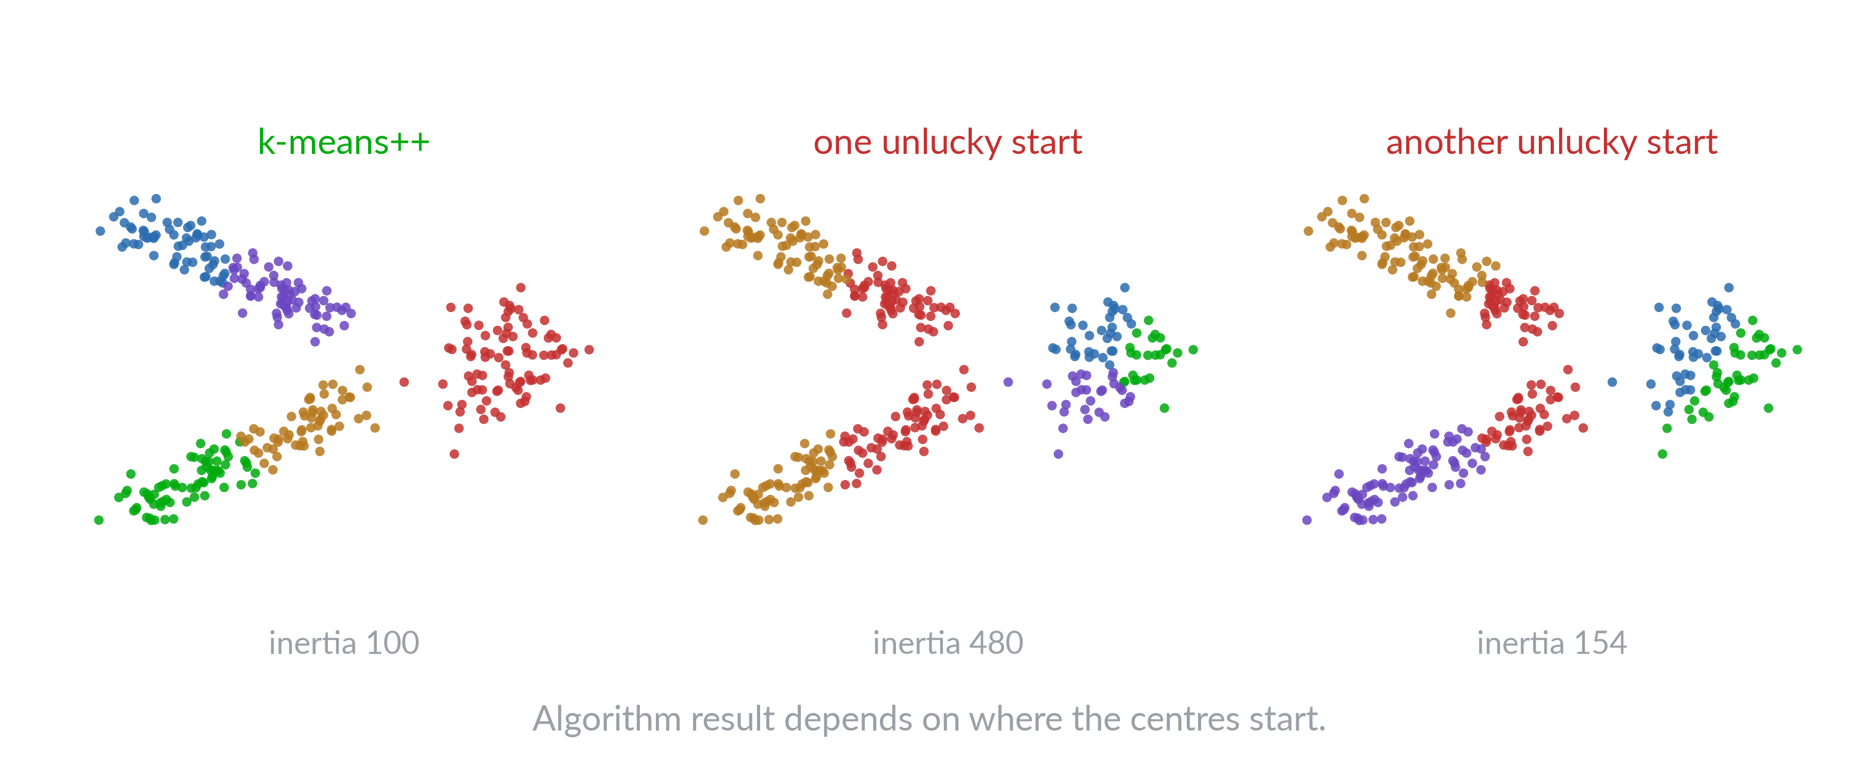
Random results

Slide 25
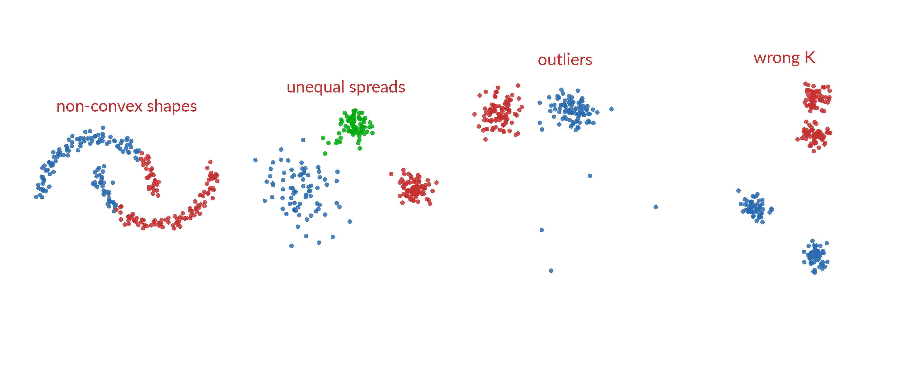
k-means fails with

Slide 26
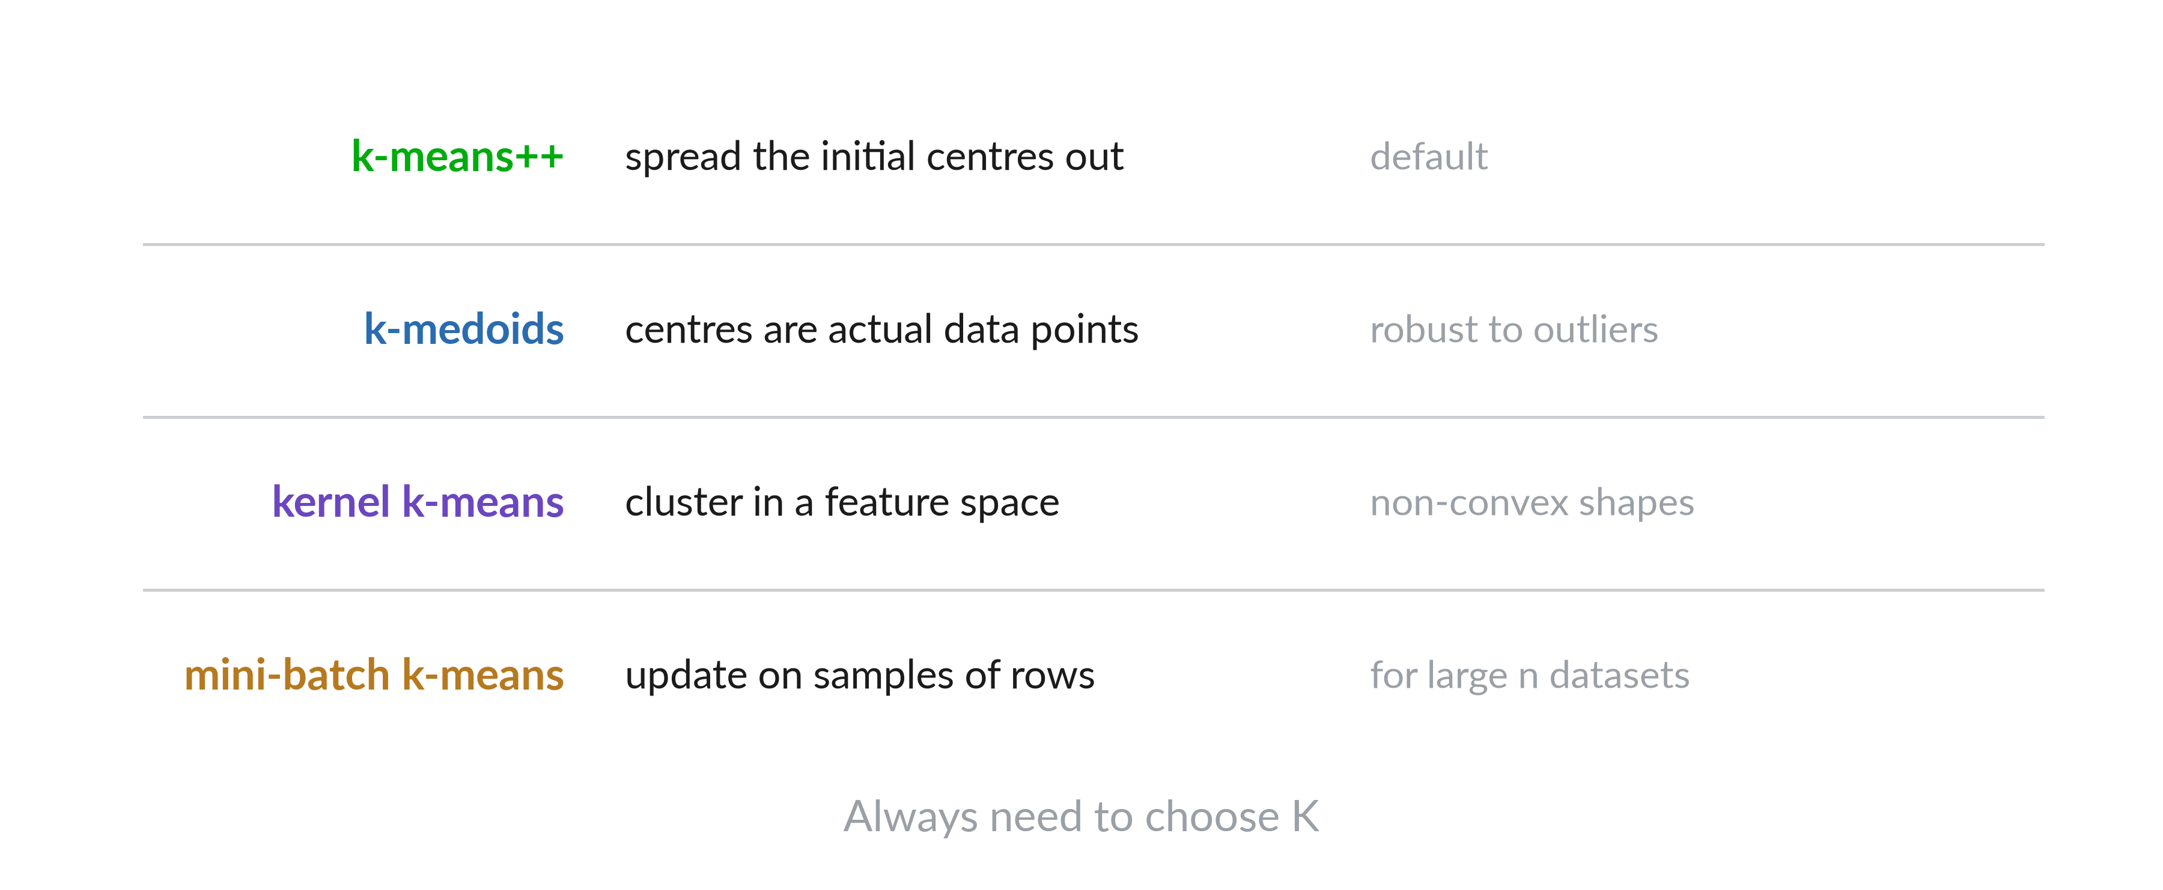
Variants

Slide 27
Mountain and subtractive clustering

Slide 28
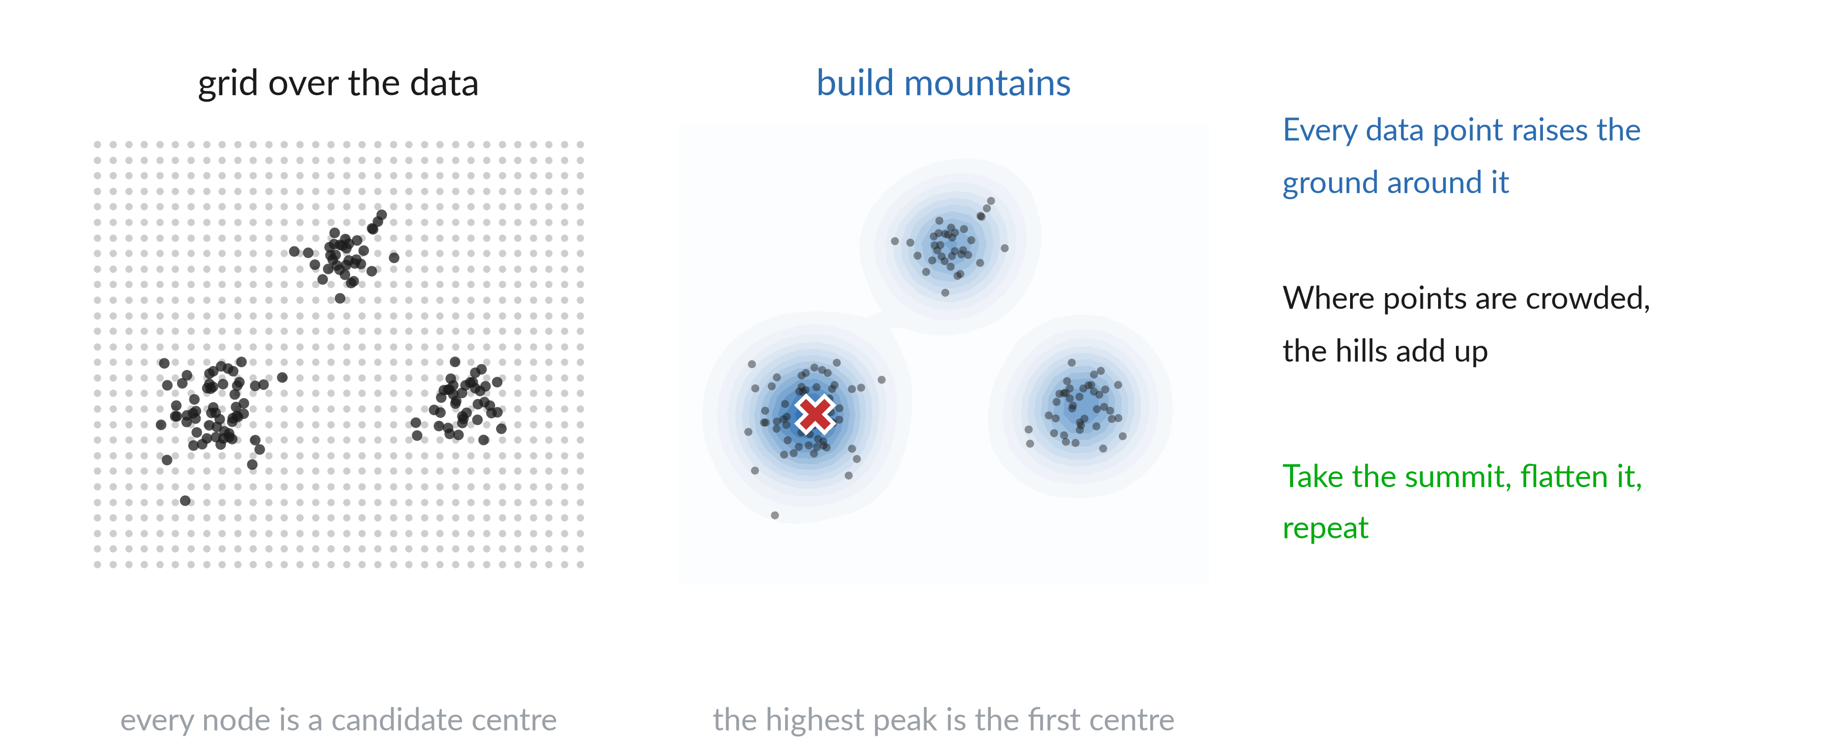
Clusters as peaks of a landscape

Slide 29
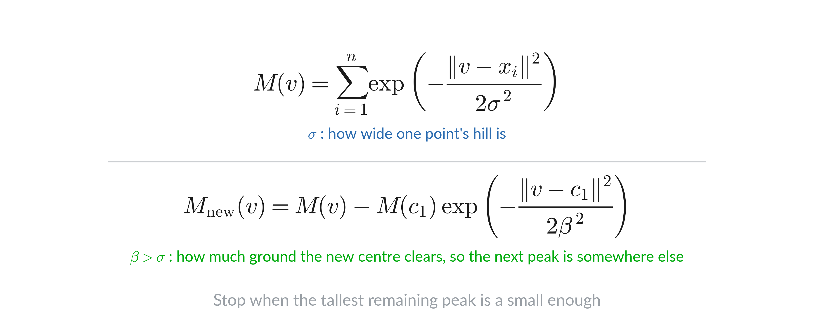
Mountain function

Slide 30
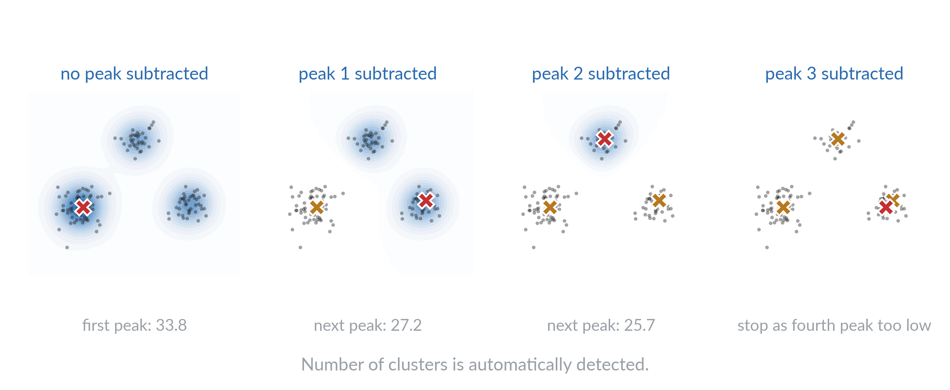
Take a peak, flatten it, repeat

Slide 31
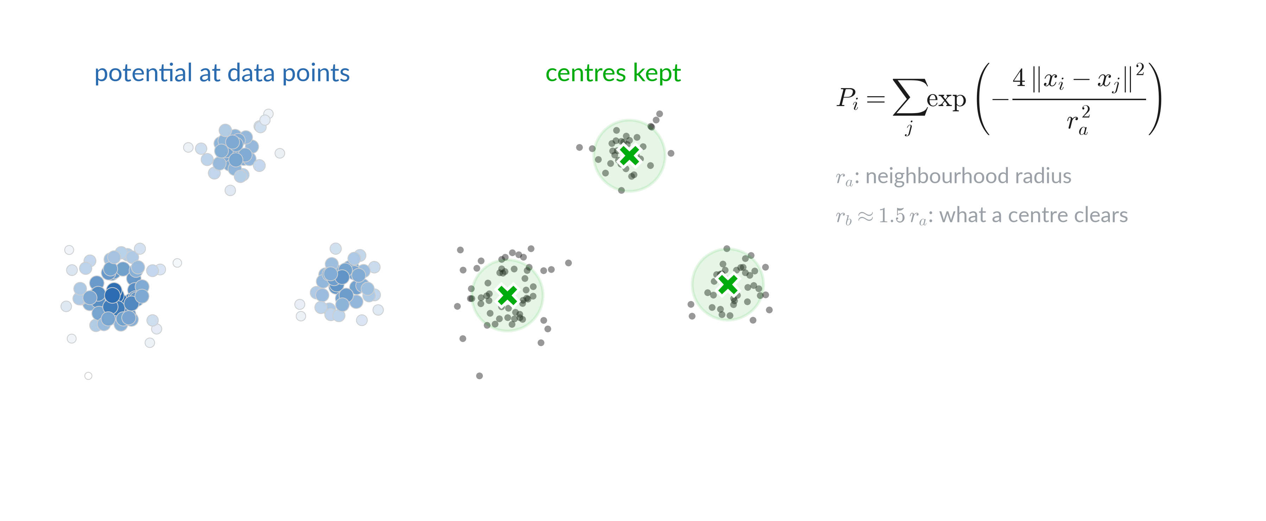
Dropping the grid

Slide 32
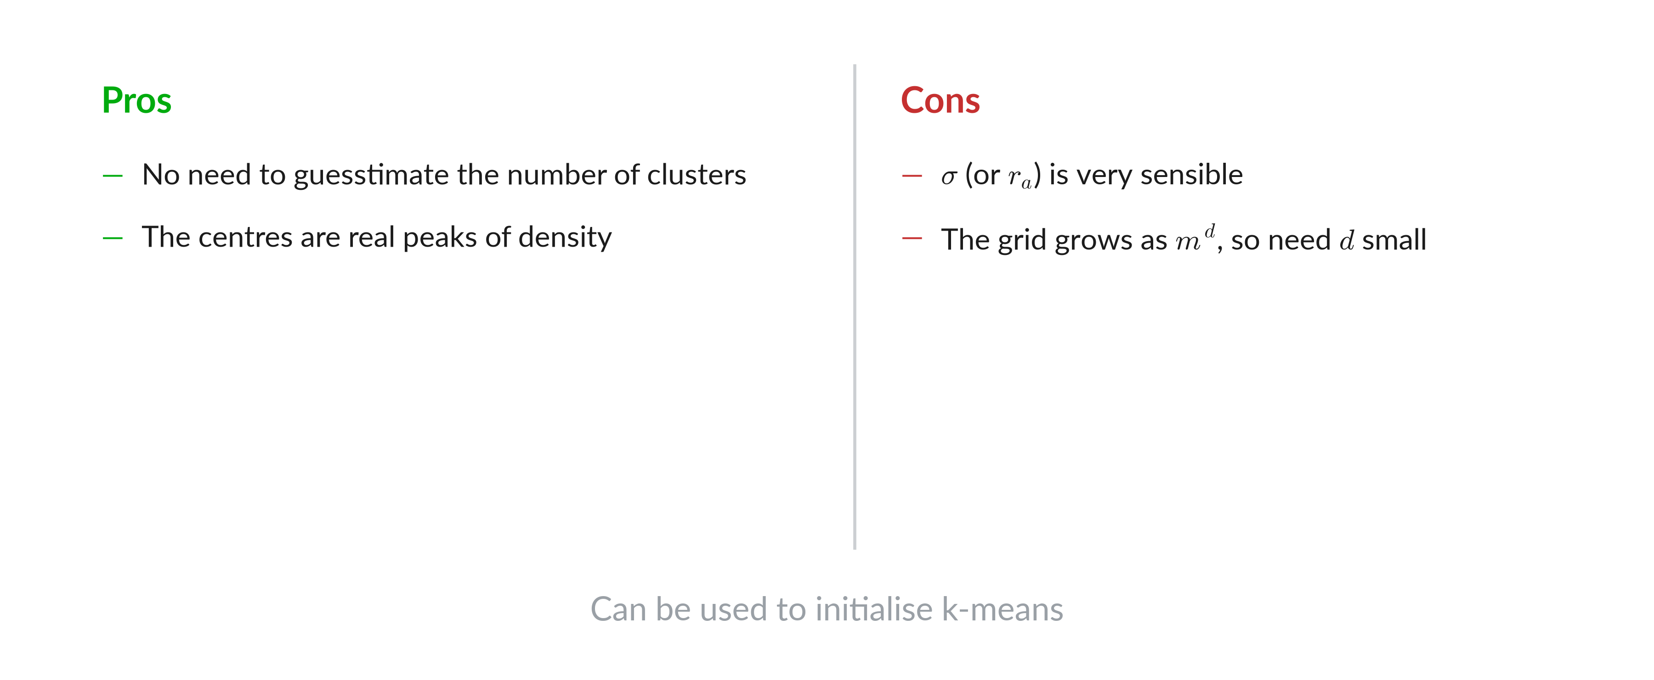
Pros and cons

Slide 33
Hierarchical clustering

Slide 34
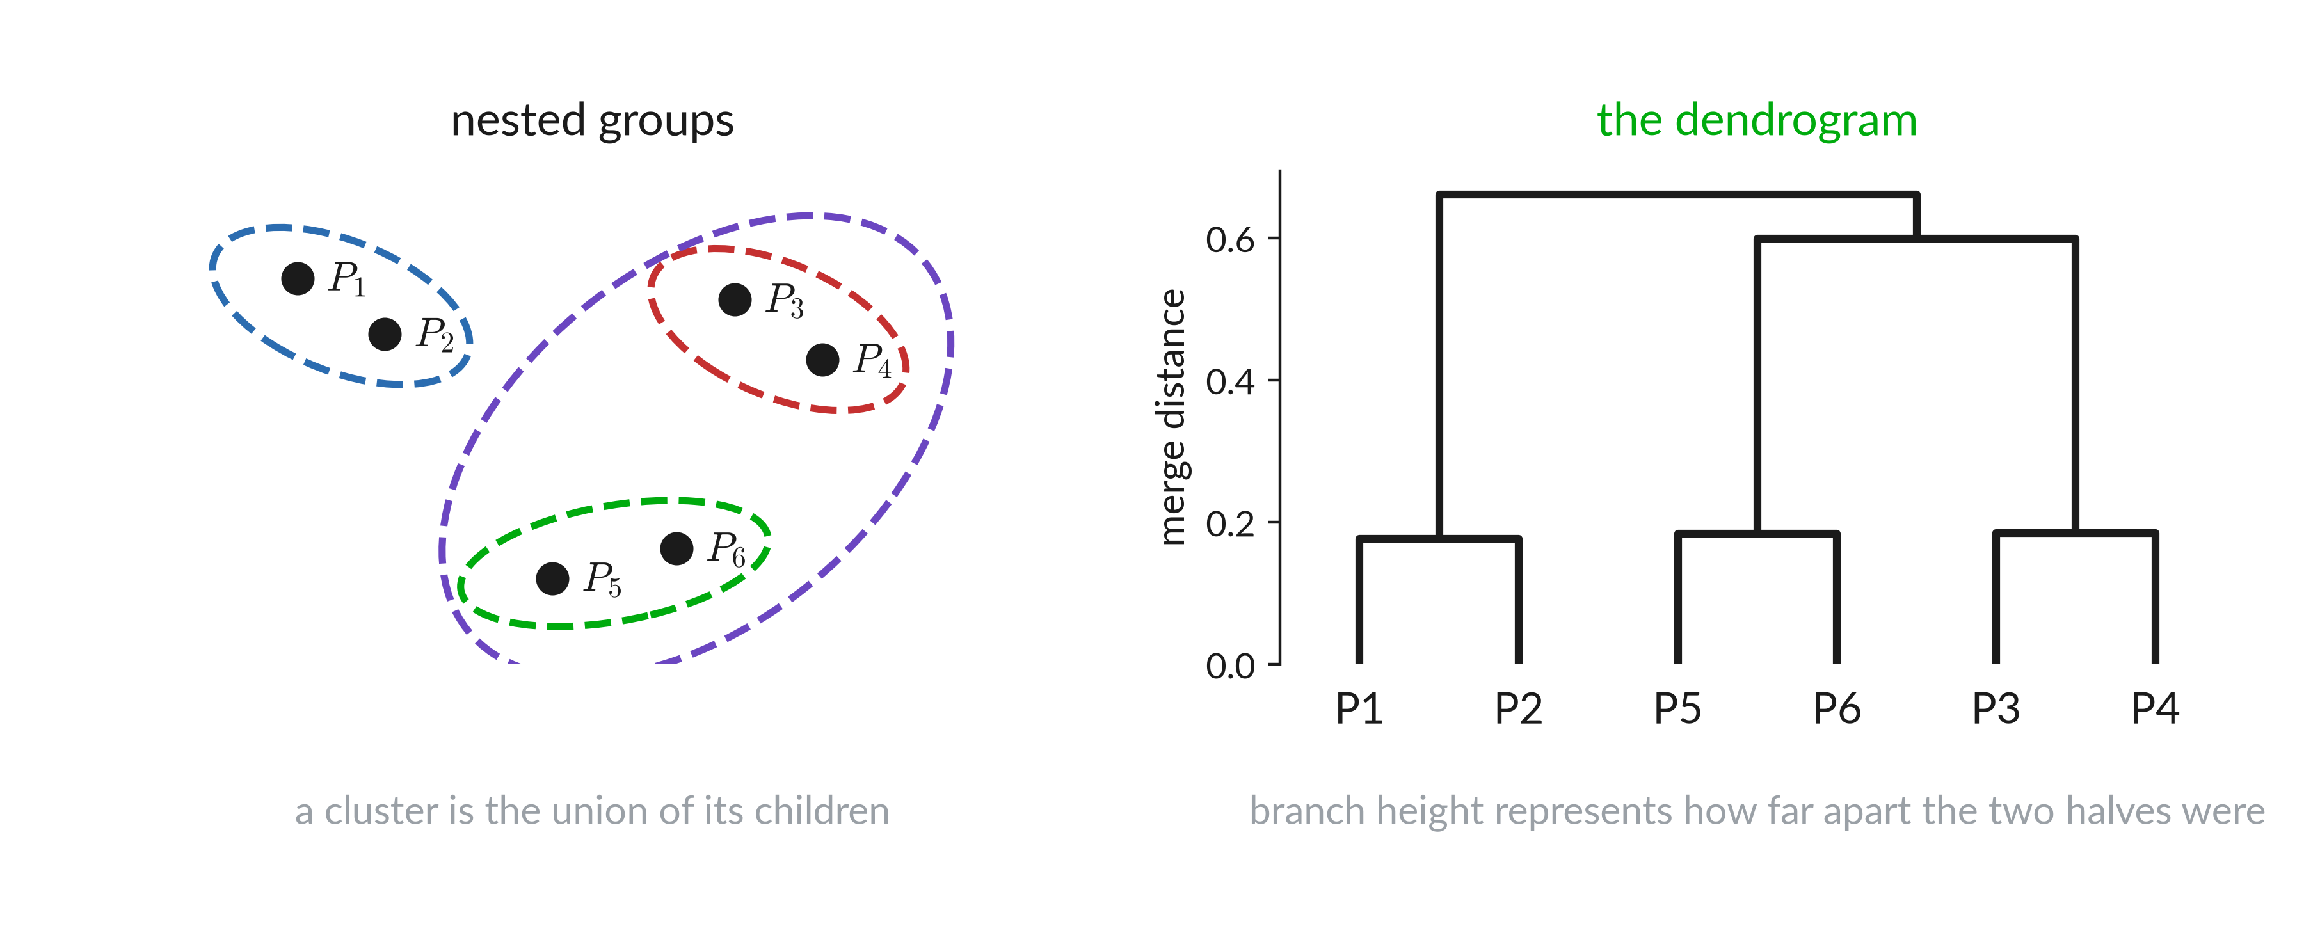
Representing clusters inside clusters

Slide 35
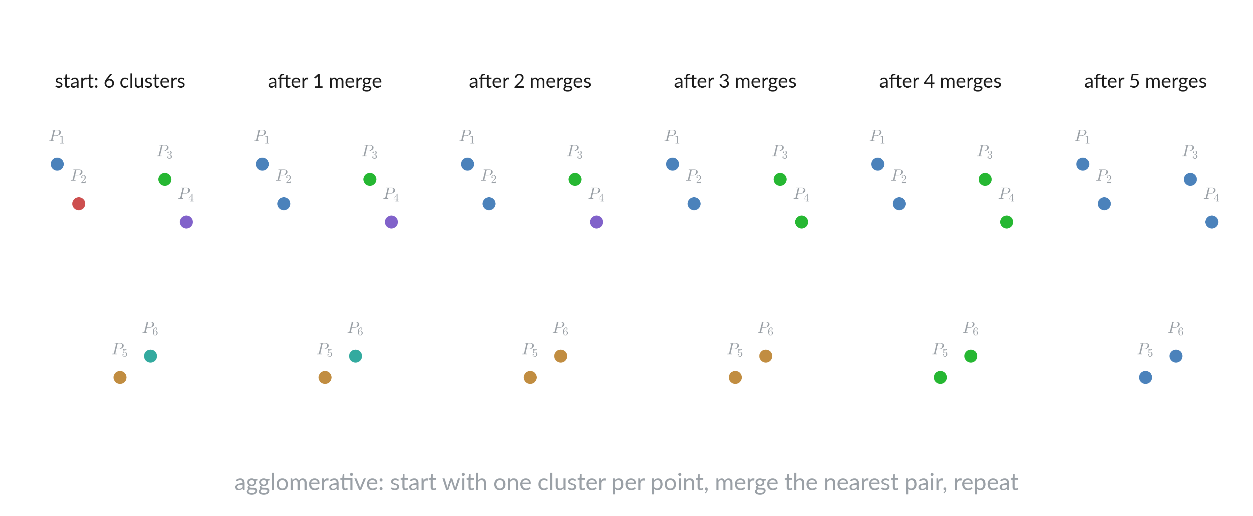
Agglomerative, one merge at a time

Slide 36
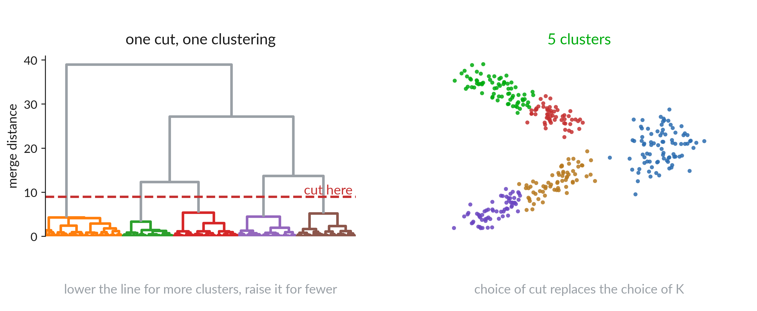
Cutting the dendrogram

Slide 37
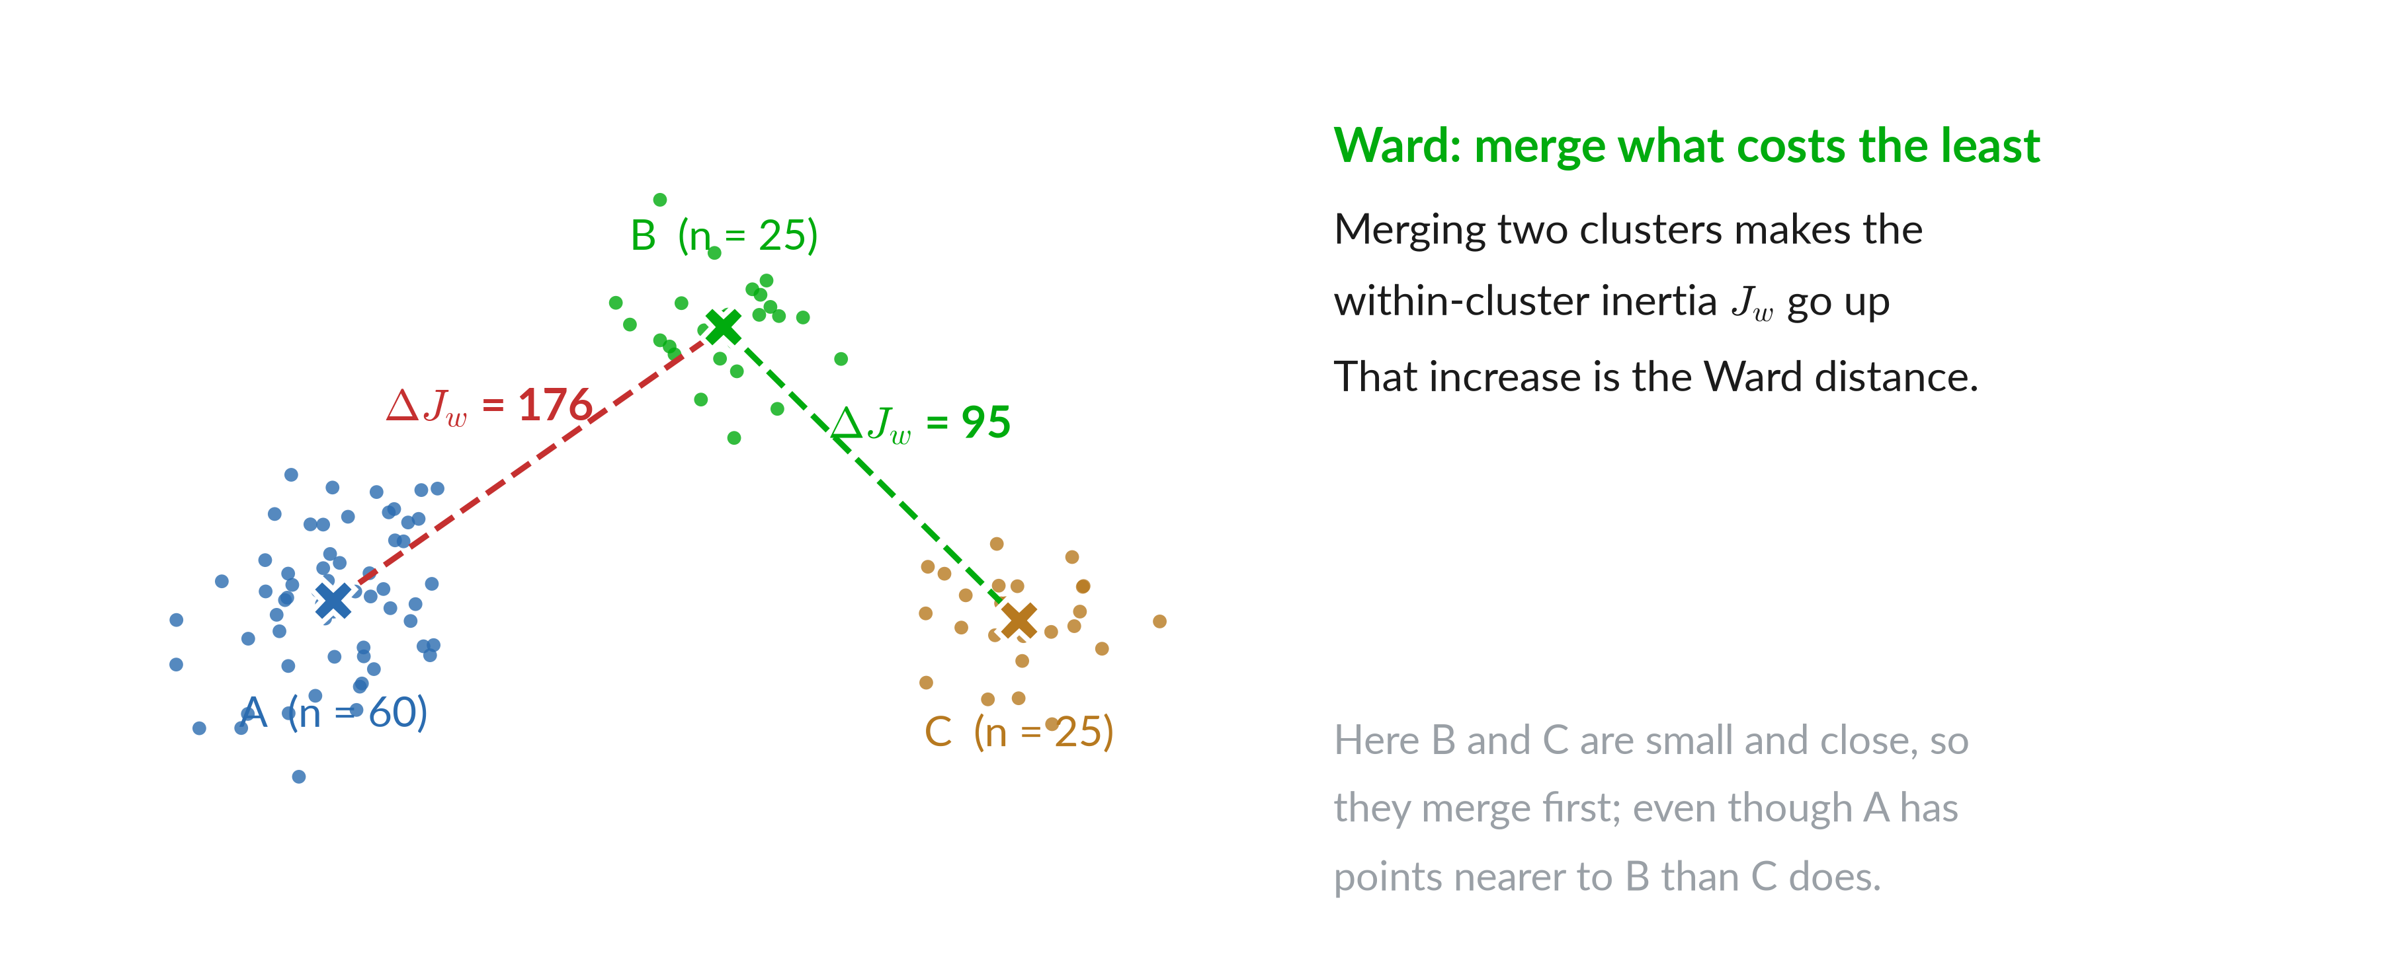
Ward: the cost of a merge

Slide 38
Moving the reference point

Slide 39
Where the Ward formula comes from

Slide 40
Ward distance

Slide 41
Every merge changes every distance

Slide 42
WPGMA: Weighted Pair Group Method with Arithmetic mean

Slide 43
Unweighted Pair Group Method with Arithmetic mean

Slide 44
Four linkages

Slide 45
Four linkages

Slide 46
Which linkage to use

Slide 47
Tree

Slide 48
DBSCAN

Slide 49
Neighborhood and crowdedness

Slide 50
Core, border, noise

Slide 51
Algorithm

Slide 52
Effect of ε

Slide 53
Reading ε off the k-NN curve

Slide 54
Effect of MinPts

Slide 55
Shapes k-means cannot reach

Slide 56
DBSCAN

Slide 57
HDBSCAN

Slide 58
DBSCAN at every scale at once

Slide 59
Six steps

Slide 60
Step 1: measure the density

Slide 61
Step 2: transform the space

Slide 62
Step 2: a worked example

Slide 63
Step 2: why the maximum

Slide 64
What the new distance does

Slide 65
Step 3: the minimum spanning tree

Slide 66
Step 3: how the tree is built

Slide 67
Step 4: cluster hierarchy

Slide 68
Step 4 on real data

Slide 69
Step 5: condense the tree

Slide 70
Step 5 on real data

Slide 71
Stability

Slide 72
Stability example

Slide 73
Step 6: keep the stable clusters

Slide 74
Six steps

Slide 75
Dataset with multiple densities

Slide 76
HDBSCAN

Slide 77
Four methods on four datasets

Slide 78
The map

