Slide 1
Session 5
Non-negative Matrix Factorization
Advanced Machine Learning · MSc DSBA · 2026
Paul Dubois

Slide 2
A matrix as a product

Slide 3
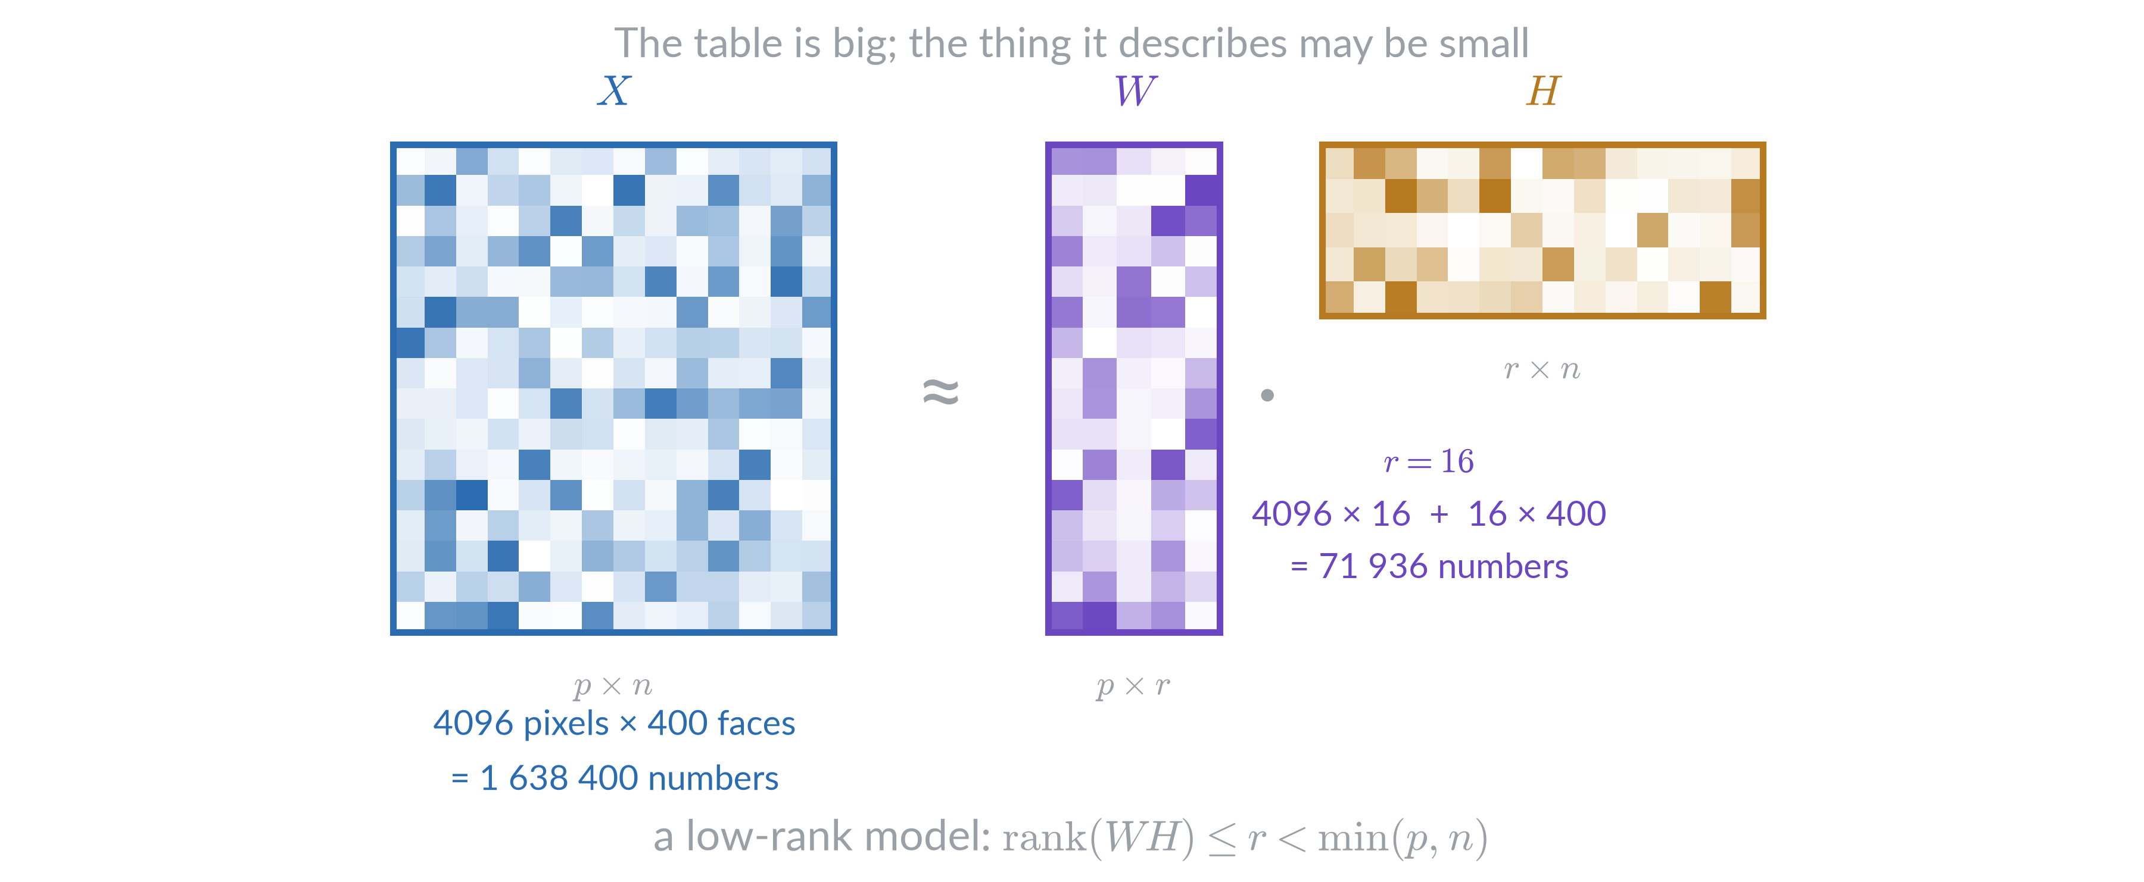
Reducing size

Slide 4
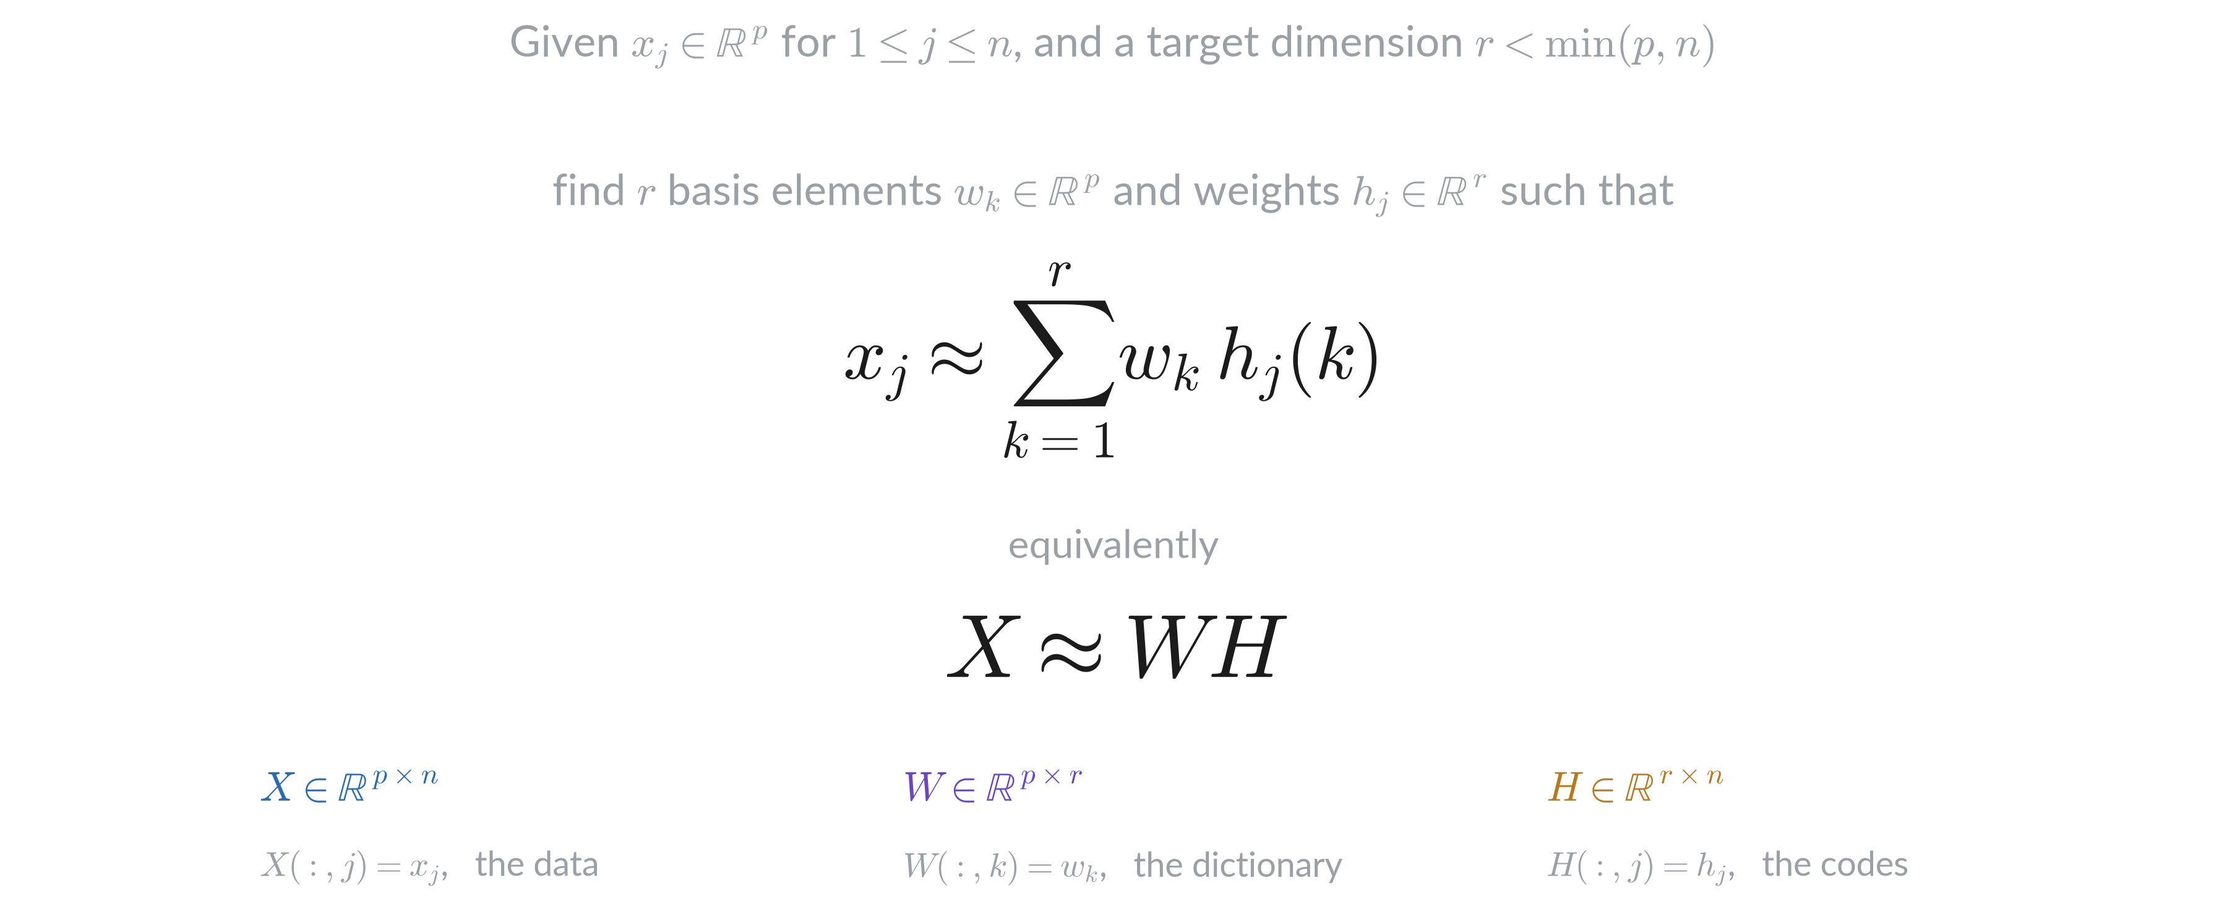
Modeling problem

Slide 5
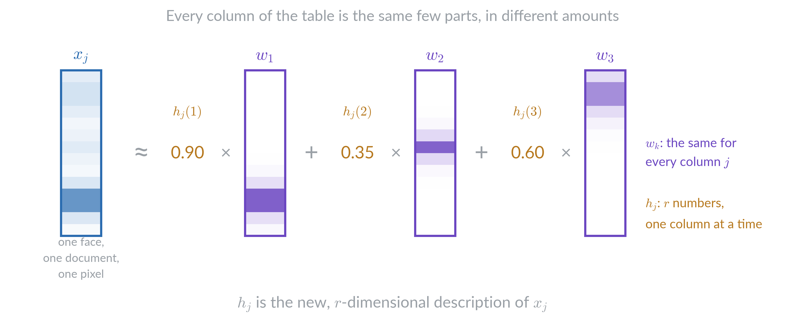
Column as a weighted sum

Slide 6
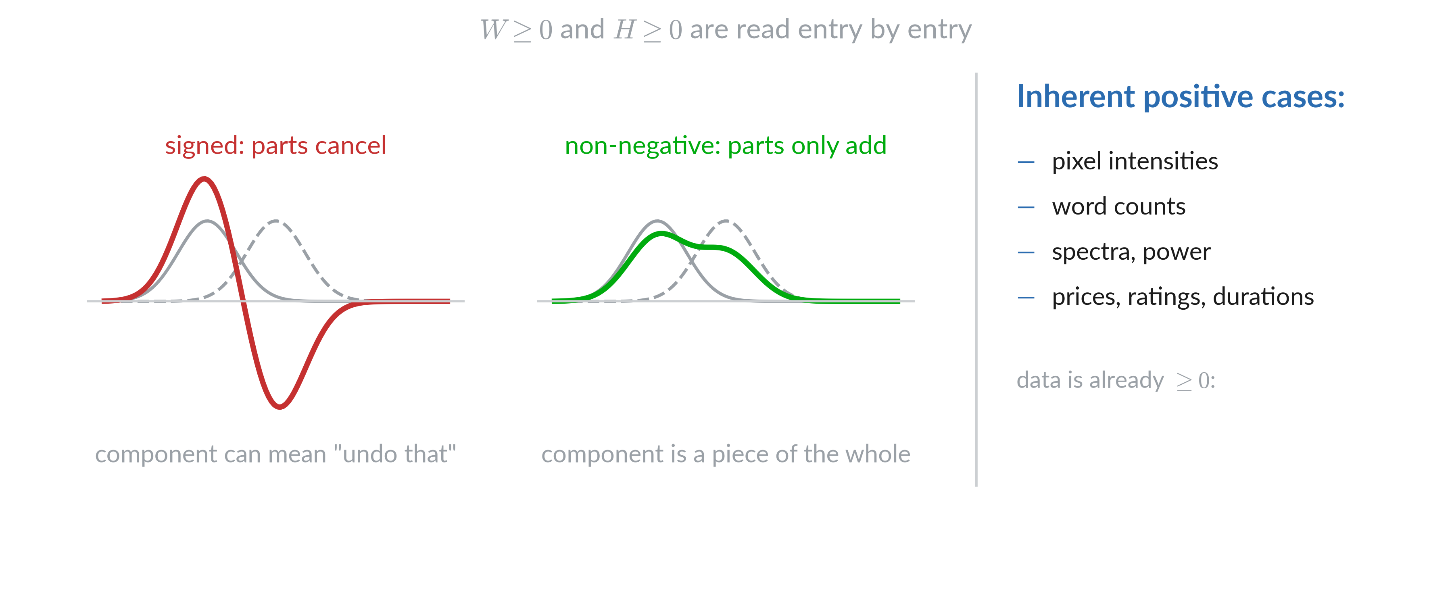
Why non-negative

Slide 7
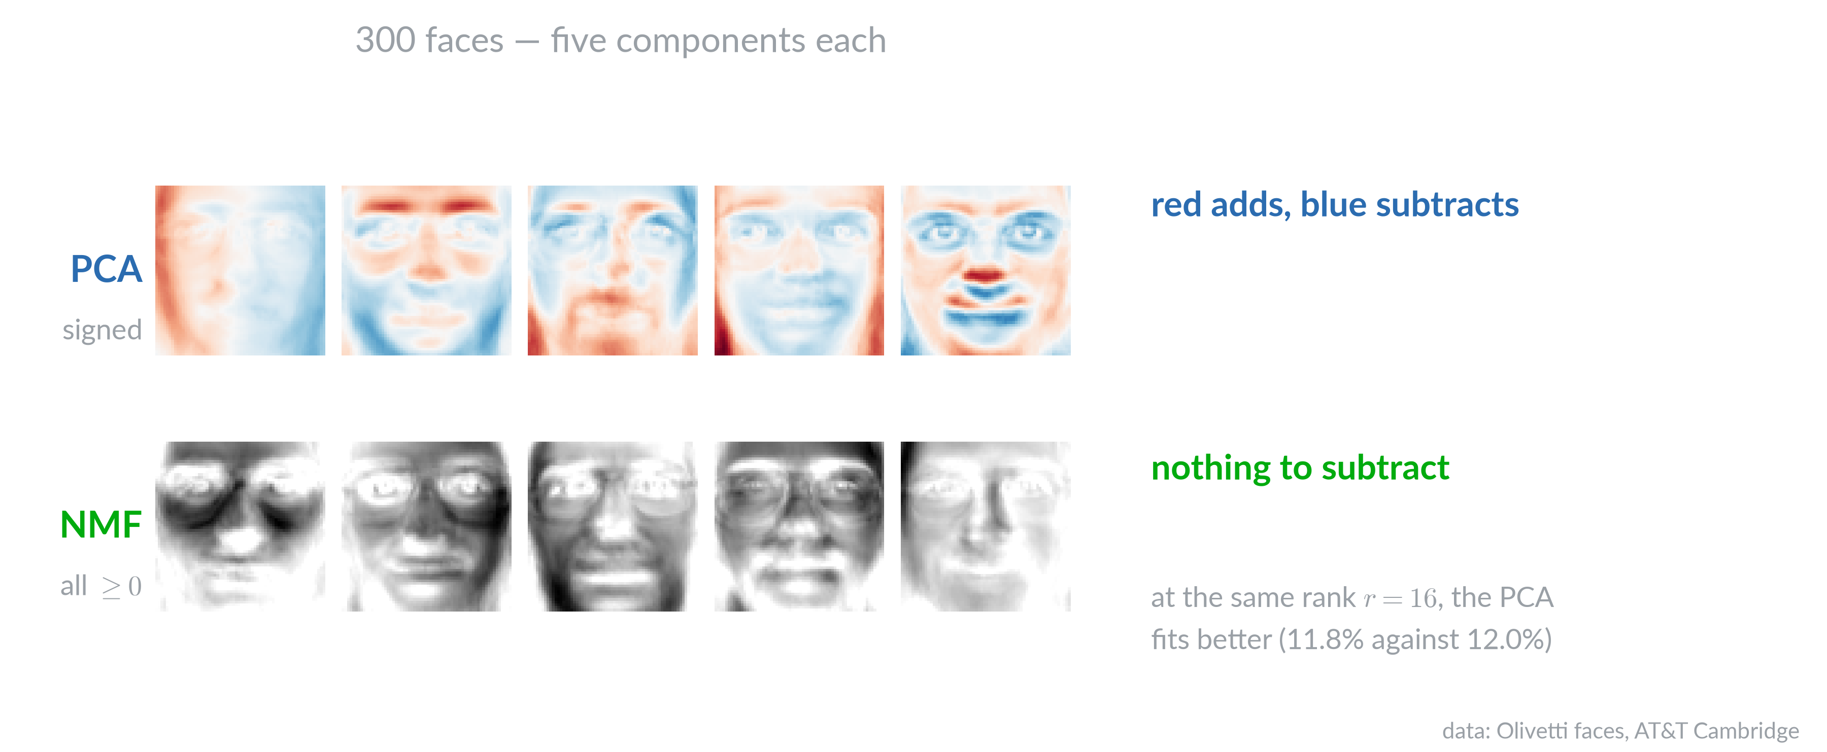
Additive components

Slide 8
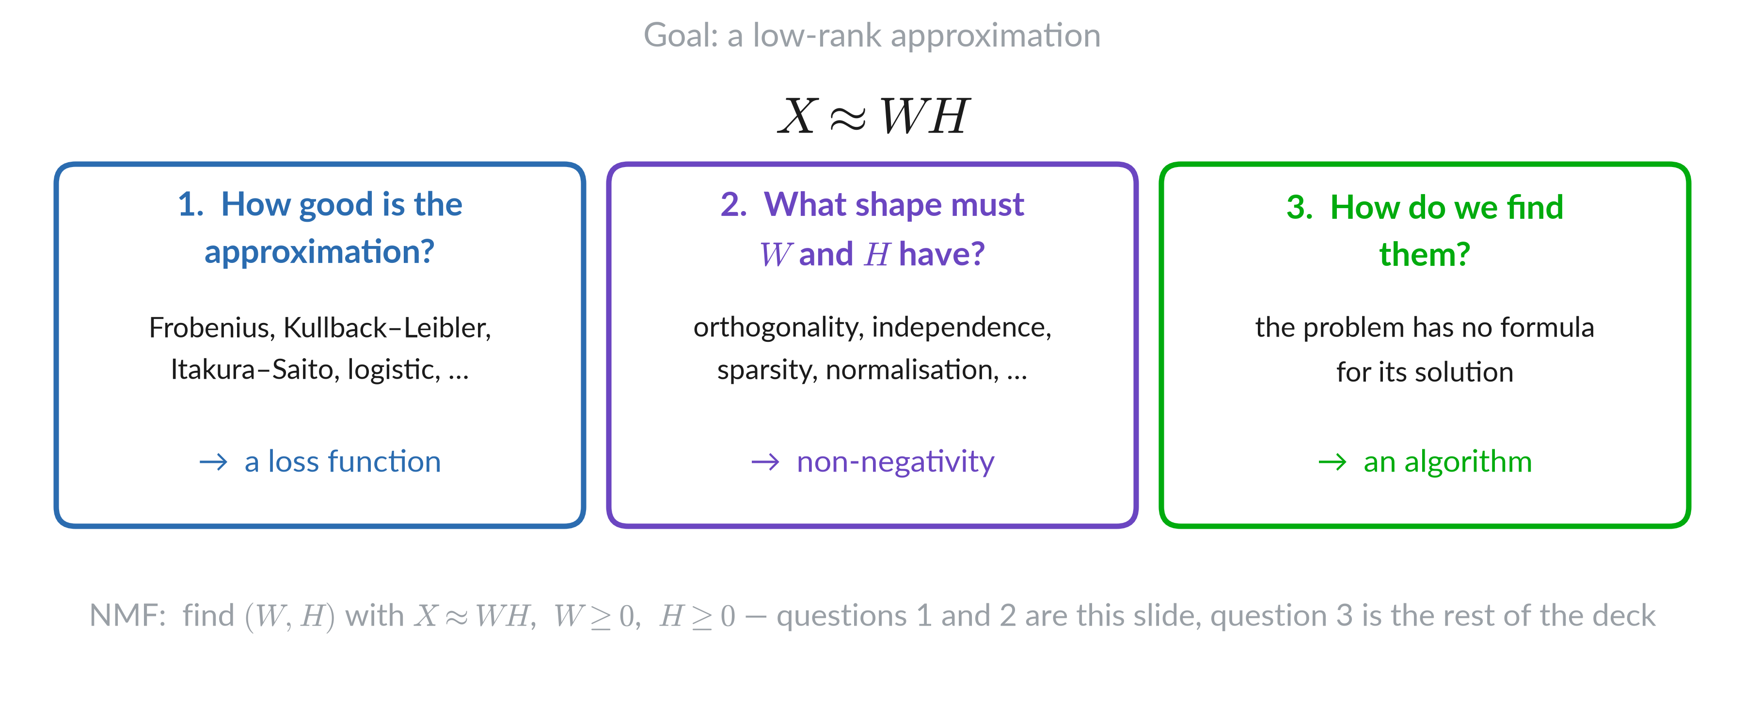
Three questions

Slide 9
What it is used for

Slide 10
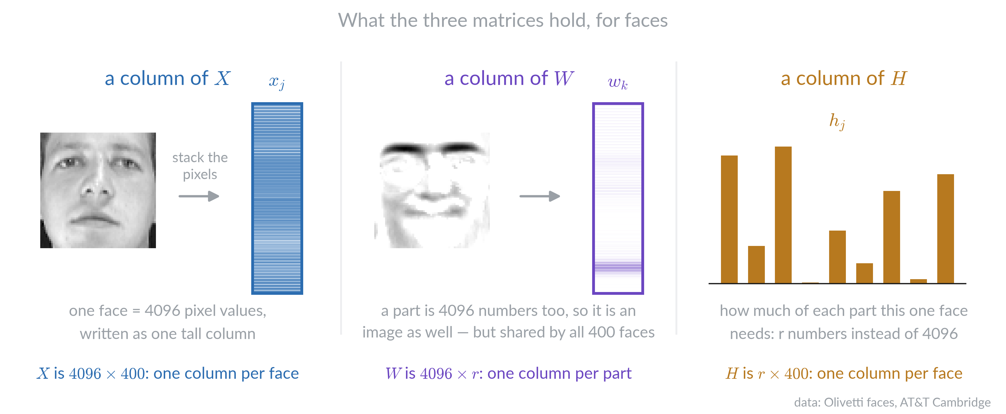
Faces: the three matrices

Slide 11
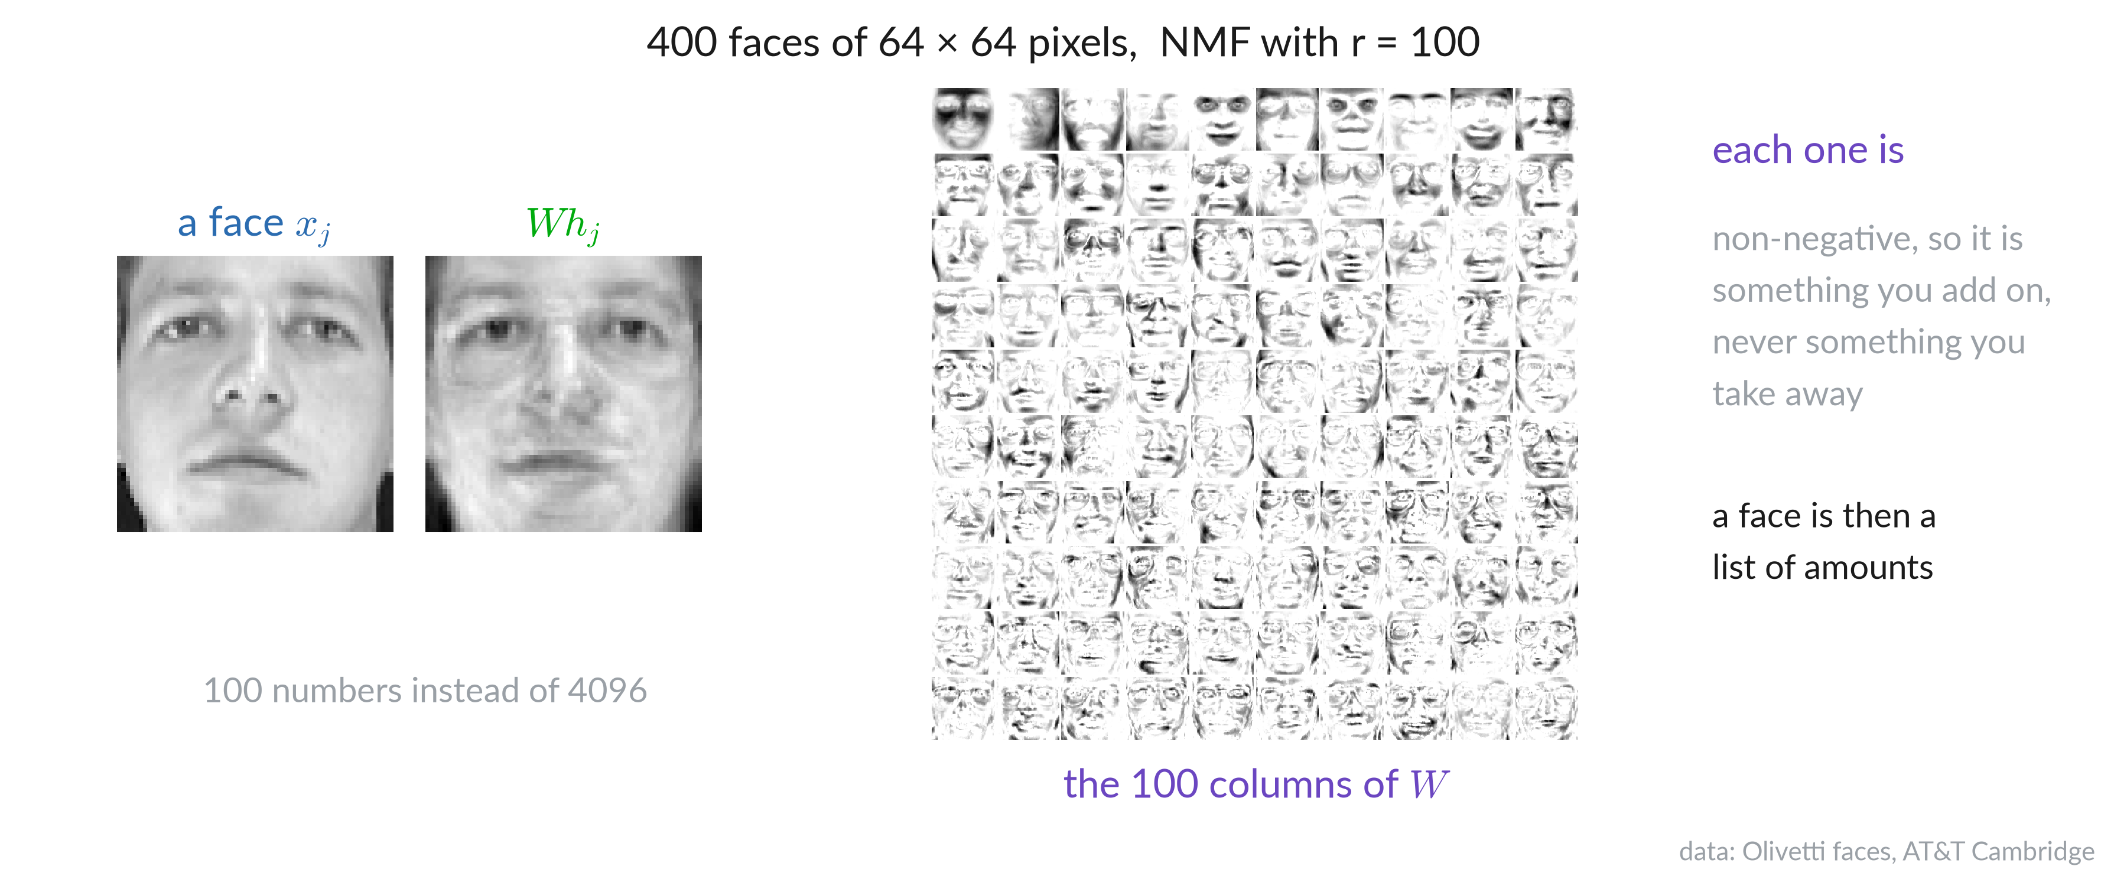
Faces: what comes out

Slide 12
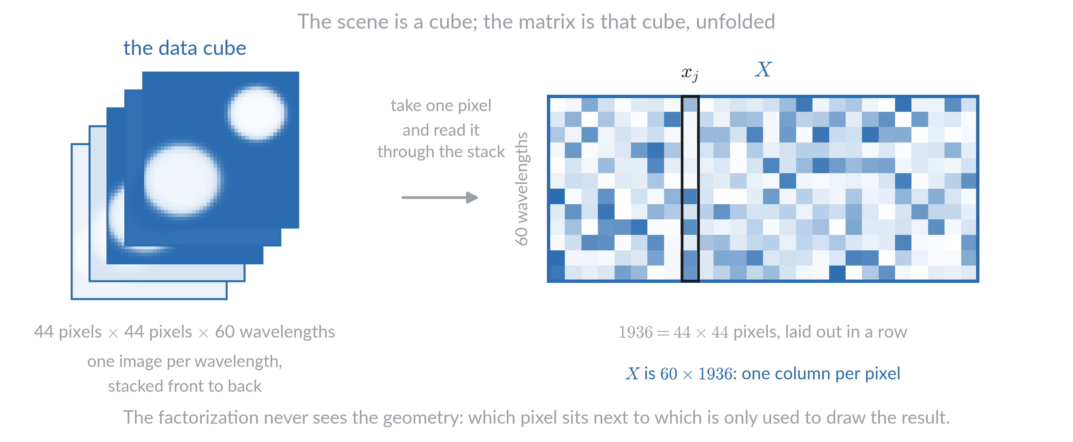
Hyperspectral unmixing: a cube, unfolded

Slide 13
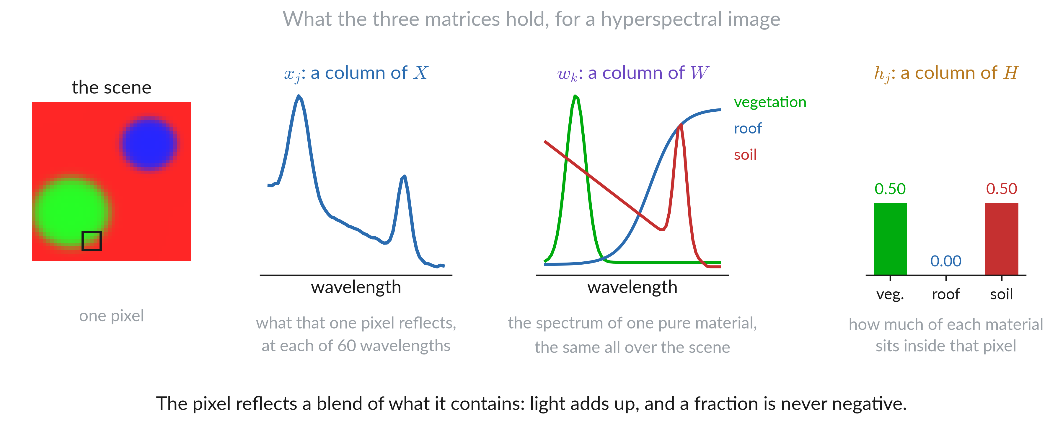
Hyperspectral unmixing: the three matrices

Slide 14
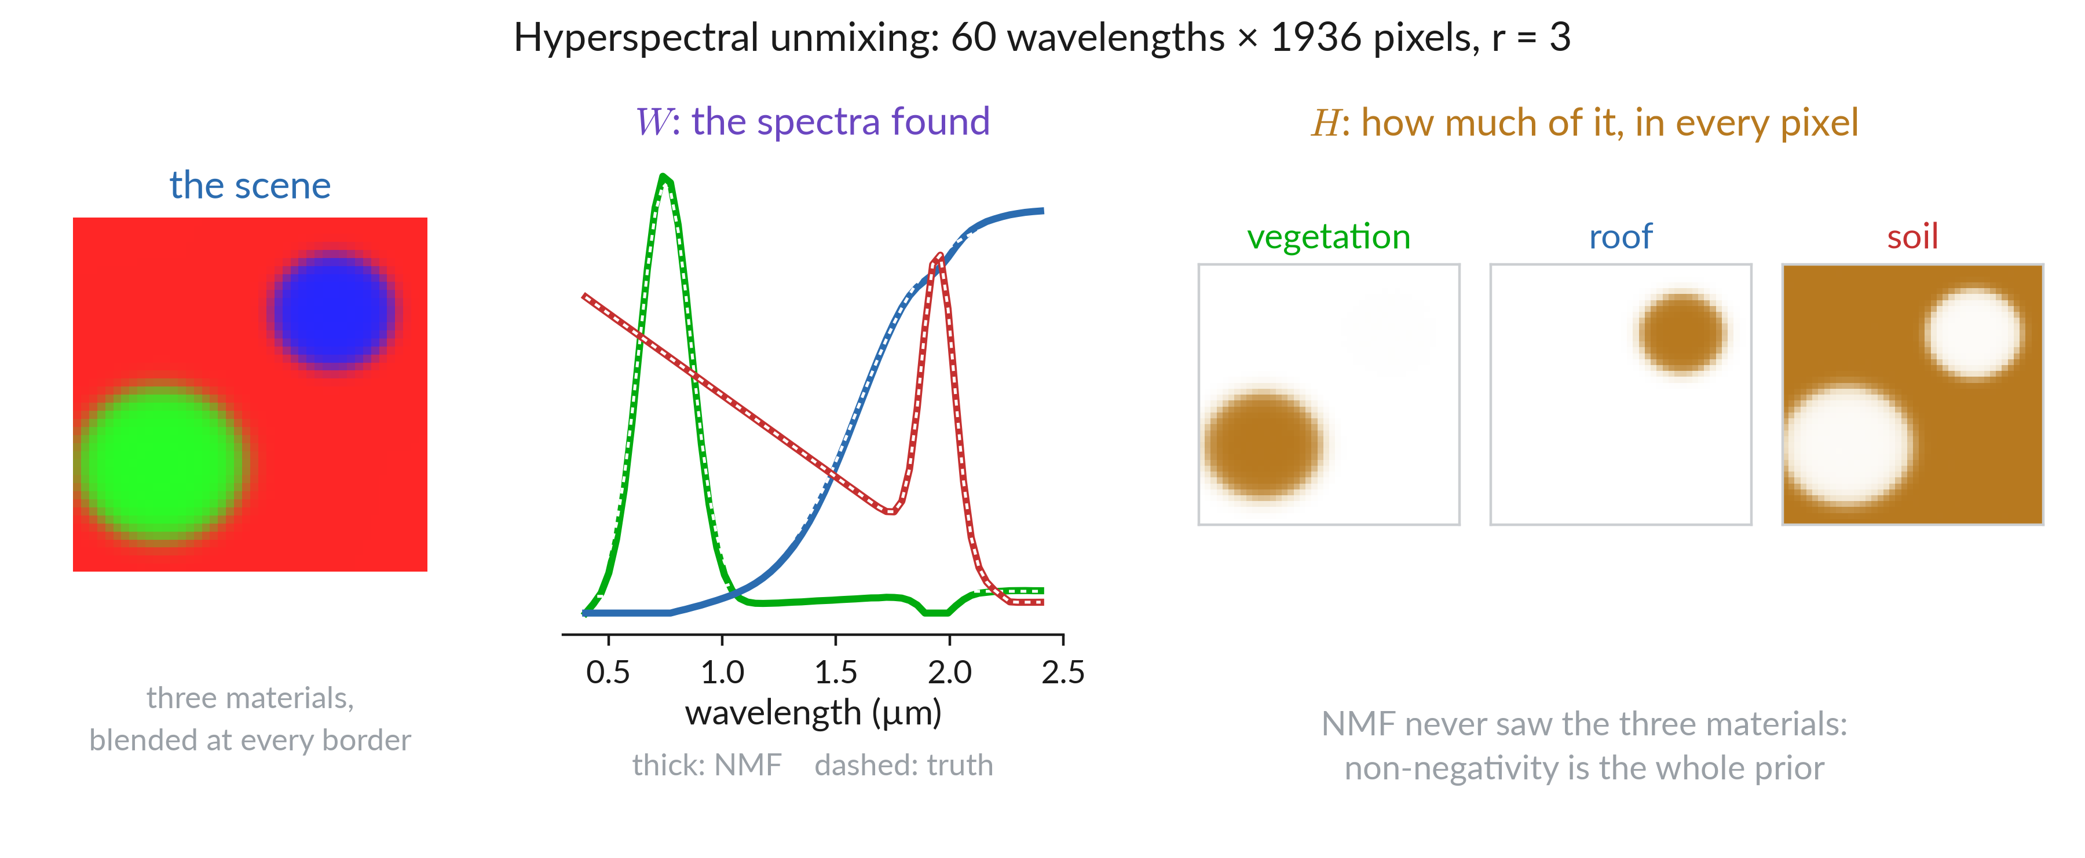
Hyperspectral unmixing: what comes out

Slide 15
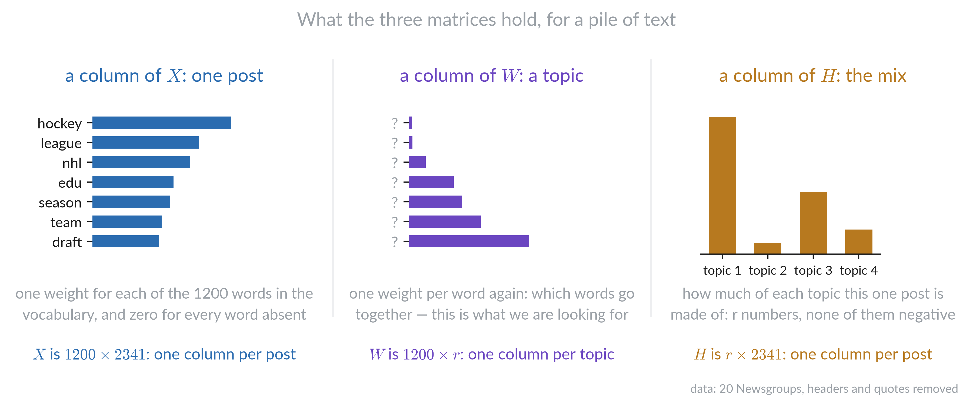
Topics in text: the three matrices

Slide 16
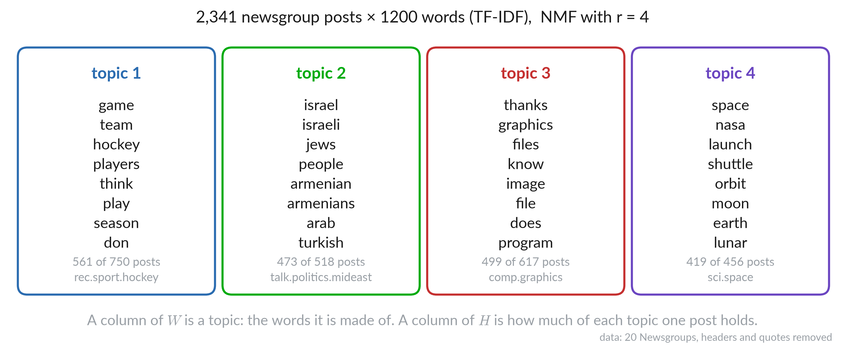
Topics in text: what comes out

Slide 17
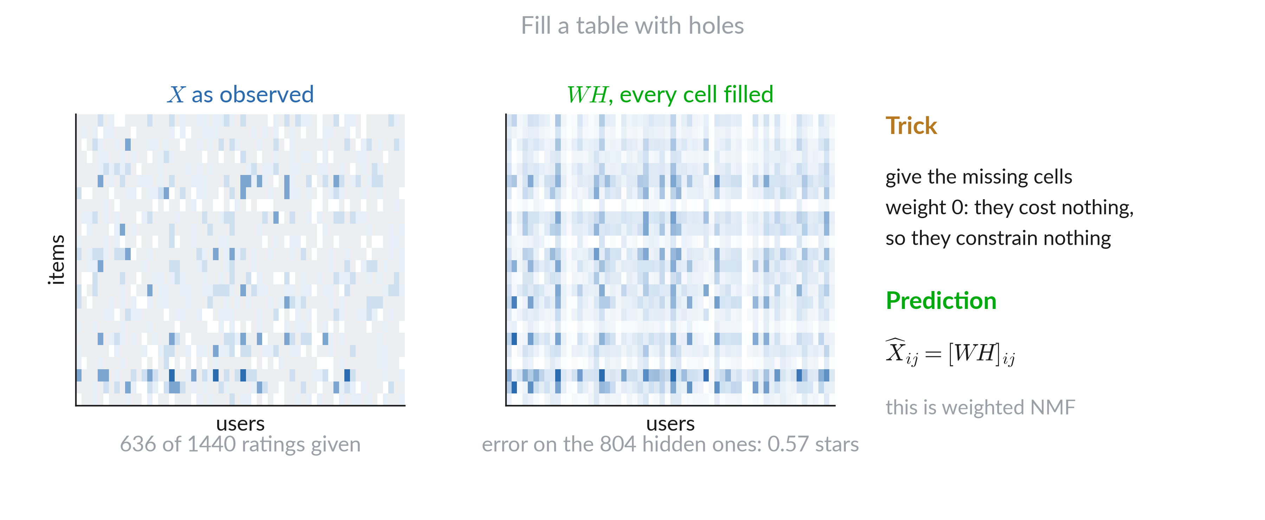
Fill missing values

Slide 18
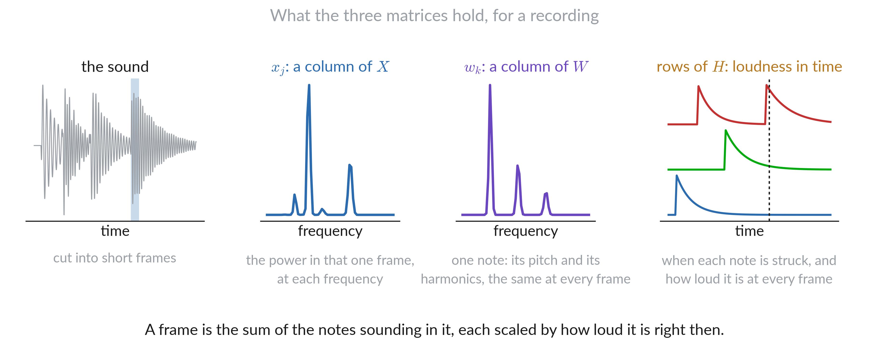
Music: the three matrices

Slide 19
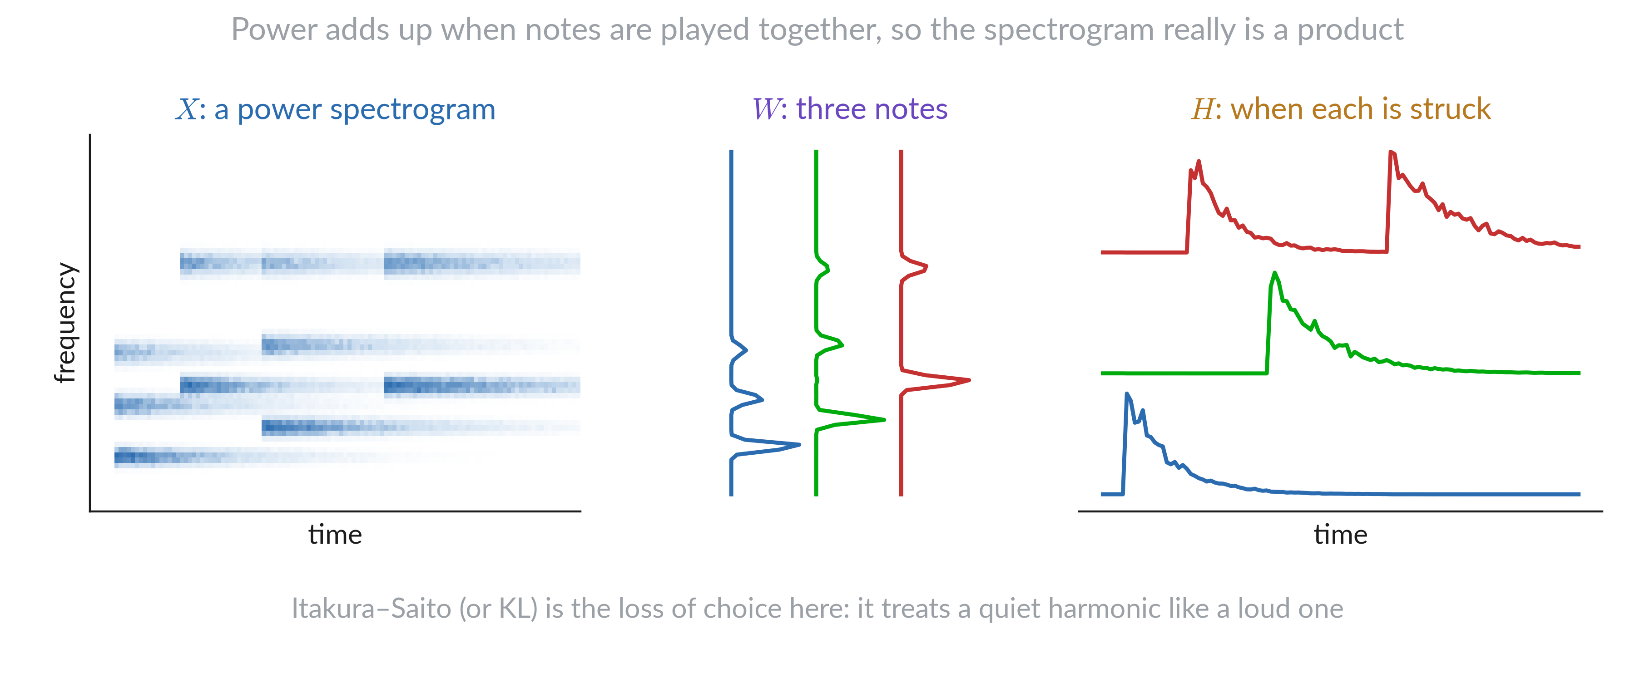
Music: what comes out

Slide 20
Choosing a loss

Slide 21
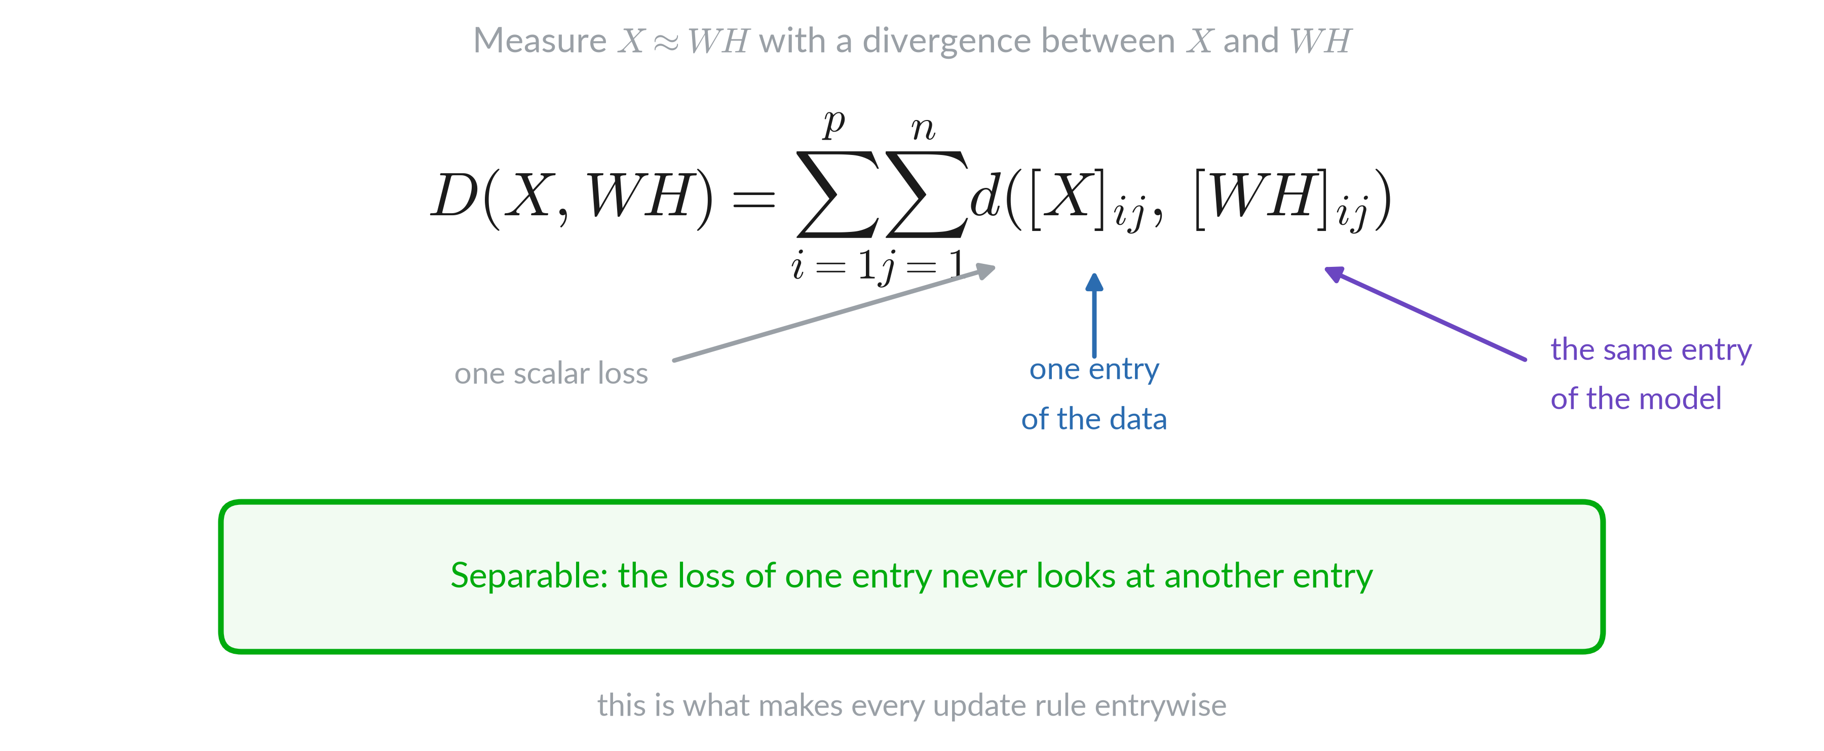
Entry by entry

Slide 22
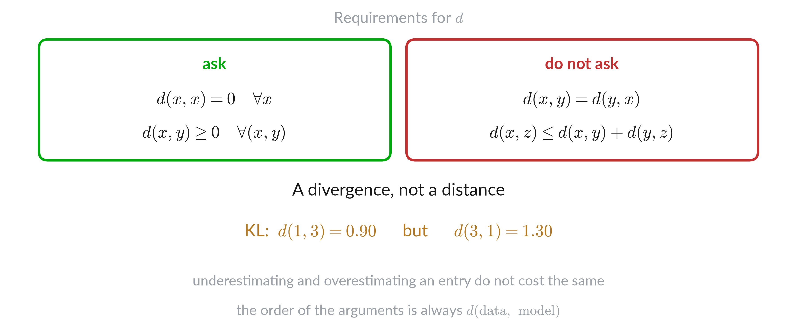
Divergence, not distance

Slide 23
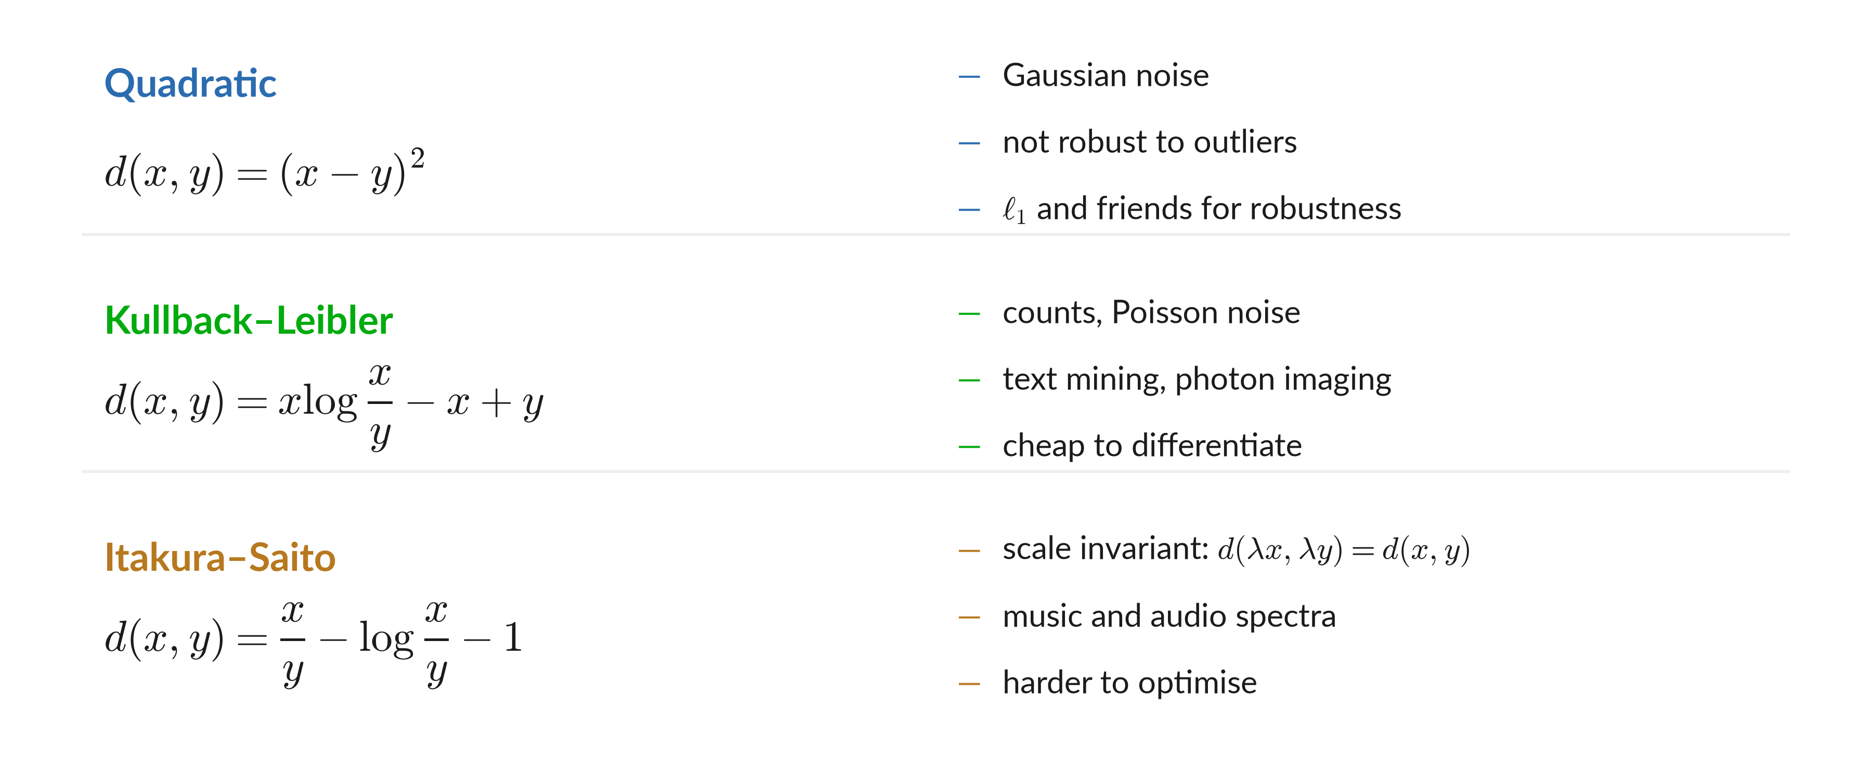
Classic choices

Slide 24
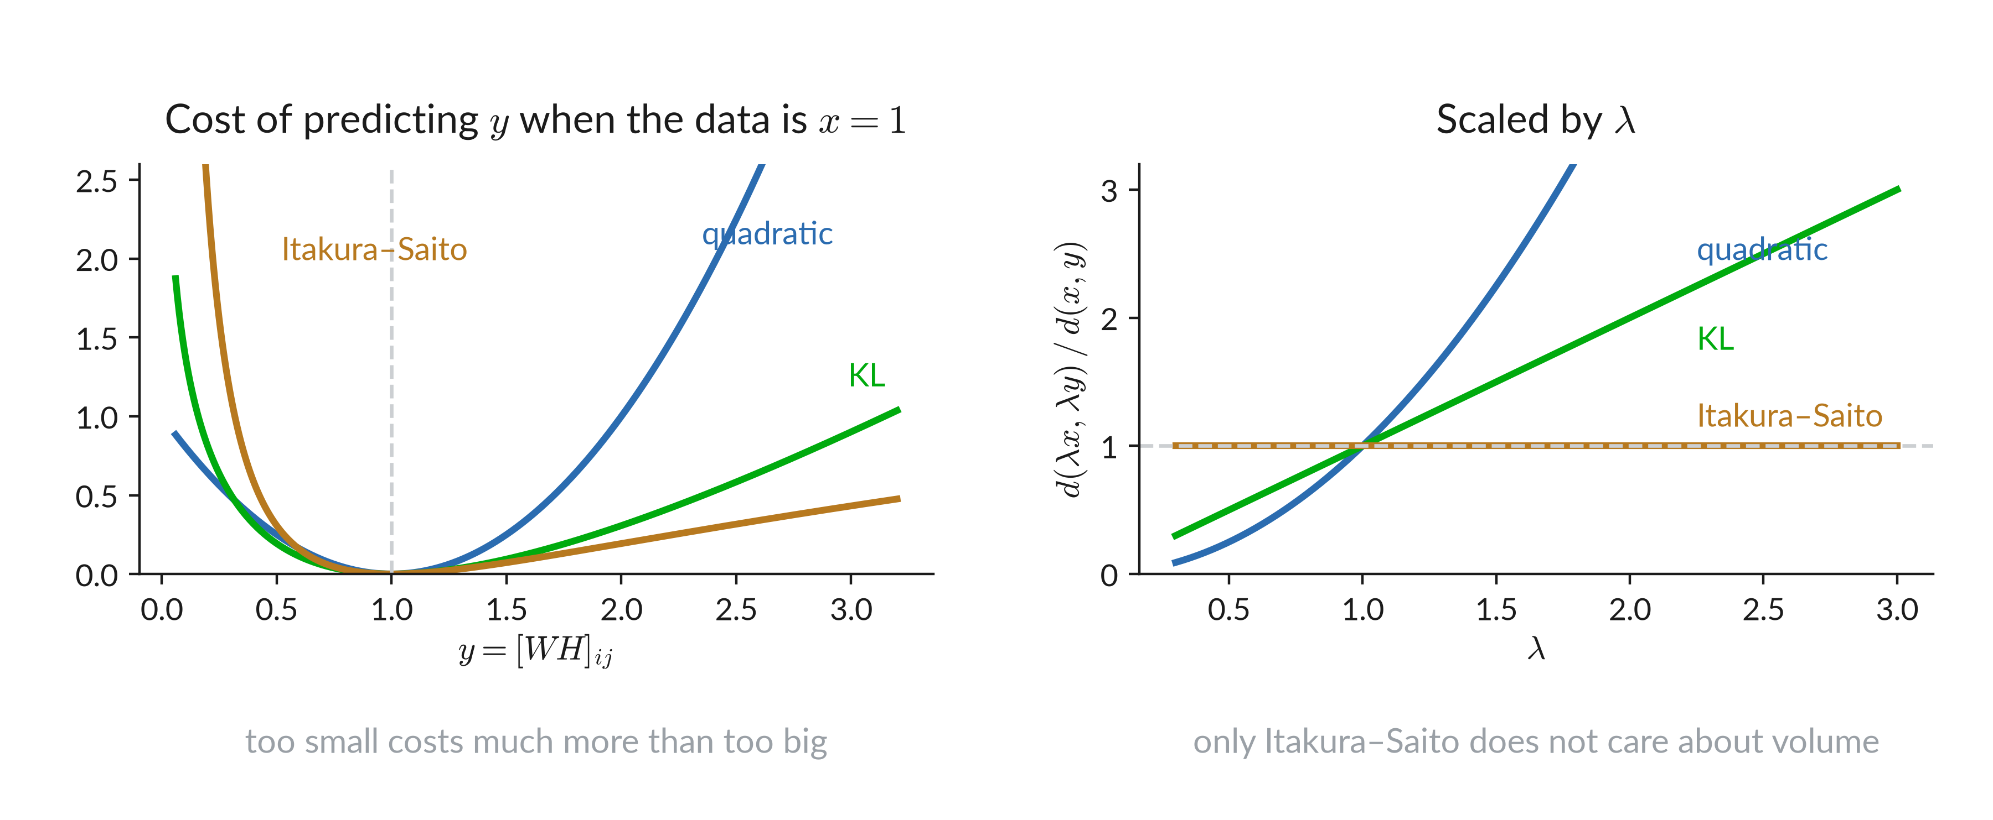
Classic choices

Slide 25
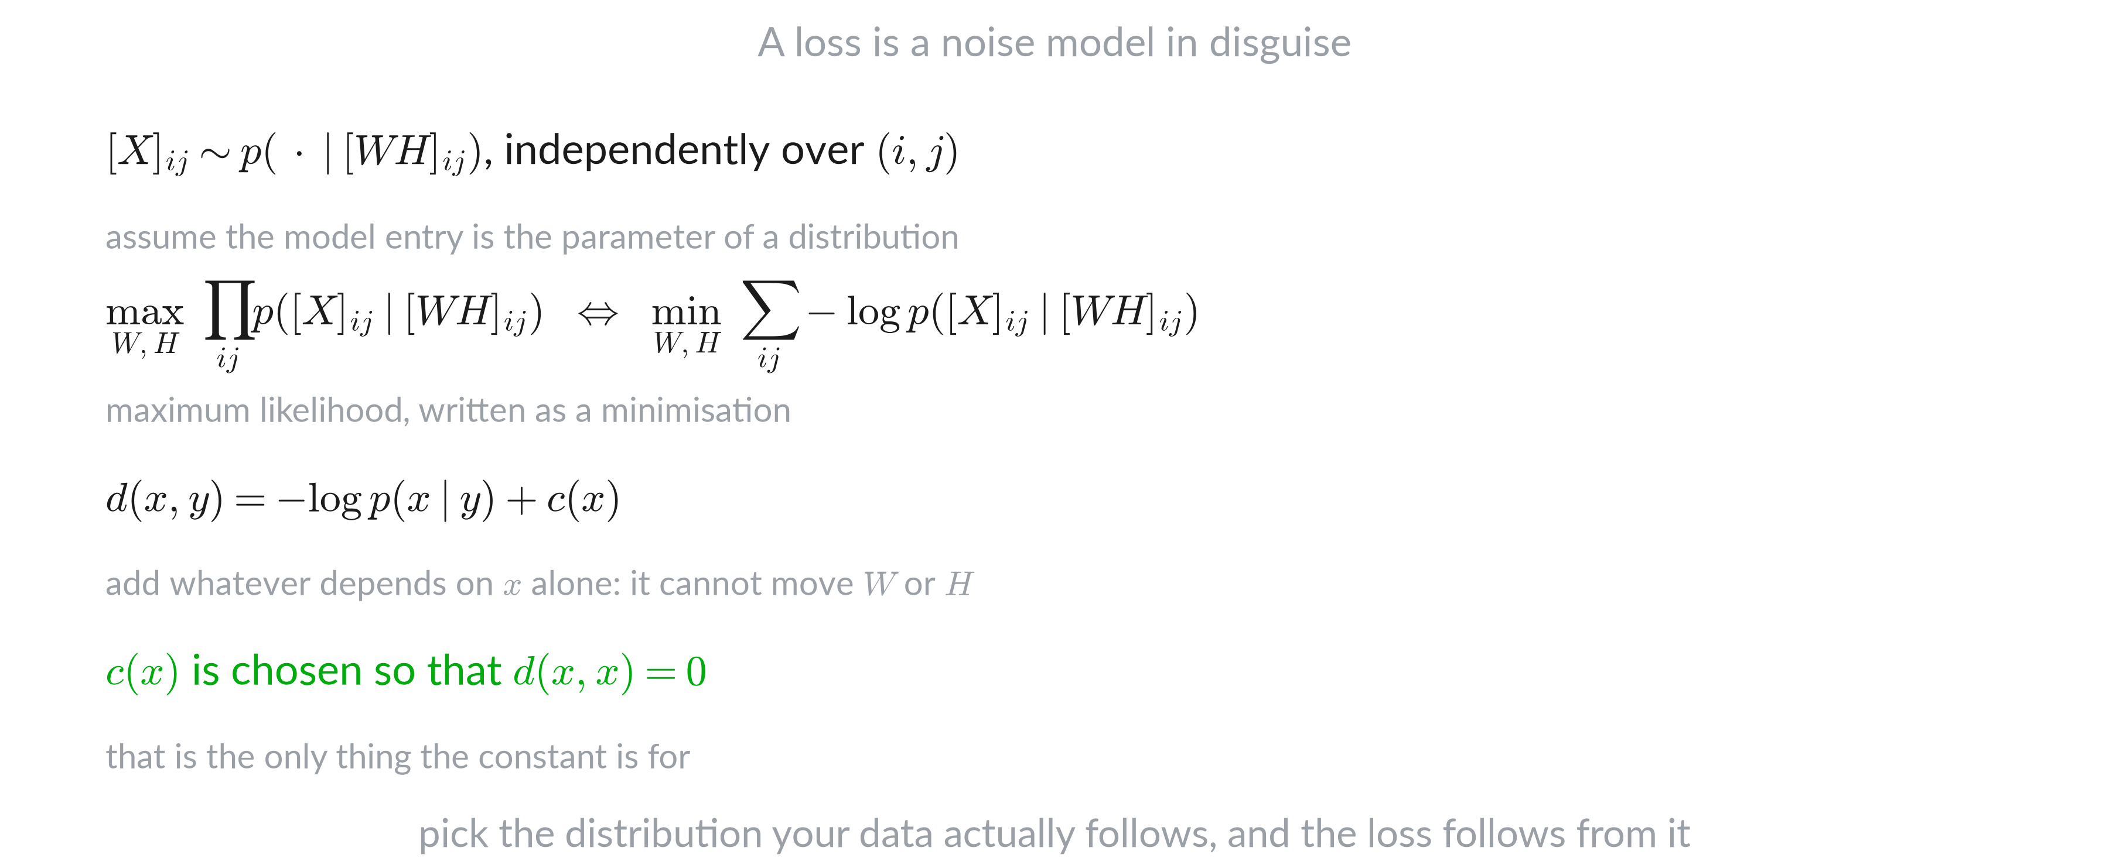
Where a loss comes from

Slide 26
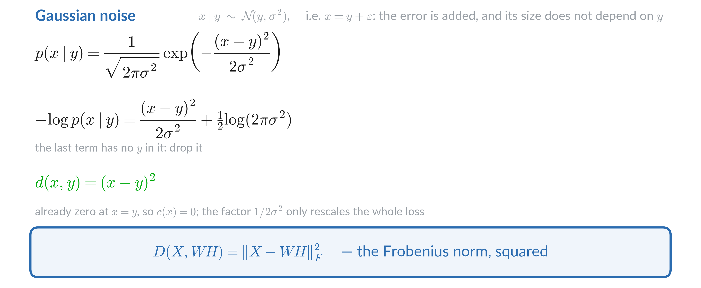
Gaussian noise gives the square

Slide 27
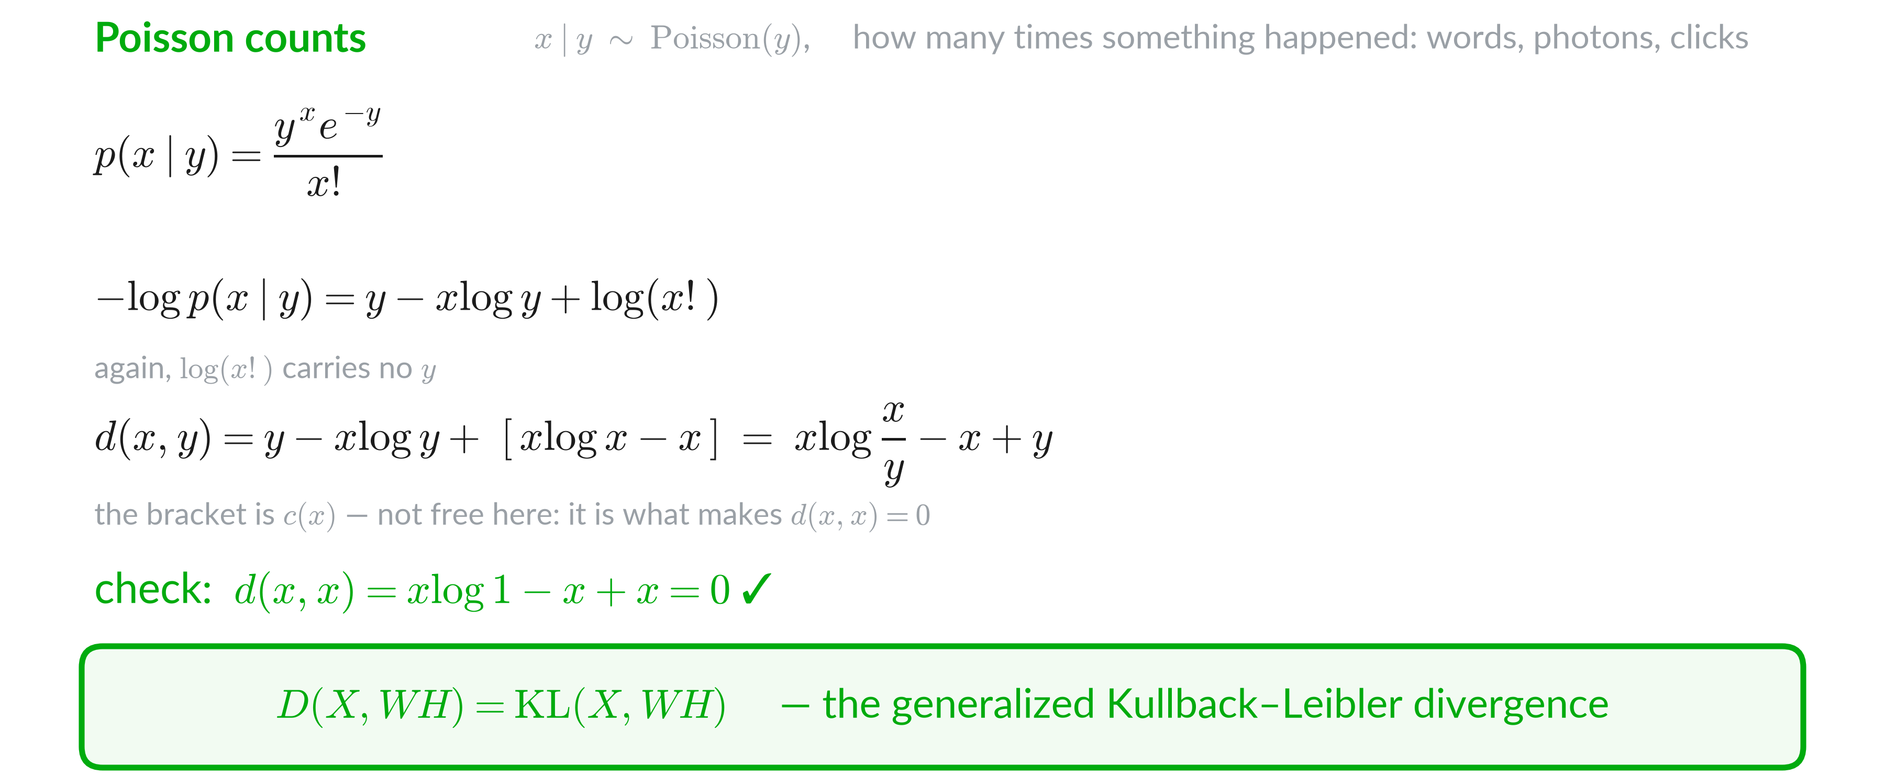
Poisson counts give KL

Slide 28
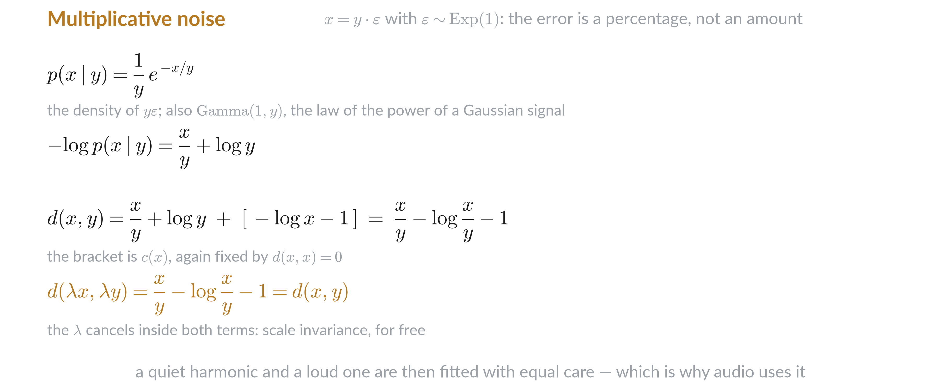
Multiplicative noise gives Itakura–Saito

Slide 29
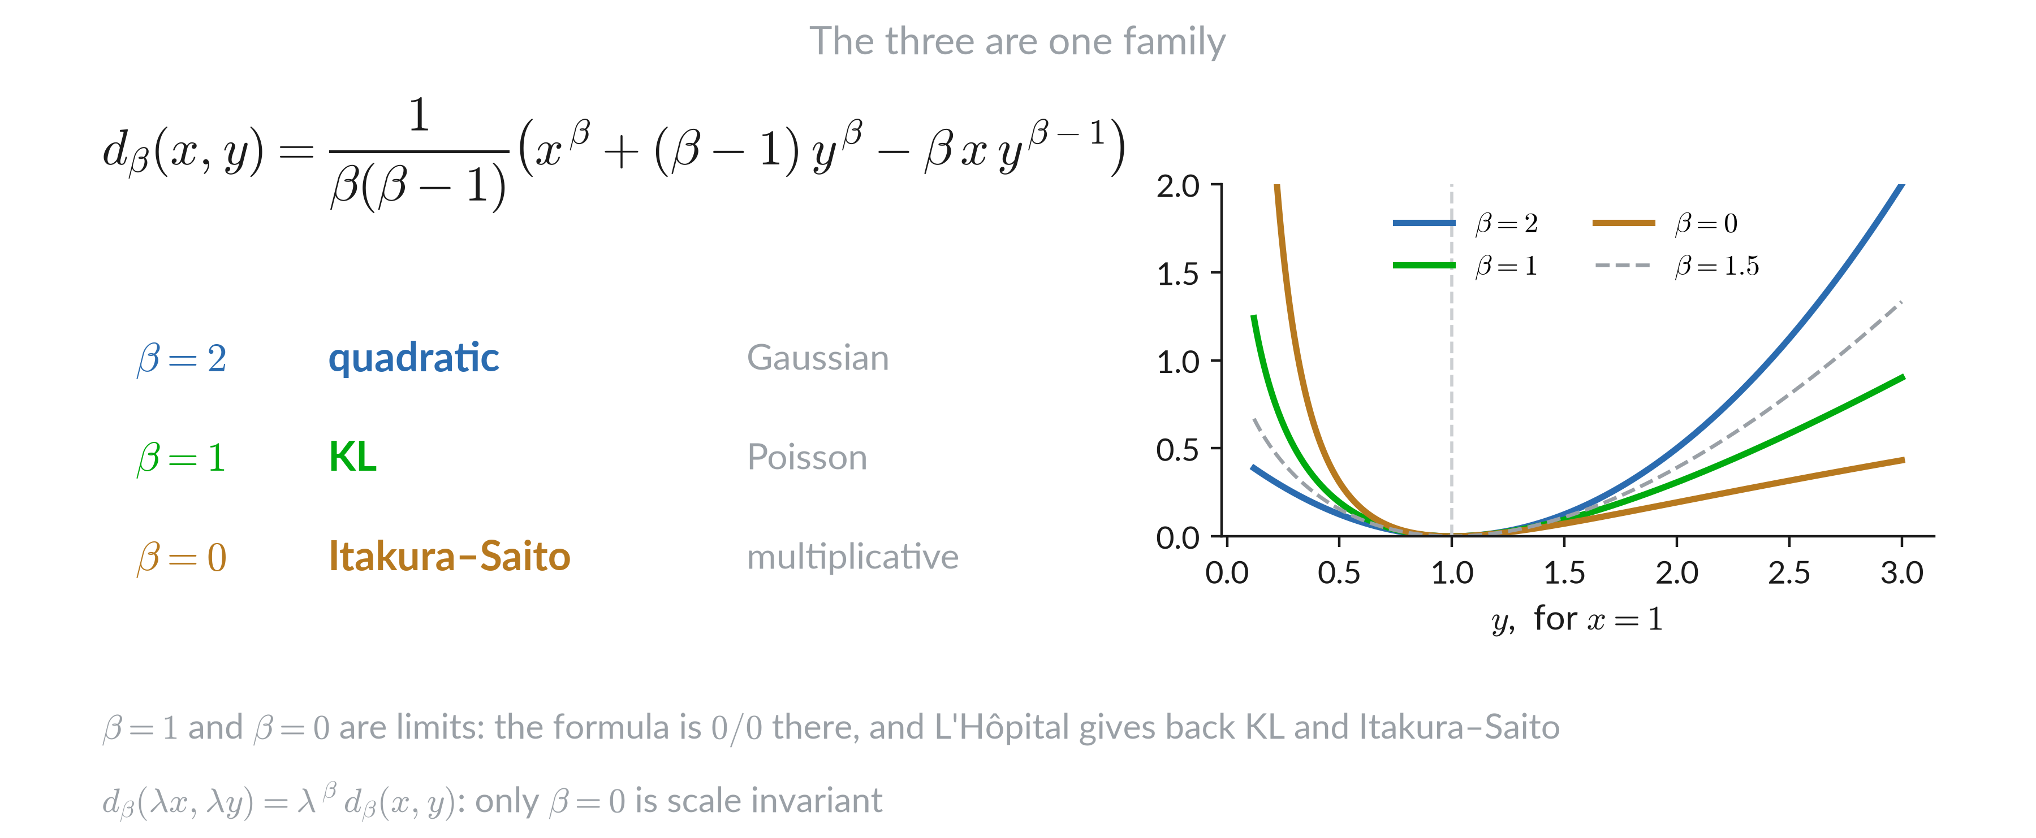
General formula

Slide 30
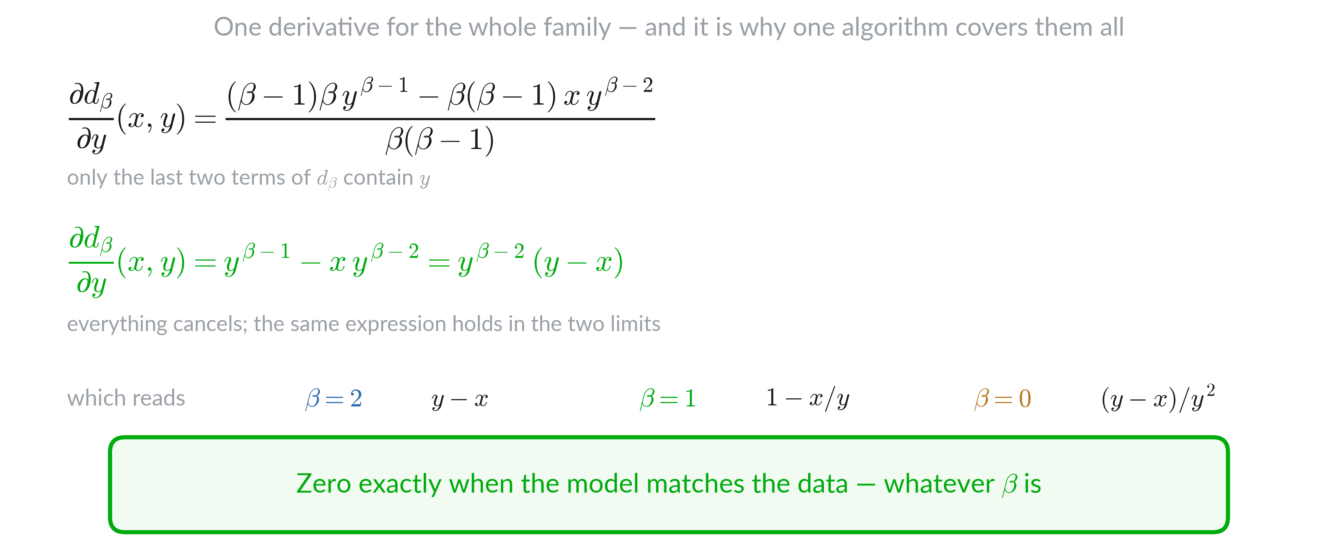
Derivative

Slide 31
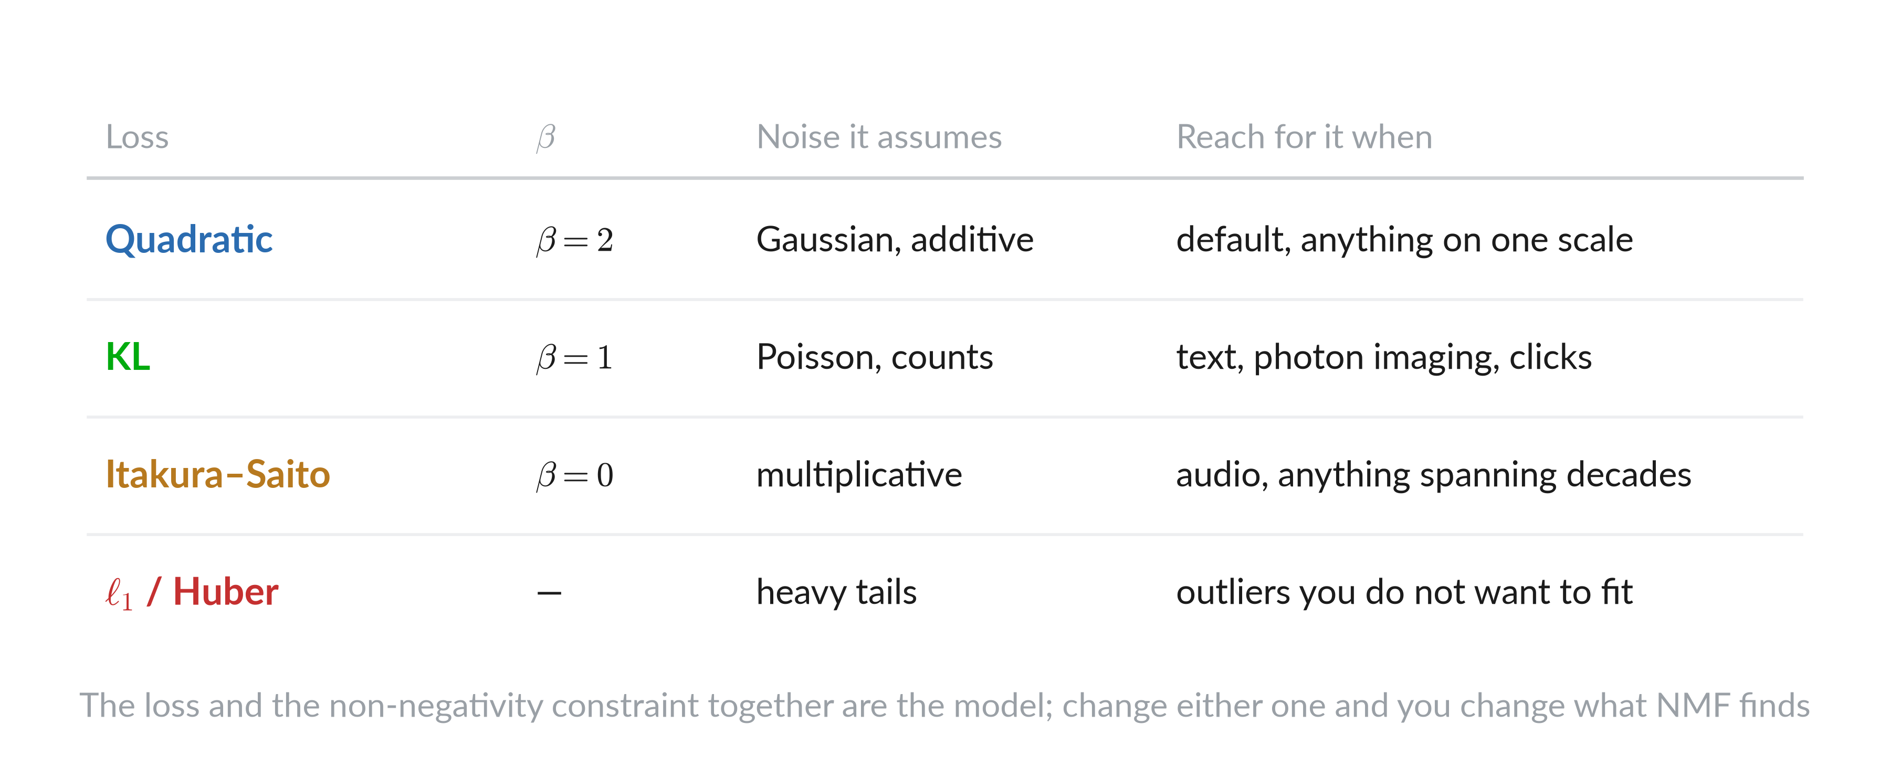
Choosing the loss

Slide 32
Mathematical optimisation

Slide 33
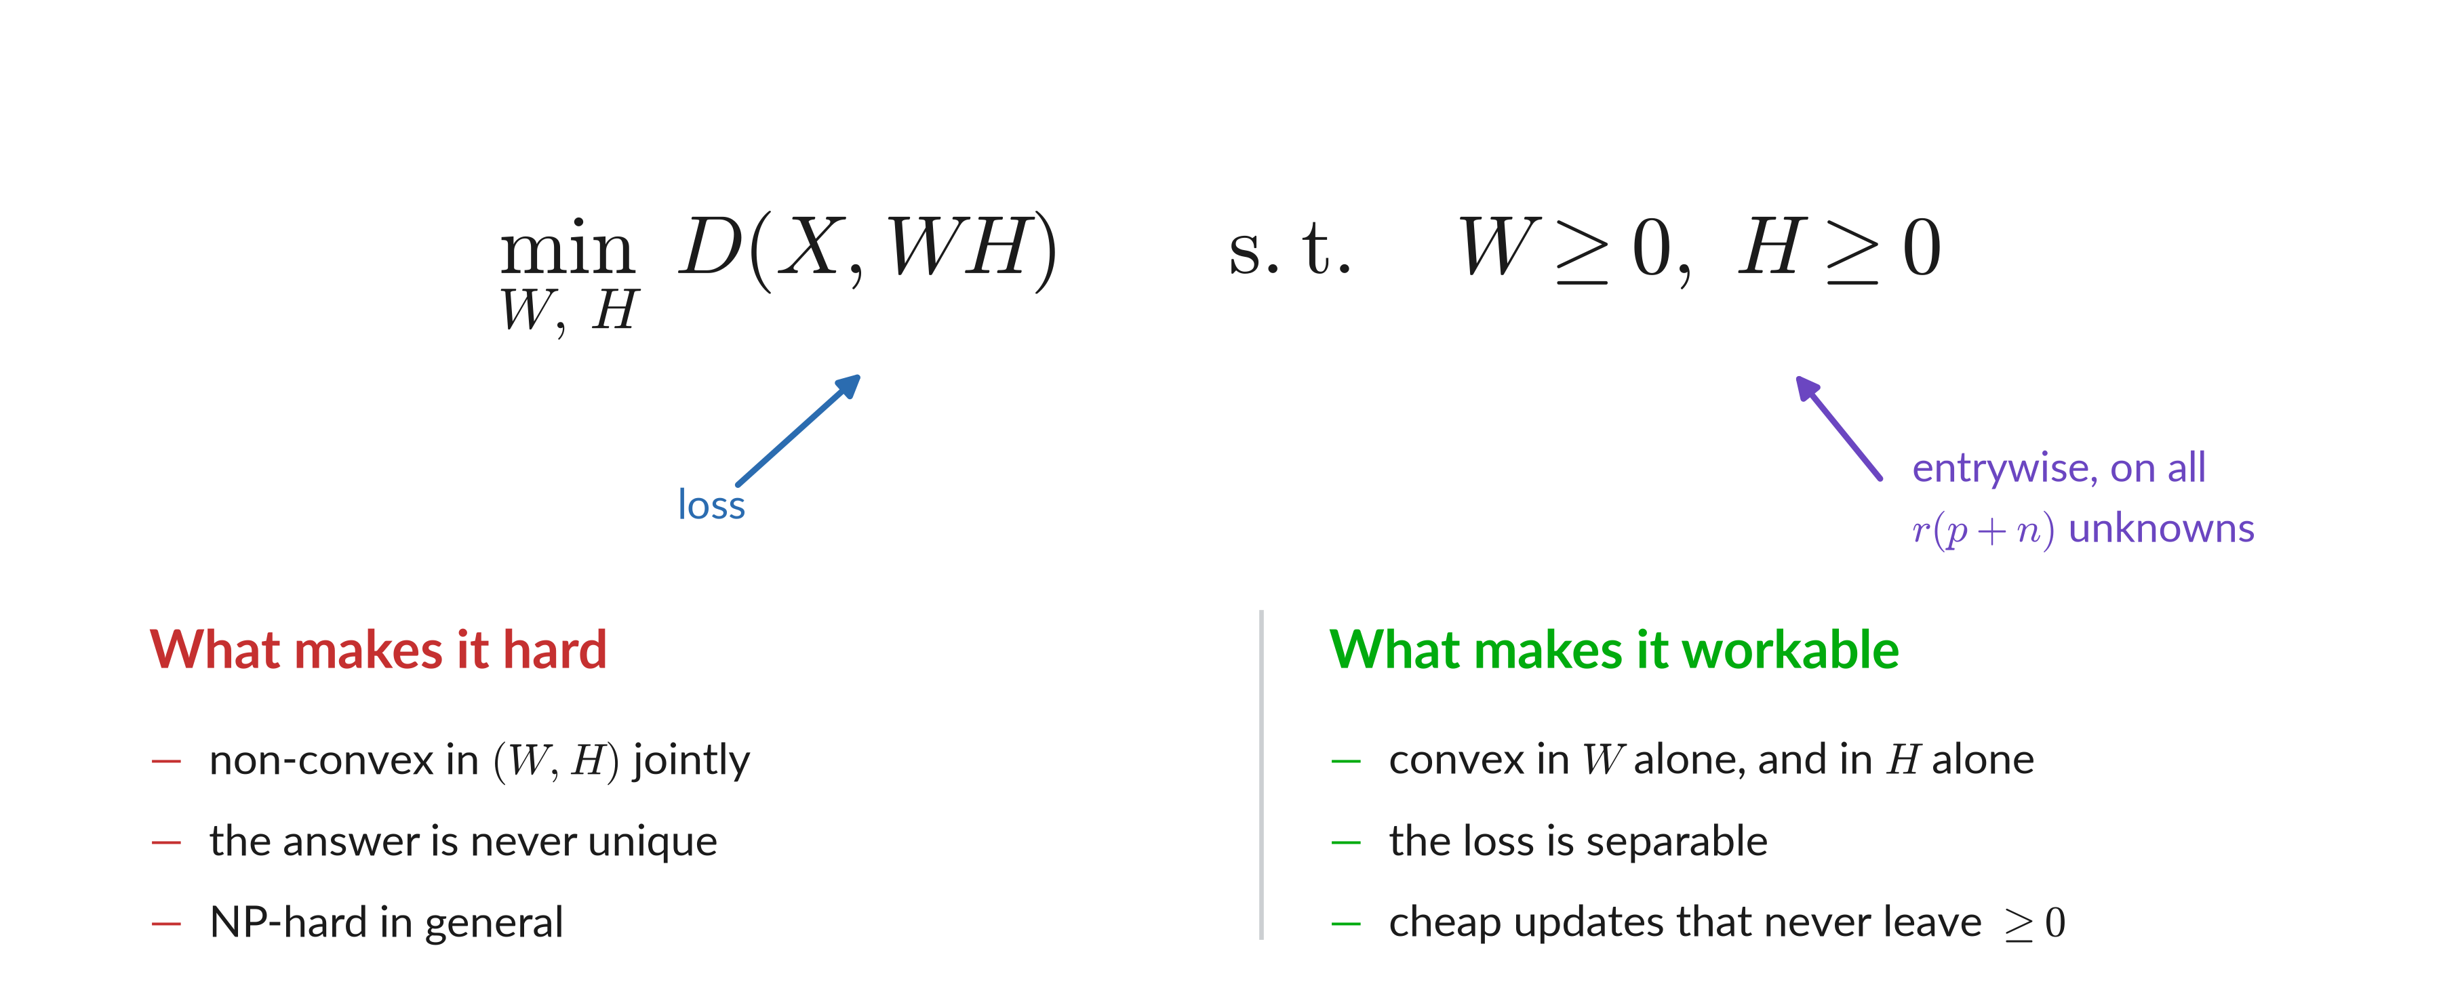
Problem formulation

Slide 34
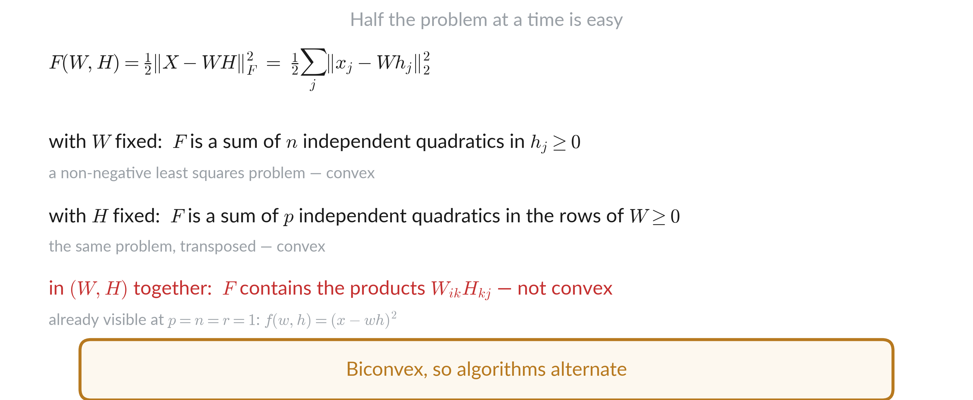
Convex in each half

Slide 35
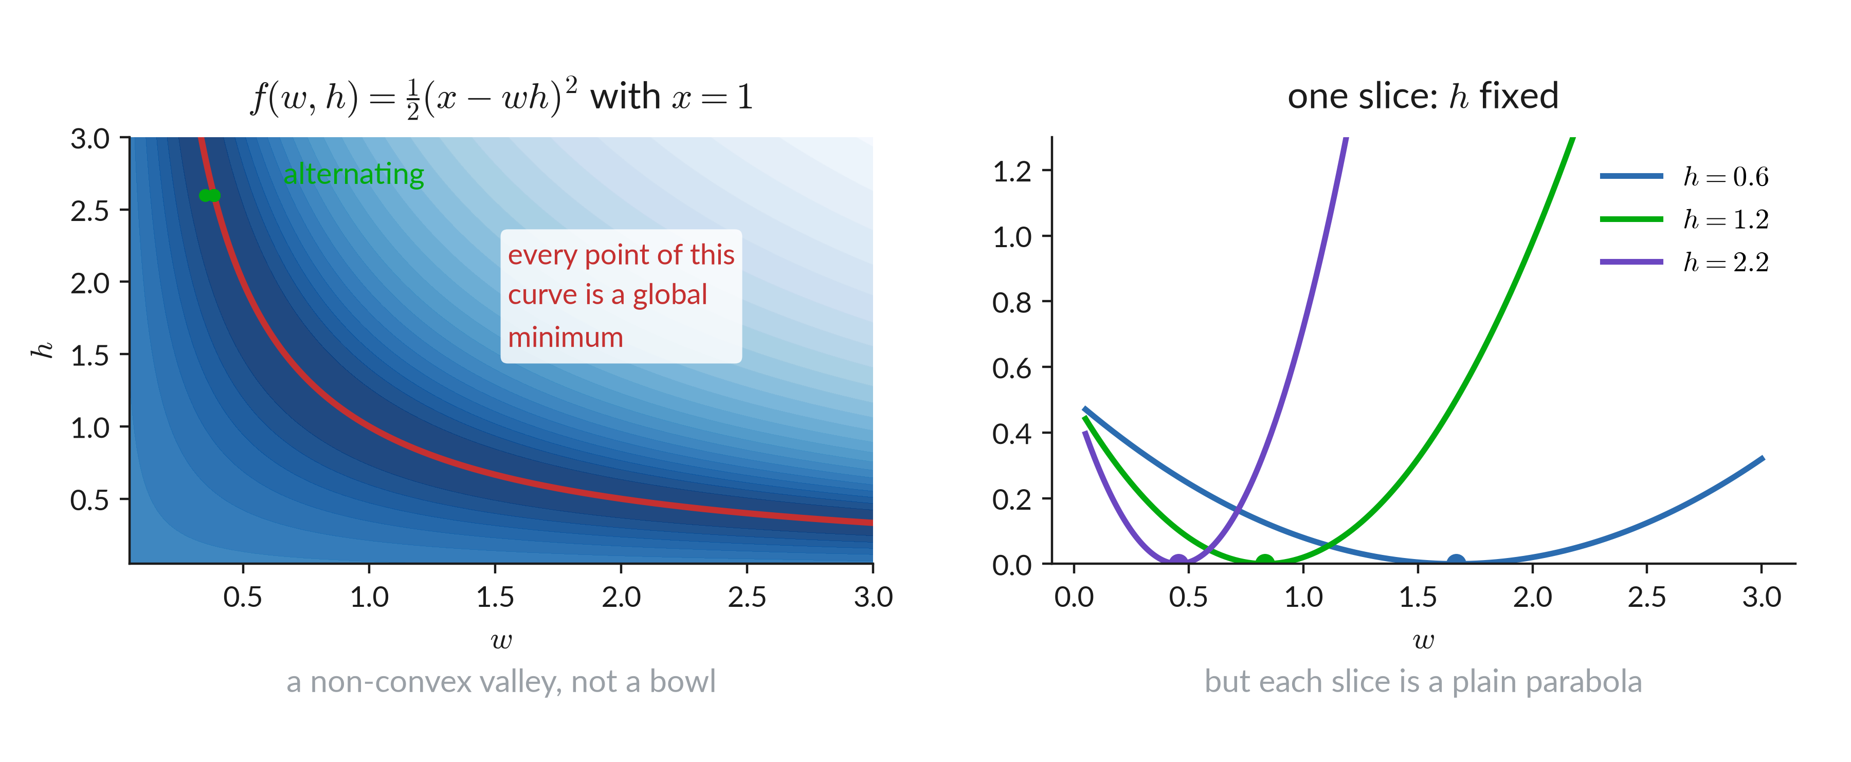
Convex in each half

Slide 36
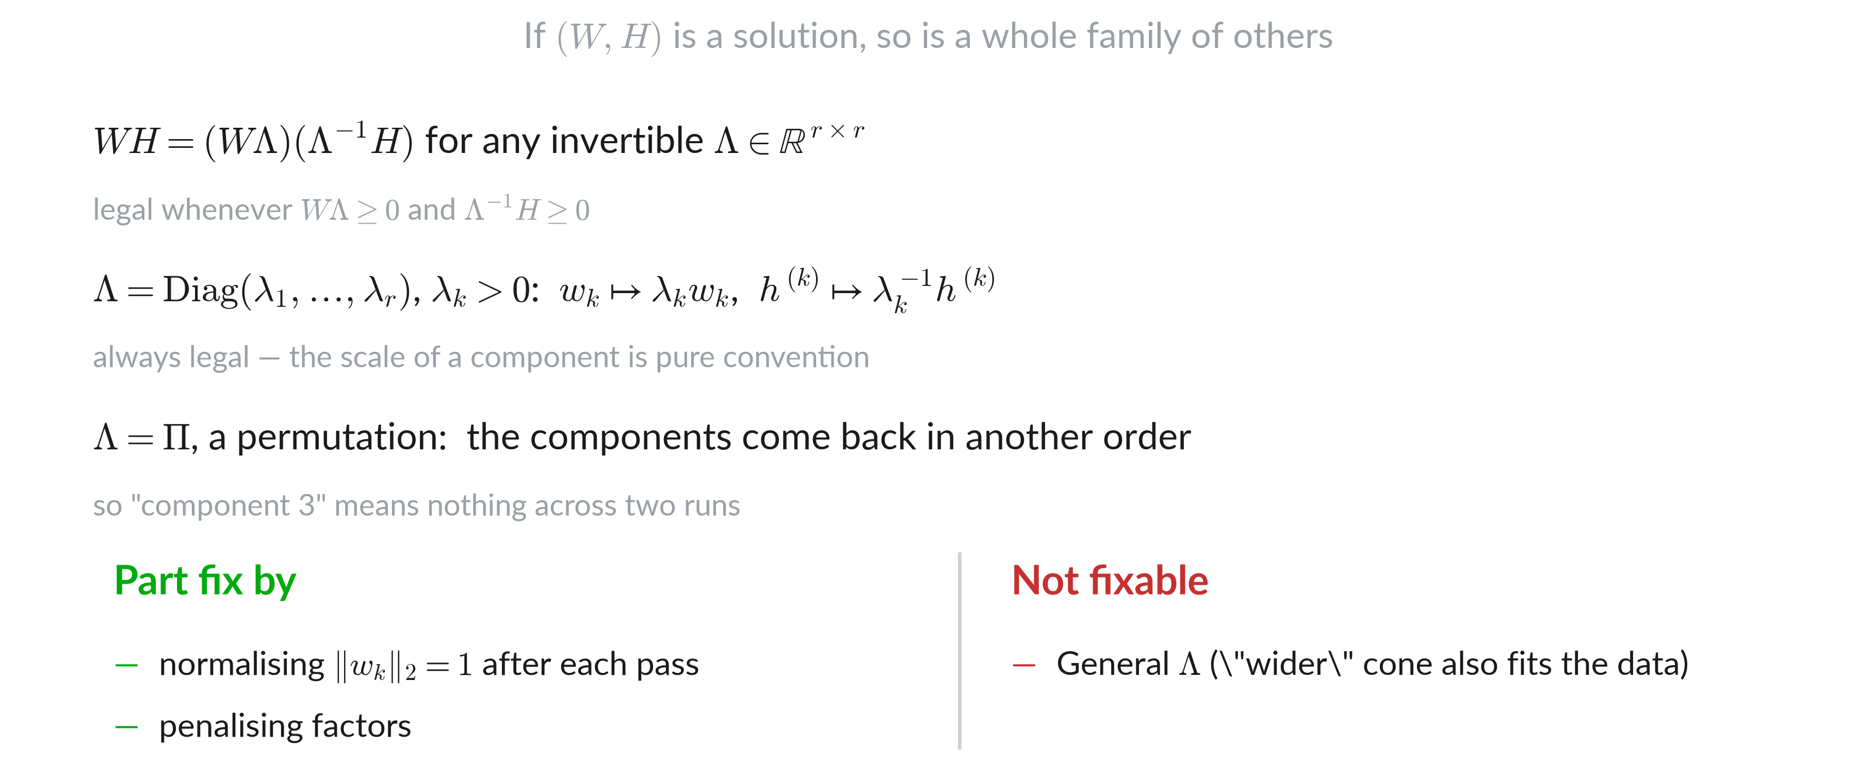
The answer is never unique

Slide 37
Hard ill-posed problem

Slide 38
Multiplicative updates

Slide 39
The Frobenius norm, as a trace

Slide 40
The gradient

Slide 41
W & H can be swapped

Slide 42
Gradient descent kept positive

Slide 43
One step size per entry

Slide 44
Why that step size

Slide 45
Lee and Seung rules

Slide 46
Why split the gradient

Slide 47
Splitting the gradient

Slide 48
Why it works

Slide 49
Two nested arguments

Slide 50
Minimize a majorant

Slide 51
What a surrogate is

Slide 52
The quadratic surrogate

Slide 53
Minimizing the surrogate

Slide 54
Where the step size came from

Slide 55
The other losses, same recipe

Slide 56
Multiplicative Updates

Slide 57
Monotone and slow

Slide 58
Initialization

Slide 59
Initialization

Slide 60
Initialization

Slide 61
Initialization

Slide 62
Weighted NMF

Slide 63
Entries with different importances

Slide 64
Weighted loss

Slide 65
Weighted rules

Slide 66
Matrix completion

Slide 67
Regularized NMF

Slide 68
Three reasons for a penalty

Slide 69
The penalized loss

Slide 70
The regularized rules

Slide 71
Sparsity

Slide 72
Other algorithms

Slide 73
Alternating least squares

Slide 74
Rank-one layers

Slide 75
One layer at a time

Slide 76
One entry at a time

Slide 77
HALS in one slide

Slide 78
Families of algorithms

Slide 79
Three algorithms, measured

Slide 80
Choosing r

Slide 81
NMF

