Slide 1
Understanding where models live
HIGH DIMENSIONS
Notes:
Paper + token intro
=> things impossible in low dimensions may become possible in higher dimension

Slide 2
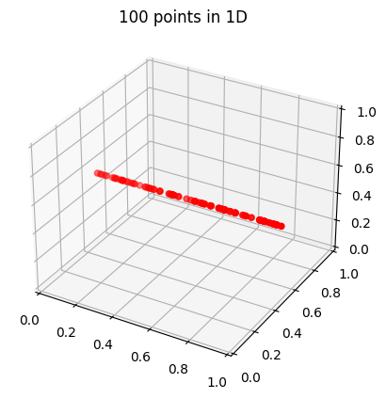
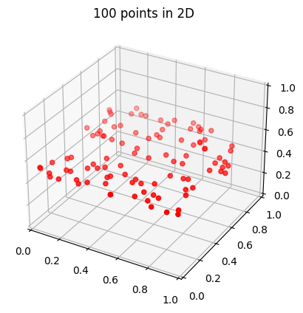
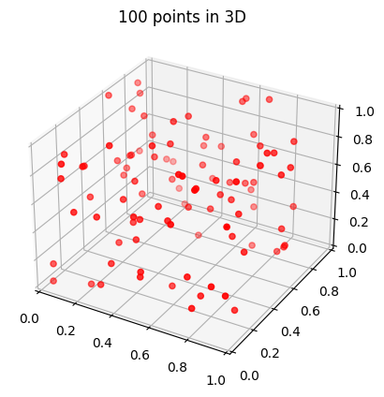
Curse of dimensionality
Notes:
For high dimensional pbs, we need A LOT of data

Slide 3
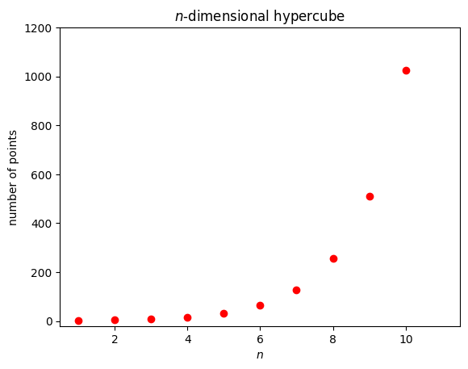
Curse of dimensionality
Notes:
Please don’t do grid search in high dimension

Slide 4
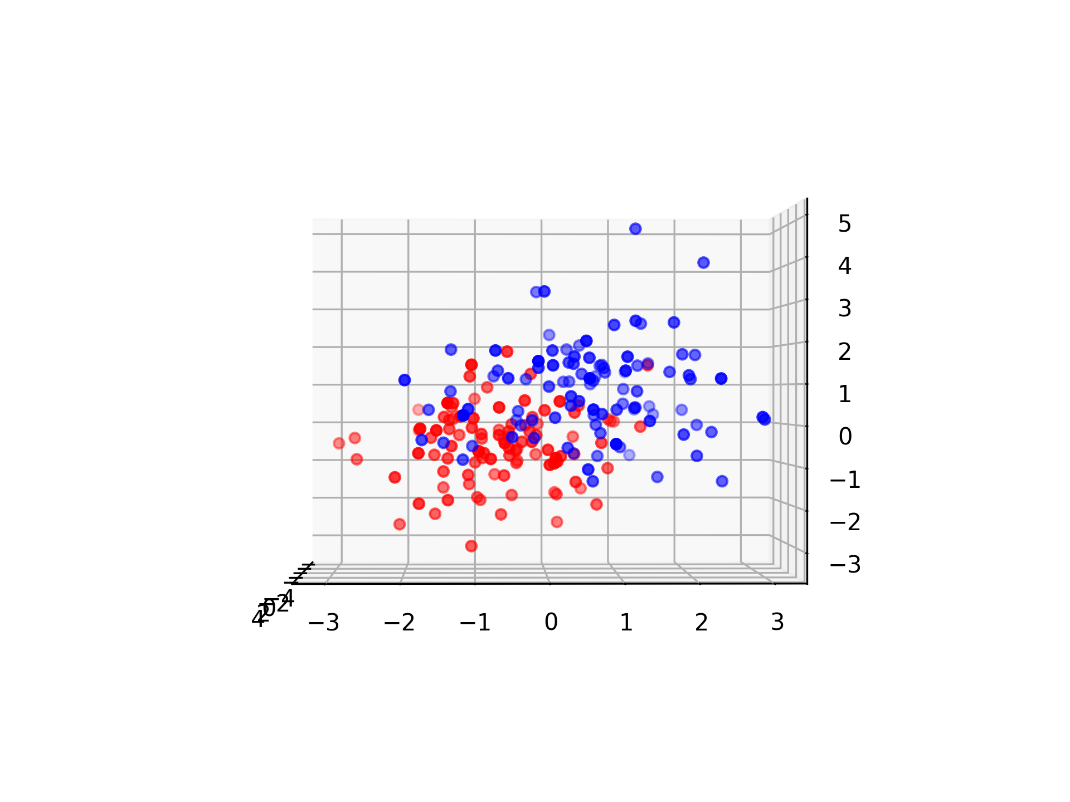
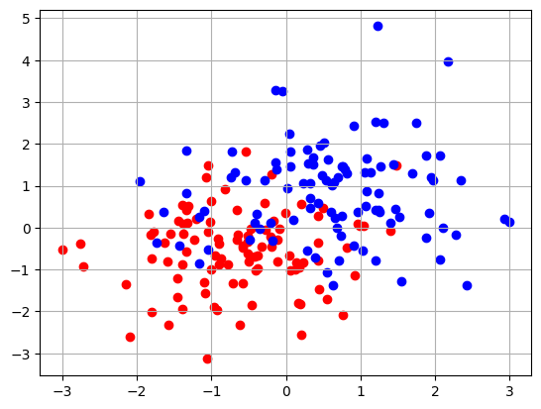
Blessing of dimensionality
Notes:
Seems hard to separate the two classes in 2D…

Slide 5
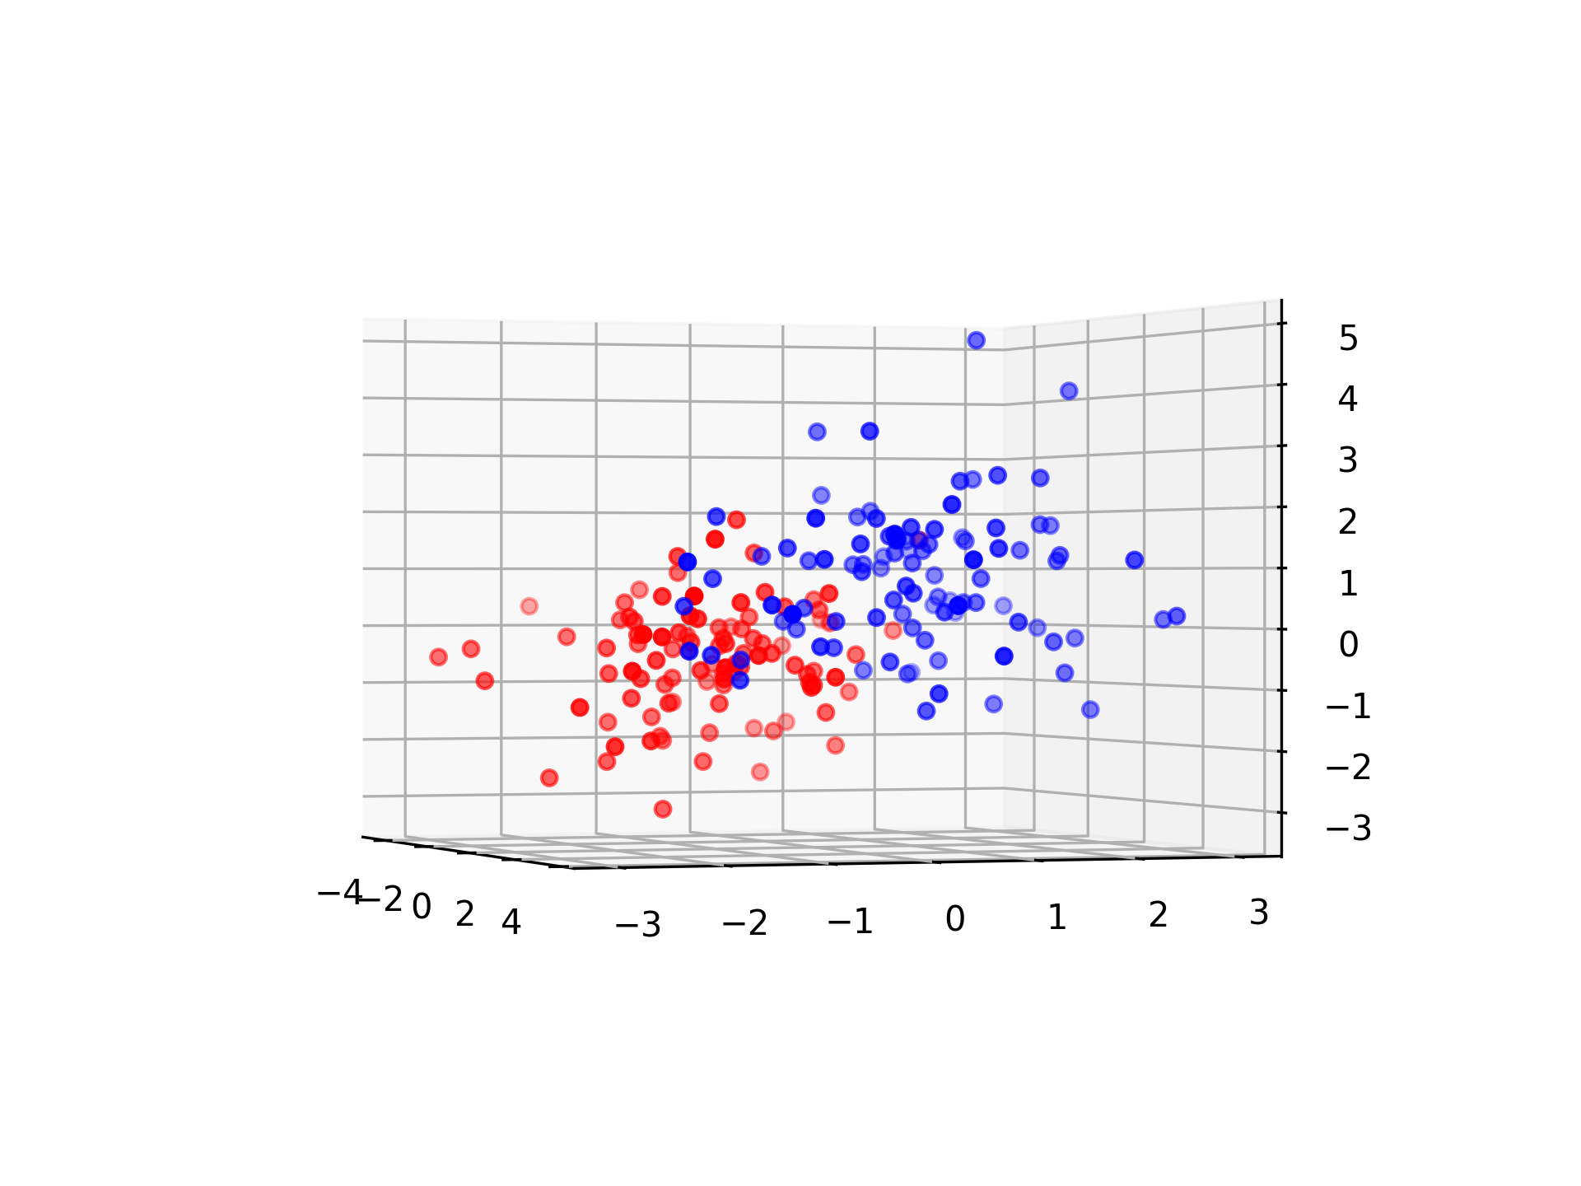
Blessing of dimensionality

Slide 6
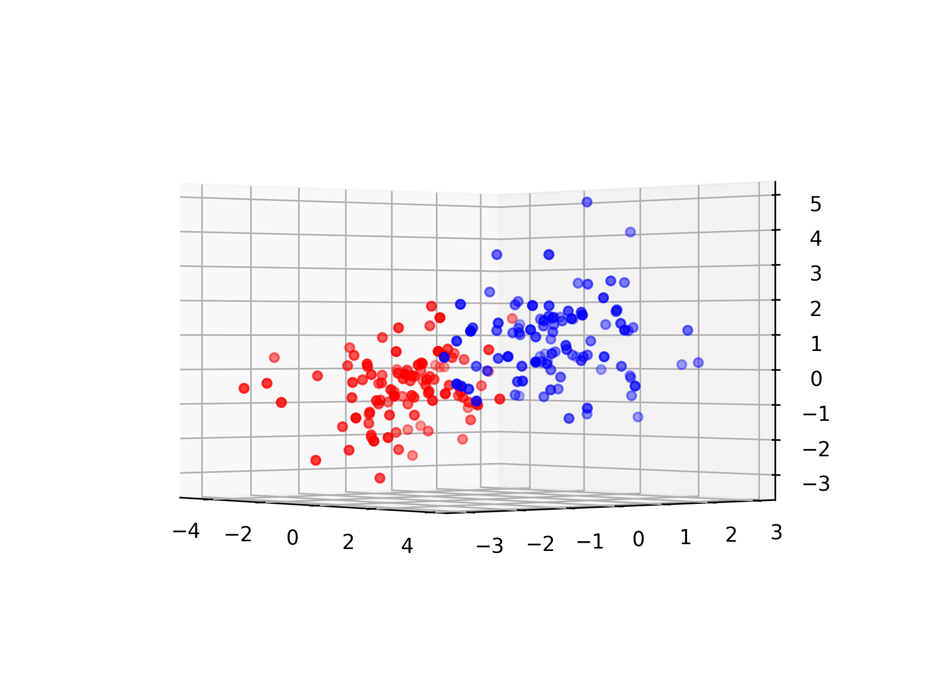
Blessing of dimensionality

Slide 7
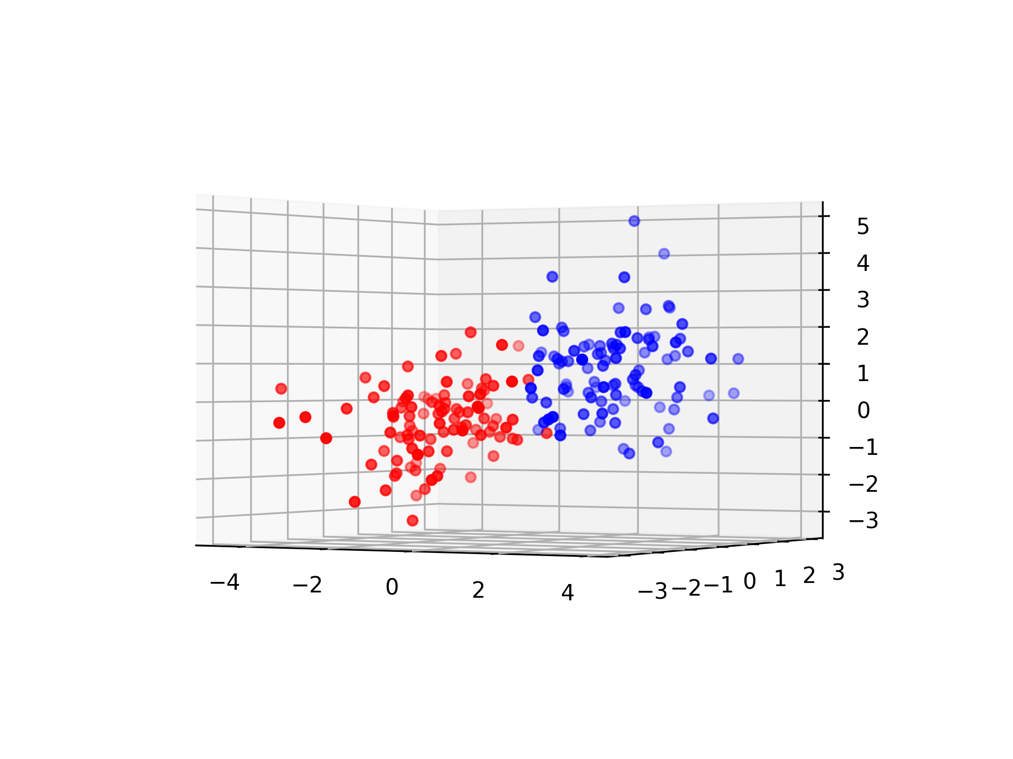
Blessing of dimensionality
Notes:
But the 3rd dimension might help!
=> higher dimensional model might allow more simple models

Slide 8
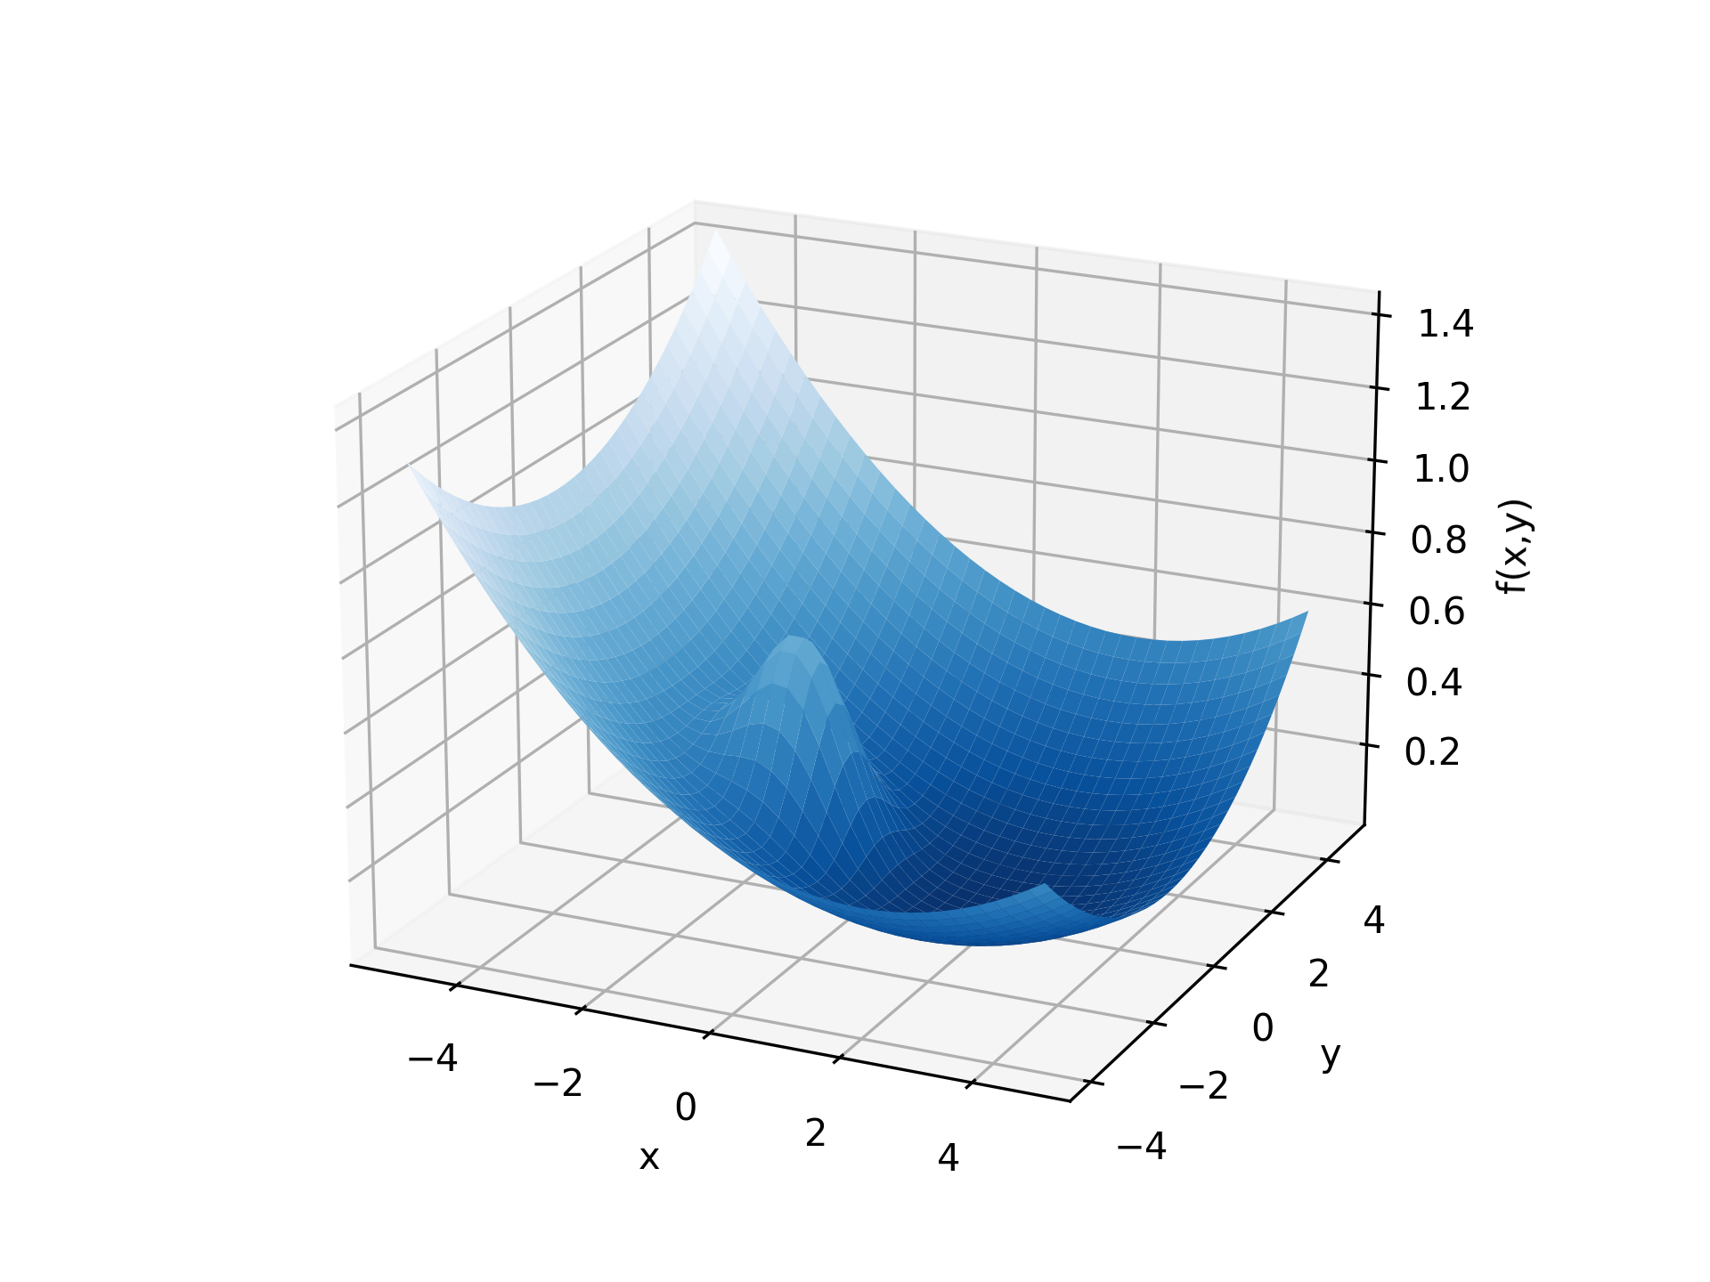
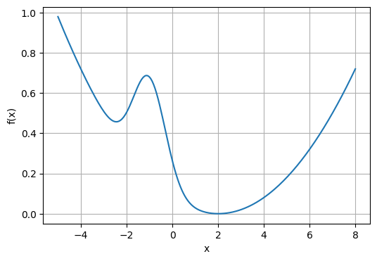
Blessing of dimensionality
Notes:
With gradient descent on the 1D function, we can get stuck in a local minimum
But the 2nd dimension may help!
=> Gradient descent is suitable for high dimensional models
The idea is that “there is (almost) always a direction that is not stuck”

Slide 9

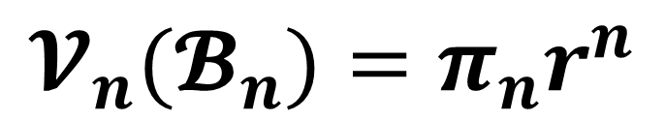
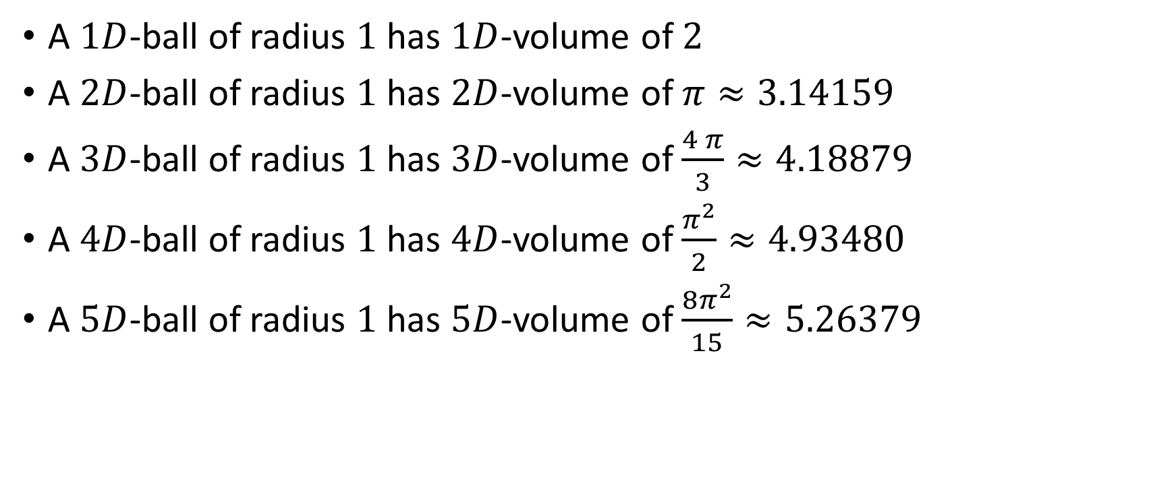
(length)
(area)
Notes:
Make audience guess for 3D, 4D (and 5D?)

Slide 10
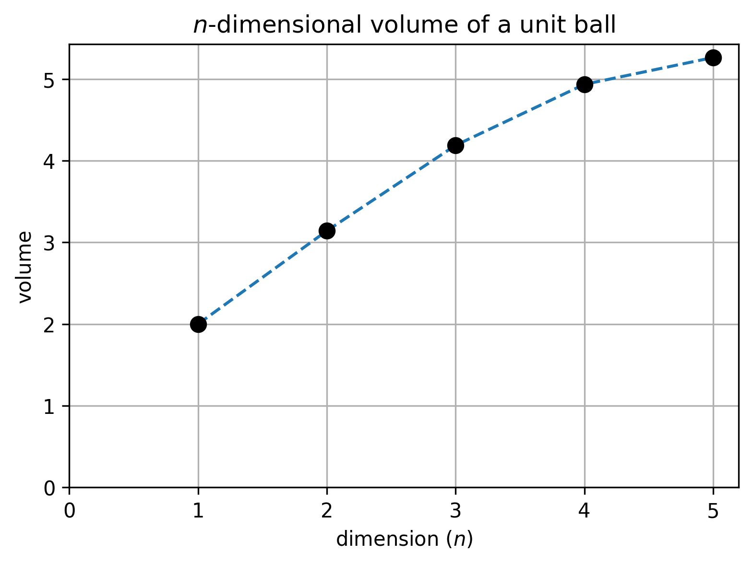
Notes:
“it makes sense that in higher dimensions, unknit balls have a larger volume”

Slide 11
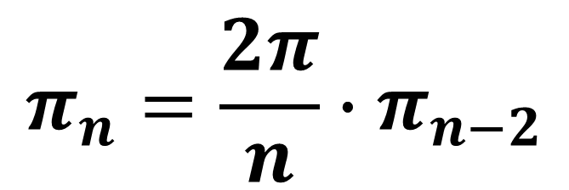
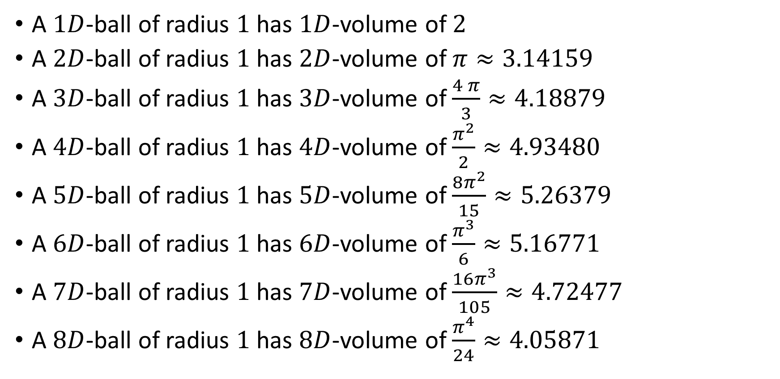

Slide 12
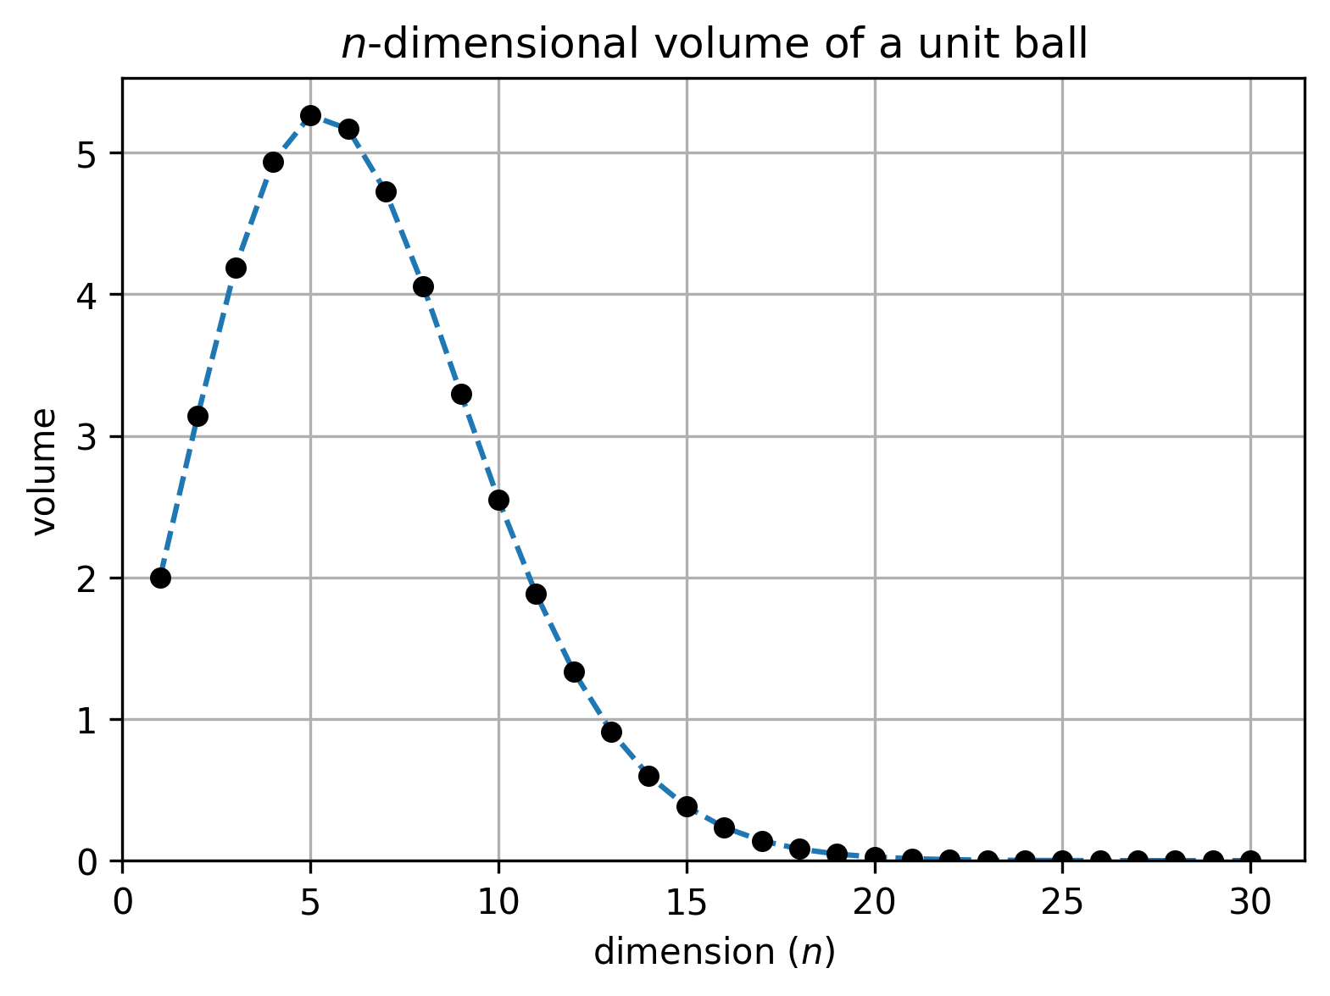
Notes:
Did you expect that?
=> “intuitional induction” from low dimensions are sometimes wrong
=> in high dimensions, unit balls are almost points (no volume) /!\ testing models with unit balls can be almost equivalent to testing with points

Slide 13
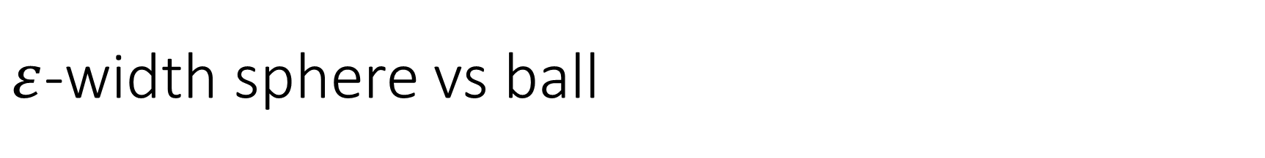
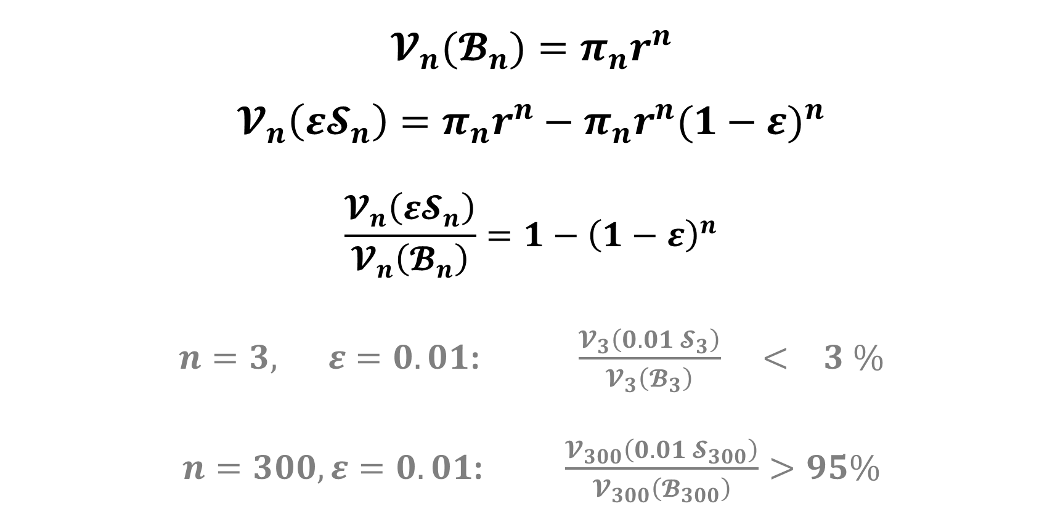


Notes:
In high dimension, almost all the volume of a ball in on the boundary => both for unit AND non-unit balls!
=> testing models on spheres or balls is very similar

Slide 14
4 circles paradox

Slide 15
4 circles paradox
(-2,2)
(2,2)
(-2,-2)
(2,-2)
Notes:
4x4 square, centered at origin

Slide 16

4 circles paradox
(-2,2)
(2,2)
(-1,1)
(1,1)
(-1,-1)
(1,-1)
(-2,-2)
(2,-2)
Notes:
Fit 4 non-intersecting unit circles

Slide 17

4 circles paradox
(-2,2)
(2,2)
(-1,1)
(1,1)
(-1,-1)
(1,-1)
(-2,-2)
(2,-2)
Notes:
Make a circle centered at origin, the largest possible without intersecting the blue circles: its radius is √𝟐−𝟏

Slide 18
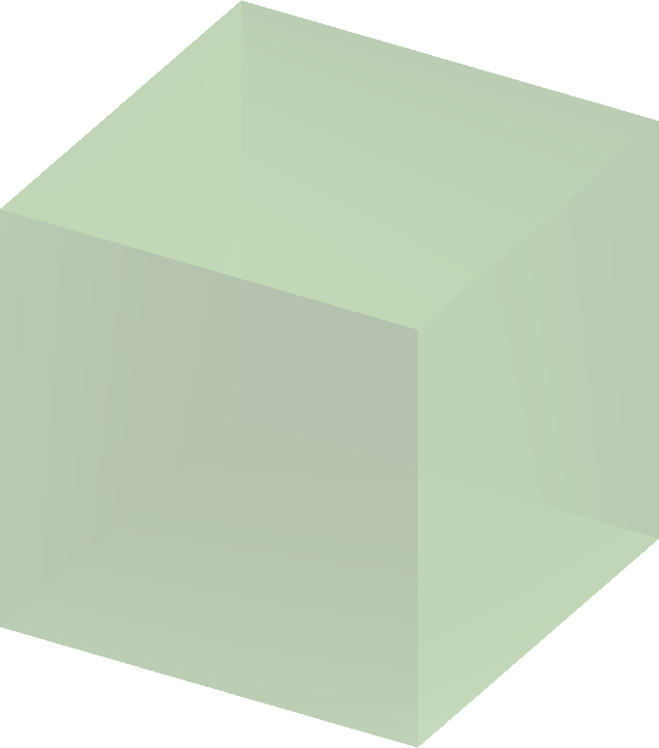
8 spheres paradox
4x4x4 cube
Notes:
4x4x4 cube, centered at origin

Slide 19
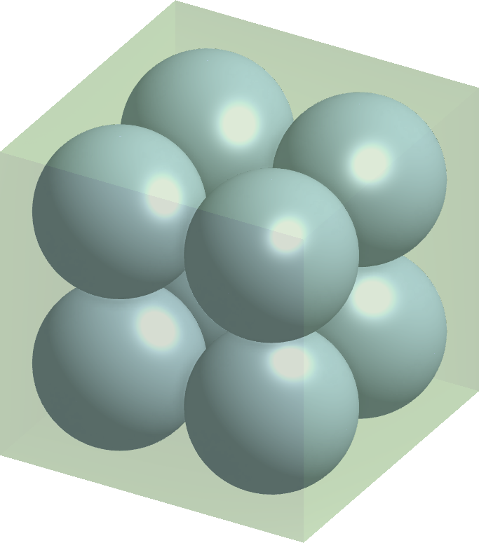
8 spheres paradox
4x4x4 cube
radius 1
Notes:
Fit 8 non-intersecting unit spheres

Slide 20
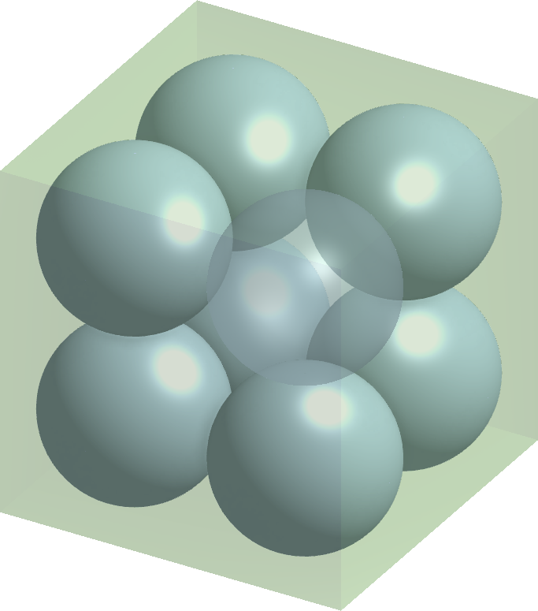
8 spheres paradox
4x4x4 cube
radius 1

Slide 21
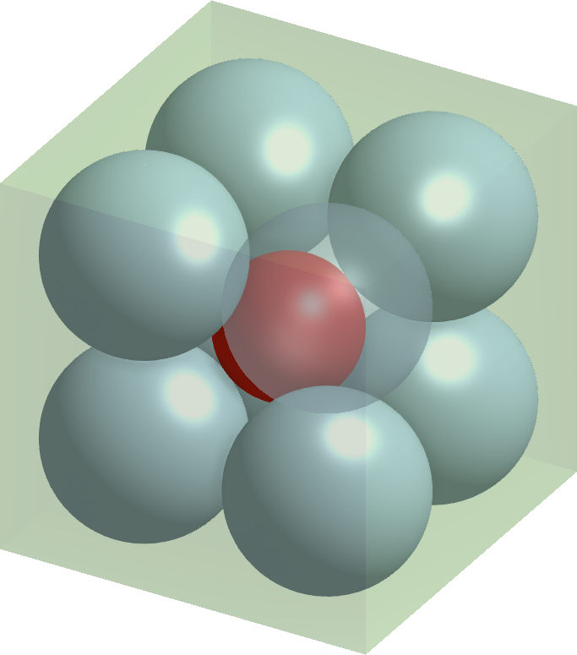

8 spheres paradox
4x4x4 cube
radius 1
Notes:
Make a sphere centered at origin, the largest possible without intersecting the blue spheres: its radius is √𝟑−𝟏

Slide 22
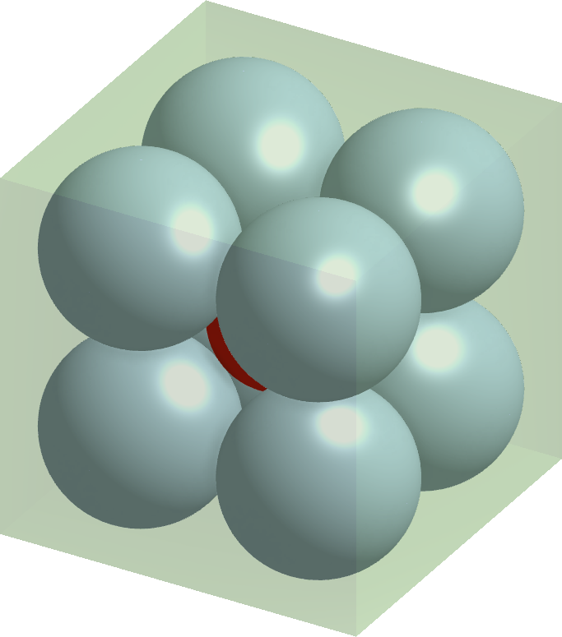
8 spheres paradox
4x4x4 cube
radius 1

Slide 23
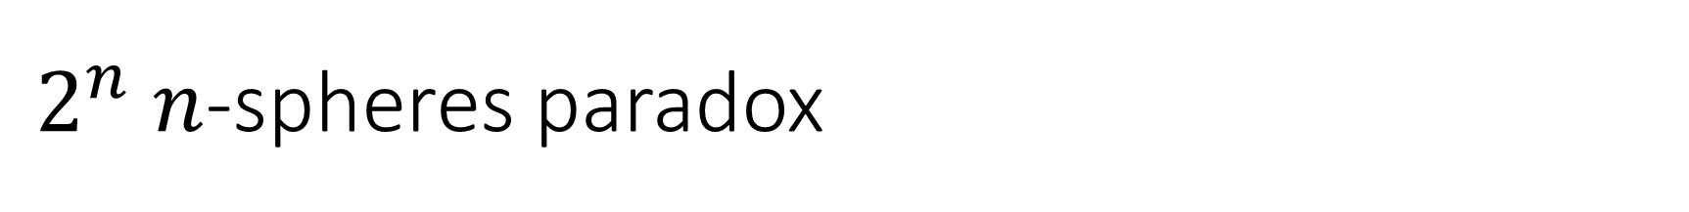

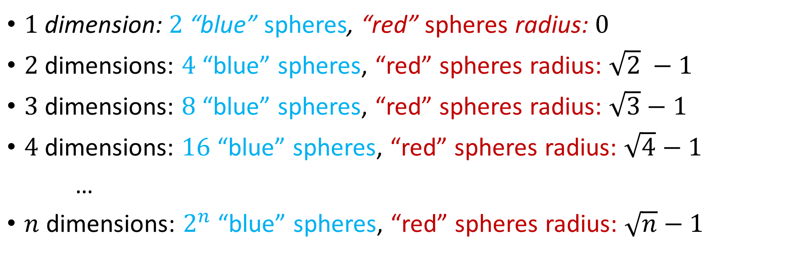

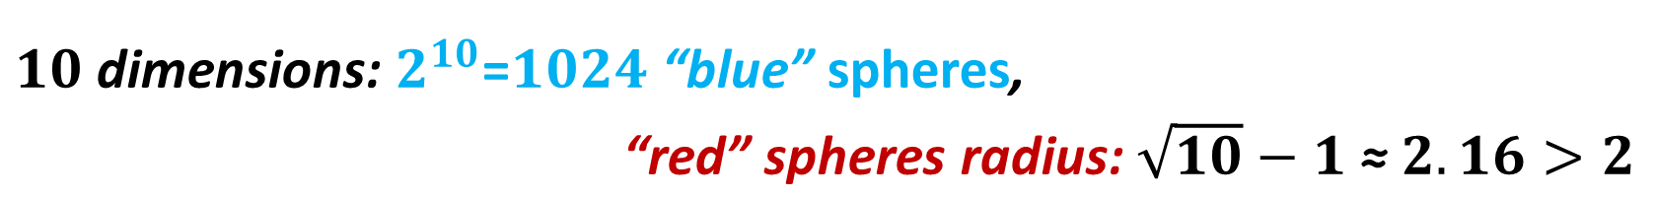

Slide 24
4 circles paradox

Slide 25
4 circles paradox
Not Touching
Notes:
This is wrong: the blue sphere still touch each other in high dimensions

Slide 26
4 circles paradox
Not Touching
Notes:
This is wrong: the blue sphere still touch each other in high dimensions

Slide 27

8 spheres paradox

Slide 28
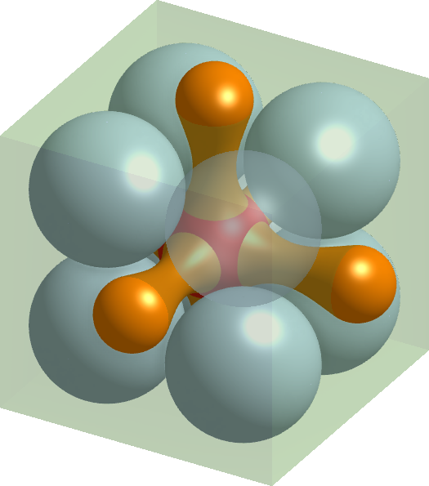
8 spheres paradox
Not Convex
Notes:
This is wrong: the red sphere remains convex in high dimensions

Slide 29
8 spheres paradox
Not Convex
Notes:
This is wrong: the red sphere remains convex in high dimensions

Slide 30




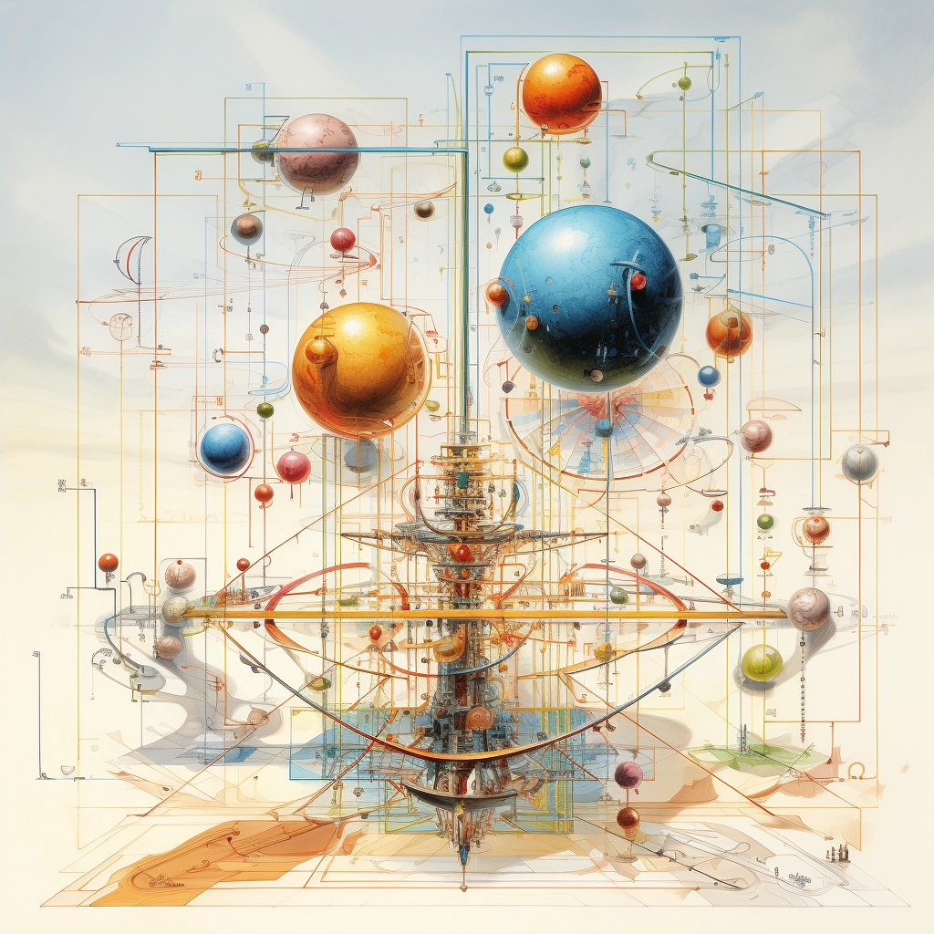
“high dimensions”
(MidJourney)
Notes:
Final note: mid-journey’s illustration of “high dimensions”… is probably not useful… or is it?
Merry Christmas !

Slide 31
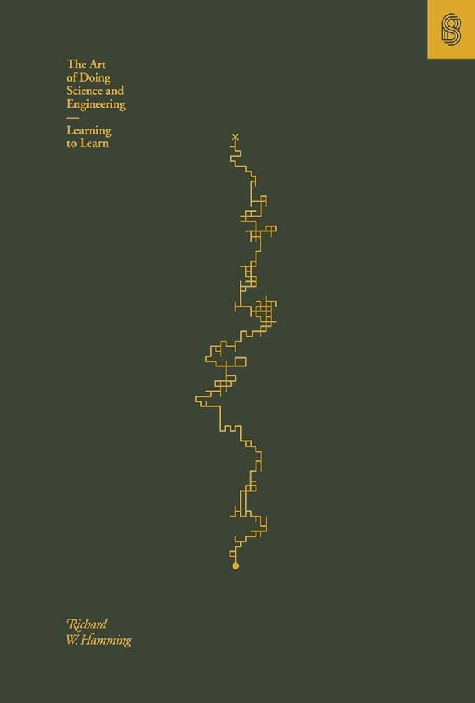

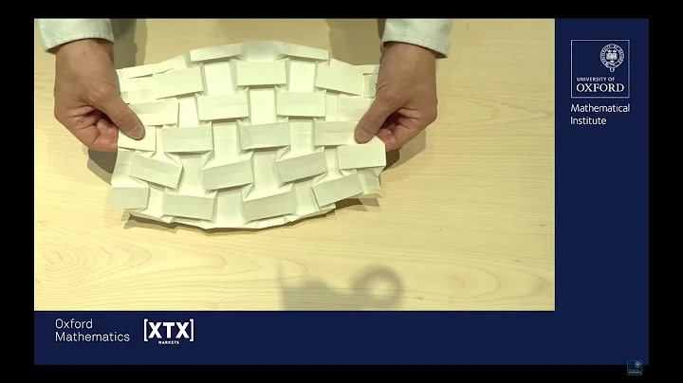
References
“The Art of Doing Science and Engineering” (Richard Hamming), Book, 1997
“A world from a sheet of paper” (Tadashi Tokieda), Oxford Mathematics Public Lecture, 14th of June 2023
“The Legend of Abraham Wald” (Bill Casselman), American Mathematical Society Public Outreach, June 2016
“MidJourney” V5.2 (Midjourney Inc.), https://www.midjourney.com/, 22nd of June 2023

