Slide 1
Session 6
Mixture Models and Expectation-Maximization
Advanced Machine Learning · MSc DSBA · 2026
Paul Dubois

Slide 2
A mixture of populations

Slide 3
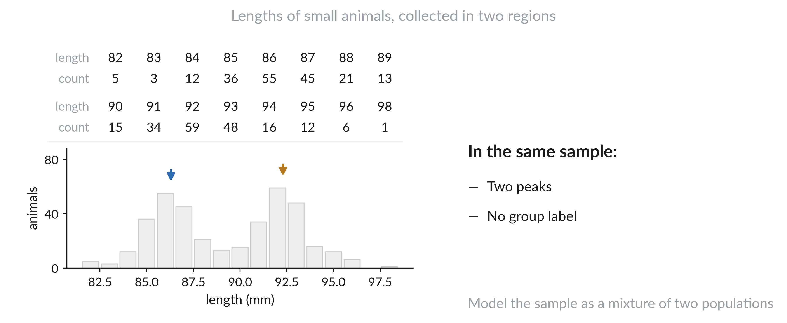
Two regimes in one sample

Slide 4
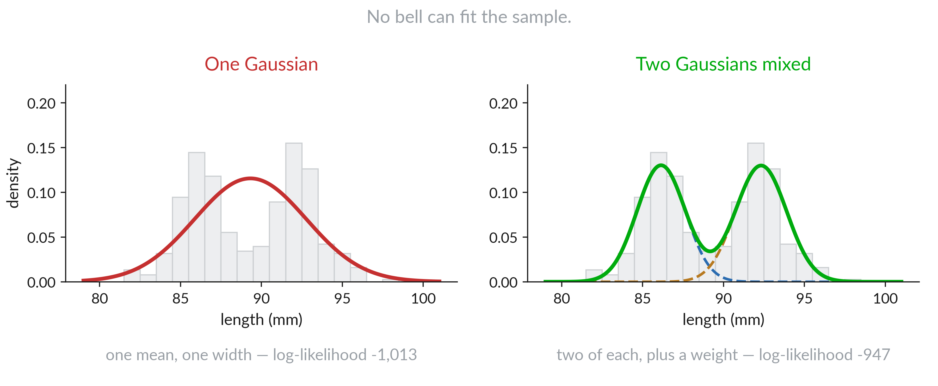
One bell is not enough

Slide 5
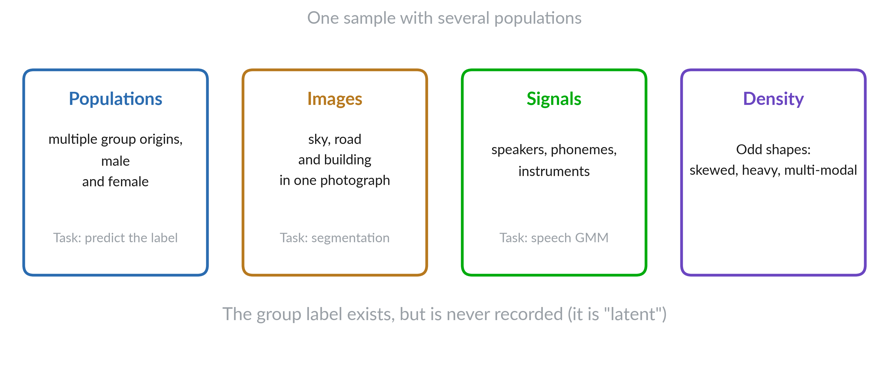
Where mixtures come up

Slide 6
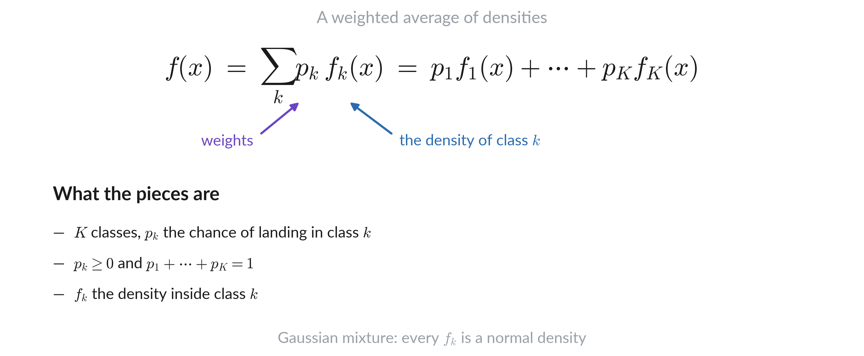
Mixture density

Slide 7
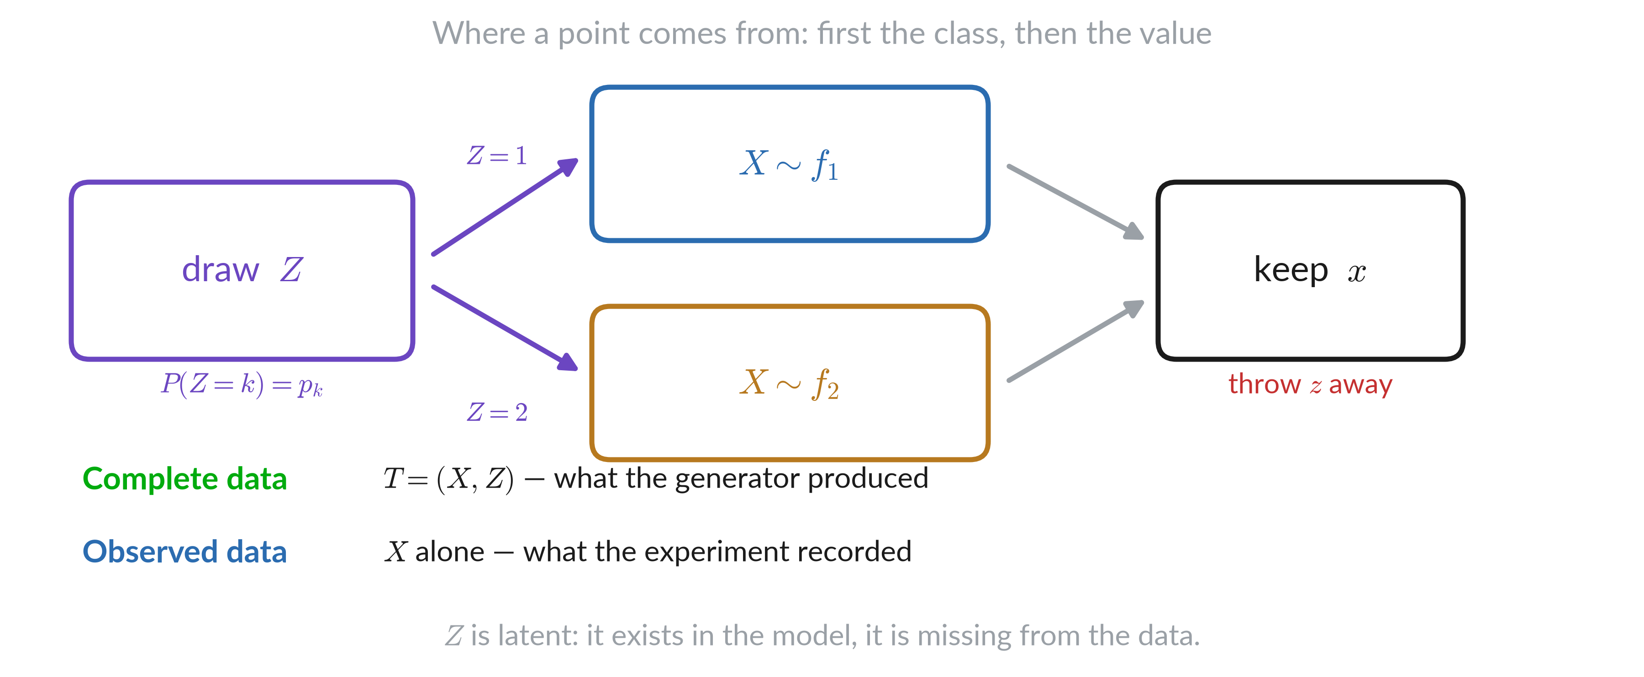
Latent variable

Slide 8
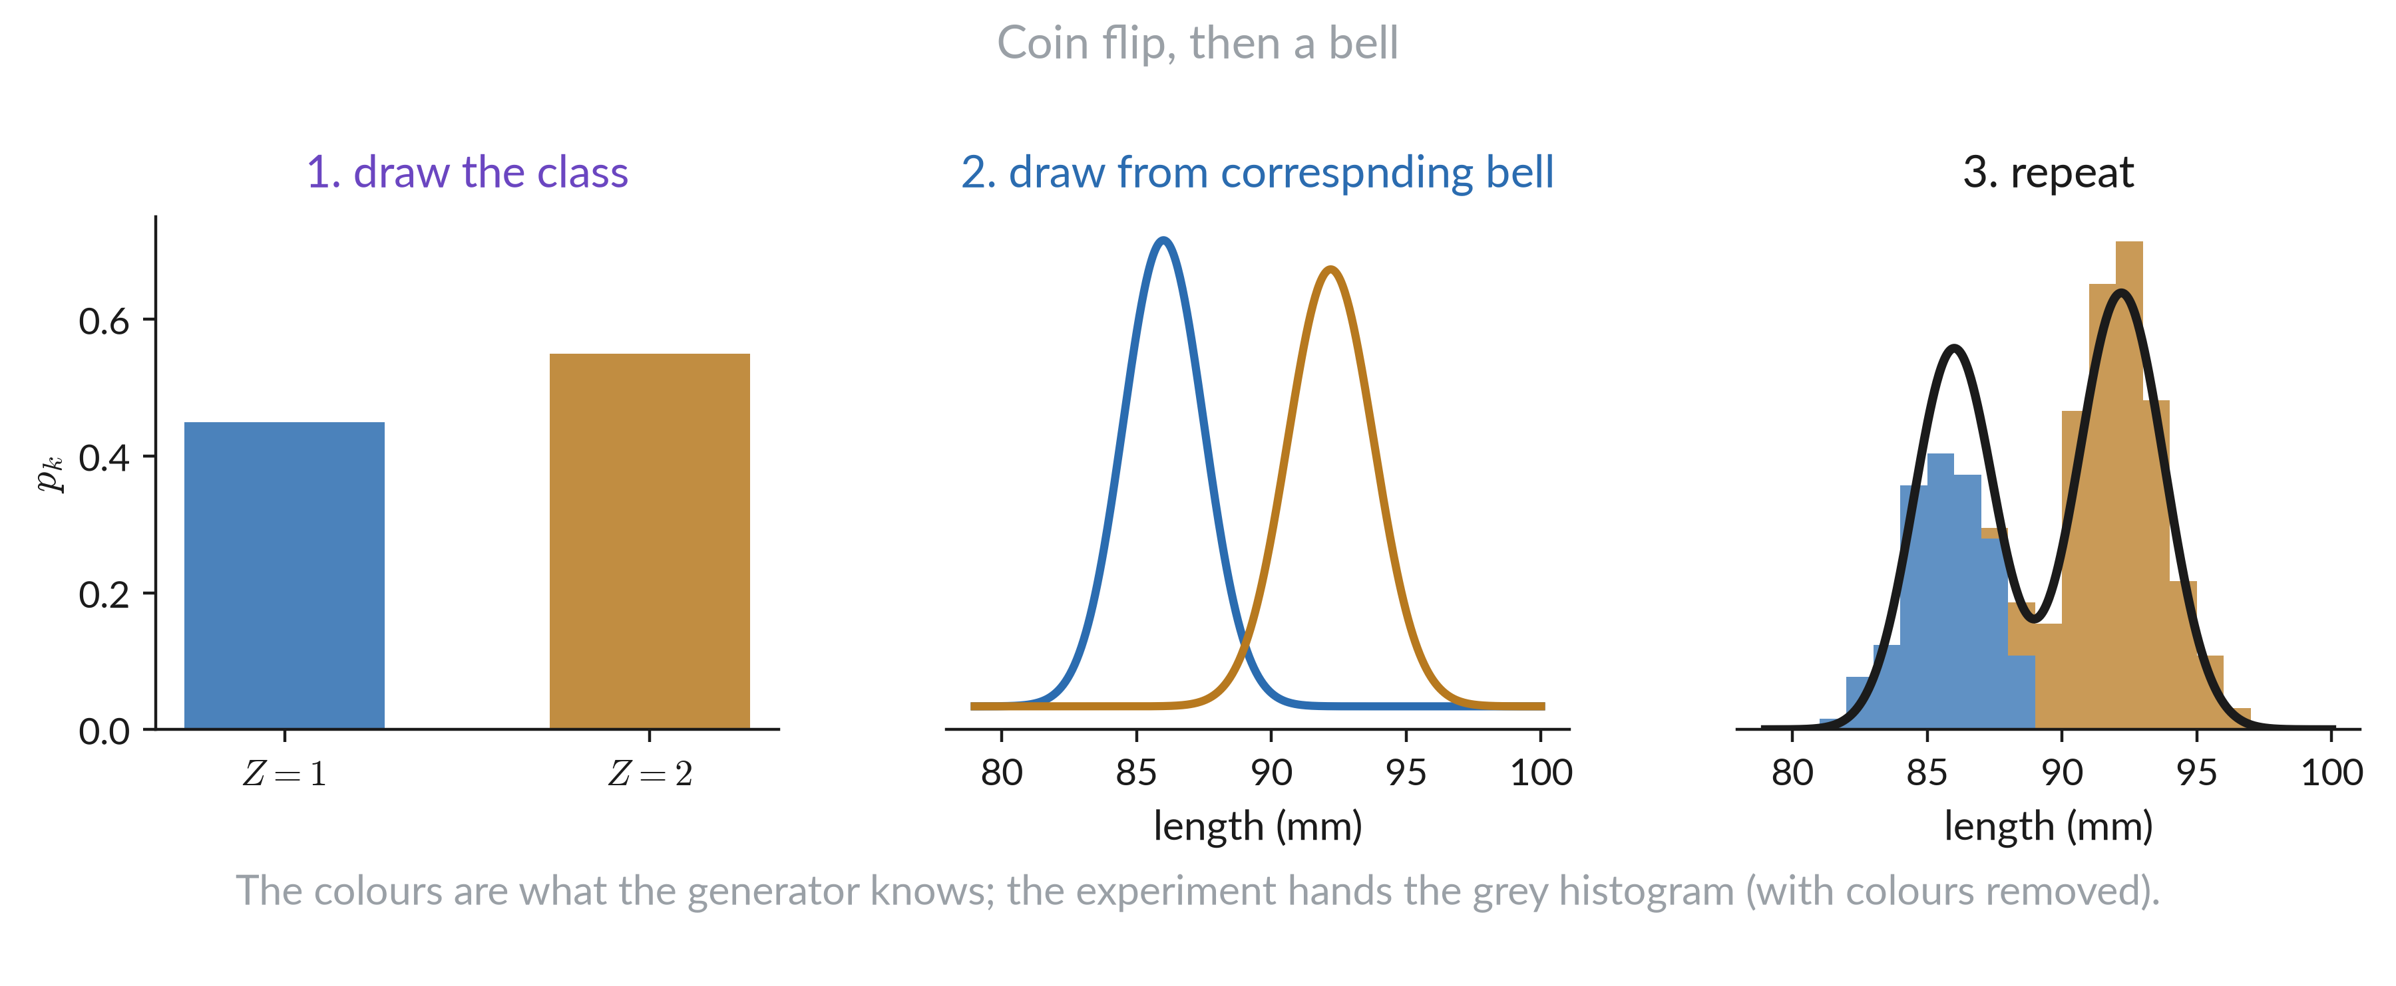
Simulating mixture

Slide 9
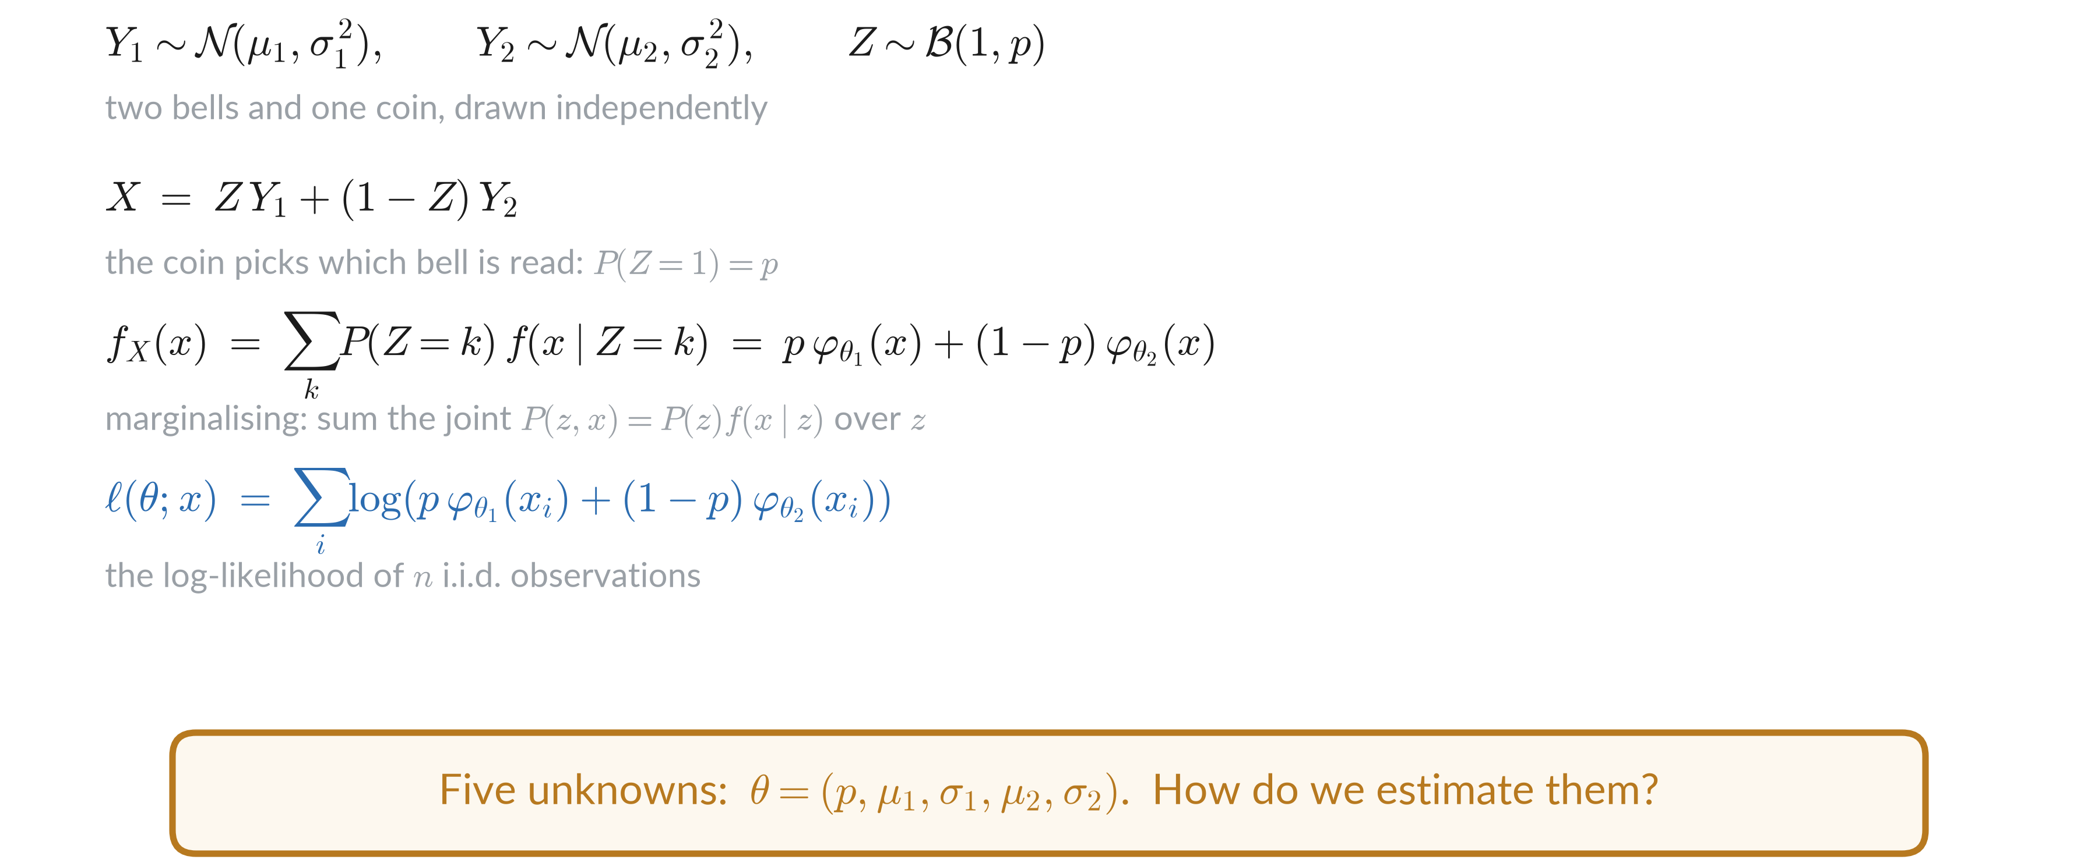
Two components case

Slide 10
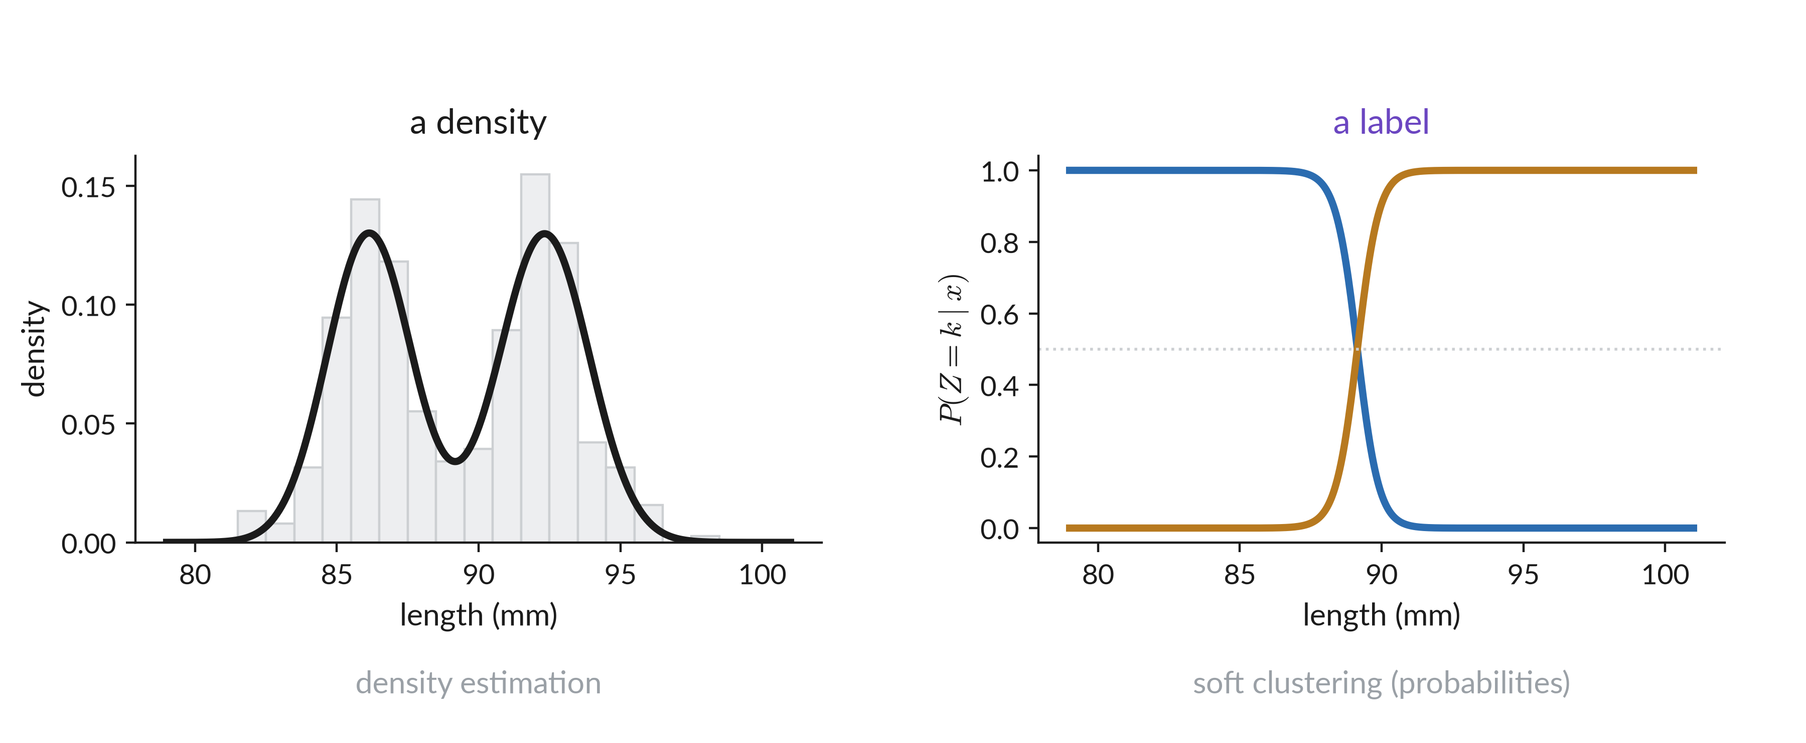
A fitted model is

Slide 11
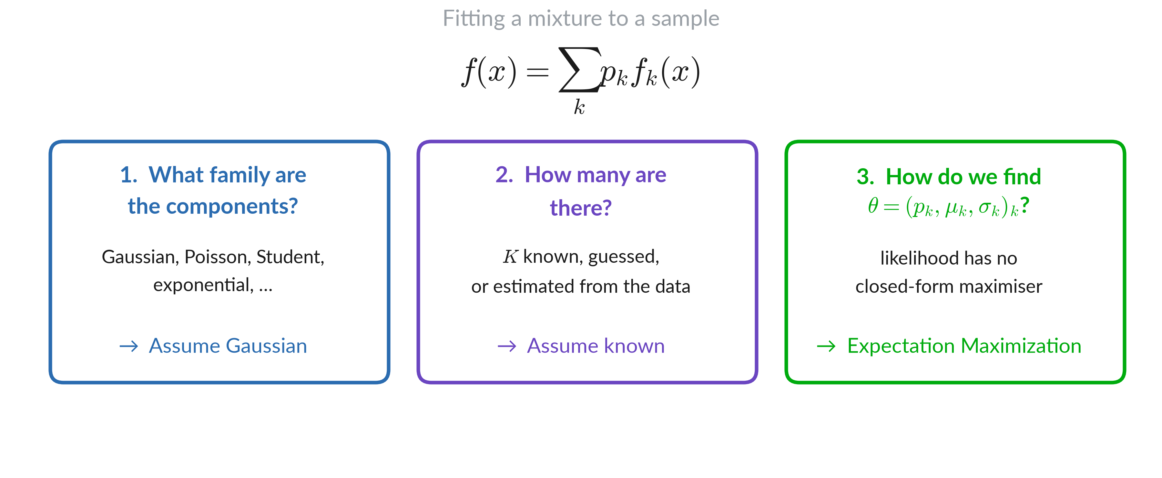
Key questions

Slide 12
What a Gaussian mixture can model

Slide 13
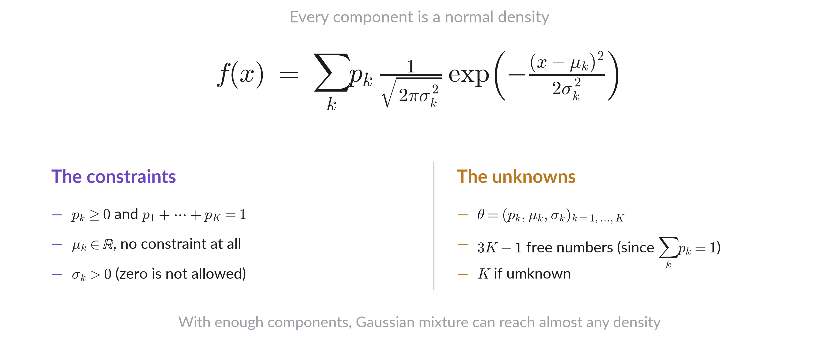
The model

Slide 14
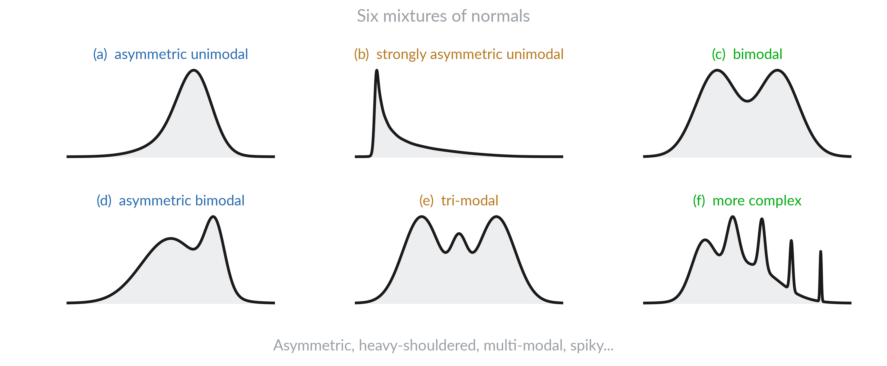
Sums of normals

Slide 15
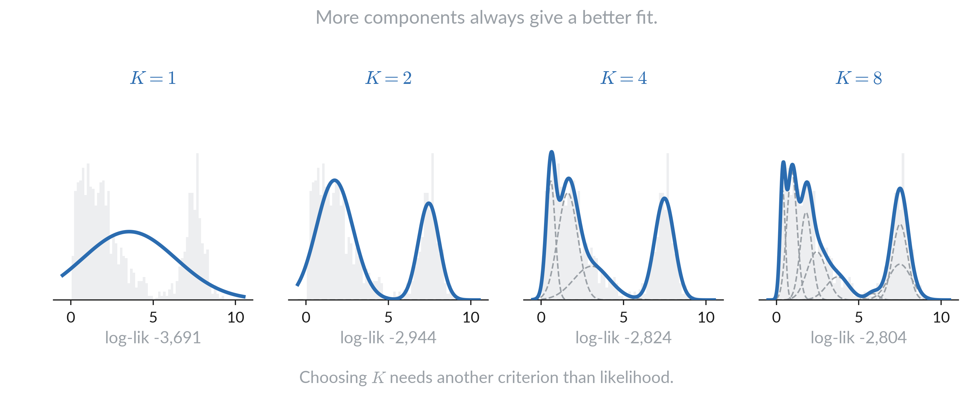
Effect of growing K

Slide 16
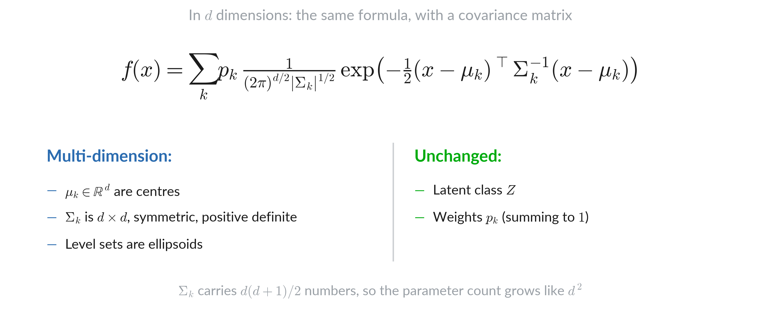
In d dimensions

Slide 17
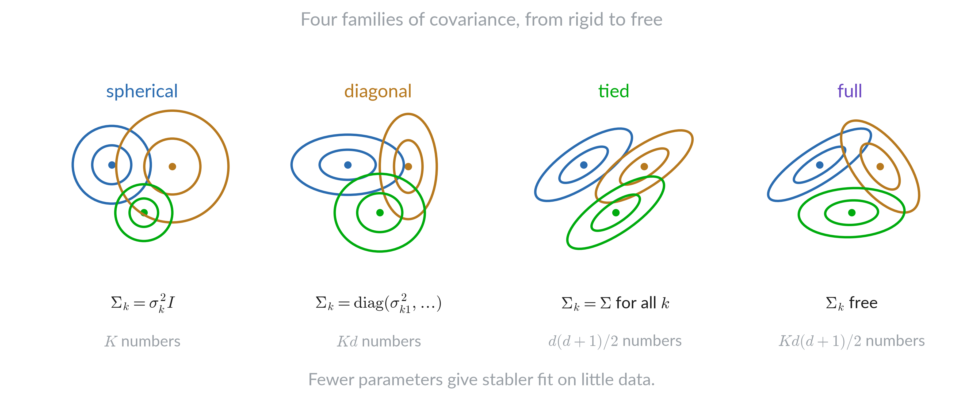
Shapes of the covariance

Slide 18
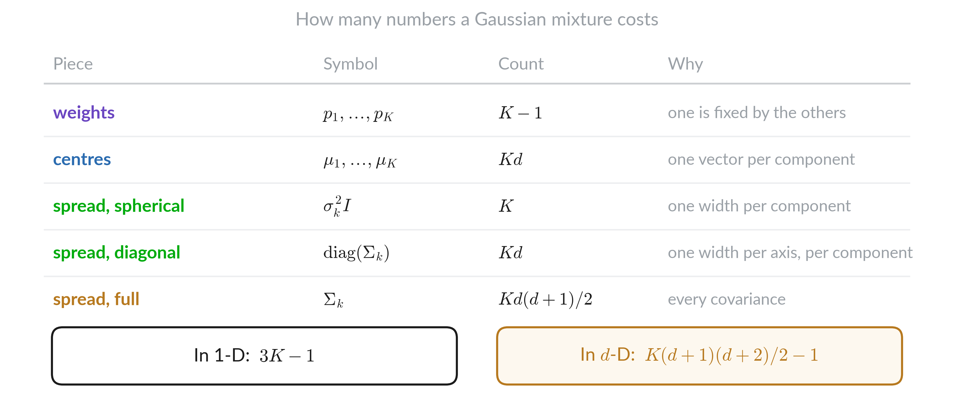
Counting parameters

Slide 19
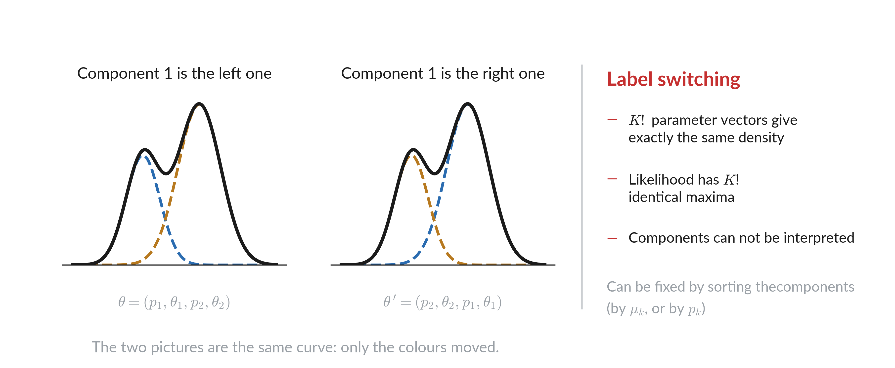
Mixture relabeled

Slide 20
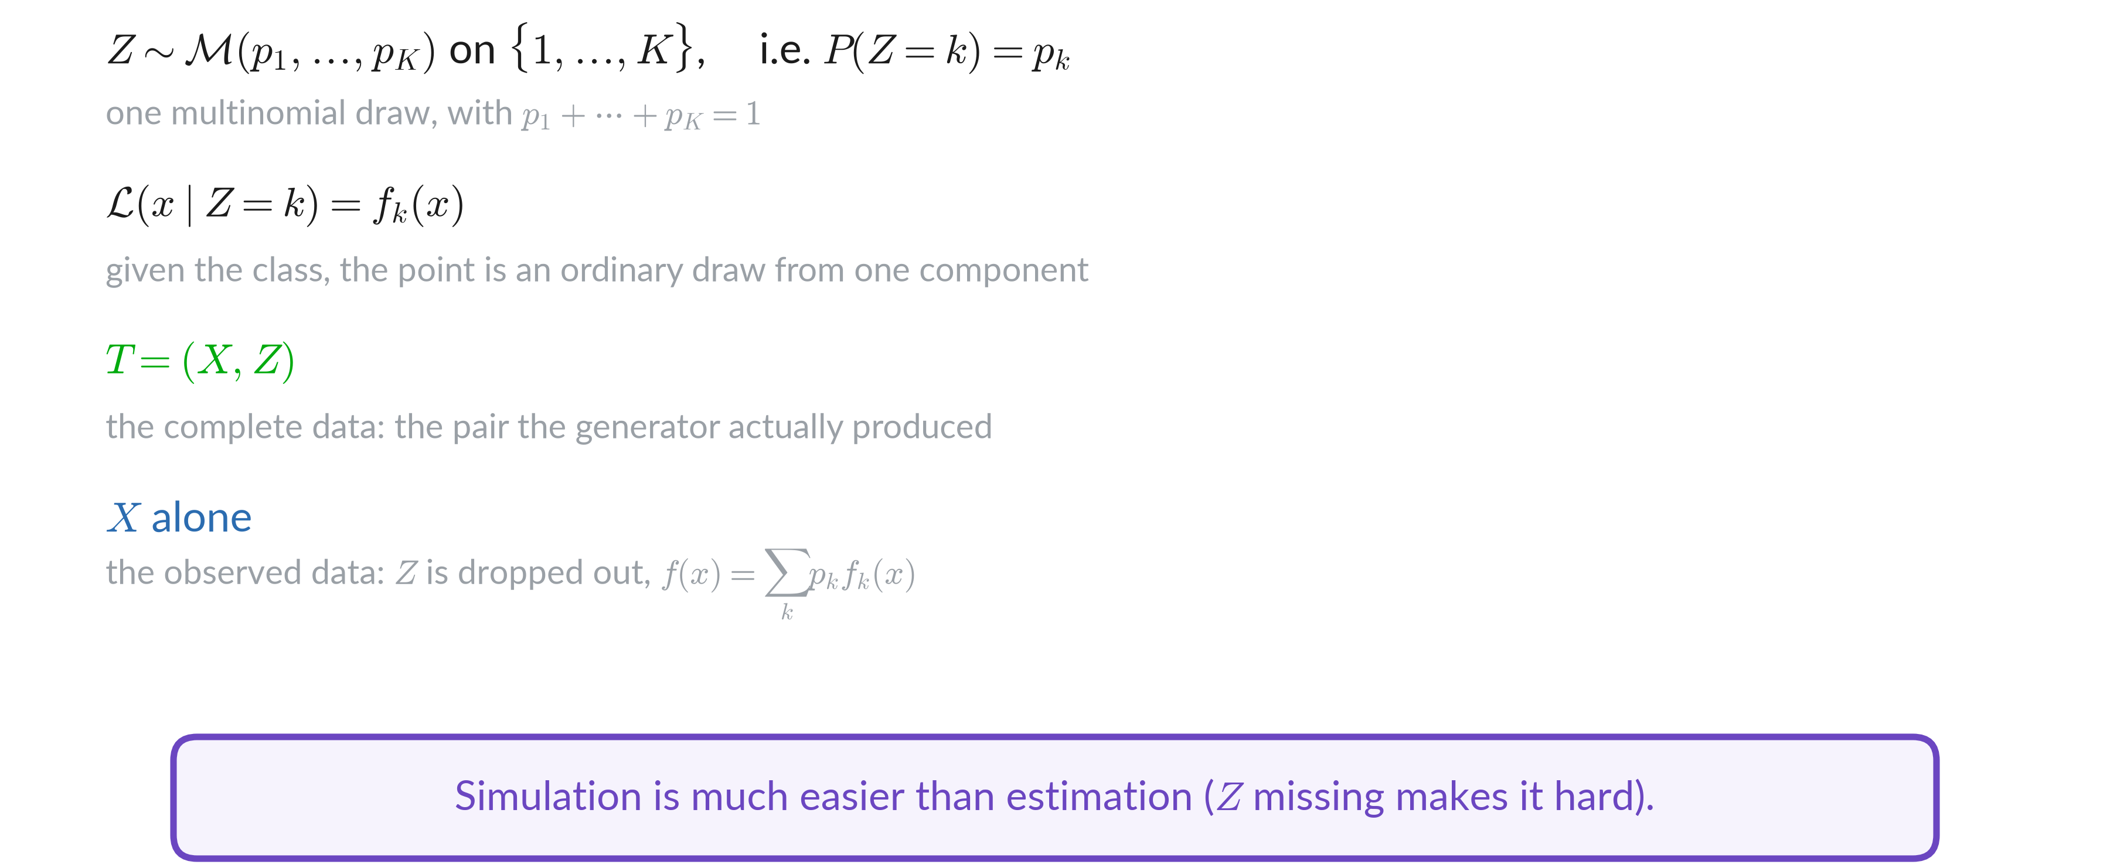
Simulation / Estimation asymmetry

Slide 21
Fitting by maximum likelihood

Slide 22
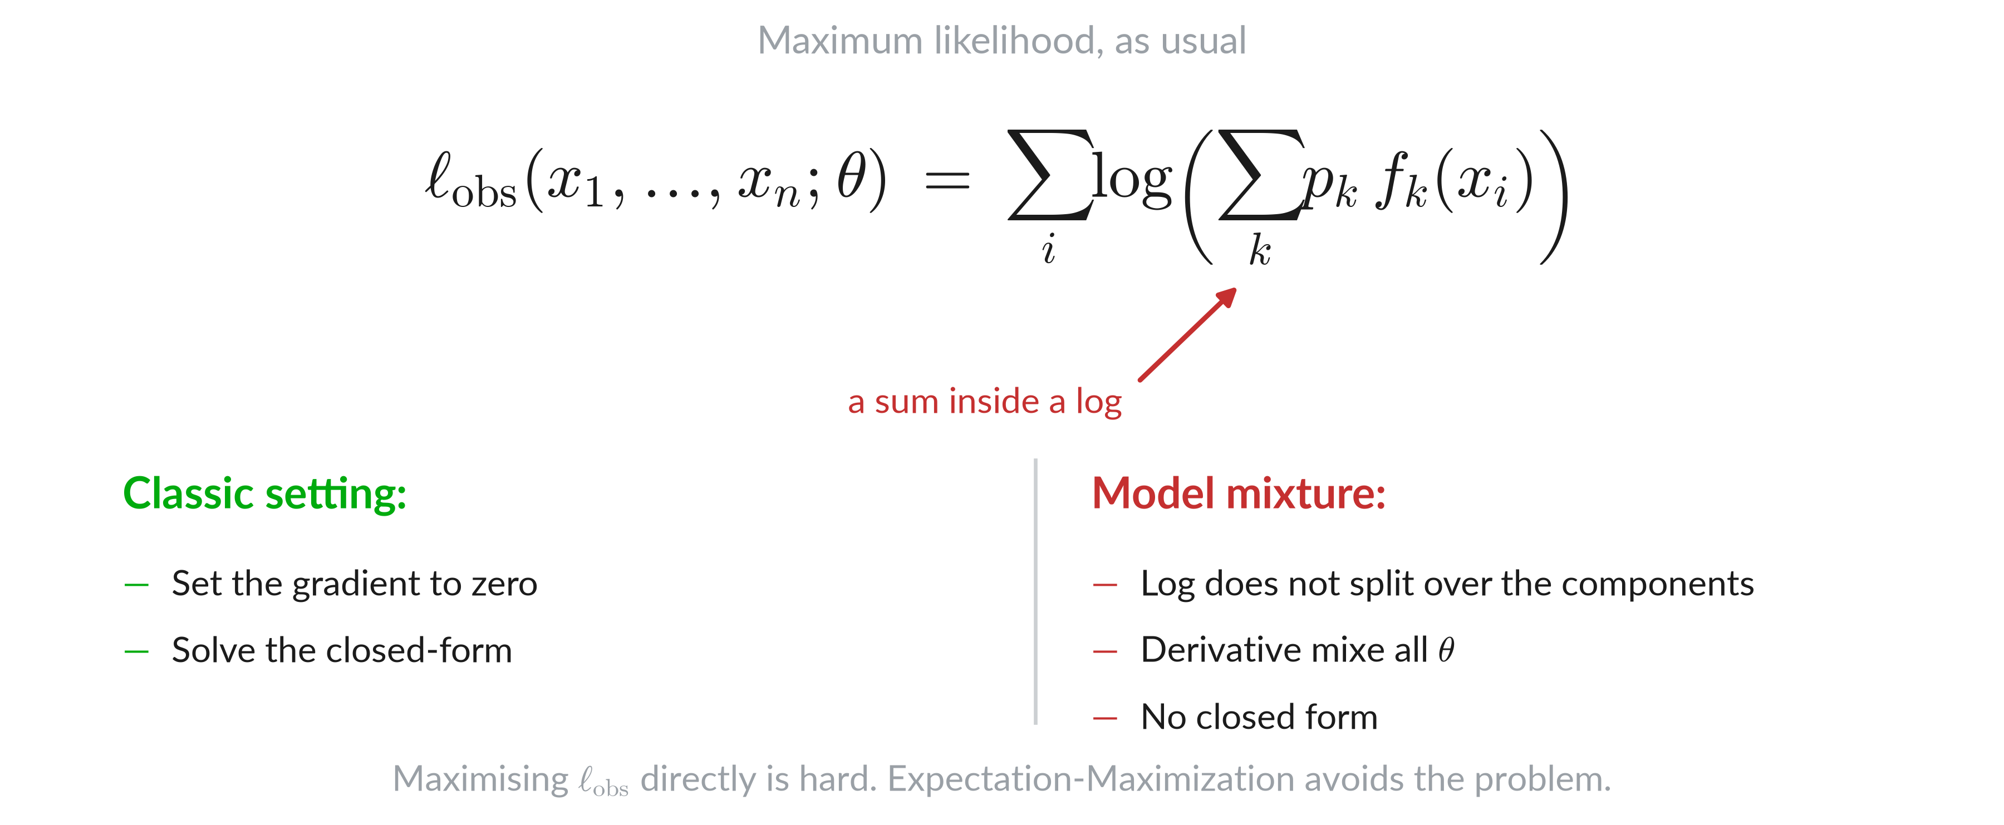
Likelihood of observed data

Slide 23
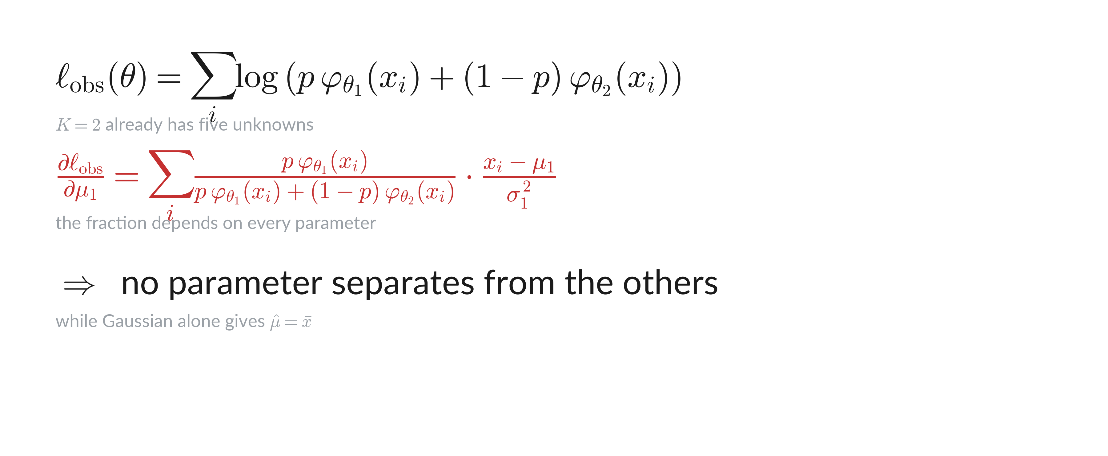
Sum inside the log

Slide 24
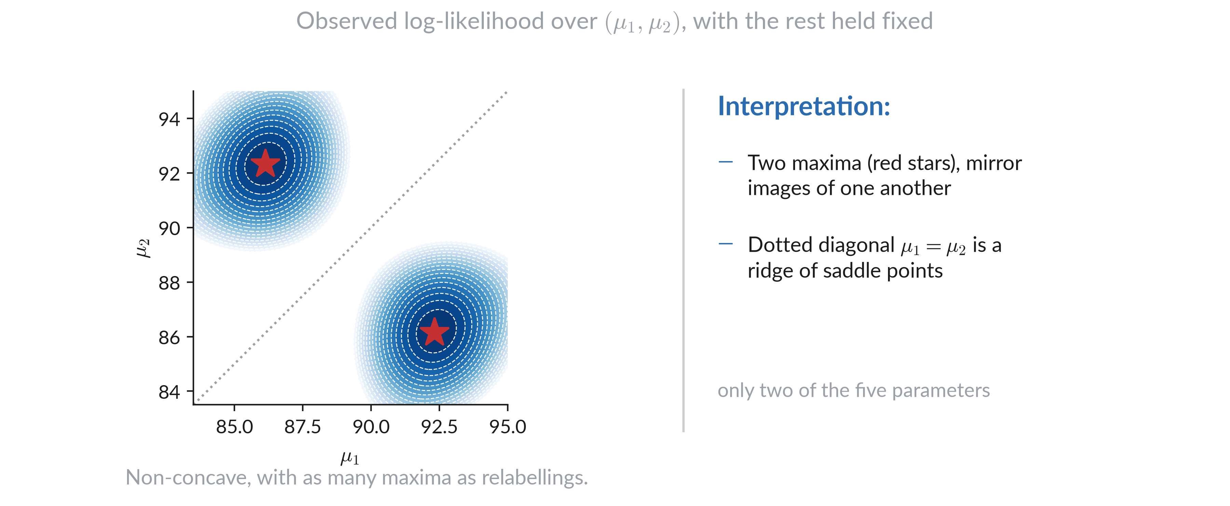
Surface of likelihood

Slide 25
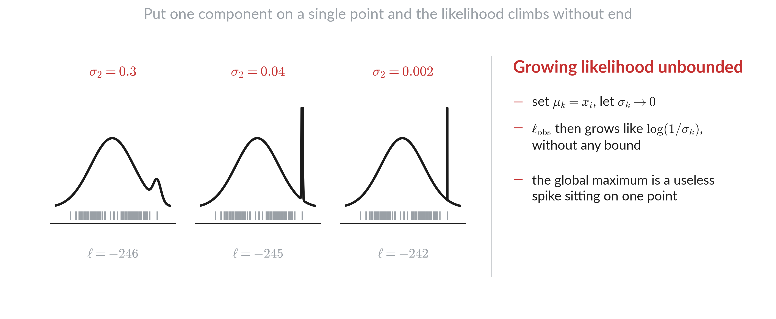
Likelihood is unbounded

Slide 26
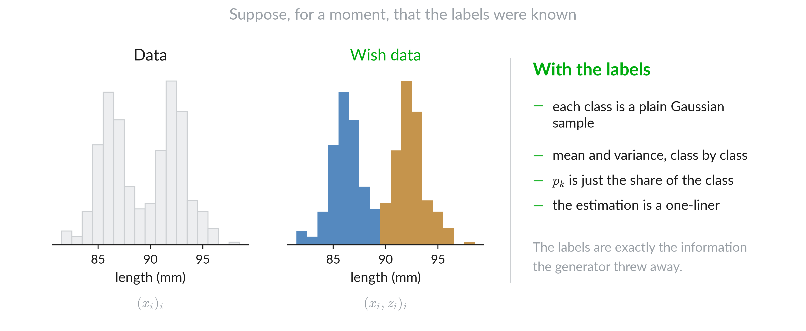
If we knew the labels

Slide 27
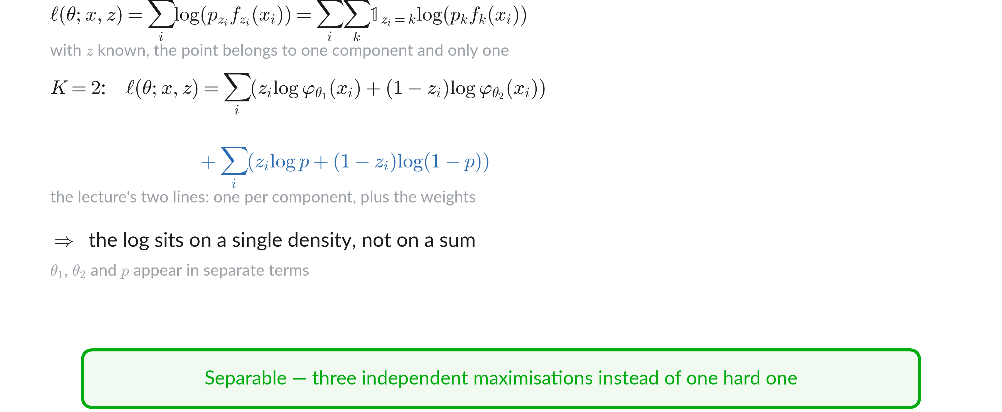
Complete-data likelihood splits

Slide 28
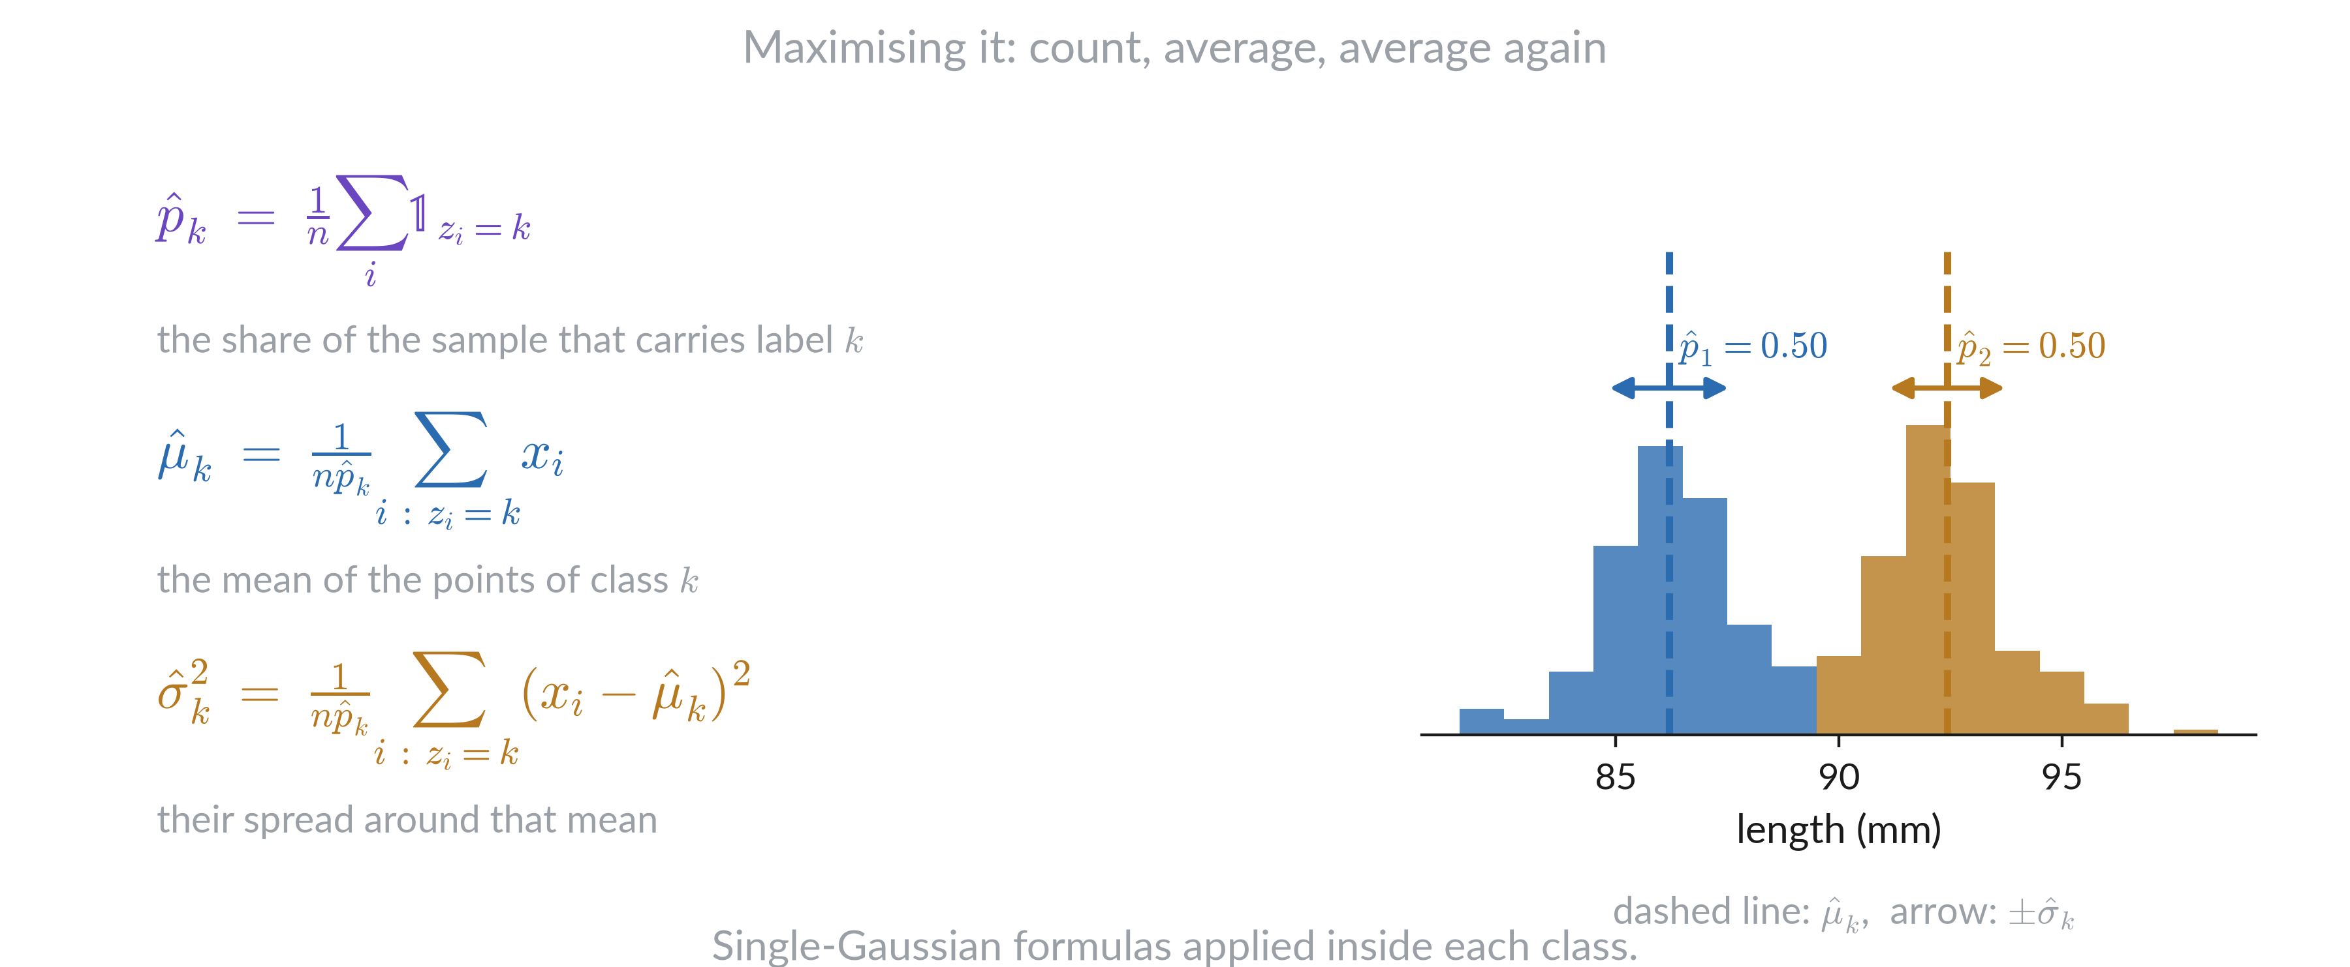
Closed form class by class

Slide 29
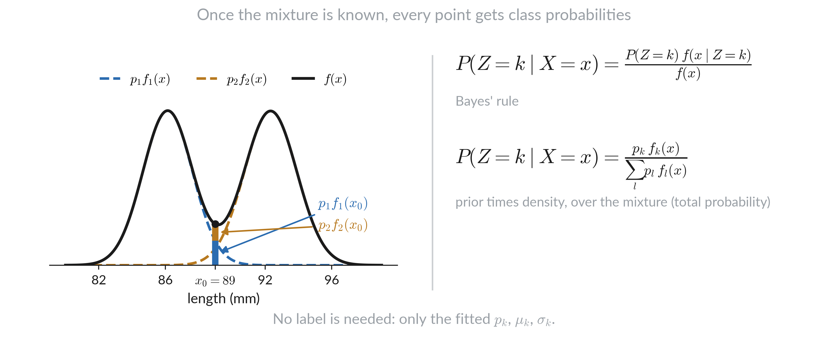
Class probabilities from the fit

Slide 30
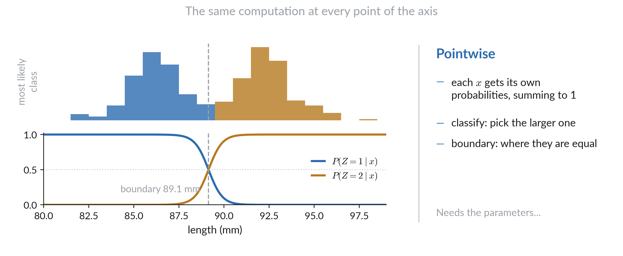
Along axis

Slide 31
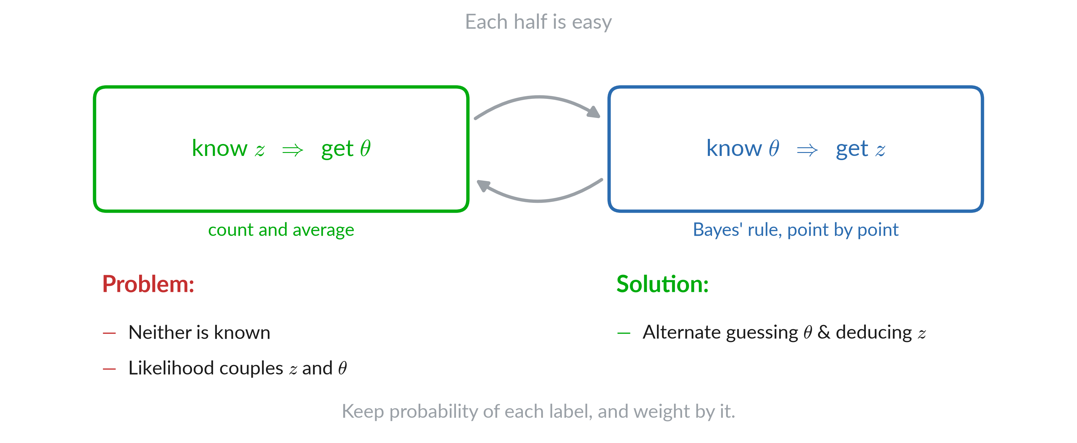
Chicken and egg

Slide 32
Responsibilities

Slide 33
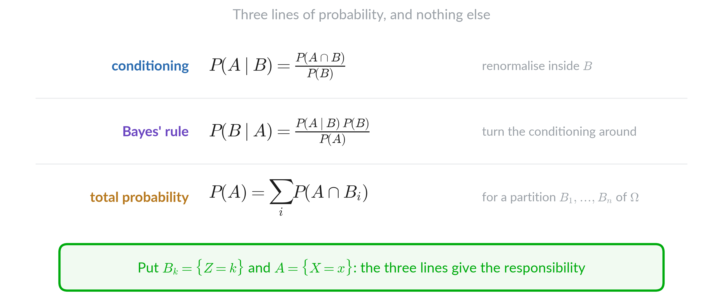
Bayes (reminder)

Slide 34
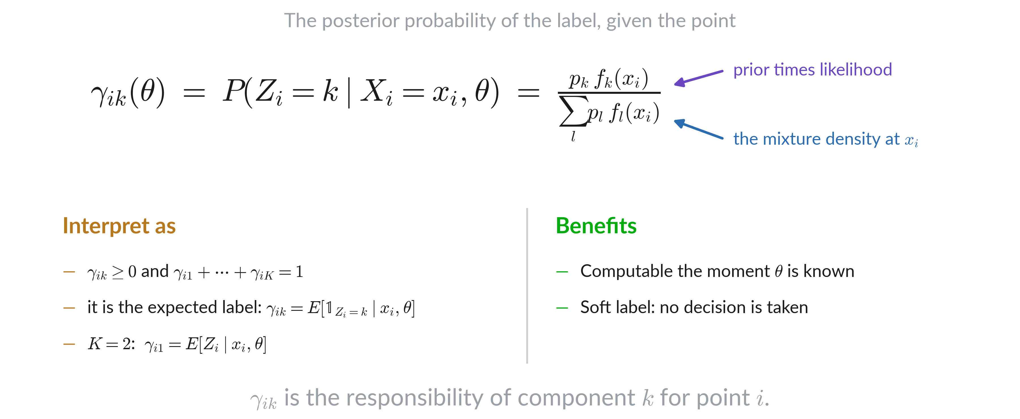
Posterior over the label

Slide 35
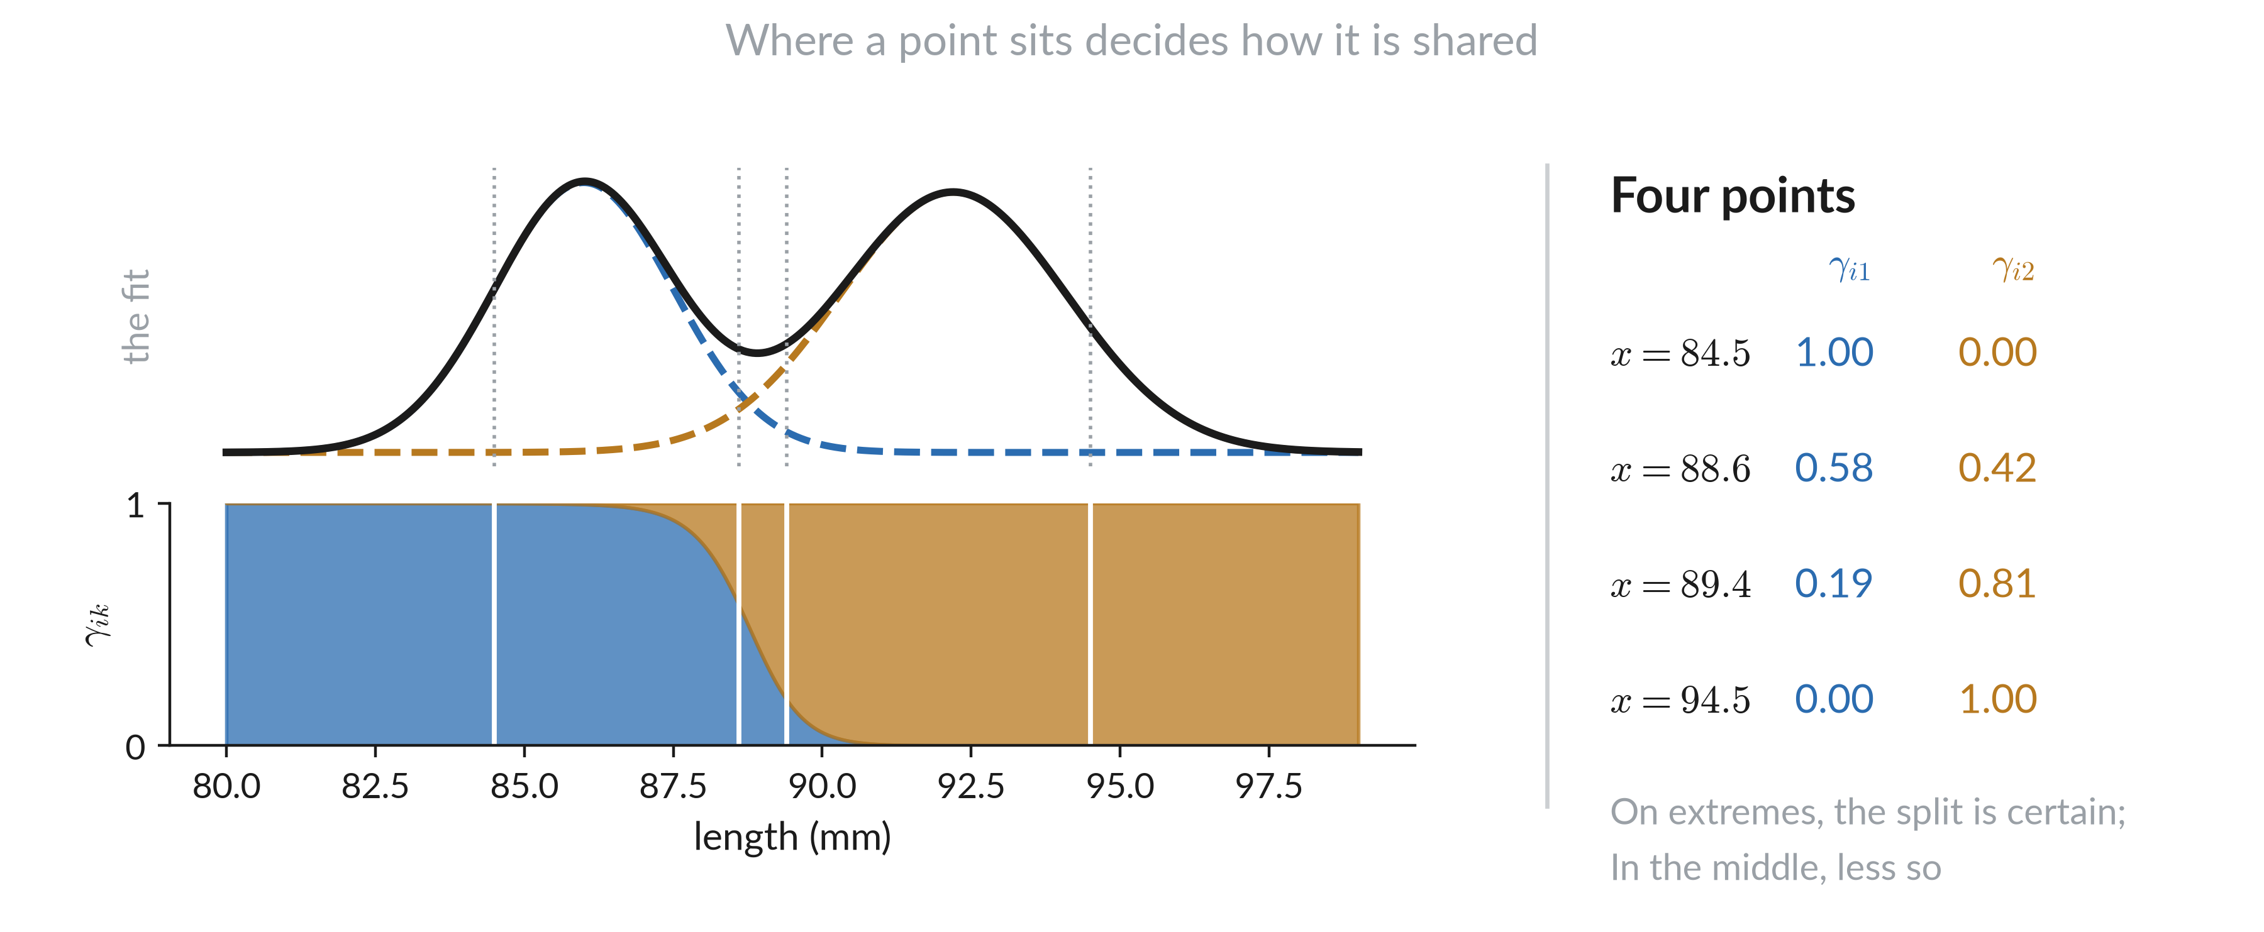
Responsibility

Slide 36
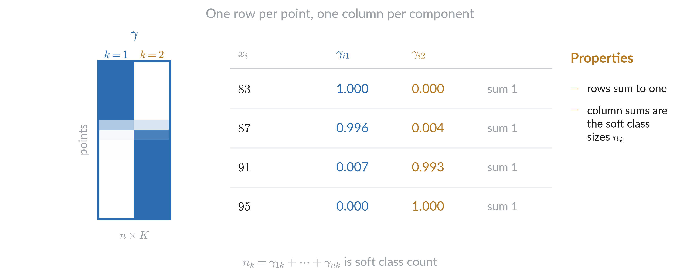
Responsibility as a matrix

Slide 37
Soft and hard

Slide 38
Expectation-Maximization algorithm

Slide 39
Alternate

Slide 40
Expectation–Maximization

Slide 41
The E-step

Slide 42
The M-step

Slide 43
Weighted by responsibility

Slide 44
Example run

Slide 45
Same run

Slide 46
Likelihood evolution

Slide 47
Cost per pass

Slide 48
Why it works

Slide 49
EM alternate view

Slide 50
Splitting the log-likelihood

Slide 51
Lower bound on the log-likelihood

Slide 52
Jensen step

Slide 53
Jensen inequality

Slide 54
E-step

Slide 55
M-step

Slide 56
Minorize–maximize steps

Slide 57
Inequalities proving monotonicity

Slide 58
Closed form derivation

Slide 59
Where it stops

Slide 60
Expectation-Maximization variations

Slide 61
Algorithm variations

Slide 62
k-means is a limit case of EM

Slide 63
k-means vs Gaussian mixture

Slide 64
Stochastic EM

Slide 65
SEM example

Slide 66
N draws per point

Slide 67
k-means vs EM vs SEM vs N-SEM

Slide 68
Reach convergence

Slide 69
Where you start matters

Slide 70
Starts comparison

Slide 71
Guarding against collapse

Slide 72
Covariance types

Slide 73
AIC and BIC

Slide 74
Number of components

Slide 75
Example on real data

Slide 76
Scoring a new point

Slide 77
Beyond the Gaussian

Slide 78
Conclusion

