Slide 1

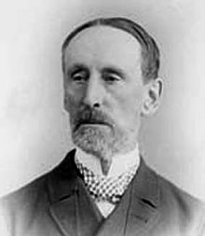

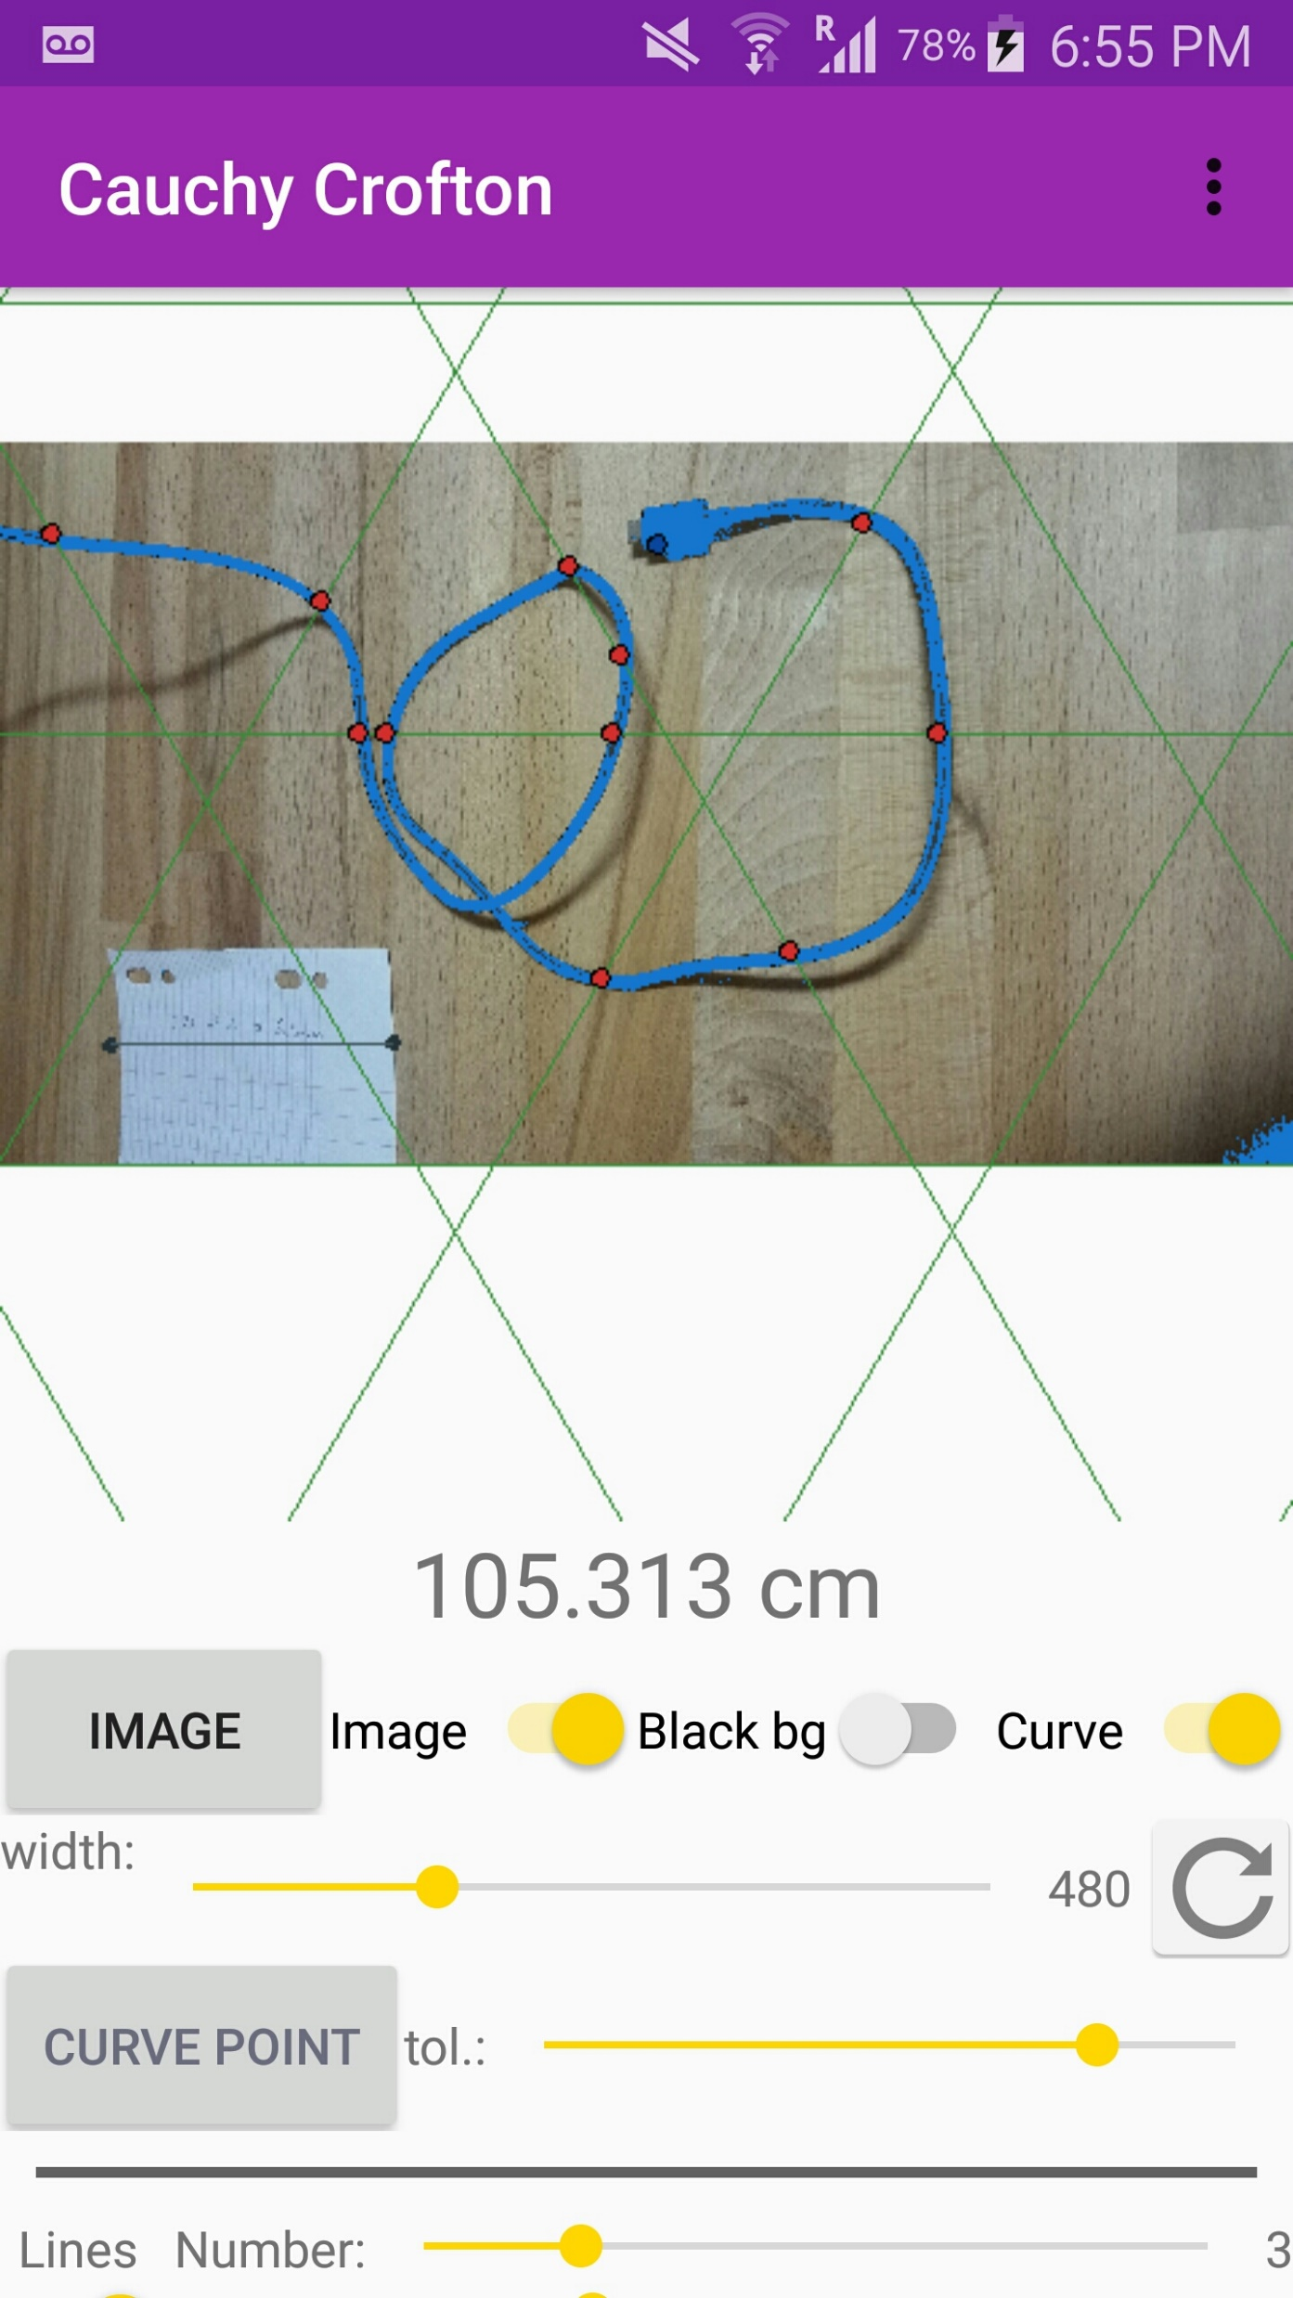

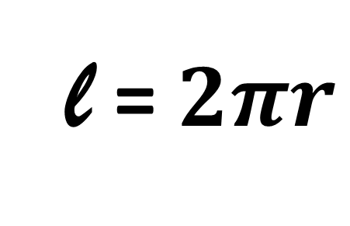
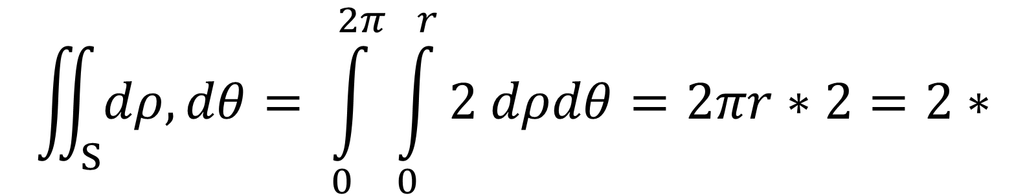
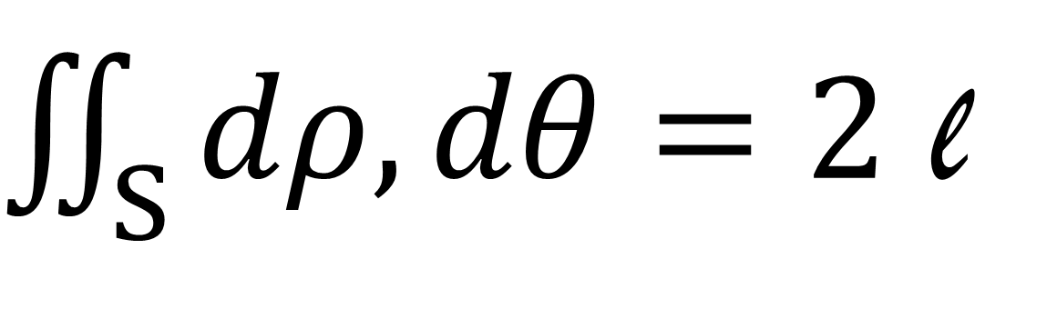
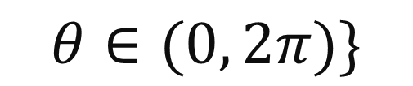
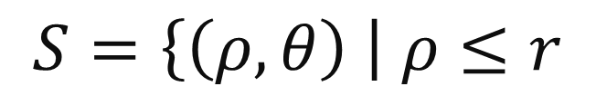
Cauchy Crofton Formula
Theorem:
Check for circle:
Line case…
$$S=\left\{\left(ρ, θ\right) \right| ρ≤r$$
$\iint_{S}{dρ, dθ}=2$ l
$$θ∈(0, 2π)\}$$
2 intersections, so count twice in the integral
Description of the set S + Example?
Usual
Integration
Length of the curve
r
Rigid motions: def + image
Polygon case…
$$\iint_{S}{dρ, dθ}= \int_{0}^{2π}{\int_{0}^{r}{2 dρdθ}}=2πr∗2=2∗$$
$$\text{l}$$
Finally:
l = $2πr$
Did you expect this result? ☺
Note: This is not that useful for the case of a circle, but remember that you may use the formula on any curve in a plane, which make it very powerful.
Also, as the formula involves an integral, we can use all the tools we already know about integrals. In particular, it is quite easy to make approximations.
Regular curve case…
Try this formula in real life !
- Only available on Play Store – (sorry)
We finally proved the statement for any regular curve
One may prove that the integral above remains unchanged after applying rigid motions
This poster summarizes a second-year project undertaken in June 2018 ; By Aadil Khan, Caroline Bouat, Chris Bishop and Paul Dubois

