Slide 1
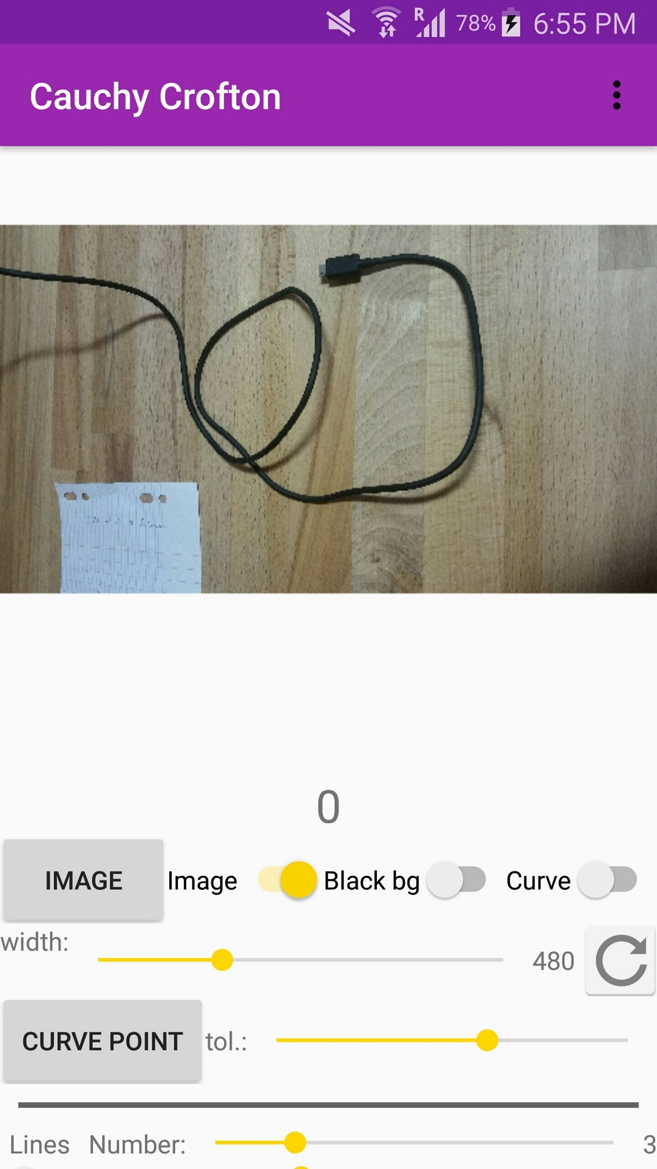
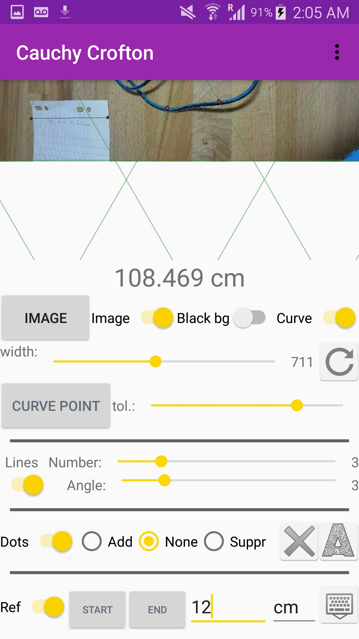
Get more information
Switch to display or not the
components generated by
the app
LENGTH CALCULATED
Load an image form gallery
The image is being pixelized to
make the calculations faster, you
can select the width of the image
Select a point on the image.
The curve will be recognized as
the part of the image that is the
same color as this point
Reset the default image width
(a good ratio resolution/calculation time)
Set the tolerance for the curve
recognition, to be combined with
the point selected on the image
Dots:
add mode, neutral mode, delete mode
Dots:
Delete all, Automatic detection
Set the number of parallel lines per width
and the angle between the parallel lines
Set the reference on the image
The reference is a distance between two dots
(beginning and end) on the image that you know
the length, it will be use to scale the length of
the curve, calculated in pixels to the unit length
you define
Set the length of the reference on the image
Set the length unit
Hide keyboard & calculate

