Slide 1

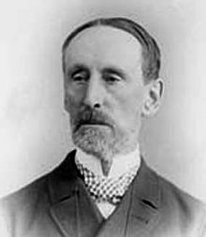
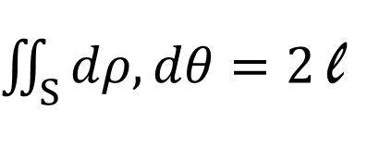
Cauchy Crofton Formula
By Aadil Khan, Caroline Bouat, Chris Bishop and Paul Dubois
Theorem:
Check for the circle case:
Line case…
$\iint_{S}{dρ, dθ}=2$l
S={(o,p)|p<r, Ao}
So
Int(s) = 2*pi*r*2 = 2l
QED
Usual
Integration
Description of the set S + Example?
Length of the curve
Poylgone case…
Rigid motions: def + image
Fun fact: this is used to calculate the length of DNA strand
Regular curve case…
One may prove that the integral above remains unchanged after applying rigid motions
We finally proved the statement for any curve

