Slide 1
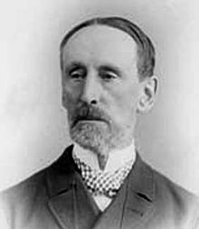

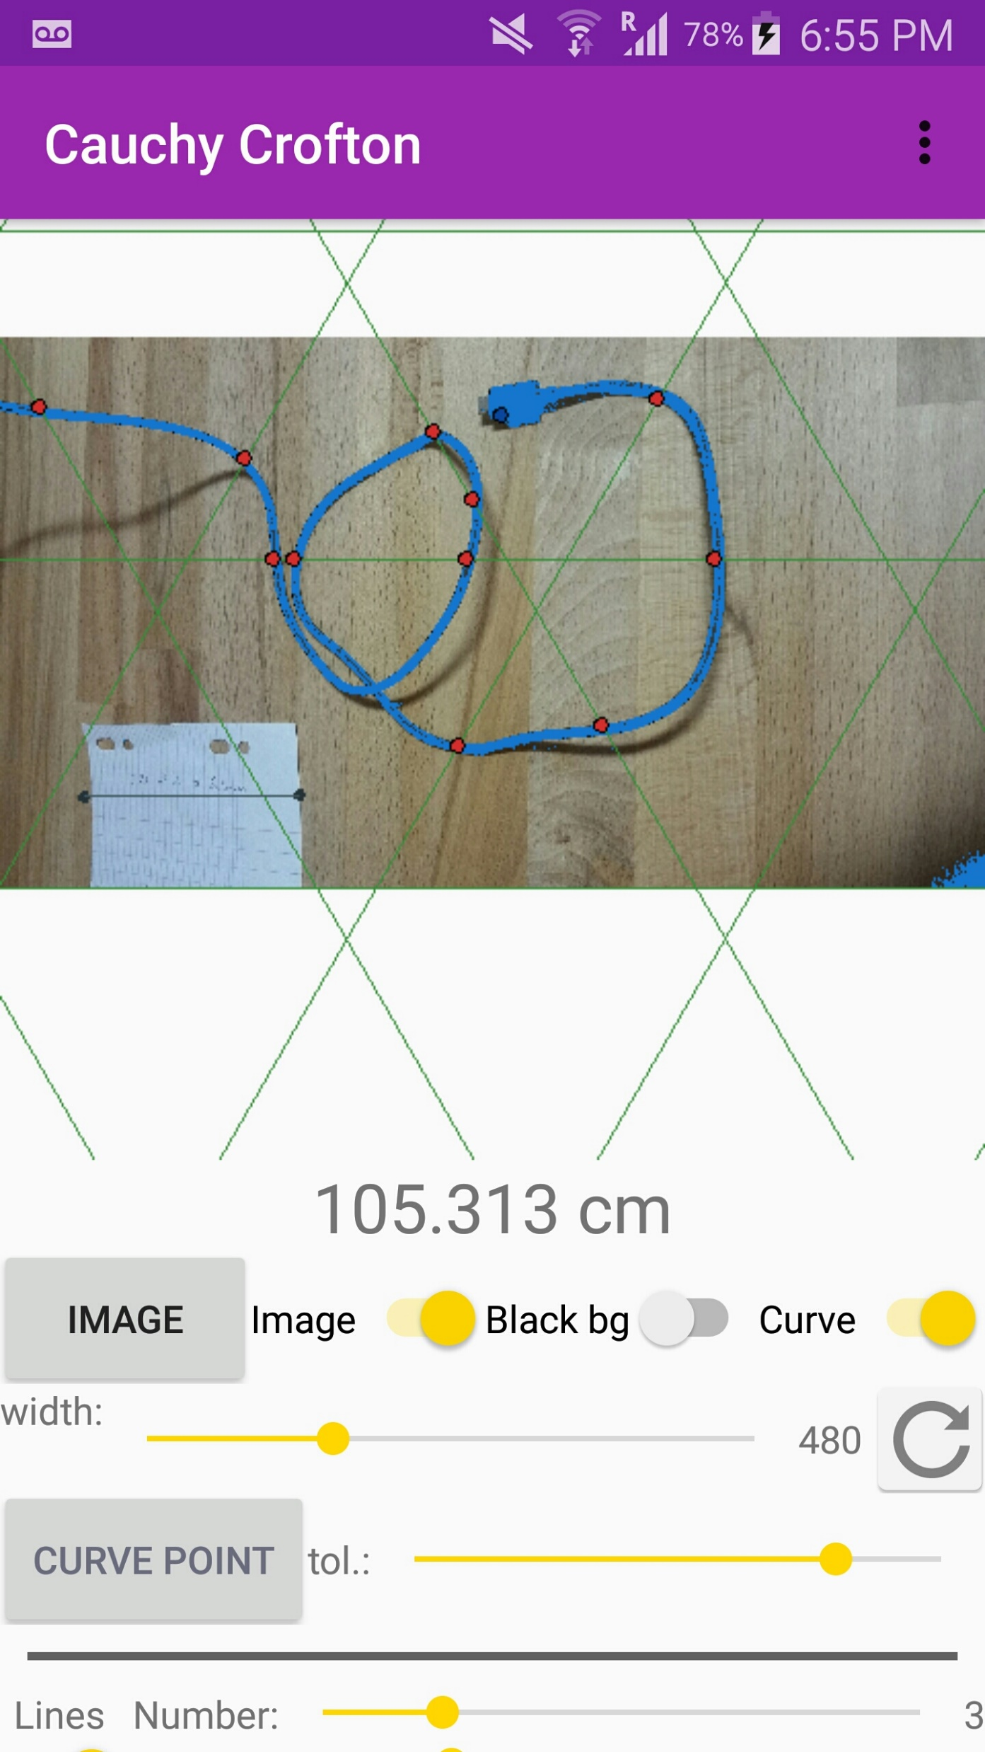
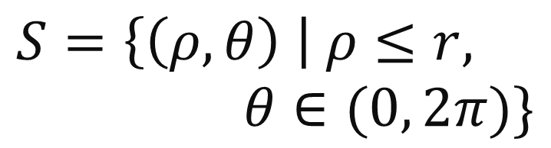
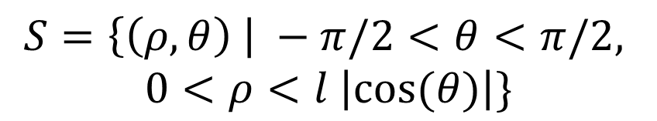
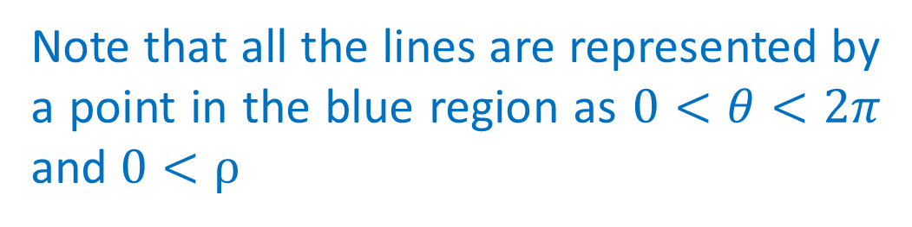
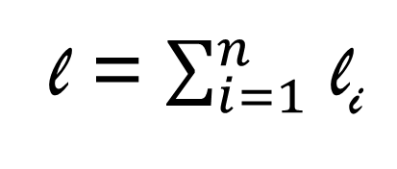
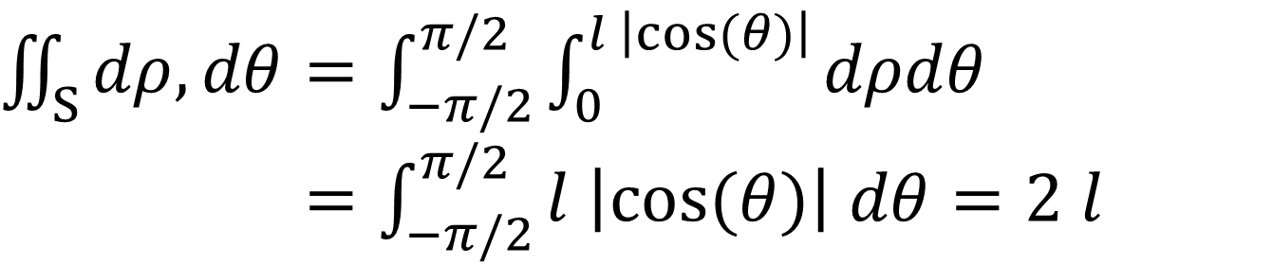

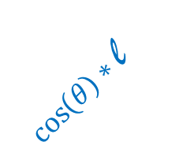
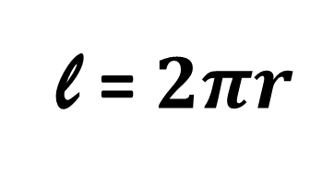
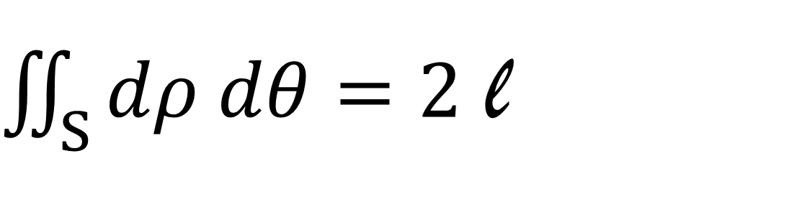
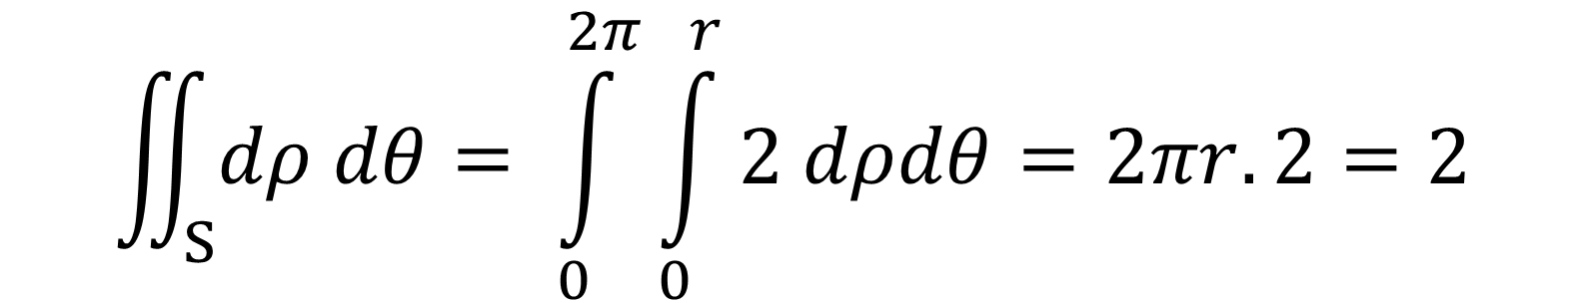
The Cauchy Crofton Formula
by Chris Bishop, Caroline Bouat, Paul Dubois, and Aadil Khan
Goal: obtain the length of a curve
Rigid motions
Check for a circle:
Suppose that you are given a curve that lies in a plane and you need to calculate its length.
We will do this by "counting" how many straight lines intersect with that curve.
One may prove that the integral in the formula remains unchanged after applying a rigid motion to our curve
$$S=\left\{\left(ρ, θ\right) \right| ρ≤r, θ∈(0, 2π)\}$$
Representation of straight lines:
2 intersections, so count twice in the integral
Translation
Rotation
To characterise a line, use:
Its distance to origin (ρ)
Its angle with the horizontal (θ)
This gives coordinates (ρ, θ)
Rigid Motion: Combination of a translation and a rotation
Quick proof:
r
ρ
θ
l
Take any line curve with length l
$$\iint_{S}{dρ dθ}= \int_{0}^{2π}{\int_{0}^{r}{2 dρdθ}}=2πr.2=2$$
We use a rigid motion (so the formula doesn’t change) to throw the line onto the x-axis, between 0 and l
$$\text{l}$$
Now plot (ρ, θ) in another plane.
ρ
l
This is the new representation of the line.
θ
Rigid Motion
l = $2πr$
Finally, obtain:
Did you expect this result?
Note that all the lines are represented by a point in the blue region as $0<θ<2π$ and $0<ρ$
$\cos\left(θ\right)∗$ l
Then, the set S becomes:
Uses of this formula:
$$S=\left\{\left(ρ, θ\right) \right| −π/2<θ<π/2,$$
$$0<ρ<l \left|cos⁡(θ)\right|\}$$
This is not that useful for the case of a circle, as we already know the length (although, we can use it to derive the formula).
Nevertheless, remember that you may use the formula on any regular curve in a plane, which makes it very powerful.
Also, as the formula involves an integral, we can use all the tools we already know about integrals. In particular, it is quite easy to make approximations.
Formula:
θ
For any curve in a plane:
Now, calculate the integral:
$\iint_{S}{dρ dθ}=2$ l
l
$\iint_{S}{dρ, dθ}=\int_{−π/2}^{π/2}{\int_{0}^{l \left|cos⁡(θ)\right|}{dρdθ}}$
$=\int_{−π/2}^{π/2}{l \left|cos⁡(θ)\right| dθ}=2 l$
Usual Integration
Length of the curve
Try this formula in real life: this app enables you to apply the formula to a picture.
Scan the QR code
Or search “Cauchy Crofton”
(Only available on Play Store)
Where S is the set of lines that intersect the curve
→ Count with multiplicity
(i.e. if a line intersects twice, put it in the set S twice)
l₂
…which gives the formula!
l₁
l₃
For any polygonal line, just apply the formula above for each component (that is straight), and sum them :
Note: As we represent the lines by points in a plane, the set S of lines that intersect the curve becomes a set of points, thus a region in a plane. We can then integrate in two dimensions over this region of the plane.
l₄
l₅
l = $\sum_{i=1}^{n}{ }$l_{i}
l₆
For any regular curve, take its limit as small pieces of straight lines
This poster summarises a second-year project undertaken in June 2018. Reference: M. do Carmo, Differential Geometry of Curves and Surfaces

