Slide 1
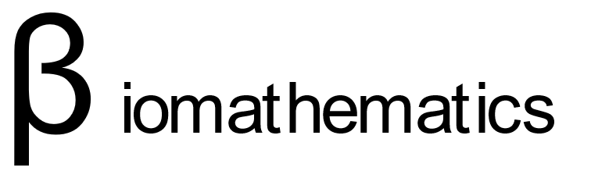





Methods for automatization of radiotherapy dosimetry.
Test Box
Test Box
Candidate:
Paul Dubois
Prof. Nikos Paragios
Prof. Paul-Henry Cournède
Directors:

Slide 2
Content
Background & Introduction
Optimization for Dosimetry
Network of Treatment Plans
Classical Setting Automation
Deep-dose Automation
Conclusion

