Slide 1
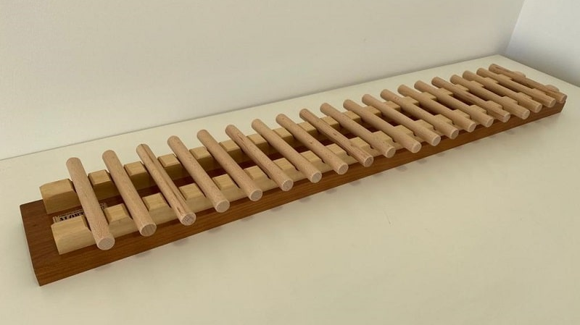
Solving Nim’s Game
Paul Dubois
for
Panic Night
ISEP 2023

Slide 2
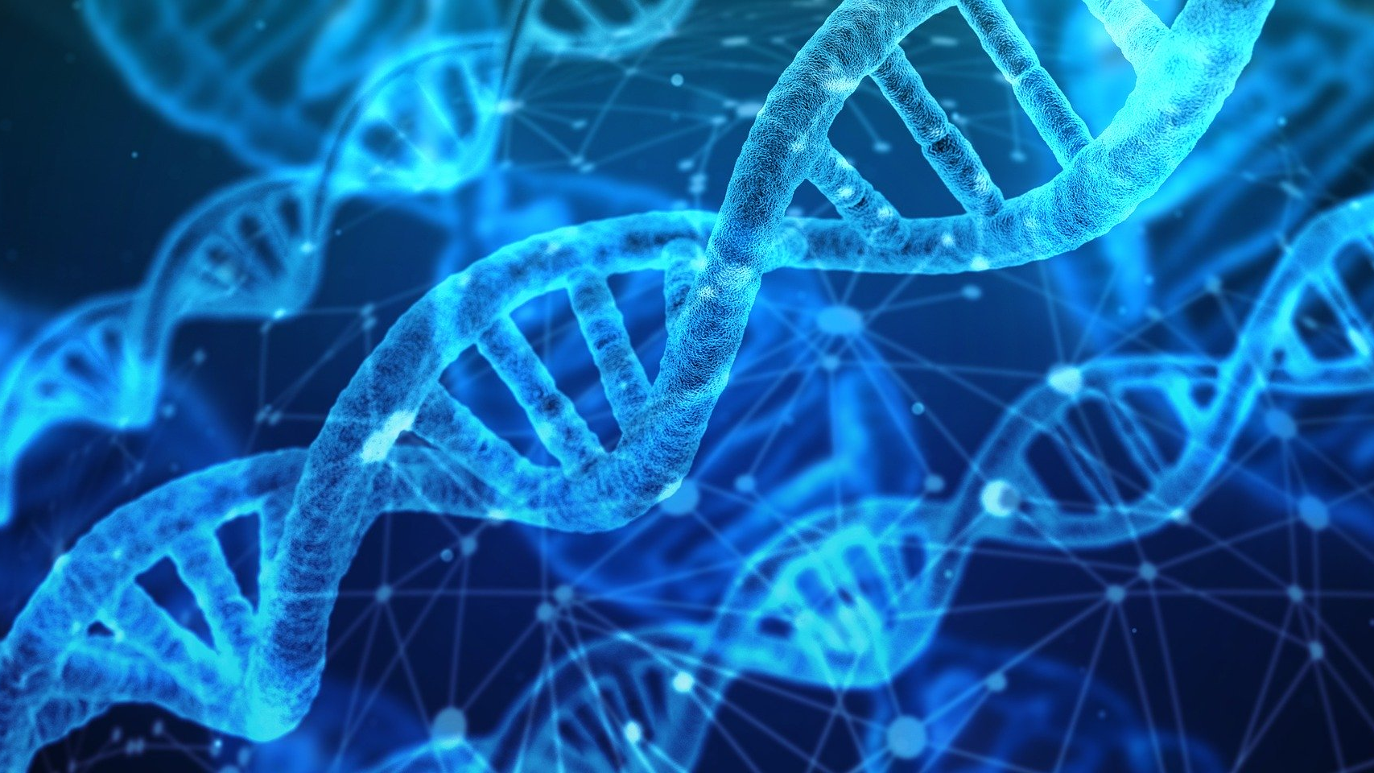
Basic Genetics
Introduction to basic rules of genetics

Slide 3
Cells…
Kernel
Cytoplasm
Membrane
Notes:
Les éléments basiques des cellules

Slide 4
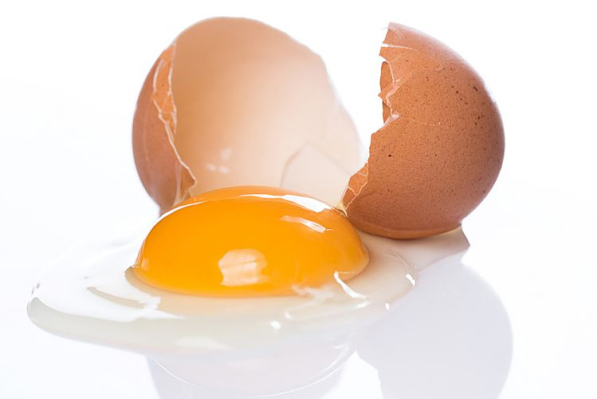
…you already know
Kernel
Cytoplasm
Membrane
Notes:
Exemple connus: l’œuf

