Slide 1
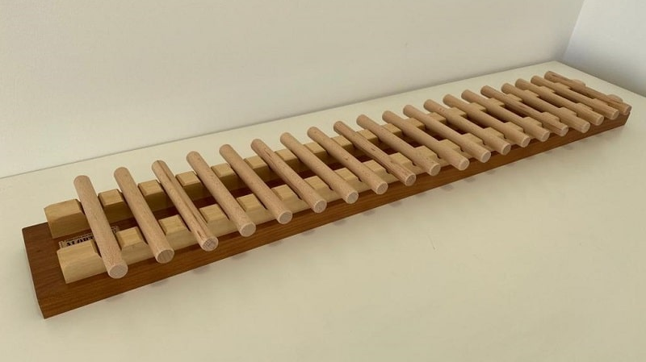
Solving Nim’s Game
Paul Dubois
for
Panic Night
ISEP 2023

