Slide 1
Automatic dose optimization for radiotherapy
Paul Dubois
TheraPanacea
MICS, CentraleSupélec
Institut du Cancer de Montpellier

Slide 2
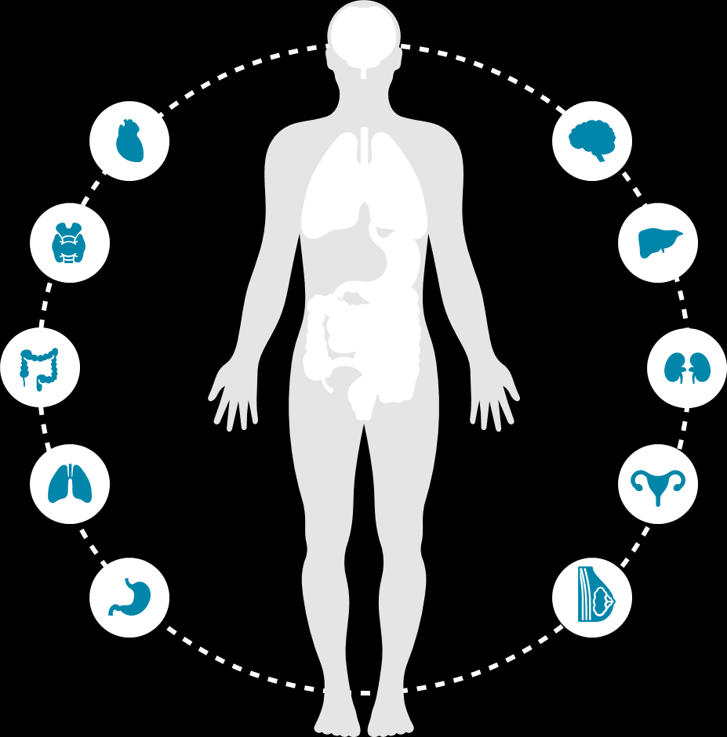

Re-inventing
cancer treatment with
Artificial Intelligence

Slide 3





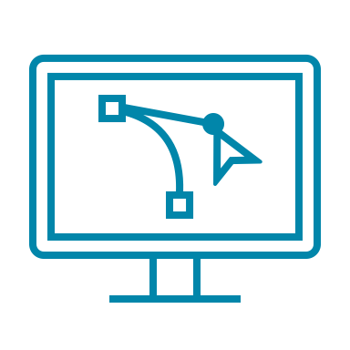








TheraPanacea Overview
European and National Science and Innovation Prizes and Awards obtained since 2017:
Company is spin-off of Artificial Intelligence research lab
Founded in 2017 and based in Paris & Pittsburgh, 70+ employees to date
Core expertise in Advanced Mathematics, Medical Imaging and AI
ART-Plan solution for Radiation Oncology 1st market launch in 2019
100+ user sites in Europe, Africa, Middle East and the US
H2020 ERC POC, Grands Prix d’Innovation de la Ville de Paris, Concours d’innovation numérique, Concours iLab des jeunes entreprises innovantes, Paris Region AI challenge, Prix de l’innovation en imagerie médicale Société Francaise de Radiologie

Slide 4
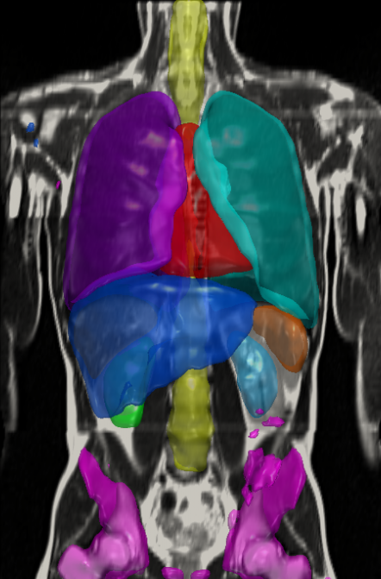
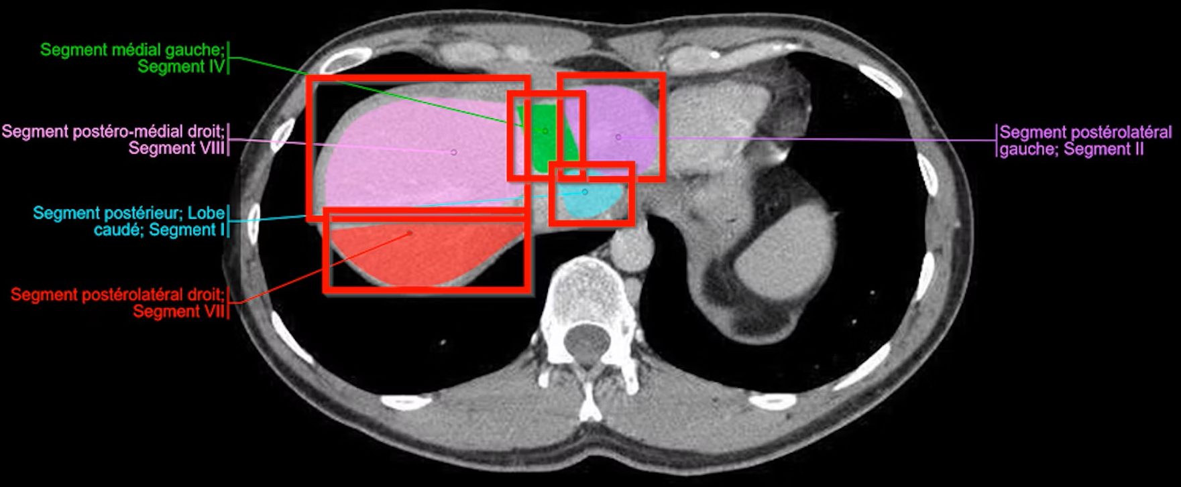
Annotation
Notes:
Annotate is our AI powered contouring tool, it has been in clinical use since 2019. We currently offer 150+ structures comprising OARS and Lymph nodes for both CT and over 70 structures for MR. Including our most recent release of CT substructures of the heart and SBRT Thorax. It takes up to 4 minutes for contours to be completed. Annotate is a robust solution that is completely plug and play. As soon as you have it installed you can take advantage of the expert contours without having to provide any training data.

Slide 5


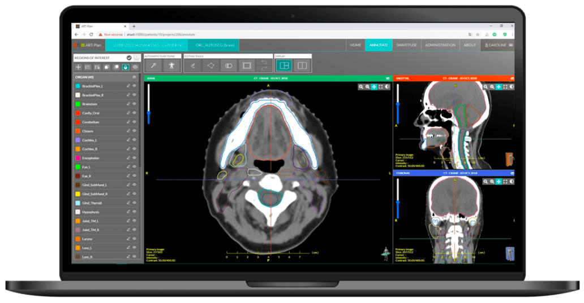


Annotate
AI-powered contouring tool
In clinical use since 2019
150 + structures (OAR and LN) on CT
Sub structures of the heart
SBRT Thorax
70 + structures on MR
3-4 minutes contouring
Plug and play
Notes:
Annotate is our AI powered contouring tool, it has been in clinical use since 2019. We currently offer 150+ structures comprising OARS and Lymph nodes for both CT and over 70 structures for MR. Including our most recent release of CT substructures of the heart and SBRT Thorax. It takes up to 4 minutes for contours to be completed. Annotate is a robust solution that is completely plug and play. As soon as you have it installed you can take advantage of the expert contours without having to provide any training data.

Slide 6

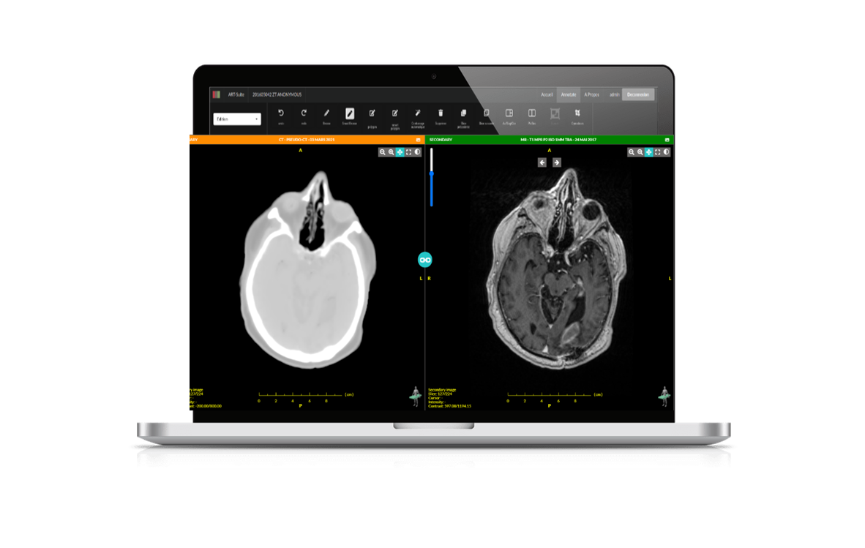


MR Box Synthetic CT for MR-guided workflow
Automatic delineation on MR
Generate a pseudo-CT from MR images
Avoid registrations errors
Accelerate adaptive routines
Less machine time
Brain T1, Pelvis T2, Pelvis/Abdo Truefisp (ViewRay)
And more under development
Notes:
The second module we will be discussing is MR Box. MR Box allows delineation on MR images and generation of pseudo CT’s from the MR’s to be used in your treatment planning system.
Currently there are 3 MR sequences available. Brain T1, Pelvis T2, and Pelvis/abdo Truefisp for ViewRay MR Linac

Slide 7
