Slide 1
M
M
i
e
S
y

Slide 2
Goldfinger
The man with a gun
Goldfinger
The man with a gun
Goldfinger
007 theme
Goldfinger
The man with a gun
Moon Raker
Jaws Teeth

Slide 3
Goldfinger
The man with a gun
Goldfinger
The man with a gun
Goldfinger
007 theme
Goldfinger
The man with a gun
Moon Raker
Jaws Teeth
A/B

Slide 4











?

Slide 5
Levels
Parts
Verse
Chorus
Bridge
Inrto
PreChorus
Type of Levels
Bass
Mids
High Mids
Highs
Reverb/fx
Pitch
Problems – with location
Pitch
Timing
Tracks
Drums
Kick
Snare
HH
Overs
Toms
Hi
Med
Low
Acoustic
Perc
Rhythm Gtr
Piano
Keys
Bass
Lead Gtr
Strings
Lead Vox
Back Vox
Yukalee
Organ
B3
Harmonica
Tamborine
Shaker
Locations
Car
Headphones
Remember user
Notes
Pitchy

Slide 6
Adjectives
Scratchy
Nasily
Boomy
Boxy
Tinny
Sillibent
Brighten
Dull
Strident
Thin
Shrill
Breathy
Flat/Sharp
Reedy
Cold/Warm
Brassy
Muffled
Muddy
Harsh
Buzzy
Plosive
Sibilants
Verse needs to come up
Bass is loud
Bass is Boomy
Snare is boxy
Vocals too loud in chorus
Thicken the snare
Too much verb
Not enough verb

Slide 7
Comment
Level
Verse
Bridge
Chorus
All
???
Shrill in Chorus
Pitchy in Bridge
Volume +2
Reverb -1

Slide 8
Lead Gtr
Boomy
Thin
Shrill
Verse
Bridge
Chorus
All
Lead Gtr Boomy in Verse
Shrill in Chorus
Pitchy in Bridge
Volume +2
Reverb -1

Slide 9
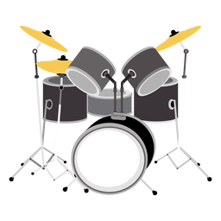
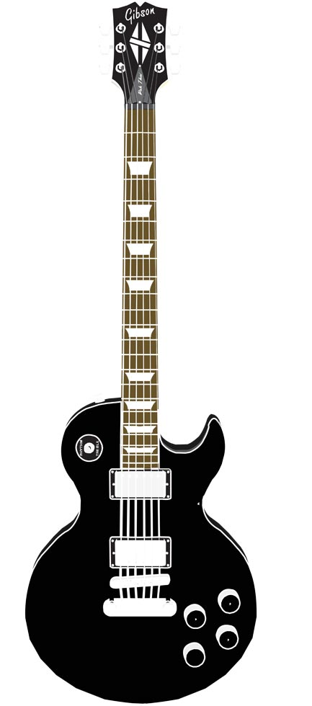


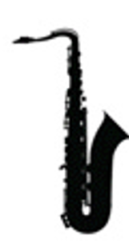

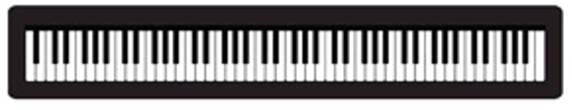
Lead Gtr

Slide 10

Lead Gtr
Vox
Bass
Drums

Slide 11
Lead Gtr

Slide 12
Mixes Ondrive
SomeDir Google
Onedrive
Change
up
open
add
done

Slide 13
M
M
i
e
S
Y

Slide 14
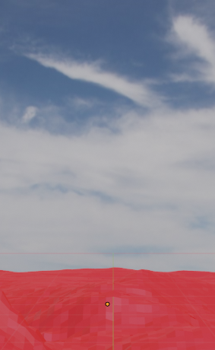

Slide 15






Slide 17


