Slide 1





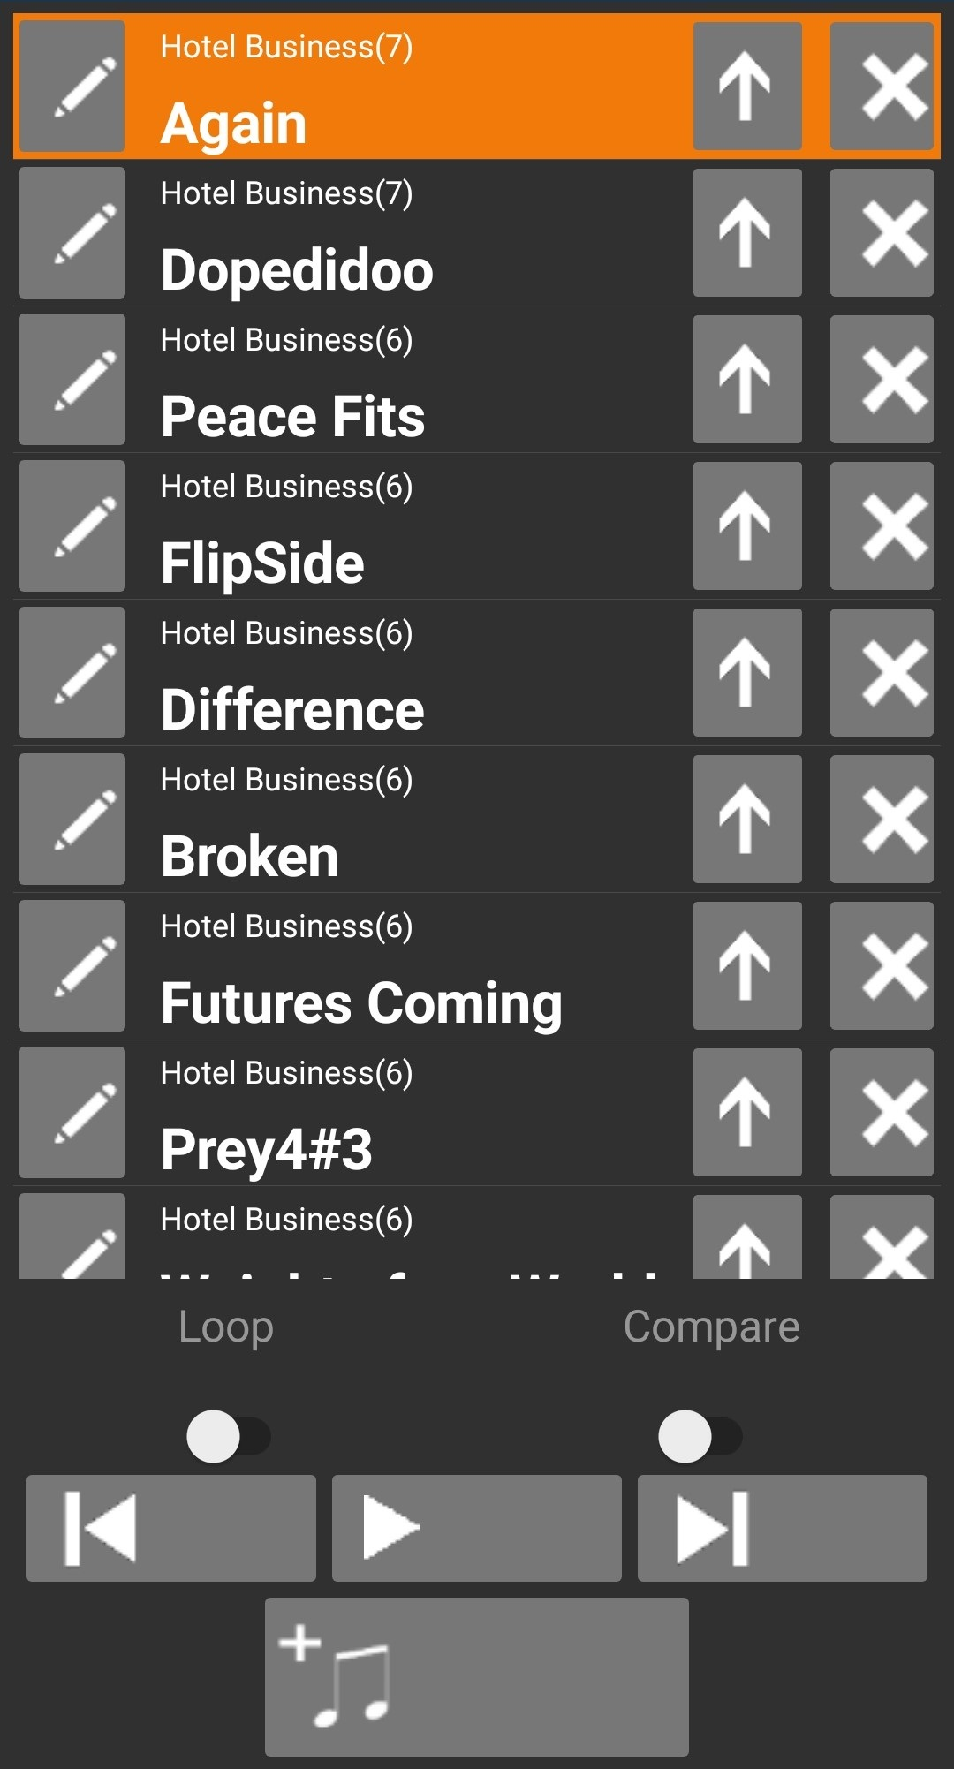



DAW
My Mixes

