Slide 1
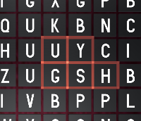

Slide 2
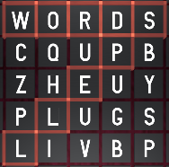
Word Spell
Select adjacent tiles in any direction to spell words. The long the word, the better the score. Advance to gain spells which help you spell longer words.
High Scores
Best Word Scores
Best Words Simple

Slide 3
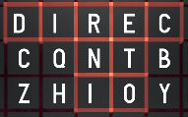
Word Spell
Select adjacent tiles in any direction to spell words. The longer the word, the better the score. Advance levels to gain spells which help you spell longer words.
But beware of lava tiles reaching the bottom. Also longer words improve your fortune which means better letter
High Scores
Best Word Scores
Best Words Simple

Slide 4
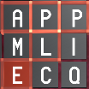
Word Spell
Pangram the letter volcano is about to blow! Legend tells of a magical prodigy who’s knowledge of words will save the day. Select adjacent tiles in any direction to spell words. Longer words improve your fortune, which means better replacement letters.
Advance levels to gain spells which let you rearrange the letters.
Beware of lava tiles (like the E), because if they reach the bottom, the game is over.
New Game
High Scores
Best Words Simple
Longest
Best Word Scores

Slide 5
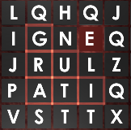

Slide 6
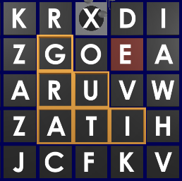

Slide 7
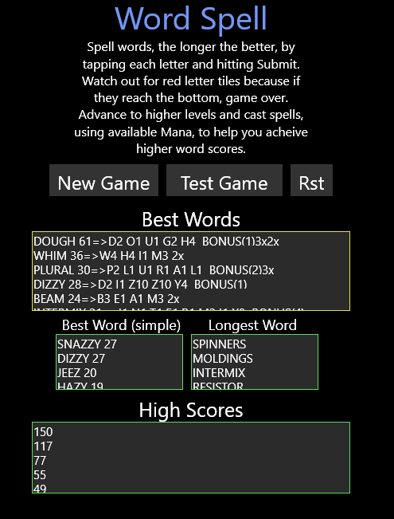

Slide 8
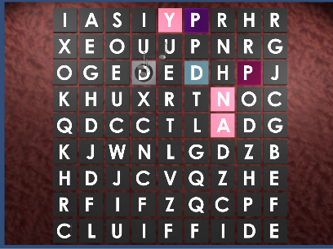
Level
Score
Mana
Cast
Click on letters
to spell a word

Slide 9
Level
Score
Mana
5
205
31
Fortune
Cast
Submitted Words
Auditioned
?
Click on letters
to spell a word

Slide 10
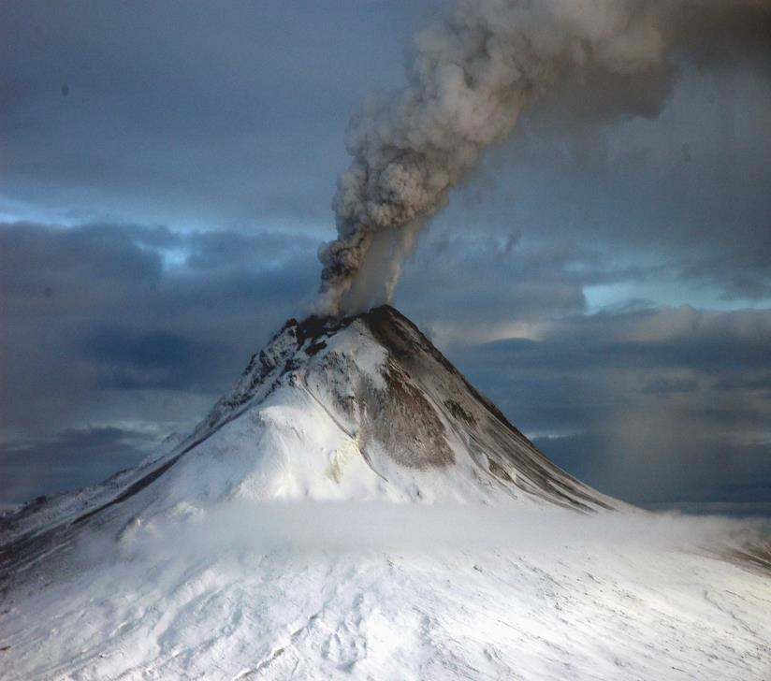
Level
Score
Mana
5
205
31
Fortune
Cast
Submitted Words
Auditioned
?
Click on letters
to spell a word

Slide 11
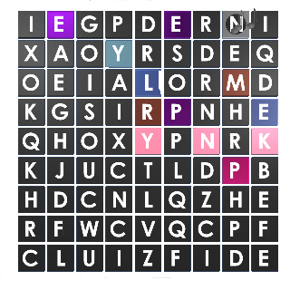
Level
Score
Mana
5
205
31
Fortune
Cast
Submitted Words
Auditioned
?
Click on letters
to spell a word

Slide 12
Level
Score
Mana
5
205
31
Fortune
Cast
Submitted Words
Auditioned
?
Click on letters
to spell a word

Slide 13
Level
Score
Mana
5
205
0
Fortune
Cast
Submitted Words
Auditioned
?
Click on letters
to spell a word

Slide 14
Level
Score
5
205
Fortune
Submitted Words
Auditioned
?
Click on letters
to spell a word

Slide 15
Level
Mana:
Score
5
205
Fortune
Submitted Words
Auditioned
?
Click on letters
to spell a word
Spell

Slide 16
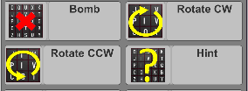
Level
Score
Mana
5
205
0
Fortune
Spells
Auditioned
?
Click on letters
to spell a word
I

Slide 17
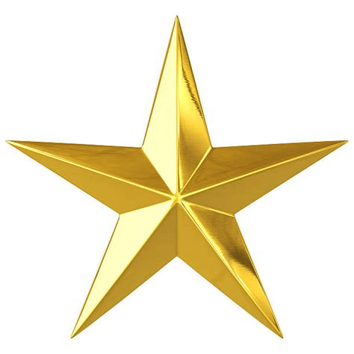

Slide 18
