Slide 1
Analyzing Customer Purchase Behavior
Women TechMaker Final Project
Paulette Rodriguez

Slide 2
Business Problem
Retail Dataset: This data set represents a series of customer transactions for a retail business across different product categories such as Beauty, Clothing, and Electronics.
As data analysts, we are tasked with identifying key trends in customer purchasing behavior that can help the company improve:
marketing strategies
optimize pricing
enhance customer targeting

Slide 3
Objective
Our objective for this project is to be able to explore patterns in customer purchases to understand and answer the following questions:
Which products or product categories generate the most revenue?
What are the purchasing patterns by gender and age group?
Are there any seasonal trends in purchasing behavior?
What is the average purchase value for different customer segments?
Can we predict potential future trends based on the available data?
With the use of R, we will import, clean, and visualize the data to help us uncover insights that can help the business make informed decisions.

Slide 4
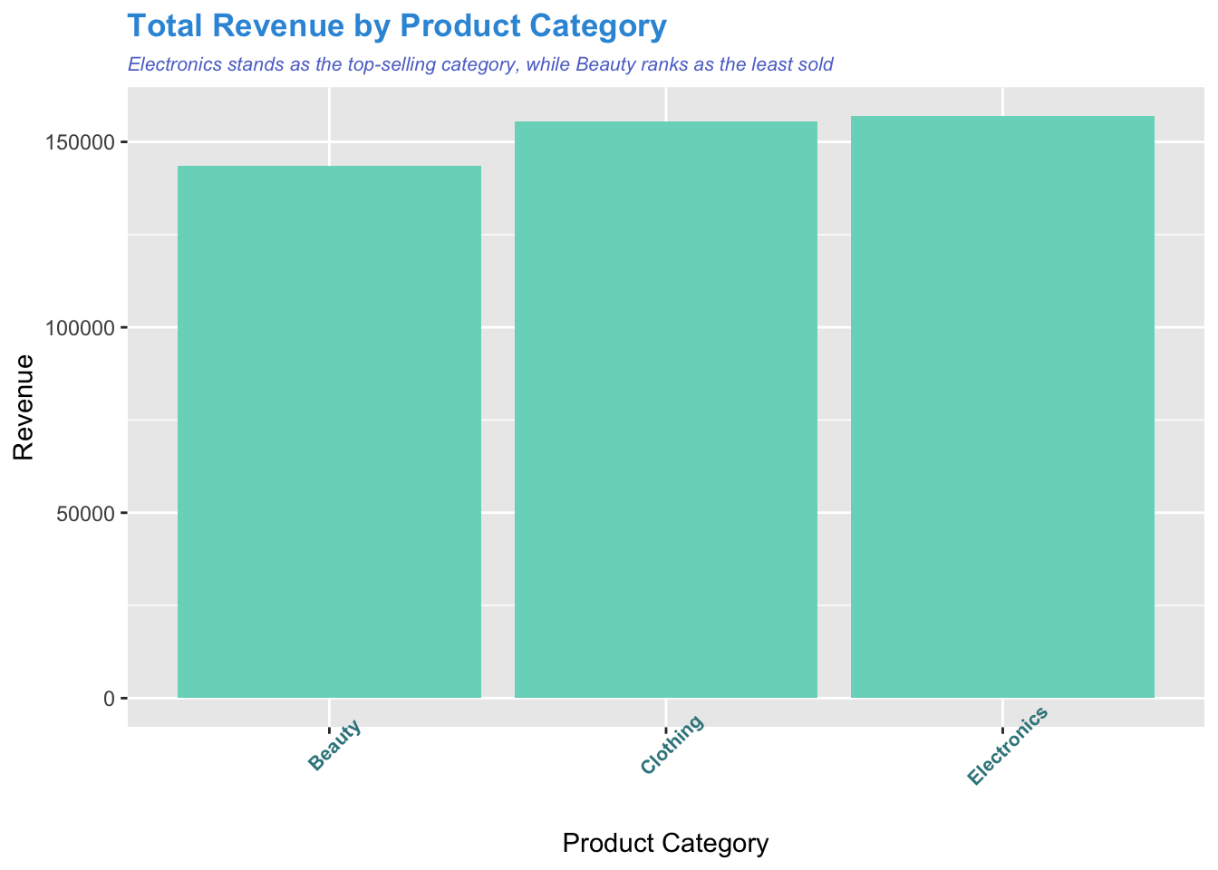
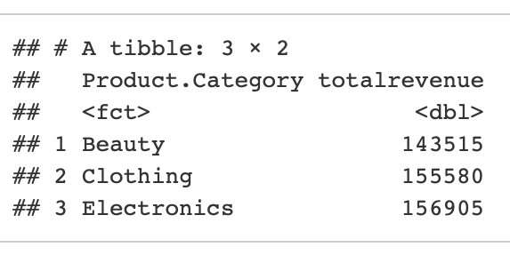
Most Generated Revenue by Product Category

Slide 5
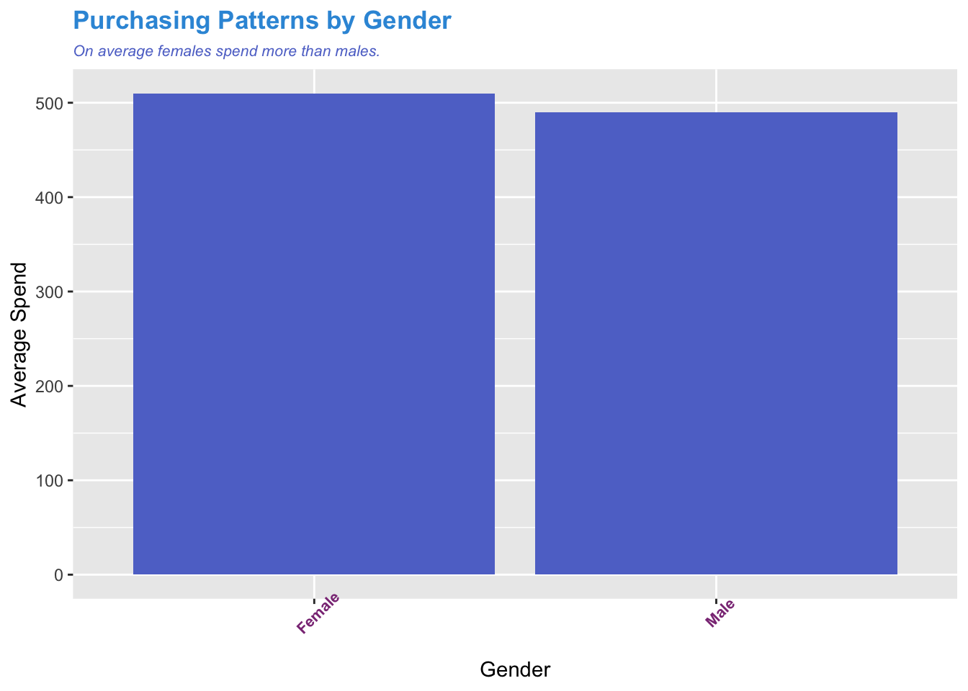
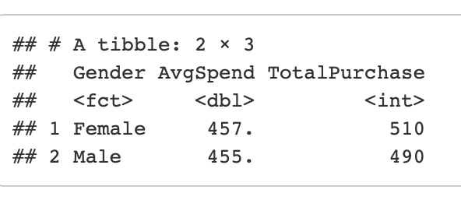
Purchasing & Spending Patterns by Gender Group

Slide 6
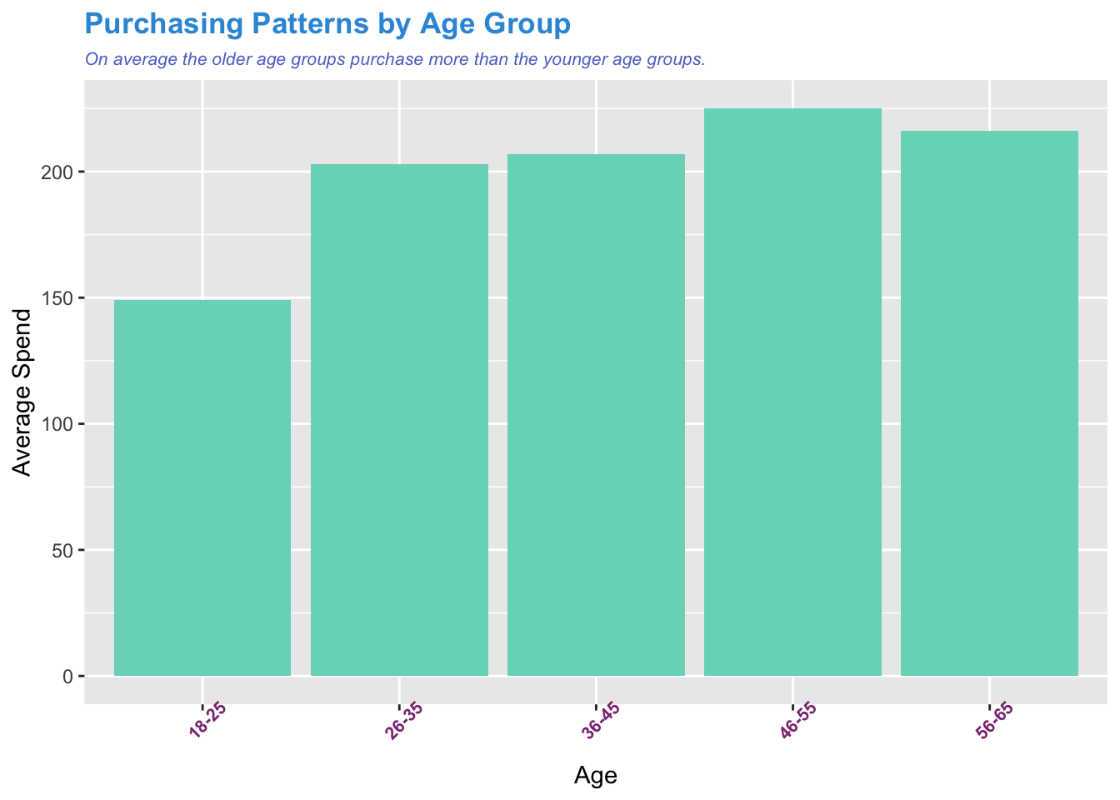
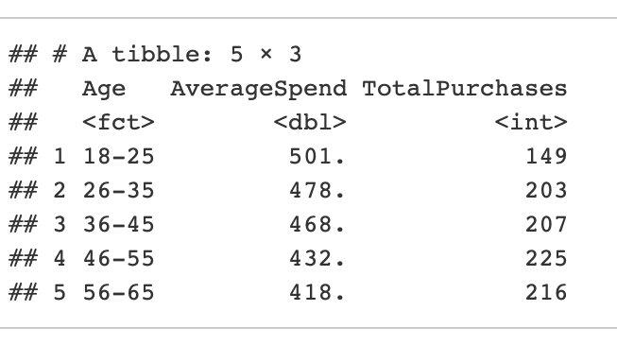
Purchasing & Spending Patterns by Age Group

Slide 7
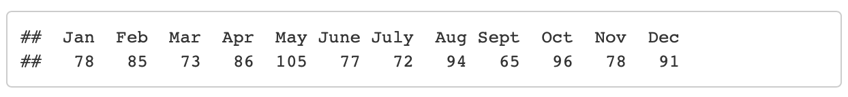
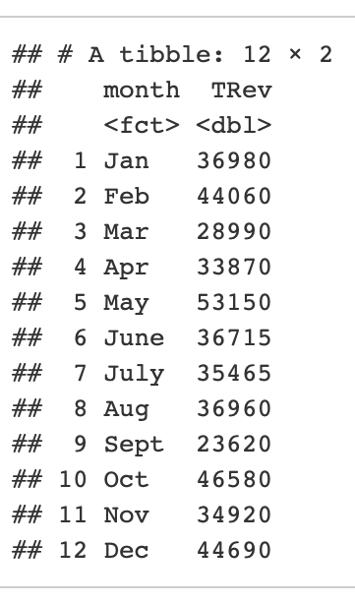
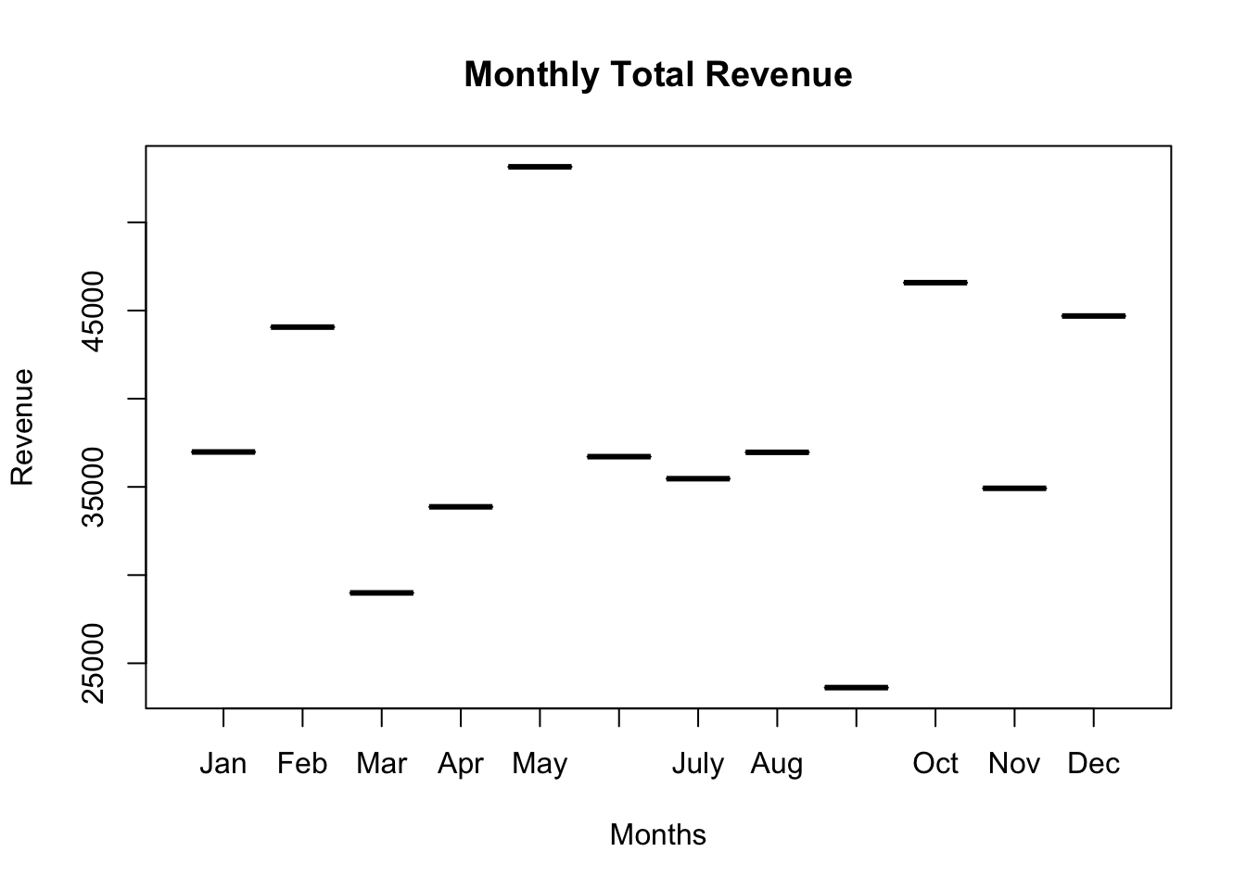
Seasonal Trends in Purchasing Behavior

Slide 8
Conclusion
Electronics generated the most revenue compared to the products Beauty and Clothing.
On average, females purchase and spend more than males.
The older customers purchase more than the younger customers, even though the younger age groups on average spend more.
The months of May, October, December, February, and January have the highest revenues.

Slide 9
Recommendations: Product Strategy
Prioritize Electronics
Continue to focus on and invest in the electronics product line, as it generate the most revenue.
Target Electronics to Older Customers
Older customers purchase more electronics, so tailor marketing and promotions to attract and retail this demographic.
Consider Electronics for Female Customers
Since females purchase and spend more overall, explore how to further target them with electronics products and promotions.

Slide 10
Recommendations: Customer Marketing
Target Female Customers
Develop targeted marketing campaigns and promotions specifically for female customers, highlighting the value and benefits of products.
Age Specific Strategies
While older customers purchase more, younger customers spend more on average, so consider creating promotions that appeal to both age groups.
Since older customers are more likely to purchase, emphasize the value and long-term benefits of your products to this demographic.
Since younger customers spend more on average, consider offering discounts, promotions, or loyalty programs to encourage repeat purchases.

Slide 11
Recommendations: Seasonal & Promotional Strategy
Optimize for Peak Months
Focus marketing and promotions during peak months (May, October, December, February, January) to capitalize on increased demand.
Leverage Holiday Seasons
Since December, February, and January are high-revenue months, plan promotions and marketing campaigns around these holidays.
Consider Early Bird Discounts
Offer early bird discounts or promotions for products that are expected to be in high demand during peak months.
Run Targeted Promotions
Tailor promotions to specific demographics and product categories based on the data, for example, offer electronics deals during peak months to attract older customers

