Slide 1
.NET Serverless Applications on AWS
Presentation & Demo for PADNUG
Kirk Davis & Paul Fryer, AWS Solution Architects
July 11, 2017

Slide 2
Overview of AWS

Slide 3
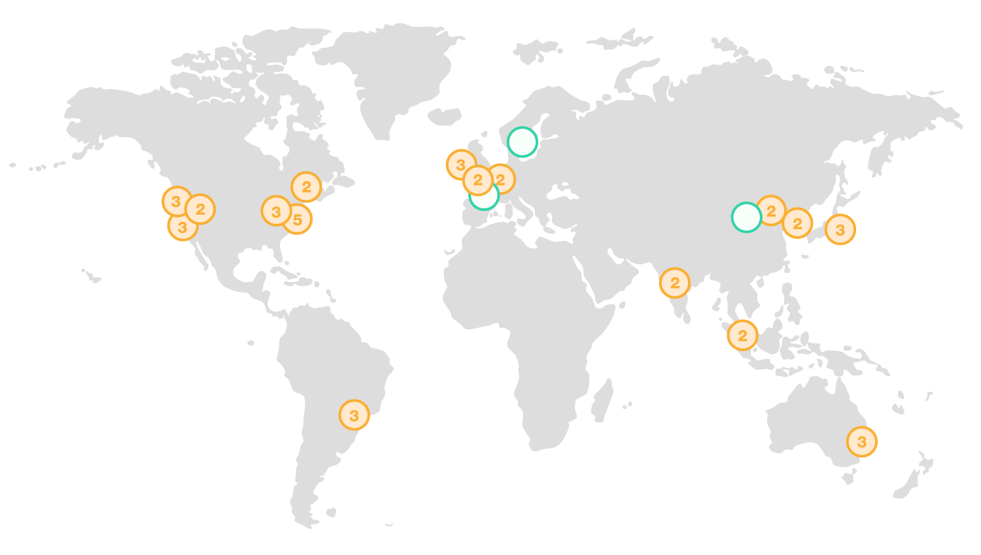
Global Infrastructure
Every day, AWS adds enough new server capacity to support Amazon.com when it was a $8.5 billion global enterprise.
Growing Footprint
16 Regions + 3 Upcoming
42 Availability Zones
74+ Edge Locations
Millions of Active Customers
190 countries
900+ Government Agencies
3,400+ Educational Institutions
1,000+ Financial Services Organizations
Notes:
At AWS, our footprint is global, spanning 5 continents and 16 regions, with highly redundant clusters of data centers in each region. This footprint is expanding continuously as we increase capacity, redundancy and add new locations to meet the needs of our customers around the world.

Slide 4


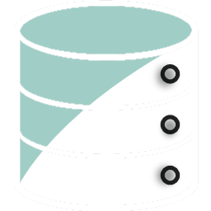
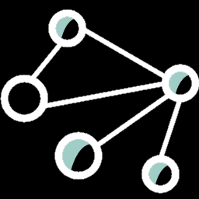
Core AWS Services
Compute: EC2, Lambda
Storage: S3, EBS, EFS
Database: RDS, DynamoDB, ElastiCache
Networking: VPC, Direct Connect, CloudFront
More: SQS, SNS, Athena, Redshift, Kinesis
Notes:
We have added so many services in the past few years, it’s very hard to give a true overview, but a lot of our services can be grouped into categories like Compute, Storage, Databases, Networking, Messaging, and so on.
This list is a few of the core services in each of the four key categories that most people start out using. EC2 stands for Elastic Compute Cloud, which is our service for launching and running virtual machines.
Lambda is our serverless compute platform, which I’ll talk about again in a couple minutes.
We have a range of database offerings, including our managed relational database service or RDS. With RDS, you can pick from popular engines like Microsoft SQL Server, Oracle, MySQL, and more, and then we manage the OS, patching, and backups. You don’t *have* to use RDS to run a database, you can launch an EC2 instance running SQL Server or some other database, if you really want to take care of all the admin stuff.
We also have a NoSQL database called DynamoDB, which can scale to hold as much data as you want, and as much throughput as you want, again, and there’s no infrastructure to manage, no OS to patch, no cluster to resize.
When you’re provisioning resources in AWS, you do it in a VPC, which stands for virtual private cloud. That’s essentially a private network, with it’s own private IP range, or CIDR block, subnets and route tables that you control completely.
CloudFront is our CDN, which is great for caching and delivering content to users around the globe, and which also has a web-application firewall integrated with it. It does caching, obviously, but also a lot of other advanced features.
We have other managed services, like SQS which is a managed queue, and SNS which is the simple notification service for doing pub-sub. There are more than 70 services, so please, go sign up for a free account and take a look if you haven’t yet.

Slide 5
EC2: Virtual Machines
Many instance types to choose from: CPU, GPU, RAM and storage options
AMI = Amazon Machine Image, a preconfigured OS (or OS + other) image, both Windows and Linux
Easily enable auto-scaling, managed load balancing, security, backups (snapshots), logging, monitoring
There is a free tier!
Notes:
EC2, or Elastic Compute Cloud, is our service for running virtual machines. We have preconfigured AMIs, or Amazon Machine Images that you can use to launch Linux or Windows Server instances, from the latest Windows Server 2016 back to Server 2003 if you’re feeling masochistic. We even have Windows Server instances in the free tier, so you start playing around for free.
We have a lot of different instance types, grouped into families, which are optimized for compute, memory, storage, I/O, or have dedicated GPUs. You can get an instance that has up to a couple TB of RAM, or even one with FPGA for extremely high-performance when running algorithms.
With EC2, you can set up scaling rules for your instances, so that the number of running instances increases or decreases to track demand – this is incredibly useful for running web applications. We have load balancing as a managed service, including a lot of advanced features like path-based routing, integration with our container management platform, ECS, and integration with our web-application firewall, or WAF.

Slide 6
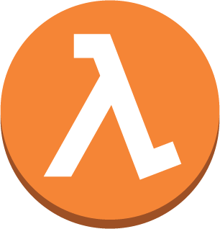

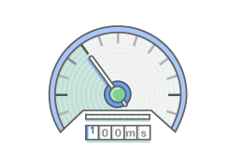
Lambda: Serverless Compute
Functions are the unit of deployment and scale
Write functions in C#, Node.js, Java, Python
Scales per request—users cannot over or under-provision
Never pay for idle
No OS to manage, no VMs, no containers to orchestrate
Notes:
Lambda is a service where you essentially upload a function that gets invoked by any of a variety of triggers, including timers for scheduled invocations. And while we say it’s a function, it can be a set of functions that get called by the entry point, or handler function, that gets called when the Lambda is invoked.
You can use C#, Node.js, Java or Python.
We scale the underlying resources to run your Lambda functions, so you don’t have to worry about spinning up servers, or even launching containers, or the cleanup afterwards.
We’ve had many customers lower the costs of some of their intermittent apps dramatically by moving to Lambda. Instead of paying for a small EC2 instance to be running around the clock to handle some function that needs to run at unpredictable intervals and scale, they can use Lambda functions that run on demand, and just pay for the time the function is running.
And since different Lambdas can scale independently of each other, and be deployed independently, Lambda is sort of the ultimate extension of a micro-services architecture, with each function being a micro-service.

Slide 7
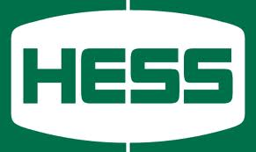

.NET / Windows Customer Examples
Moved 300 servers, including .NET applications, Windows Server & SQL Server, plus other infrastructure to AWS in 6 months.
Migrated their complete datacenter footprint to AWS in six months, taking advantage of the automation and services available with AWS to speed up deployments. They’re running on Windows, IIS and .NET (including ASP.NET)
Notes:
Hess is an oil and gas company that decided to sell off their downstream businesses including retail, energy marketing and terminals. So they had to deliver to the buyer the complete IT infrastructure that supported all that – so they moved some 300 servers, including lots of Windows servers, Microsoft SQL Server, Oracle databases, storage and all the other bits into AWS in six months flat, and then handed it all off to the buyer.
Infospace is a provider of metasearch and monetization solutions that was running in two colo facilities, on a Microsoft stack. Their entire search application is in .NET. Their colo contracts were coming up for renewal, and after looking at the costs of the status quo, they decided to move everything into AWS, and to extend their apps to take advantage of AWS services like CloudFront – our content-delivery network – and Route 53, our DNS management service. What they found was that they were able to speed up lot of aspects of their development lifecycle – it used to take a couple weeks to build, configure and deploy a new server into their colocation facility. In AWS, they use a pre-configured Windows AMI, or machine image, and Chef to automatically install and configure .NET, IIS and their app, in 20 minutes.

Slide 8
AWS Tools for .NET Devs

Slide 9
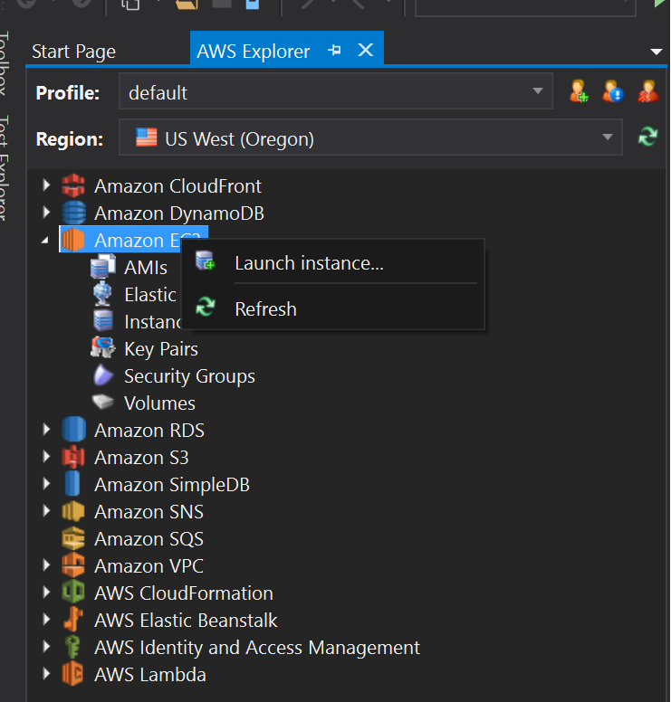
AWS Toolkit for Visual Studio
See your AWS resources
Launch VMs, databases, create DynamoDB tables, more
ASP.NET and Lambda deployment wizards
Scan DynamoDB tables
Test your Lambda functions
Manage CloudFormation stacks
More!
Notes:
The AWS Toolkit for Visual Studio is a plugin for the Visual Studio IDE that makes it easier for developers to develop, debug, and deploy .NET applications that use Amazon Web Services, or that run on AWS.
You can launch virtual machines, both Windows and Linux, launch managed databases, create NoSQL database tables on DynamoDB, query and scan those tables, create, deploy and test Lambda functions, and more.
Another great feature is that you can deploy your ASP.NET web applications using our Elastic Beanstalk service using the plugin’s deployment wizard. I’ll talk a little more about Elastic Beanstalk in a moment.

Slide 10
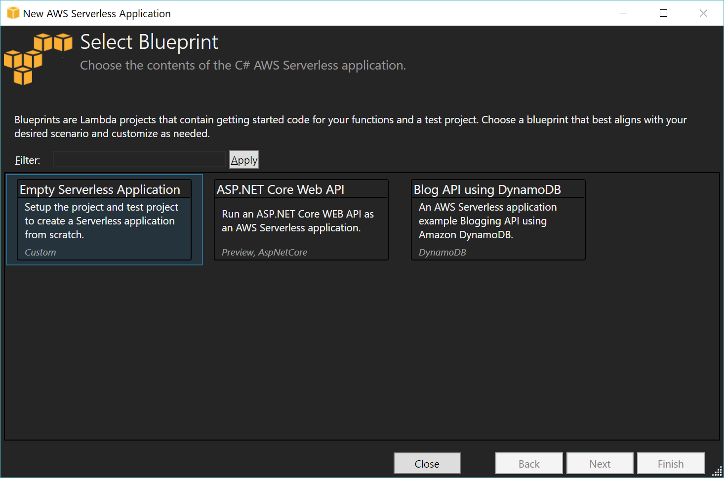
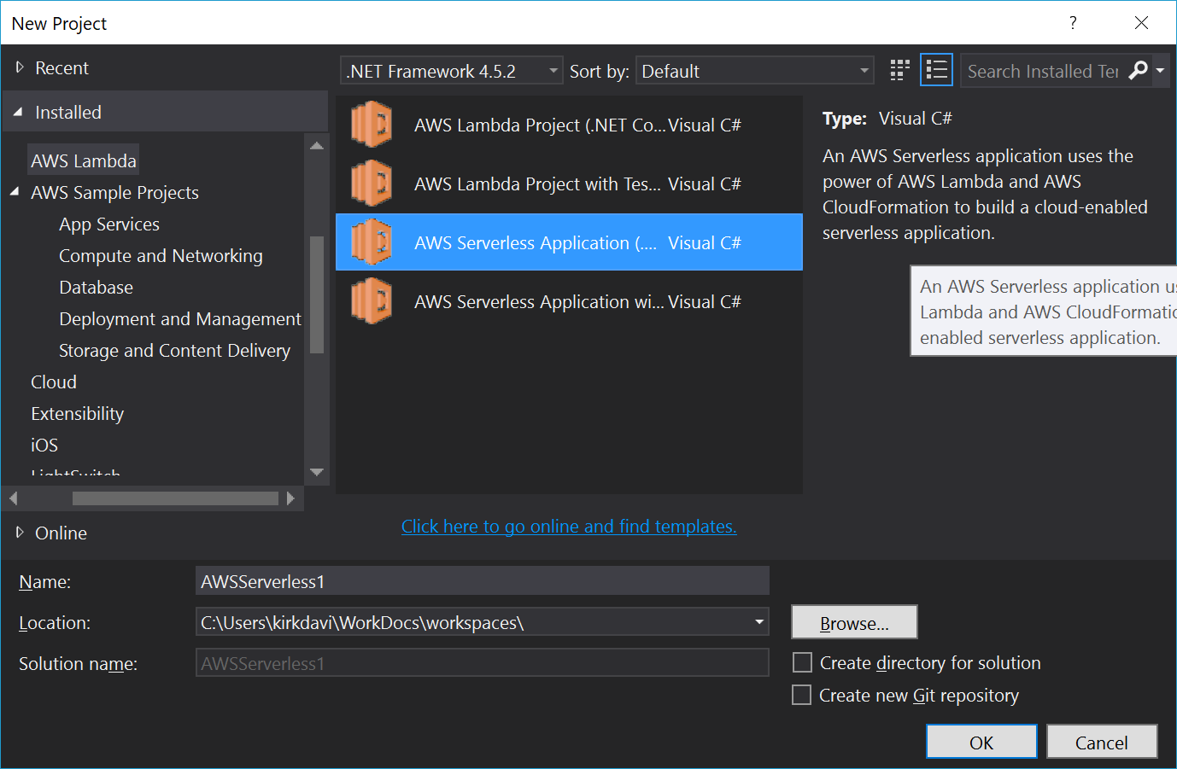
AWS Toolkit for Visual Studio
Lots of sample project templates in the New Project wizard.
Notes:
ONE ANIMATION
The Toolkit also installs a number of new project templates to get you up and running quickly. There are projects for Lambda, for ASP.NET, console apps, and more. Much like any other template, they come with some boilerplate code, and the references you’ll need, and so on.
ADVANCE TO SHOW
If you pick the serverless .NET project type, there’s currently three different templates you can pick from, an empty one, an ASP.NET Core Web API project, and a sample Blog API project that uses DynamoDB.
The Toolkit is available for Visual Studio 2010 thru 2017.

Slide 11
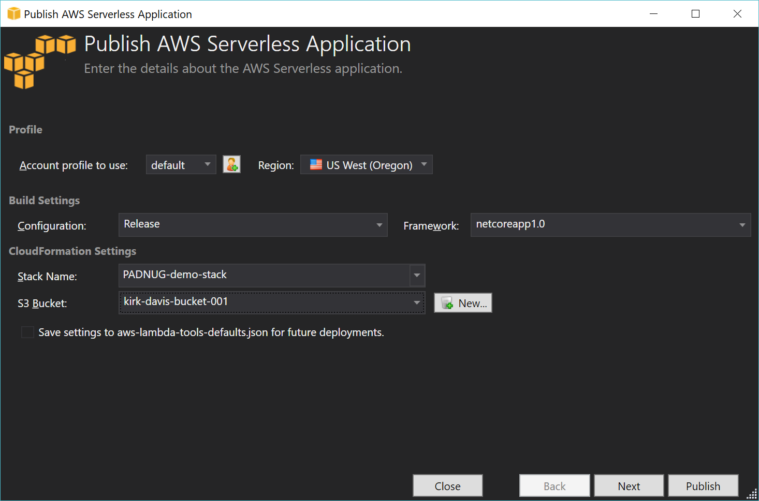
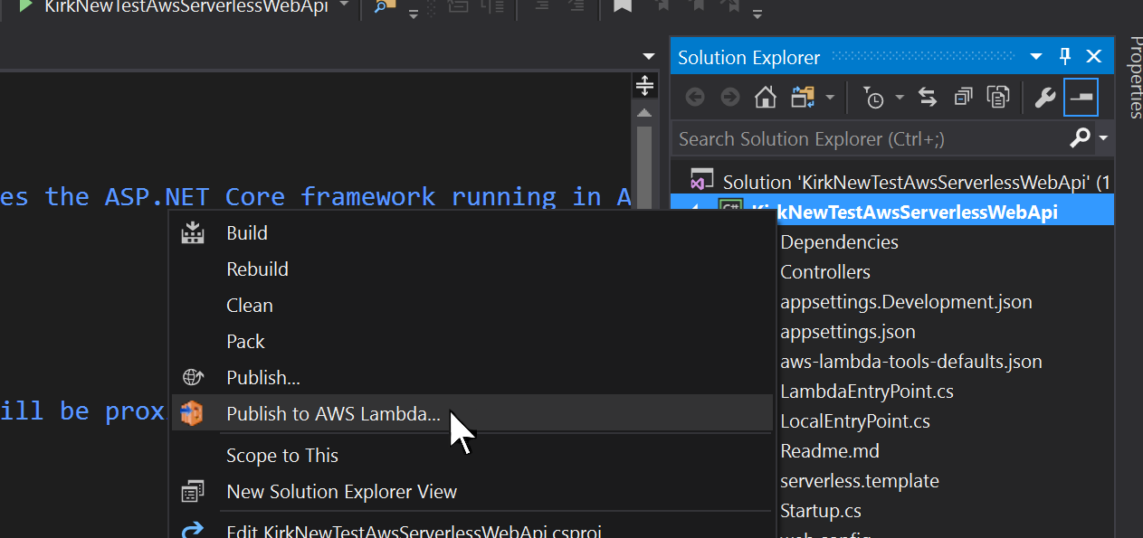
AWS Toolkit for Visual Studio
Notes:
ONE ANIMATION
To deploy your serverless .NET app, you can just right-click the project and choose “Deploy to Lambda” to pop open the deployment wizard, which looks like this. ADVANCE TO SHOW WIZARD This is especially useful for doing dev and test deployments where you want to iterate rapidly.
You can also automate deployments using Git and a CICD pipeline, and we have services like CodePipeline, CodeDeploy and CodeBuild that you can use for that, or you can use Bamboo or TeamCity, or other tools.

Slide 12
AWS SDK for .NET
.NET assemblies to make it easier to program against the AWS APIs.
.NET Framework 3.5 and later
.NET Core
Install the packages with NuGet (recommended)
Available as .MSI installer (includes Toolkit)
In NuGet, look for packages named ASWSDK.
*
Notes:
The AWS SDK is the collection of .NET libraries we publish to make it easier to build .NET applications that use AWS services. That includes core services, like EC2 and S3, and services we’ve just launched recently like AWS Athena and X-Ray.
There are also some other cool libraries, like the AWS.SessionProvider package which makes it trivially easy to use DynamoDB for your ASP.NET Website’s session state. You might want to do that to enable you to scale your web-server tier out and in without having to use sticky sessions, or setting up a separate state server.

Slide 13
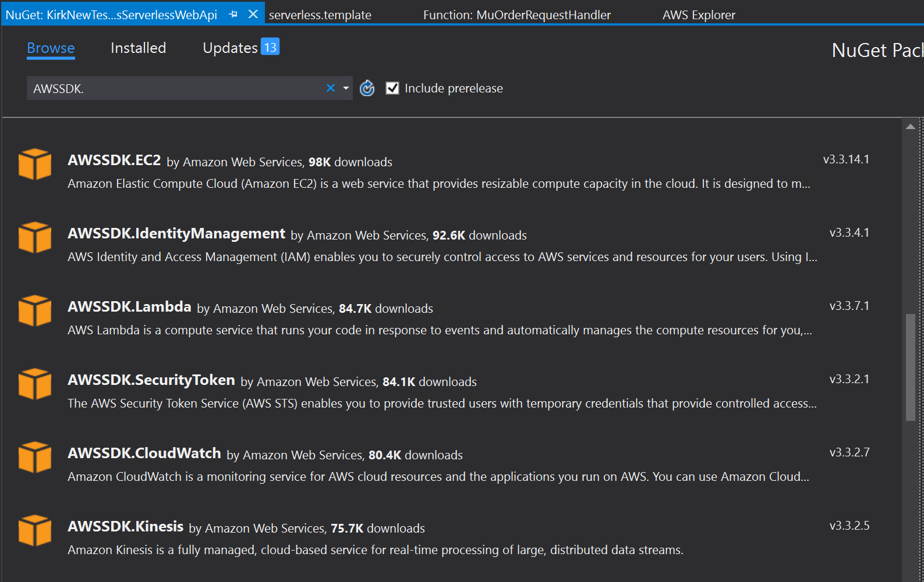
AWS SDK for .NET

Slide 14

Elastic Beanstalk
Easy-to-use service for deploying & scaling web applications
Supports multiple pre-configured stacks including IIS + ASP.NET
Supports inclusion of an RDS database, including MS SQL Server
Automatically handles the deployment and scaling
You retain full control of the resources
Deployment options include
Green/Blue deployments via URL swapping
Rolling deployments
Application versioning and rollbacks
Notes:
Elastic Beanstalk is a service for automatically provisioning and deploying a pre-configured stack for running and scaling applications on Amazon EC2. So it’s not for serverless apps, and so we’re not going to spend much time talking about it today, but for the many of you who are no doubt building ASP.NET MVC or even ye olde web forms, beanstalk takes a lot of the tedious work out of getting from code to a running a website that scales up and down.
You can even include a SQL Server database which will get deployed and torn-down with the website, which is useful for dev and QA deployments.

Slide 15

CodeStar
Helps dev teams collaborate to build & deploy software
Easily create a project using a template, which provisions all the services needed for the project
Dashboard tracks commits, build results, deployments
Auto-configuration of a continuous delivery pipeline
Integration with JIRA
Notes:
CodeStar is a new service that essentially wraps up a lot of different services and components into a template, which helps get a new project off the ground quickly.
When you create a new project, CodeStar will set up your source code repository, configure CodeBuild to build and test your code, CodeDeploy to handle the deployments, and CloudWatch for monitoring.
You can choose Visual Studio for your project, and then connect Team Explorer to your CodeStar project’s CodeCommit git repo.

Slide 16
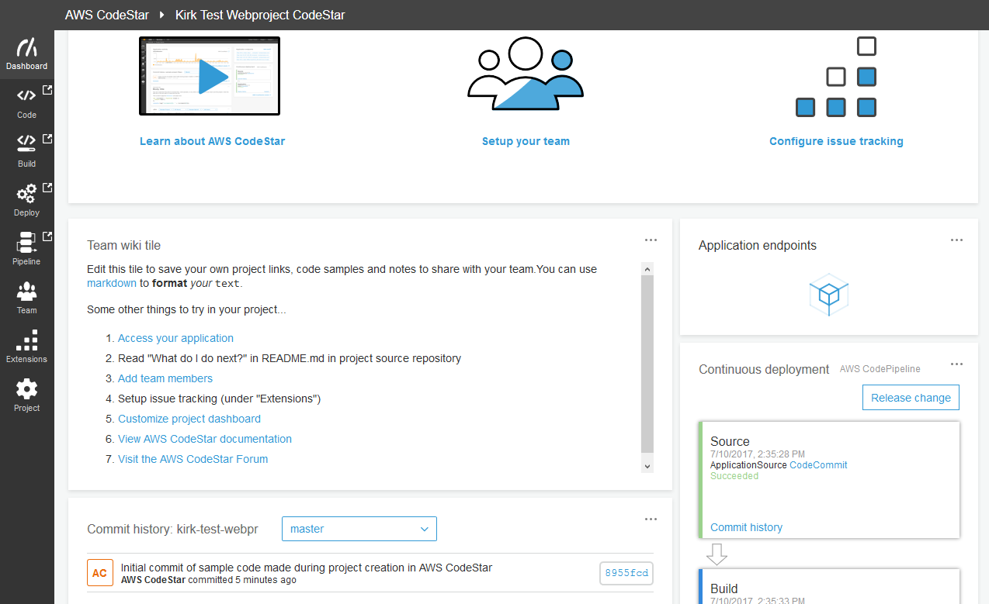
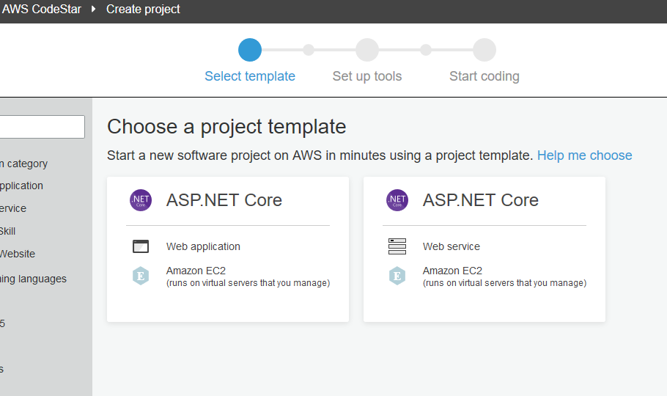
CodeStar Project Templates

Slide 17


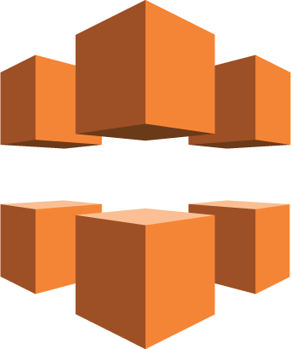

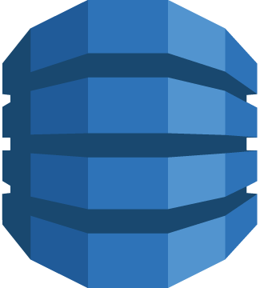

Demo
Browser
CloudWatch
API Gateway
CloudFront
stream
Price Query (C#)
S3 Bucket HTML+JS+Images
DynamoDB
Sync Function (C#)
CloudWatch Event (timer)
us-east-1
us-east-2
us-west-1
us-west-2
Notes:
ONE ANIMATION

