Slide 1
Sizing, Not Signaling
An option-implied cross-asset allocation rule
Pavlos Giannakis
FINM 33150 Quantitative Trading Strategies · Spring 2026
Due: May 25, 2026 · 11:59 PM CST
github.com/paulgiann/finm33150-final-project
Notes:
Hi, I'm Pavlos. The project is called Sizing, Not Signaling. It's an option-implied cross-asset allocation rule using exchange-traded funds, or ETFs. The repository link is on the slide if you want to follow along.

Slide 2
The question
What does this project actually test?
Can option-implied volatility be useful for sizing risk
across a multi-asset portfolio?
Headline preview
USD 1.00M -> USD 1.48M
Max drawdown -14.5% vs benchmark -45.2%
Sharpe IS +0.47 -> OOS +0.28
Lower upside, smoother path.
Earlier demo project tested whether option-implied
term-structure kinks carried a directional signal.
They did in 2008-2017; they did not in 2018-2024.
Here the data pipeline is reused, but the use case shifts:
implied vol is used to size risk, not to predict direction.
Sizing, Not Signaling · Pavlos Giannakis · FINM 33150 (Spring 2026)
2 / 12
Notes:
The question for this project is simple. Can option-implied volatility help me size risk across a multi-asset portfolio? In my demo project, I tested whether option-implied signals could predict direction. They worked in-sample, but failed out-of-sample. Here I use the same data, but the goal is different. Implied volatility decides how big each position should be, not which way prices will go. The preview is on the right. The strategy turns one million dollars into 1.48 million with a worst drawdown of -14.5%. The equal-weight benchmark on the same eight funds ends higher at 2.64 million, but loses about 45% at its worst.

Slide 3
The universe
Eight liquid US-listed ETFs, selection frozen at end-2017
Ticker | Asset class | Issuer | AUM (2017-12-31)
SPY | US large-cap equity | SPDR S&P 500 Trust | USD 280B
IWM | US small-cap equity | iShares Russell 2000 | USD 45B
EFA | Developed ex-US equity | iShares MSCI EAFE | USD 80B
EEM | Emerging-markets equity | iShares MSCI Emerging Markets | USD 35B
XLK | US technology sector | Select Sector SPDR XLK | USD 19B
XLF | US financials sector | Select Sector SPDR XLF | USD 31B
GLD | Gold | SPDR Gold Trust | USD 34B
TLT | US 20Y+ Treasuries | iShares 20+ Year Treasury Bond | USD 8B
Selection rule: largest-AUM US-listed ETF per slot as of 2017-12-31. Frozen before any OOS data is touched, so the selection cannot exploit later performance.
Sizing, Not Signaling · Pavlos Giannakis · FINM 33150 (Spring 2026)
3 / 12
Notes:
The universe is eight liquid US-listed exchange-traded funds. They cover large-cap equity through SPY — the S&P 500 fund. Small caps through IWM — the iShares Russell 2000. Developed international markets through EFA — the iShares MSCI EAFE fund. Emerging markets through EEM — the iShares MSCI Emerging Markets fund. The technology sector through XLK. The financials sector through XLF. Gold through GLD — the SPDR Gold Trust. And long-duration Treasuries through TLT — the iShares 20-Plus Year Treasury Bond fund. I picked the single largest fund by assets under management for each slot, fixed as of end-2017. The selection was frozen before I looked at any out-of-sample data, so I didn't pick winners with hindsight.

Slide 4
Mechanic 1: implied-volatility sizing
Each sleeve scaled inversely to its 30-day ATM IV
wi,t = vtgt · si,t · gt / σi,tIV · N
vtgt = 10% per leg · gt = regime gross multiplier · N = 8 legs
σIV = 30-day ATM implied volatility (WRDS OptionMetrics)
Intuition
Constraints
High IV -> smaller position
Low IV -> larger position
Each leg contributes a similar dollar risk, not equal dollar capital.
Forward-looking estimate: the option market's price for protection right now, not realised vol from the past.
Per-leg vol target: 10%
Gross-exposure ceiling: 3.5× (realised peak ~1.31×)
Weekly Friday rebalance, 4 bps round-trip cost
Sizing, Not Signaling · Pavlos Giannakis · FINM 33150 (Spring 2026)
4 / 12
Notes:
The first mechanic is position sizing. The formula on the slide says each leg's weight is proportional to a volatility target and a signal, scaled by a regime multiplier, divided by that asset's implied volatility. In plain words: when the option market prices high risk on an asset, I take a smaller position. When it prices low risk, I take a larger position. Every leg ends up contributing about the same dollar risk — not the same dollar capital. This is standard risk parity, but I use implied volatility instead of historical volatility, because implied volatility is forward-looking. It tells me what the market is pricing for risk right now.

Slide 5
Mechanic 2: macro stress gate
VIX + Chicago Fed NFCI composite into four discrete regimes
Calm
Normal
Stress
Crisis
1.5×
1.0×
0.5×
0×
24% of days
62% of days
13% of days
1.2% of days
Both VIX and NFCI in low percentiles
Default operating regime
Composite above the 85th percentile
Composite above the 97th percentile
How it scales the book. Position-sizing rule from slide 4 is multiplied by gt. Calm windows let the book lean into the trade; stress halves gross; crisis shuts it down. Net effect: the strategy was effectively flat through the worst of 2008-2009 and 2020.
Sizing, Not Signaling · Pavlos Giannakis · FINM 33150 (Spring 2026)
5 / 12
Notes:
The second mechanic is a macro stress gate. I build a composite stress signal from two inputs. VIX — the Chicago Board Options Exchange equity volatility index. And the Chicago Federal Reserve's National Financial Conditions Index, often shortened to NFCI. I use that composite to label each day as one of four regimes. Calm days run at 1.5 times gross exposure. Normal days, which are about 62% of the sample, run at 1.0. Stress days at half. Crisis days, the book is off. So the gate scales the total book. The first mechanic still decides how that total is distributed across the eight funds. The practical effect is the strategy was effectively flat through 2008-09 and through March 2020. That's where most of the drawdown reduction comes from.

Slide 6
Discipline: frozen parameters
All free choices tuned on 2008-2017, then frozen before 2018 is touched
In-sample · 2008-2017
Out-of-sample · 2018-2024
Design window. Parameters tuned here.
Held out entirely. No re-tuning after end-2017.
Sharpe +0.47
Total return +34.1%
Max drawdown -11.3%
Annualised return +3.17%
Sharpe +0.28
Total return +9.8%
Max drawdown -14.5%
Annualised return +1.59%
Performance decays from IS to OOS but stays positive. The held-out result is a test of the fixed rule, not a retuned version of it. iid-bootstrap intervals overlap (next slide), so the decline is moderate, not a complete collapse.
Sizing, Not Signaling · Pavlos Giannakis · FINM 33150 (Spring 2026)
6 / 12
Notes:
Discipline is the whole point of this slide. Every parameter — the volatility target, the gross exposure cap, the regime thresholds, the regime multipliers, the drawdown kill-switch — was tuned only on the 2008 to 2017 window. Then I saved them to a frozen specification file at end-2017 and never changed them again. So the 2018 to 2024 results are a real out-of-sample test of a fixed rule. The numbers: in-sample Sharpe ratio of 0.47 with an 11% drawdown. Out-of-sample Sharpe drops to 0.28 with a 14.5% drawdown. Performance decays — that's expected — but it stays positive.

Slide 7
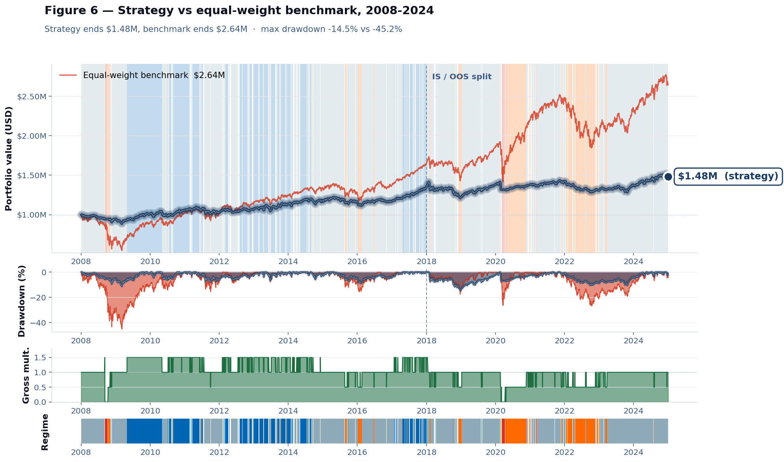
Headline result
USD 1.00M -> USD 1.48M, max drawdown -14.5%, full-sample Sharpe +0.40
TERMINAL WEALTH
USD 1.48M
benchmark USD 2.64M
MAX DRAWDOWN
-14.5%
benchmark -45.2%
FULL-SAMPLE SHARPE
+0.40
benchmark +0.42
ANNUALISED VOL
6.4%
benchmark 16.9%
The strategy trails the benchmark on terminal wealth by ~USD 1.16M. In exchange, the worst peak-to-trough loss is roughly one-third of the benchmark's.
Sizing, Not Signaling · Pavlos Giannakis · FINM 33150 (Spring 2026)
7 / 12
Notes:
Headline. One million dollars of starting capital grows to 1.48 million. The benchmark — a daily-rebalanced equal-weight portfolio of the same eight funds — ends at 2.64 million. So the strategy underperforms by about 1.16 million in terminal wealth. The trade-off is in the drawdown column. My worst drawdown is -14.5%. The benchmark's is -45%. About a third of the depth. Annualised volatility is 6.4% versus 16.9% — a much smoother ride. Sharpe ratios are basically tied at 0.40 and 0.42. So I'm not winning on returns. I'm giving up returns in exchange for risk control.

Slide 8
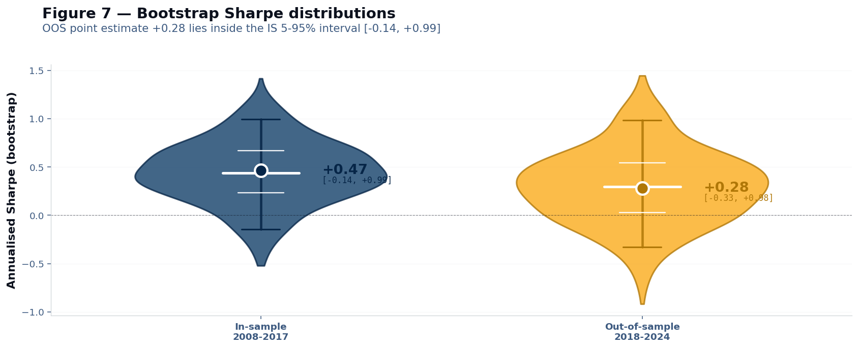
Held-out validation
IS Sharpe +0.47 -> OOS Sharpe +0.28; bootstrap intervals overlap
Bootstrap test
IS 5-95% CI:
[-0.14, +0.99]
OOS 5-95% CI:
[-0.33, +0.98]
Each point Sharpe sits inside the other window's interval — consistent with moderate decay, not a complete OOS collapse.
Why this matters. Parameters were frozen before 2018. The OOS Sharpe is the fixed rule's performance, not a retuned version. Overlap doesn't prove no overfitting, but it rules out a sharp collapse.
Sizing, Not Signaling · Pavlos Giannakis · FINM 33150 (Spring 2026)
8 / 12
Notes:
This is the held-out validation. The point estimates are 0.47 in-sample and 0.28 out-of-sample. The violin shapes show what happens if I resample the daily returns with replacement and recompute the Sharpe ratio a thousand times. They give me a confidence interval around each estimate. The 5 to 95 percent intervals overlap. In-sample runs roughly from minus 0.14 to plus 0.99. Out-of-sample runs from minus 0.33 to plus 0.98. Each point estimate sits inside the other window's interval. That doesn't prove the strategy isn't overfit, but it rules out a sharp collapse. The decay is moderate, not 'the strategy stopped working.'

Slide 9
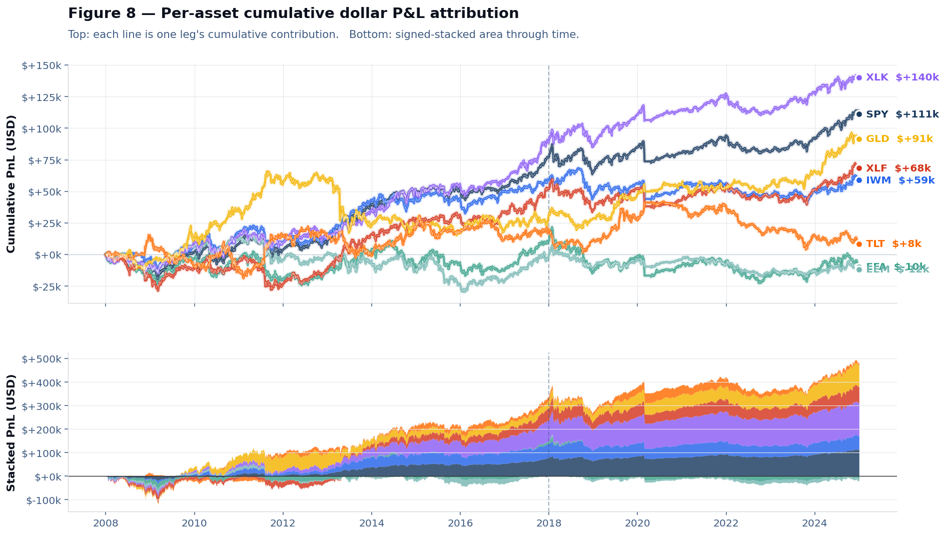
Where the returns came from
Per-asset cumulative P&L on a USD 1M book
Top contributors
XLK +140k
SPY +111k
GLD +91k
XLF +68k
IWM +59k
TLT +8k
EFA -10k
EEM -12k
Returns concentrate in US equity sleeves and gold. International equity (EFA, EEM) contributed slightly negative on a risk-sized basis. Gold's near-zero correlation with the equity legs is what justifies its place in the book.
Sizing, Not Signaling · Pavlos Giannakis · FINM 33150 (Spring 2026)
9 / 12
Notes:
Per-asset cumulative dollar P&L on a one-million-dollar book. The picture is concentrated. The tech fund, XLK, contributed plus 140 thousand dollars. SPY — the S&P 500 — contributed 111 thousand. GLD, the gold fund, added 91 thousand. That's notable, because gold's correlation with the equity legs is near zero, which is exactly the diversification value you want. The financials sector, XLF, and small caps, IWM, added the next tier — about 68 and 59 thousand. The international equity funds — EFA for developed markets and EEM for emerging markets — contributed slightly negative on a risk-sized basis. TLT, the long-duration Treasury fund, added a small positive. So the returns came from US equity and gold. International exposures didn't pay over this period.

Slide 10
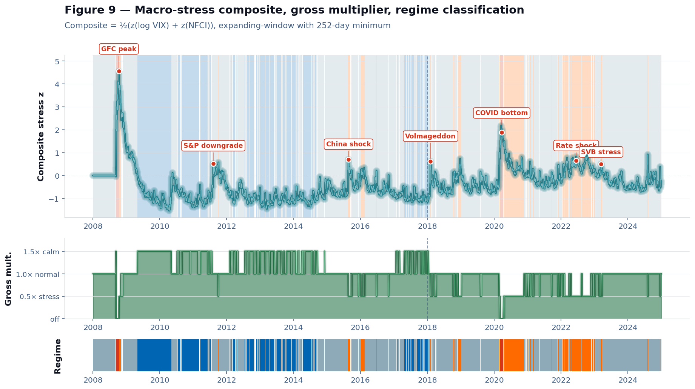
Regime behaviour
The gate effectively flattens the book through 2008-09 and 2020
Within-regime mu
Calm +8.1 bps/d
Normal +0.4 bps/d
Stress -8.6 bps/d
Crisis -4.0 bps/d
Calm n = 1,026 days
Crisis n = 52 days
Stress and crisis days do still lose money, but they lose half or zero of what an un-gated 1.0× book would lose. The gate's value is shrinking exposure, not turning negative into positive.
Sizing, Not Signaling · Pavlos Giannakis · FINM 33150 (Spring 2026)
10 / 12
Notes:
The top panel is the composite stress index with the macro events labelled. The global financial crisis peak in 2008. The US sovereign credit downgrade in 2011. The China growth shock in 2015. The February 2018 volatility spike known as Volmageddon. The COVID crash in March 2020. The 2022 Federal Reserve rate-hike cycle. And the Silicon Valley Bank failure in March 2023. The middle panel is the gross multiplier through time. You can see it going to zero through the worst of 2008-09 and through March 2020. On the right are the average daily returns by regime. Calm days average plus 8 basis points — about 8 hundredths of a percent. Normal days are roughly flat. Stress days lose 9 basis points. Crisis days lose 4. So the gate doesn't turn losing regimes into winners. It shrinks the position in regimes where the book would otherwise lose more.

Slide 11
What this project shows
Option data was more useful as a risk input than as a directional signal
1
2
3
Sizing beat signaling
Smoother path, lower upside
The gate did its job
The earlier demo used IV term-structure kinks as a directional signal — it failed out-of-sample. Repurposing the same data as a risk-sizing input produced a held-out Sharpe that decayed but stayed positive.
The strategy ends at USD 1.48M vs USD 2.64M for the equal-weight benchmark. In exchange, max drawdown is -14.5% vs about -45%. Useful for a drawdown-sensitive allocator, not for terminal-wealth maximisers.
The regime gate cut gross exposure in stress and shut it to zero in crisis. The book was effectively flat through the worst of 2008-09 and 2020. Most of the drawdown reduction is exposure scaling, not stock selection.
Sizing, Not Signaling · Pavlos Giannakis · FINM 33150 (Spring 2026)
11 / 12
Notes:
Three takeaways. First, sizing beat signaling. The same option data that failed as a directional predictor in my demo worked as a risk-sizing input here. Out-of-sample Sharpe decayed but stayed positive. Second, smoother path, not higher returns. The strategy ends at 1.48 million versus 2.64 for the benchmark. But the drawdown is a third of the size, and the volatility is roughly a third of the size. Useful for an allocator that cares about path. Third, the gate did its job. Most of the drawdown reduction comes from scaling exposure in stress, not from picking better assets.

Slide 12
Limitations & references
Limitations
Readings
ETF universe is fixed at end-2017 and not refreshed.
Weekly rebalance is one design point; daily or monthly cadences would change turnover and costs.
Four discrete regime buckets — smoother exposure functions are a natural extension.
Crisis bucket has only 52 observations; per-regime statistics there are descriptive, not estimated.
Harvey & Liu (2015)
Backtesting; multiple-testing concerns in strategy evaluation.
Johnson, Naik, Page, Pedersen & Sapra (PIMCO, 2013)
The Stock-Bond Correlation: instability of cross-asset correlations across regimes.
Thank you.
github.com/paulgiann/finm33150-final-project
Notes:
Limitations. The universe is fixed at end-2017 and not refreshed. Weekly rebalance is a design choice. Four discrete regime buckets is simple — a smoother exposure function would be a natural extension. The crisis bucket has only 52 observations, so those statistics are descriptive rather than properly estimated. On readings: I drew on Harvey and Liu for backtesting discipline and multiple-testing concerns, and on the Pacific Investment Management Company paper from 2013 for the instability of cross-asset correlations across regimes. Thank you — happy to take questions.

