Slide 1
AI-Based Badminton Stroke Classification
Paul George Karippaparambil | Student ID: 8031408E | ITI123

Slide 2
The Problem
— Recreational badminton players lack affordable coaching
— Professional coaching is expensive and inaccessible
— Goal: classify 5 shot types from video automatically
— Clear, Drive, Drop, Lift, Smash
— Framed as a video classification task (spatial + temporal)

Slide 3
Dataset: ShuttleSet
— 22,302 video clips from professional tournaments
— Source: Wang et al. 2023 (arXiv:2306.04948)
— 2-3 second clips per shot, 5 classes
— Train: 15,611 | Val: 2,208 | Test: 4,483
— Stratified 70/10/20 split preserving class ratios

Slide 4
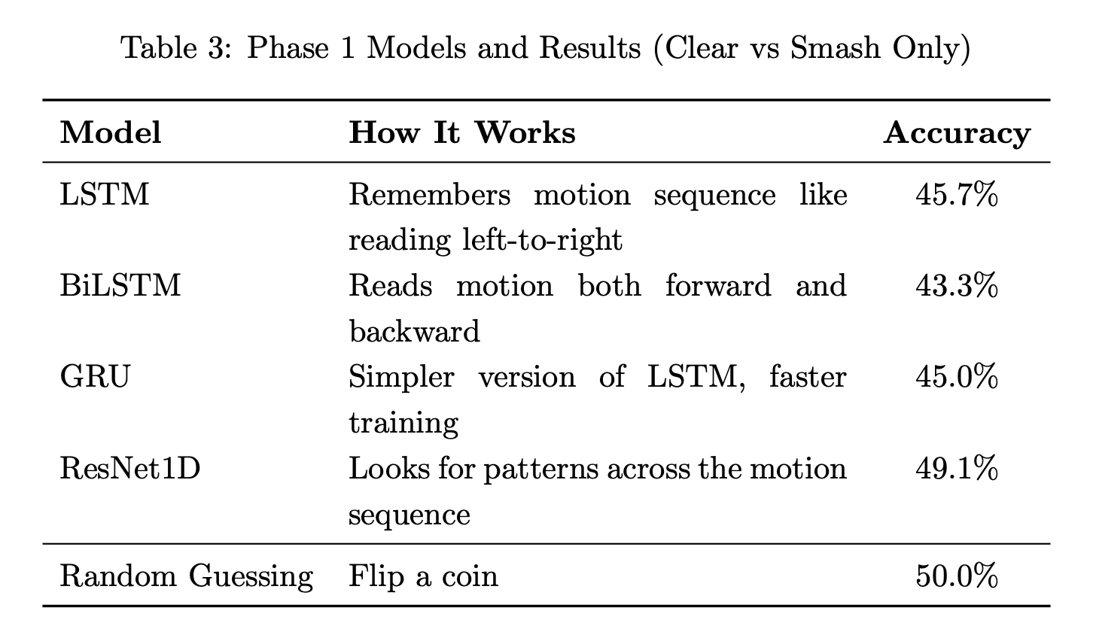
Phase 1: Pose-only approach achieved ~50% accuracy — equivalent to random guessing.
— Wrist angle difference between Clear and Smash: only 1.1 degrees

Slide 5
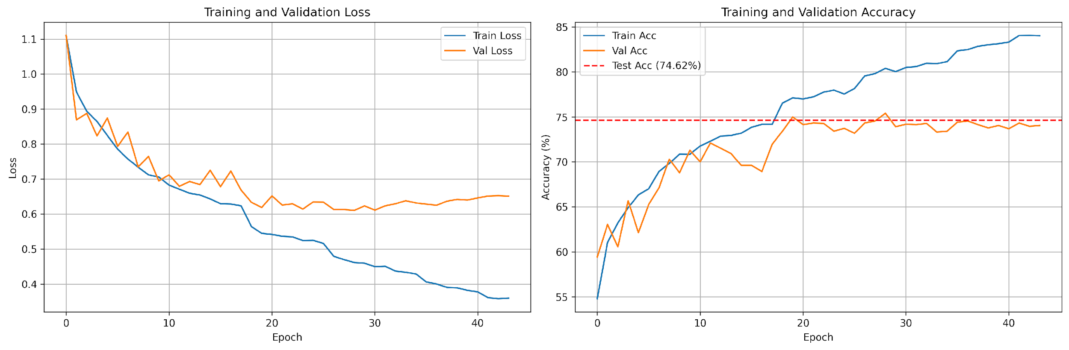
Phase 2: Video-based CNN + LSTM achieved 75.3% — a 51% relative improvement.
— Visual appearance captures what skeletal pose cannot

Slide 6
01
Model Architecture & Design Decisions

Slide 7
Why CNN + RNN?
Video classification requires solving two problems simultaneously. The CNN (ResNet18) extracts spatial features from each frame — racket angle, body posture, court position. The RNN (BiLSTM) learns temporal patterns across 16 sequential frames — the motion dynamics of approach, contact, and follow-through. Neither alone is sufficient. CNN misses motion; RNN cannot process raw pixels. Combined, they form a proven architecture for video action recognition.

Slide 8
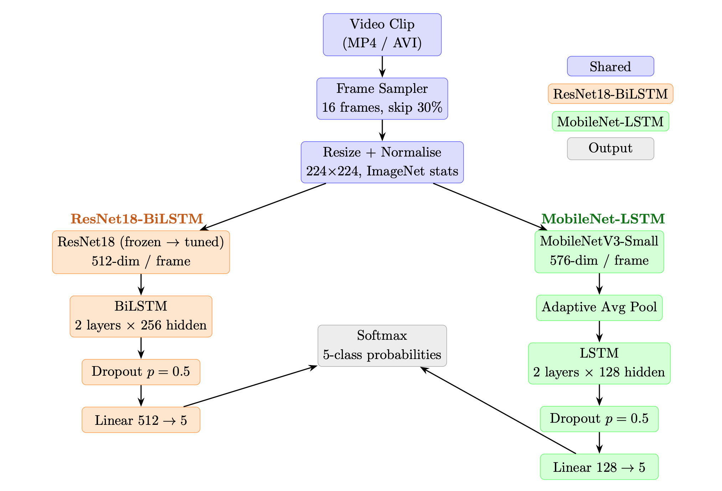
Full Architecture Pipeline

Slide 9
02
Experiments & Model Comparison

Slide 10
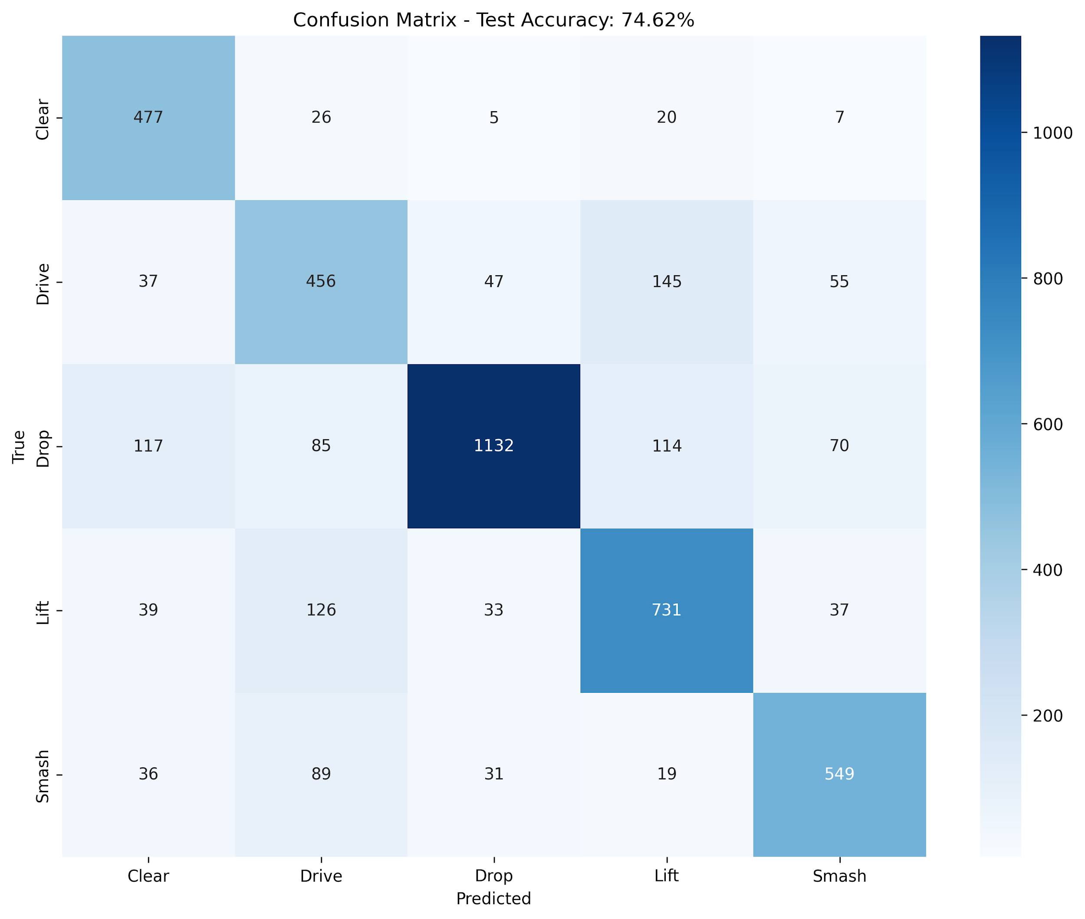
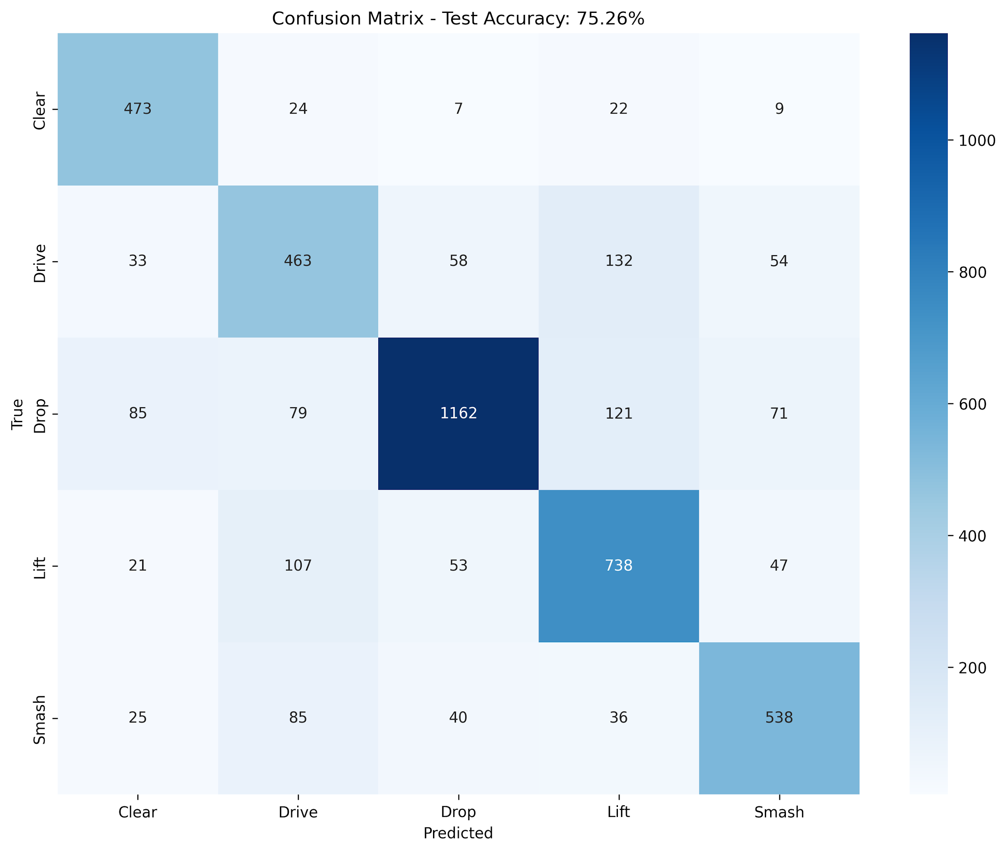
Option A vs Option B
Option A — ResNet18 + BiLSTM: 74.62% test accuracy. 14.3M params, 164MB. Best Drop precision (90.7%). Lower overfitting: 9.99% train-val gap. Bidirectional temporal context. Proven, standard architecture.
Option B — MobileNetV3 + LSTM: 75.3% test accuracy (+0.64%). 4.1M params, 17.3MB (89% smaller). Better Drive/Clear precision. Higher overfitting: 11.02% gap. Unidirectional only. Accuracy difference not statistically significant. Selected for deployment.

Slide 11
Why MobileNet-LSTM Was Deployed
MobileNet-LSTM (Option B) was selected for the deployed Shot Coach application. It achieves higher test accuracy (75.3% vs 74.6%) while using ~70% fewer parameters (4M vs 14M), giving faster inference (<60 ms vs 150 ms on Apple M1) and a 10x smaller model file (17 MB vs 164 MB). The accuracy difference of 0.64% is not statistically significant (95% CI: [-0.7%, +2.0%]), so the efficiency gains made MobileNet-LSTM the clear choice for a web-deployed, resource-constrained environment. ResNet18-BiLSTM remains a valid alternative where bidirectional temporal context is preferred.

Slide 12
Training Configuration
Optimizer: Adam with LR = 0.001
Batch size 64.
Early stopping with patience = 15 epochs.
Total: 44 epochs. Trained on Google Colab T4 GPU.
Data augmentation: random horizontal flip (50%), color jitter for brightness and contrast (+-20%), standard ImageNet normalization. Augmentation adds robustness to lighting variation and left-handed players.

Slide 13
03
Results

Slide 14
75.3%
Test Accuracy
3,373 correct out of 4,483 test samples | Weighted F1: 0.753 | +51% vs pose baseline

Slide 15
Per-Class Performance
— Drop: 90.7% precision, 74.6% recall, F1 0.819 (strongest)
— Clear: 67.6% precision, 89.2% recall, F1 0.769
— Smash: 76.5% precision, 75.8% recall, F1 0.761
— Lift: 71.0% precision, 75.7% recall, F1 0.733
— Drive: 58.3% precision, 61.6% recall, F1 0.599 (hardest)
— Drive vs Lift confusion: 145 misclassified (similar trajectories)

Slide 16
04
Deployment & Application

Slide 17
Shot Coach: Streamlit Web App
— Upload video -> classify shot type in 5-10 seconds
— MobileNet-LSTM inference: shot classified in <60 ms
— Confidence bar with all 5 class probabilities
— Frame sampling timeline visualization
— Smart warnings for long, short, or multi-shot videos
— Shot descriptions and technique tips per shot type

Slide 18
Responsible AI
— Bias: trained exclusively on professional tournament footage
— Transparency: confidence scores and frame sampling shown
— Low-confidence warnings manage user expectations
— No personal data collection or storage
— Model limitations clearly communicated in the UI

Slide 19
Lessons Learned & Future Work
Pose data alone is insufficient — visual RGB frames are essential. Class imbalance needs weighted loss; unweighted drops accuracy by 5-7%. User-facing confidence warnings are critical for building trust in AI predictions.
Future: 3D CNN (SlowFast) for richer temporal modeling. ROI extraction to focus on the player region. Expand dataset with recreational player footage. Deployed live on Hugging Face Spaces (huggingface.co/spaces/paulgk/badminton-shot).

Slide 20
Thank You
Questions & Live Demo | GitHub Repository Available

