Slide 1
AWS Fundamental
Prepared By: Gourab Paul

Slide 2
Cloud Computing
Traditional Computing
Also known as on-remises computing
Means users have physical servers and hardware at their workplace.
Users buy and maintain this equipment and they need IT experts to set it up and keep running.
Key Features of Traditional Computing
Control: user have full control over his infrastructure, can modify as he need
Security: users are responsible for securing their data and system
Scalability: expanding this infrastructure can be time consuming and expensive

Slide 3
Cloud Computing
Virtual Infrastructure
Instead of owning and managing physical equipment user can use services and resources provided over the internet by cloud service providers (CSPs).
Key Features
Scalability: users can adjust their need of resources without buying more hardware
Cost-Efficiency: follows a pay-as-you-go model. Users can only pay what they use, eliminating the need for large upfront investment. Also reduce maintenance cost.
Accessibility and Collaboration: allow users to access their resources from anywhere
Security and Reliable: cloud providers prioritize security and invest in strong measures to protect users data.
Rapid provisioning and Scalability
Cost Effectiveness
Collaborative Development and Teamwork
Focus on Application Development

Slide 4
Cloud Computing
Choosing the Right Path
Budget:
Scalability Needs
Expertise
Security Requirements
Traditional computing provides control and customization, while cloud computing offers scalability, cost-efficiency, and accessibility.

Slide 5
Cloud Computing: IaaS vs PaaS vs SaaS
Aspect | IaaS (Infrastructure as a Service) | PaaS (Platform as a Service) | SaaS (Software as a Service)
Service Definition | Provides virtualized computing resources | Provides a platform for application development and deployment | Delivers software applications over the internet
User Responsibility | Users manage and control the infrastructure, including OS, middleware, and applications | Users manage applications and data, while the cloud provider handles the underlying infrastructure | Users consume the software application without managing infrastructure or development
Flexibility and Customization | High level of customization and control | Limited customization, focusing on application development | Little to no customization of the software application
Development Focus | Infrastructure setup and management | Application development and deployment | Application usage and configuration
Scalability | Users can scale virtual machines and resources as needed | Scalability is managed by the platform provider, offering auto-scaling | Scalability is handled by the SaaS provider
Examples | AWS EC2, Google Compute Engine, Azure Virtual Machines | Google App Engine, AWS Elastic Beanstalk, Heroku | Google Workspace, Microsoft 365, Salesforce
Use Cases | Best suited for IT administrators and DevOps teams requiring full control over infrastructure | Ideal for developers who want to focus on coding without infrastructure concerns | Great for end-users seeking ready-to-use software solutions
Deployment Time | Longer deployment time, as users need to set up and configure infrastructure | Shorter deployment time, as the platform provides pre-configured environments | Almost instant deployment, as the software is already configured
Maintenance | Users are responsible for maintenance tasks like patching and updates | Platform provider manages underlying maintenance tasks | SaaS provider handles maintenance and updates
Cost Structure | Pay for the resources you use (compute, storage, etc.) | Pay for platform resources and services, often a subscription model | Typically subscription-based pricing per user or usage
Examples in Practice | Running a virtual server for hosting a website | Developing and deploying a web application on a platform | Using email, word processing, or CRM software in a web browser

Slide 6
AWS (Amazon Web Service)
AWS uses distributed IT Infrastructure to provide different IT resources on demand.
It’s provide different services such as infrastructure as a service (IaaS), Platform as a Service (PaaS) and packaged Software as a Service (SaaS).
Based on the concept of Pay-As-You-Go, AWS provides the services to the customers.
AWS provides services to customers when required without any prior commitment or upfront investment. Pay-As-You-Go enables the customers to procure services from AWS.
Computing
Programming models
Database Storage
Networking

Slide 7
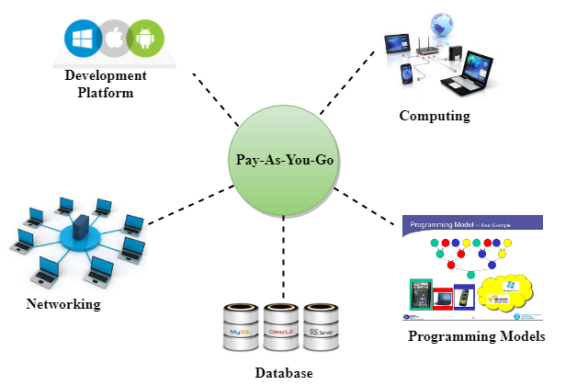
AWS
Advantages
Flexibility
Cost-Effectiveness
Scalability/Elasticity
Security

Slide 8
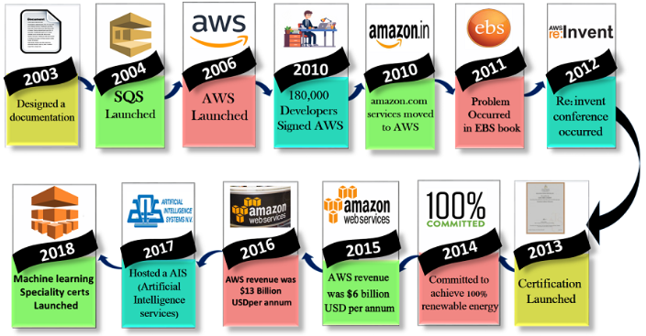
AWS
History

Slide 9
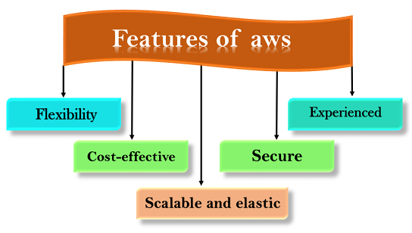
AWS-Features

Slide 10
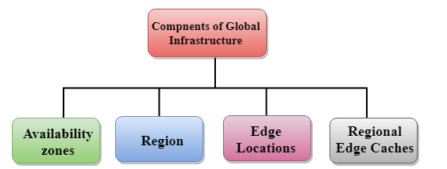
AWS-Global Infrastructure
Availability Zones: can be a several data center, but if they are close together, they act as one availability zone.
Region: A region is a collection of data centers which are completely isolated from other regions and consist of more than two availability zones connected to each other through links. It’s an geographical area of datacenters.
Edges locations: is not a region but a small location that AWS have. It is used for caching the content. Consists of CloudFront, Amazon’s Content Delivery Network (CDN).
Regional Edge Cache: Regional Edge cache lies between CloudFront Origin servers and the edge locations. Data is removed from the cache at the edge location while the data is retained at the Regional Edge Caches. When the user requests the data, then data is no longer available at the edge location. Therefore, the edge location retrieves the cached data from the Regional edge cache instead of the Origin servers that have high latency

Slide 11
AWS-Account ID and Pricing
AWS assigns two types of unique ID to each user’s account,
An AWS Account (12-digit number)
used to construct Amazon Resource Names (ARNs)
A canonical user ID (64-digit hexadecimal encoded a 256-number)
A canonical user ID is used in an Amazon S3 bucket policy for cross-account access means that AWS account can access the resources in another AWS account. For example, if you want AWS account access to your bucket, you need to specify the canonical user ID to your bucket's policy
AWS pricing:
Compute
Storage
Data Transfer

Slide 12
AWS-IAM
IAM – Identity Access Management
Allows us to manage users and their level of access to the different parts of AWS platforms. It’s a web service that enables AWS’s customers to manage users and user permissions in AWS.
Enables the organization to create multiple users, each with its own security credentials, controlled and billed to a single AWS account.
Features
Centralized control of AWS account
Shared Access to AWS account
Granular permissions: used to set a permission that user can use a particular service but not other services.
Identity Federation and Multifactor Authentication
Networking Controls and Provide temporary access for users/devices and services where necessary
Integrates with many different AWS services
Supports PCI (Payment Card Industry) DSS (Data Security Standard) Compliance
Eventually Consistent and Free to Use

Slide 13
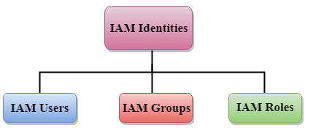
AWS- IAM Identities
IAM identities are created to provide authentication for people and processes in users AWS account.
IAM Identities: Users, Groups, Roles

Slide 14
AWS-IAM Roles
Delegation: a process of granting the permissions to the user to allow the access to the AWS resources that you control.
The trusting and trusted account can be of three types:
Same account
Two different accounts under the same organization control
Two different accounts owned by different organizations.
Permission Policy: grants the user with a role the needed permissions to carry out the intended tasks.
Trust Policy
Federation
Trust Policy
Permissions Policy
Permission Boundary
Principal
Cross-account access

Slide 15
AWS-SAML (Security Assertion Markup Language)
Users need to enter a username and password to login in any application
It’s is a Xml-based framework that allows the identity providers to provide authorization credentials to the service provider, and a technique of achieving Single Sign-On (SSO).
SAML provides a service known as Single Sign-On means that users have to log in once and can use the same credentials to log in to another service provider.
With SAML, both the service provider and identity provider exist separately, but centralizes the user management and provides access to the SaaS solutions.
Advantage:
SAML SSO
Open Standard SSO
Strong Security
Improved online experience for end users
Reduced administrative cost for service providers
Risk transference
Two types:
Service Provider: Service provider requires the authentication from the identity provider that grants the access to the user.
Identity Provider: An identity provider is an entity within a system that sends the authentication to the service provider is about who they are along with the user access rights. It maintains a directory of the user and provides an authentication mechanism.

Slide 16
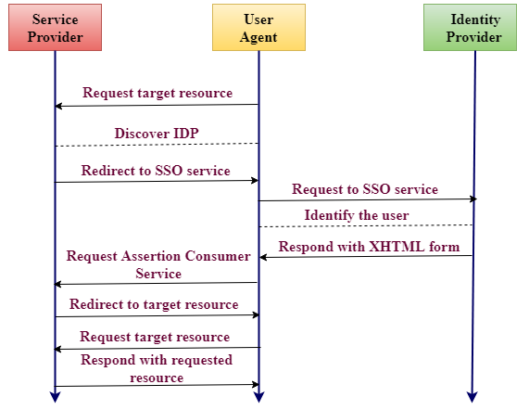
AWS-SAML (Security Assertion Markup Language)
A SAML Assertion is an XML document that the identity provider sends to the service provider containing user authorization. Three types of SAML Assertion,
Authentication
Attribute
Decision
Working of SAML:

Slide 17
AWS-EC2 (Elastic Compute Cloud)
Amazon EC2 is a web service that provides resizable compute capacity in the cloud.
It’s reduces the time required to obtain and boot new user instances to minutes rather than in older days, if you need a server then you had to put a purchase order and cabling is done to get a new server which is a very time consuming process. Amazon has provided an EC which is a virtual machine in the cloud that completely change the industry.
We can scale the compute capacity up and down as per the computing requirement changes, and pay only for the resources that we actually use.
It also provides the developers with the tools to build resilient applications that isolate themselves from some common scenarios.

Slide 18
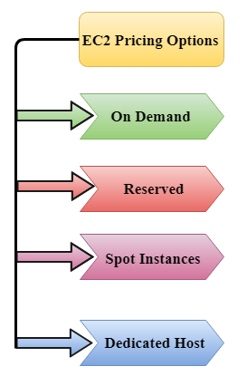
AWS-EC2 Pricing Options
On Demand
Allow to pay a fixed rate by the hour or even by the second with no commitment
Linux instance is by the second and windows instance is by the hour.
On demand is perfect for the users who want low cost and flexibility of Amazon EC2 without any up-front investment or long-term commitment.
Suitable for the applications with short term, spiky or unpredictable workloads that cannot be interrupted.
It is useful for the applications that have been developed or tested on Amazon EC2 for the first time.
On Demand instance is recommended when you are not sure which instance type is required for your performance needs.

Slide 19
AWS-EC2 Pricing Options
Reserved
It’s like a contract with Amazon. The contract can be for 1 or 3 years in length.
Give discount on the hourly charge for an instance.
Used for those application that require reserved capacity.
Users can make up-front payments to reduce their total computing costs.
Types
Standard Reserved Instances: useful when application is at the steady state and provide up to 75% of on demand.
Convertible Reserved Instances: provides the feature that has the capability to change the attributes of RI as long as the exchange results in the creation of Reserved Instances of equal or greater value. It also useful for the steady state applications.
Schedule Reserved Instances: available to launch within the specified time window user reserve. Allow to match user capacity reservation to a predictable recurring schedule that only requires a fraction of a day, a week, or a month.

Slide 20
AWS-EC2 Pricing Spot Instances
Allow user to bid for a price whatever price that user want for instance capacity and providing better saving if your applications have flexible start and end times.
Spot Instances are useful for those applications that have flexible start and end times.
It is useful for those applications that are feasible at very low compute price.
Useful for those users who have an urgent need for large amounts of additional computing capacity.
Provide less discounts as compared to On Demand prices.
Used to optimize user costs on the AWS cloud and scale our application’s throughput up to 10x
It will continue to exist until you terminate these instances.

Slide 21
AWS-EC2 Dedicated Hosts
It’s a physical server with EC2 instance capacity which is fully dedicated to your use.
Can help user to reduce costs by allowing user to use user’s existing server-bound software licenses. Like, VMware, SQL, etc.
Dedicated hosts are used to address compliance requirements and reduces host by allowing to use your existing server-bound server licenses
Can be purchased as a Reservation for up to 70% off on-demand price.

Slide 22
AWS-EBS (Elastic Block Store)
EC2 is a virtual server in a cloud while EBS is a virtual disk in a cloud.
Allows user to create storage volumes and attach them to the EC2 instances.
Placed in a specific availability zone and they are automatically replicated to protect you from the failure of a single component.
EBS volume does not exit on one disk it spreads across the Availability Zone. EBS volume is a disk which is attached to an EC2 instance.
EBS volume attached to the EC2 instance where windows or Linux is installed known as Root device of volume.

Slide 23
AWS-EBS Volume Types
Two types of volume
SSD-Backed Volumes
Two Types: General Purpose SSD (refer as GP2), Provisioned Purpose SSD (refer as IO1)
HDD-Backed Volumes
Three types:
Throughput Optimized HDD (ST1), low-cost HDD designed for those applications that require higher throughput up to 500 MB/s
Cold HDD (SC1), lowest cost storage designed for the applications where the workloads are infrequently accessed.
Magnetic Volume, lowest cost storage per gigabyte of all EBS volume types

Slide 24
AWS-EC2 vs EBS
Feature | EC2 Instances | EBS Volumes
Primary Purpose | Virtual machines for running applications and services | Block storage for data storage and persistence
Resource Type | Compute resources (CPU, RAM) | Storage resources
Instance Types | Various instance types optimized for different workloads | EBS volumes can be attached to any EC2 instance
Scalability | Easily scalable by launching additional instances | Scalable by increasing volume size or attaching more volumes
Data Persistence | Data is typically not persisted if the instance is terminated | Data persists independently of the instance
Performance | Performance depends on the instance type and specifications | Performance depends on volume type and size
Storage Capacity | Limited storage capacity per instance type | Scalable storage capacity up to 16 TB per volume
Data Backups | Data must be manually backed up or snapshotting | Supports automated snapshots for data backups
High Availability | EC2 instances can be part of Auto Scaling groups for high availability | EBS volumes can be backed up and replicated for data redundancy
Data Durability | Data durability is tied to instance termination | EBS volumes offer higher data durability and reliability
Cost | Pay for compute resources (per hour) | Pay for storage capacity (per GB-month)
Use Cases | Running applications, web servers, databases, etc. | Storing data for databases, file systems, etc.

Slide 25
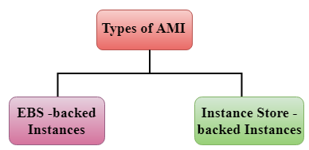
AWS-AMI (Amazon Machine Images)
A virtual image to create a virtual machine within an EC2 instance.
Can create multiple instance using single AMI or different when user need instances with the same or different configuration.
Provide a template for the root volume of an instance
EBS-backend Instances
EBS is nothing but a volume that provides you persistent storage
Instance Store - backed Instances
As soon as the instance is terminated, all the data will be lost

Slide 26
AWS-AMI:Instance store vs EBS - backed instance
Feature | Instance Store-Backed Instances | EBS-Backed Instances
Storage Type | Instance store uses ephemeral, temporary storage directly attached to the physical host. | EBS instances use network-attached block storage volumes.
Data Persistence | Data on instance store is volatile and is lost if the instance is stopped or terminated. | Data on EBS volumes persists even if the instance is stopped or terminated.
Data Durability | Lower data durability as data is not replicated. | Higher data durability with options for replication and snapshots.
Boot Volume | Instance store can be used as a boot volume, but it's not commonly recommended for important data. | EBS volumes are commonly used as boot volumes, providing data persistence and backups.
Performance | Typically provides high I/O performance due to local storage. | Performance can vary based on EBS volume type, with some latency due to network access.
Use Cases | - Stateful workloads that can tolerate data loss. - Temporary storage for processing data. | - Production workloads requiring data persistence. - Databases, web servers, and application hosting.
Snapshot Capabilities | Cannot create EBS snapshots for backup and recovery. | EBS volumes support creating snapshots for data backups and disaster recovery.
Cost Implications | Often cheaper in terms of instance cost, but lacks data persistence. | May incur additional EBS volume costs, but provides data persistence and backup features

Slide 27
AWS-Load Balancing
A virtual machine or appliance that balances web application load that could be HTTP or HTTPs traffic that user are getting in.
It balances a load of multiple web servers so that no web server gets overwhelmed.
Application Load Balancer
Operate at layer 7 of the OSI layer, and identifies the incoming traffic and forwards it to the right resources. For example, if a URL has /API extensions, then it is routed to the appropriate application resources
Network Load Balancer
Operated at the layer 4 of the OSI model, and makes routing decisions aat the transport layer (TCP/SSH), can handle millions of requests per second.
Classic Load Balancer

