Slide 1

PURE BLOOD
Name & ID
Gourab Kanti Paul 17182103141
Satyajit Sarkar 17182103157
Romzan Ali Mohon 17182103177

Slide 2
Overview:
Introduction
Why we select this project?
What technology we use for this problem?
Project Overview
Future Work
Conclusion

Slide 3
Introduction
PureBlood is a software for users who are seeking donors for a blood donation. By using PureBlood, users can easily register themselves, search for donors, and see specific information about donors. They can use this for communication purpose.

Slide 4
Why we select this project?
A blood donation occurs when a person voluntarily donates blood to another person. According to Wikipedia, In Bangladesh, about 50-55% of blood donations are from onetime donation for a specific patient. Blood seekers generally searches for blood donor in social media (like Facebook, Twitter etc.) or through relatives. This is a very time-consuming job. According to a statistic, about 65% of the blood donors cannot give blood to blood seekers due to lack of communication properly.
That's why we decide to create this project where peoples can easily find, and communicate with donors easily.

Slide 5
What technology we use for this project?
HTML
CSS
PHP
MySQL Database

Slide 6
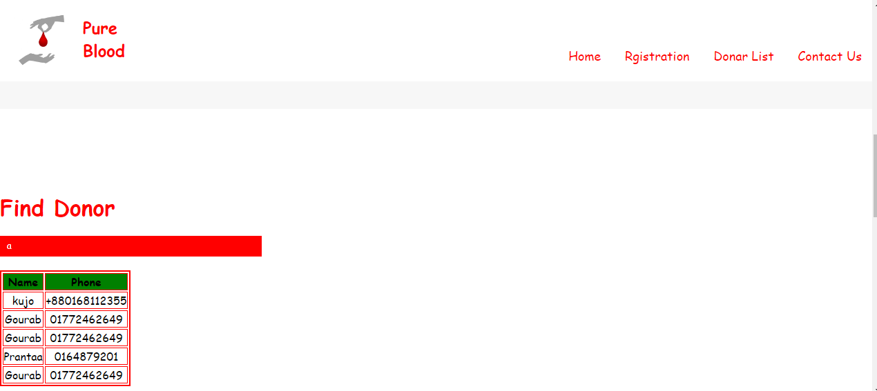
Project Overview

Slide 7
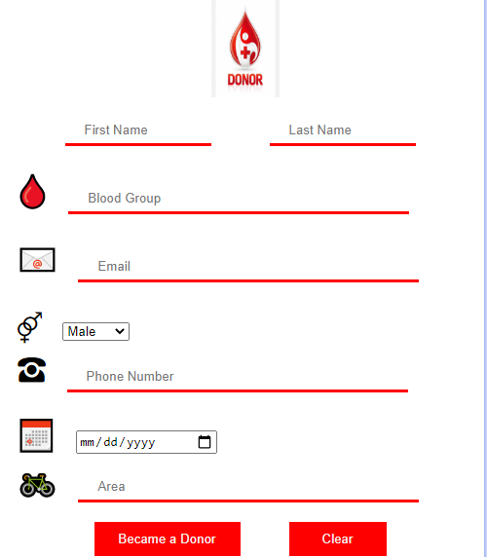
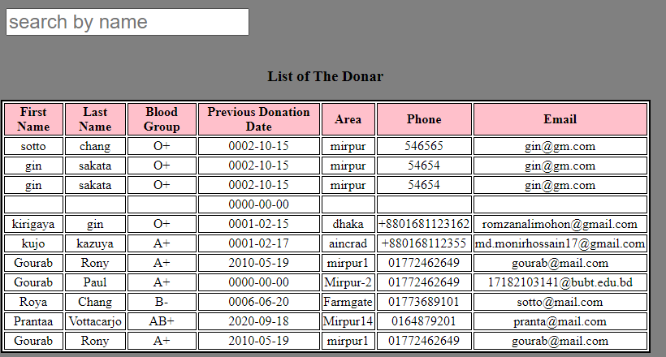
Project Overview

Slide 8
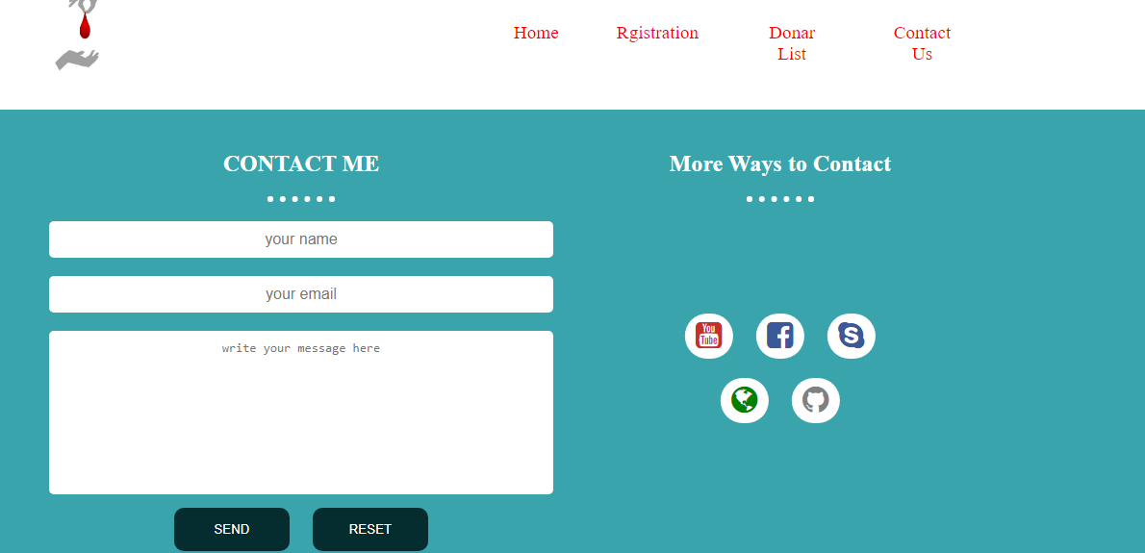
Project Overview

Slide 9
Future work
Add Log-in option
Add Location
Update security
Others update depends on users feedback

Slide 10
Conclusion
This system is fully a free, easy, and simple website for users. User can easily find their objective and do their work. A better idea is to use the application which Mobile device is very popular with people too. This application is providing each entity the facility to approach nearby blood donors so that it will become much easier to rare groups in the hour of need.
This system will reduce gap between blood donors and blood seekers.

Slide 11
Thank You

