Slide 1

Growth-Adjusted Life Distribution Forecasting
ANNUAL RELIABILITY & MAINTAINABILITY SYMPOSIUM · RAMS 2027
A simulation-based framework that carries a development growth trend into a fleet-level life estimate.
Paul Govan · GE Aerospace
The gap → The idea → The case study → What it means
Notes:
Open warm, then straight into the anecdote. Do not read the abstract. ~20 min talk, reserve 5 for Q&A.

Slide 2
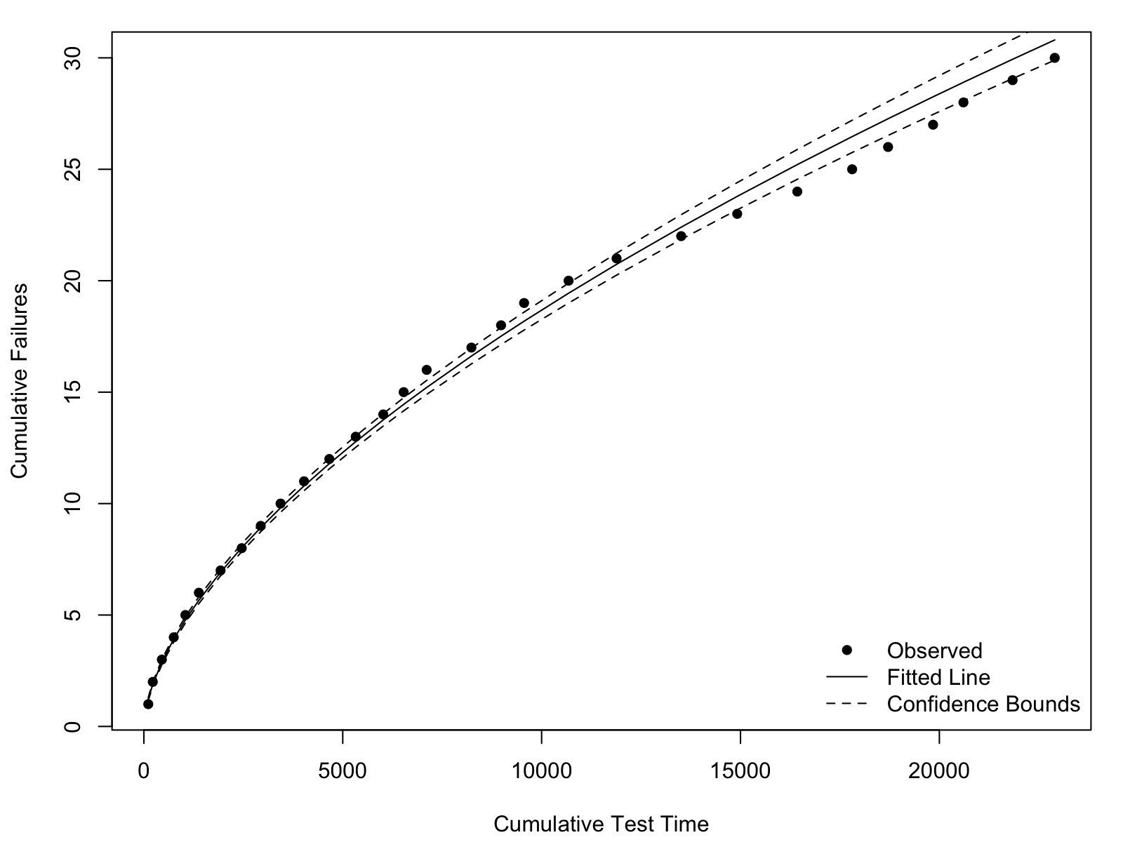
BACKGROUND & INTRODUCTION
When the growth was real — but the forecast didn't show it
1
The design got better.
We drove design improvements through development, and the growth analysis confirmed it: failure intensity was trending down. The system was genuinely improving.
2
But the life distribution didn't move — yet.
When we fitted the fleet's life distribution, that improvement wasn't reflected. The forecast still looked like the un-improved design.
3
The growth model couldn't give us the piece we needed.
Development: reliability genuinely improving (βg = 0.60)
Crow-AMSAA is a system-level trend. It never spoke to individual-unit risk — when a given unit is likely to fail.
A system that was improving, and a forecast that ignored it — with no bridge between them.
Notes:
The anecdote. Keep products generic (GE disclosure norms). Set up BOTH halves of the gap: (a) growth was real but the life distribution didn't reflect it, (b) the growth model gave no per-unit risk. Slides 11 and 14 pay this off.

Slide 3
BACKGROUND & INTRODUCTION
Two analyses that never talk
RELIABILITY GROWTH (RGA)
LIFE DISTRIBUTION (WEIBULL)
“Is the system improving?”
“How long does a unit last?”
• System-level failure intensity
• Tracks a trend over test time
• Projects a future failure count / MTBF
• Says nothing about a single unit's life
→ ⁄⁄
• Unit-level time-to-failure
• Gives B-life and per-unit risk
• Fitted to a fixed set of failures
• Assumes the distribution isn't changing
no bridge
The improvement seen in development never reaches the fleet's life distribution — so forecasts can systematically under-call future reliability.
Notes:
This is the anecdote generalized. The whole method is the bridge between these two boxes.

Slide 4
BACKGROUND & INTRODUCTION
Ignore growth, and the data works against you
Censoring
Small-sample bias
Costly to be wrong
High-reliability units are pulled before they fail — the effective information is far smaller than the sample size.
With few failures, MLE is unstable; the Weibull shape parameter is especially sensitive.
Extrapolating beyond the data under-calls reliability, with real safety and economic stakes.
Reliability growth adds a fourth problem the others don't touch: the life distribution itself isn't fixed.
Notes:
Existing remedies improve estimation of a STATIC distribution. None propagate a growth trend. That's the gap.

Slide 5
MAIN BODY
The idea, in one picture
1
2
3
Growth trend
→
Fewer expected failures
→
Life distribution shifts right
The development Crow-AMSAA rate βg
Growth lowers the count the fleet will see over a fixed window
Re-fit to the reduced-failure data → longer characteristic life
Not a fixed growth multiplier on a distribution — the growth trend reshapes how many failures the surviving fleet is expected to produce, and the distribution is re-fitted to match.
Notes:
Contrast with ad hoc multipliers. Mechanism: growth -> fewer forecast failures -> larger fitted eta. Everything after makes this quantitative and bounded.

Slide 6
MAIN BODY
One program, two phases
PHASE 1
PHASE 2
Developmental growth test
Fielded fleet (matured design)
• 30 prototypes built & tested in sequence
• Test-analyze-fix: each build improves
• Crow-AMSAA quantifies the trend βg
• 100 units over a 1000-hour campaign
• 20 failures, 80 still surviving
• Weibull fit = the no-growth baseline
bridge
The trend estimated in Phase 1 is projected onto the Phase 2 fleet. Both phases are non-repairable units.
Notes:
Genuine growth in Phase 1, bridged onto a real fleet. Forecast is conditional on that Phase-1 trend carrying into service.

Slide 7
MAIN BODY
Three stages, one pipeline
1
2
3
Growth lowers the target
Conditional Weibull simulation
Re-fit + Monte Carlo
→
→
The growth rate scales down how many failures the fleet is expected to see over the forecast window.
Draw failure times for surviving units, calibrated to hit that reduced count; censor the rest.
Fit a growth-adjusted Weibull to the combined data; repeat to get variability bands.
The equations live in the backup. The story only needs these three moves.
Notes:
Keep at altitude. Do not walk equations 1-11 unless asked (backup).

Slide 8
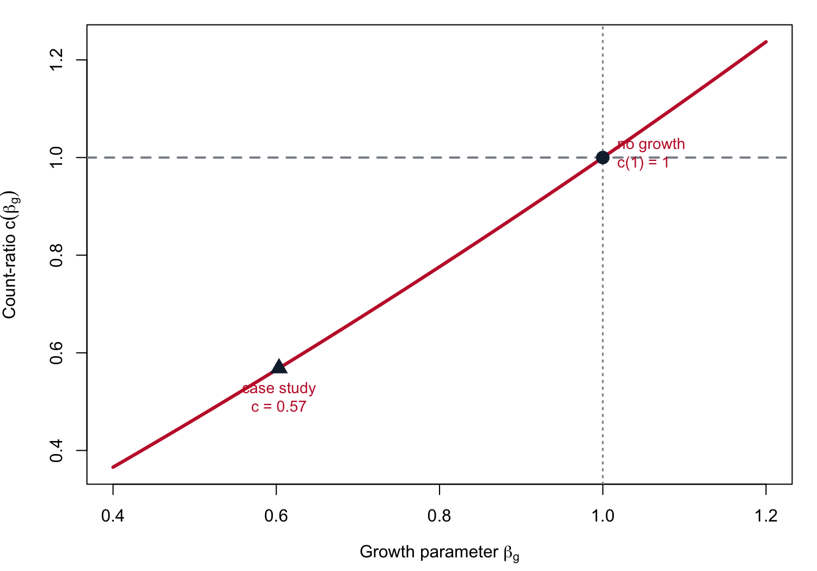
MAIN BODY
The one number: the count-ratio c(βg)
Stronger growth (smaller βg) lowers the expected failure count over the window.
c(1) = 1 — no growth exactly recovers the no-growth benchmark.
Case study: c = 0.57 — growth cuts the expected failures nearly in half.
Scale-free: only the dimensionless growth rate enters — no development time unit is imported into the fleet.
Notes:
The only relation shown. c multiplies the no-growth count. Below 1 => fewer failures => larger fitted life.

Slide 9
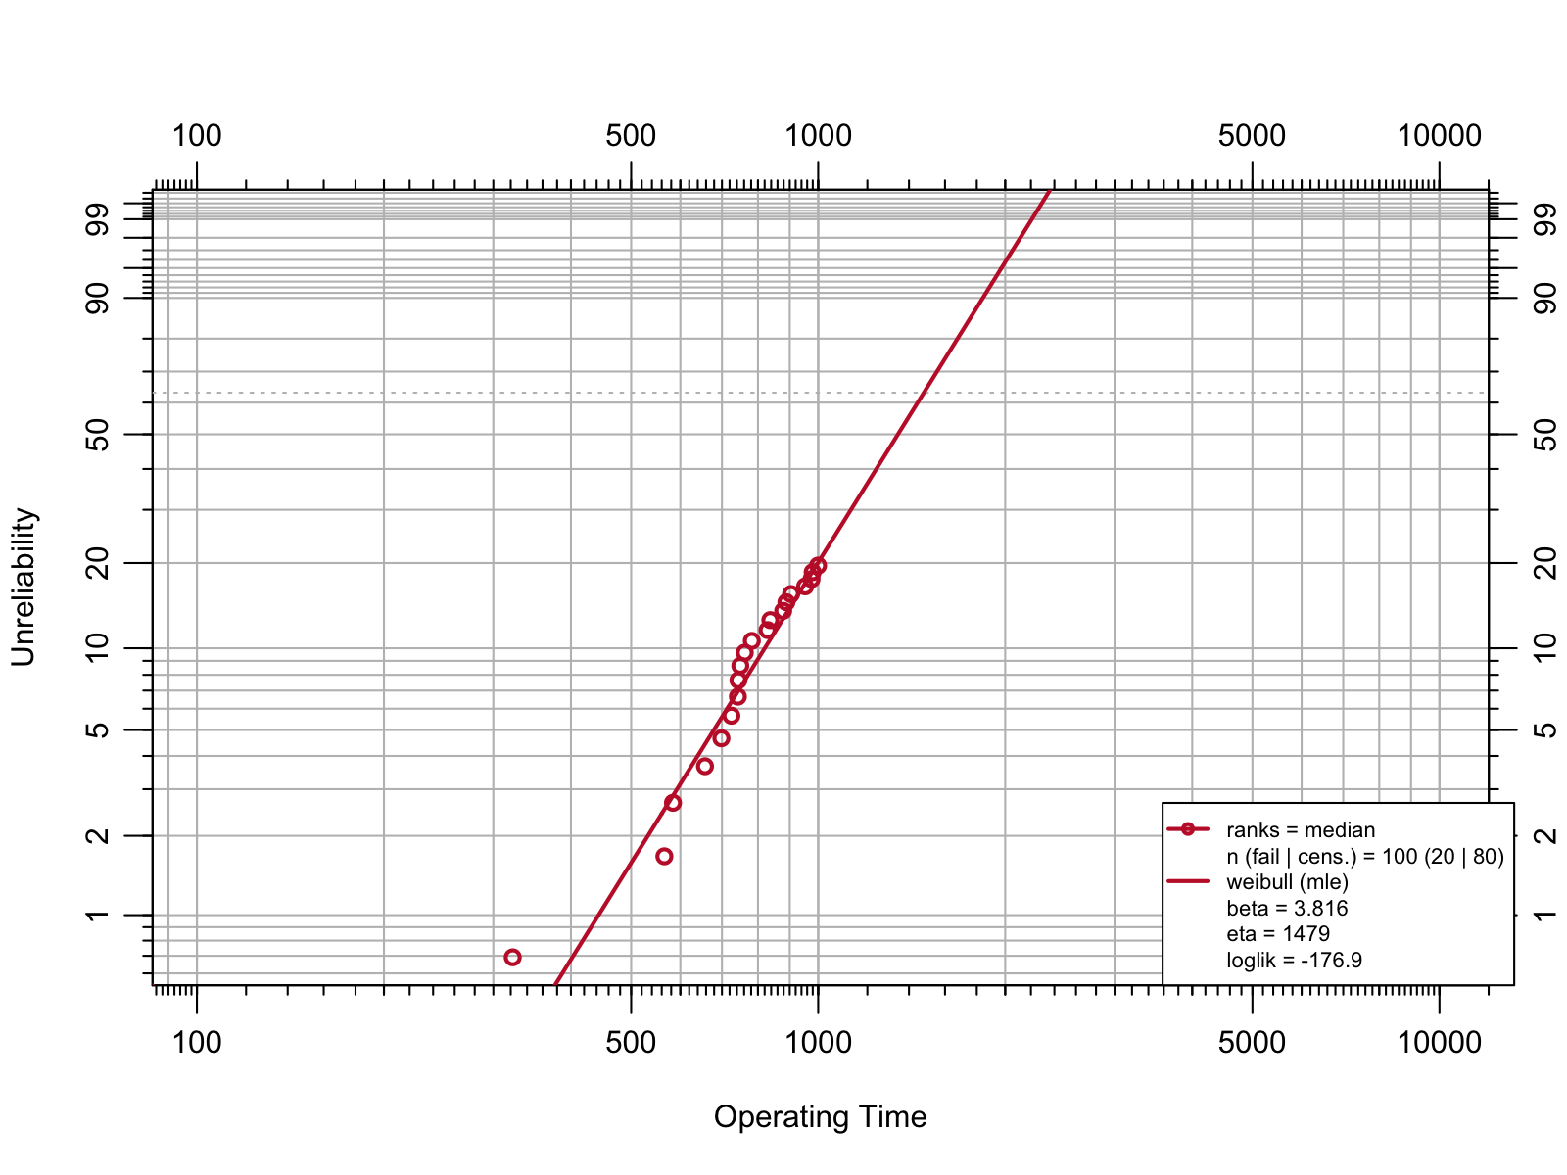
MAIN BODY
Step 1 — the fleet's baseline life
No-growth baseline (MLE)
β = 3.82 shape > 1 → wear-out
η = 1479 characteristic life
20 failures · 80 surviving
This fit is the reference the growth adjustment is measured against.
Notes:
Heavy censoring: 80 of 100 units survive. Baseline anchors everything downstream.

Slide 10
MAIN BODY
Step 2 — development shows real growth
Crow-AMSAA growth fit
βg = 0.60 < 1 → improving
R² = 0.996 trend fits tightly
growth rate g = 0.40
Decreasing failure intensity as the design matured — genuine, not an artifact.
Notes:
This beta_g is SYSTEM-level. Distinct from the unit-level Weibull beta on the previous slide.

Slide 11
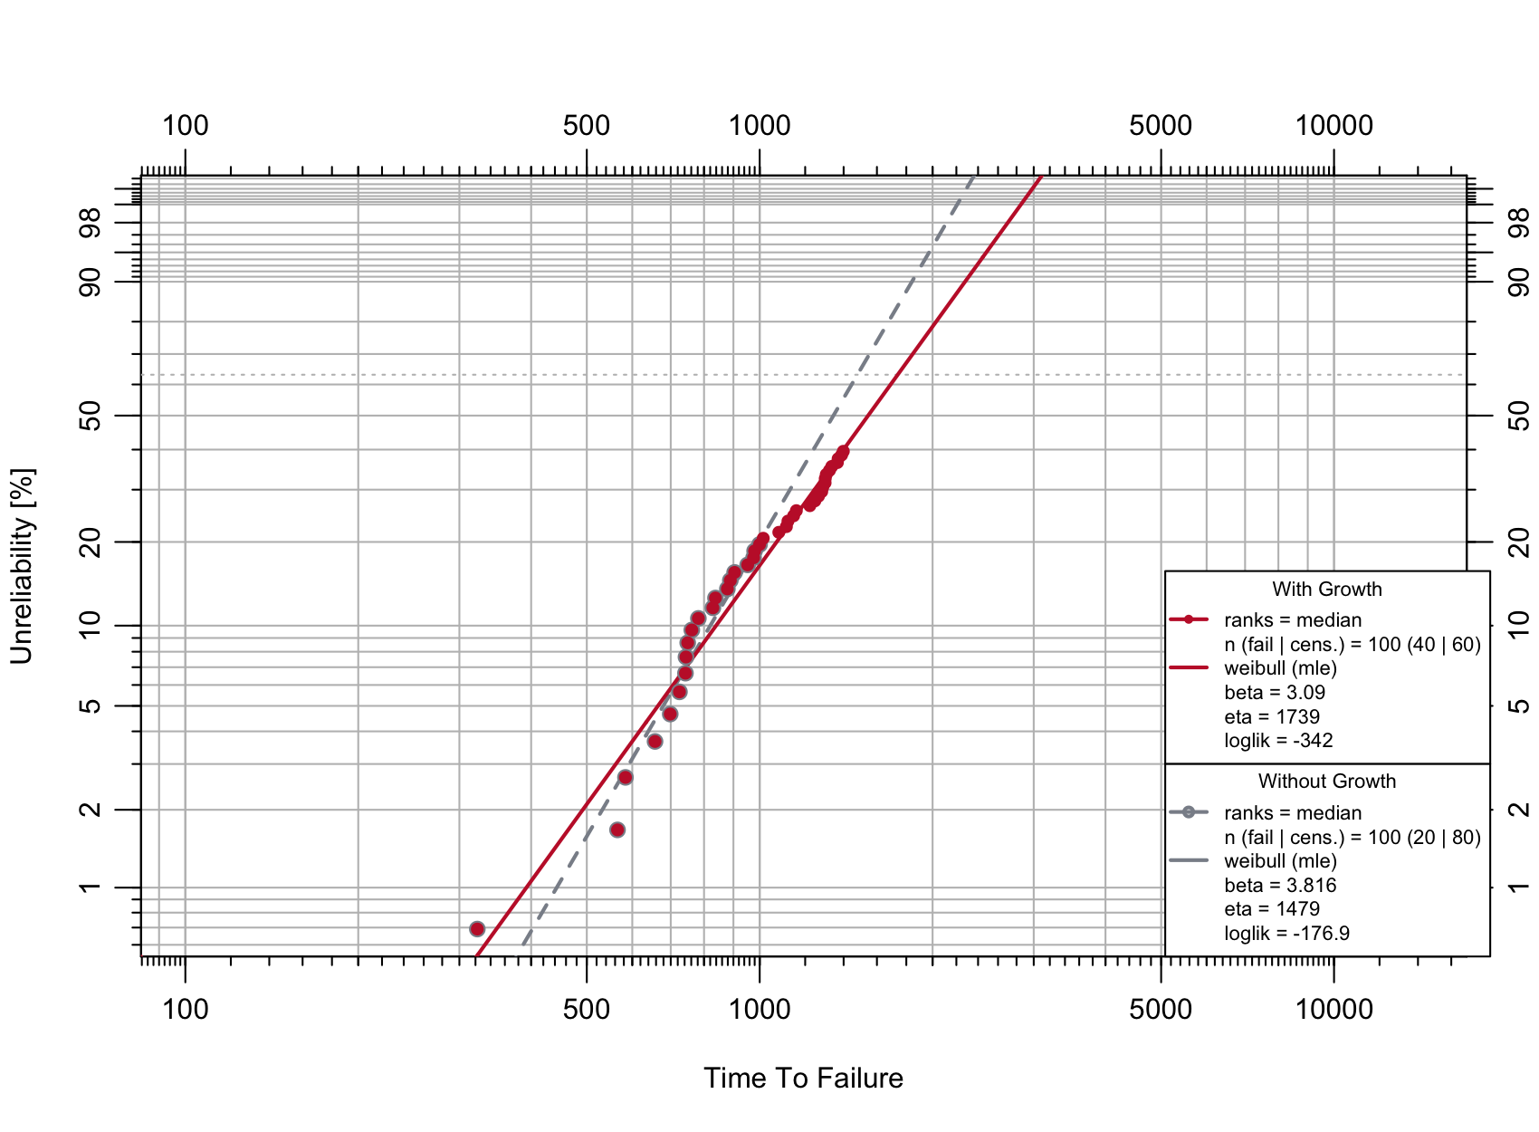
MAIN BODY
The payoff: growth finally moves the life estimate
Characteristic life η
1479 → 1739
+17.6%
B10 life (conservative indicator)
820 → 839
+2.3%
Same fleet data. The development trend, propagated, lifts the fitted life — here's where the improvement finally shows up in unit-level risk.
Notes:
Growth shows primarily as a shift in eta (+18%). B10 is conservative because the shape drops slightly. Report both; lead with eta.

Slide 12
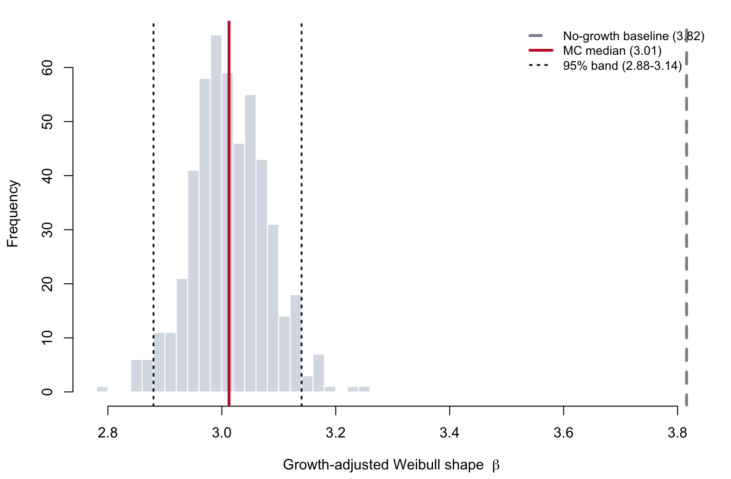
MAIN BODY
How much does it vary?
500 valid iterations
• MC median β = 3.01 (baseline 3.82)
• 95% band 2.88 – 3.14
• Growth lowers the shape; spread dominated by the simulation, not growth-parameter error
Read these as forecast variability bands conditional on the fitted model — not inferential confidence intervals.
Notes:
The shift is stable across draws, not a lucky sample. Precise: variability band, not a confidence interval; model-form uncertainty not represented.

Slide 13
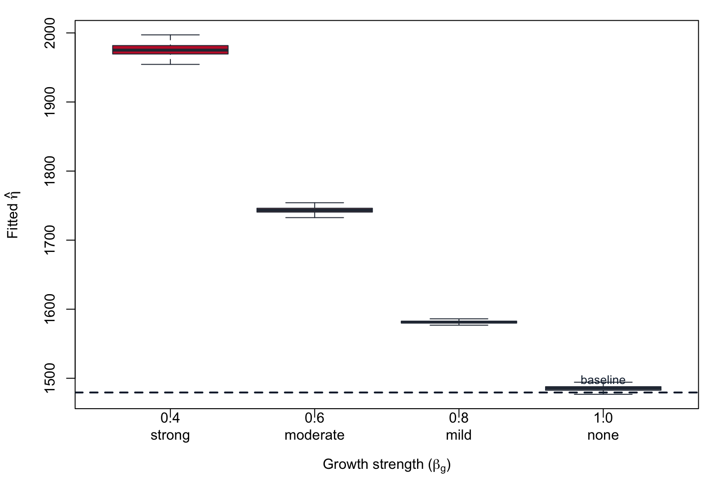
MAIN BODY
What actually moves the answer
• Stronger growth → larger η
• monotonic and orderly
• At βg = 1 it returns to the baseline — the shift is entirely the growth trend
• Robust to WHEN you assess the fleet
What matters most is having enough observed failures to pin down the baseline.
Notes:
The 'none' box on the baseline is the credibility check. Variation elsewhere is inherited from the baseline fit under censoring.

Slide 14
SUMMARY & CONCLUSIONS
Summary & conclusions
• Bridges the two silos — reliability growth and unit-level life estimation, normally analyzed apart.
• Growth lifts the fitted life: characteristic life η +17.6% (1479 → 1739); B10 +2.3% (820 → 839).
• A mechanical consequence, not a coincidence: growth lowers the expected failure count (count-ratio c = 0.57), forcing a larger characteristic life.
• Stable under Monte Carlo: median shape β = 3.01 (baseline 3.82), 95% band 2.88 – 3.14 — spread dominated by the simulation, not growth-parameter error.
• An optimistic bound: valid only if development growth continues in service; freeze the design → the no-growth baseline applies.
• Honest by construction: we quantify the shift's magnitude and variability — never a claim of better predictive accuracy.
The contribution: a repeatable, bounded way to turn an observed growth trend into a fleet-level life estimate.
Notes:
Conclusions in bulleted form. Lead with eta (+17.6%); B10 is the conservative companion. The last two bullets are the non-negotiable honesty RAMS reviewers look for — never overclaim accuracy.

Slide 15
NEXT STEPS & FUTURE WORK
Next steps & future work
• Validate predictive accuracy against a fleet that genuinely keeps improving, so the forecast can be compared to held-out ground truth.
• Propagate more uncertainty — model-form (the Crow-AMSAA power law) and the input Weibull shape β, held fixed here.
• Test alternative growth models — e.g. a piecewise NHPP with change-point detection, which may yield different counts.
• Relax the homogeneous-fleet assumption — distinct subpopulations and repair / replacement scenarios.
• Reproducible & open-source — ReliaGrowR (CRAN) + WeibullR; currently under rOpenSci software review.
ReliaGrowR on CRAN: cran.r-project.org/package=ReliaGrowR
Notes:
Next Steps / Future Work as its own slide, bulleted. Drawn from the paper's Limitations section (validation gap, unpropagated uncertainties, alternative models, fleet homogeneity) plus the open-source tooling.

Slide 16
REFERENCES
References
• L. H. Crow, “Reliability analysis for complex, repairable systems,” U.S. Army AMSAA, Tech. Rep. 138, 1975.
• P. Govan, “ReliaGrowR: Modeling and plotting functions for reliability growth analysis,” in Proc. 2026 RAMS, doi:10.1109/RAMS50514.2026.11424445.
• P. Govan, ReliaGrowR: Reliability Growth Analysis, R package, 2024, doi:10.32614/CRAN.package.ReliaGrowR.
• D. Silkworth and J. Symynck, WeibullR: Weibull Analysis for Reliability Engineering, R package v1.2.4, 2025.
• H. Guo, A. Mettas, G. Sarakakis, and P. Niu, “Piecewise NHPP models with MLE for repairable systems,” in Proc. 2010 RAMS, doi:10.1109/RAMS.2010.5448029.
• C. W. Zhang, T. Zhang, D. Xu, and M. Xie, “Analyzing highly censored reliability data without exact failure times,” Qual. Eng., 2013, doi:10.1080/08982112.2013.783598.
• E. Makalic and D. F. Schmidt, “Minimum message length inference of the Weibull distribution,” in AI 2023, LNCS 14471, pp. 291–303, doi:10.1007/978-981-99-8388-9_24.
• T. M. Grile and R. A. Bettinger, “Reliability analysis of deep space satellites launched 1991–2020,” Qual. Reliab. Eng. Int., 2024, doi:10.1002/qre.3600.
• V. M. R. Muggeo, “segmented: an R package to fit regression models with broken-line relationships,” R News, vol. 8(1), pp. 20–25, 2008.
Notes:
Standard RAMS closer. Equation/algorithm backup slides can follow (hidden) for Q&A.

