Slide 1

The Cost of Financial Fraud Victimization
Ankit Kalda, David Sovich
Claire Célérier

Slide 2
Why do we care?

Slide 3
Fraud is Pervasive in Finance/ Household Finance
Financial Institutions have paid close to $400bn of fines, criminal penalties, and class-action settlements since 2000, the most in any industry
Causes:
Financial intermediation: information asymmetries give room for exploitation and obfuscation
Investors / Depositors: low financial literacy and behavioral biases might affect decisions
Labor force: low moral standards (Frey and Meier, 2005; Wang et al., 2011; Cohn, Fehr and Marechal, Nature 2014) / Low litigation risk / personal costs (see Egan et al., 2019, Kalda et al., 2023)
Implications: Worsen inequalities / Distrust / Antifinance sentiment
Notes:
https://goodjobsfirst.org/wp-content/uploads/2024/04/The-High-Cost-of-Misconduct-Corporate-Penalties-Reach-the-Trillion-Dollar-Mark.pdf
Source: https://violationtracker.goodjobsfirst.org/pages/violation-tracker-data-sources

Slide 4
However… Academic Research is Still Limited
Access to data makes it challenging to identify instances of fraud
We often lack counterfactuals/exogenous shocks to infer causality
Inflated perception of the benefits of finance might bias the publication process
While fraud prevention drives regulation: Securities and Exchange Commission in 1934, Consumer Financial Protection Bureau (2011)…

Slide 5
What do we learn?

Slide 6
Result 1: Victims are Young and Low-Income
In 2003, the Fair and Accurate Credit Transactions Act (FACTA) provides consumers with the right to place fraud alerts on their credit files
Since then, the Federal Trade Commission (FTC) and the Bureau of Justice Statistics (BJS) have published yearly reports on identity theft
These reports provide data on victimization, including age, income, and costs

Slide 7
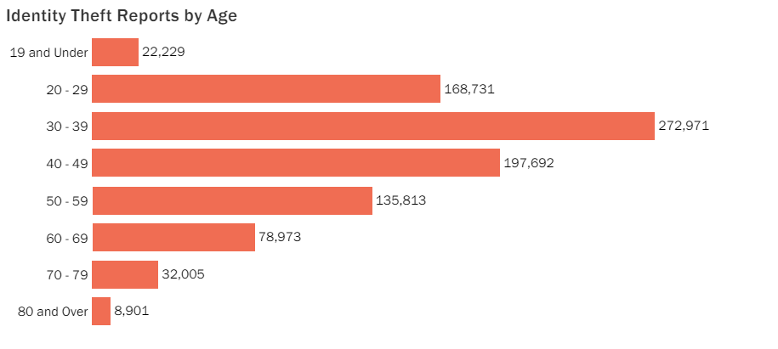
Identity Theft Report by Age, FTC, 2023
Source: FTC, Consumer Sentinel Network Data Book 2023

Slide 8
Result 2: Decrease in Account Opening and Credit Balances
To increase protection, victims of identity theft can place a credit freeze on their credit report
The credit freeze restricts access to credit reports, preventing new accounts from being opened
Close to 60% of victims of identity theft who contacted a credit bureau have placed a credit freeze on their report (Bureau of Justice Statistics, 2023)

Slide 9
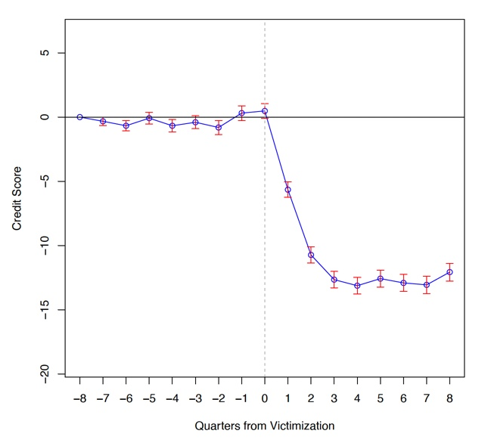
Result 3: Decrease in Credit Score
Fraudulent Account Opened
As debt accumulates and payments are missed, the credit score automatically decreases (Equifax Website)
The drop in credit score limits the magnitude of the fraud!
What happens after a fraud alert filing?

Slide 10
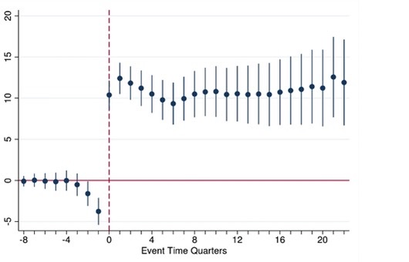
Change in Credit Score after a Fraud Alert Filing
Blascak, Cheney et al. (2021) – Philadelphia Fed Working Paper – Consumer Finance Institute

Slide 11
Result 4: Increase in Bankruptcy
Why is it the case as direct costs (credit balances) are mostly borne by credit institutions (90%)?
Identity theft is associated with bankruptcy fraud: Identity thieves file for bankruptcy on behalf of the victim…
Why? Not to foreclose the house in case of mortgage fraud!
Filing for bankruptcy can also be victim’s strategy to solve the situation after severe identity theft

Slide 12
Institutional Background
Heterogeneity across Markets
The data covers credit card but also mortgage and student loan fraud => Implications might vary across these different markets
For example, the paper indicates an average balance of 28,000$ on fraudulent accounts, while the BJS indicates a median balance of 200$. Is the average driven by mortgage fraud?
Heterogeneity in Fraud Alerts
Initial Fraud Alerts are often filed for precautionary motives, at no cost
Extended Fraud Alerts require submitting a police report or an identity theft report with detailed information on the accounts and evidence => much more likely to be victims
The absence of summary statistics limits our understanding of the context and findings

Slide 13
Research Questions

Slide 14
Why don’t Banks invest more in fraud detection?
Evidence suggests that financial institutions underinvests in fraud detection to ease access to credit and maintain market share
Fraud-related costs are shifted to customers through higher rates or fees
Question: Can regulation lead credit institutions to internalize the externalities, for example by imposing caps on interest rates or mandating the disclosure of fraud-related losses?

Slide 15
Costs and Benefits of Access to Credit / Formal Finance
Credit has always existed and initially relied on informal networks where personal relationships and reputation played a central role
The shift to formal finance broadened access to credit but introduced new risks, such as identity theft
Stylized facts: fraud is more prevalent in the U.S. credit market than in any other developed economies, and in subprime credit sectors
Question: Which characteristics of credit markets drive fraud: innovative / unsecured etc.? Should government intervention restrict access to some credit products to mitigate fraud?

Slide 16
Conclusion

Slide 17
Conclusion
Low-income populations and minorities are more likely to be victims of fraud in financial markets
Research is needed to address the issue for finance to better serve the needs of ordinary people

Slide 18
Thank you!

