Slide 1
Cyclistic Bike Share Analysis
Trends in Casual Riders vs Annual Members
Notes:
This slideshow is created as part of the Google Data Analytics Professional Certificate’s capstone project.
The purpose of this project is to demonstrate all the skills learned during the program and put them to use performing data analysis in a way that can be showcased as part of a portfolio of our accomplishments.
The goal of this project is to analyze data from a fictional bike share company called Cyclistic, identify trends in how different users, create visualizations to show those trends and provide insights to a marketing team on how to use this data to complete their objective.

Slide 2

Background
Cyclistic is a bike-share service operating in Chicago.
Riders are split into two categories:
Casual Riders
Annual Members
Annual Members are more profitable than Casual Riders.
Marketing campaign is to be created to convert Casual Riders into annual members.
Notes:
Cyclistic is a bike-share service operating a fleet of 5842 bicycles across 692 stations in Chicago.
Cyclistic categorized their riders in one of two categories:
Casual riders who use single-ride passes or full-day passes
Riders with annual memberships.
Cyclistic's financial analysts have concluded that annual members are more profitable than casual riders. As a result, the marketing team wants to create a marketing campaign designed to convert casual riders into annual members.

Slide 3
Objective
Analyze data
Provide Insights
Determine differences
Identify trends
Notes:
Before the marketing campaign can be started, trends need to be identified in Cyclistic's historical bike trip data. This requires the following actions to be performed:
Historical bike trip data will be analyzed.
Difference between casual riders and annual members need to be found.
Trends in how casual riders and annual members use Cyclistic will be identified.
Insights will be provided to the marketing team on how to use this information.

Slide 4
Preparation
Cyclistic is not a real company.
Data for this case study comes from Divvy.
Data is made freely available.
Analysis performed on 12 months of data.
Notes:
Cyclistic is not a real company, however the data for this exercise is real and comes from company called Divvy, which is a real bike ride-share company that operates in Chicago.
This analysis will be performed using the past twelve months of data (2022-04 to 2023-03) from Divvy's severs.
Divvy offers this data freely. There is a license associated with it, which allows for it to be used in academic purposes such as this.
This data contains no private information (names, credit card numbers, etc).

Slide 5
Data Processing
When a ride took place
Month
Day of the Week
Time of Day
Where a ride took place
Starting latitude and longitude of ride
Cross referenced with geospatial position of neighborhoods in Chicago
Determined which neighborhood a ride took place in.
Duration of Ride
Notes:
The bulk of the data processing involved determining when a ride took place and where a ride took place.
When a ride took place was determined by taking the start time of a ride and using that to determine the month, day of the week and the time of day (morning, afternoon, evening or night) that a ride took place. Ride duration was calculated by finding the difference between when a ride ended and when a ride started.
Identifying where a ride took place was done by taking the starting latitude and longitude of a ride and cross referencing it with geospatial data of the different neighborhoods of Chicago. By doing this we could determine in what area of Chicago a ride took place.

Slide 6
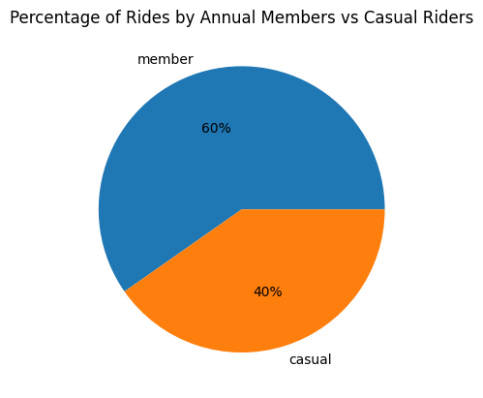
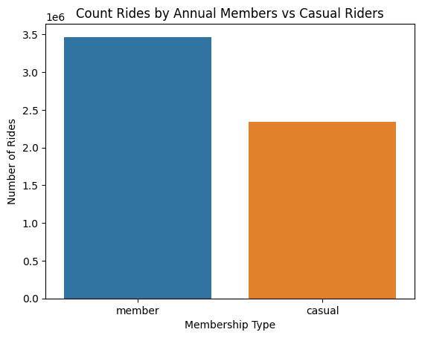
Who is Riding?
Notes:
The first step of our analysis was identifying how many rides were done by Casual Riders and how many were done by Annual Members.
Over the course of the year, approximately 3.5 Million rides were done by Annual Members (60%) and 2.5M were done by Casual Riders (40%)

Slide 7
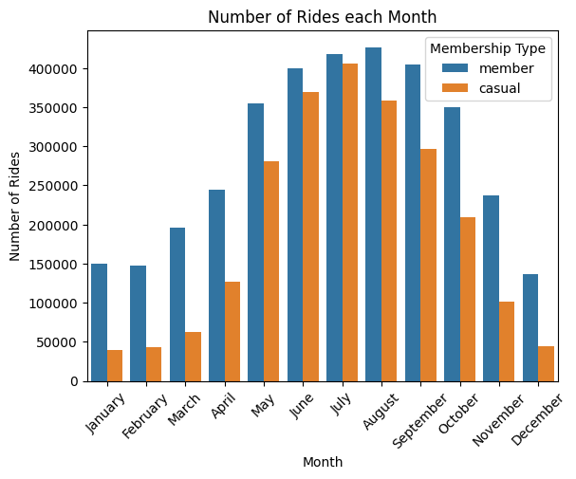
When are Users Riding?
More rides in warmer, summer months than colder winter months.
Almost as many Casual Riders as Annual Members in summer.
Very few Casual Riders in winter.
Significant number of Annual Members rides during the winter.
Notes:
The following graph shows the number of rides over the different months.
What we can see is that most of the rides took place during the warm summer months while the cold winter months have the fewest.
And while the winter does have fewer number of rides, Annual Members do ride in significant numbers during those months.
In comparison, Casual Riders ride very little in the winter but ride in large amounts during the summer; there are almost as many Casual Riders during the summer as there are Annual Members.

Slide 8
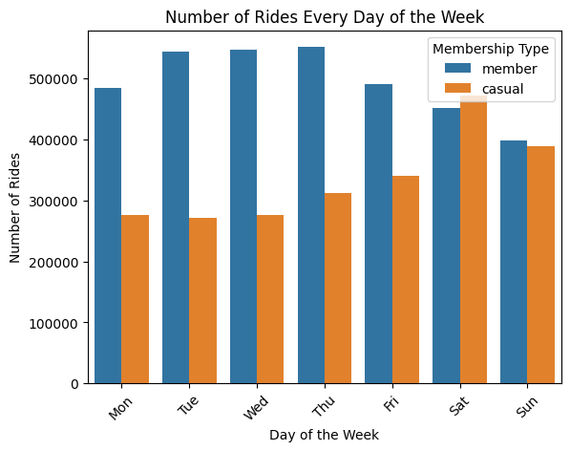
When are Users Riding?
Annual Members more often to ride during the week.
Casual Riders more often to ride during the weekend.
Notes:
The following graph shows the number of rides by day of the week.
We see that Annual Members are more likely to ride during the week (Monday to Friday) while Casual Riders are more often to ride on the weekend (Saturday and Sunday).

Slide 9
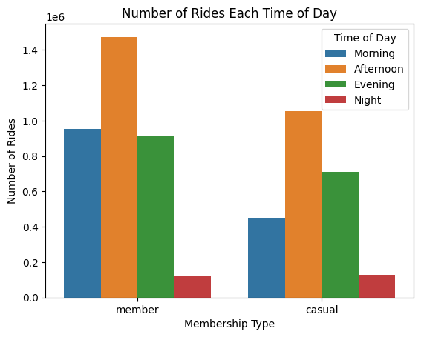
When are Users Riding?
Most rides happen during the afternoon.
Casual Riders are more likely to ride in the evening than in the morning.
Annual Members ride in the morning and evening at equal frequency.
Notes:
This graphic shows the number the number of rides by time of day.
Both Casual Riders and Annual Members are more often to ride during the afternoon and least often at night.
However, Casual Riders are more likely to ride during the evening than during the morning, while Annual Members ride morning and evening at relatively equal numbers.

Slide 10
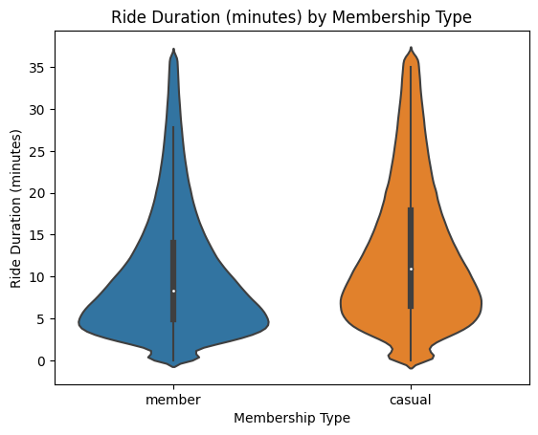
How Long are Users Riding?
Annual Members are more likely to take shorter rides than Casual Riders.
The ride duration for Annual Members is heavily grouped around the 5-minute mark.
Casual Riders also favor short rides, however the frequency is not as extreme.
Notes:
Rides from Annual Members tend to be shorter than Casual Riders.
The ride duration for Annual Members is heavily grouped around the 5-minute mark, and while casual riders do also tend to like short rides, the concentration is not as extreme.

Slide 11
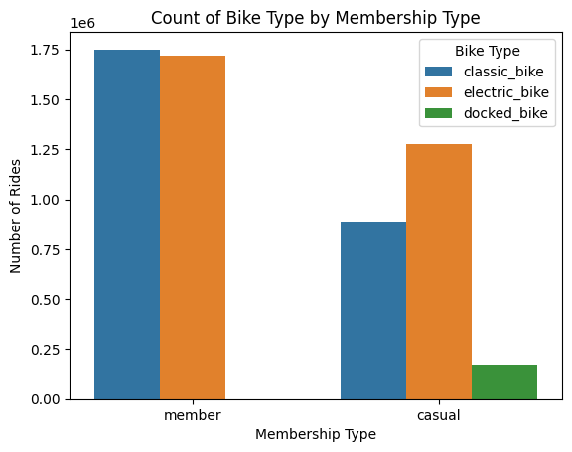
What are Users Riding?
Casual Riders prefer electric bikes.
Annual Members do not have much of a preference.
Casual Riders are the only ones using docked bikes.
Notes:
Casual Riders seem to prefer electric bikes over classic peddle bikes while Annual Members do not seem to have a preference one way or the other.
Casual Riders are also the only group that rides docked bikes.

Slide 12
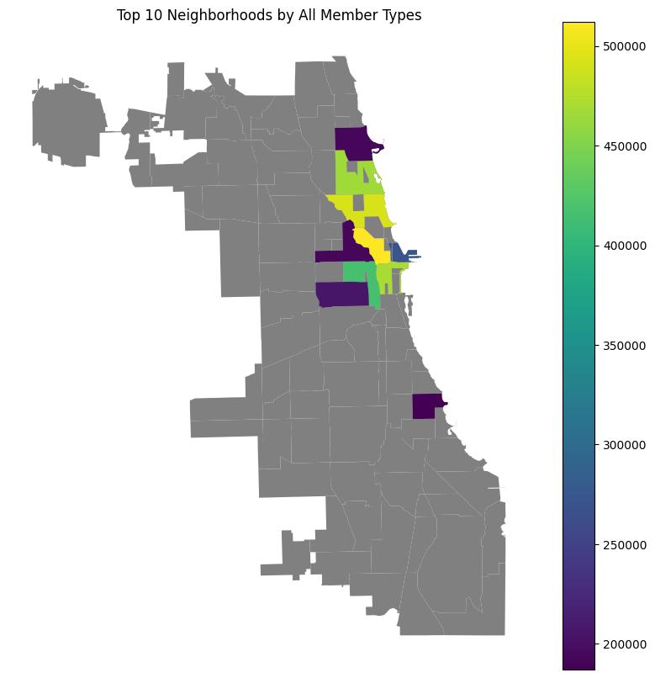
Where are Users Riding?
Neighborhood | Total Number of Rides
River North | 512118
Lincoln Park | 493069
Loop | 469775
Lake View | 465804
West Loop | 416402
Streeterville | 273027
Little Italy, UIC | 205535
West Town | 192760
Uptown | 192334
Hyde Park | 187048
Notes:
By taking the starting latitude and longitude of a ride, and cross referencing it with geospatial data of the different neighborhoods of Chicago we were able to determine which areas of the city rides took place in.
The graph above shows the top ten neighborhoods that contained the most rides (both Casual Riders and Annual Members). These areas are color coded with yellow being the largest quantity and violet being the smallest quantity and various colors of green and blue being in the middle. The neighborhoods outlined in grey are ones outside the top ten.

Slide 13
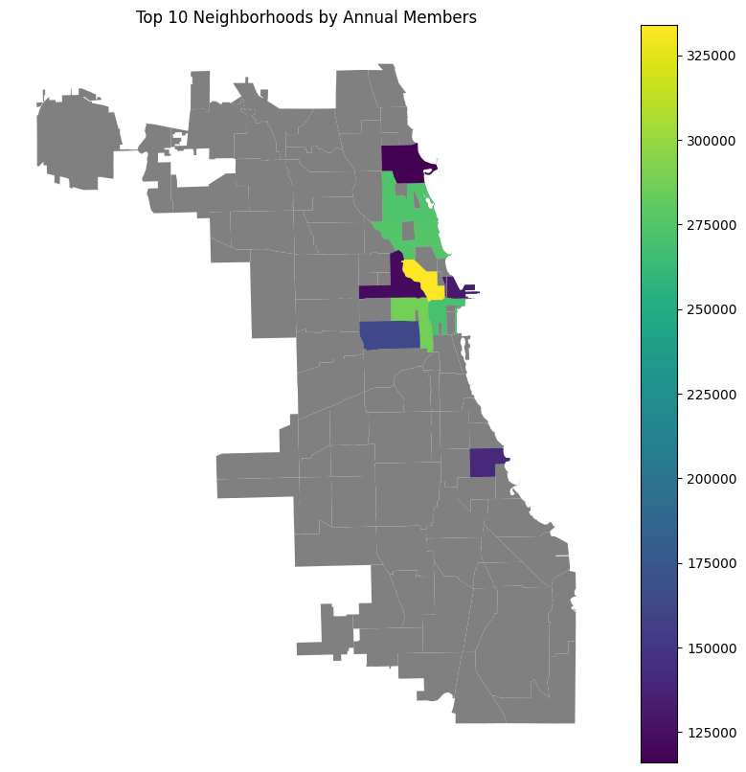
Where are Annual Members Riding?
Neighborhood | Member Rides | Casual Rides
River North | 333971 | 178147
West Loop | 287350 | 129052
Lincoln Park | 275832 | 217237
Lake View | 273894 | 191910
Loop | 270927 | 198848
Little Italy, UIC | 163382 | 42153
Hyde Park | 140057 | 46991
Streeterville | 130714 | 142313
West Town | 122512 | 70248
Uptown | 115989 | 76345
Notes:
The next step is to take that same map and separate the Annual Members from the Casual Riders. Above is the top 10 neighborhoods for annual members.
At first glance this map and the total rider map do not seem that different; all the same neighborhoods are listed, just with a different number of rides. But looking at the table we can start to see a difference between the two groups.
The table is sorted by Member Rides in descending order, and we see that the Casual Rides don’t follow the same trend; their numbers are all over the place. It looks like the casual riders choose to ride in some areas more than those with annual memberships do.

Slide 14
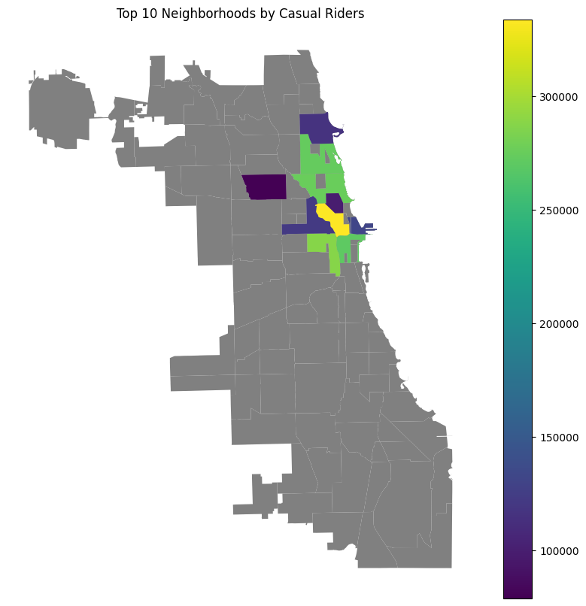
Where are Casual Members Riding?
Neighborhood | Member Rides | Casual Rides
Lincoln Park | 275832 | 217237
Loop | 270927 | 198848
Lake View | 273894 | 191910
River North | 333971 | 178147
Streeterville | 130714 | 142313
West Loop | 287350 | 129052
Uptown | 115989 | 76345
Old Town | 98929 | 75899
West Town | 122512 | 70248
Logan Square | 78771 | 64315
Notes:
Continuing this, if we look at where Casual Riders tend to go, we see another change; there are neighborhoods (Old Town and Logan Square) that make the top ten for Casual Riders but not for Annual Members. There are still more annual members in those neighborhoods, but Casual Riders give those neighborhoods more attention.
Looking again at the table we can see that Streeterville is a neighborhood that gets more Casual Rides than Member Rides. This is unique because it is the first neighborhood we have seen where there are more Casual Rides than Member Rides. As a result, we will proceed with mapping the difference between Casual Rides and Member Rides.

Slide 15
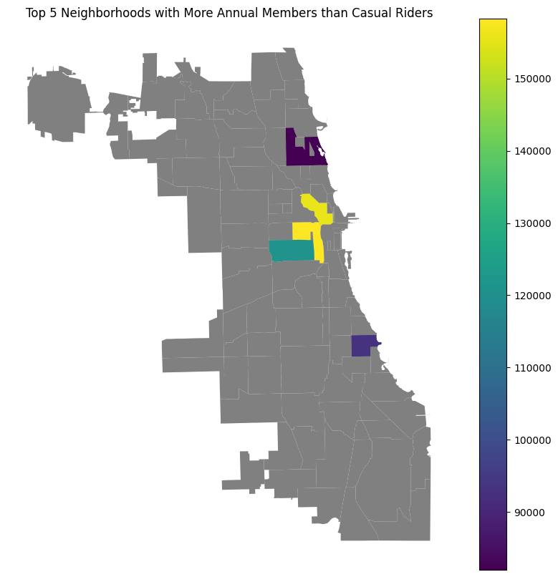
Neighborhoods with More Member Rides than Casual Rides
Neighborhood | Member Rides | Casual Rides | Difference
West Loop | 287350 | 129052 | 158298
River North | 333971 | 178147 | 155824
Little Italy, UIC | 163382 | 42153 | 121229
Hyde Park | 140057 | 46991 | 93066
Lake View | 273894 | 191910 | 81984
Notes:
Starting with the Annual Members again, this map shows the top five neighborhoods where the number of Member Rides out numbered the number of Casual Rides.
There isn’t too much surprising here, it’s a lot of the same neighborhoods that we have been seeing before.
However, the one trend that we can identify here is that the neighborhoods with more Member Rides tend to be urban.

Slide 16
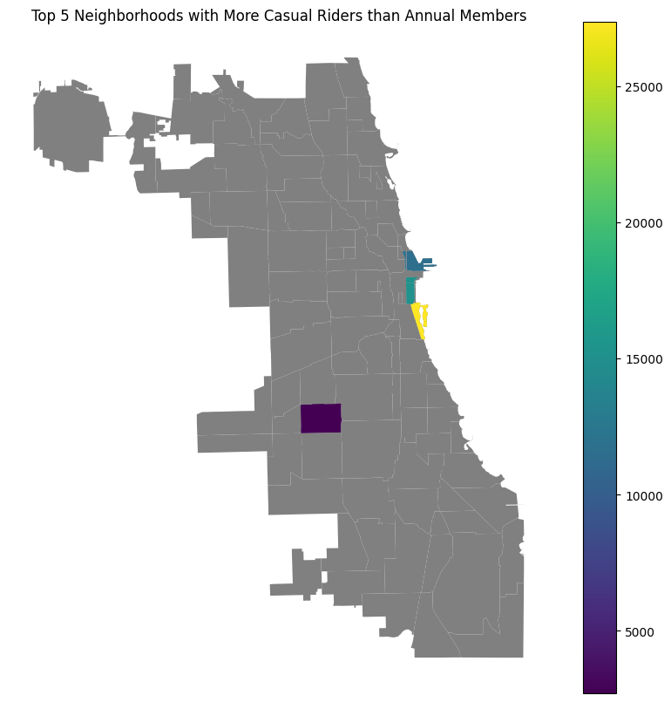
Neighborhoods with More Casual Rides than Member Rides
Neighborhood | Member Rides | Casual Rides | Difference
Museum Campus | 18008 | 45370 | 27362
Grant Park | 32255 | 47651 | 15396
Millenium Park | 12754 | 28004 | 15250
Streeterville | 130714 | 142313 | 11599
Gage Park | 2148 | 4849 | 2701
Notes:
And when we look at neighborhoods with more Casual Rides than Member Rides, we see Casual Riders preferring to ride in neighborhoods with more parks and green space.

Slide 17
Summary
Annual Members are more likely to:
Ride during the week.
Ride in the winter.
Take shorter rides.
Ride in the morning.
Ride in urban areas.
Casual Riders are more likely to:
Ride during the weekend.
Take longer rides.
Ride in recreational areas.
Prefer electric bikes.
Notes:
To summarize the results of our analysis:
Annual Members seem more likely to ride during the week, more inclined to ride during the winter, will often take shorter rides, ride more in the morning and ride in urban areas.
Meanwhile, Casual Riders are more likely to ride during the weekend, take longer rides, ride in recreational areas and prefer to ride electric bikes.

Slide 18
Conclusion
Annual Members use Cyclistic for their daily commute.
Casual Riders use Cyclistic for leisure and recreation.
Notes:
From this we can draw a conclusion that most Annual Members tend to use Cyclistic as part of their daily commute while Casual Riders use it for leisure.
Annual Members are riding in the morning, during the week and even if the weather is colder; they still need to get to work and they are choosing Cyclistic to do it.
Casual Riders ride during the weekend, later in the day during the warmer summer months and they are more likely to ride in areas where it’s fun to ride, like parks or other green spaces.

Slide 19

Action to Take
Design marketing campaign to target recreational users.
Run ads during the summer when casual users are more likely to ride.
Use electric bikes to encourage switching to annual membership.
Notes:
From the trends in Annual Members and Casual Riders, we would suggest that the marketing department take the following actions:
Target users who ride for recreation. Those who go out to parks or are looking for a fun way to get around town during the weekends.
Focus ads to run during the summer when casual riders are more likely to use the service as opposed to winter.
Incorporate electric bikes in the advertising. Either by showing off the electric bikes or possibly offer a promotion or some incentive to make accessing an electric bike easier with an annual membership to encourage more casual riders to switch.

Slide 20

Future Analysis
Tracking habits of individual users.
Filtering out tourists from analysis.
Profile users to get a better idea of user trends.
Notes:
One limitation with this analysis is that we were limited to examining rides and not users. There was no way to know for sure if we have thousands of individual users using the service or just a handful of ‘power users’. By having additional access to who is using the service we can make our analysis more accurate.
For example, we have no way to know from the ride data if a casual rider is a tourist using the service while they are visiting or if they are a resident of Chicago who uses the service regularly. A tourist is unlikely to ever get an annual membership, but a resident could be encouraged to switch.
By having more data on individual users, we can also profile them better. Do they ride as part of a commute or just for recreation or both? Do they ride multiple times a day, a few times a week or only a few times a month?
By getting access to more user information, not only can we better identify what separates annual members from casual riders, but we can look to see how to best fit the needs of all our customers.

