Slide 1

Bellabeat Wellness Tracker Analysis
Trends Between BMI Groups

Slide 2
Background
Bellabeat is a high-tech manufacturer of health focused products for women.
Bellabeat’s fitness trackers collect a large amount of data from their customers.
A marketing strategy is to be made based on the insights gathered from this data
Notes:
Bellabeat is a high-tech manufacturer of health-focused products for women. Bellabeat's fitness trackers collect a large amount of data from their customers. It is believed that this data can provide insights into how consumers use Bellabeat products and guide the marketing strategy for the company.

Slide 3
Objective
Analyze Data
Identify Trends
Provide Recommendations & Insights
Notes:
Analyze the data from Bellabeat fitness trackers.
Identify any trends that occur.
Provide insights and recommendations for the marketing strategy.

Slide 4
Preparation
Bellabeat is not a real company.
Data comes from FitBit Fitness Tracker Dataset.
Data is freely available and appears credible with no bias.
The dataset contains the following health information:
Steps Walked
Intensity of Activities
Hours Slept
Body Weight

Slide 5
Data Processing
Separated the users into two groups by BMI
Compared each group by
Steps walked in a day
Intensity of activities
Hours of Sleep

Slide 6
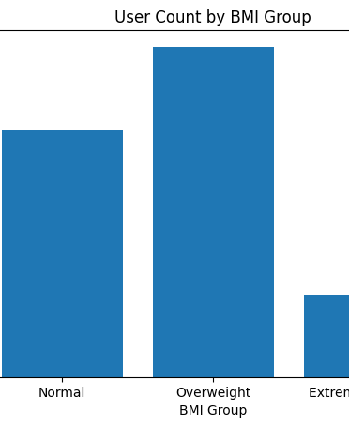
BMI as a Health Metric
BMI Group chosen as a criteria to differentiate users.
Assume that users with a normal BMI have better habits than those who are overweight.
Extremely Obese users were cut from analysis due to there only being one user in the dataset.

Slide 7
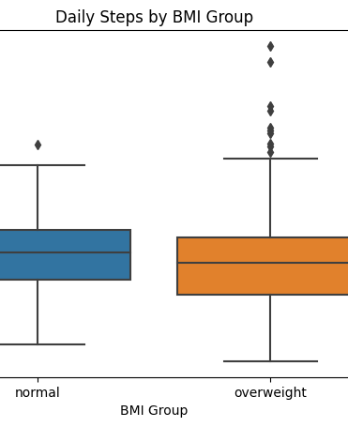
Daily Steps
Both groups average a similar number of daily steps.
Normal BMI group is more consistent with fewer outliers.

Slide 8
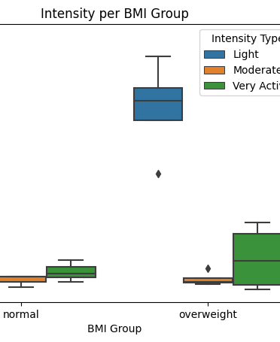
Intensity
Users with normal BMI get more light intensity hours than the overweight group.
Users with overweight BMI get more hours of high intensity activity.

Slide 9
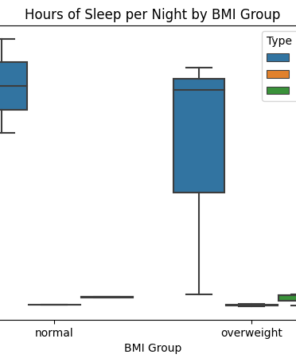
Sleep
Users in the Normal BMI group get more sleep and more consistent sleep.
Users in the Overweigth BMI group get less sleep and less consistent sleep.

Slide 10

Summary
Normal BMI Users
More Consistent Daily Steps
More Light Intensity Activity
More Sleep
Overweight BMI Users
Less Consistent Daily Steps
More Hight Intensity Activity
Less Sleep

Slide 11
Conclusion
Simple but consistent lifestyle changes will lead to better health outcomes.
Regularly getting your steps in.
More light intensity activity.
Getting proper and consistent sleep.

Slide 12

Action to Take
Promote products that help maintain small but impactful lifestyle habits.

Slide 13

Future Analysis
Increase sample size
Wider range of BMI types
More information on nutrition
Alternative to BMI for health metric

