Slide 1
Fine-Grained Fruit Classification
EfficientNet-B3 Classification

Slide 2

1. Our topic: Fine-grained Fruit Classification
Our goal is to build a system that classifies 20 fruit varieties from photographs.
🍎 Apples
🍌 Bananas
🥝 Kiwis
🍐 Pears
🍅 Tomatoes
8 varieties
3 varieties
2 varieties
5 varieties
2 varieties
The core challenge: many fruits look nearly identical.

Slide 3
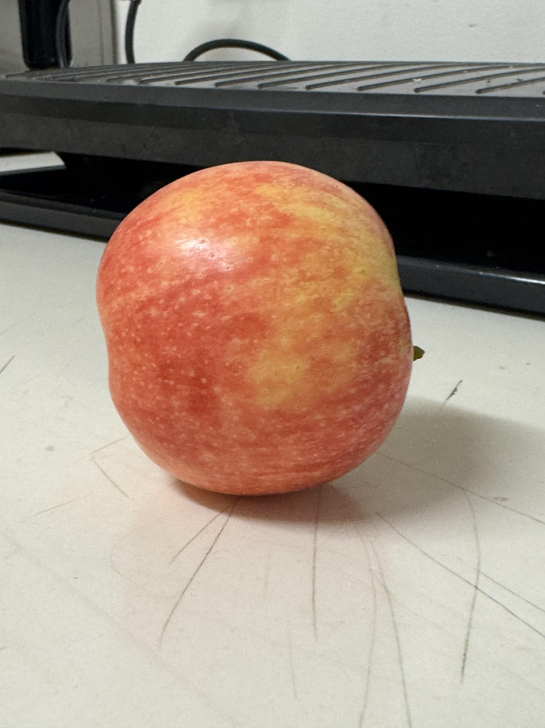
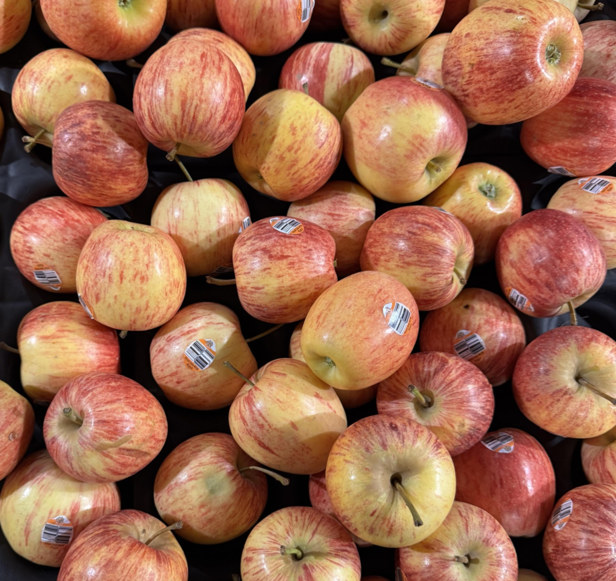
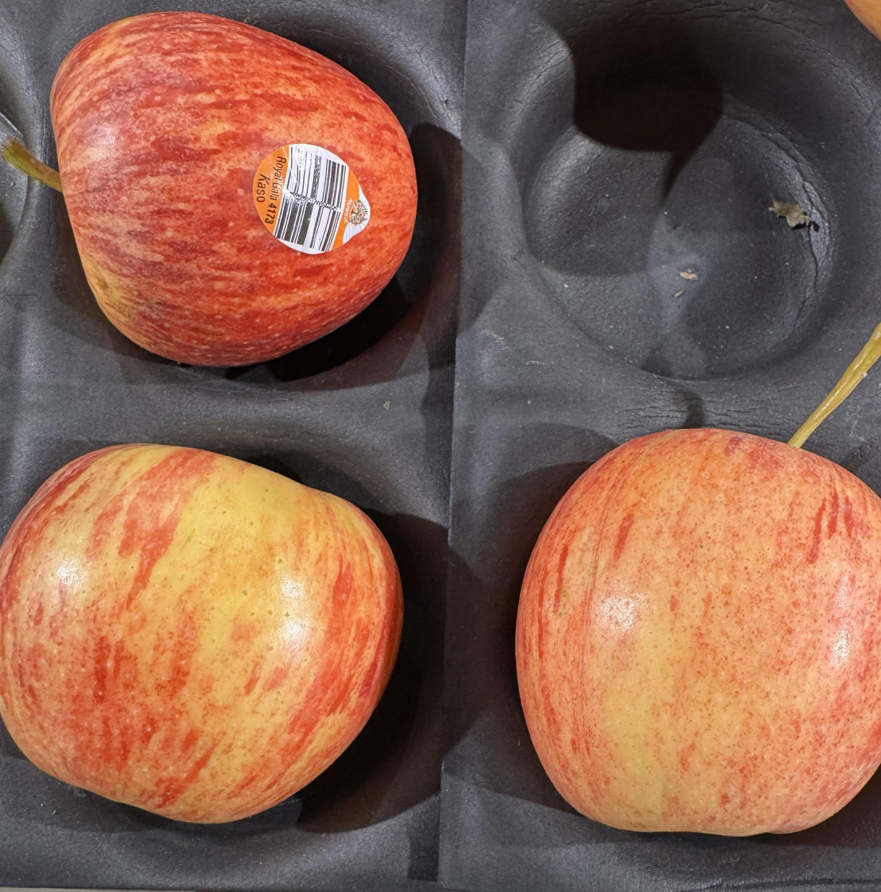
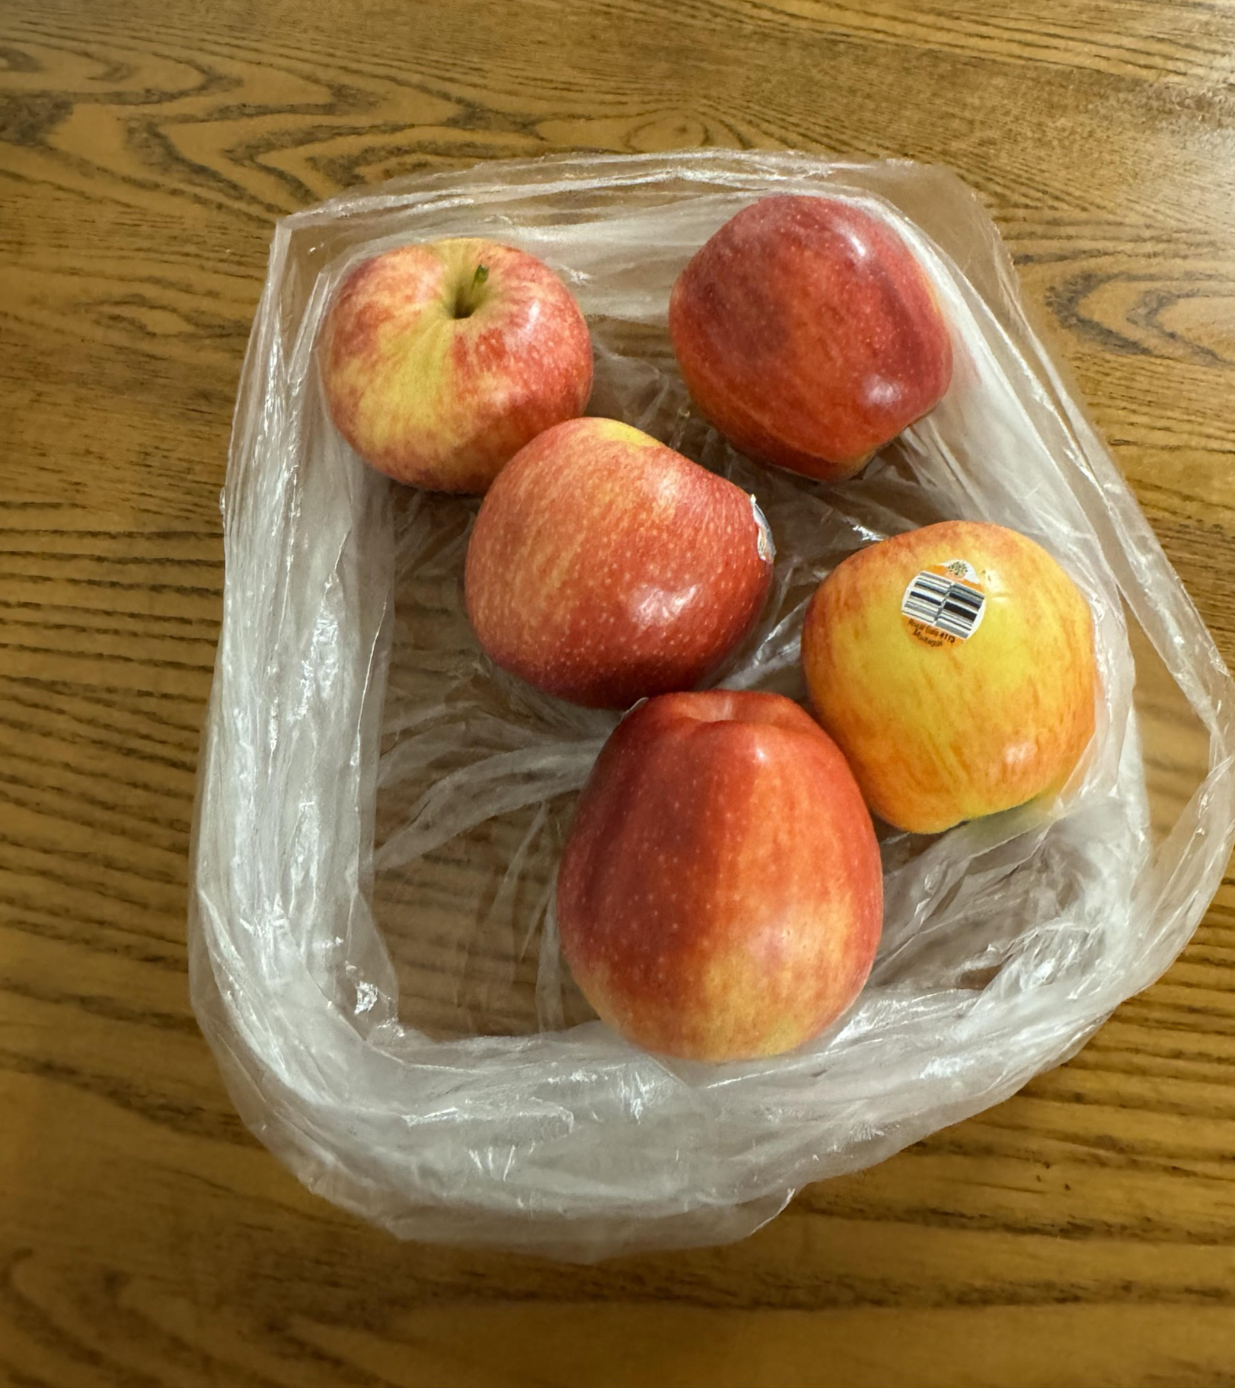
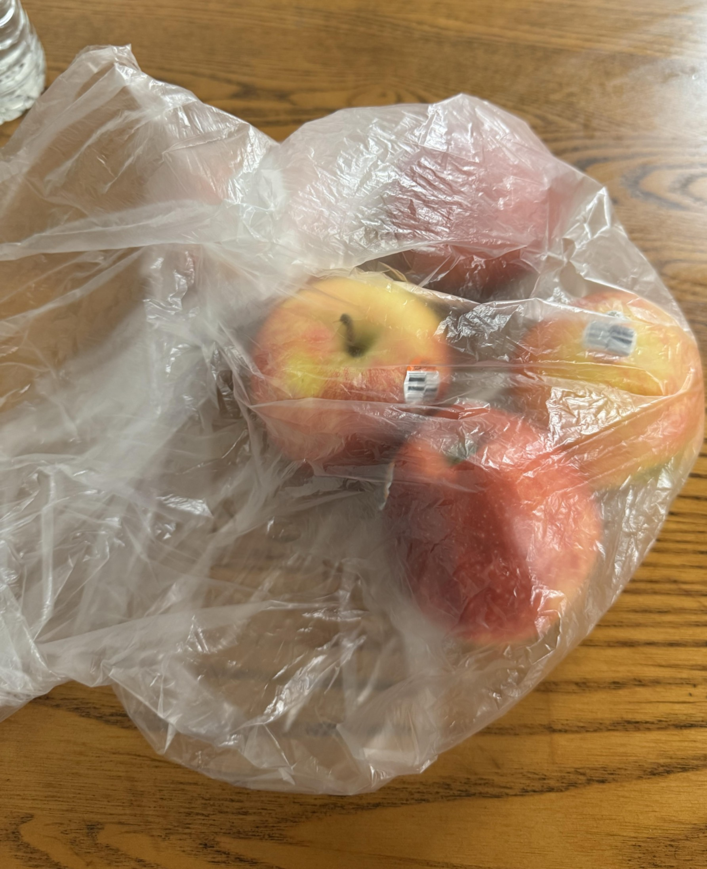
2. Dataset
How Images Were Captured
Devices:
iPhone & Android smartphones
Backgrounds:
Tables, bags, hands, various surfaces
Angles:
Top, side, close-up, and angled shots
Lighting:
Natural, artificial, and mixed light
Ripeness:
Multiple ripeness stages per variety
Packaging:
Some fruits in clear plastic bags
32 robot camera images for each apple royal gala, pink lady, granny smith kept separate for fine tuning and evaluation.

Slide 4
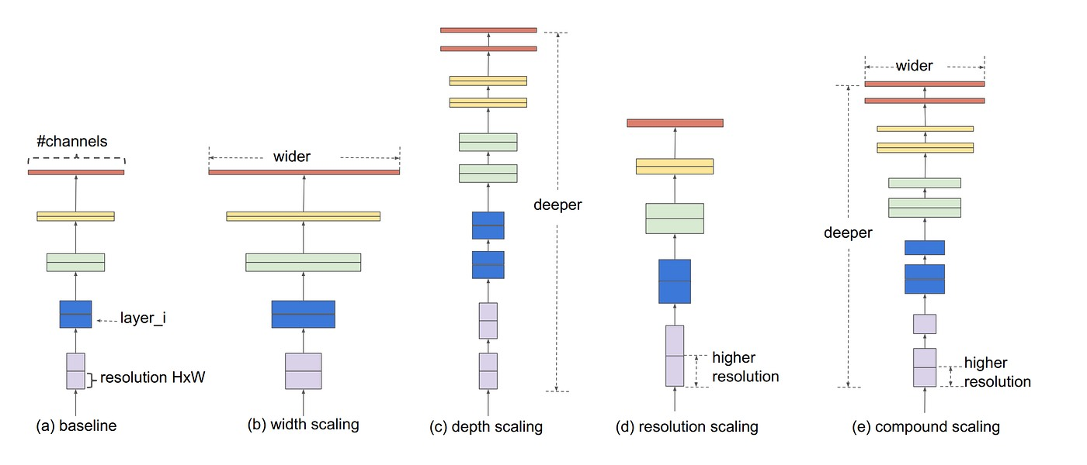
3. Why EfficientNet-B3?
Most CNN architectures scale up by going either
DEEPER (more layers)
EfficientNetB3 follows compound scaling
✓
It scales all three together in a principled ratio, keeping the network balanced.
Higher resolution is useless if the network is too shallow to process the detail.
Going deeper is wasteful if channels are too narrow to carry information.
Early layers learn edges → middle layers learn shapes → deep layers learn high-level concepts
✗
✗
Vanishing gradients at extreme depth; sharp diminishing returns
WIDER (more channels)
✓
More diverse feature detectors running in parallel per layer
✗
Saturates fast. A very wide but shallow network can't learn complex multi-step abstractions, because width doesn't add representational depth.
HIGHER RESOLUTION (larger input)
✓
More spatial detail — catches subtle texture & colour differences
✗
4× more compute per resolution doubling; accuracy plateaus fast
Tan & Le (2019). EfficientNet: Rethinking Model Scaling for Convolutional Neural Networks. ICML.

Slide 5
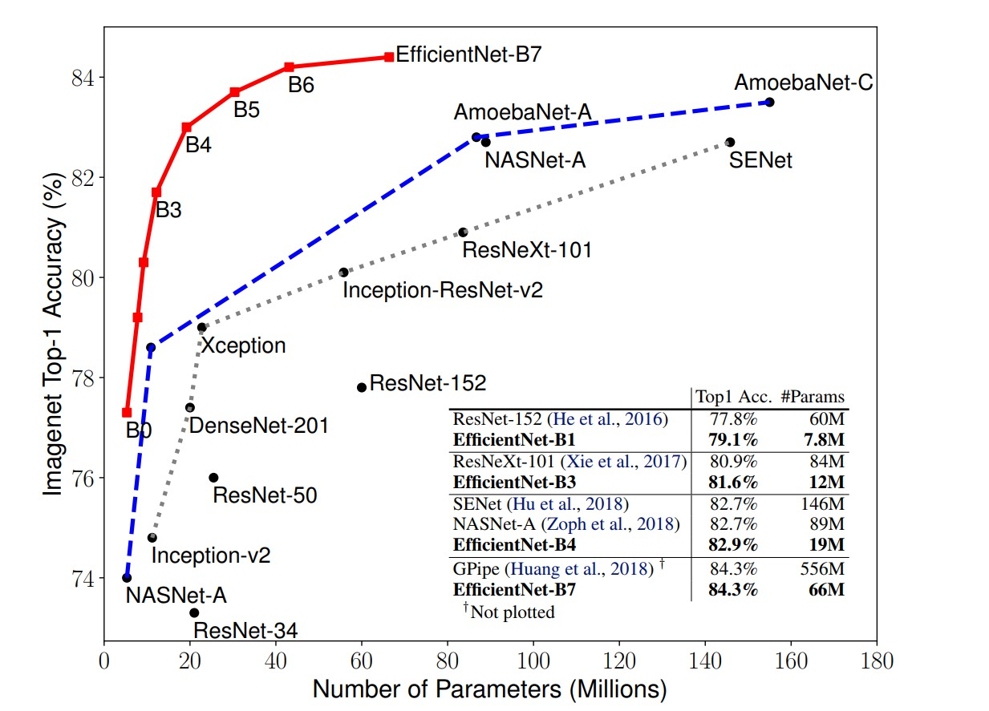
3. Why EfficientNet-B3?
Why EfficientNet-B3?
300 × 300 input
High-resolution input captures the fine colour & texture detail needed to tell apple varieties apart.
12M parameters
Compact enough to train well on a small dataset of ~1,500 images.
ImageNet pretrained
Starts with rich general visual knowledge, needing only fine-tuning for fruit.
Tan & Le (2019). EfficientNet: Rethinking Model Scaling for Convolutional Neural Networks. ICML.

Slide 6
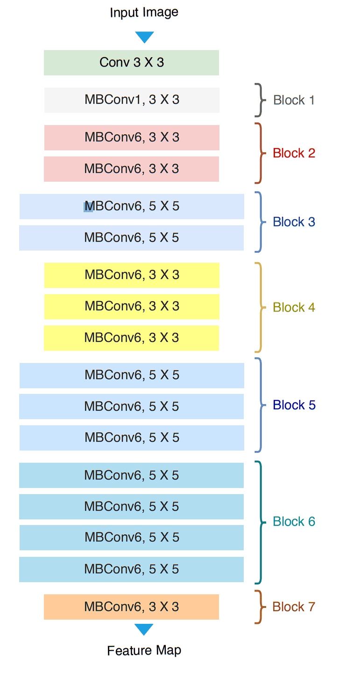
4. EfficientNet-B3 Architecture: Inspiration
Instance
Tree-1
Tree-2
· · ·
Tree-n
Class-A
Class-B
Class-B
Majority-Voting
Final-Class → Class-B
Tashin & Noor (2021). EfficientNet: Classification and understanding of cloud structures via satellite images with EfficientUNet

Slide 7
Instance
Tree-1
Tree-2
· · ·
Tree-n
Class-A
Class-B
Class-B
Majority-Voting
Final-Class → Class-B
Each decision tree independently classifies the instance by following a path through its nodes. The majority class across all trees becomes the final prediction — reducing variance and improving accuracy over a single tree.

Slide 8
4. Tapping Mechanism
INPUT
EfficientNet-B3 Backbone
Grad-CAM Heatmap
Focus Region
Guided Aug.
Block 1
Block 2
Block 3
Crop and enlarge
Block 4
A Fruit
Block 5
COOL
HOT
+ distracting
background
Block 6
Voted + Constrained
Heatmap kept only inside foreground mask — ignores shelves, packaging, background.
Foreground Overlap Score
Blur non-focused background
Block 7
"Does the heatmap
actually point at
the fruit?"
conv_head
(always added)
Only inside
focus region
1 Input
2 Backbone
3 Grad-CAM
4 Vote & Mask
5 Augment
Notes:
In this diagram, we can see the full pipeline of how tapping works in our model. We fed all photos of fruits with backgrounds into the EfficientNet-B3 backbone, which processes it through 7 blocks. From my testing, I notice that from block 1 to block 5, some blocks targets on whole photos, some blocks target on the background not the fruit.We tap Block 6, Block 7, and always include the convolutional head output — these are the three points where we grab copies of the features for our IEL head. These tapped features are then used to generate a Grad-CAM heatmap, which essentially asks "where is the model actually looking?". We then check whether this heatmap overlaps with the actual foreground — the fruit — rather than background noise like shelves or packaging. If it passes this check, we use the focus region to guide augmentation: either cropping and enlarging the fruit area, or blurring everything outside it. The key insight is that by tapping multiple deep layers rather than just the final one, our Grad-CAM heatmaps are more reliable and better localised on the fruit, which in turn makes the augmentation more targeted and more effective.

Slide 9
Multi-Layer Voting (MLV) — Architecture Diagram
tap_blocks = [-1]
INPUT
EfficientNet-B3
Grad-CAM Heatmap
Focus Region
Guided Aug.
Block 1
Block 2
Crop and enlarge
Block 3
A Fruit
Block 4
COOL
HOT
+ distracting
background
Voted + Constrained
Block 5
Heatmap is kept only inside the foreground mask — ignoring shelves, packaging, backgrounds.
Foreground Overlap Score
Blur non-focused background
tap =
[-1]
Block 7
"Does the heatmap
actually point at
the fruit?"
Only inside
focus region
1 Input
2 Backbone
3 Grad-CAM
4 Vote & Mask
5 Augment
Grad-CAM heatmaps reveal where each block "looks". The foreground mask constrains the vote to the fruit surface. Only the final block is used (tap_blocks = [-1]).
Notes:
Early blocks (B1–B5) see locally, with no context. When B2 detects "edges," it detects every edge in the image — the fruit's outline, the shelf's edge, the plastic packaging border, the sticker — all equally. It has a tiny receptive field so it has no idea what object an edge belongs to. Its heatmap spreads all over the image because it genuinely can't tell the apple edge apart from the shelf edge.
Block 6 sees globally, with full context. By the time features reach B6, the receptive field has expanded to cover nearly the whole image. B6 has learned to ask "which region in this entire scene is the discriminative fruit object?" — not "where are there edges?" It has enough context to know that a red round thing in the centre is the fruit, and the rectangular grey thing behind it is a shelf. That's why its attention lands on the fruit.
So the paradox isn't really a paradox: the more a layer "understands," the better it can ignore irrelevant details. Early layers are powerful but blind — they fire on everything. B6 is selective precisely because it sees the big picture.

Slide 10
5. Training Technique
Stage 1 — Foundation Training
Stage 2 — Guided Augmentation
Phase 3 — Robot Fine-Tuning
• Train on original phone images (30 epochs) • Frozen backbone first, then top 3 blocks unfrozen • Goal: build reliable fruit features • Generate Grad-CAM heat maps
• Use heat maps to apply smart augmentation: – Blur backgrounds outside the fruit region – Crop & enlarge the high-attention fruit area • Train for another 30 epochs • Top 4 backbone blocks unfrozen
• Start from best Stage 2 checkpoint • 15 epochs on ~20 robot images per class • Adapts to new camera environment quickly • Robot images kept fully separate until here
→
→
Why two stages? The model must first learn to classify fruit before its attention maps become reliable enough to guide augmentation. Applying Grad-CAM guidance from scratch would be circular — the model has nothing meaningful to attend to yet.

Slide 11
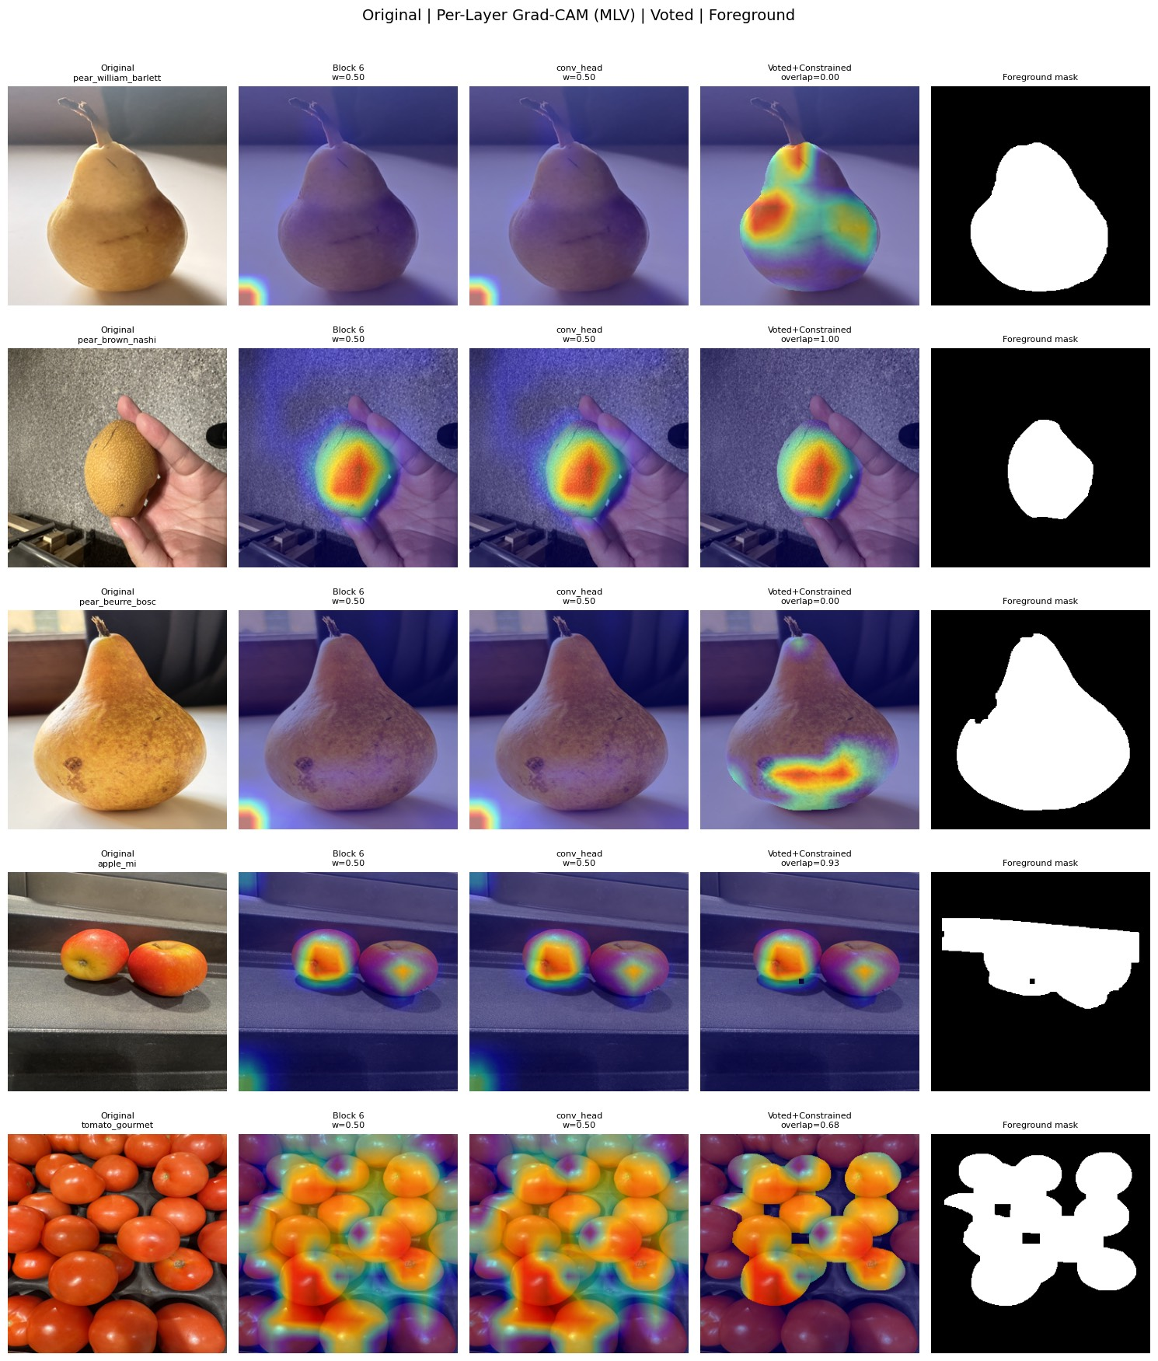
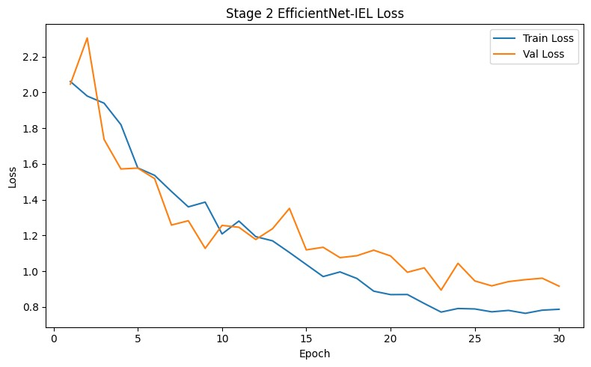
6. Results: Standard 20-Class Performance
91.55%
0.9098
Test Accuracy
Macro F1 Score
426 images
Across all 20 classes

Slide 12
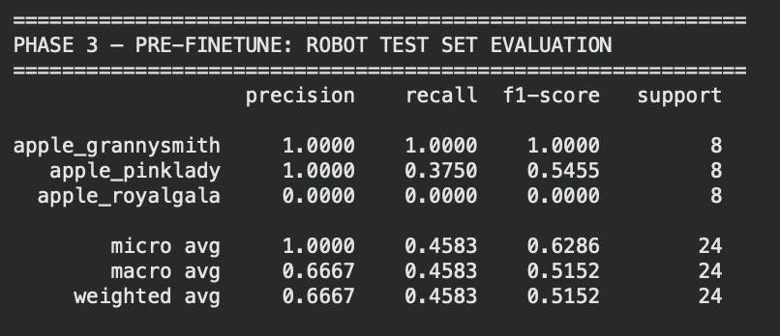
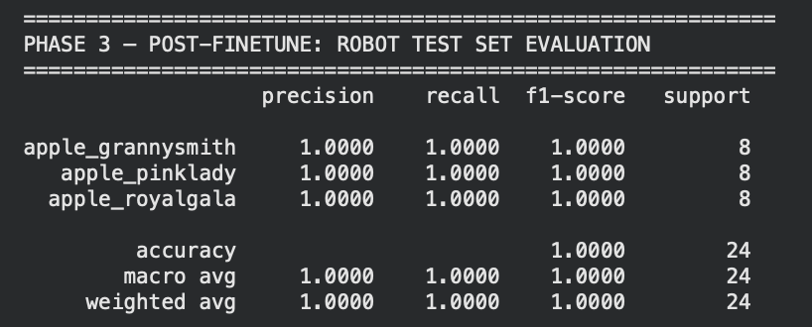
6. Results: Robot Camera Evaluation
Before Fine-Tuning
After Fine-Tuning
→
60/15/25 Train-Test Split - Fine Tune for 15 epochs

Slide 13
7. Discussion: What Worked & Common Errors
✓ What Worked Well
✗ Common Error Patterns
Grad-CAM guided augmentation
Multi-layer voting
Stage 2 consistently lowered validation loss across all 30 epochs — genuine generalisation gain.
Although it works well, it still focuses on backgrounds in some images. This technique should be more clearly examine to provide higher accuracy
Multi-layer voting
Generally, the architecture works well, it captures on the fruit.
Unusual capture conditions and more images
Lighting is one of main issues as it changes the fruits colors which can affect the prediction. More images with different lighting setting could help the improvement. Similar issue to fruits in plastic bags. Require a technique to separate the bag and the object inside of it.
EfficientNet compound scaling
Rich, multi-level feature hierarchy captured both colour and texture detail.
Robot images
Rapid robot adaptation
Images from robot has lower resolution, and the environment setting is quite dark which makes it hard to differentiate apple pink lady and apple royal gala.
High accuracy on robot test set after just 15 fine-tuning epochs with minimal data.

Slide 14
Thank You

Slide 15
4. Discussion — Further Improvement Strategies
📸
Expand the Dataset
🎯
Better Foreground Detection
🤖
More Robot Training Data
More images per class — especially for Ambrosia, Jazz, and Kanzi — would directly address the remaining confusion between similar apple varieties.
Replace GrabCut with a dedicated segmentation model to produce cleaner heat maps, especially in complex backgrounds with multiple objects.
Collect 50–100 robot images per class (from ~20 now) to make domain adaptation more robust to lighting and angle variation.
🧠
Newer Architectures
⚖
Additional Sensors
Test ConvNeXt or Vision Transformers — these have shown improvements over EfficientNet on fine-grained visual tasks with comparable parameter counts.
Combine camera with weight sensors or near-infrared spectroscopy — Kanzi and Jazz differ in internal composition even when external colour is indistinguishable.

