Slide 1
BLOSUM scores compared to single SNAP scores
Thomas Eska, Paul Hager, Thomas Heinzinger

Slide 2
Outline
Task
Dataset
Feature
Algorithm structure and Hyperparameters
Performance

Slide 3
Task
Predict binding site residues using SNAP features
Extension: Do BLOSUM scores aid in the prediction?

Slide 4
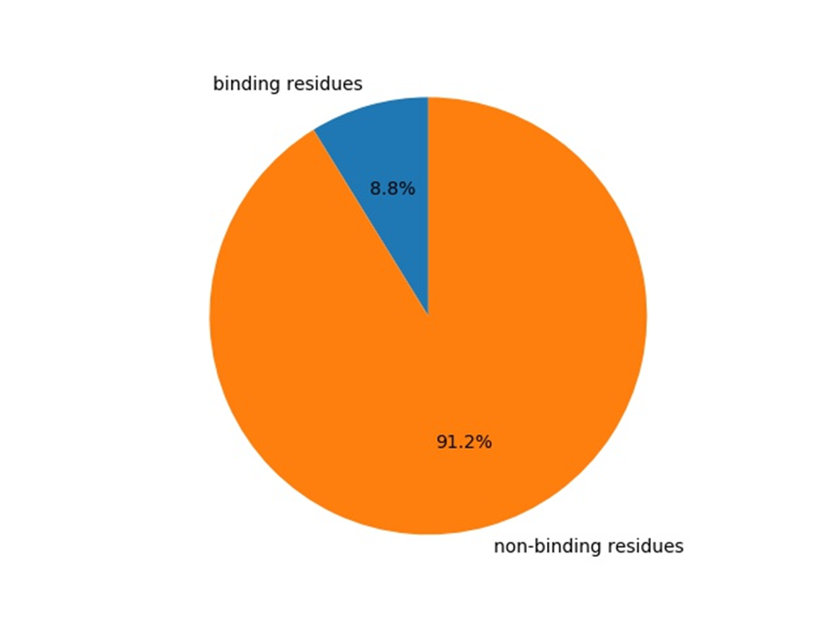
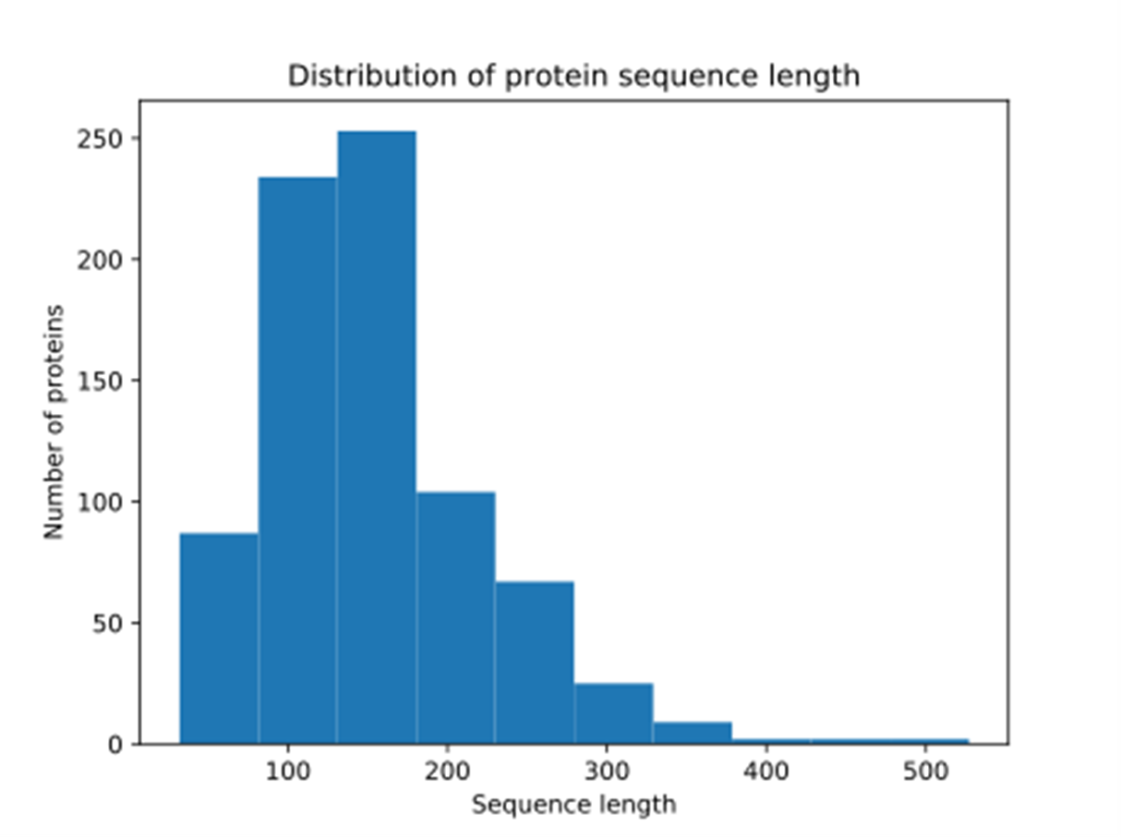
Training dataset
769 Proteins from BioLip
→ 117435 residues

Slide 5
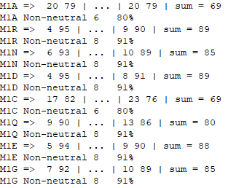
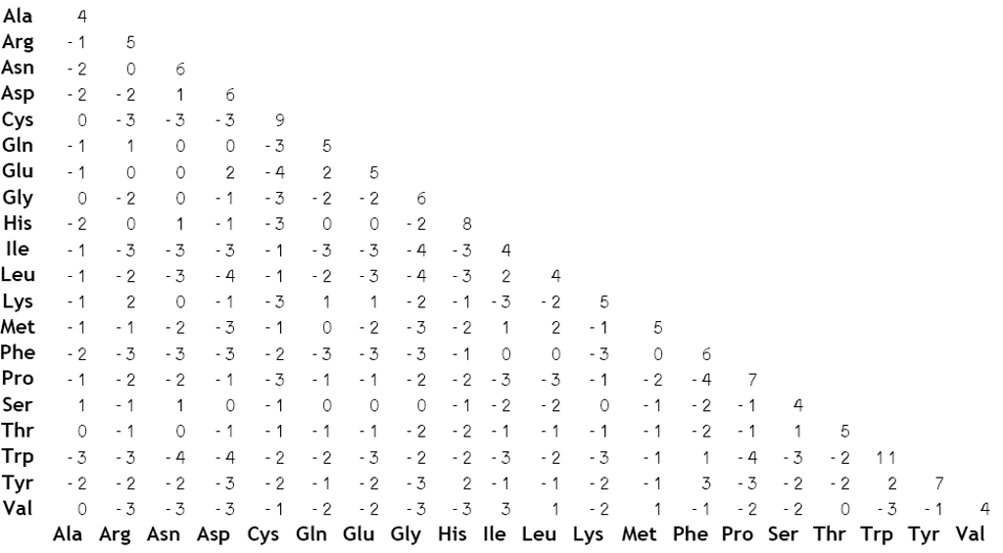
Feature: Introduction
SNAP-scores
BLOSUM62-scores

Slide 6
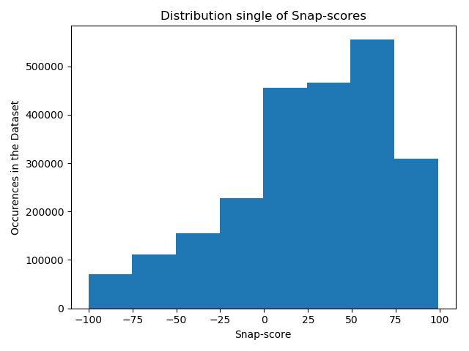
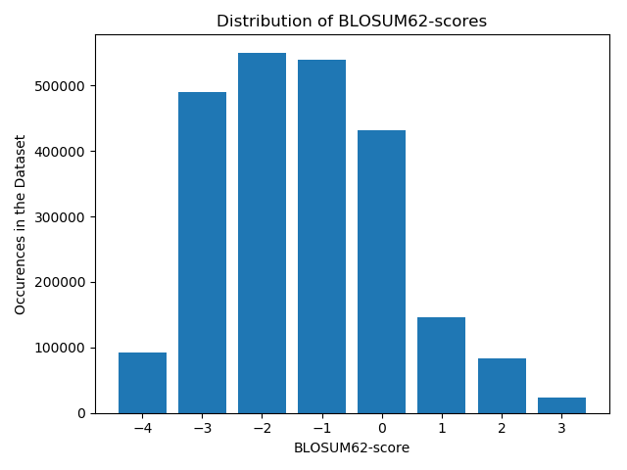
Distribution of Scores

Slide 7
Feature: First Ideas
Large (-) BLOSUM => Very unlikely substitution => Strong functional effect
Requires high SNAP2 to be functionally significant (i.e. binding)
Large (+) BLOSUM => Very likely substitution => Weak functional effect
Small SNAP2 can still imply functional significance (i.e. binding)
Set cutoffs to map BLOSUM to SNAP scores
BLOSUM diagonal can be ignored
Result:
[-1, 1, -1, -1, -1, 1, 1, -1, -1, -1, -1, 1, 0, -1, 1, 1, 1, 1, -1, -1]

Slide 8
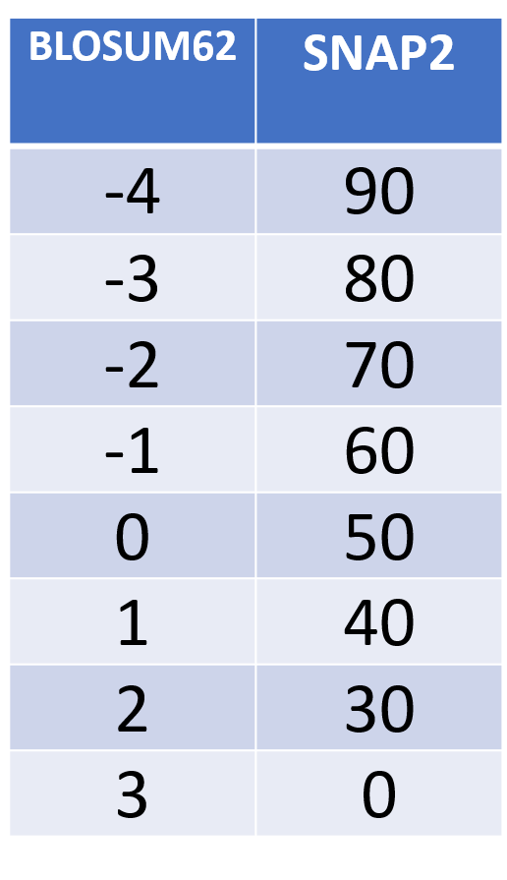
CUTOFFS
CONVERSION
Mutation | BLOSUM | SNAP | Feature
M -> A | -1 | 59 | -1
M -> R | -1 | 91 | 1
M -> N | -2 | 85 | 1
M -> D | -3 | 80 | -1
M -> C | -1 | 80 | 1
… | … | … | …
M -> V | 1 | 82 | 1

Slide 9

Cutoff Results
Cross-Validation with original params
MCC = 0.001
Predicts similar to random (random = 0)
Problem: Too little information to get meaningful results

Slide 10
Feature: Raw Scores
Solution: input raw scores
[48, -1, 75, -1, 70, -2, 79, -3, 36, -1, 58, 0, 76, -2, 73, -3, 67, -2, 15, 1, 24, 2, 76, -1, 0, 0, 30, 0, 79, -2, 65, -1, 62, -1, 68, -1, 51, -1, 27, 1]

Slide 11
Feature: Scaled Values
BLOSUM scores are very small compared to SNAP scores
[48, -25, 75, -25, 70, -50, 79, -75, 36, -25, 58, 0, 76, -50, 73, -75, 67, -50, 15, 33, 24, 66, 76, -25, 0, 0, 30, 0, 79, -50, 65, -25, 62, -25, 68, -25, 51, -25, 27, 33]

Slide 12
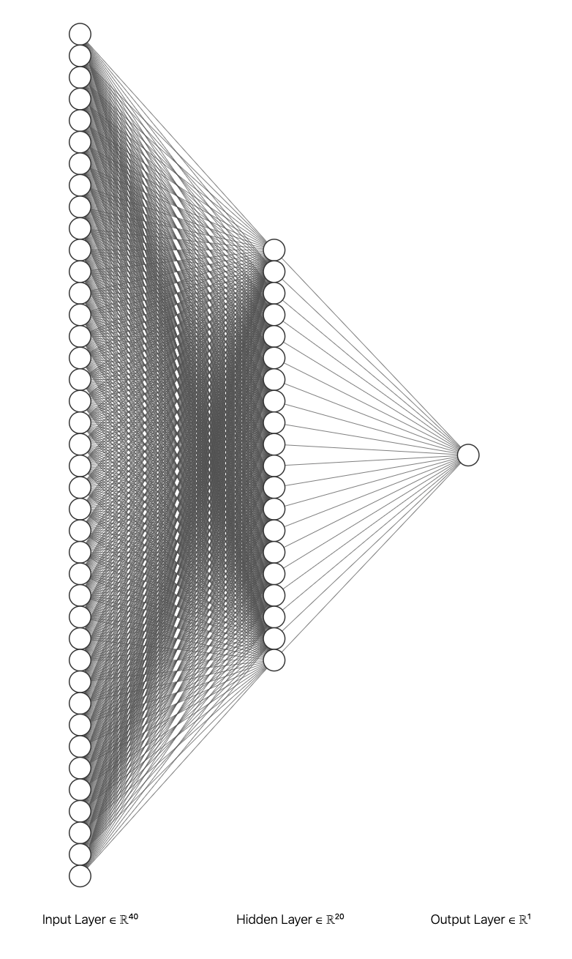
Algorithm
Single layer ANN
40 input units, 1 output unit
20 hidden units
Weighted loss
Binary Cross Entropy Loss & Sigmoid

Slide 13
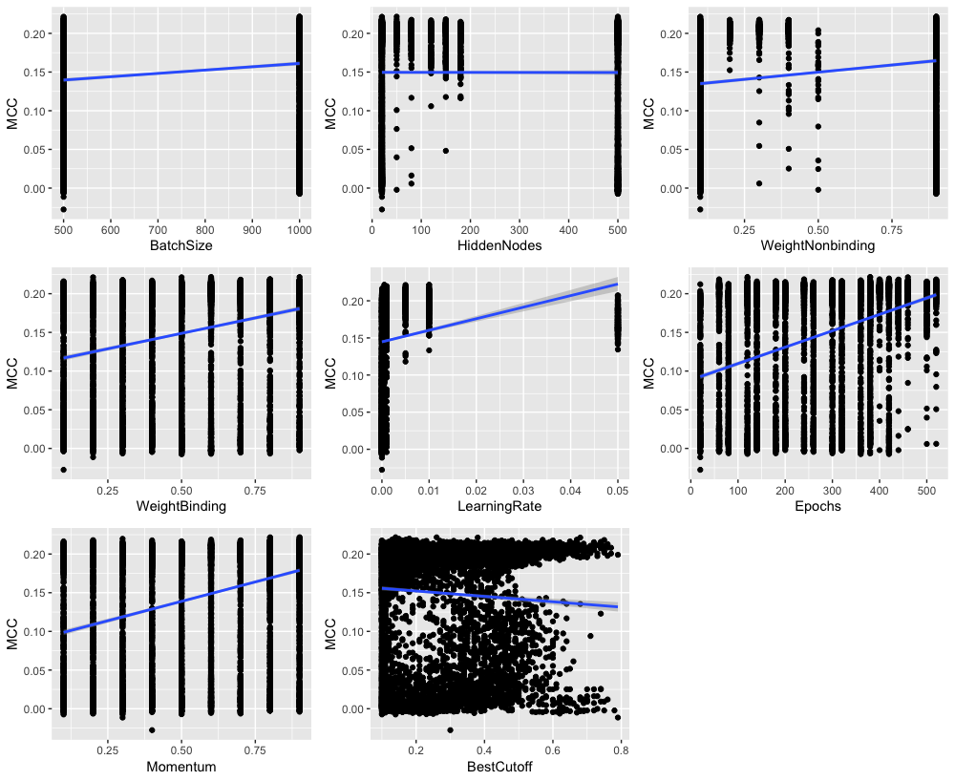
Hyperparameter
Batch Size: 500
Weights:
Binding: 0.5
Non-binding: 0.1
Learning rate: 0.005
Prediction Cutoff: 0.57
Momentum: 0.9
Epochs: 380

Slide 14
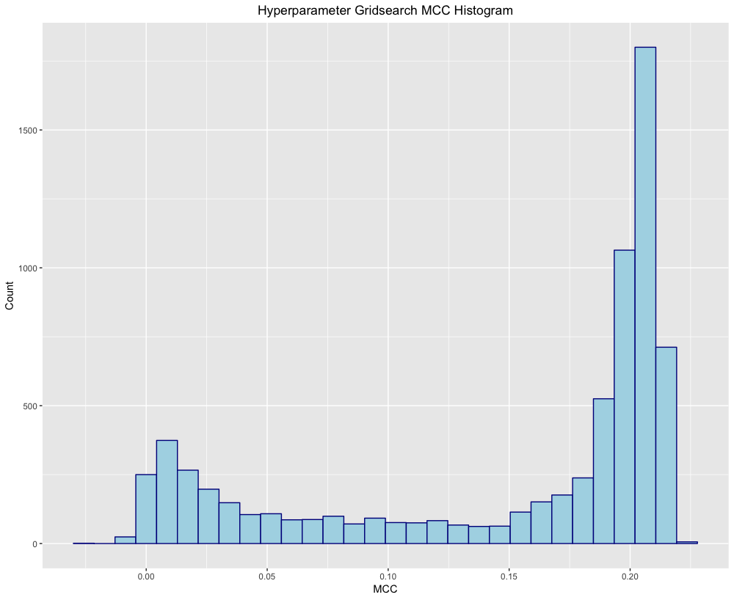
Hyperparameter

Slide 15
Testing Different BLOSUM Matrices
 | No BLOSUM | BLOSUM45 | BLOSUM62 | BLOSUM80
MCC | 0.20 ± 0.01 | 0.206 ± 0.009 | 0.197 ± 0.008 | 0.197 ± 0.009
F1 | 0.27 ± 0.01 | 0.263 ± 0.009 | 0.255 ± 0.008 | 0.254 ± 0.009
Precision | 0.27 ± 0.01 | 0.31 ± 0.01 | 0.30 ± 0.01 | 0.30 ± 0.01
Recall | 0.26 ± 0.01 | 0.229 ± 0.008 | 0.222 ± 0.008 | 0.220 ± 0.008

Slide 16
Testing Dataset
31827 residues from BioLip
(No overlap with training data)
No other information known

Slide 17
Confusion Matrix
 | Binding | Non-binding
Predicted Binding | 1041 ~3.3% | 1506 ~4.7%
Predicted Non-binding | 2320 ~7.3% | 26960 ~84.7%

Slide 18
…compared to random
Our Prediction
Random Prediction
 | Binding | Non-binding
Predicted Binding | 1041 ~3.3% | 1506 ~4.7%
Predicted Non-binding | 2320 ~7.3% | 26960 ~84.7%
 | Binding | Non-binding
Predicted Binding | 277 ~0.8% | 2377 ~7.4%
Predicted Non-binding | 3084 ~9.6% | 26089 ~81.9%

Slide 19
Performance
Imbalanced Dataset => Matthews correlation coefficient
Other measures:
F1-score
Precision
Recall/TPR

Slide 20
Performance
Cross-validation:
MCC: 19% ± 1%
F1-score: 19% ± 1%
Precision: 40% ± 2%
Recall: 13.4% ± 0.7%
Coverage: 1
Testset:
MCC: 29.1% ± 0.7%
F1-score: 35.2% ± 0.6%
Precision: 40.9% ± 0.6%
Recall: 31.0% ± 0.9%
Coverage: 1

Slide 21
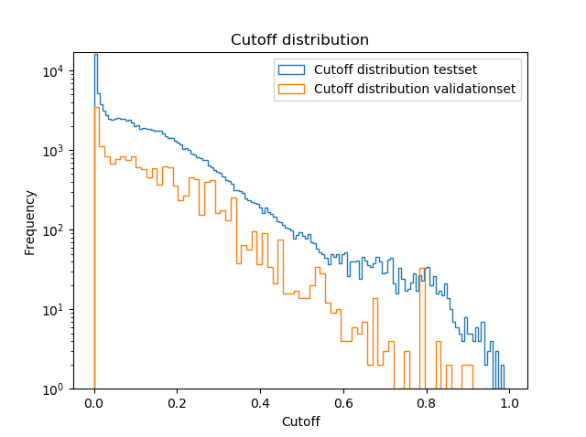
Cutoff Distribution

Slide 22
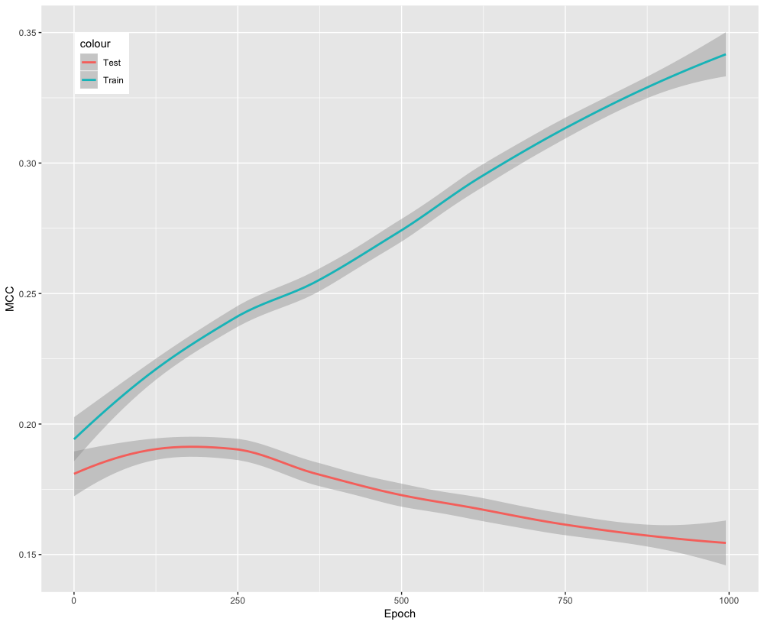
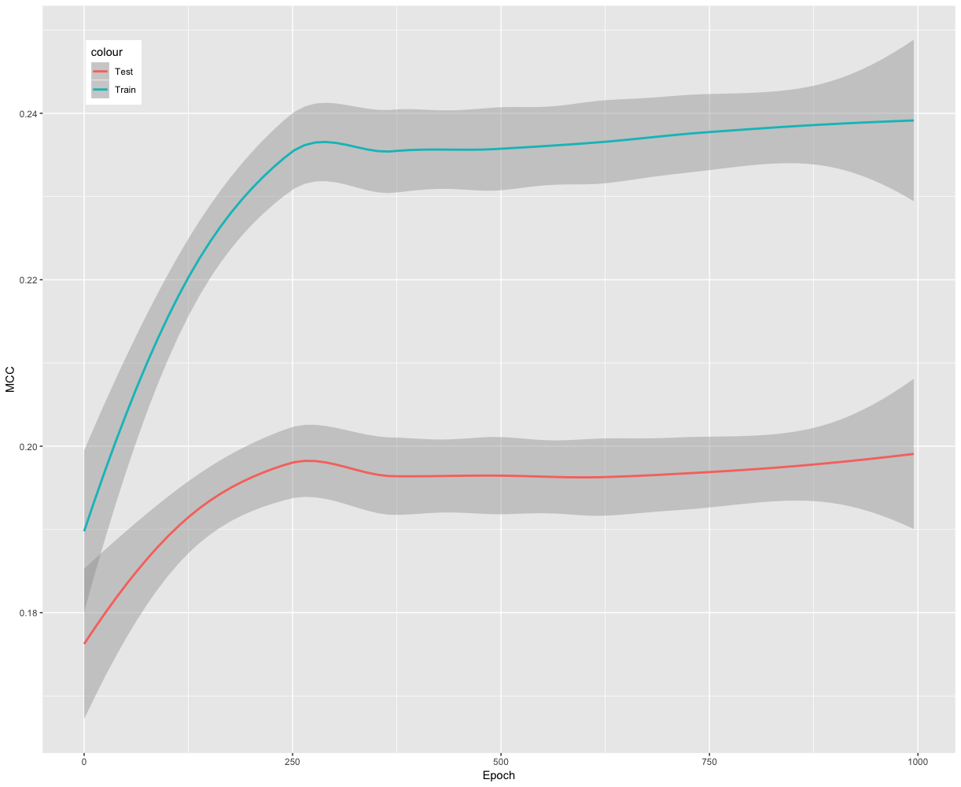
Testing for overfitting

Slide 23
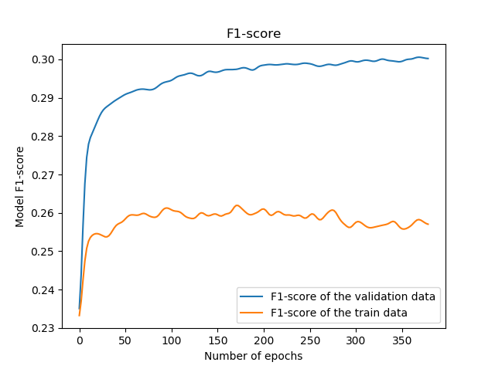
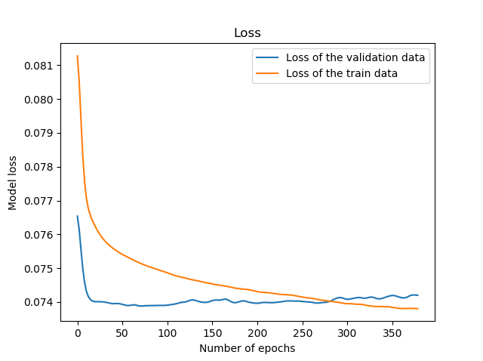
Testing for Overfitting

Slide 24
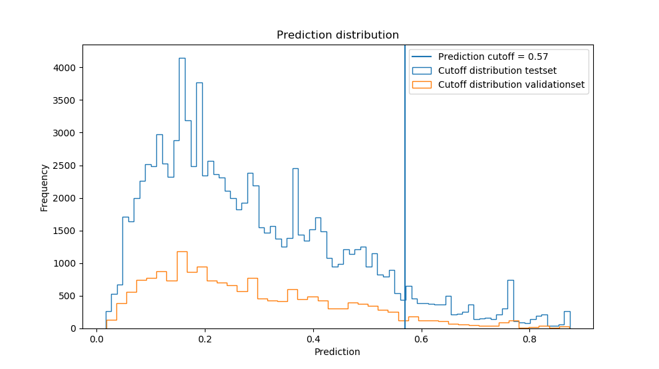

Slide 25
Thank you!
Questions?

Slide 26
Sources
[1] Yang, J et al. “BioLiP: a semi-manually curated database for biologically relevant ligand-protein interactions.” Nucleic acids research (2012)
[2] Tyzack, J et al. “Ranking enzyme structures in the PDB by bound ligand similarity to biological substrates.” Structure (2017)
[3] Schelling et al. “Evolutionary couplings and sequence variation effect predict protein binding sites.” Proteins: Structure, Function, and Bioinformatics (2018)
[4] Hecht, M et al. “Better prediction of functional effects for sequence variant.” BMC Genomics (2015)

Slide 27
stats
TP: 519
FP: 517
TN: 27949
FN: 2842
FPR: 0.01816201784585119
Precision: 0.500965250965251 ± 0.016364012582564594
Recall/TPR: 0.15441832787860757 ± 0.006444302866129453
F1-score: 0.2360700477598363 ± 0.008823521693012324
MCC: 0.23597300754427067 ± 0.00979017430278977

Slide 28
Stats crossvalidation
TP: 1401
FP: 2221
TN: 105203
FN: 9076
TPR: 0.13372148515796506 ± 0.006728852995094254
FPR: 0.020675081918379506 ±
Precision: 0.38680287134180014 ± 0.01515588223022108
MCC: 0.1864096719348082 ± 0.009743841686838386
F1: 0.1898892068383594 ± 0.008877620919506887

