Slide 1
BLOSUM scores compared to single SNAP2 scores
Thomas Eska, Paul Hager, Thomas Heinzinger

Slide 2
Feature: First Ideas
Large (-) BLOSUM => Very unlikely substitution => Strong functional effect
Requires high SNAP2 to be functionally significant (i.e. binding)
Large (+) BLOSUM => Very likely substitution => Weak functional effect
Small SNAP2 can still imply functional significance (i.e. binding)
Cutoffs:
-4: 90, -3: 80, -2:70, -1: 60, 0:50, 1:40, 2:30, 3:0
BLOSUM diagonal can be ignored
Result:
[-1, -1, -1, -1, 1, -1, 1, -1, -1, 1, 0, -1, -1, 1, 1, -1, -1, -1, 1, 1]

Slide 3
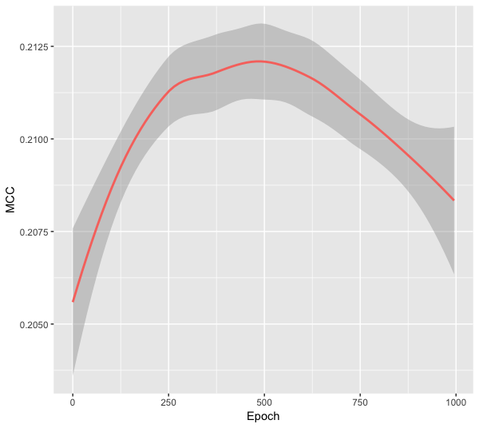
Testing for Overfitting

Slide 4
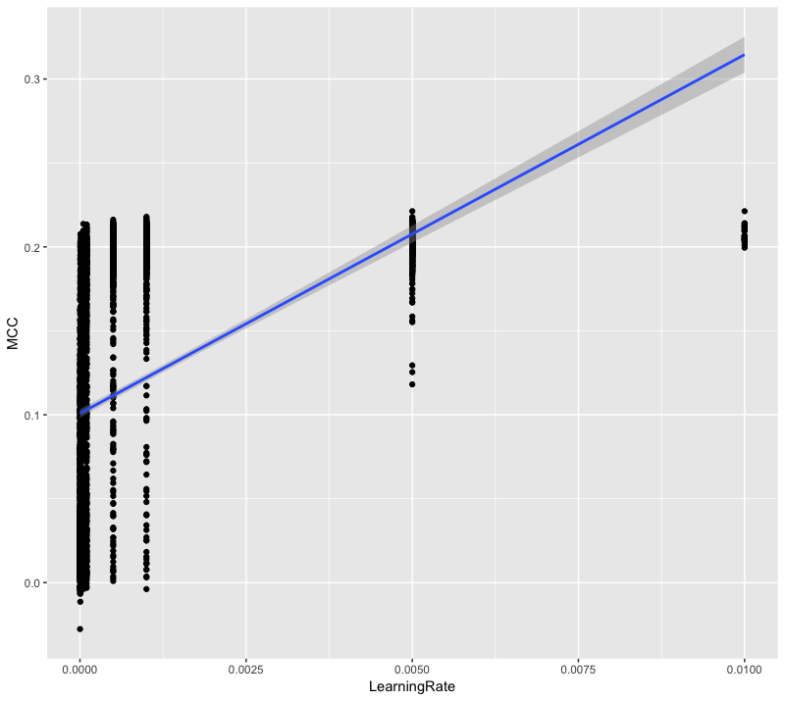
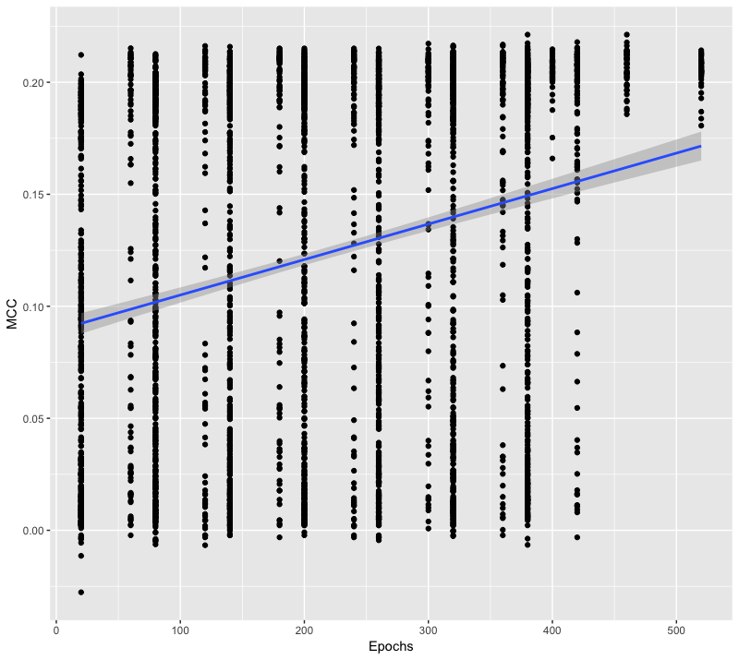
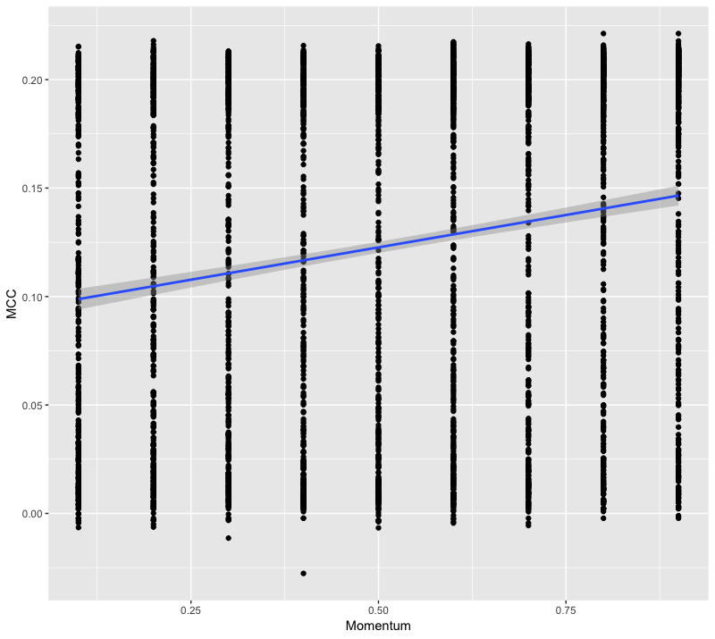
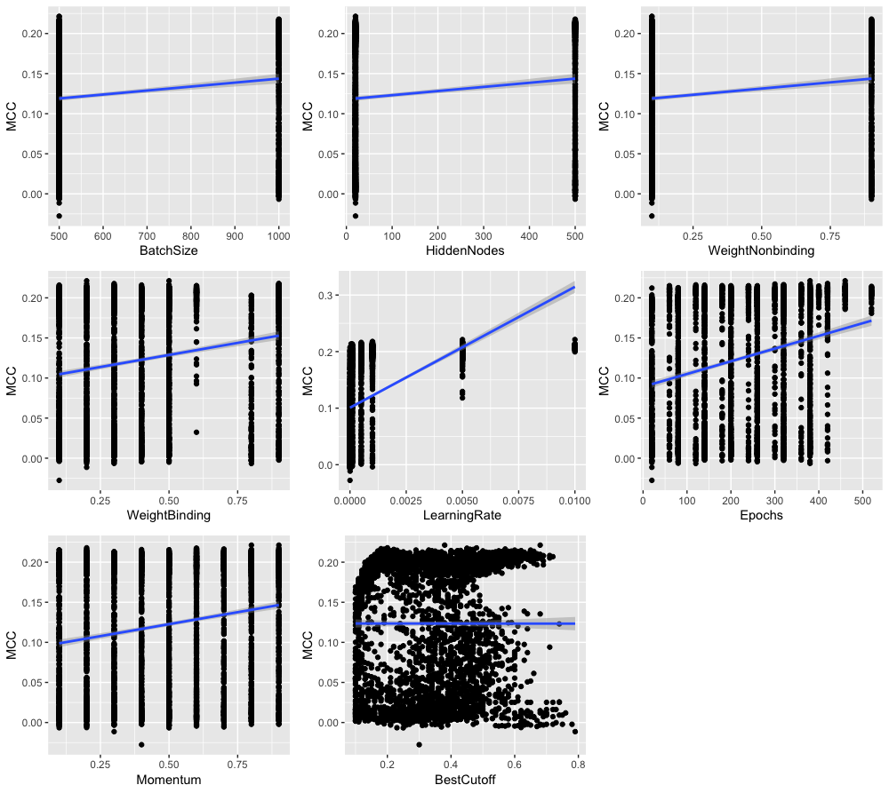
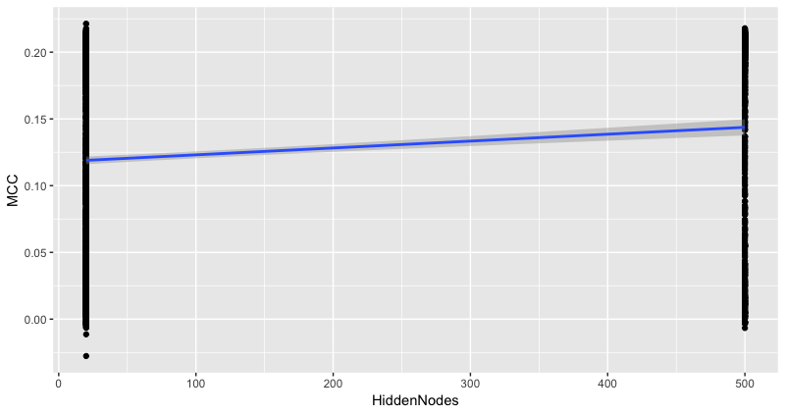
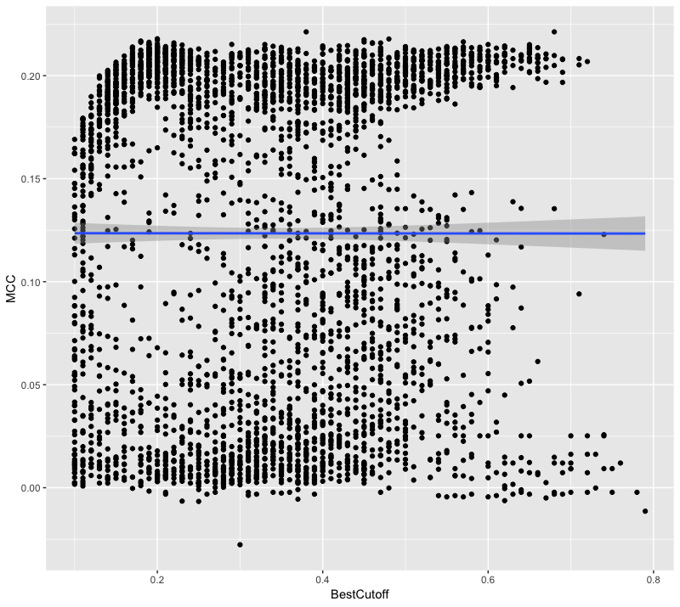
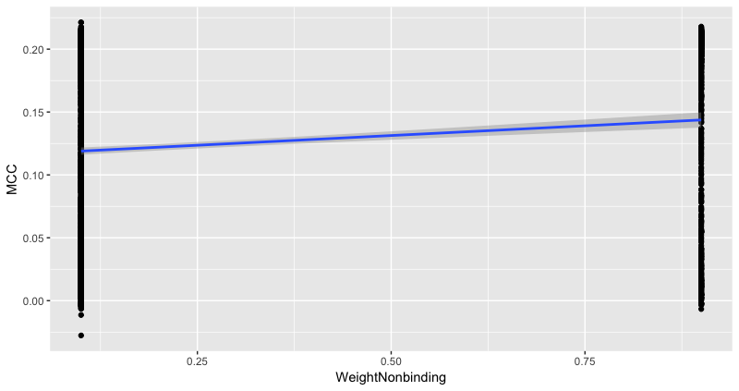
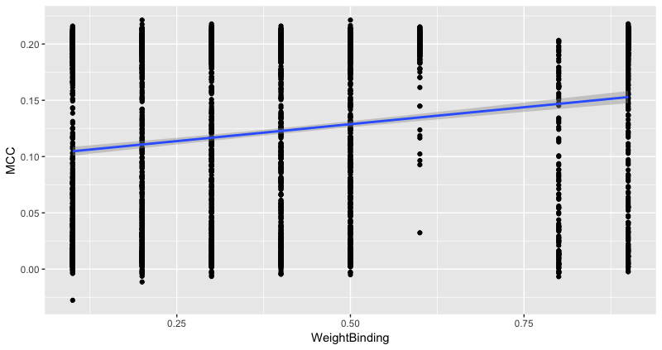
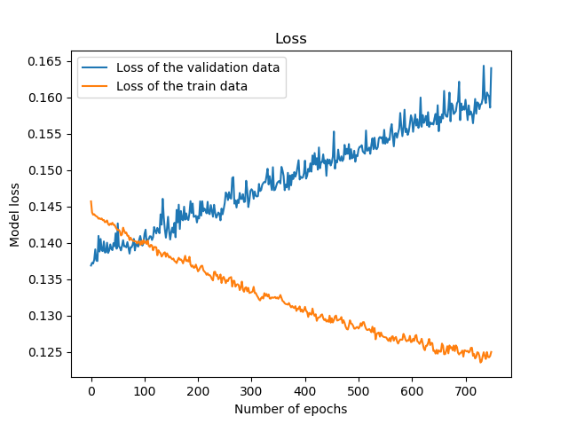
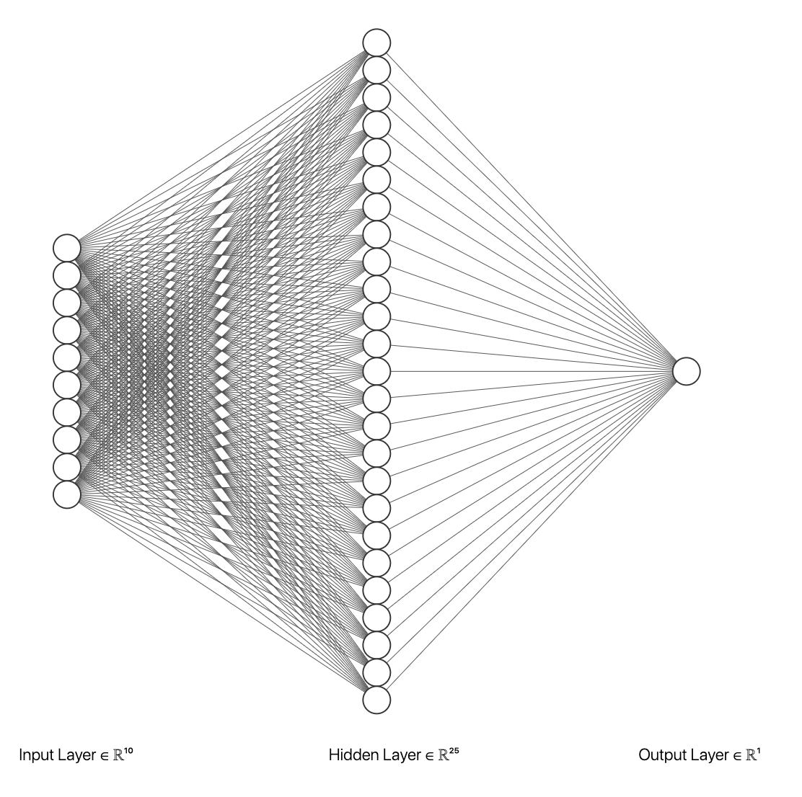
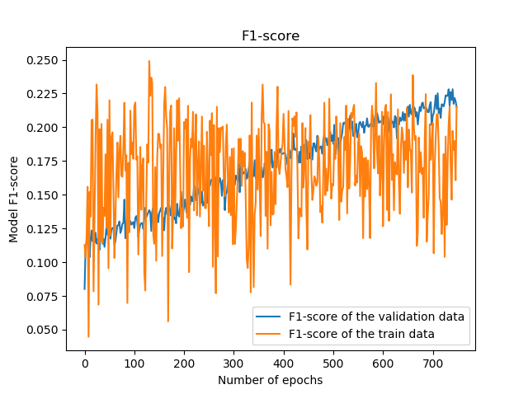
Hyper Parameter Grid Search

Slide 5
Confusion Matrix
 | True | False
Predicted True | 519 ~1.6% | 517 ~1.6%
Predicted False | 2842 ~8.9% | 27949 ~87.8%

