Slide 1
BLOSUM scores compared to single SNAP scores
Thomas Heinzinger, Thomas Eska, Paul Hager

Slide 2
Outline
Feature
Algorithm structure and Hyperparameters
Performance

Slide 3
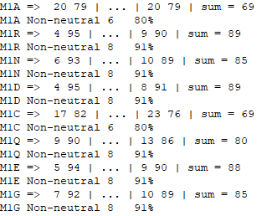
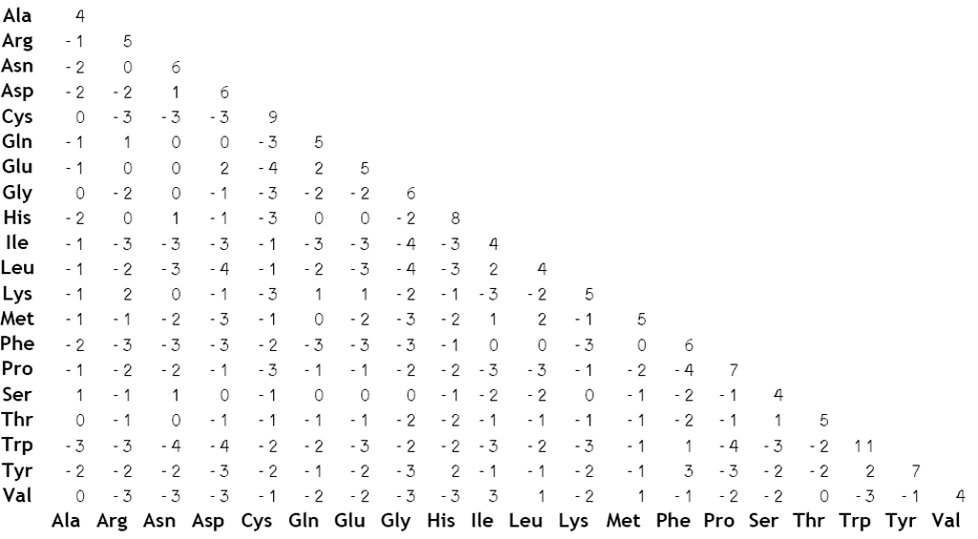
Feature: Introduction
SNAP-scores
BLOSUM62-scores

Slide 4
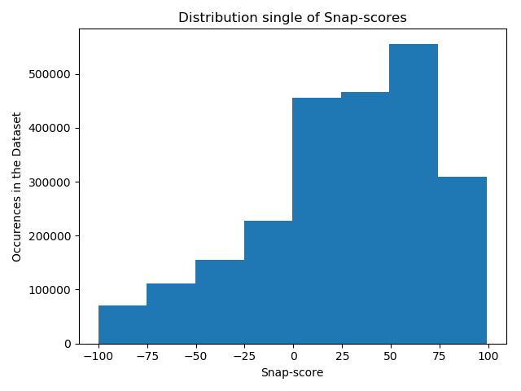
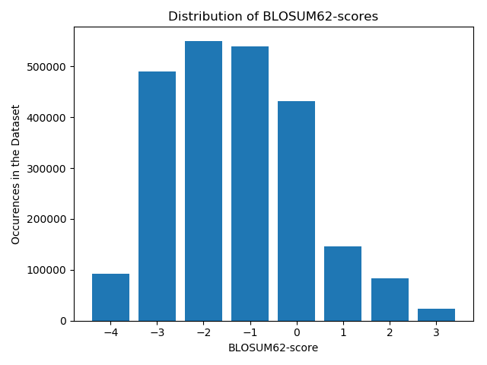
Distribution of scores

Slide 5
Feature: first Ideas
Large (-) BLOSUM => Very unlikely substitution => Strong functional effect
Requires high SNAP2 to be functionally significant (i.e. binding)
Large (+) BLOSUM => Very likely substitution => Weak functional effect
Small SNAP2 can still imply functional significance (i.e. binding)
Set cutoffs to map BLOSUM to SNAP scores
BLOSUM diagonal can be ignored
Result:
[-1, 1, -1, -1, -1, 1, 1, -1, -1, -1, -1, 1, 0, -1, 1, 1, 1, 1, -1, -1]

Slide 6
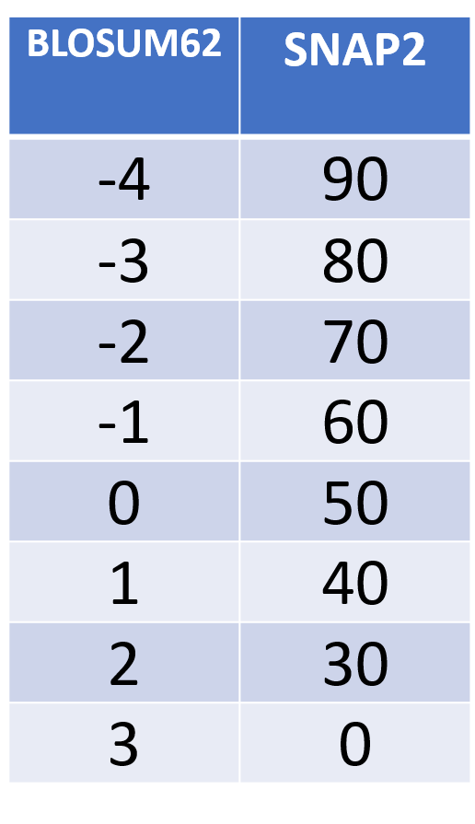
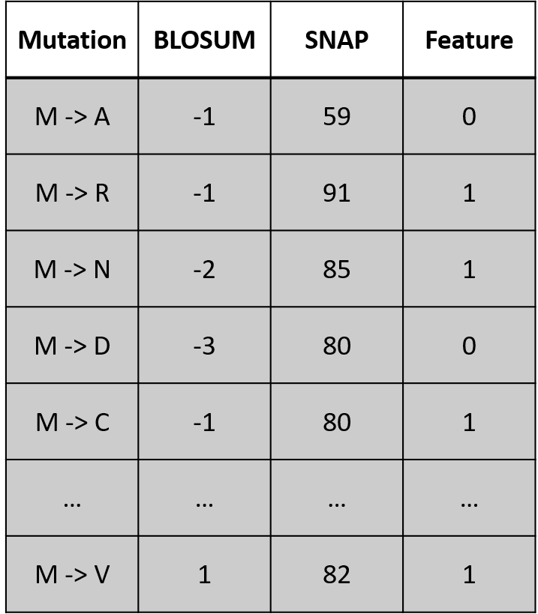
CUTOFFS
CONVERSION

Slide 7
Feature: raw scores
Predicts similar to random
Problem: Too little Information to get meaningful results
Solution: input raw scores
[48, -1, 75, -1, 70, -2, 79, -3, 36, -1, 58, 0, 76, -2, 73, -3, 67, -2, 15, 1,
24, 2, 76, -1, 0, 0, 30, 0, 79, -2, 65, -1, 62, -1, 68, -1, 51, -1, 27, 1]

Slide 8
Feature: scaled Values
BLOSUM scores are very small compared to SNAP scores
[48, -25, 75, -25, 70, -50, 79, -75, 36, -25, 58, 0, 76, -50, 73, -75, 67,
-50, 15, 33, 24, 66, 76, -25, 0, 0, 30, 0, 79, -50, 65, -25, 62, -25, 68,
-25, 51, -25, 27, 33]

Slide 9
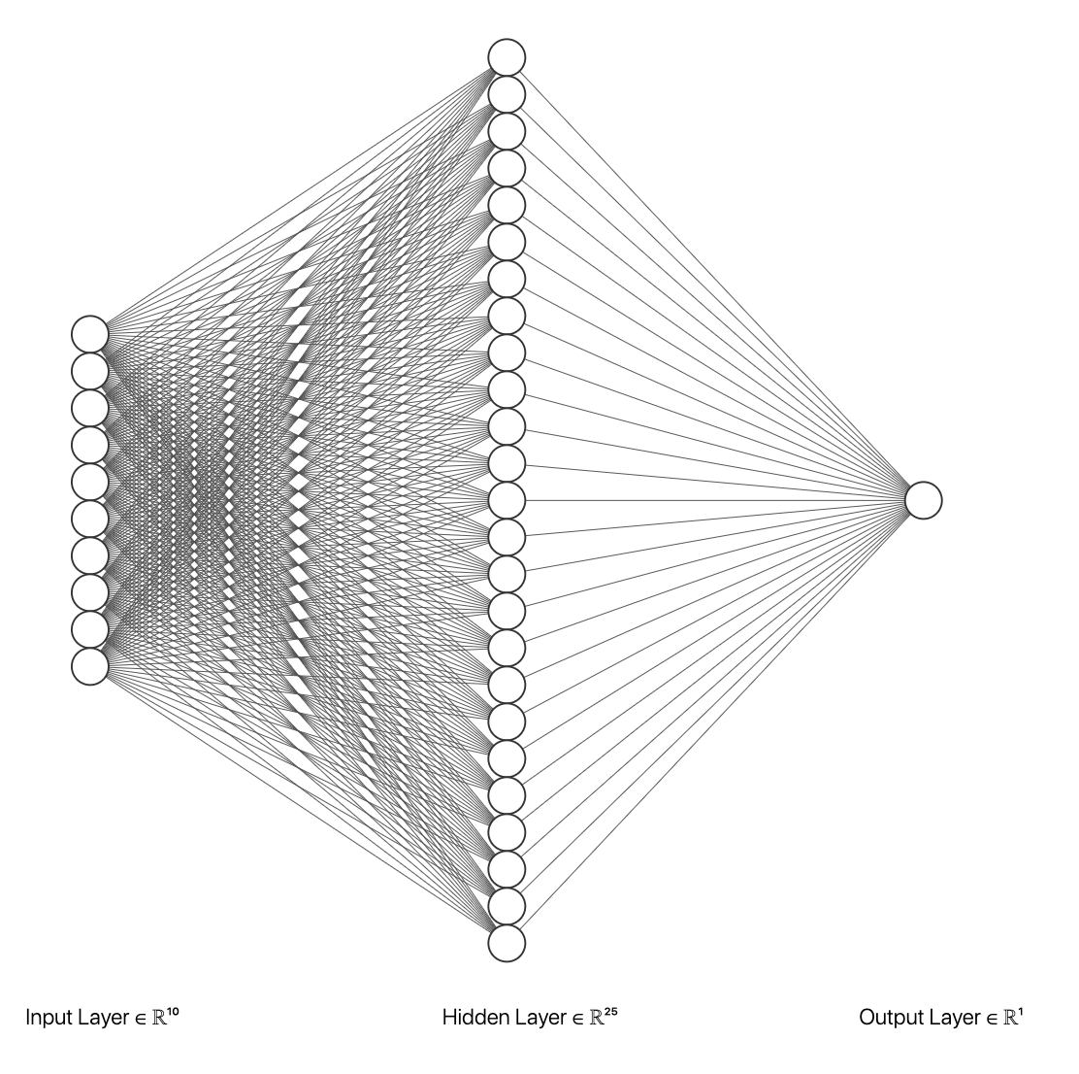
Algorithm
200
Single layer ANN
40 input units, 1 output unit
200 hidden units
Weigthed loss
40
48
-25
75
-25
:
:
:
[0, 1]

Slide 10
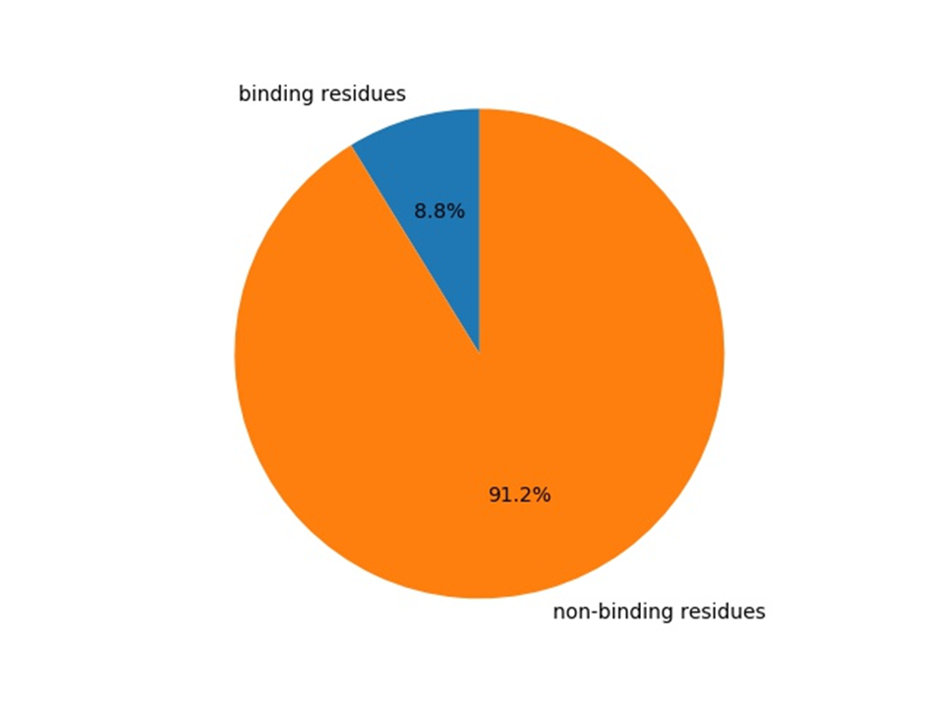
Training dataset
769 Proteins from BioLip
→ 117435 residues

Slide 11
Hyperparameter
Weigths:
Binding: 0.6
Non-binding: 0.4
Learning rate: 0.003
Prediction Cutoff: 0.4
Momentum: 0.9
Epochs: 200

Slide 12
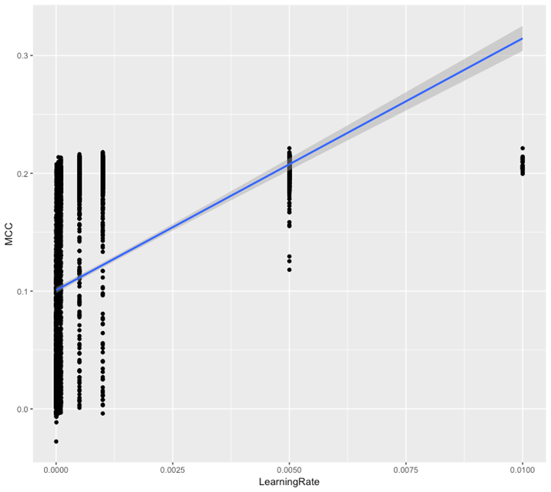
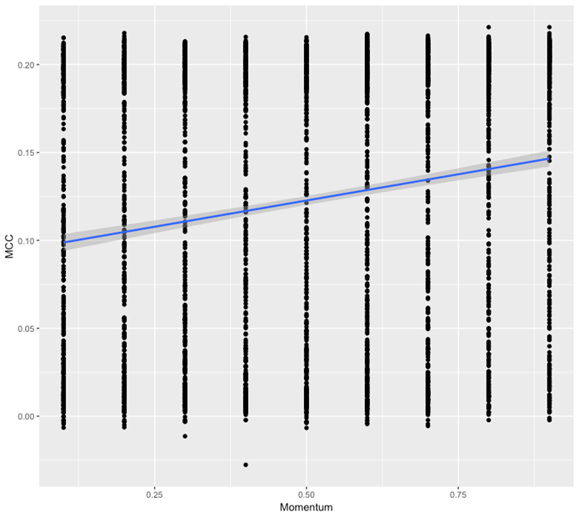
Hyperparameter: Grid search

Slide 13
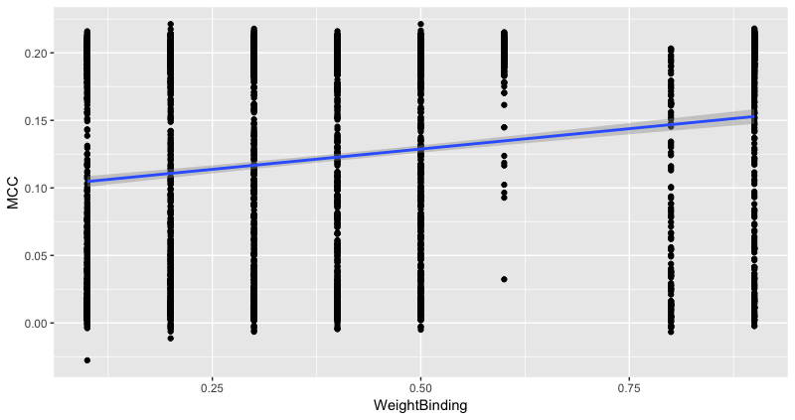
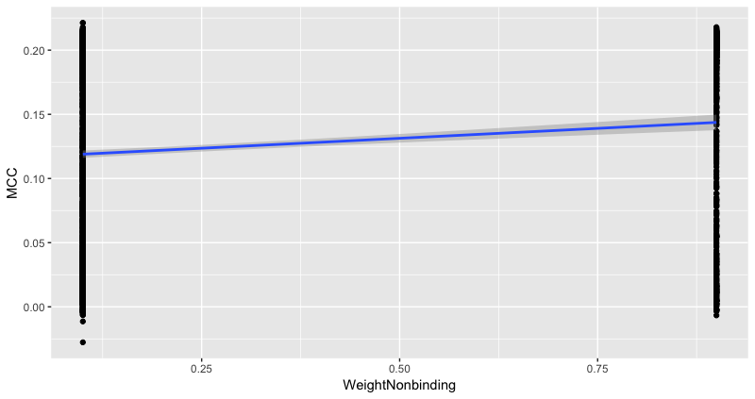
Hyperparameter: Grid search

Slide 14
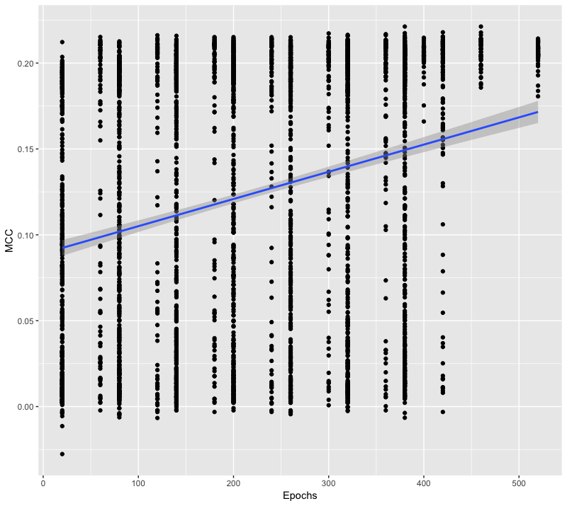
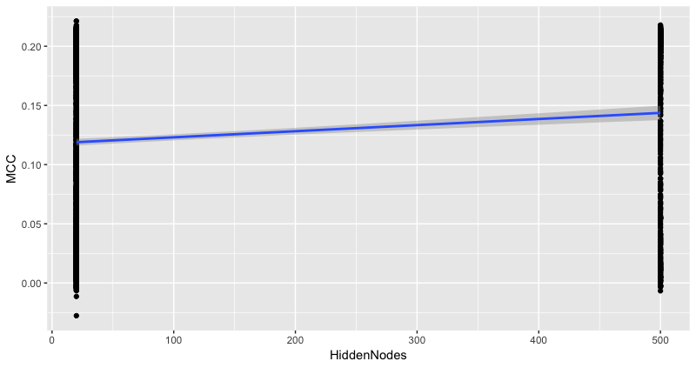
Hyperparameter: Grid search

Slide 15
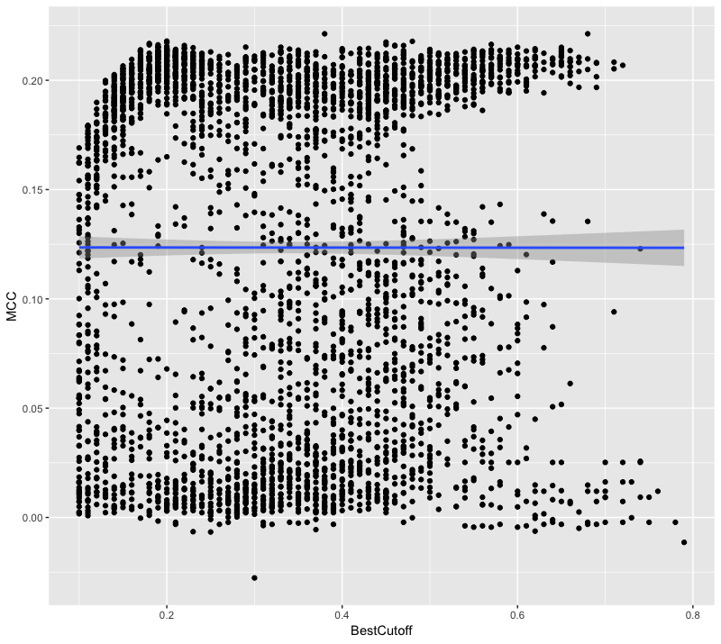
Hyperparameter: Grid search

Slide 16

Performance
Imbalanced Dataset => Matthews correlation coefficient
Cross-validation:
MCC: 0.19 ± 0.06
F1-score: 0.19 ± 0.05
Testset:
MCC: 0.24 ± 0.01
F1-score: 0.24 ± 0.01

Slide 17
Confusion Matrix
 | Binding | Non-binding
Predicted Binding | 519 ~1.6% | 517 ~1.6%
Predicted Non-binding | 2842 ~8.9% | 27949 ~87.8%

Slide 18
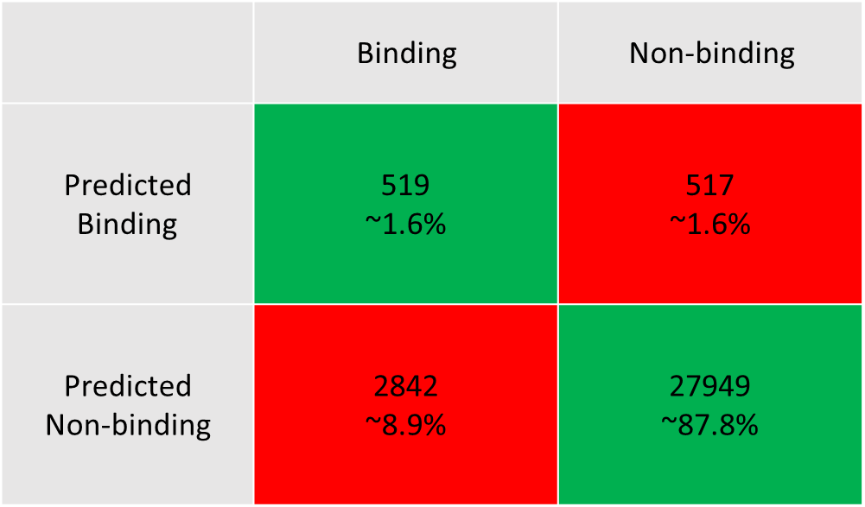
…compared to random
Our Prediction
Random Prediction
 | Binding | Non-binding
Predicted Binding | 277 ~0.8% | 2377 ~7.4%
Predicted Non-binding | 3084 ~9.6% | 26089 ~81.9%
MCC: 0.24
MCC: -0.001

Slide 19
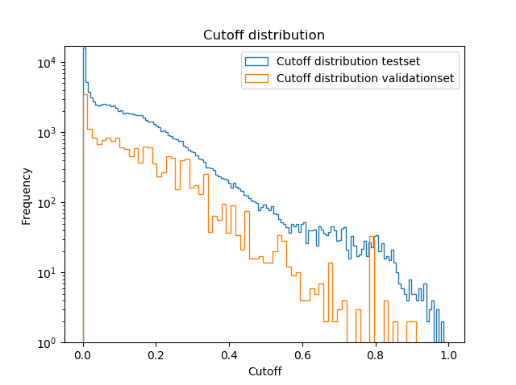
Cutoff distribution

Slide 20
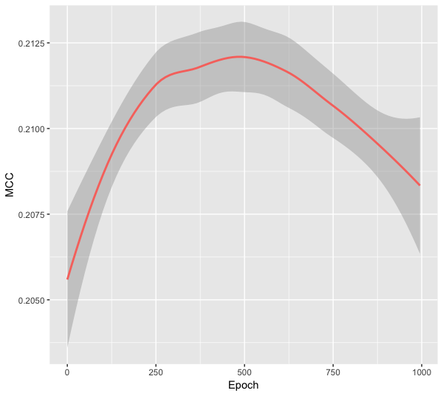
Testing for overfitting

Slide 21
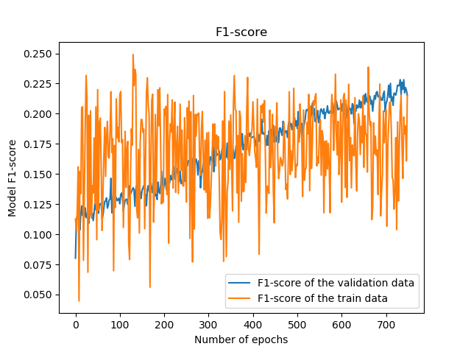
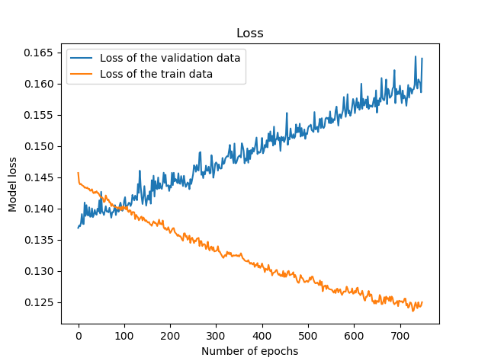
Testing for overfitting

Slide 22
Thank you!
Questions?

Slide 23
stats
TP: 519
FP: 517
TN: 27949
FN: 2842
FPR: 0.01816201784585119
Precision: 0.500965250965251 ± 0.016364012582564594
Recall/TPR: 0.15441832787860757 ± 0.006444302866129453
F1-score: 0.2360700477598363 ± 0.008823521693012324
MCC: 0.23597300754427067 ± 0.00979017430278977

Slide 24
Stats crossvalidation
TP: 1401
FP: 2221
TN: 105203
FN: 9076
TPR: 0.13372148515796506 ± 0.006728852995094254
FPR: 0.020675081918379506 ±
Precision: 0.38680287134180014 ± 0.01515588223022108
MCC: 0.1864096719348082 ± 0.009743841686838386
F1: 0.1898892068383594 ± 0.008877620919506887

