Slide 1
BLOSUM scores compared to single SNAP scores
Thomas Eska, Paul Hager, Thomas Heinzinger

Slide 2
Outline
Task
Dataset
Feature
Algorithm structure and Hyperparameters
Performance

Slide 3
Task
Predict binding site residues using SNAP features
Extension: Do BLOSUM scores aid in the prediction?

Slide 4
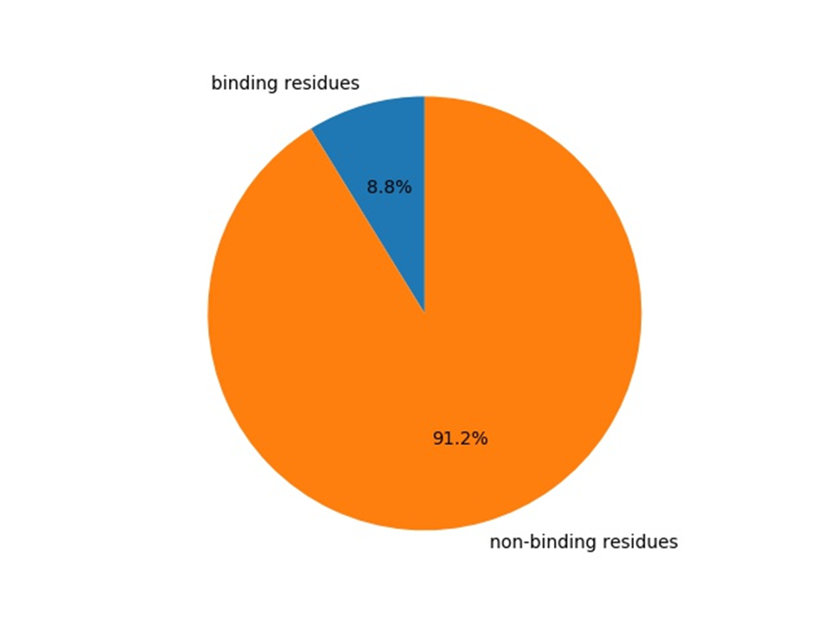
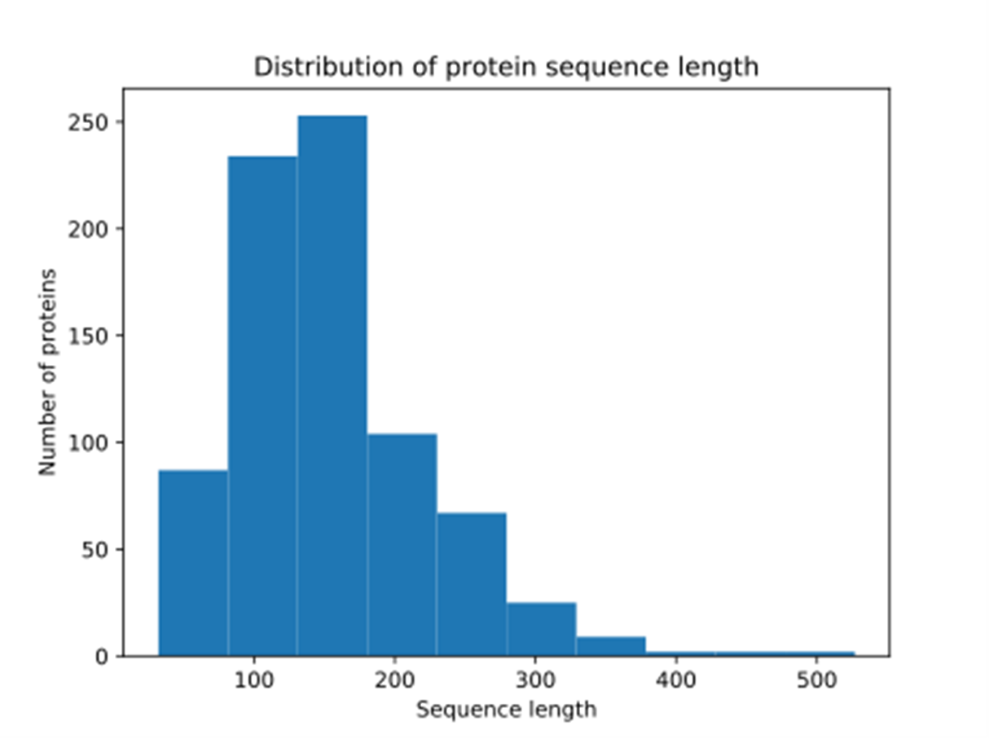
Training dataset
769 Proteins from BioLip
→ 117435 residues

Slide 5
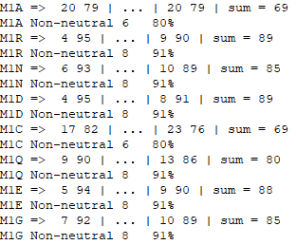
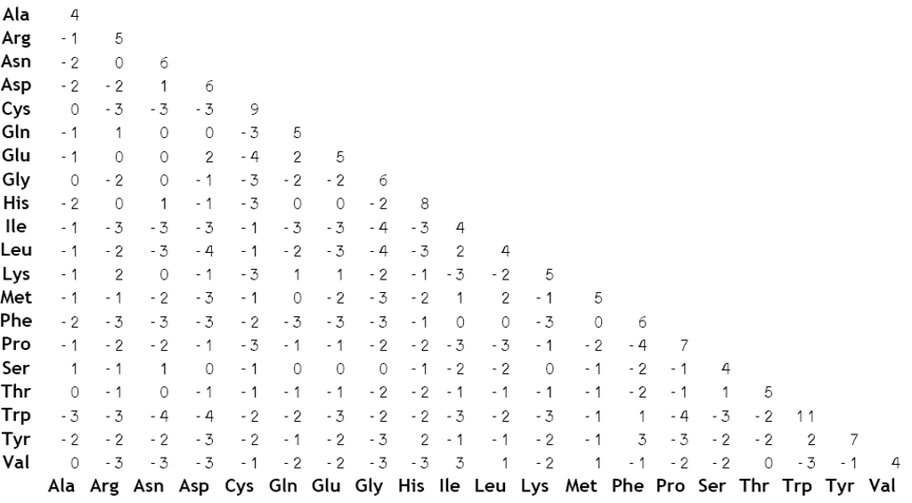
Feature: Introduction
SNAP-scores
BLOSUM62-scores

Slide 6
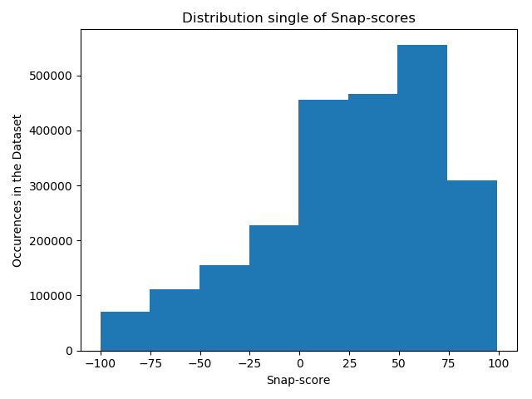
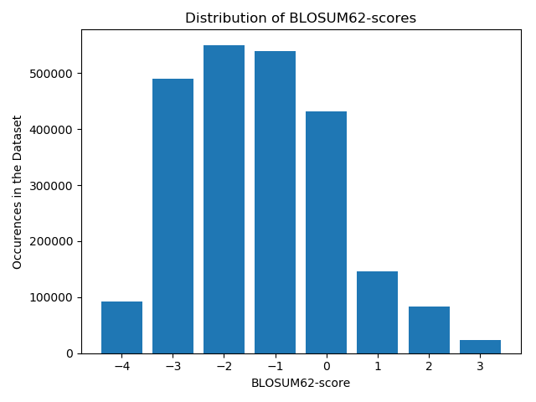
Distribution of Scores

Slide 7
Feature: First Ideas
Large (-) BLOSUM => Very unlikely substitution => Strong functional effect
Requires high SNAP2 to be functionally significant (i.e. binding)
Large (+) BLOSUM => Very likely substitution => Weak functional effect
Small SNAP2 can still imply functional significance (i.e. binding)
Set cutoffs to map BLOSUM to SNAP scores
BLOSUM diagonal can be ignored
Result:
[-1, 1, -1, -1, -1, 1, 1, -1, -1, -1, -1, 1, 0, -1, 1, 1, 1, 1, -1, -1]

Slide 8
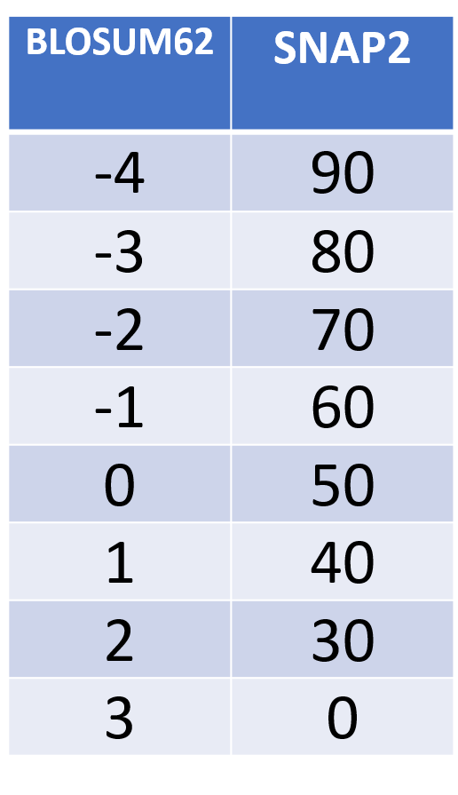
CUTOFFS
CONVERSION
Mutation | BLOSUM | SNAP | Feature
M -> A | -1 | 59 | -1
M -> R | -1 | 91 | 1
M -> N | -2 | 85 | 1
M -> D | -3 | 80 | -1
M -> C | -1 | 80 | 1
… | … | … | …
M -> V | 1 | 82 | 1

Slide 9

Cutoff Results
Cross-Validation with original params
MCC = 0.001
Predicts similar to random (random = 0)
Problem: Too little information to get meaningful results

Slide 10
Feature: Raw Scores
Solution: input raw scores
[48, -1, 75, -1, 70, -2, 79, -3, 36, -1, 58, 0, 76, -2, 73, -3, 67, -2, 15, 1, 24, 2, 76, -1, 0, 0, 30, 0, 79, -2, 65, -1, 62, -1, 68, -1, 51, -1, 27, 1]

Slide 11
Feature: Scaled Values
BLOSUM scores are very small compared to SNAP scores
[48, -25, 75, -25, 70, -50, 79, -75, 36, -25, 58, 0, 76, -50, 73, -75, 67, -50, 15, 33, 24, 66, 76, -25, 0, 0, 30, 0, 79, -50, 65, -25, 62, -25, 68, -25, 51, -25, 27, 33]

Slide 12
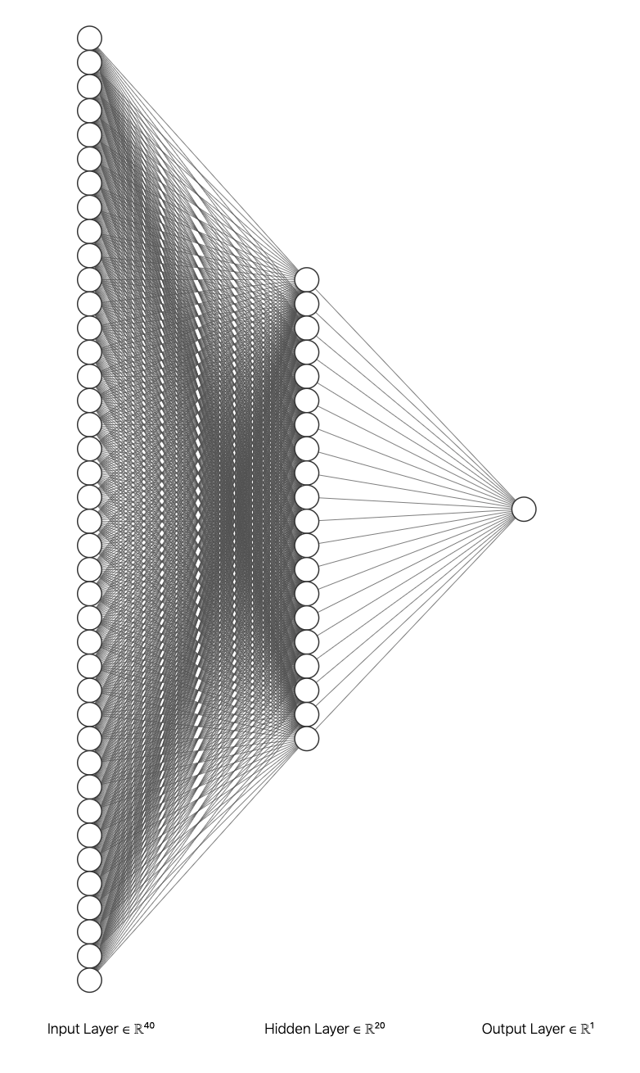
Algorithm
Single layer ANN
40 input units, 1 output unit
20 hidden units
Weighted loss
Binary Cross Entropy Loss & Sigmoid

Slide 13
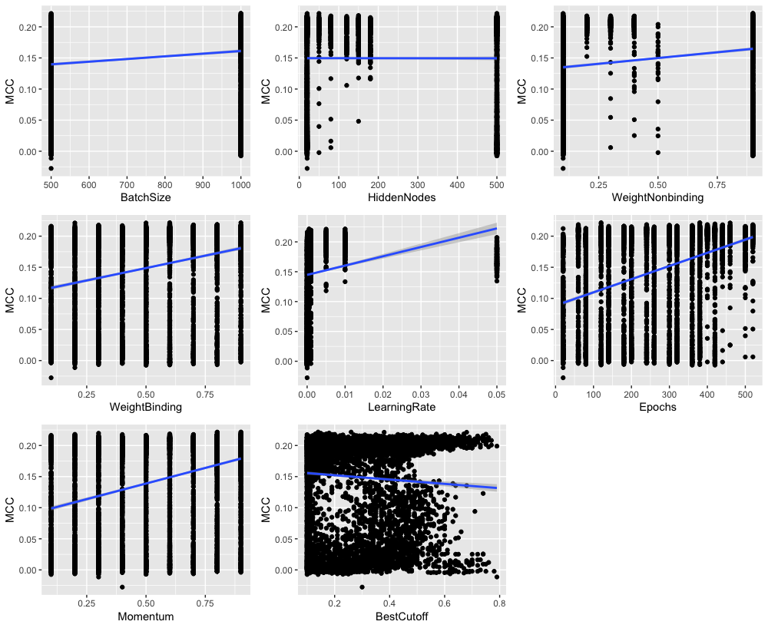
Hyperparameter
Batch Size: 500
Weights:
Binding: 0.5
Non-binding: 0.1
Learning rate: 0.005
Prediction Cutoff: 0.57
Momentum: 0.9
Epochs: 380

Slide 14
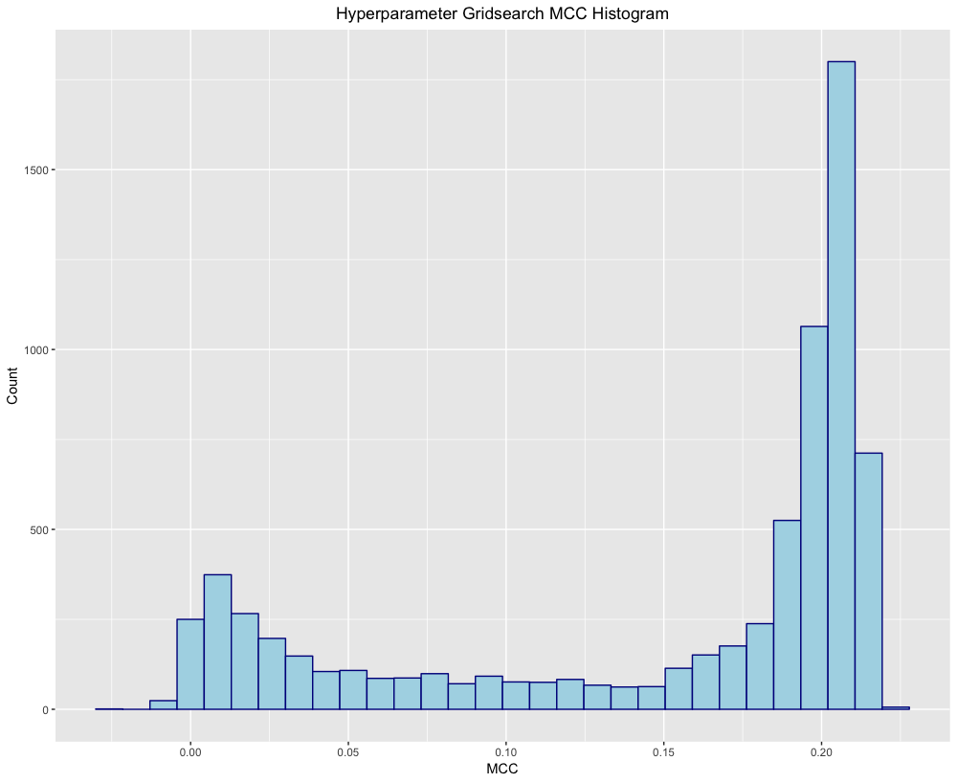
Hyperparameter

Slide 15
Testing Different BLOSUM Matrices
No BLOSUM
BLOSUM45
BLOSUM62
BLOSUM80

Slide 16
Testing Dataset
31827 residues from BioLip
(No overlap with training data)
No other information known

Slide 17
Confusion Matrix
 | Binding | Non-binding
Predicted Binding | 1041 ~3.3% | 1506 ~4.7%
Predicted Non-binding | 2320 ~7.3% | 26960 ~84.7%

Slide 18
…compared to random
Our Prediction
Random Prediction
 | Binding | Non-binding
Predicted Binding | 1041 ~3.3% | 1506 ~4.7%
Predicted Non-binding | 2320 ~7.3% | 26960 ~84.7%
 | Binding | Non-binding
Predicted Binding | 277 ~0.8% | 2377 ~7.4%
Predicted Non-binding | 3084 ~9.6% | 26089 ~81.9%

Slide 19
Performance
Imbalanced Dataset => Matthews correlation coefficient
Other measures:
F1-score
Precision
Recall/TPR

Slide 20
Performance
Cross-validation:
MCC: 19% ± 1%
F1-score: 19% ± 1%
Precision: 40% ± 2%
Recall: 13.4% ± 0.7%
Coverage: 1
Testset:
MCC: 29% ± 1%
F1-score: 35% ± 1%
Precision: 40% ± 1%
Recall: 30% ± 1%
Coverage: 1

Slide 21
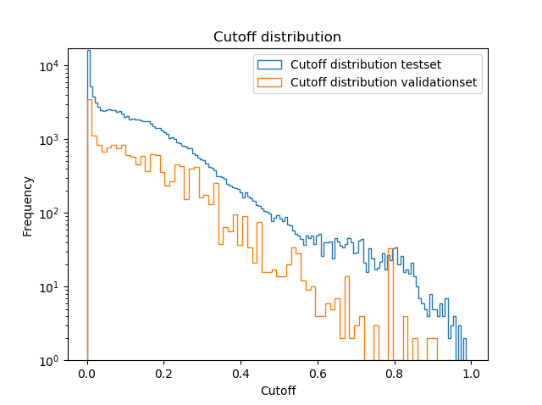
Cutoff Distribution

Slide 22
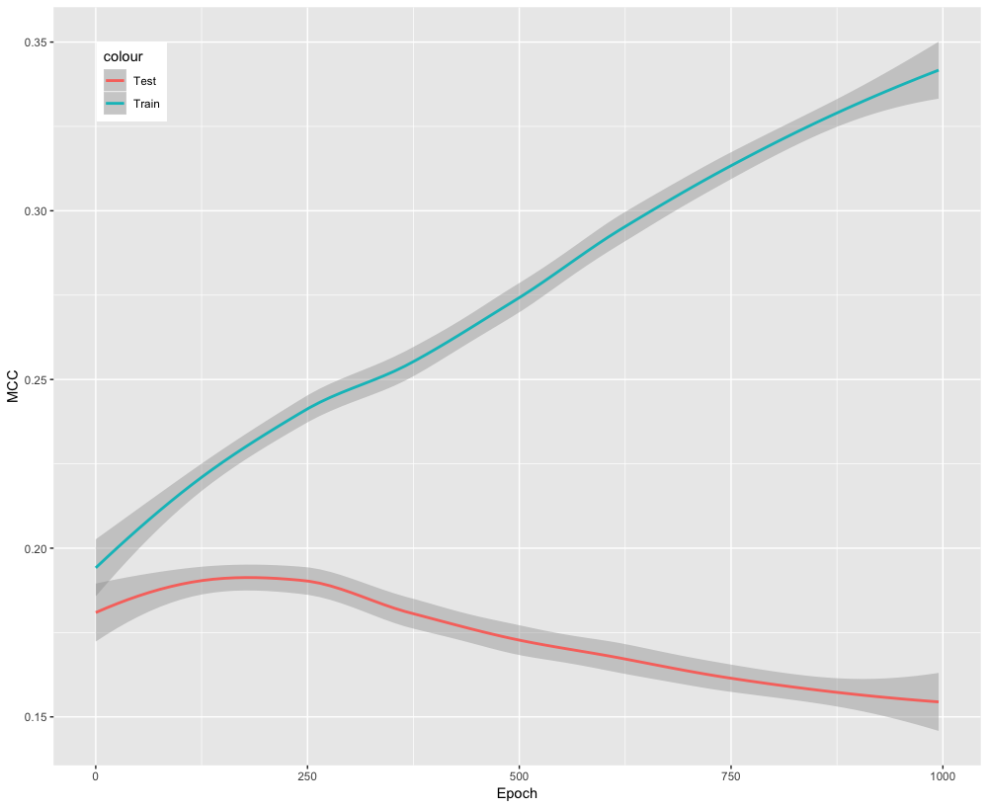
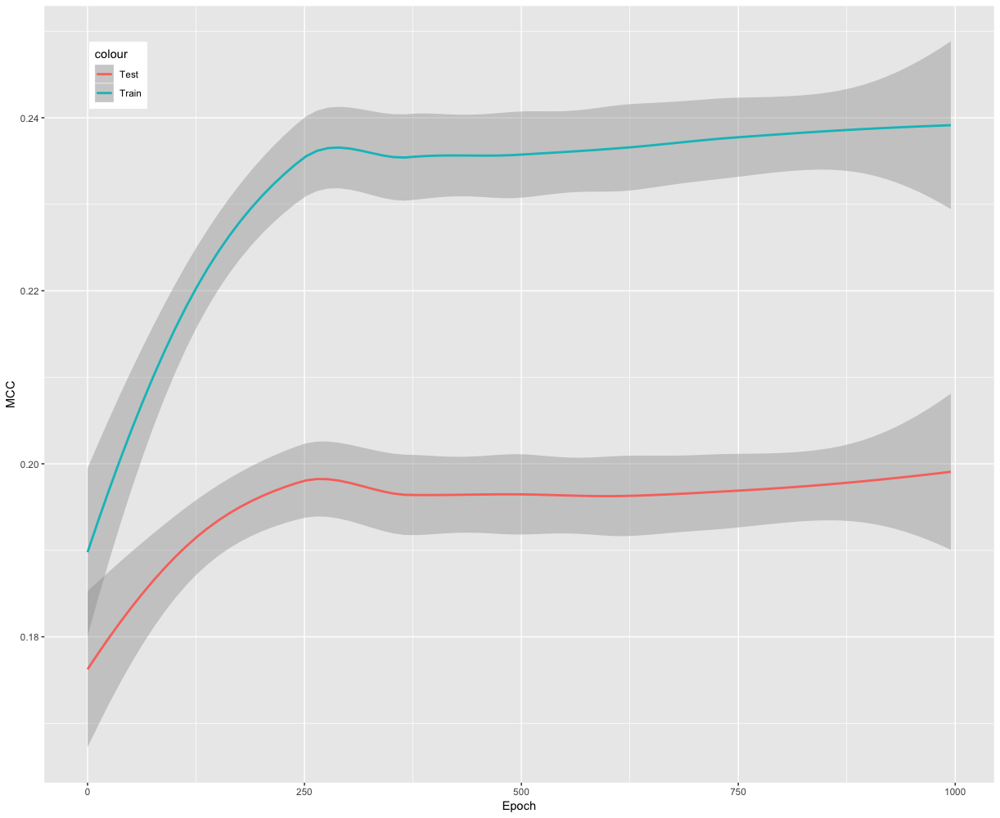
Testing for overfitting

Slide 23
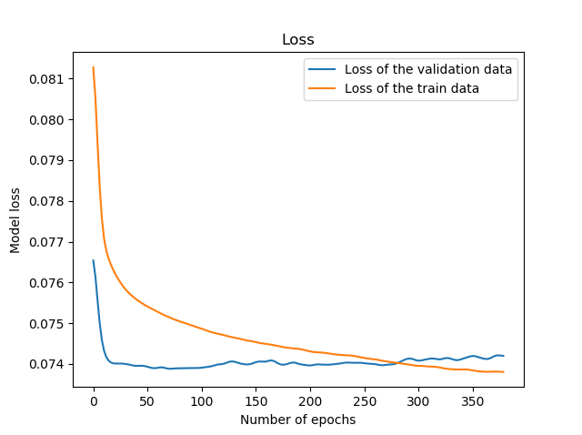
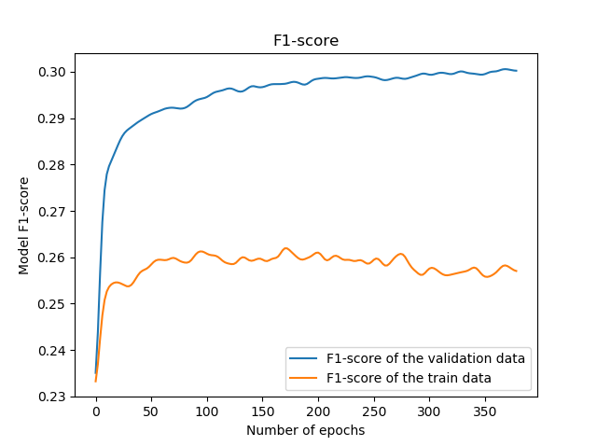
Testing for Overfitting

Slide 24
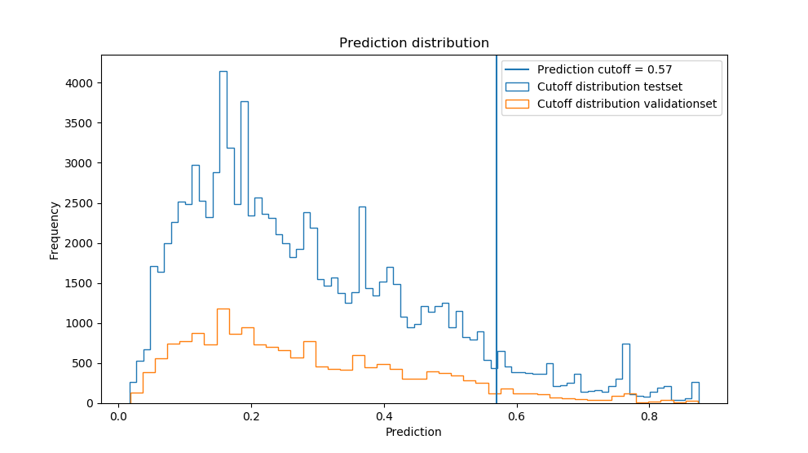

Slide 25
Thank you!
Questions?

Slide 26
Sources
[1] Yang, J et al. “BioLiP: a semi-manually curated database for biologically relevant ligand-protein interactions.” Nucleic acids research (2012)
[2] Tyzack, J et al. “Ranking enzyme structures in the PDB by bound ligand similarity to biological substrates.” Structure (2017)
[3] Schelling et al. “Evolutionary couplings and sequence variation effect predict protein binding sites.” Proteins: Structure, Function, and Bioinformatics (2018)
[4] Hecht, M et al. “Better prediction of functional effects for sequence variant.” BMC Genomics (2015)

Slide 27
stats
TP: 519
FP: 517
TN: 27949
FN: 2842
FPR: 0.01816201784585119
Precision: 0.500965250965251 ± 0.016364012582564594
Recall/TPR: 0.15441832787860757 ± 0.006444302866129453
F1-score: 0.2360700477598363 ± 0.008823521693012324
MCC: 0.23597300754427067 ± 0.00979017430278977

Slide 28
Stats crossvalidation
TP: 1401
FP: 2221
TN: 105203
FN: 9076
TPR: 0.13372148515796506 ± 0.006728852995094254
FPR: 0.020675081918379506 ±
Precision: 0.38680287134180014 ± 0.01515588223022108
MCC: 0.1864096719348082 ± 0.009743841686838386
F1: 0.1898892068383594 ± 0.008877620919506887

