Slide 1


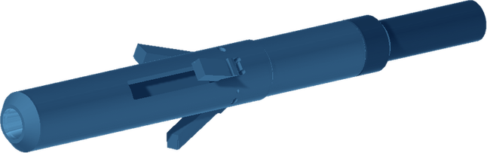



PIPE CUTTER
CUTTING
INTERNAL HYDRAULIC CASING CUTTER
GENERAL DESCRIPTION
INTERNAL HYDRAULIC CUTTER THAT CUTS SINGLE OR MULTIPLE STRINGS OF CONCENTRIC OR ECCENTRIC CASING. IT CAN BE USED IN ANY CUTTING APPLICATION WHERE ROTATION AND PRESSURE CAN BE APPLIED TO THE TOOL. IT IS MAINLY RUN IN WELL ABANDONMENT OPERATIONS, WHEN CASINGS HAVE BEEN CEMENTED AND CANNOT BE CUT AND PULLED INDIVIDUALLY.
TECHNICAL CHARACTERISTICS
Designed to cut (in) | 4-1/2 - 5-1/2 | 6-5/8 - 13-3/8 | 9-5/8 - 16 | 13-3/8 - 36
Top connection (API) | 2-3/8 IF | 3-1/2 REG | 6-5/8 REG | 6-5/8 REG or 7-5/8 REG
Tool diameter (in) | 3-5/8 | 5-3/4 | 8-1/4 | 11-3/4
Dimensions in inches. Cutter arms are available in various sizes to cut single or multiple strings.
OPERATING PARAMETERS
Flow rate | Up to 400 L/min
Head pressure | 35 to 60 bar
Maximum | 80 bar / 90 rpm
Surface test | 300 L/min at 5 bar
Start of rotation | 70 rpm (max. 100)
Start of pumping | 150 L/min
DESIGN FEATURES
If pressure rises too quickly in the surface test, the piston may be blocked.
■ Casing cutting: single or multiple strings, concentric or eccentric.
■ Hydraulic and rotary: works wherever rotation and pressure can be applied to the tool.
■ Abandonment duty: cuts cemented casings that cannot be cut and pulled one by one.
■ Carbide-dressed arms: crushed carbide on the cutter arms, in several sizes for single or multiple strings.
■ Three knife reloading types: standard (general use), hardfacing (reinforced, high-strength steels) and carbide (high wear resistance, abrasive environments).
CUTTING PROCEDURE
■ Record parameters: PUW, SOW and free torque.
■ Prepare: close the purge line and reset the WOB.
■ Start: begin rotation, then pump at 150 L/min while monitoring return flow and torque.
■ Cut: once return is confirmed, increase gradually to 50 - 60 bar, then stabilise the flow without further pump adjustment.
HOW TO ORDER
Please specify: 1. casing size range to cut 2. top connection 3. knife reloading type (standard, hardfacing or carbide) 4. single or multiple strings to cut.

