Slide 1
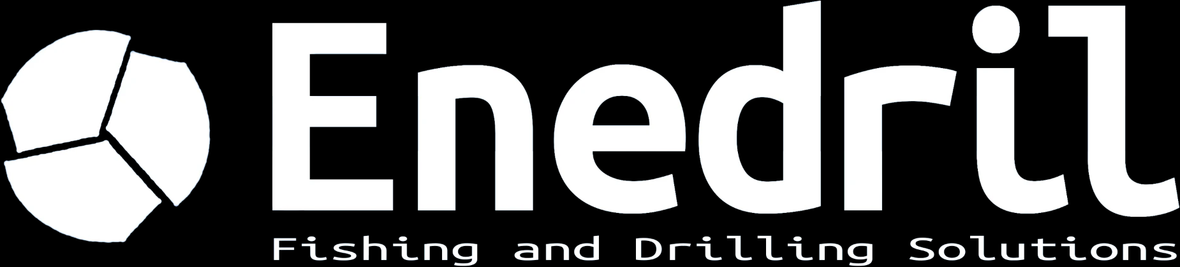
DIRECTIONAL DRILLING
& FISHING SOLUTIONS
FRANCE

Slide 2
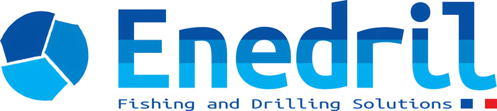
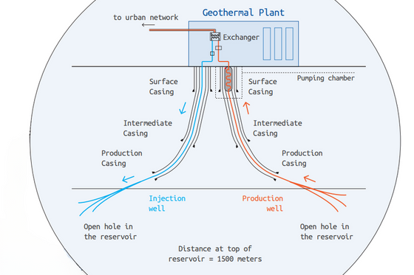

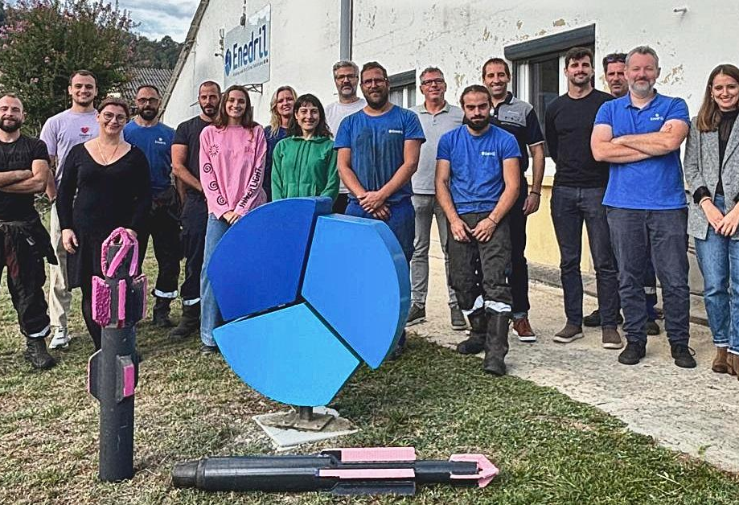
ABOUT US
Enedril (formerly Mustang Services) is an independent French company founded in 2013 and specialised in directional drilling, fishing and well intervention for geothermal, oil & gas and underground gas storage projects, in France and abroad. We combine solid field experience with technical know-how, and we are known for being fast, flexible and easy to work with.
98,500 m
60
142
2,500
drilled
wells, up to 3,000 m TVD
fishing, workover and P&A jobs
tools in stock
OUR FACILITIES
Since 2021 we operate from Lons, near Pau, with two fully equipped workshops of more than 1,000 m², a 5 t overhead crane, a break-out unit, a jar tester, lathe, milling and grinding machines and a separate welding shop.
A 3,500 m² outdoor yard stores tubulars, stabilizers and on-site containers, for large-scale logistics.
A rare equipment stock in France: mud motors from 3-1/8" to 9-5/8", shock tools, drilling jars, MWD kits and a very wide range of fishing tools.
Geothermal doublet: injection and production wells
OUR VALUES
RESPECT
For our clients, our teams and the people and places around us.
TEAMWORK
Real success comes from strong values and working together.
ENVIRONMENT
Caring for the environment is at the core of what we do.
ISO 9001:2015 CERTIFIED
A quality management system that follows every job from start to finish: safety, quality and reliability on each intervention.
About 15 clients supported each year, in France and internationally.
WHY CHOOSE US
EXPERIENCE
Years in the industry and a wide range of projects completed across sectors.
EXCELLENCE
Dedication to excellence, safety and innovation for superior results.
CUSTOM SOLUTIONS
Every project is unique: tailored tools and procedures.
RELIABILITY
A partner ready to go the extra mile to meet your needs and deadlines.
OUR PURPOSE
Supporting the next generations in the energy transition by contributing to the production of more responsible energy.
Enedril · Fishing and Drilling Solutions · 3 avenue des lacs, 64140 Lons (France) · info@enedril.fr · +33 (0)5 59 04 50 45
2

Slide 3
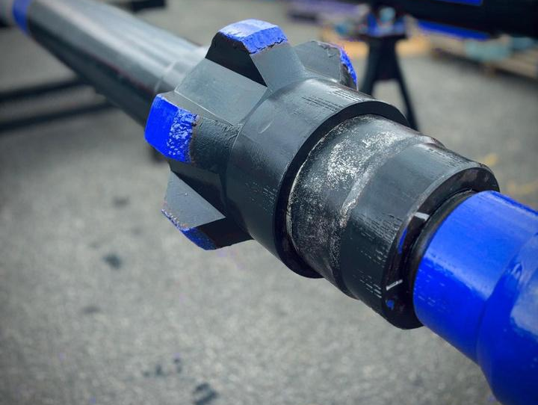
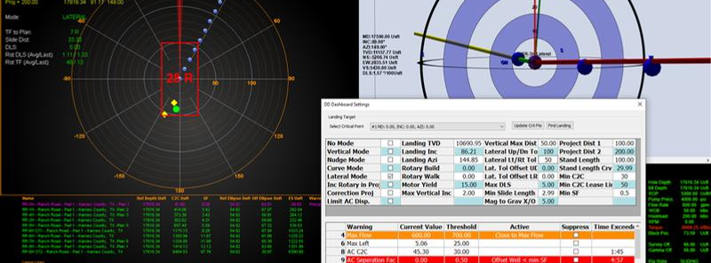
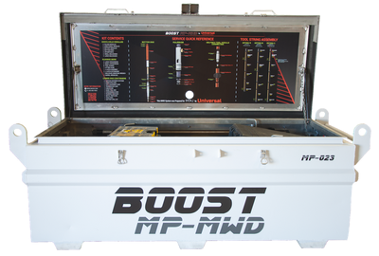
DIRECTIONAL DRILLING
& MWD
Enedril provides advanced directional drilling solutions for complex wells with high precision requirements: downhole motors (PDM), rotary steerable systems (RSS) and high-temperature MWD tools. Experienced Directional Drillers and MWD Engineers steer and optimise the trajectory continuously, with well planning done in-house.
3-1/8" to 9-5/8"
RSS
up to 200°C
PDM motors, high-temperature power sections
Push-the-bit and point-the-bit systems
MWD kits with HT electronics
MUD MOTORS & RSS
PDMs from 3-1/8" to 9-5/8" OD with a wide range of power sections, including high-temperature stators. Push-the-bit and point-the-bit RSS for precise control in complex formations.
WELL PLANNING
Innova and DrillScan software: torque and drag, hydraulics and anti-collision, to drill safely and efficiently in line with project goals. Full simulation, high-frequency data recorder.
BOOST MUD PULSE MWD SYSTEM
Rock solid performance for aggressive drilling conditions. A positive mud pulse system that sends surveys, directional telemetry, gamma ray and other sensor data to surface in real time.
■ Field-proven design, standard rating 185°C, 200°C version available
■ Top and bottom mounted positive pulse systems
■ Motor-driven pulser with anti-plugging technology: performs in LCM and high-solids mud
■ Wide range of flow rates and rotary speeds, easy to assemble and service
■ Down-linking for adjustable logging sequences (4 programmable)
OUTSIDE DIAMETER
47.6 mm (1.875")
PRESSURE RATING
20,000 psi
TEMPERATURE
-20 to 185°C
COLLAR SIZES
3.5" to 8"
FLOW RATE
75 - 1,200 gpm
BATTERY LIFE
400+ h (2 modules)
SHOCK LIMIT
500 g
INTERNAL MEMORY
24 MB
Telemetry: inclination, azimuth, toolface, continuous inclination and azimuth, gamma ray, shock, vibration, RPM, stick-slip, temperature, annular pressure, battery status. Inclination ±0.10°, azimuth ±0.50°, toolface ±0.20°.
ALSO AVAILABLE
Survey equipment (LWD, gyro, dual telemetry)
Turbodrilling
Jar placement
Non-magnetic equipment
Slimhole tools 3-1/2"
High-temperature systems
98,500 m drilled · 60 wells · up to 3,000 m TVD · geothermal, oil & gas, underground gas storage
Enedril · Fishing and Drilling Solutions · 3 avenue des lacs, 64140 Lons (France) · info@enedril.fr · +33 (0)5 59 04 50 45
3

Slide 4
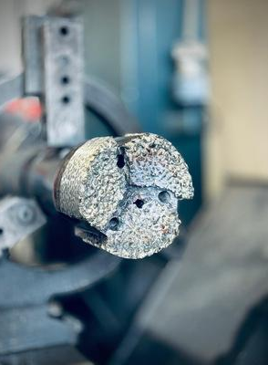
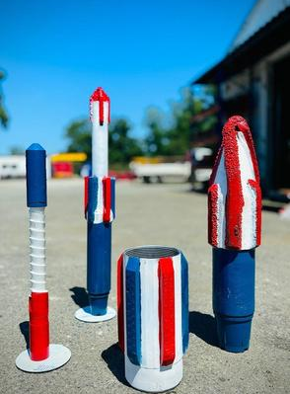
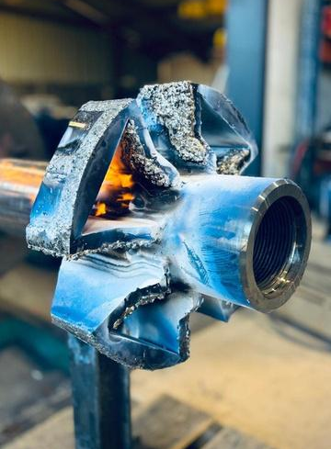
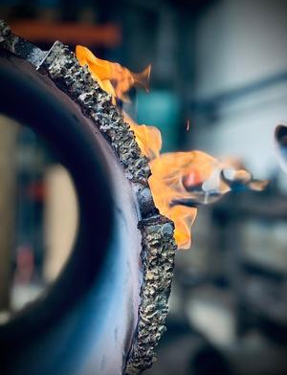
FISHING, WORKOVER
& PLUG AND ABANDONMENT
Fishing, workover and plug & abandonment (P&A): the full range of operations to recover, restore and secure wells, during drilling, workover or abandonment. Our fishing team responds quickly with a large rental and sale fleet, backed by our own workshop and custom tool design.
2,500
24 / 48h
142
ISO 9001
tools available
response time
fishing, workover and P&A interventions
certified quality management
FISHING
WORKOVER
PLUG & ABANDONMENT
Recovery of rods, drill strings, BHAs and stuck or lost tools.
Jarring and impact tools, shock tools and intensifiers.
Overshots, spears, die collars, magnets, taper taps.
Tools on site for rental or purchase.
Well restoration and preparation for return to production.
Section milling and wash over.
Casing repair, scrapers, impression blocks, junk baskets.
Enlargement and reaming with RTU, DTU and SPX underreamers.
Safe, definitive abandonment of wells.
Cutting with hydraulic pipe cutters and section mills.
Whipstocks and sidetracks, packers, bridge plugs, liner hangers.
Cold cutter, wellhead replacement, casing jack, tanks.
WATER WELLS TOO
We also work on water wells, typically between 300 and 1,000 m, in support of drilling contractors. Habits formed on 3,000 m wells mean we handle shallow wells with the same rigor.
CUT & PULL
Hydraulic and external pipe cutters, spears and overshots to cut and pull casing, tubing or stuck strings.
REAMING
Rotary and directional underreamers, hole openers, roller reamers and SPX drag-type underreamers.
MILLING
Junk mills, pilot and taper mills, section mills and washover shoes to clear and open the hole.
WHERE WE WORK
Based in Lons (64), south-west France. We mobilise across metropolitan France within 24 to 48 hours in an emergency, and have international experience in Europe and North Africa. A single dedicated team follows each job from diagnosis to resolution.
Enedril · Fishing and Drilling Solutions · 3 avenue des lacs, 64140 Lons (France) · info@enedril.fr · +33 (0)5 59 04 50 45
4

Slide 5
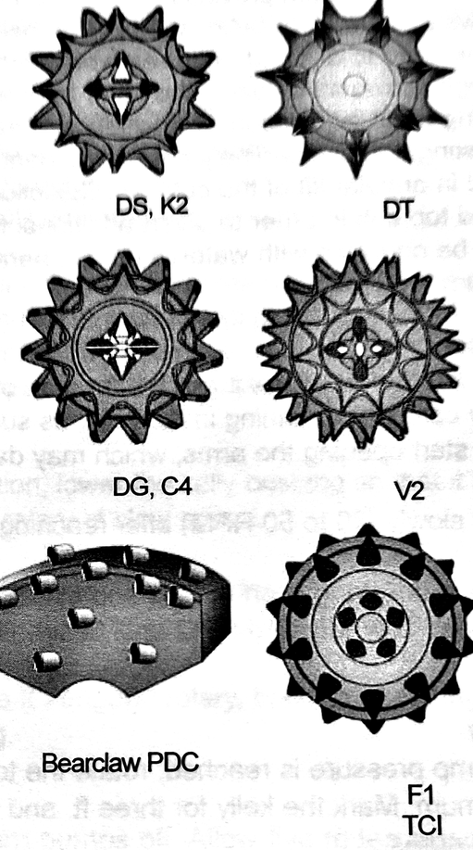
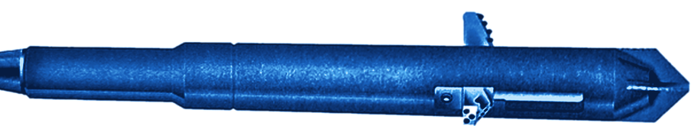
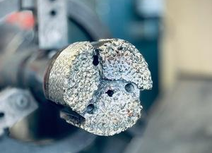
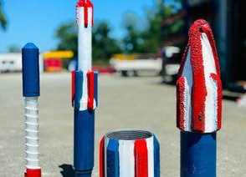
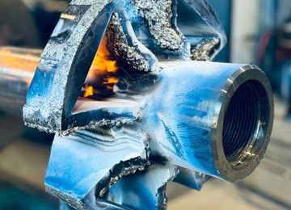
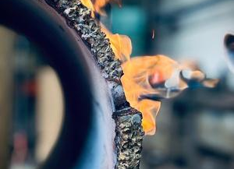
TOOL CATALOGUE
A selection of the main tools in stock, available for rental or purchase. The full catalogue and technical data sheets are available on request. Sizes in inches; tool series are quoted where applicable.
CLEANING | Range
Casing scraper | 3-5/8" - 7-7/8"
Impression block | 2-1/8" - 13-1/2"
Reverse circ. junk basket | 5-5/8" - 17"
Junk basket | 3-1/2" - 13-3/8"
CUTTING | Range
Hydraulic pipe cutter | 3600, 5700, 8200, 11700s
Section mill | 3600, 5500, 8200, 11700s
External hydraulic cutter | 5-5/8" - 8"
MILLING & WASHOVER | Range
Economill | 3-3/4" - 12-1/8"
Junk mill | 2-1/8" - 17-3/8"
Super junk mill | 3-3/4" - 18-3/8"
Pilot mill | 3-1/4" - 8-1/2"
Taper mill | 2-1/2" - 18-1/2"
Washover shoe | 2-9/16" - 13-3/8"
RECOVERY | Range
Die collar | 4" - 9-5/8"
Fishing magnet | 3-3/4" - 15"
Spear, internal | 6-3/4" - 8"
Spear | 2-3/8" - 20"
Overshot | SFS, SH, XSH, FS
Taper tap | 3-1/16" - 8"
REAMING & ENLARGEMENT | Range
Rotary underreamer (RTU) | DTS 350, 5700, 8200
Drilling-type underreamer (DTU) | 5700, 8200, 12000, 18000
Master Driller | 8200, 14000
Hole opener | 14-3/4"
SPX drag-type underreamer | 5700
Roller reamer | 8200
JARRING & IMPACT | Range
Fishing jar | 3-1/8" - 8"
Jar intensifier | 3-1/8" - 6-1/2"
Safety joint | 3-1/2" - 8"
Stabilizer | 3-1/8" - 9-1/2"
Crossover (XO) | 3-3/8" - 11-3/4"
Bit sub / Float sub / Bull nose | 2-3/16" - 10-1/4"
FOR WATER WELLS (typically 300 - 1,000 m)
Cut & pull: hydraulic pipe cutters, external cutters, spears, overshots, jars.
Reaming: RTU, DTU, SPX drag-type, hole openers, roller reamers.
Milling: junk mills, pilot mills, taper mills, section mills, washover shoes.
Stock available, response within 24/48h anywhere in metropolitan France.
UNDERREAMERS
DTU and SPX data sheets available
■ Downhole tools and bits: drilling bits (PDC), underreaming, jars, stabilizers, tubulars, circulating subs.
■ Special interventions: whipstocks and sidetracks, packers, bridge plugs, liner hangers, casing jack, tanks.
■ Custom tools: designed with an API 5 & 7 certified machine shop, repaired and redressed in our workshop.
HOW TO REQUEST A QUOTATION: specify the tool type, size or series, top and bottom connections, and the operation planned (cut & pull, reaming, milling...). Rental or purchase.
Enedril · Fishing and Drilling Solutions · 3 avenue des lacs, 64140 Lons (France) · info@enedril.fr · +33 (0)5 59 04 50 45
5

Slide 6
Enedril
3, avenue des lacs
64140 Lons (FRANCE)
info@enedril.fr
+33 (0)5 59 04 50 45
www.enedril.com
Fishing response within 24/48h across metropolitan France

