Slide 1

TOOL CATALOGUE
FISHING · MILLING · ENLARGEMENT · JARRING · DRILLING
Data sheets of the main downhole tools available from our stock in Lons, near Pau. Each tool has its own page: description, technical characteristics, design features, operating parameters and ordering information.
2,500
24 / 48h
40
7
tools in stock
response time
data sheets
tool families
ABOUT ENEDRIL
Enedril (formerly Mustang Oil Services) is an independent French company founded in 2013 and specialised in directional drilling, fishing and well intervention for geothermal, oil & gas and underground gas storage projects, in France and abroad. Run since 2022 by Fabien and Alexis, the company continues its activities with a new dynamic, and became Enedril in 2025.
HOW TO ORDER A TOOL
■ Find the tool in the summary (next page) or by family. Each sheet ends with a "How to order" box.
■ Tell us the tool type, size or series, top and bottom connections and the casing or hole size.
■ Dimensions are given in inches and loads in lb unless stated: values are indicative. Other sizes and special versions are available on request.
■ Fishing response within 24 to 48 hours across metropolitan France.
CONTACT
Enedril · 3 avenue des Lacs, 64140 Lons (France)
info@enedril.fr · +33 (0)5 59 04 50 45 · www.enedril.com
Enedril · Fishing and Drilling Solutions · 3 avenue des lacs, 64140 Lons (France) · info@enedril.fr · +33 (0)5 59 04 50 45
1

Slide 2

SUMMARY
CLEANING AND JUNK RECOVERY
HOLE ENLARGEMENT
Scraper
3
RTU
22
Impression Block (LIB)
4
DTU
23
Circulating Sub
5
Hole Opener
24
RCJB
6
SPX
25
Junk Basket
7
JARRING AND IMPACT
Venturi Basket
8
Fishing Magnet
9
Intensifier
26
String Magnet
10
Jar Z
27
CUTTING
Bumper Sub
28
Drilling Jar
29
Hydraulic External Cutter (HEC)
11
Safety Joint
30
Pipe Cutter
12
CATCHING TOOLS
Section Mill
13
MILLING
Die Collar
31
Hook
32
Economill
14
Overshot
33
Junk Mill
15
Taper Tap
34
Super Junk Mill
16
Spear
35
Viper Pilot Mill
17
T-Tang (T catch)
36
Pilot Mill
18
T-Dog 4-11/16
37
String Mill
19
T-Dog 5-3/4
38
Taper Mill
20
DRILLING AND DIRECTIONAL
Washover Shoe
21
Stabilizer (Stab)
39
PDM with sleeve
40
Boost MWD
41
Whipstock
42
Enedril · Fishing and Drilling Solutions · 3 avenue des lacs, 64140 Lons (France) · info@enedril.fr · +33 (0)5 59 04 50 45
2

Slide 3


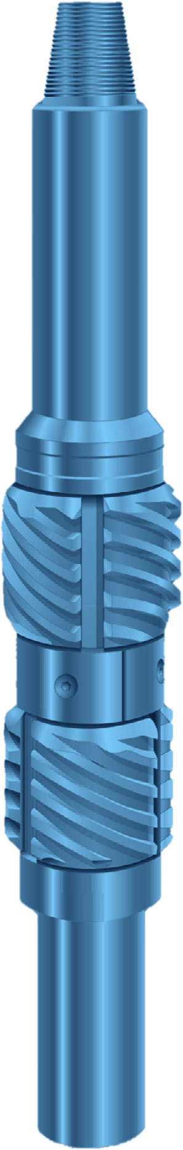



SCRAPER
CLEANING
FULL-CIRCLE CASING SCRAPER
GENERAL DESCRIPTION
CASING SCRAPER THAT REMOVES MUD, CEMENT, BULLETS, RUST, SCALE, PARAFFIN AND PERFORATION BURRS FROM THE INSIDE WALL OF CASING. THE BLADES ARE SPACED TO CONTACT 600 DEGREES OF THE CASING SURFACE AT ONCE, SO EVERY PART OF THE WALL IS SCRAPED WHETHER THE TOOL IS ROTATED OR SPUDDED. SHORT AND COMPACT, WITH A LONG TAPER ON THE BLADES, IT PASSES THROUGH CASING JOINTS WITHOUT HANGING. IT WORKS IN VERTICAL OR ROTARY OPERATIONS AND CAN BE RUN ON DRILL PIPE, PIN UP OR PIN DOWN.
TECHNICAL CHARACTERISTICS
Scraper for casing OD | Casing weight (lb/ft) | Casing ID min. | Casing ID max. | Top connection API Reg. | Fishing neck Ø | Tool ID | Tool OD
4-1/2 | 9.5 - 13.5 | 3.886 | 4.622 | 2-3/8 | 3-1/8 | 13/16 | 3-5/8
5-1/2 | 14.0 - 23.0 | 4.662 | 5.250 | 2-7/8 | 3-3/4 | 1-1/4 | 4-3/8
5-1/2, dressed for 6-5/8 | 20.0 - 33.0 | 5.600 | 6.188 | 2-7/8 | 3-3/4 | 1-1/4 | 4-3/8
7 | 17.0 - 38.0 | 5.850 | 6.688 | 3-1/2 | 4-1/4 | 1-1/2 | 5-1/2
7, dressed for 7-5/8 | 24.0 - 47.1 | 6.308 | 7.188 | 3-1/2 | 4-1/4 | 1-1/2 | 5-1/2
9-5/8 | 32.3 - 64.9 | 8.224 | 9.188 | 4-1/2 | 5-1/2 | 2-1/4 | 8-1/8
10-3/4 | 32.75 - 79.2 | 9.22 | 10.412 | 6-5/8 | 7-3/4 | 3-1/2 | 9-3/16
13-3/8 | 48.0 - 98.0 | 11.911 | 13.238 | 6-5/8 | 7-3/4 | 3-1/2 | 11
Dimensions in inches. One blade size covers a full range of casing weights for each casing OD. Casing ID range = recommended minimum and maximum.
DESIGN FEATURES
APPLICATIONS
■ Full-circle scraping: two rows of blades overlap, covering 600 degrees of casing wall.
■ Spring-loaded blades: move in or out with gradual ID changes and stay on the clean wall without cutting the metal.
■ Abrupt obstructions: a burr or cement fragment is held by the close-fitting blade slot, the mandrel and the split retainer ring.
■ Wear-resistant blades: precision-cast tool steel, tough, slightly work-hardening in service.
■ Secure construction: springs fully enclosed, blades fit closely over the spring housing, so loss downhole is virtually impossible.
■ One-piece mandrel: heat-treated alloy steel, pin by box, with a fishing neck at both ends.
■ Clean out cement, hardened mud and paraffin.
■ Remove perforation burrs and embedded bullets.
■ Dress burrs, nicks and tight spots left by bits, fishing tools or dents.
■ Prepare a clean casing ID before running packers, patches, spears, swabs and wireline tools.
OPERATION AND MAINTENANCE
■ Run: usually pin up, with a bit installed below; scrape by rotating or spudding.
■ After each run: disassemble, clean, inspect and replace worn parts; blades and springs are removed after taking out the four retainer-ring screws.
■ Re-dressing: a blade installation tool (required accessory) compresses the blades during assembly.
HOW TO ORDER
Please specify: 1. tool or part name 2. size and weight of casing 3. tool joint connection 4. recommended spares: one set of blades and one set of springs.

Slide 4
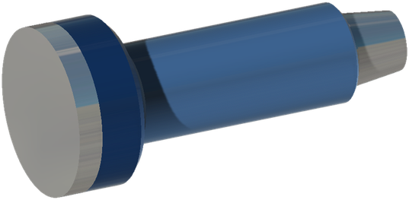
IMPRESSION BLOCK
CLEAN OUT
GENERAL DESCRIPTION
IMPRESSION BLOCKS ARE MADE FROM A LOW ALLOY STEEL OUTER CASING, WITH EITHER A LEAD OR A TAR INNER FILLING, DEPENDING ON THE CONDITIONS IN WHICH THE IMPRESSION IS TAKEN. LEAD IS IDEAL FOR DEEPER, HIGHER TEMPERATURE CONDITIONS, WHILE TAR IS VERY GOOD FOR LARGE OD, SHALLOW APPLICATIONS. ANY SIZE OF IMPRESSION BLOCK CAN BE BUILT TO ORDER.
SPECIFICATIONS
Top connection | 2-3/8 API REG | 2-7/8 API REG | 3-1/2 API REG
Tool OD (in) | 4 | 5 | 6
Material used | Lead | Lead | Lead
Top connection | 4-1/2 API REG | 6-5/8 API REG | 7-5/8 API REG
Tool OD (in) | 8-1/2 | 12-1/4 | 17-1/2 - 26
Material used | Lead | Lead | Tar
Dimensions in inches. Other sizes on request.
DESIGN FEATURES
HOW TO ORDER
■ Steel body: low alloy steel outer casing.
■ Lead filling: deeper, higher temperature conditions.
■ Tar filling: large OD, shallow applications.
■ Made to order: any size can be built.
Please specify: 1. tool OD 2. top connection 3. filling (lead or tar) 4. casing or hole size.

Slide 5
CIRCULATING SUB
DRILLING
BALL-DROP CIRCULATION SUB
GENERAL DESCRIPTION
SIMPLE, RUGGED CONVENTIONAL BALL-DROP CIRCULATION SUB IN A SINGLE-COLLAR CONFIGURATION WITH NO MID-BODY CONNECTION. IT IS EASY TO USE AND OFFERS VARIABLE CYCLE CAPABILITY. A NOVEL BALL DISPOSAL SYSTEM LETS THE BALLS BE EMPTIED WITHOUT DISASSEMBLY, ALLOWING FIELD SERVICE AND MULTIPLE RUNS. STANDARD API CONNECTIONS AND HIGH-STRENGTH MATERIAL OPTIONS FOR DEEP GAS ARE AVAILABLE.
APPLICATIONS
DESIGN FEATURES
■ Wellbore cleanout
■ Managed pressure drilling
■ Underbalanced drilling
■ Cementing operations
■ Workover and completions
■ Stuck pipe mitigation operations
■ Single collar design: no mid-body connections.
■ Variable cycle capability.
■ Standard API connections.
■ Ball drop activation: rugged and proven.
■ Ball disposal: balls emptied without disassembly; field serviceable, multi-run.
■ High-strength material options for deep gas.
ITEMS TO DISCUSS
HOW TO ORDER
■ Customizable housing for increased cycles
■ Operating temperature range for the application
■ Repair and maintenance options for staged repairs
■ Chemical compatibility with specialist drilling fluids
■ Compatibility and operation with third-party downhole tools
■ Installation, handling and operating guidelines
Please specify: 1. tool size and top and bottom connections (standard API) 2. number of cycles required 3. material grade (high strength for deep gas, if needed) 4. operating temperature range 5. drilling fluid and chemical compatibility 6. third-party tools in the string.
A high-temperature / high-pressure version is available for demanding applications: ask for details.

Slide 6
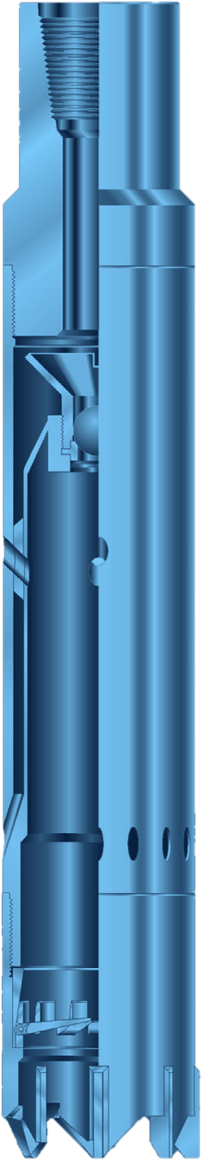
RCJB
FISHING
REVERSE CIRCULATION JUNK BASKET
GENERAL DESCRIPTION
JUNK BASKET THAT USES REVERSE CIRCULATION TO RECOVER SMALL JUNK THAT OTHER BASKETS WOULD MISS. FLUID IS JETTED OUT AND DOWN AGAINST THE FULL CIRCUMFERENCE OF THE HOLE, SWEEPS LOOSE OBJECTS TOWARD THE CENTRE AND RETURNS UP THROUGH THE BARREL AND OUT OF PORTS AT ITS UPPER END. A DRAIN THROUGH THE TOOL PREVENTS PULLING A WET STRING EVEN IF THE INNER BARREL IS PLUGGED BY CORE. IT RECOVERS BIT CONES AND BEARINGS, BROKEN SLIPS, WIRELINE, HAND TOOLS, MILLING CUTTINGS AND DEBRIS, AND CAN BE CONVERTED INTO A FISHING MAGNET.
TECHNICAL CHARACTERISTICS
STANDARD TYPE (popular bit cone sizes)
W7R TYPE (W7R and other oversize cones)
Hole size | Barrel OD | Max. fish Ø | Top conn. | Teeth | Wt (lb)
3-3/4 - 4 | 3-5/8 | 2-1/4 | 2-3/8 | 6 | 85
4-1/8 - 4-1/2 | 4 | 2-1/2 | 2-3/8 | 6 | 98
4-5/8 - 5 | 4-1/2 | 3-1/16 | 2-7/8 | 8 | 108
5-1/8 - 5-1/2 | 4-7/8 | 3-9/16 | 2-7/8 | 8 | 128
5-5/8 - 6 | 5-1/8 | 3-3/4 | 3-1/2 | 8 | 142
6-1/8 - 6-1/2 | 5-3/4 | 4-3/8 | 3-1/2 | 8 | 185
6-5/8 - 7-3/8 | 6-1/4 | 4-3/4 | 4-1/2 | 8 | 238
7-1/2 - 8-1/4 | 7 | 5-1/8 | 4-1/2 | 8 | 293
8-3/8 - 9-1/2 | 7-7/8 | 6-1/16 | 5-1/2 | 8 | 374
9-5/8 - 10-5/8 | 9-1/8 | 7-1/16 | 6-5/8 | 10 | 441
10-3/4 - 11-5/8 | 10-1/8 | 7-5/8 | 6-5/8 | 10 | 576
11-3/4 - 12-1/2 | 11 | 8-5/16 | 6-5/8 | 12 | 665
12-5/8 - 13-5/8 | 11-7/8 | 8-1/2 | 6-5/8 | 12 | 797
13-3/4 - 16 | 13 | 9-13/16 | 6-5/8 | 14 | 932
16 - 17-1/2 | 15 | 11 | 6-5/8 | 16 | 1,563
Hole size | Barrel OD | Max. fish Ø | Top conn. | Teeth | Wt (lb)
3-3/4 - 4-1/8 | 3-5/8 | 2-3/4 | 2-3/8 | 6 | 78
4-1/4 - 4-1/2 | 4-1/8 | 3 | 2-3/8 | 6 | 85
4-5/8 - 5 | 4-1/2 | 3-3/8 | 2-3/8 | 8 | 95
5-1/8 - 5-1/2 | 4-7/8 | 3-5/8 | 2-7/8 | 8 | 108
5-5/8 - 6 | 5-3/8 | 4-1/16 | 2-7/8 | 8 | 141
6-1/8 - 7 | 5-7/8 | 4-5/8 | 3-1/2 | 8 | 173
7-1/8 - 7-1/2 | 6-3/4 | 5-1/4 | 3-1/2 | 8 | 223
7-5/8 - 8-1/2 | 7-5/16 | 5-5/8 | 4-1/2 | 8 | 280
8-5/8 - 9-1/2 | 8-3/16 | 6-1/2 | 4-1/2 | 10 | 380
9-5/8 - 10-3/8 | 9-1/8 | 7-1/8 | 5-1/2 | 10 | 407
10-1/2 - 11-5/8 | 9-7/8 | 7-3/4 | 5-1/2 | 10 | 484
11-3/4 - 13-3/8 | 11 | 8-5/8 | 6-5/8 | 12 | 597
13-1/2 - 15 | 12-3/4 | 9-15/16 | 6-5/8 | 14 | 794
Dimensions in inches, weights in lb (approximate). Hole size is the range the tool is designed for; max. fish Ø applies to the mill shoe.
DESIGN FEATURES
OPERATING PARAMETERS
■ Reverse circulation: a steel ball dropped down the string seats in the valve and sends flow through the barrel passages, out against the hole wall and back up the barrel.
■ Junk catcher: spring-loaded fingers fold back to admit core and fish, then dig in on pulling to cut off the core.
■ Mill shoes: type A with side wings (standard); type B hard-faced with sintered tungsten carbide; type C flat-bottomed, hard-faced, for cutting cores.
■ Finger shoe: for loose or larger junk; fingers close beneath the fish; replaceable fingers.
■ Magnet insert: fits the catcher recess, converts to a fishing magnet and keeps reverse circulation.
Before dropping ball | Circulate a few minutes about 10 ft off bottom
Mill shoe | Cut a core of at least 10 in.; 1 ton on hard-faced shoes, 50 - 150 rpm
Finger shoe | Rotate slowly, lower to about 2 tons on bottom
Precaution | String tool-joint IDs must pass the steel ball; keep the ball at surface while running in
Add a junk sub above the top sub if small junk is prevalent. Wash the tool after each job, paying attention to the space between inner and outer barrels.
HOW TO ORDER
Please specify: 1. tool name and type (standard or W7R) 2. OD and type of shoe 3. top connection 4. recommended spares: 2 junk catchers, 2 mill shoes, 1 valve cup, 1 valve seat, 1 steel ball 5. accessories: 2 finger shoes, 4 finger shoe replacements, 1 magnet insert.

Slide 7
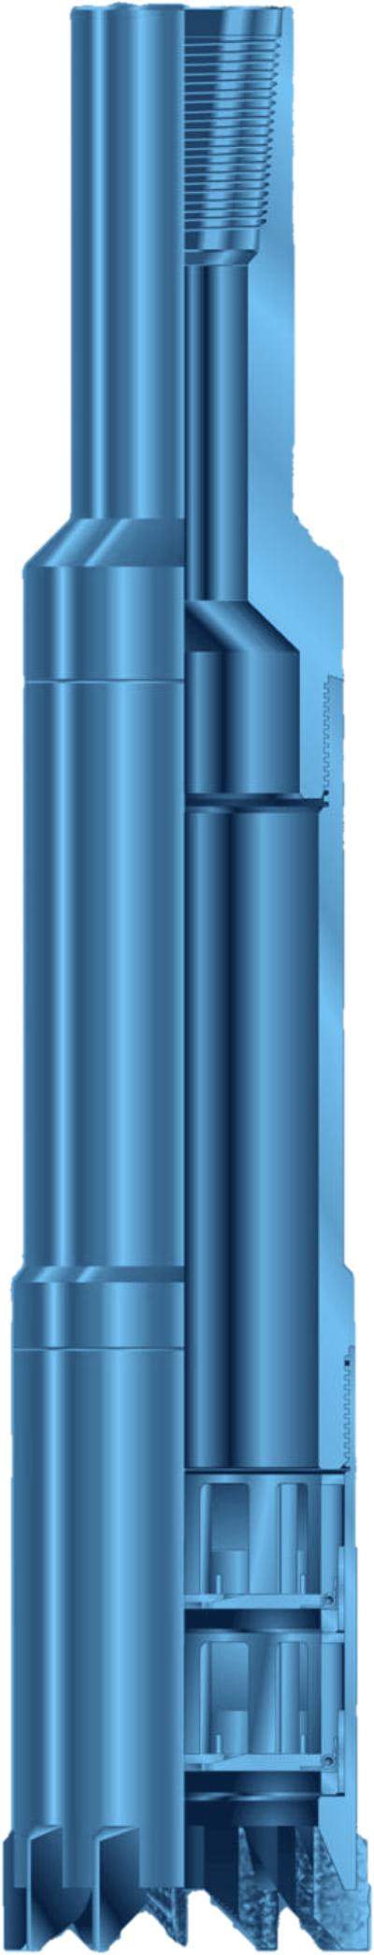
JUNK BASKET
FISHING
JUNK BASKET WITH DOUBLE CATCHERS
GENERAL DESCRIPTION
SIMPLE, DEPENDABLE FISHING TOOL FOR RETRIEVING LOOSE JUNK FROM THE BOTTOM OF THE HOLE: BIT CONES, BEARINGS, BROKEN SLIPS, WIRELINE, HAND TOOLS, DEBRIS FROM TWISTED-OFF STRINGS AND MILLING CUTTINGS. TWO FREE-REVOLVING CATCHERS SIT INSIDE A MILL SHOE, SO THE BASKET CUTS A SHORT CORE THAT LOCKS THE JUNK IN THE BARREL. IT CAN ALSO TAKE A CORE SAMPLE, DRILL A FULL-GAUGE HOLE OR REAM. MAGNET INSERTS AND ACCESSORY SHOES ADAPT IT TO THE JOB.
TECHNICAL CHARACTERISTICS
Hole size | Barrel OD | Shoe OD | Max. fish Ø | Teeth | Wt (lb)
3-3/4 - 4-1/8 | 3-5/8 | 3-5/8 | 2-11/16 | 8 | 55
4-1/4 - 4-1/2 | 3-3/4 | 4-1/16 | 2-15/16 | 8 | 60
4-5/8 - 5 | 3-7/8 | 4-1/2 | 3-9/32 | 8 | 65
4-5/8 - 5 | 3-7/8 | 4-1/2 | 3-3/8 | 8 | 65
5-1/8 - 5-1/2 | 4-1/4 | 4-7/8 | 3-23/32 | 8 | 80
5-3/8 - 6 | 5-1/8 | 5-1/8 | 3-25/32 | 8 | 80
5-5/8 - 6 | 4-3/4 | 5-3/8 | 4-1/16 | 8 | 100
6-1/8 - 6-1/2 | 5-3/4 | 5-3/4 | 4-13/32 | 8 | 200
6-1/8 - 6-1/2 | 5-1/8 | 5-7/8 | 4-5/16 | 8 | 110
Hole size | Barrel OD | Shoe OD | Max. fish Ø | Teeth | Wt (lb)
6-1/8 - 6-1/2 | 5-1/4 | 5-7/8 | 4-1/2 | 8 | 110
6-5/8 - 7 | 5-3/4 | 6-1/4 | 4-13/16 | 8 | 125
7-1/4 - 8 | 6-1/2 | 7-1/8 | 5-7/16 | 8 | 160
8-1/4 - 9 | 7-1/2 | 8-1/8 | 6-3/16 | 8 | 205
9-1/4 - 10-1/8 | 8-1/2 | 9-1/8 | 7-3/16 | 10 | 255
10-1/4 - 11-5/8 | 9-3/8 | 10-1/8 | 8-1/16 | 12 | 290
11-3/4 - 12-1/2 | 10-3/8 | 11-1/4 | 9-1/16 | 12 | 360
12-5/8 - 15 | 11-3/8 | 12-1/4 | 10-1/16 | 12 | 450
15 - 20 | 13-3/4 | 14-1/2 | 12-1/16 | 16 | 655
Dimensions in inches, weights in lb (approximate). Shoes should be at least 1/8 in. over the barrel size.
DESIGN FEATURES
OPERATING PARAMETERS
■ Double catchers: the upper fingers reach half way to the centre and break the core on pull; the lower catcher has alternating long and short fingers forming a close-fitting basket.
■ Free-revolving catchers: spin inside the shoe, which prevents finger breakage.
■ Rivet-free catchers: manganese bronze or steel fingers, redressed easily on location.
■ Magnet insert: replaces the two catchers and turns the basket into a fishing magnet, useful in hard formations or to clean the hole before diamond drilling.
Approach | Start circulation at reduced pressure just before bottom, rotate and lower slowly onto the fish
Mill shoes | 1 ton on bottom, 50 - 150 rpm
Finger shoes | Rotate and lower slowly to about 2 tons on bottom
Breaking the core | Stop rotation and circulation, release torque, take an upward pull; a hydraulic jar above helps
SHOE SELECTION
After use, disassemble, clean and lubricate all internal parts, inspect catcher fingers and springs, and paint or grease the outside.
■ Type A mill shoe: side wings, hard metal facing; standard, for soft formations and loose fish.
■ Type B mill shoe: hard-faced with sintered tungsten carbide, for hard formations.
■ Type C mill shoe: flat bottom, hard-faced on bottom, inner and outer faces; cuts cores and burns metal.
■ Finger shoe: for large, loose junk or junk too big for the catchers.
HOW TO ORDER
Please specify: 1. tool name and size 2. OD and type of shoe 3. top connection, if other than standard 4. recommended spares: 2 upper catchers, 2 lower catchers, 3 mill shoes, 2 finger shoes, 4 finger shoe replacements.

Slide 8
VENTURI BASKET
FISHING
VENTURI JUNK BASKET
GENERAL DESCRIPTION
JUNK RETRIEVAL TOOL FOR COILED TUBING. FLUID PUMPED THROUGH THE STRING AND OUT OF NOZZLES IN THE VENTURI CHAMBER CREATES A VACUUM THAT DRAWS FLUID AND DEBRIS IN AT THE BOTTOM OF THE TOOL AND BACK UP THROUGH THE VENTURI TUBES; MOST OF IT MIXES WITH THE PRESSURIZED FLOW AND RECIRCULATES AROUND THE BOTTOM. IN EFFECT A HIGH-POWERED VACUUM CLEANER, IT WORKS WITH FLUID, MULTIPHASE FLUID, FOAM OR GAS. A HOLLOW MAGNETIC SECTION WITH A FINGER-TYPE TRAP HOLDS THE JUNK INSIDE THE TOOL, AND IT DOES NOT DEPEND ON HOLE SIZE: A 3-1/8 IN. OD TOOL CAN CLEAN UP 7 IN. CASING.
TECHNICAL CHARACTERISTICS
Size (OD) | ID | Top connection | Length | Tensile strength
1-3/4 | 0.469 | 1 AMMT box | 33 | 36,000 lb
2-1/16 | 1 | 1-1/2 AMMT box | 33 | 45,840 lb
2-1/4 | 1 | 1-1/2 AMMT box | 33 | 45,840 lb
2-5/8 | 1 | 1-1/2 AMMT box | 36-5/8 | 45,840 lb
3-1/8 | 1 | 2-3/8 PAC pin | 42 | 109,600 lb
3-1/8 | 1 | 2-3/8 REG box | 42 | 109,600 lb
Dimensions in inches. All sizes: operating pressure 5,000 psi, temperature rating 0 to 350 F, standard nozzle 0.062 in.
DESIGN FEATURES
OPTIONAL NOZZLES
■ Venturi suction: nozzles create a vacuum that pulls fluid and debris into the tool from the bottom.
■ Interchangeable nozzles: changed out to suit the available pump rate, fluid or gas.
■ Debris filter screen: placed before the venturi chamber to keep debris out of the venturi tubes.
■ Magnetic trap: hollow magnetic section with a finger-type trap retains junk; debris is carried out of the well inside the tool.
■ Barrel extensions: extension tubes increase the volume of junk the tool can carry.
■ Hole size independent: works in holes much larger than the tool OD.
Nozzle sizes (in.) | 0.062 (std), 0.078, 0.094, 0.109, 0.125, 0.140, 0.156, 0.171, 0.187
Applies to | All sizes, 1-3/4 to 3-1/8 (two nozzle series: 1-3/4 to 2-1/4 and 2-5/8 to 3-1/8)
EXTENSION TUBES
Tool size | Extension tube lengths (ft)
1-3/4 | 4, 6
2-1/16 | 4, 6
2-1/4 | 4
2-5/8 | 2, 4, 5, 5
3-1/8 | 4, 10
HOW TO ORDER
Please specify: 1. tool size and top connection 2. nozzle size for the pump rate and fluid 3. extension tube length(s) for the junk volume to be carried 4. service kit.
OPERATING PARAMETERS
Fluids | Fluid, multiphase fluid, foam, gas
Pressure | 5,000 psi
Temperature | 0 to 350 F

Slide 9
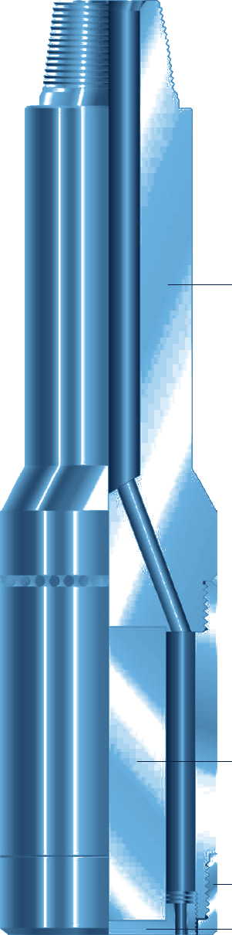
Fishing Magnet
FISHING
PERMANENT MAGNET FOR JUNK RETRIEVAL
GENERAL DESCRIPTION
PERMANENT-MAGNET TOOL THAT RETRIEVES UNDRILLABLE OBJECTS WITH MAGNETIC ATTRACTION: BIT CONES, BEARINGS, SLIPS, MILL CUTTINGS, TONG PINS AND HAMMERS. IT PICKS UP SMALL, ODD-SHAPED ITEMS THAT INSIDE OR OUTSIDE CATCH TOOLS CANNOT HOLD. AVAILABLE FROM 1 IN. TO 20 IN. O.D., ON PIPE OR WIRELINE, WITH PULLS FROM 5 LB TO 5,000 LB DEPENDING ON SIZE. IT IS ALSO USED TO CLEAR THE HOLE BEFORE DIAMOND CORING.
TECHNICAL CHARACTERISTICS
O.D. | Hole size | Top pin | Approx. pull (lb) | Wt (lb)
1 | 1-1/4 to 2 | 5/8 11-N.C. | 5 - 7 | 1
1-1/4 | 1-5/8 to 2-1/2 | 5/8 S.R. | 8 - 10 | 1-1/2
1-1/2 | 2 to 2-3/4 | 5/8 S.R. | 11 - 14 | 3-1/4
1-3/4 | 2-3/8 to 3-1/4 | 3/4 S.R. | 15 - 20 | 5
2-1/4 | 2-3/4 to 3-5/8 | 3/4 S.R. | 25 - 50 | 16
2-1/2 | 3 to 3-3/4 | 3/4 S.R. | 50 - 85 | 18
3 | 3-1/4 to 4-1/8 | 2-3/8 Tbg | 85 - 190 | 20
3-1/4 | 4 to 4-1/4 | 2-3/8 Tbg | 85 - 190 | 25
3-1/2 | 4-1/4 to 4-1/2 | 2-3/8 API Reg. | 150 - 250 | 27-1/2
4 | 4-1/2 to 5 | 2-3/8 API Reg. | 175 - 250 | 43
4-1/2 | 5-1/8 to 5-1/2 | 2-7/8 API Reg. | 250 - 320 | 67
5 | 5-5/8 to 6 | 2-7/8 API Reg. | 320 - 385 | 80
O.D. | Hole size | Top pin | Approx. pull (lb) | Wt (lb)
5-1/2 | 6-1/8 to 6-1/2 | 3-1/2 API Reg. | 385 - 425 | 95
5-3/4 | 6-1/8 to 6-1/2 | 3-1/2 API Reg. | 385 - 425 | 106
6 | 6-5/8 to 7-1/2 | 3-1/2 API Reg. | 425 - 500 | 120
7 | 7-5/8 to 8-1/2 | 4-1/2 API Reg. | 550 - 700 | 162
8 | 8-5/8 to 9-3/4 | 4-1/2 API Reg. | 700 - 850 | 205
9 | 9-7/8 to 11-5/8 | 4-1/2 API Reg. | 850 - 1,000 | 335
10 | 10-1/2 to 11-7/8 | 6-5/8 API Reg. | 1,000 - 1,125 | 390
10-1/2 | 11-3/4 to 13 | 6-5/8 API Reg. | 1,125 - 1,260 | 431
11-1/2 | 12-1/4 to 14 | 6-5/8 API Reg. | 1,260 - 1,550 | 512
14 | 15 | 6-5/8 API Reg. | 1,700 - 2,100 | 770
16 | 17 | 6-5/8 API Reg. | 3,200 - 4,000 | 1,200
19 | 20 | 13-3/8 V-4 thd | 4,200 - 5,000 | 1,700
Dimensions in inches, weights in lb (complete assembly, approximate). S.R.: sucker rod pin; Tbg: tubing pin. Pulls assume the magnet face fully covers a flat surface; pick-up capacity drops considerably on smaller contact areas.
DESIGN FEATURES
OPERATING PARAMETERS
■ Focused field: flux is concentrated at the bottom pole plate; the outer case is not magnetised, so the tool works inside cased hole.
■ Circulation: ports through the body exit inside the guide and keep the pole plate clean.
■ Guides: flush (standard) for large or flat objects; lipped for 3 or more cones or leaning objects; mill guide for tong dies, 1 - 2 cones and safety runs before diamond coring.
■ Run on pipe or wireline: wireline needs adaptors and gives no circulation.
Approach | Stop 6 in. to 1 ft above the fish; circulate to wash
Contact | Reduce flow, lower onto fish, rotate lightly, stop pumps
Max. weight, rotating | 5,000 lb
Max. weight, no rotation | 10,000 lb
Proper charge | 2,500 gauss or more
Excess weight or rotation can damage the pole plate and magnetic element. Never store two magnets face to face: the smaller loses charge. Clean ports after each run.
HOW TO ORDER
Please specify: 1. tool name and assembly number 2. O.D. 3. top connection if other than standard. Recommended accessories: 1 lipped guide and 1 mill guide.

Slide 10
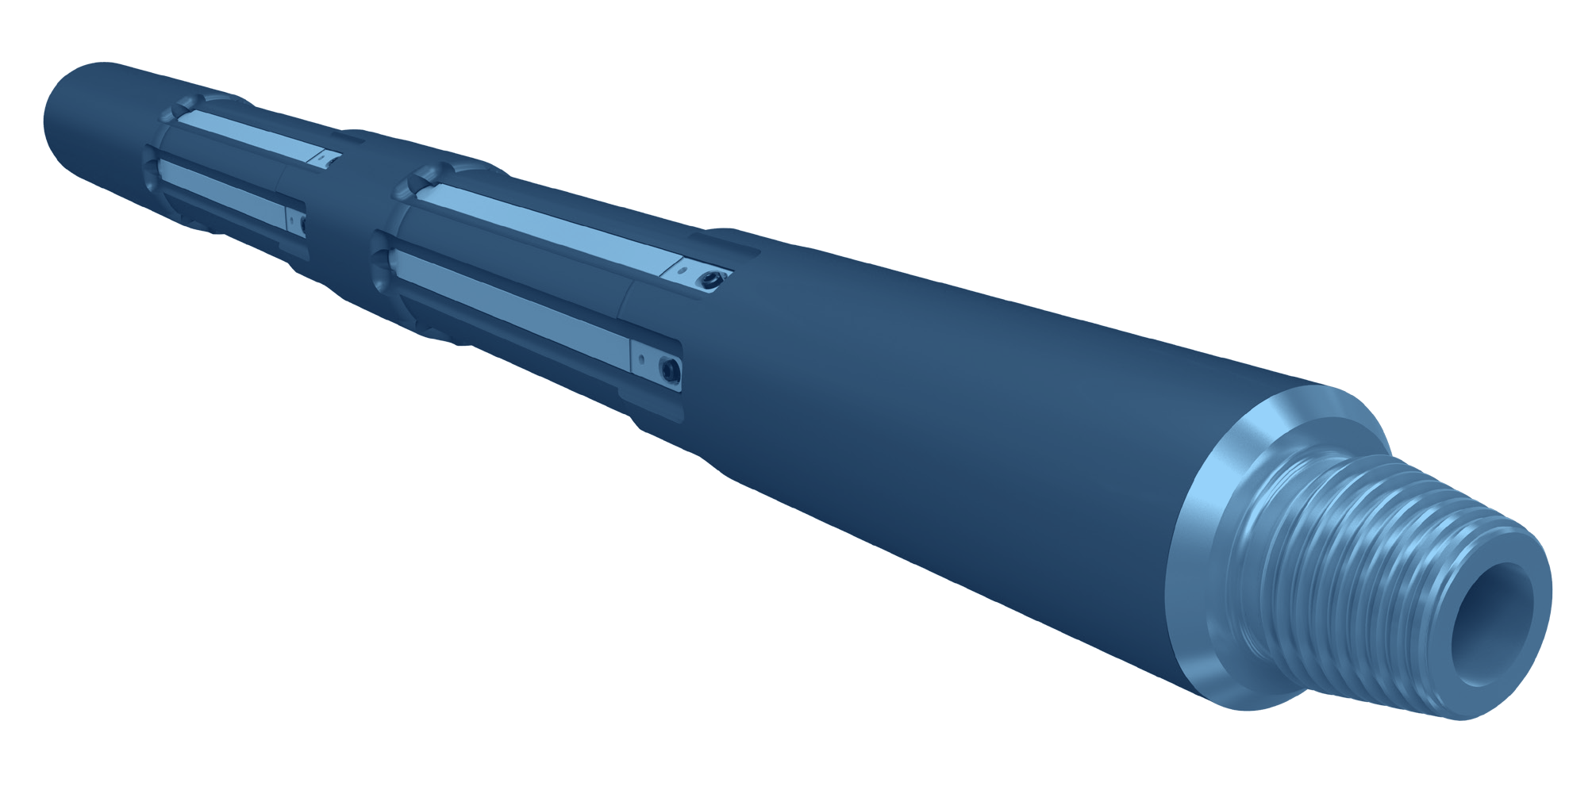
STRING MAGNET
CLEANING
IN-LINE STRING MAGNET
GENERAL DESCRIPTION
IN-LINE MAGNET RUN IN THE WORK STRING TO COLLECT FERROUS DEBRIS DURING CASING CUTTING, MILLING, PLUG AND ABANDONMENT AND CASING EXIT OPERATIONS, ESPECIALLY WHERE THE AVAILABLE CIRCULATION IS NOT ENOUGH TO CARRY THE SWARF OUT OF THE HOLE. LARGE MAGNETIC SLEEVES WITH RARE EARTH MAGNETS GIVE A HIGH PICK-UP CAPACITY. THE BODY IS A SINGLE PIECE WITH NO INTERNAL CONNECTION AND IS RATED FOR HIGH TORQUE. AVAILABLE FOR CASING FROM 4-1/2 TO 14 IN., IN STANDARD OR HIGH TEMPERATURE VERSIONS.
TECHNICAL CHARACTERISTICS
Casing size (in) | Tool OD (in) | Connection | Tool yield torque (ft-lb) | Tool tensile (lb) | Connection yield torque (ft-lb) | Connection tensile* (lb)
4-1/2, 4-3/4, 5 | 3-1/8 | 2-3/8 API Reg | 15,000 | 457,940 | 5,810 | 362,660
5-1/2, 6 | 3-3/4 | 2-7/8 API Reg | 20,000 | 698,880 | 11,080 | 478,540
6-5/8, 7 | 4-3/4 | 3-1/2 API IF | 25,000 | 1,032,640 | 18,090 | 572,690
7-5/8 | 5 | 3-1/2 API IF | 42,500 | 2,467,780 | 18,090 | 572,690
9-5/8 | 6-1/2 | 4-1/2 API IF | 80,000 | 2,126,520 | 38,060 | 919,880
10-3/4 | 8 | 6-5/8 API Reg | 105,000 | 3,759,840 | 83,380 | 1,770,500
13-3/8, 13-5/8, 14 | 10-1/8 | 6-5/8 API Reg | 250,000 | 4,879,680 | 83,380 | 1,770,500
* Tensile load at zero make-up torque. Dimensions in inches, loads in lb and ft-lb.
DESIGN FEATURES
■ Large magnetic area: high pick-up capacity for ferrous debris.
■ Rare earth magnets: powerful field, standard and high temperature options.
■ Replaceable sleeves: magnetic sleeves are easily removed and replaced.
■ One-piece body: solid mandrel with no internal connection.
■ High torque rating: suited to milling and cutting strings.
■ Fishable through the ID.
APPLICATIONS
BENEFITS
■ Casing cutting and milling
■ Plug and abandonment
■ Casing exit (window milling)
■ Wellbore cleanout where circulation is limited
■ Better ferrous debris removal when circulation is inadequate
■ Cleaner wellbore, less non-productive time
■ Lower overall cost of the operation
HOW TO ORDER
Please specify: 1. casing size and weight 2. tool OD and top / bottom connections 3. standard or high temperature magnets 4. number of magnetic sleeves and spare sleeves.

Slide 11
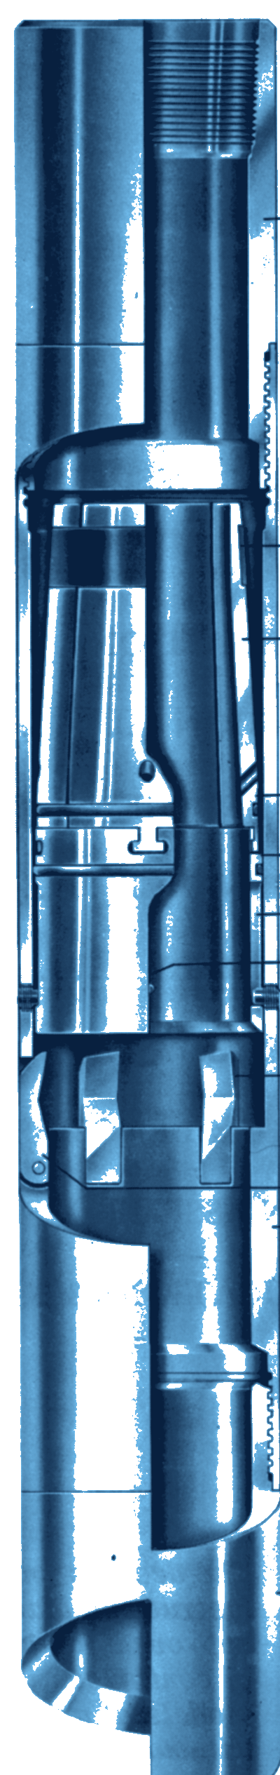
HEC
FISHING
HYDRAULIC EXTERNAL CUTTER
GENERAL DESCRIPTION
HYDRAULICALLY ACTUATED EXTERNAL CUTTER THAT CUTS AND RECOVERS TUBING OR DRILL PIPE IN A SINGLE TRIP. RUN ON A WASHOVER STRING, IT CUTS STUCK PIPE FROM THE OUTSIDE: THE KNIVES ARE FED BY PUMP PRESSURE, GIVING FAST, SMOOTH AND CLEAN CUTS UNDER SENSITIVE OPERATOR CONTROL. IT CUTS ALL TYPES OF DRILL PIPE AND TUBING, REGARDLESS OF TOOL-JOINT STYLE.
TECHNICAL CHARACTERISTICS
Cutter ref. | Pipe to cut | Cutter O.D. | Cutter I.D. | Max. size passed over* | Min. hole to run in | Wt (lb)
70086 | 1.315 - 2-1/16 | 3-3/4 | 2-7/8 | 2-3/4 | 4 | 55
34415 | 1.315 - 2-3/8 | 4-1/16 | 3-3/16 | 3-1/16 | 4-5/16 | 60
70209 | 1.900 - 2-7/8 | 4-7/16 | 3-5/8 | 3-7/16 | 4-11/16 | 73
41727 | 1.900 - 2-7/8 | 4-11/16 | 3-7/8 | 3-3/4 | 4-15/16 | 85
34551 | 2-1/16 - 4 | 5-5/8 | 4-5/16 | 4-3/16 | 5-7/8 | 95
51148 | 2-3/8 - 4 | 6-1/16 | 4-7/8 | 4-13/16 | 6-1/4 | 105
35957 | 3-1/2 - 5 | 8 | 6-1/2 | 6-3/8 | 8-1/2 | 230
* Maximum pipe O.D. the cutter will pass over, dressed with the largest piston segment. Dimensions in inches, weights in lb (approximate).
DESIGN FEATURES
PERFORMANCE PARAMETERS
■ Cuts and recovers: tubing or drill pipe in one trip, inside a washover string.
■ Hydraulic feed: pump pressure drives the knives; sensitive control of the cut.
■ Run-in protection: shear pins hold the piston until the cut starts (about 145 psi).
■ Interchangeable piston segments: one cutter covers several pipe sizes; threaded-edge segments pass collars.
■ Cool, flushed cut: each segment has a fluid passage for flushing and cooling.
■ Hardened knives: tempered tool steel, replaceable in the field.
■ Guide options: standard cut-lip, extra long wall hook or mill-toothed.
Rotary speed while cutting | 15 - 25 rpm
Shear pins | 1 pin: about 377 lb; 2 pins: 754 lb
Proving the cut | Torque drop, weight rise
Cut position | 1 joint above washover shoe
PULL CAPACITY AND HYDRAULICS
Cutter ref. | Max. load (lb) | psi | gpm
70086 | 2,530 - 7,910 | 20 - 40 | 120 - 220
34415 | 1,860 - 3,340 | 20 - 45 | 120 - 220
70209 | 1,550 - 3,570 | 10 - 25 | 120 - 145
41727 | 1,128 - 1,780 | 10 - 30 | 100 - 200
34551 | 6,100 - 16,800 | 15 - 55 | 180 - 230
51148 | 2,350 - 4,800 | 15 - 40 | 125 - 200
35957 | 5,160 - 9,040 | 10 - 20 | 140 - 180
OPERATING NOTES
■ Before the run: wash over the stuck pipe to centralise it at the cut point.
■ Avoid surging: pressure surges can break a knife tip.
■ After the cut: torque drops and the weight indicator rises; raise the string slowly to confirm.
Approximate values, depending on pipe size. Static loads: if shock loaded, reduce by 50%.
HOW TO ORDER
Please specify: 1. cutter ref. and size of pipe to cut 2. piston segment size 3. connection (top and bottom) 4. guide type (standard, wall hook or mill-toothed) 5. recommended spares: knives, knife pins, shear pins, piston and rubber rings.

Slide 12
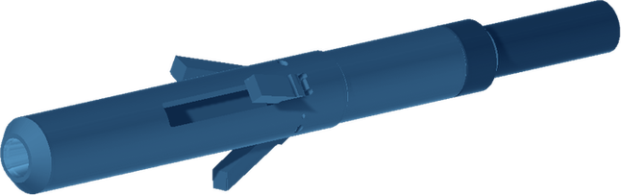
PIPE CUTTER
CUTTING
INTERNAL HYDRAULIC CASING CUTTER
GENERAL DESCRIPTION
INTERNAL HYDRAULIC CUTTER THAT CUTS SINGLE OR MULTIPLE STRINGS OF CONCENTRIC OR ECCENTRIC CASING. IT CAN BE USED IN ANY CUTTING APPLICATION WHERE ROTATION AND PRESSURE CAN BE APPLIED TO THE TOOL. IT IS MAINLY RUN IN WELL ABANDONMENT OPERATIONS, WHEN CASINGS HAVE BEEN CEMENTED AND CANNOT BE CUT AND PULLED INDIVIDUALLY.
TECHNICAL CHARACTERISTICS
Designed to cut (in) | 4-1/2 - 5-1/2 | 6-5/8 - 13-3/8 | 9-5/8 - 16 | 13-3/8 - 36
Top connection (API) | 2-3/8 IF | 3-1/2 REG | 6-5/8 REG | 6-5/8 REG or 7-5/8 REG
Tool diameter (in) | 3-5/8 | 5-3/4 | 8-1/4 | 11-3/4
Dimensions in inches. Cutter arms are available in various sizes to cut single or multiple strings.
OPERATING PARAMETERS
Flow rate | Up to 400 L/min
Head pressure | 35 to 60 bar
Maximum | 80 bar / 90 rpm
Surface test | 300 L/min at 5 bar
Start of rotation | 70 rpm (max. 100)
Start of pumping | 150 L/min
DESIGN FEATURES
If pressure rises too quickly in the surface test, the piston may be blocked.
■ Casing cutting: single or multiple strings, concentric or eccentric.
■ Hydraulic and rotary: works wherever rotation and pressure can be applied to the tool.
■ Abandonment duty: cuts cemented casings that cannot be cut and pulled one by one.
■ Carbide-dressed arms: crushed carbide on the cutter arms, in several sizes for single or multiple strings.
■ Three knife reloading types: standard (general use), hardfacing (reinforced, high-strength steels) and carbide (high wear resistance, abrasive environments).
CUTTING PROCEDURE
■ Record parameters: PUW, SOW and free torque.
■ Prepare: close the purge line and reset the WOB.
■ Start: begin rotation, then pump at 150 L/min while monitoring return flow and torque.
■ Cut: once return is confirmed, increase gradually to 50 - 60 bar, then stabilise the flow without further pump adjustment.
HOW TO ORDER
Please specify: 1. casing size range to cut 2. top connection 3. knife reloading type (standard, hardfacing or carbide) 4. single or multiple strings to cut.

Slide 13
SECTION MILL
MILLING
HYDRAULICALLY ACTUATED CASING SECTION MILL
GENERAL DESCRIPTION
HYDRAULICALLY ACTUATED TOOL THAT MILLS A SECTION OUT OF CASING OR TUBING, AND CAN ALSO BE USED TO CUT A SINGLE STRING OF CASING. PUMP PRESSURE ACROSS THE PISTON PUSHES A CAM DOWN AND EXPANDS THE KNIVES AGAINST THE CASING: THE CUT-OUT KNIVES PART THE PIPE FIRST, THEN ALL THE KNIVES TAKE PART IN MILLING. WHEN CIRCULATION STOPS, THE PISTON SPRING RETRACTS THE CAM AND THE KNIVES FOLD BACK INTO THE BODY FOR RETRIEVAL. KNIVES ARE DRESSED WITH TUNGSTEN CARBIDE INSERTS, SUITED TO POORLY CEMENTED, SPLIT OR CORRODED CASING; A SECTION OF UP TO 60 FT IS TYPICALLY MILLED WITH ONE SET OF KNIVES.
TECHNICAL CHARACTERISTICS
Tool series | Casing size | Body Ø | Fishing neck length | Fishing neck Ø | Overall length | Top pin API Reg. | Wt (lb)
3600 | 4-1/2 | 3-5/8 | 18 | 3-1/8 | 56 | 2-3/8 | 135
4100 | 5 | 4-1/8 | 18 | 3-1/4 | 66 | 2-3/8 | 175
4500 | 5-1/2, 6 | 4-1/2 | 18 | 4-1/8 | 70 | 2-7/8 | 220
5500 | 6-5/8, 7 | 5-1/2 | 18 | 4-3/4 | 74 | 3-1/2 | 350
6100 | 7-5/8 | 6-1/8 | 18 | 4-3/4 | 74 | 3-1/2 | 368
7200 | 8-5/8, 9-5/8 | 7-1/4 | 18 | 5-3/4 | 89 | 4-1/2 | 554
8200 | 9-5/8 | 8-1/4 | 18 | 5-3/4 or 8 | 87 | 4-1/2 or 6-5/8 | 900
9200 | 10-3/4, 11-3/4 | 9-1/4 | 18 | 5-3/4 or 8 | 87 | 4-1/2 or 6-5/8 | 980
11700 | 13-3/8, 16 | 11-1/2 | 18 | 8 or 9 | 90 | 6-5/8 or 7-5/8 | 1,725
Dimensions in inches, weights in lb (approximate). Standard API regular pin connections; others on request.
DESIGN FEATURES
FLOW RATES (GPM)
■ Staged knife opening: three knives cut out, then all six mill.
■ Carbide cutting structure: inserts laid in a brick-work pattern for footage and penetration.
■ Positive cut-out signal: the Flo-Tel option doubles the flow area once the casing is parted, giving a 200 - 250 psi pressure drop at surface. Standard on series 4100 to 11700; not available on 3600.
■ Self-retracting: piston spring closes the knives when pumps stop.
■ Jetted top sub: limits velocity through the piston above 300 gpm.
■ Simple servicing: replaceable knives, arm-stop stabilizers and Flo-Tel unit.
Tool series | During cut-out | During milling
3600 | 110 - 160 | 110 - 160
4100 | 80 - 125 | 110 - 160
4500 | 80 - 125 | 150 - 200
5500 | 80 - 125 | 200 - 250
6100 | 80 - 125 | 200 - 250
7200 | 80 - 125 | 200 - 300
8200 | 80 - 125 | 300 - 400
9200 | 80 - 125 | 350 - 450
11700 | 350 - 450 | 350 - 600
OPERATING PARAMETERS
Rotary speed, cut-out | 60 rpm to start
Rotary speed, milling | 80 - 120 rpm
Weight on mill | 4,000 - 8,000 lb
Min. pressure at tool | about 300 psi to cut out
Pipe cutter use | 80 - 100 rpm
HOW TO ORDER
Please specify: 1. tool series 2. size and weight of casing to be milled 3. top pin connection.

Slide 14
ECONOMILL
MILLING
LOW-COST LIGHT-DUTY MILL
GENERAL DESCRIPTION
LOW-COST MILLING TOOL FOR LIGHT-DUTY JOBS, DRESSED WITH TUNGSTEN CARBIDE. IT IS EFFECTIVE FOR MILLING PACKERS, RETAINERS, BRIDGE PLUGS AND CEMENT. IT HAS STANDARD API CONNECTIONS, SO IT IS MADE UP AND BROKEN OUT WITH A STANDARD BIT BREAKER AND NEEDS NO ADDITIONAL SUB. FLUID IS DIRECTED ALONG EACH CUTTING BLADE AND THROUGH THE CENTRE OF THE HEAD FOR CUTTINGS REMOVAL AND COOLING.
TECHNICAL CHARACTERISTICS
Tool series | Dressed diameter (in.) | Top pin conn. (API Reg.) | Recommended make-up torque (ft-lb) | Overall length (in.) | Wt (lb)
3000 | 3-1/4 - 4-3/8 | 2-3/8 | 3,000 - 3,500 | 7-5/8 | 17
4000 | 4-1/2 - 5-3/8 | 2-7/8 | 6,000 - 7,000 | 8-5/8 | 26
5000 | 5-1/2 - 7-3/8 | 3-1/2 | 7,000 - 9,000 | 9 | 40
7000 | 7-1/2 - 8-3/4 | 4-1/2 | 12,000 - 16,000 | 11-1/2 | 76
10000 | 10-1/4 - 12-1/4 | 6-5/8 | 28,000 - 32,000 | 16-1/2 | 125
Dimensions in inches, weights in lb (approximate). Column order follows the source layout.
DESIGN FEATURES
PERFORMANCE PARAMETERS
■ Tungsten carbide dressing: for packers, retainers, bridge plugs and cement.
■ Standard API pin connection: made up with a standard bit breaker; no extra sub needed.
■ Circulation: flow along each blade and through the head centre for cooling and cuttings removal.
■ Stabilizing ribs: above the blades, to protect the casing.
■ Cast construction: not to be used as a junk mill; cast material has lower strength.
Weight on mill | 2,000 - 8,000 lb
Practice | Light weight, low speed
Surface speed | 250 - 340 ft/min
Rotary speed | Surf. speed / (O.D. x 3.14)
If bouncing | Cut speed, then raise slowly
Stabilizer | Above mill, O.D. not larger
HOW TO ORDER
Please specify: 1. mill dressed diameter 2. size and weight of the casing to run through, if known 3. protective subs, available on request.

Slide 15
JUNK MILL
MILLING
CONVENTIONAL JUNK MILL
GENERAL DESCRIPTION
THE WORKHORSE OF DOWNHOLE MILLING, USED TO MILL ALMOST ANYTHING IN THE HOLE INCLUDING CEMENT AND RUBBER PRODUCTS. IT IS THE ONLY TOOL ABLE TO MILL DRILL PIPE CEMENTED INSIDE AND OUT. IT IS ALSO USED TO MILL CAST-IRON BRIDGE PLUGS, AND TO MILL CASING THAT HAS BEEN MILLED TO THE POINT OF ROTATING, RUN ON A JOINT OF SLIGHTLY BENT DRILL PIPE. THREE DRESSING OPTIONS ARE LISTED: CONVENTIONAL, CONEBUSTER AND SUPER.
TECHNICAL CHARACTERISTICS
Cutting diameter (in.) | Top pin conn. (API Reg.) | Overall length: conventional and Conebuster (in.) | Overall length: Super (in.) | Fishing neck length (in.) | Fishing neck dia. (in.) | Wt (lb)
3-1/2 - 4-1/2 | 2-3/8 | 20 | 20 | 12 | 3 | 45
4-1/2 - 5-1/2 | 2-7/8 | 21 | 21 | 12 | 3-3/4 | 62
5-1/2 - 5-5/8 | 3-1/2 | 23 | 21 | 12 | 4-1/4 | 95
5-3/4 - 7-1/2 | 3-1/2 | 23 | 21 | 12 | 4-3/4 | 105
7-1/2 - 9 | 4-1/2 | 27 | 27 | 12 | 5-3/4 | 180
9-1/2 - 12-1/4 | 6-5/8 | 29 | 29 | 12 | 7-3/4 | 350
13 - 15 | 6-5/8 or 7-5/8 | 30 | 30 | 12 | 7-3/4 or 9-1/2 | 500
17 - 17-1/2 | 6-5/8 or 7-5/8 | 33 | 33 | 12 | 7-3/4 or 9-1/2 | 625
18-1/2 - 26 | 6-5/8 or 7-5/8 | 37 | 37 | 12 | 7-3/4 or 9-1/2 | 1,200
Dimensions in inches, weights in lb (approximate).
DESIGN FEATURES
PERFORMANCE PARAMETERS
■ Fishing neck: allows retrieval of the mill if it is left in the hole.
■ Dressing options: conventional, Conebuster or Super.
■ Inside casing: mill head O.D. equal to the casing drift; wear pads of the same O.D. protect the casing; stabilizer of the same O.D. run directly above.
■ Bridge plugs: mill O.D. about 1/8 in. under the plug size, to avoid skinning the casing.
Weight on mill | 4,000 - 10,000 lb
Start-up rotary speed | 60 - 80 rpm
Rotary speed once milling | 80 - 100 rpm, normal pump
Weight, second pass | 4,000 - 6,000 lb
Surface speed | 250 - 340 ft/min
Rotary speed | Surf. speed / (O.D. x 3.14)
Loose junk cycle | Mill 1-2 ft, lift 15-20 ft, settle
Stationary junk cycle | Each 3-5 ft, lift 10-15 ft, ream
Rough running | Cut speed/weight, raise slowly
Stabilizer spacing | 60 - 90 ft above mill (vertical)
OPERATING NOTES
■ Open hole: mill O.D. about 1/8 in. under hole diameter; at least 10,000 lb of drill collars; junk sub directly above the mill.
■ Spudding: frequent spudding pounds loose junk onto bottom for effective milling; a rise in torque shows junk alongside the mill.
■ Starting: set down on the junk while turning, then bring weight up; never apply weight before rotating.
HOW TO ORDER
Please specify: 1. mill diameter 2. size and weight of the casing to run through, if available 3. top connection 4. dressing (conventional, Conebuster or Super).

Slide 16
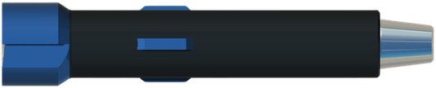
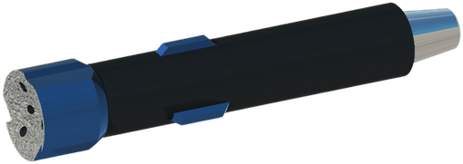
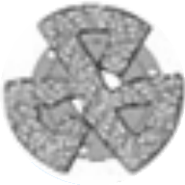
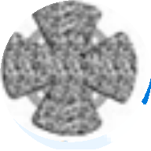

SUPER JUNK MILL
MILLING
GENERAL DESCRIPTION
THE JUNK MILL IS A HIGH-PERFORMANCE MILLING TOOL DESIGNED TO GRIND AND REMOVE METAL DEBRIS AND OBSTRUCTIONS IN THE WELLBORE, SUCH AS STUCK TOOLS, CASING FRAGMENTS OR DRILL BITS. IT IS USED IN TOUGH ENVIRONMENTS WHERE STANDARD MILLS MIGHT NOT SUFFICE, OFFERING SUPERIOR CUTTING POWER AND DURABILITY.
TECHNICAL CHARACTERISTICS
DRESSING OPTIONS
Dressed OD (in) | Top pin connection
3-1/2 - 4-1/4 | 2-3/8 API REG
4-1/2 - 5-1/2 | 2-7/8 API REG
5-1/2 - 7-1/2 | 3-1/2 API REG
7-1/2 - 9 | 4-1/2 API REG
9-1/2 - 12-1/4 | 6-5/8 API REG
13 - 15 | 6-5/8, 7-5/8
17 - 17-1/2 | 6-5/8, 7-5/8
18-1/2 - 26 | 6-5/8, 7-5/8
Conventional
Conebuster
Super
USAGE RECOMMENDATIONS
TYPES OF DEBRIS MILLED
■ Circulation: use with a robust circulation system to clear milling debris efficiently.
■ Debris collection: often combined with a fishing magnet or a junk basket to collect any metallic debris left behind.
■ Stabilizers: useful for tool stability, more consistent cutting action and longer mill life.
■ Broken drill bits
■ Casing fragments
■ Stuck tools
■ Fishing equipment debris
■ Miscellaneous metallic obstructions
HOW TO ORDER
Please specify: 1. dressed OD 2. top pin connection 3. dressing (conventional, Conebuster or Super).

Slide 17
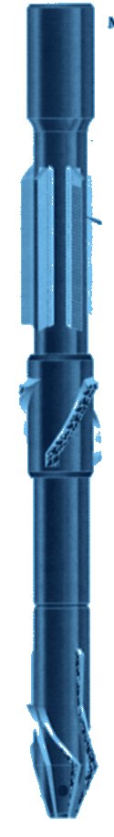
VIPER PILOT MILL
MILLING
CASING REMOVAL AND SLOT RECOVERY MILL
GENERAL DESCRIPTION
MILLING TOOL DESIGNED FOR THE EFFICIENT REMOVAL OF DOWNHOLE CASING STRINGS. IT IS USED MAINLY FOR OFFSHORE PLATFORM SLOT RECOVERY, WHERE INTERMEDIATE CASING IS REMOVED BACK TO THE SURFACE STRING OR CONDUCTOR SO THE WELL CAN BE RE-DRILLED TO A NEW TARGET INSTEAD OF BEING ABANDONED. WHERE THE CASING CEMENT IS POOR A MIX OF RETRIEVAL AND MILLING IS USED; WHERE CASING IS CEMENTED BACK TO THE SPOOLS, MILLING ALONE IS USED. THE BLADES CARRY A BRICK-PATTERN CARBIDE CUTTING STRUCTURE FOR HIGH PENETRATION RATE, IDEAL CUTTING SIZE AND LONG MILLING LIFE.
TECHNICAL CHARACTERISTICS
Tool series | Casing size | Body dia. | Blade dia. | No. of blades | Top pin conn. | Fishing neck length | Fishing neck dia. | Overall length | Wt (lb)
4500 | 4-1/2 | 4-3/4 | 5.250 | 3 | 3-1/2 IF BU | 12 | 4-3/4 | 36 | 100
5000 | 5 | 4-3/4 | 5.813 | 3 | 3-1/2 IF BU | 12 | 4-3/4 | 36 | 110
5500 | 5-1/2 | 4-3/4 | 6.300 | 3 | 3-1/2 IF BU | 12 | 4-3/4 | 36 | 120
6000 | 6 | 4-3/4 | 6.875 | 3 | 3-1/2 IF BU | 12 | 4-3/4 | 42 | 150
6600 | 6-5/8 | 5-3/4 | 7.640 | 3 | 4-1/2 IF BU | 12 | 5-3/4 | 42 | 175
7000 | 7 | 5-3/4 | 7.906 | 3 | 4-1/2 Reg. BU | 12 | 5-3/4 | 42 | 190
7600 | 7-5/8 | 6-1/4 | 8.750 | 5 | 4-1/2 IF BU | 18 | 6-1/4 | 48 | 250
8600 | 8-5/8 | 6-3/4 | 9.875 | 5 | 5-1/2 Reg. BU | 18 | 6-3/4 | 48 | 275
9600 | 9-5/8 | 8 | 10.875 | 5 | 6-5/8 Reg. BU | 18 | 8 | 60 | 300
10700 | 10-3/4 | 9 | 12.000 | 5 | 7-5/8 Reg. BU | 18 | 9 | 60 | 325
11700 | 11-3/4 | 10-1/4 | 13.000 | 5 | 8-5/8 Reg. BU | 18 | 10-1/4 | 60 | 375
13300 | 13-3/8 | 11-1/2 | 14.625 | 5 | 8-5/8 Reg. BU | 18 | 11-1/2 | 72 | 400
16000 | 16 | 14 | 17.250 | 5 | 8-5/8 Reg. BU | 18 | 14 | 72 | 425
Dimensions in inches, weights in lb (approximate). Pilot stabilisation and guide or taper mill are dressed to the casing drift diameter. stabiliser sleeve available on casing sizes 7-5/8 in. and larger.
DESIGN FEATURES
OPERATING PARAMETERS
■ Cutting structure: carbide inserts in a brick pattern, developed to resist early wear and breakage.
■ Blades: high-grade alloy steel, cutting edge set at the angle for maximum efficiency.
■ Extended blade length: more footage per mill.
■ Stabiliser: sleeve-type, changeable at the rig site; useful on eccentric casing strings.
■ Deviated holes: blade design does not skin the next casing string.
Weight on mill | 5,000 - 10,000 lb
Cutting surface speed | 250 - 340 ft/min
Rotary speed | From surface speed and casing O.D.
MILL STABILITY
■ Taper mill: run directly ahead of the mill to clear junk or enlarge the casing stub.
■ Stabiliser: same diameter as the mill, run immediately above it.
■ Sizing: O.D. and stabilisation diameter set to avoid damage to outer casing strings.
HOW TO ORDER
Please specify: 1. tool series 2. size and weight of the casing to be milled 3. top pin connection.

Slide 18
PILOT MILL
MILLING
PILOT MILL FOR TUBULARS AND LINERS
GENERAL DESCRIPTION
MILLING TOOL WITH A GUIDE NOSE (PILOT) THAT ENTERS THE TUBULAR BEING MILLED AND KEEPS THE BLADES CENTRED ON IT. IT IS USED TO MILL WASHPIPE, SAFETY JOINTS, CROSSOVER SWAGES, WASHOVER SHOES, ADAPTERS, CASING, LINERS, DRILL PIPE AND SWAGED CASING. LINER HANGERS CAN BE MILLED EFFICIENTLY, AVOIDING INSIDE CUTS AND SPEAR RUNS. THE NOSE CAN BE DRESSED TO MILL ANY JUNK MET ALONG THE WAY.
TECHNICAL CHARACTERISTICS
Blade O.D. | Top pin conn. (API reg.) | Pilot O.D. | Overall length | Fishing neck length | Wt (lb)
3-1/4 - 3-7/8 | 2-3/8 | 1-3/4 - 2-3/4 | 27 | 12 | 40
4-1/8 - 4-3/8 | 2-3/8 | 1-3/4 - 2-3/4 | 27 | 12 | 45
4-1/8 - 5-3/8 | 2-7/8 | 2-1/8 - 3-1/4 | 27 | 12 | 120
5-1/2 - 5-5/8 | 3-1/2 | 2-1/2 - 4-3/4 | 38 | 16 | 240
5-3/4 - 7-3/8 | 3-1/2 | 2-1/2 - 4-3/4 | 38 | 16 | 255
6-1/8 - 9-7/8 | 4-1/2 | 4-3/4 - 6-3/4 | 42 | 18 | 305
Dimensions in inches, weights in lb (approximate). Standard API regular pin. Other sizes on request.
DESIGN FEATURES
OPERATING PARAMETERS
■ Guide nose: the pilot sits in the tubular bore and centres the blades.
■ Blade size: about 1/4 in. over the O.D. of the tool joint or coupling to be milled.
■ Pilot size: same as the drift diameter of the tubular.
■ Dressable nose: can be dressed to mill junk.
■ Fishing neck: standard neck for handling and recovery.
■ Typical jobs: washpipe (most efficient tool for stuck washpipe), liners and hangers, adapters, swaged casing, drill collars with open I.D.
Rotary speed (start) | 80 - 100 rpm
Tool weight (start) | 2,000 - 6,000 lb or less
H-40 / K-55 casing | 4,000 - 6,000 lb; 80 - 100 rpm
N-80 / P-110 / Q-135 casing | 8,000 - 10,000 lb; 100 - 120 rpm
Entering the tubular | about 30 rpm, 2,000 lb
Typical milling rate (casing) | 8 - 12 ft/hr
OPERATING NOTES
■ Alignment check: rotate at about 125 rpm above the tubular to find neutral torque, then enter the pilot slowly; a gradual slow-down when rotation stops shows good alignment.
■ Steady feed: apply weight at a constant rate, do not drill off.
■ Cuttings: below a shoe, ream up and down every 15 - 20 ft milled; also in holes deviated 30 degrees or more.
■ Rate drop: may be a loose steel ring turning with the mill; spud gently. If cutting stops with no torque rise, a tubular section may be turning: pull and retrieve with a spear.
■ Wear pattern: hook wear means efficient cutting; taper wear means ease off the weight.
HOW TO ORDER
Please specify: 1. size and weight of the casing to be milled 2. size and weight of the casing to run through, if known 3. top pin connection.

Slide 19
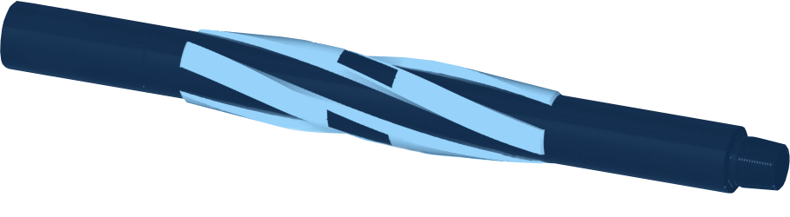
STRING MILL
MILLING
SPIRAL BLADE STRING MILL
GENERAL DESCRIPTION
THE STRING MILL IS A SPIRAL-BLADED MILLING TOOL RUN IN THE STRING TO REMOVE DEBRIS, PERFORATION BURRS AND OTHER FOREIGN MATERIAL LEFT IN THE CASING ID AFTER DRILLING, WELLBORE CLEAN-UP AND PRE-COMPLETION RUNNING OPERATIONS. ITS ALIGNED FLUID CHANNELS GIVE MAXIMUM FLUID BY-PASS AND 360 DEGREE COVER FOR BETTER RECOVERY. IT IS PARTICULARLY SUITED TO PREPARING CASING WINDOWS BEFORE RUNNING LINERS OR COMPLETIONS. IT IS RUN ALONGSIDE A NON-ROTATING CASING SCRAPER AHEAD OF THE DRIFT SUB, REMOVING DRILLING FLUID RESIDUE, SCALE AND CEMENT WHILE RUNNING IN HOLE AND RECIPROCATING THE STRING. THE BLADES CAN BE FACED WITH A CHOICE OF HARDFACING, DEPENDING ON OPERATIONAL REQUIREMENTS.
TECHNICAL CHARACTERISTICS
Casing (in) | Weight (lb/ft) | Drift (in) | Max hard OD (in) | Body ID (in) | Overall length (in) | Neck length (in) | Neck OD (in) | Rig connection | Torsional yield (ft-lb) | Make-up torque (ft-lb) | Tensile (lb)
4-1/2 | 9.5 - 16.5 | 3.965 - 3.629 | 3.965 - 3.629 | 1.50 | 57 | 18 | 3.125 | 2-7/8 HT PAC | 8,500 | 5,100 | 214,200
5-1/2 | 23 - 28.4 | 4.545 - 4.315 | 4.545 - 4.315 | 1.50 | 57 | 18 | 3.125 | 2-7/8 HT PAC | 8,500 | 5,100 | 214,200
7 | 26 | 6.151 | 6.151 | 2.69 | 64 | 18 | 4.750 | NC38 | 11,800 | 9,100 | 580,000
7 | 29 | 6.059 | 6.059 | 2.250 | 76 | 27.5 | 4.750 | NC38 | 11,800 | 9,100 | 580,000
7 | 32 | 5.969 | 5.969 | 2.250 | 76 | 27.5 | 4.750 | NC38 | 11,800 | 9,100 | 580,000
9-5/8 | 43.5 | 8.599 | 8.599 | 3.500 | 76.5 | 18 | 6.500 | NC50 | 51,700 | 27,000 | 944,000
9-5/8 | 47 | 8.525 | 8.525 | 3.500 | 76.5 | 18 | 6.500 | NC50 | 51,700 | 27,000 | 944,000
9-5/8 | 53.5 | 8.379 | 8.379 | 3.500 | 76.5 | 18 | 6.500 | NC50 | 51,700 | 27,000 | 944,000
9-5/8 | 58.4 | 8.279 | 8.279 | 3.500 | 76.5 | 18 | 6.500 | NC50 | 51,700 | 27,000 | 944,000
9-5/8 | 59.4 | 8.250 | 8.250 | 3.500 | 76.5 | 18 | 6.500 | NC50 | 51,700 | 27,000 | 944,000
Other sizes, bespoke ODs and blade lengths on request. Dimensions in inches, loads in lb and ft-lb.
OPERATING LIMITS
Casing (in) | Max run speed (ft/min) | Max rotating speed (rpm) | Max compression when rotating (lb) | Max pressure test (psi)
4-1/2, 5-1/2 | 60 | 30 | 5,000 | 10,000
7 | 60 | 120 | 30,000 | 10,000
9-5/8 | 60 | 120 | 40,000 | 10,000
BENEFITS
HOW TO ORDER
■ High fluid by-pass: fluid and debris flow past the tool body.
■ Compatible: large inner bore, works with all standard clean-up tools and prevents surge and swab.
■ Robust: no internal or external screws or bolts.
■ Flexible: API and non-standard casing sizes, bespoke ODs and blade lengths.
Please specify: 1. casing size and weight 2. rig connection 3. blade length and hardfacing 4. other tools run in the string (scraper, drift sub).

Slide 20
TAPER MILL
MILLING
CP AND CT TAPER MILLS
GENERAL DESCRIPTION
TAPER MILLS REMOVE RESTRICTIONS AND MILL THROUGH PINCHED OR COLLAPSED CASING. THEY CARRY A TAPERED OR SHORT BLUNT NOSE THAT SERVES AS A GUIDE. TWO VERSIONS: THE CP, WITH A SHORT BLUNT NOSE AND A SHORT TAPER, PRODUCES MUCH LESS TORQUE AND CAN TAKE MORE WEIGHT, SUITING THE TOUGHEST JOBS WHERE A LONG NOSE MIGHT BREAK; THE CT, WITH SPIRAL BLADES AND A POINTED NOSE, IS DESIGNED TO MILL THROUGH RESTRICTIONS.
TECHNICAL CHARACTERISTICS
Dressed O.D. | Top pin conn. (API reg.) | Length CT | Length CP | Fishing neck length | Fishing neck O.D. | Wt CT (lb) | Wt CP (lb)
3-1/4 - 3-7/8 | 2-3/8 | 34 | 30 | 10 | 3 | 80 | 60
4 - 4-3/8 | 2-3/8 | 34 | 30 | 10 | 3-1/8 | 90 | 70
4-1/2 - 5-3/8 | 2-7/8 | 38 | 31 | 10 | 3-3/4 | 106 | 75
5-1/2 - 5-5/8 | 3-1/2 | 42 | 32 | 13 | 4-1/4 | 155 | 115
5-3/4 - 6-3/8 | 3-1/2 | 44 | 32 | 13 | 4-3/4 | 160 | 120
6-1/2 - 7-3/8 | 3-1/2 | 46 | 34 | 13 | 4-3/4 | 170 | 130
7-1/2 - 7-7/8 | 4-1/2 | 54 | 36 | 13 | 5-3/4 | 250 | 185
8-3/8 - 9-1/2 | 4-1/2 | 54 | 36 | 14 | 5-3/4 | 280 | 220
9-3/8 - 9-7/8 | 4-1/2 or 6-5/8 | 54 | 36 | 14 | 5-3/4 or 7-3/4 | 345 | 280
10-3/8 - 11 | 6-5/8 | 57 | 38 | 14 | 7-3/4 | 415 | 355
11-1/2 - 12-1/4 | 6-5/8 | 60 | 40 | 14 | 7-3/4 | 455 | 390
14-3/4 - 15 | 6-5/8 | 70 | 60 | 18 | 7-3/4 | 525 | 460
17 - 17-1/2 | 6-5/8 | 70 | 60 | 18 | 7-3/4 | 595 | 530
20 - 26 | 6-5/8 or 7-5/8 | 76 | 66 | 18 | 7-3/4 or 9-1/2 | 1,250 | 1,125
Dimensions in inches (overall lengths in inches), weights in lb (approximate). Ranges as dressed diameters of each size group.
DESIGN FEATURES
OPERATING PARAMETERS
■ CP: blunt nose, short taper; low torque, tolerates more weight.
■ CT: spiral blades and pointed nose for restrictions.
■ Typical jobs: reaming collapsed casing and liners, cleaning permanent whipstock windows, milling jagged or split shoes, enlarging restrictions through retainers and adapters.
■ Stabilising: keep 1/2 to 1 in. under drift diameter.
Weight range (general) | 2,000 - 4,000 lb
Start rotation above collapse | 75 rpm (min. 75 rpm)
Weight increase in collapse | 1,000 - 2,000 lb, slowly
Collapsed casing | about 50 rpm; 2,000 - 3,000 lb
Whipstock window clean-up | 40 rpm; under 1,000 lb
Retainers / adapters | about 70 rpm; 2,000 - 6,000 lb
After clearing restriction | 80 - 100 rpm
OPERATING NOTES
Run a mill about 1/4 in. larger than the minimum I.D. of the collapse and enlarge in stages; do not use a taper mill if the collapse has passed centre. A string taper mill can be used if there is a danger of sidetracking. Governing factor is torque: reduce speed and weight if it rises. For a window, run the same diameter as the largest window mill, rotate slowly its full length and repeat until torque is minimal; do not try to make hole.
HOW TO ORDER
Please specify: 1. type (CP or CT) 2. dressed diameter 3. top pin connection 4. fishing neck diameter, if different from standard.

Slide 21
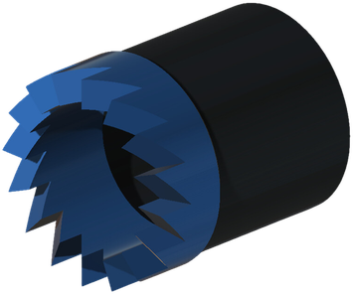
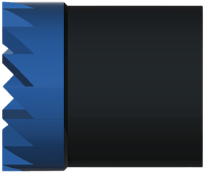
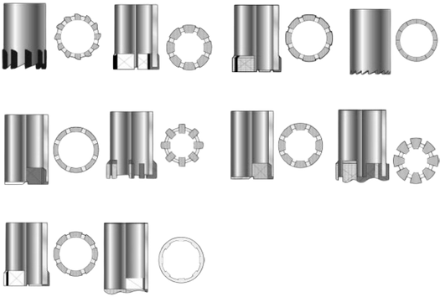
WASHOVER SHOE
MILLING
GENERAL DESCRIPTION
WASHOVER SHOES ARE MADE IN VARIOUS SIZES AND STYLES TO MEET THE MANY CONDITIONS MET IN FISHING AND WASHOVER OPERATIONS. RUN AT THE BOTTOM OF THE WASHOVER STRING, THE SHOE CUTS A CLEARANCE BETWEEN THE FISH AND THE WALL OF THE WELLBORE DURING RETRIEVAL OPERATIONS, OR FREES STUCK DOWNHOLE OBJECTS. IT CAN BE DRESSED WITH CARBIDE INSERTS FOR HARD MILLING AND LONGER WORK DURATION. WASHOVER EXTENSIONS, WASHOVER PIPES AND TOP SUBS ARE AVAILABLE TO SUIT THE CONNECTION SIZE OF THE WASHOVER STRING, TOGETHER WITH THE APPROPRIATE LIFTING EQUIPMENT.
SHOE STYLES
SIZE RANGE
Shoe OD | 2-9/16 - 13-3/8 in
Metric | 65 - 340 mm
OPERATING PARAMETERS
Rotary speed | 60 - 80 rpm
Weight on shoe | 2,000 - 6,000 lb
Technique | Pick up from time to time
Guideline values for washover shoes; adjust to the formation and the fish.
MAIN APPLICATIONS
TECHNICAL FEATURES
■ Recovering stuck drill pipe, tubing or casing.
■ Clearing wellbore restrictions caused by collapsed formations or debris.
■ Assisting fishing operations with a clean passage around stuck equipment.
■ Cutting edge designed for efficient material removal.
■ Many sizes to match casing and tubing diameters.
■ Hardfaced or carbide-enhanced surfaces for durability and cutting efficiency.
■ Optimised fluid ports to keep circulation and carry debris away.
■ Compatible with various thread connections.
HOW TO ORDER
Please specify: 1. shoe OD and style 2. cutting surface (hardfacing or carbide inserts) 3. connection to the washover string 4. washover extensions, pipes and top subs required.

Slide 22
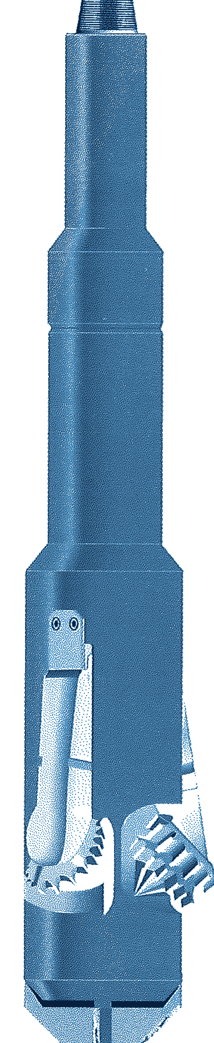
RTU
ENLARGEMENT
ROCK-TYPE UNDERREAMER
GENERAL DESCRIPTION
RUGGED THREE-CONE UNDERREAMER THAT ENLARGES A HOLE TO NEARLY TWICE ITS OWN BODY DIAMETER. A WIDE RANGE OF CONE TYPES MATCHES THE CUTTER TO THE FORMATION, AND A CHOICE OF ORIFICE SIZES TAILORS PERFORMANCE TO THE RIG HYDRAULICS. THE TOOL CAN BE SERVICED ON LOCATION, THE CUTTER ARMS ARE CHANGED QUICKLY ON THE RIG FLOOR, AND FULL CIRCULATION IS KEPT AT ALL TIMES WITH WATER, MUD, AIR, AERATED MUD OR FOAM.
TECHNICAL CHARACTERISTICS
Tool series | Std. opening Ø | Optional opening Ø | Body Ø | Collapsed Ø | Through casing Ø x lb/ft | Fishing neck length | Fishing neck Ø | Overall length | Top pin API Reg. | Wt (lb)
3600 | 6 | 4-3/4 - 6-1/2 | 3-5/8 | 3-3/4 | 4-1/2 x 15 | 8 | 3-3/8 | 26-1/2 | 2-3/8 | 175
4500 | 6-1/2, 8-1/2 | 6 - 9 | 4-1/2 | 4-5/8 | 5-1/2 x 20 | 18 | 4-1/8 | 67 | 2-7/8 | 235
5700 | 11 | 8 - 11 | 5-3/4 | 5-7/8 | 7 x 38 | 18 | 4-3/4 | 76-1/2 | 3-1/2 | 380
5800 | 11 | 8 - 11 | 5-7/8 | 5-7/8 | 6-5/8 x 20 | 18 | 4-3/4 | 76-1/2 | 3-1/2 | 380
6000 | 12 | 11 - 12 | 6 | 6-1/8 | 7 x 26 | 18 | 4-3/4 | 78-1/2 | 3-1/2 | 380
6100 | 12 | 11 - 12 | 6-1/8 | 6-1/8 | 7 x 20 | 18 | 4-3/4 | 78-1/2 | 3-1/2 | 380
6200 | 12 | 11 - 13 | 6-1/4 | 6-1/4 | 7 x 17 | 18 | 4-3/4 | 78-1/2 | 3-1/2 | 380
7200* | 14 | 9 - 14 | 7-1/4 | 7-3/8 | 8-5/8 x 40 | 18 | 5-3/4 | 86 | 4-1/2 | 775
8200* | 16 | 10 - 16 | 8-1/4 | 8-3/8 | 9-5/8 x 47 | 18 | 5-3/4 or 8 | 89 | 4-1/2 or 6-5/8 | 920
9500* | 17-1/2 | 13 - 18 | 9-1/2 | 9-3/4 | 10-3/4 x 45 | 18 | 8 | 91 | 6-5/8 | 1,160
11700* | 17-1/2 | 14-3/4 - 22 | 11-3/4 | 12-1/4 | 13-3/8 x 68 | 20 | 8 | 91 | 6-5/8 | 1,670
15000 LP* | 26 | 17-1/2 - 30 | 14-3/4 | 14-3/4 | 16 x 75 | 20 | 8 or 9 | 97 | 6-5/8 or 7-5/8 | 2,800
22000 | 32 - 40 | 32 - 40 | 22 | 22 | 24-1/2 x 113 | 20 | 9 or 10 | 124-1/4 | 7-5/8 or 8-5/8 | 5,900
* Available with PDC Bearclaw cutters. Dimensions in inches, weights in lb (approximate). Optional opening diameters on request.
DESIGN FEATURES
PERFORMANCE PARAMETERS
■ Three-cone cutters: enlarges to almost twice the body diameter.
■ Cutter options: milled tooth, TCI or PDC Bearclaw cutting structures.
■ Tailored hydraulics: orifice sizes selected to suit the rig conditions.
■ Full circulation: constant flow volume through the tool.
■ Field serviceable: serviced on location; arms swapped on the rig floor.
■ Optional Flo-Tel: pump pressure drops 200 - 250 psi once the arms are fully extended, confirming full gauge and avoiding second trips.
Rpm to shoulder depth | 30 - 50 rpm
Rpm, cutting shoulder | 80 - 150 rpm max.
Rpm, underreaming | 80 rpm
Weight on tool | 1,000 lb per in. of body Ø
With Flo-Tel | 80 - 150 rpm, max. pump pressure
Circulating medium | Water, mud, air, foam
CUTTING THE SHOULDER
■ Start: establish flow, rotate at 80 - 150 rpm and drill off slowly for 5 - 10 minutes.
■ Open the arms: lift off with the pump on and repeat to be sure they are fully open.
■ Shoulder reached: weight starts to register, then add weight to underream.
OPERATING NOTES
■ Running in: go slowly at the top of the section; surge pressure can open the arms and damage casing.
■ Rate of penetration: keep below 100 ft/hr or the hole may not reach drift gauge.
■ Dull cutters: pull at the first sign of dulling.
HOW TO ORDER
Please specify: 1. tool series 2. top and bottom connections 3. fishing neck Ø 4. opening Ø 5. size and weight of casing to run through, if known 6. bullnose or bits (ordered separately) 7. cutting structure (milled tooth, TCI or PDC).

Slide 23
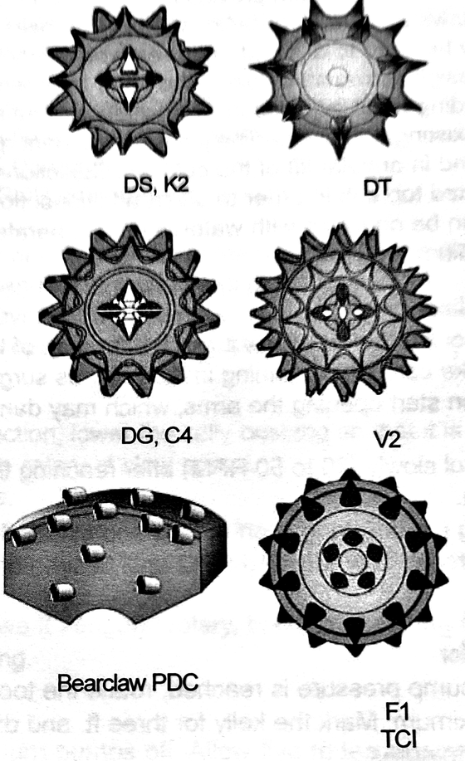
DTU
ENLARGEMENT
DRILLING-TYPE UNDERREAMER
GENERAL DESCRIPTION
DRILLING-TYPE UNDERREAMER THAT ENLARGES PREVIOUSLY DRILLED PILOT HOLES. A BOTTOM BOX CONNECTION LETS A BIT OR A BULLNOSE RUN BELOW THE TOOL, SO THE DTU CAN DRILL AND UNDERREAM AT THE SAME TIME. MUD FLOW CAN BE SPLIT BETWEEN THE CUTTER ARMS AND THE BIT OR BULLNOSE. IT RUNS WITH WATER, MUD, AIR, AERATED MUD OR ANY OTHER CIRCULATING MEDIUM.
TECHNICAL CHARACTERISTICS
Tool series | Std. opening Ø | Optional opening Ø | Body Ø | Collapsed Ø | Through casing Ø x lb/ft | Fishing neck length | Fishing neck Ø | Overall length | Top pin API Reg. | Wt (lb)
3600 | 6 | 5-1/2 - 6 | 3-5/8 | 3-5/8 | 4-1/2 x 15 | 8 | 3-3/8 | 35 | 2-3/8 | 170
5700 | 8-3/4 | 7 - 8-3/4 | 5-3/4 | 6 | 7 x 38 | 18 | 4-3/4 | 70 | 3-1/2 | 360
7200* | 11 | 9 - 11 | 7-1/4 | 7-1/2 | 8-5/8 x 40 | 18 | 5-3/4 | 74 | 4-1/2 | 770
8200* | 14 | 10 - 14 | 8-1/4 | 8-1/4 | 9-5/8 x 53 | 18 | 5-3/4 or 8 | 79 | 4-1/2 or 6-5/8 | 900
9500* | 15 | 12 - 15 | 9-1/2 | 10-1/4 | 11-3/4 x 71 | 18 | 8 | 82 | 6-5/8 | 1,150
11700* | 17-1/2 | 14-3/4 - 20 | 11-3/4 | 11-3/4 | 13-3/8 x 92 | 20 | 8 | 96 | 6-5/8 | 1,670
15000* | 17-1/2 - 26 | 17-1/2 - 26 | 14-3/4 | 14-3/4 | 16 x 75 | 20 | 8 or 9 | 97 | 6-5/8 or 7-5/8 | 2,800
17000* | 32 | 24 - 32 | 17 | 17 | 18-5/8 x 78 | 20 | 9 or 10 | 87 | 7-5/8 or 8-5/8 | 3,000
22000 | 36 | 28 - 36 | 22 | 22 | 24-1/2 x 113 | 20 | 9 or 10 | 100 | 7-5/8 or 8-5/8 | 4,400
* Available with PDC Bearclaw cutters. Dimensions in inches, weights in lb (approximate). Optional opening diameters on request.
DESIGN FEATURES
CUTTER OPTIONS
■ Drill and underream in one run: bottom box connection for a bit or bullnose.
■ Flexible hydraulics: flow can be divided between the arms and the bit or bullnose; orifice jets are selected to suit the available hydraulics.
■ Cooling and cleaning: jet placement keeps the cutters cool and aids annular lift of cuttings.
■ Extra flow options: jetted bullnose and jetted top sub to divert more flow when needed.
■ Cutting structures: open-bearing milled tooth (standard), TCI or PDC Bearclaw.
Gauge diameter tolerances, arms open
Size (in) | Tolerance
6 - 9 | +1/16 - 0
9-1/2 - 13 | +3/32 - 0
14 - 18 | +1/8 - 0
20 - 30 | +3/16 - 0
Applies to arm sets of RTU, DTU, drag and XTU underreamers, all cutting structures.
PERFORMANCE PARAMETERS
Rotary speed, reaching shoulder depth | 30 - 50 rpm
Rotary speed, cutting the shoulder | 80 - 150 rpm max.
Rotary speed, underreaming | 80 rpm
Weight on tool | 1,000 lb per inch of body Ø
Stabilization | Full-gauge stabilizer 60 - 90 ft above and below
Position in the BHA | Middle of the drill collars
HOW TO ORDER
Please specify: 1. tool series 2. top and bottom connections 3. fishing neck Ø 4. opening Ø 5. size and weight of casing to run through, if known 6. bullnose or bits (ordered separately) 7. cutting structure (milled tooth, TCI or PDC).

Slide 24
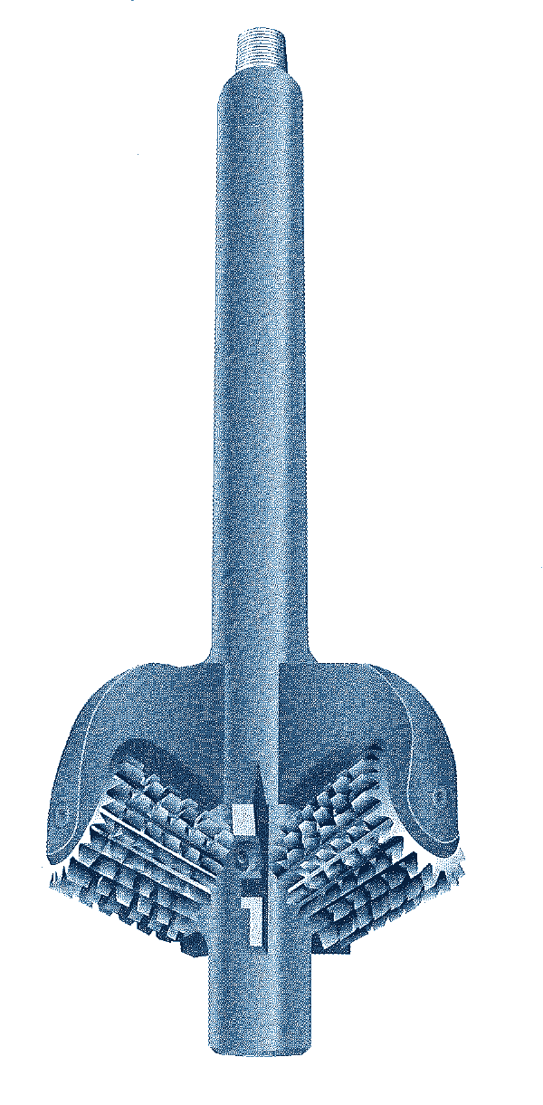
HOLE OPENER
ENLARGEMENT
FIXED-DIAMETER HOLE OPENER
GENERAL DESCRIPTION
FIXED-DIAMETER HOLE OPENER THAT ENLARGES A PREVIOUSLY DRILLED PILOT HOLE FROM THE SURFACE. THE CUTTERS ARE RIGIDLY ATTACHED TO THE BODY: THERE IS NO HYDRAULIC ACTUATION, AND THE TOOL ALWAYS CUTS AT ITS FULL GAUGE. USED MAINLY FOR SURFACE HOLES AND CONDUCTOR CASING, WHERE A BIGGER HOLE GIVES ENOUGH CLEARANCE TO RUN AND CEMENT THE CASING (FOR EXAMPLE, A 17-1/2 IN. HOLE OPENED TO RUN 13-3/8 IN. CASING). THE CHOICE OF CUTTERS LETS IT HANDLE SOFT TO HARD-ABRASIVE FORMATIONS. CUTTER SIZES FROM 26 TO 42 IN.
TECHNICAL CHARACTERISTICS
Std. opening Ø | Min. pilot hole Ø | Fishing neck length | Fishing neck Ø | Top pin API Reg. | Bottom neck length | Bottom neck Ø | Bottom box API Reg. | Body length | Min. bore Ø
26 | 14 | 60 | 9-1/2 | 6-5/8 - 7-5/8 | 12 | 9-1/2 | 7-5/8 | 96 | 1
28 | 16 | 60 | 9-7/8 | 6-5/8 - 7-5/8 | 12 | 9-1/2 | 7-5/8 | 96 | 1
30 | 18 | 60 | 9-7/8 | 6-5/8 - 7-5/8 | 12 | 9-1/2 | 7-5/8 | 100 | 2
32 | 20 | 60 | 10 | 7-5/8 - 8-5/8 | 15 | 9-1/2 | 8-5/8 | 100 | 2
34 | 22 | 60 | 10 | 7-5/8 - 8-5/8 | 15 | 9-1/2 | 8-5/8 | 101 | 2
36 | 24 | 60 | 10 | 7-5/8 - 8-5/8 | 15 | 9-1/2 | 8-5/8 | 103 | 3
38 | 26 | 60 | 10 | 8-5/8 | 15 | 9-1/2 | 8-5/8 | 106 | 3
40 | 28 | 60 | 10 | 8-5/8 | 15 | 9-1/2 | 8-5/8 | 106 | 3
42 | 30 | 60 | 10 | 8-5/8 | 15 | 9-1/2 | 7-5/8 | 106 | 3
Dimensions in inches, approximate. Intermediate sizes or sizes larger than 42 in. available on request.
DESIGN FEATURES
OPERATING PARAMETERS
■ Fixed gauge: cutters rigidly mounted; no hydraulic actuation.
■ Demountable cutters: easily replaced on the rig floor.
■ Cutters: sealed-bearing milled tooth or tungsten carbide insert.
■ Long fishing necks: can be made up below the rotary table despite the large size.
■ Replaceable nozzles: effective hole cleaning.
■ Wide formation range: soft to hard-abrasive.
Formation | Cutter | Weight (lb) | rpm
Soft | Milled tooth | 15,000 - 25,000 | 125 - 150
Medium | Milled tooth | 20,000 - 35,000 | 75 - 85
Hard | Button type | 35,000 - 45,000 | 50 - 60
Extr. hard | TCI button | 30,000 - 45,000 | 30 - 40
Guideline for 19-3/4 - 26 in. holes; smaller sizes need less weight.
GAUGE TOLERANCE (ARMS OPEN)
Size (in) | Plus | Minus
18 - 26 | +1/8 | - 1/16
27 - 42 | +5/32 | - 1/16
43 and larger | +3/16 | - 1/16
NOZZLES AND CUTTERS
Gauge as dressed, not ground; milled tooth and TCI.
■ Nozzles: threaded retainer holds the jet nozzle in its sleeve; O-ring seal.
■ Cutter sets: replacement sets include all parts needed.
■ Rebuild kits: cutter bearing rebuild kits on special order.
MASTER DRILLER (CONE ARM VERSION)
Cone-arm hole opener, up to 36 in.; one body takes several arm sizes. Bottom box for bit or bullnose. Milled tooth, TCI or PDC cones; soft to medium-hard formations. Body series 8200 to 15000: std. opening 12-1/4 to 36-5/8 in., min. pilot hole 8-1/2 to 24-5/8 in., body Ø 8-1/4 to 15-5/8 in., 640 - 1,900 lb.
HOW TO ORDER
Please specify: 1. pilot hole size 2. hole opening size 3. top and bottom connections if not standard 4. fishing neck diameter if not standard 5. cutter type (milled tooth or tungsten carbide insert) and formation (soft or medium).

Slide 25
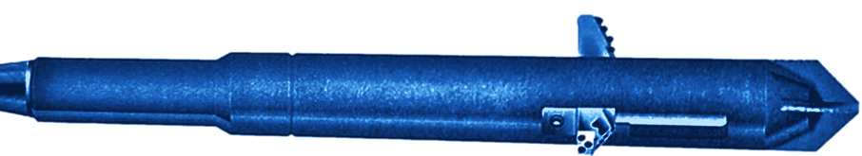
SPX
ENLARGEMENT
DRAG-TYPE UNDERREAMER, PDC CUTTERS
GENERAL DESCRIPTION
DRAG-TYPE UNDERREAMER WITH SPX PDC CUTTERS ON THE CUTTING EDGE: THE HARDNESS AND WEAR RESISTANCE OF POLYCRYSTALLINE DIAMOND, BACKED BY THE STRENGTH OF CEMENTED TUNGSTEN CARBIDE. THE CUTTERS SHEAR THROUGH SOFT TO MEDIUM-HARD FORMATIONS FASTER THAN CONVENTIONAL TOOLS AND NEED LESS TOOL WEIGHT. USED IN POORLY CONSOLIDATED SOFT TO MEDIUM FORMATIONS WHERE LARGER DIAMETERS ARE REQUIRED FOR GRAVEL PACKING OR CEMENTING. A PILOT HOLE CAN BE ENLARGED UP TO THREE TIMES THE BODY DIAMETER IN A SINGLE TRIP.
TECHNICAL CHARACTERISTICS
Tool series | Body Ø | Min. pilot hole Ø | Std. expanded Ø, SPX (PDC) | Std. expanded Ø, tungsten carbide | Fishing neck length | Fishing neck Ø | Overall length | Top pin API | Wt (lb)
3600 | 3-3/8 | 3-3/4 | N/A | 9 | 8 | 3-3/8 | 26-1/2 | 2-3/8 Reg. | tbc
4500 | 4-1/2 | 4-3/4 | 6-1/2, 6-3/4, 8-1/2 | Upon request | 18 | 4-1/4 | 69 | 3-1/2 IF | 230
4700 | 4-3/4 | 5 | Upon request | 12 | 18 | 4-1/8 | 67 | 2-7/8 Reg. | tbc
5700 | 5-3/4 | 6 | 7-1/2, 8, 8-1/2, 12, 13 | 16 | 18 | 4-3/4 | 70 | 3-1/2 Reg. | 350
7200 | 7-1/4 | 7-5/8 | 10, 12-1/4, 13, 14, 15, 16 | 22 | 18 | 5-3/4 | 78 | 4-1/2 Reg. | 750
8200 | 8-1/4 | 8-1/2 | 10, 12-1/4, 14, 15, 16, 17 | 23 | 18 | 5-3/4 or 8 | 78 | 4-1/2 or 6-5/8 Reg. | tbc
9500 | 9-1/2 | 9-7/8 | 12-1/4, 17-1/2 | 28 | 18 | 8 | 78 | 6-5/8 Reg. | tbc
11700 | 11-3/4 | 12-1/4 | Upon request | 36 | 18 | 8 or 9 | 86 | 6-5/8 or 7-5/8 Reg. | tbc
All dimensions in inches, weights in lb (approximate). Other expanded diameters, orifices and connections available on request. tbc: to be confirmed.
DESIGN FEATURES
PERFORMANCE PARAMETERS
■ Self-cleaning arms: a circulation jet nozzle sends part of the flow out of each arm pocket, cleaning the cutting surfaces, improving cuttings removal and dissipating frictional heat.
■ Durable arms: dressed with long-wearing cutting-grade tungsten carbide.
■ Field serviceable: low-cost cutter arms and orifices can be replaced in the field.
■ Optional Flo-Tel: pump pressure drops by 200 - 250 psi when the arms are fully extended, confirming full-gauge underreaming.
Rotary speed, cutting the shoulder | 40 - 60 rpm
Flow rate | Increase gradually, 250 - 450 gpm
Weight on tool | Start at 3,000 lb, up to 10,000 lb
With Flo-Tel | 80 - 150 rpm at max. pump pressure
Circulating medium | Water, mud, air, aerated mud, foam
Max. enlargement | 3 x body Ø in a single trip
ADVANTAGES
HOW TO ORDER
■ Faster penetration and more time on bottom
■ Less rig time and lower total cost per foot
■ Quick drilling through producing zones limits formation damage and hole-stability problems
Please specify: 1. tool series 2. top and bottom connections 3. fishing neck Ø 4. opening Ø 5. size and weight of casing to run through, if known 6. bullnose or bits (ordered separately) 7. cutting structure (milled tooth, TCI or PDC).

Slide 26
INTENSIFIER
JARRING
JAR INTENSIFIER, HYDRAULIC FLUID SPRING
GENERAL DESCRIPTION
HYDRAULIC FLUID SPRING RUN WITH AN OIL JAR TO BOOST JARRING. AS THE STRING IS PULLED, A PISTON COMPRESSES A HIGHLY COMPRESSIBLE SILICONE FLUID AND STORES ENERGY JUST ABOVE THE DRILL COLLARS. WHEN THE JAR TRIPS, THIS ENERGY ACCELERATES THE COLLARS AND JAR UPWARD FOR A HIGH-IMPACT BLOW, LARGELY INDEPENDENT OF STRING DRAG OR DEPTH. IT ALSO CUSHIONS THE REBOUND AFTER EACH STROKE, AND ALLOWS FEWER DRILL COLLARS, ESPECIALLY IN SHALLOW HOLES.
TECHNICAL CHARACTERISTICS
O.D. | I.D. | Total stroke to solid | Collar weight (lb) | Tensile at yield (lb) | Torque at yield (ft-lb) | Fluid volume (gal)
1-5/8 | 1/4 | 6 | 1,100 - 1,400 | 43,200 | 260 | 0.13
1-13/16 | 5/16 | 6 | 1,360 - 1,800 | 59,400 | 340 | 0.195
2-1/4 | 3/8 | 6 | 1,560 - 2,100 | 118,500 | 1,800 | 0.211
2-29/32 | 1 | 12-3/4 | 2,200 - 3,000 | 194,800 | 2,260 | 0.692
3-1/8 | 1 | 8-3/4 | 2,400 - 3,300 | 229,200 | 4,068 | 0.375
3-3/4 | 1-1/4 | 8-1/4 | 4,200 - 5,700 | 345,000 | 7,640 | 0.82
3-3/4 | 1-1/2 | 7-7/8 | 3,400 - 4,600 | 299,700 | 5,340 | 0.63
3-3/4 | 1-7/8 | 7-5/8 | 3,500 - 4,700 | 179,500 | 2,980 | 0.613
4-1/4 | 1-15/16 | 8-5/8 | 3,500 - 4,700 | 430,300 | 9,920 | 0.92
4-1/2 | 2-3/8 | 10-3/8 | 3,600 - 4,900 | 375,000 | 11,160 | 1.15
4-3/4 | 1-1/2 | 8-7/8 | 6,300 - 8,500 | 591,900 | 18,420 | 1.0
4-3/4 | 2 | 10-1/8 | 5,600 - 7,500 | 468,800 | 17,200 | 1.35
6 | 2 | 8-5/8 | 10,200 - 13,800 | 937,000 | 34,320 | 1.57
6-1/4 | 2-1/4 | 13 | 11,800 - 16,000 | 917,400 | 40,680 | 4.24
6-3/4 | 2-3/8 | 13 | 13,000 - 17,500 | 1,013,800 | 48,660 | 3.45
7-3/4 | 3-1/16 | 13 | 11,000 - 15,000 | 1,587,900 | 64,020 | 4.65
9 | 3-3/4 | 13 | 12,000 - 16,000 | 1,621,000 | 92,260 | 3.2
Dimensions in inches. Each intensifier is matched to a jar of the same O.D. x I.D.; connections as for the matching jar. Tensile strengths are calculated theoretical yield values (about +/-20%); torque at yield is theoretical. Figures are a guide only: apply a safety factor.
DESIGN FEATURES
OPERATING NOTES
■ Energy storage: compressible silicone fluid acts as a spring above the collars.
■ Splined mandrel: torque transmitted in either direction, open or closed.
■ High-pressure seals: non-extrusion ring assemblies limit seal damage and wear.
■ Safe to fill and use: fluid-filled, charged with a low-pressure hand pump only.
■ Shock cushioning: absorbs rebound of the string after each jarring stroke.
■ String order from the fish: fishing tool, jar, drill collars, intensifier, string.
■ Stroke: 6 to 13 in under pull, depending on size.
■ No heavy weights above: no collars or heavy-weight for at least 1,000 ft above the intensifier.
■ Hot holes: above 180 F (82 C) bottom-hole temperature, bleed a little fluid before running.
HOW TO ORDER
Please specify: 1. intensifier size and the jar it matches 2. connections and O.D., if not standard 3. spares: packing sets, piston assemblies, seal rings, fill plugs, service kit 4. special intensifier fluid.

Slide 27
JAR Z
JARRING
HYDRAULIC OIL JAR, STRAIGHT PULL
GENERAL DESCRIPTION
STRAIGHT-PULL HYDRAULIC OIL JAR FOR FISHING, DRILL STEM TESTING AND CORING. A METERING PISTON DELAYS THE STROKE WHILE THE OPERATOR TAKES STRETCH IN THE STRING, SO THE BLOW CAN BE SET FROM VERY LIGHT TO VERY HIGH IMPACT WITH NO ADJUSTMENT BEFORE OR AFTER THE RUN. THE HYDRAULIC SYSTEM IS CLOSED: OIL CANNOT ESCAPE AND WELL FLUIDS CANNOT ENTER. THE JAR RESETS WITH ONLY A FEW HUNDRED POUNDS OF WEIGHT AND TRANSMITS FULL TORQUE IN BOTH DIRECTIONS AT ALL TIMES.
TECHNICAL CHARACTERISTICS
Connection | O.D. | I.D. | Total stroke | Test pull load (lb) | Max. jarring load (lb) | Tensile at yield (lb) | Torque at yield (ft-lb) | Collar weight above jar (lb)
Sucker rod | 1-5/8 | 1/4 | 7-1/16 | 5,000 - 8,500 | 15,400 | 46,300 | 260 | 1,100 - 1,450
1-13/16 WFJ | 1-13/16 | 5/16 | 7 | 6,000 - 10,000 | 18,000 | 59,400 | 340 | 1,360 - 1,800
1-1/4 Reg | 2-1/4 | 3/8 | 6-15/16 | 7,200 - 12,000 | 21,000 | 118,500 | 1,800 | 1,560 - 2,100
2-3/8 PH-6 | 2-29/32 | 1 | 11-7/16 | 12,600 - 19,000 | 35,400 | 194,800 | 2,260 | 2,200 - 3,000
2-3/8 EUE | 3-1/16 | 1-1/2 | 11-9/16 | 12,000 - 16,000 | 27,800 | 160,200 | 2,200 | 2,300 - 3,100
2-3/8 Reg | 3-1/8 | 1 | 11-13/16 | 15,000 - 23,000 | 32,400 | 229,200 | 4,060 | 2,400 - 3,300
2-7/8 Reg | 3-3/4 | 1-1/4 | 11-13/16 | 18,000 - 26,000 | 56,500 | 345,000 | 7,640 | 4,200 - 5,700
2-3/8 IF | 3-3/4 | 1-1/2 | 12-1/8 | 15,000 - 26,000 | 46,000 | 299,700 | 5,340 | 3,400 - 4,600
2-3/8 EUE | 3-3/4 | 1-7/8 | 10-1/8 | 15,000 - 26,000 | 46,500 | 179,500 | 2,980 | 3,500 - 4,700
2-7/8 IF | 4-1/4 | 1-15/16 | 11-13/16 | 18,000 - 28,000 | 46,700 | 430,300 | 9,920 | 3,500 - 4,700
2-7/8 EUE | 4-1/2 | 2-3/8 | 12-1/4 | 18,000 - 28,000 | 49,000 | 375,000 | 11,160 | 3,600 - 4,900
3-1/2 FH | 4-3/4 | 1-1/2 | 11-13/16 | 28,000 - 45,000 | 85,000 | 591,900 | 18,420 | 6,300 - 8,500
3-1/2 FH | 4-3/4 | 2 | 13-5/16 | 28,000 - 45,000 | 74,500 | 468,800 | 17,200 | 5,600 - 7,500
4-1/2 FH | 6 | 2 | 11-7/16 | 41,000 - 62,000 | 136,400 | 937,000 | 34,320 | 10,200 - 13,800
4-1/2 IF | 6-1/4 | 2-1/4 | 14-3/8 | 55,000 - 80,000 | 159,000 | 917,400 | 40,680 | 11,800 - 16,000
5-1/2 Reg | 6-3/4 | 2-3/8 | 14-11/16 | 62,000 - 110,000 | 172,800 | 1,013,800 | 48,660 | 13,000 - 17,500
6-5/8 Reg | 7-3/4 | 3-1/16 | 14-3/8 | 63,000 - 100,000 | 149,000 | 1,587,900 | 64,020 | 11,000 - 15,000
7-5/8 Reg | 9 | 3-3/4 | 13-13/16 | 80,000 - 120,000 | 214,000 | 1,621,000 | 92,260 | 14,300 - 19,600
Dimensions in inches. Tensile strengths are calculated theoretical yield values (about +/-20%); torque at yield is the theoretical value, recommended operating torque is 50% of it. Figures are a guide only: apply a safety factor.
DESIGN FEATURES
OPERATING NOTES
■ Adjustable blow: impact set by the stretch taken in the string, no prior adjustment.
■ Closed hydraulic system: internal parts are constantly lubricated; no leakage in or out.
■ Easy reset: large piston ports open on closing, so only friction weight is needed.
■ Full torque: transmitted in either direction at any point of the stroke.
■ Fast repeat blows: limited only by the time to raise and lower the string.
■ Fishing: run directly below the drill collars; add a jar intensifier about four collars above the jar.
■ Drill stem testing, coring: 3 to 15 collars above the jar; does not interfere with test tools.
■ Never exceed the maximum jarring load. Do not tong the threaded joints; tong at least 4 in away.
■ First blow: can take seconds to minutes, depending on depth, stretch, temperature and hole condition.
HOW TO ORDER
Please specify: 1. jar size (O.D. x I.D.) 2. top and bottom connections, if not standard 3. spares: packing set, piston assembly, non-extrusion and seal protector rings, fill plugs 4. service kit and jar oil.

Slide 28
BUMPER SUB
JARRING
FISHING BUMPER SUB
GENERAL DESCRIPTION
DURABLE FISHING BUMPER SUB MADE OF HEAT-TREATED ALLOY STEEL FOR SUSTAINED BUMPING WITH MINIMAL MAINTENANCE. RUN IN THE STRING JUST ABOVE THE FISHING TOOL OR SAFETY JOINT, IT LETS THE OPERATOR DELIVER SOLID DOWNWARD OR UPWARD BLOWS AT WILL, FOR EXAMPLE TO RELEASE A FISHING TOOL THAT CANNOT PULL THE FISH. A HEXAGONAL MANDREL SLIDES IN A MATCHING BODY, SO TORQUE IS TRANSMITTED OVER THE WHOLE STROKE. IT CAN ALSO ACT AS A FEED-OFF TOOL FOR INTERNAL PIPE CUTTING.
TECHNICAL CHARACTERISTICS
O.D. | I.D. | Tensile at yield (lb) | Torque at yield (ft-lb)
1-13/16 | 3/8 | 68,720 | 1,020
1-29/32 | 3/8 | 78,620 | 850
2-1/4 | 1/2 | 172,900 | 2,440
2-1/2 | 1/2 | 160,600 | 1,940
3-1/8 | 1-1/2 | 158,600 | 3,300
3-1/8 | 1 | 224,900 | 4,200
3-3/8 | 1 | 256,000 | 5,740
3-3/4 | 1-1/2 | 316,200 | 6,000
3-3/4 | 1-1/4 | 268,500 | 9,400
3-3/4 | 1-7/8 | 231,000 | 6,810
4-1/8 | 1-1/2 | 370,200 | 9,270
4-1/4 | 1-15/16 | 305,000 | 9,200
4-1/4 | 1-1/2 | 439,000 | 9,160
4-1/2 | 2-3/8 | 336,600 | 10,240
O.D. | I.D. | Tensile at yield (lb) | Torque at yield (ft-lb)
4-5/8 | 1-7/8 | 442,000 | 13,440
4-5/8 | 2 | 465,900 | 12,280
4-3/4 | 1-1/2 | 581,100 | 13,800
4-3/4 | 2 | 465,900 | 8,200
5-1/2 | 2 | 613,400 | 22,070
5-3/4 | 2 | 723,600 | 26,850
6 | 2 | 767,000 | 29,490
6-1/8 | 2-1/4 | 768,600 | 30,840
6-1/4 | 2-1/4 | 864,400 | 38,000
6-1/2 | 2-1/4 | 864,400 | 42,000
6-3/4 | 2-3/4 | 871,000 | 37,600
7-3/4 | 3-1/2 | 1,060,000 | 50,400
8 | 3-1/2 | 1,060,000 | 54,600
9 | 4 | 1,600,000 | 64,110
Dimensions in inches. Standard stroke 20 in; strokes of 30, 36, 42, 48 and 60 in also available (convert by changing mandrel and middle body only). Tensile strengths are calculated theoretical yield values (about +/-20%); same values typically apply to other strokes. Figures are a guide only: apply a safety factor.
DESIGN FEATURES
OPERATING NOTES
■ Solid blows both ways: downward on closing, upward on opening against the knocker.
■ Hexagonal mandrel: torque transmitted over the full stroke.
■ Alloy steel body: heat-treated parts for bumping, tension and torque.
■ Sealed knocker: packing rings seal mandrel to middle body; optional chevron packing.
■ Low maintenance: wash and lubricate after use; check seals for wear.
■ Bump down: pull to fully open plus stretch, then drop the string and brake before the sub closes for repeated blows, or drop freely for one solid blow.
■ Jar up: take moderate stretch, drop by that stretch only and brake; the sub rebounds open and strikes the knocker.
■ At surface: hold a sledge between body and mandrel shoulder, slack off and pull it out to release a fishing tool.
HOW TO ORDER
Please specify: 1. size (O.D. x I.D.) 2. connection size and type 3. length of stroke 4. recommended spares: 8 non-extrusion rings, 8 seal protector rings, 16 knocker seals.

Slide 29
Drilling Jar
JARRING
DOUBLE-ACTING HYDRAULIC / MECHANICAL DRILLING JAR
GENERAL DESCRIPTION
HYDRAULIC-DELAY JAR FOR BOTH UPSTROKE AND DOWNSTROKE, WITH A MECHANICAL LATCH, BUILT FOR COMPLEX DRILLING PROGRAMS. THE DOWNSTROKE DELAY MAKES IT EFFECTIVE IN DIRECTIONAL, HORIZONTAL AND EXTENDED-REACH WELLS. BECAUSE NO BLEED-THROUGH OPERATION IS NEEDED WHEN TAGGING OR PICKING UP OFF BOTTOM, IT CAN BE PLACED IN COMPRESSION IN THE DRILLSTRING. LATCH RELEASE SETTINGS ARE ADJUSTABLE.
TECHNICAL CHARACTERISTICS
Tool O.D. (in) | 4-1/4 | 4-3/4 | 6-1/4 | 6-1/2 | 6-3/4 | 7 | 8 | 9-1/2
Tool O.D. (mm) | 108 | 121 | 159 | 165 | 171 | 178 | 203 | 241
Inside Ø (in) | 2 | 2-1/4 | 2-1/4 | 2-1/4 | 2-1/2 | 2-1/2 | 2-13/16 | 3
Max. hole Ø (in)* | 6-1/4 | 7-7/8 | 12-1/4 | 12-1/4 | 12-1/4 | 12-1/4 | 17-1/2 | 26
Max. jar load (lbf) | 86,000 | 84,000 | 160,000 | 160,000 | 190,000 | 190,000 | 300,000 | 350,000
Tensile yield (lbf) | 350,000 | 362,000 | 755,000 | 755,000 | 823,000 | 1,000,000 | 1,000,000 | 1,225,000
Torsional yield (lbf-ft)** | 11,500 | 11,500 | 37,500 | 37,500 | 44,500 | 70,000 | 73,500 | 95,000
Total stroke (in) | 17.5 | 19 | 22 | 22 | 20 | 20 | 21 | 21
Std up latch (lbf) | 35,000 | 40,000 | 90,000 | 90,000 | 90,000 | 90,000 | 95,000 | 100,000
Max. up latch (lbf) | 50,000 | 55,000 | 140,000 | 140,000 | 140,000 | 140,000 | 150,000 | 155,000
Std down latch (lbf)*** | 15,750 | 18,000 | 40,500 | 40,500 | 40,500 | 40,500 | 42,750 | 45,000
Max. down latch (lbf) | 22,500 | 27,000 | 63,000 | 63,000 | 63,000 | 63,000 | 67,500 | 69,800
Pump open area (in²) | 5.4 | 6.5 | 9.6 | 9.6 | 11.0 | 11.0 | 14.2 | 15.9
Length, latched (ft) | 22 | 19.8 | 22.5 | 22.5 | 23.0 | 23.0 | 22.5 | 23.0
Weight (lb) | 730 | 850 | 2,000 | 2,100 | 2,300 | 2,500 | 3,100 | 5,200
Ref. | 4525 | 431 | 442 | 428 | 440 | 480 | 411 | 437
* Hole openers not recommended. ** Rating based on the yield of the body connections, independent of tool-joint connections. *** Down latch setting is 45% of the up latch setting, tolerance +/- 5.
DESIGN FEATURES
OPERATING PARAMETERS
■ Delay in both directions: hydraulic delay with mechanical latch, upstroke and downstroke.
■ Adjustable latch: release settings can be changed up to the maximum values above.
■ Jet-type metering device controls the hydraulic delay.
■ Safe on the rig floor: no unexpected jarring while making connections or drilling.
■ Simple to operate: no torque needed in the jarring procedure.
■ Built for high friction: weight can be stacked before firing, even in horizontal sections.
■ Consistent firing: continuous, repeatable jarring performance.
Placement in string | Tension, neutral or compression
Delay | Hydraulic, up and down
Torque for jarring | None required
Tagging / picking up | No bleed-through needed
Down latch | 45% of up latch, +/- 5
Hole openers | Not recommended
HOW TO ORDER
Please specify: 1. tool O.D. and ref. 2. top and bottom connections 3. up and down latch release settings (standard or adjusted, within the maximum) 4. hole diameter and drilling program (directional, horizontal or extended reach).

Slide 30
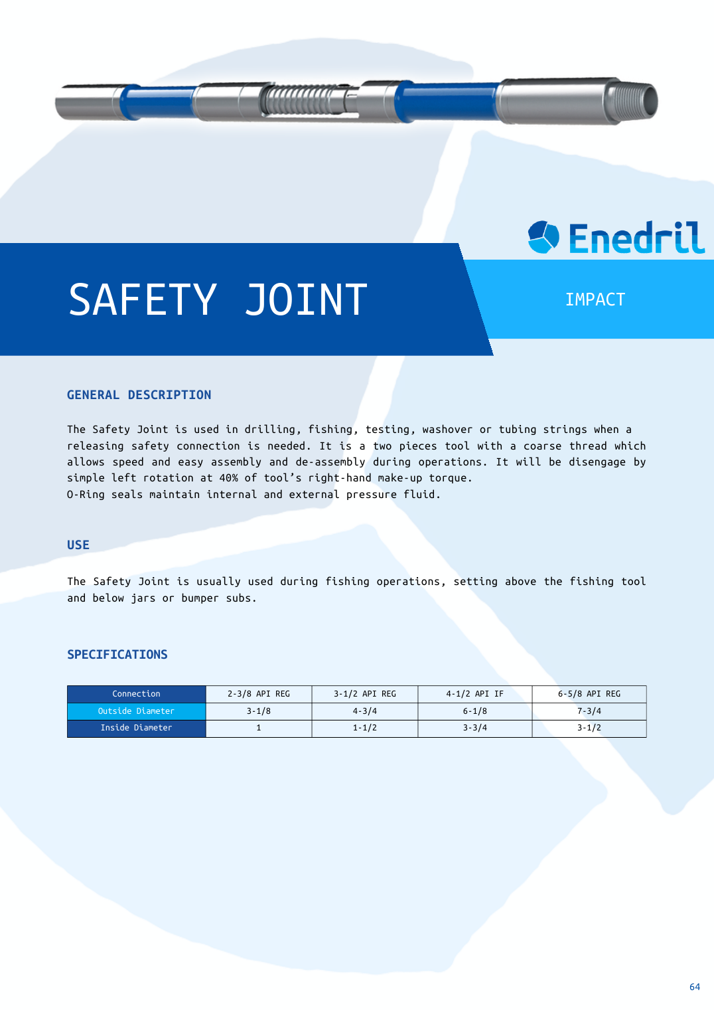

Slide 31
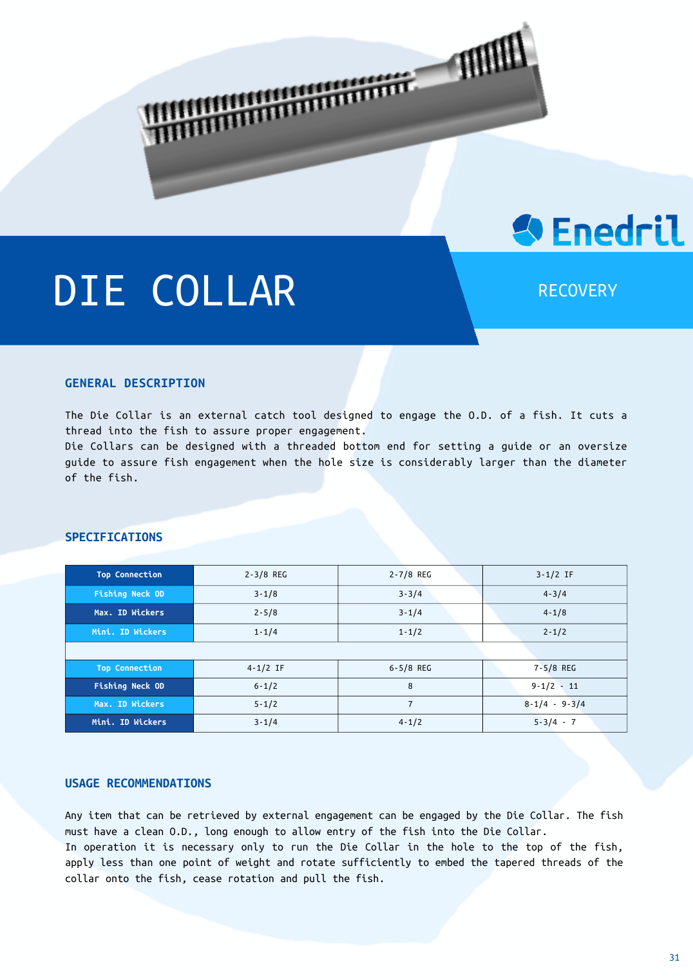

Slide 32
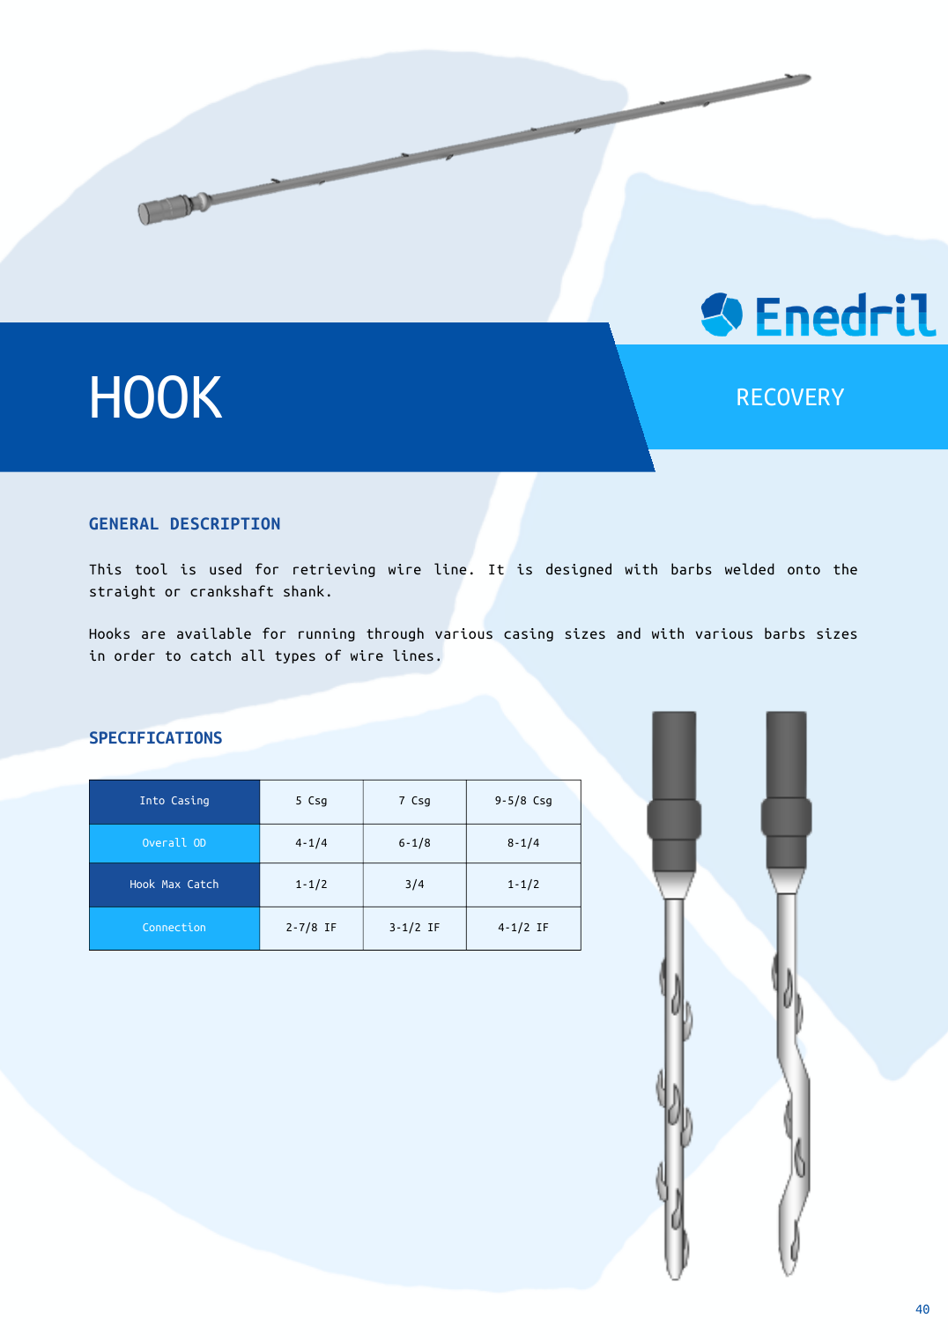

Slide 33
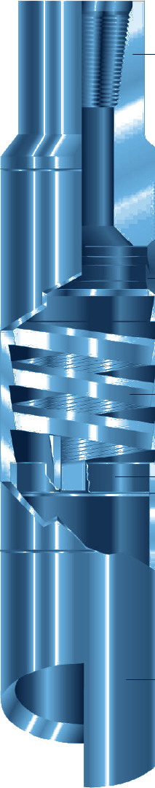
Overshot
FISHING
SERIES 150 RELEASING AND CIRCULATING OVERSHOT
GENERAL DESCRIPTION
EXTERNAL-CATCH FISHING TOOL THAT ENGAGES, PACKS OFF AND PULLS TWISTED-OFF OR LOST TUBING, DRILL PIPE, COUPLINGS, TOOL JOINTS, CASING AND OTHER SMOOTH-O.D. FISH. A SPIRAL OR BASKET GRAPPLE GRIPS THE FISH OVER A LONG SECTION, SO HEAVY PULLING, TORSION AND JARRING LOADS ARE TAKEN WITHOUT DAMAGING THE TOOL OR THE FISH. ENGAGING AND RELEASING BOTH USE RIGHT-HAND ROTATION ONLY.
FULL STRENGTH SIZES
WIDE CATCH VERSION
Overshot O.D. | Max. catch, spiral | Max. catch, basket | Type | Wt (lb)*
3-5/8 | 2-1/2 | 2 | FS | 55
4-1/8 | 3-1/8 | 2-5/8 | FS | 70
5-9/16 | 4-1/4 | 3-11/16 | FS | 130
5-5/8 | 4-5/8 | 4-1/8 | FS | 130
5-3/4 | 4-3/4 | 4-1/4 | FS | 138
7-7/8 | 6-1/4 | 5-1/2 | FS | 261
8-1/8 | 6-1/2 | 5-3/4 | FS | 274
8-1/4 | 6-5/8 | 5-7/8 | FS | 280
9-5/8 | 8 | 7-1/4 | FS | 337
10-1/8 | 8-1/2 | 7-3/4 | FS | 358
10-5/8 | 9 | 8-1/4 | FS | 401
11-1/4 | 9-5/8 | 8-7/8 | FS | 520
11-3/4 | 10-1/8 | 9-3/8 | FS | 642
Tool O.D. | Catch range | Max. catch, spiral | Max. catch, basket | Load, spiral (lb)
4-11/16 | 1/4 | 3-21/32 | 3-1/16 | 332,100
5-3/4 | 5/16 | 4-3/4 | 4-1/8 | 407,100
7-3/8 | 3/16 | 6-1/2 | 5-7/8 | 435,200
8-1/8 | 5/16 | 7 | 6-1/4 | 548,900
9-1/8 | 5/16 | 8 | 7-1/4 | 548,900
11-3/4 | 1/2 | 10-1/8 | 9 | 969,000
Same design with an extended catch range, up to four times that of a standard overshot, to reach heavily worn fish. Standard or high-pressure seals, full flow through the fish, coarse top-sub threads with set screws, 18 in. fish neck. Can cut grapple inventory by up to 75%.
* Assembly dressed with spiral parts. Inches. FS = full strength. Slim-hole and semi full strength types also exist; undersize parts fit smaller fish.
DESIGN FEATURES
OPERATION
■ Spiral or basket grapple: spiral for fish near maximum catch size, basket for smaller fish.
■ Pack-off: sleeve packer with spiral grapple; double-lip mill control packer (field-replaceable seals) with basket grapple.
■ Circulation through the fish to help free it.
■ Right-hand only: no left-hand rotation to engage or release.
■ Accessories: oversize, wall hook and mill guides, extension subs, lock rings; coarse-thread version for easier assembly.
■ Engage: rotate slowly right while lowering over the fish, let the twist slack out, then pull.
■ If the fish stays: start the pumps and keep an upward strain.
■ Release: bump down, then rotate right while slowly raising.
■ Precautions: stop the pumps before lowering over the fish; bump full string weight before releasing; no left-hand rotation without upward strain.
HOW TO ORDER
Please specify: 1. tool name and assembly number 2. size and type of fish 3. top connection 4. O.D. if other than standard. Spares (spiral): 3 packers, 2 grapples per size, 1 control. Spares (basket): 2 grapples, mill control packers per size.

Slide 34
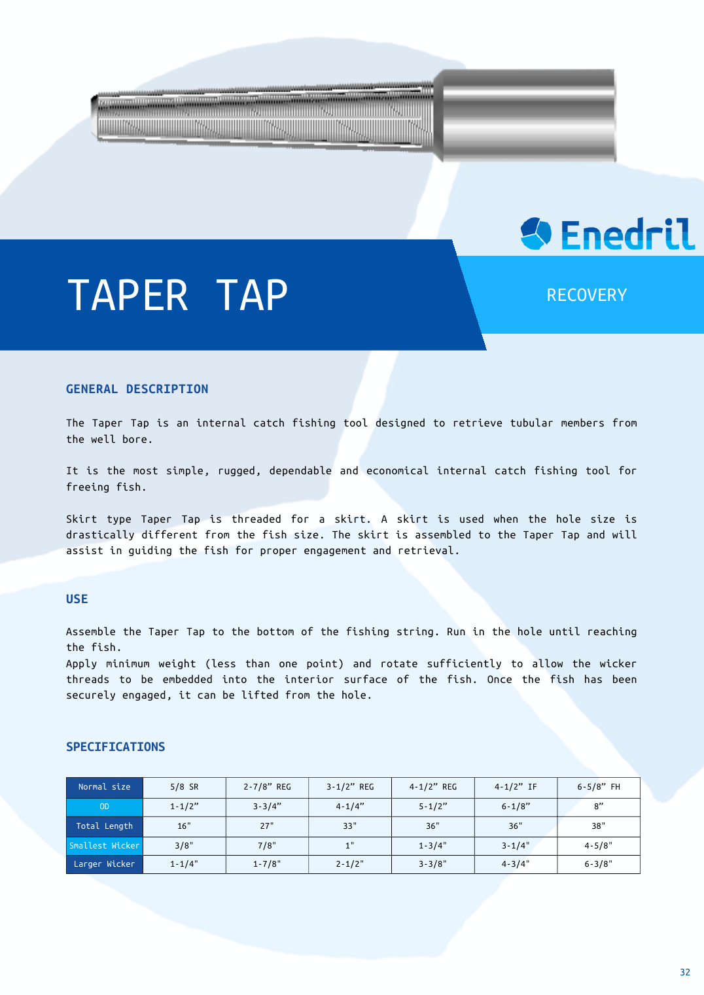

Slide 35
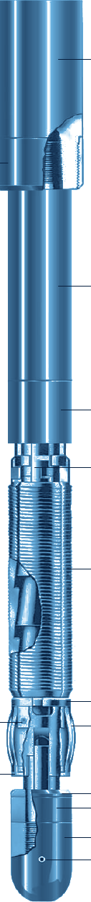
Spear
FISHING
FULL CIRCLE RELEASING SPEAR
GENERAL DESCRIPTION
INTERNAL-CATCH FISHING SPEAR FOR TUBING, DRILL PIPE AND CASING OF ALL SIZES. FULL CIRCLE SLIPS AND THE TAPERS ON THE BODY SPREAD THE EXPANSION STRAIN OVER A LONG VERTICAL SECTION AND ALMOST THE WHOLE INNER CIRCUMFERENCE OF THE FISH, ALLOWING HEAVY PULLING AND JARRING WITHOUT DISTORTING IT. CAN BE RUN WITH INTERNAL CUTTERS FOR CUT-AND-PULL OPERATIONS.
DRILL PIPE AND TUBING
CASING
Spear size | Slips Ø retracted | Slip area (sq in) | Wt (lb) | Body yield (lb)
2-3/8 DP | 1-11/16 | 55 | 32 | 56,400
2-3/8 Tbg | 1-29/32 | 59 | 40 | 71,500
2-7/8 DP | 2 | 74 | 55 | 110,400
2-7/8 Tbg | 2-5/16 | 87 | 60 | 134,000
3-1/2 DP | 2-7/16 | 95 | 71 | 172,000
3-1/2 Tbg | 2-13/16 | 115 | 92 | 224,000
4 DP | 3-3/32 | 126 | 107 | 296,000
4 Tbg | 3-5/16 | 135 | 127 | 275,000
4-1/2 DP | 3-15/32 | 178 | 180 | 318,000
5-1/2 DP | 4-1/2 | 265 | 270 | 628,000
Spear size | Slips Ø retracted | Slip area (sq in) | Wt (lb) | Body yield (lb)
4-1/2 | 3-25/32 | 210 | 132 | 376,000
5 | 4 | 217 | 169 | 454,000
5-1/2 | 4-1/2 | 265 | 226 | 628,000
6 | - | 315 | 283 | 945,000
6-5/8 | 5-1/2 | 350 | 358 | 1,060,000
7 | 5-3/4 | 365 | 398 | 1,228,000
7-5/8 | 6-7/16 | 430 | 502 | 1,414,000
8-5/8 | 7-1/4 | 485 | 652 | 1,761,000
9-5/8 | 8-3/16 | 580 | 833 | 2,324,000
10-3/4 | 9-1/2 | 690 | 1,240 | 3,300,000
11-3/4 | 10-9/16 | 785 | 1,552 | 4,300,000
13-3/8 | 12 | 890 | 2,017 | 5,961,000
Dimensions in inches. DP: drill pipe, Tbg: tubing. Yield strengths are theoretical body values (accuracy about 20%), not the strength of the fish; jarring may multiply the pull load by 3 to 10. Each spear has 3 to 6 slips depending on size.
DESIGN FEATURES
OPERATION
■ Full circle slips: large engagement area, low risk of rupturing the fish.
■ Friction grip: friction springs up to 3-1/2 in. nominal and 4 in. tubing; friction blocks on larger sizes and casing.
■ Safety ring: stops the spear entering a fish too small to release from.
■ Two release modes: bump down and rotate; left-hand wickers on the slips as back-up.
■ Circulation: safety ring packoff seals inside the fish.
■ Engage: lower slowly into the fish, rotate at least 1/6 turn to the left, then pull.
■ Release: bump down full string weight, rotate at least 1/6 turn to the right and raise.
■ Deep or crooked holes: more rotation may be needed; it does no harm.
■ Always keep a heavy upward strain when rotating the fish, and bump down before releasing.
ACCESSORIES
HOW TO ORDER
Mill, side hill and sub-type nuts; 36 in. extensions (bored for circulation); skirts and guides for oversize holes; stop subs.
Please specify: 1. spear name and assembly number 2. size and type of top connection 3. size and weight of the pipe to be caught. Recommended spares: 2 sets of slips per fish size, 1 unitizer (or 2 friction block assemblies), 2 friction retainers, 1 stop, 1 safety ring per slip size.

Slide 36
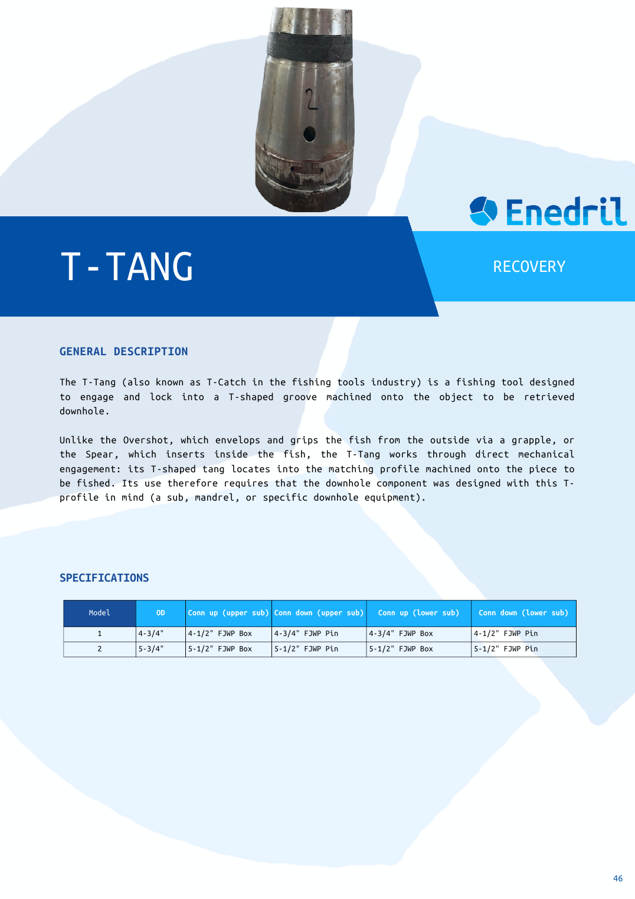

Slide 37
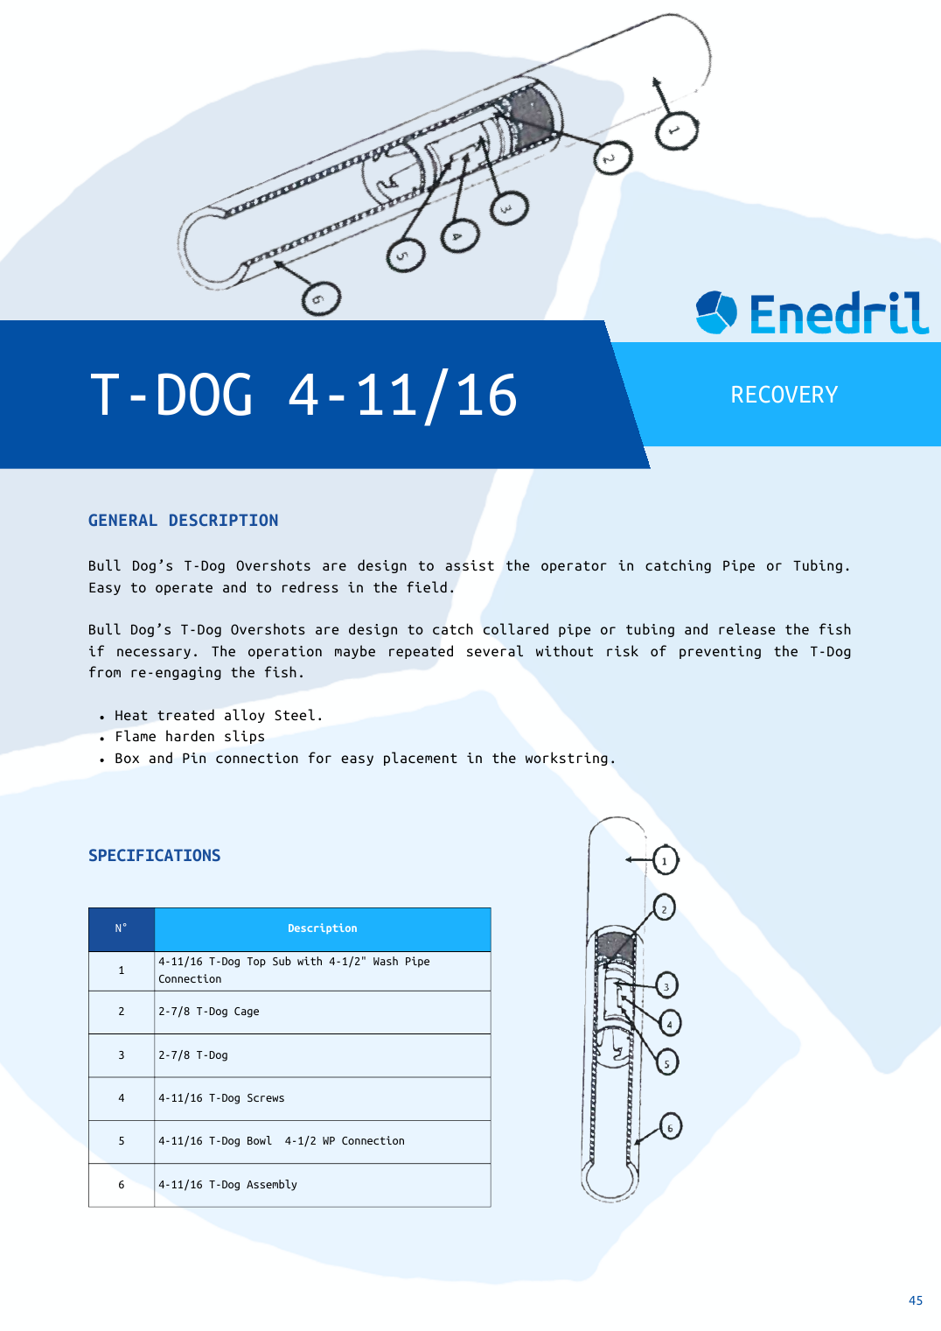

Slide 38
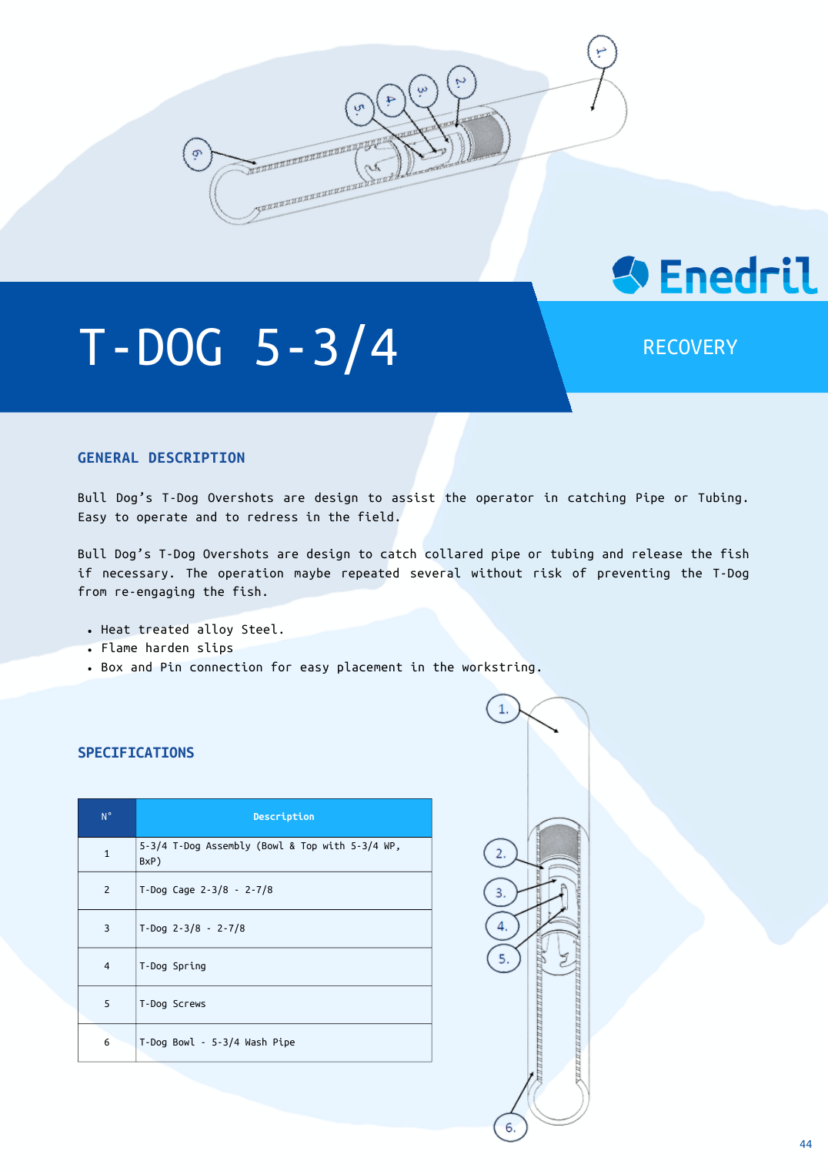

Slide 39
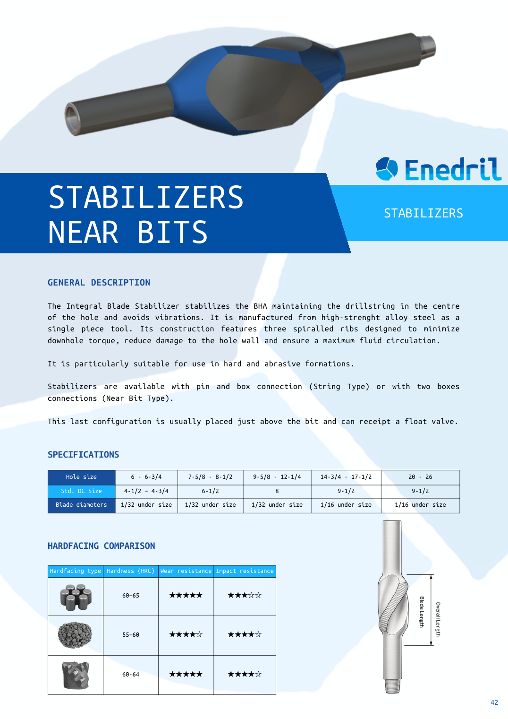

Slide 40
PDM
DRILLING
POSITIVE DISPLACEMENT MOTOR WITH SLEEVE STABILIZER
GENERAL DESCRIPTION
POSITIVE DISPLACEMENT MUD MOTOR (PDM) FOR DIRECTIONAL AND PERFORMANCE DRILLING, FROM 3-1/8 TO 9-5/8 IN. IN STOCK. THE MOTOR IS BUILT FROM A POWER SECTION (ROTOR AND STATOR), AN ADJUSTABLE OR FIXED BENT HOUSING, A DRIVESHAFT ASSEMBLY, A SEALED OR MUD-LUBRICATED BEARING ASSEMBLY AND THE BIT BOX. THE BEARING HOUSING CARRIES A THREAD FOR A SCREW-ON SLEEVE STABILIZER (STRAIGHT OR SPIRAL BLADE) OR OFFSET PAD, USED TO TUNE THE BUILD RATE AND TO REDUCE LATERAL VIBRATION. SPEED IS PROPORTIONAL TO FLOW, TORQUE TO DIFFERENTIAL PRESSURE.
TECHNICAL CHARACTERISTICS
Power section OD (in) | Lobes | Stages | Max. flow (gpm) | Max. bit speed (rpm) | Std. max diff. press. (psi) | Std. torque (lb-ft) | High-power diff. press. (psi) | High-power torque (lb-ft)
3-3/8 | 7/8 | 3.0 | 120 | 188 | 460 | 782 | 690 | 1,170
3-3/4 | 6/7 | 3.0 | 200 | 160 | 440 | 1,314 | 660 | 1,970
4-3/4 | 7/8 | 2.6 | 300 | 79 | 390 | 3,500 | 590 | 5,250
5 | 6/7 | 8.0 | 350 | 302 | 1,215 | 3,500 | 1,820 | 5,250
6-1/4 | 7/8 | 2.9 | 500 | 82 | 425 | 6,277 | 640 | 9,420
6-1/2 | 8/9 | 4.0 | 500 | 145 | 605 | 4,674 | 910 | 7,010
6-3/4 | 7/8 | 5.7 | 600 | 150 | 845 | 8,204 | 1,270 | 12,310
7 | 7/8 | 7.5 | 600 | 186 | 1,120 | 8,508 | 1,680 | 12,760
7-3/4 | 7/8 | 4.0 | 900 | 149 | 570 | 8,333 | 860 | 12,500
8 | 6/7 | 5.0 | 900 | 159 | 715 | 9,618 | 1,070 | 14,430
9-5/8 | 6/7 | 6.0 | 1,200 | 155 | 880 | 15,775 | 1,320 | 23,660
11-1/4 | 6/7 | 5.6 | 1,800 | 162 | 820 | 19,377 | 1,230 | 29,070
One configuration per size: the highest-torque standard power section listed. Other lobe and stage combinations are available. High-power = enhanced elastomer power section (about 50% higher differential pressure). Values per manufacturer motor tables, for reference.
DESIGN FEATURES
PERFORMANCE PARAMETERS
■ Modular motor: power section, bent housing, driveshaft, bearing assembly and bit box can be selected to suit the job.
■ Adjustable bend: field-adjustable housing (2.38, 3 or 4 degrees) for a wide range of build rates; fixed housings on request.
■ Sleeve stabilizer option: threaded bearing housing takes a screw-on straight or spiral blade sleeve, or an offset pad.
■ Bearing assembly: oil sealed (100% of the flow to the bit) or mud lubricated.
■ Driveshaft: conventional or high-torque version for the strongest power sections.
■ Dump sub and rotor catch: bypass while tripping; retrieval of the motor after a housing failure.
Speed | Proportional to flow rate
Torque | Proportional to differential pressure, independent of flow
More torque | More stages, enhanced elastomer or even-wall stator
Stall | Standpipe pressure rises, penetration stops
If stalled | Stop rotation, slow or stop pumps, release torque slowly, lift off bottom
HOW TO ORDER
Please specify: 1. motor OD and power section (lobes, stages, standard or high-power) 2. bearing type 3. housing angle 4. sleeve stabilizer type and size, or offset pad 5. top sub / dump sub and bit box connection 6. fluid, temperature and flow range.

Slide 41
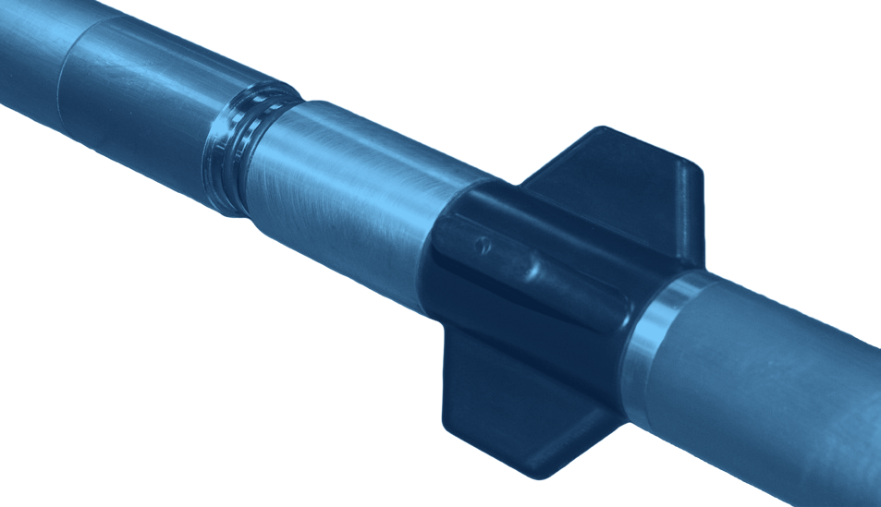
BOOST MWD
DRILLING
MUD PULSE MWD SYSTEM
GENERAL DESCRIPTION
BOOST IS A POSITIVE MUD PULSE MWD SYSTEM THAT SENDS SURVEYS, DIRECTIONAL TELEMETRY, GAMMA RAY AND OTHER SENSOR DATA TO SURFACE IN REAL TIME, USING PRESSURE SIGNALS IN THE WELLBORE. THE CORE SYSTEM INCLUDES PULSERS, ELECTRONICS, SENSORS AND BATTERIES, WITH MANY CONFIGURABLE OPTIONS. ADJUSTABLE MODULE PLACEMENT ALLOWS ALTERNATIVE SENSOR POSITIONS, AND DOWN-LINKING ALLOWS ADJUSTABLE LOGGING SEQUENCES.
TECHNICAL CHARACTERISTICS
Outside diameter | 47.625 mm (1.875")
Length, 1 battery | 5.28 m (17.3 ft)
Length, 2 batteries | 6.94 m (22.8 ft)
Pressure rating | 137,895 kPa (20,000 psi)
Operating temperature | -20 to +185 °C (-4 to 347 °F)
High-temp. version | 200 °C available
Rotary speed | 60 rpm recommended
Wireline | Retrievable, re-insertable
Min. I.D. to retrieve | 57 mm (2.25")
Bend radius | 20° / 10 m
Collar sizes | 89 - 203 mm (3.5" - 8")
Flow rate | 0.28 - 4.45 m³/min (75 - 1,200 gpm)
Data transmission | Positive mud pulse
Power supply | Lithium 28 VDC / 3 A
Battery capacity | 400+ h (2 battery modules)
Flow switch | Vibration, in pulser driver electronics
Shock limit | 500 g, 0.5 ms, half sine, all axes
Vibration limit | 5 - 30 Hz @ 1" d.a.; 30 - 500 Hz, 20 g
LCM tolerance | 40 - 50 ppb, any size, premixed
Pulse width | 0.250 - 2.00 s
Transmission time | 10 - 28 s
Internal memory | 24 MB
Programmable sequences | 4
Top or bottom mounted | Both positive pulse versions
d.a.: double amplitude. Standard tools are rated to 185 °C; high-temperature options are available.
SENSOR SPECIFICATIONS
DESIGN FEATURES
Parameter | Range | Accuracy | Spread
Inclination | 0 - 180° | ± 0.10° | 0.20°
Azimuth | 0 - 360° | ± 0.50° | 0.50°
Tool face | 0 - 360° | ± 0.20° | 0.40°
Dip angle | 0 - ± 90° | ± 0.2° | 0.40°
Magnetic field | 0 - 100,000 nT | ± 125 nT | 250 nT
Temperature | -35 - 200 °C | ± 0.5 °C | 1.00
■ Field-proven design: rugged and dependable, for aggressive drilling conditions.
■ Anti-plugging pulser: motor driven, performs well in LCM and high-solids mud.
■ Simple operation: wide range of flow rates and rotary speeds.
■ Ratcheting military connector: robust barrel-to-barrel inter-module link, easy to assemble and service.
■ Stable in the hole: precision-trimmed centralizers; shock mitigation absorbs vibration, reduces wear and improves MTBF.
■ Custom configuration: adjustable module placement, down-linking, configurable options.
TELEMETRY PARAMETERS
Inclination, azimuth, magnetic, dip angle and gravity qualifiers, raw X, Y, Z survey, toolface, continuous inclination and azimuth, battery status, shock, vibration, RPM, stick-slip, temperature, generic variables, annular pressure, orbital gamma (360° available).
HOW TO ORDER
Please specify: 1. collar size 2. top or bottom mounted version 3. 1 or 2 battery modules 4. temperature rating (185 °C standard, 200 °C option) 5. sensor options (e.g. orbital gamma) and logging sequences.

Slide 42
WHIPSTOCK
WHIPSTOCK
RETRIEVABLE CASING SIDETRACK WHIPSTOCKS
GENERAL DESCRIPTION
FAMILY OF RETRIEVABLE WHIPSTOCKS USED TO SIDETRACK OUT OF CASED HOLE, FOR RE-DRILLS, RE-ENTRIES AND MULTILATERAL WINDOWS. THE WHIPSTOCK IS RUN ON A STARTER MILL TOGETHER WITH ITS ANCHORING DEVICE, ORIENTED, SET, AND THE STARTER MILL IS SHEARED OFF THE WHIP; THE WINDOW IS THEN MILLED AND POLISHED ALONG THE WHIP FACE. THREE SETTING SYSTEMS ARE COVERED: A COMBINATION PACKER AND WHIPSTOCK (SET HYDRAULICALLY, SEALS THE HOLE), AN ANCHOR AND WHIPSTOCK (SET HYDRAULICALLY, NO SEAL) AND A MECHANICALLY SET BOTTOM-TRIP WHIPSTOCK. ALL HAVE A 3 DEGREE FACE ANGLE FOR POSITIVE KICK-OFF AND CAN BE RETRIEVED IN ONE TRIP. WINDOWS CAN BE MILLED THROUGH TWO STRINGS OF CASING.
TECHNICAL CHARACTERISTICS - PACKER TYPE
Casing size | Overall length | Body Ø | Packer length | Whip face length | Face angle (°) | Wt (lb) | Bypass valve length | Bypass valve Ø | Valve wt (lb)
5-1/2 | 182 | 4-3/16 | 76 | 106 | 3 | 585 | 25 | 3-3/8 | 40
7-5/8 | 216 | 5-5/8 | 84 | 133 | 3 | 980 | 43 | 4-3/4 | 150
7-5/8 | 229 | 5-15/16 | 84 | 146 | 3 | 1,400 | 43 | 4-3/4 | 150
9-5/8 | 261 | 8-5/8 | 84 | 178 | 3 | 2,500 | 46 | 6-3/4 | 240
13-3/8 | 338 | 11-3/4 | 87 | 251 | 3 | 6,595 | 38 | 8-1/4 | 400
TECHNICAL CHARACTERISTICS - MECHANICAL BOTTOM-TRIP TYPE
Casing size | Overall length | Body Ø | Anchor length | Whip face length | Face angle (°) | Wt (lb)
5 - 5-1/2 | 142-3/8 | 4-5/16 | 35-1/8 | 74 | 3 | 570
7 | 172-1/8 | 5-7/16 | 38-1/8 | 95 | 3 | 875
8-5/8 | 189-1/2 | 7-7/16 | 43-1/2 | 124 | 3 | 1,175
Dimensions in inches, weights in lb (approximate). Packer type: bypass valve data listed separately. Bottom-trip type can also be set permanently; 7-5/8 and 9-5/8 sizes on request.
DESIGN FEATURES
SETTING PARAMETERS
■ One trip: anchor or packer, starter mill and whip run together; retrieved in one trip.
■ Anchor or packer: large slip area reduces casing stress; ratchet ring and anti-rotation keys hold the whip.
■ Shear bolt: confirms the anchor is fully set before milling starts.
■ Bottom-trip type: sets with 3,600 lb on a trigger rod; no hydraulic pressure; slips retract on retrieval.
■ Orientation: muleshoe sub, gyro or MWD.
Hydraulic set (packer, anchor) | 3,000 - 3,500 psi
Bottom-trip set, shear-down | 15,000 - 20,000 lb
Set depth | 2 - 6 ft above a casing collar
Hole angle above 4° | Set within 90° of high side
Window milling | Starter, window, watermelon mills
HOW TO ORDER
Please specify: 1. casing size and weight 2. setting system (packer, anchor or bottom-trip) 3. connections 4. orientation method.

