Slide 1

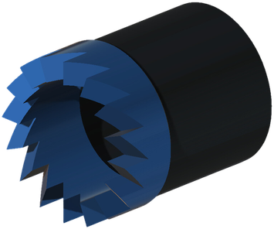
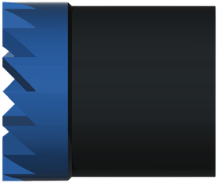

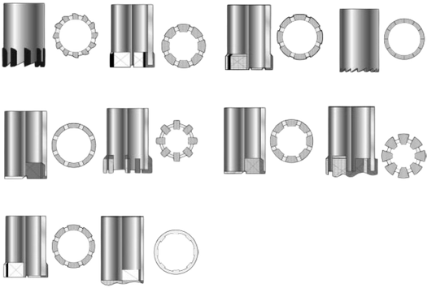



WASHOVER SHOE
MILLING
GENERAL DESCRIPTION
WASHOVER SHOES ARE MADE IN VARIOUS SIZES AND STYLES TO MEET THE MANY CONDITIONS MET IN FISHING AND WASHOVER OPERATIONS. RUN AT THE BOTTOM OF THE WASHOVER STRING, THE SHOE CUTS A CLEARANCE BETWEEN THE FISH AND THE WALL OF THE WELLBORE DURING RETRIEVAL OPERATIONS, OR FREES STUCK DOWNHOLE OBJECTS. IT CAN BE DRESSED WITH CARBIDE INSERTS FOR HARD MILLING AND LONGER WORK DURATION. WASHOVER EXTENSIONS, WASHOVER PIPES AND TOP SUBS ARE AVAILABLE TO SUIT THE CONNECTION SIZE OF THE WASHOVER STRING, TOGETHER WITH THE APPROPRIATE LIFTING EQUIPMENT.
SHOE STYLES
SIZE RANGE
Shoe OD | 2-9/16 - 13-3/8 in
Metric | 65 - 340 mm
OPERATING PARAMETERS
Rotary speed | 60 - 80 rpm
Weight on shoe | 2,000 - 6,000 lb
Technique | Pick up from time to time
Guideline values for washover shoes; adjust to the formation and the fish.
MAIN APPLICATIONS
TECHNICAL FEATURES
■ Recovering stuck drill pipe, tubing or casing.
■ Clearing wellbore restrictions caused by collapsed formations or debris.
■ Assisting fishing operations with a clean passage around stuck equipment.
■ Cutting edge designed for efficient material removal.
■ Many sizes to match casing and tubing diameters.
■ Hardfaced or carbide-enhanced surfaces for durability and cutting efficiency.
■ Optimised fluid ports to keep circulation and carry debris away.
■ Compatible with various thread connections.
HOW TO ORDER
Please specify: 1. shoe OD and style 2. cutting surface (hardfacing or carbide inserts) 3. connection to the washover string 4. washover extensions, pipes and top subs required.

