Slide 1

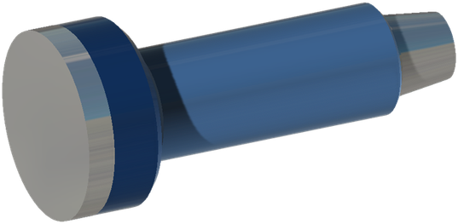




IMPRESSION BLOCK
CLEAN OUT
GENERAL DESCRIPTION
IMPRESSION BLOCKS ARE MADE FROM A LOW ALLOY STEEL OUTER CASING, WITH EITHER A LEAD OR A TAR INNER FILLING, DEPENDING ON THE CONDITIONS IN WHICH THE IMPRESSION IS TAKEN. LEAD IS IDEAL FOR DEEPER, HIGHER TEMPERATURE CONDITIONS, WHILE TAR IS VERY GOOD FOR LARGE OD, SHALLOW APPLICATIONS. ANY SIZE OF IMPRESSION BLOCK CAN BE BUILT TO ORDER.
SPECIFICATIONS
Top connection | 2-3/8 API REG | 2-7/8 API REG | 3-1/2 API REG
Tool OD (in) | 4 | 5 | 6
Material used | Lead | Lead | Lead
Top connection | 4-1/2 API REG | 6-5/8 API REG | 7-5/8 API REG
Tool OD (in) | 8-1/2 | 12-1/4 | 17-1/2 - 26
Material used | Lead | Lead | Tar
Dimensions in inches. Other sizes on request.
DESIGN FEATURES
HOW TO ORDER
■ Steel body: low alloy steel outer casing.
■ Lead filling: deeper, higher temperature conditions.
■ Tar filling: large OD, shallow applications.
■ Made to order: any size can be built.
Please specify: 1. tool OD 2. top connection 3. filling (lead or tar) 4. casing or hole size.

