Slide 1

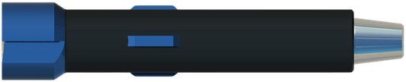
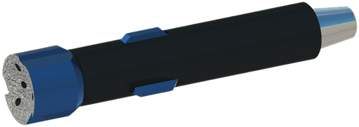

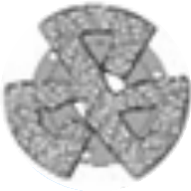
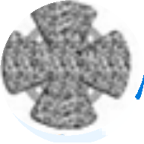




SUPER JUNK MILL
MILLING
GENERAL DESCRIPTION
THE JUNK MILL IS A HIGH-PERFORMANCE MILLING TOOL DESIGNED TO GRIND AND REMOVE METAL DEBRIS AND OBSTRUCTIONS IN THE WELLBORE, SUCH AS STUCK TOOLS, CASING FRAGMENTS OR DRILL BITS. IT IS USED IN TOUGH ENVIRONMENTS WHERE STANDARD MILLS MIGHT NOT SUFFICE, OFFERING SUPERIOR CUTTING POWER AND DURABILITY.
TECHNICAL CHARACTERISTICS
DRESSING OPTIONS
Dressed OD (in) | Top pin connection
3-1/2 - 4-1/4 | 2-3/8 API REG
4-1/2 - 5-1/2 | 2-7/8 API REG
5-1/2 - 7-1/2 | 3-1/2 API REG
7-1/2 - 9 | 4-1/2 API REG
9-1/2 - 12-1/4 | 6-5/8 API REG
13 - 15 | 6-5/8, 7-5/8
17 - 17-1/2 | 6-5/8, 7-5/8
18-1/2 - 26 | 6-5/8, 7-5/8
Conventional
Conebuster
Super
USAGE RECOMMENDATIONS
TYPES OF DEBRIS MILLED
■ Circulation: use with a robust circulation system to clear milling debris efficiently.
■ Debris collection: often combined with a fishing magnet or a junk basket to collect any metallic debris left behind.
■ Stabilizers: useful for tool stability, more consistent cutting action and longer mill life.
■ Broken drill bits
■ Casing fragments
■ Stuck tools
■ Fishing equipment debris
■ Miscellaneous metallic obstructions
HOW TO ORDER
Please specify: 1. dressed OD 2. top pin connection 3. dressing (conventional, Conebuster or Super).

