Slide 1


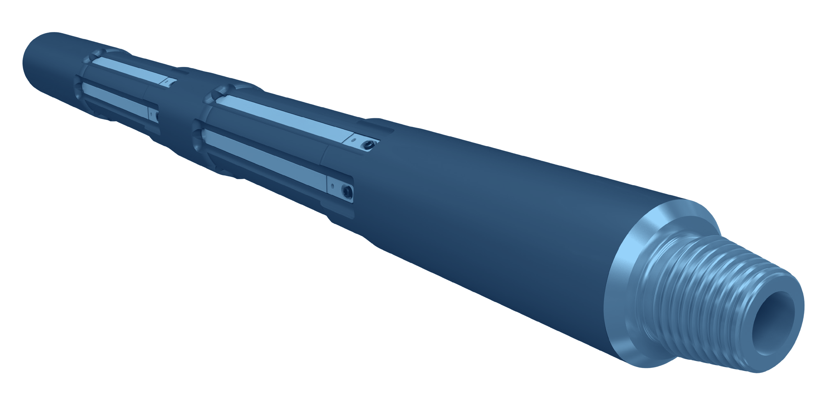



STRING MAGNET
CLEANING
IN-LINE STRING MAGNET
GENERAL DESCRIPTION
IN-LINE MAGNET RUN IN THE WORK STRING TO COLLECT FERROUS DEBRIS DURING CASING CUTTING, MILLING, PLUG AND ABANDONMENT AND CASING EXIT OPERATIONS, ESPECIALLY WHERE THE AVAILABLE CIRCULATION IS NOT ENOUGH TO CARRY THE SWARF OUT OF THE HOLE. LARGE MAGNETIC SLEEVES WITH RARE EARTH MAGNETS GIVE A HIGH PICK-UP CAPACITY. THE BODY IS A SINGLE PIECE WITH NO INTERNAL CONNECTION AND IS RATED FOR HIGH TORQUE. AVAILABLE FOR CASING FROM 4-1/2 TO 14 IN., IN STANDARD OR HIGH TEMPERATURE VERSIONS.
TECHNICAL CHARACTERISTICS
Casing size (in) | Tool OD (in) | Connection | Tool yield torque (ft-lb) | Tool tensile (lb) | Connection yield torque (ft-lb) | Connection tensile* (lb)
4-1/2, 4-3/4, 5 | 3-1/8 | 2-3/8 API Reg | 15,000 | 457,940 | 5,810 | 362,660
5-1/2, 6 | 3-3/4 | 2-7/8 API Reg | 20,000 | 698,880 | 11,080 | 478,540
6-5/8, 7 | 4-3/4 | 3-1/2 API IF | 25,000 | 1,032,640 | 18,090 | 572,690
7-5/8 | 5 | 3-1/2 API IF | 42,500 | 2,467,780 | 18,090 | 572,690
9-5/8 | 6-1/2 | 4-1/2 API IF | 80,000 | 2,126,520 | 38,060 | 919,880
10-3/4 | 8 | 6-5/8 API Reg | 105,000 | 3,759,840 | 83,380 | 1,770,500
13-3/8, 13-5/8, 14 | 10-1/8 | 6-5/8 API Reg | 250,000 | 4,879,680 | 83,380 | 1,770,500
* Tensile load at zero make-up torque. Dimensions in inches, loads in lb and ft-lb.
DESIGN FEATURES
■ Large magnetic area: high pick-up capacity for ferrous debris.
■ Rare earth magnets: powerful field, standard and high temperature options.
■ Replaceable sleeves: magnetic sleeves are easily removed and replaced.
■ One-piece body: solid mandrel with no internal connection.
■ High torque rating: suited to milling and cutting strings.
■ Fishable through the ID.
APPLICATIONS
BENEFITS
■ Casing cutting and milling
■ Plug and abandonment
■ Casing exit (window milling)
■ Wellbore cleanout where circulation is limited
■ Better ferrous debris removal when circulation is inadequate
■ Cleaner wellbore, less non-productive time
■ Lower overall cost of the operation
HOW TO ORDER
Please specify: 1. casing size and weight 2. tool OD and top / bottom connections 3. standard or high temperature magnets 4. number of magnetic sleeves and spare sleeves.

