Slide 1


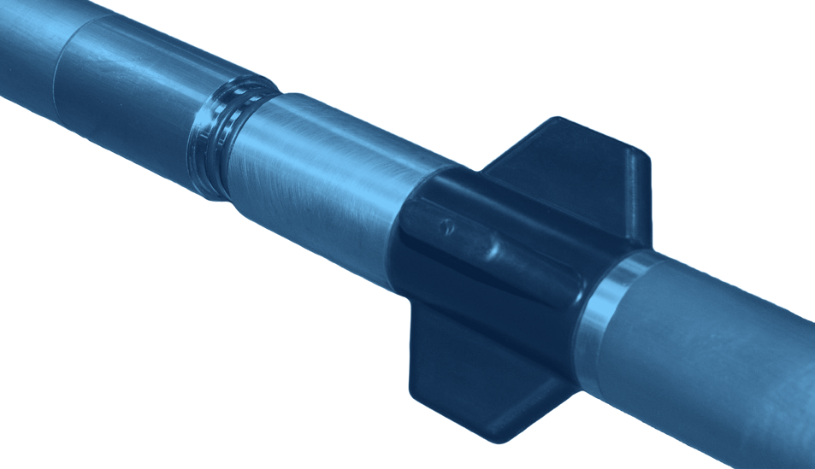



BOOST MWD
DRILLING
MUD PULSE MWD SYSTEM
GENERAL DESCRIPTION
BOOST IS A POSITIVE MUD PULSE MWD SYSTEM THAT SENDS SURVEYS, DIRECTIONAL TELEMETRY, GAMMA RAY AND OTHER SENSOR DATA TO SURFACE IN REAL TIME, USING PRESSURE SIGNALS IN THE WELLBORE. THE CORE SYSTEM INCLUDES PULSERS, ELECTRONICS, SENSORS AND BATTERIES, WITH MANY CONFIGURABLE OPTIONS. ADJUSTABLE MODULE PLACEMENT ALLOWS ALTERNATIVE SENSOR POSITIONS, AND DOWN-LINKING ALLOWS ADJUSTABLE LOGGING SEQUENCES.
TECHNICAL CHARACTERISTICS
Outside diameter | 47.625 mm (1.875")
Length, 1 battery | 5.28 m (17.3 ft)
Length, 2 batteries | 6.94 m (22.8 ft)
Pressure rating | 137,895 kPa (20,000 psi)
Operating temperature | -20 to +185 °C (-4 to 347 °F)
High-temp. version | 200 °C available
Rotary speed | 60 rpm recommended
Wireline | Retrievable, re-insertable
Min. I.D. to retrieve | 57 mm (2.25")
Bend radius | 20° / 10 m
Collar sizes | 89 - 203 mm (3.5" - 8")
Flow rate | 0.28 - 4.45 m³/min (75 - 1,200 gpm)
Data transmission | Positive mud pulse
Power supply | Lithium 28 VDC / 3 A
Battery capacity | 400+ h (2 battery modules)
Flow switch | Vibration, in pulser driver electronics
Shock limit | 500 g, 0.5 ms, half sine, all axes
Vibration limit | 5 - 30 Hz @ 1" d.a.; 30 - 500 Hz, 20 g
LCM tolerance | 40 - 50 ppb, any size, premixed
Pulse width | 0.250 - 2.00 s
Transmission time | 10 - 28 s
Internal memory | 24 MB
Programmable sequences | 4
Top or bottom mounted | Both positive pulse versions
d.a.: double amplitude. Standard tools are rated to 185 °C; high-temperature options are available.
SENSOR SPECIFICATIONS
DESIGN FEATURES
Parameter | Range | Accuracy | Spread
Inclination | 0 - 180° | ± 0.10° | 0.20°
Azimuth | 0 - 360° | ± 0.50° | 0.50°
Tool face | 0 - 360° | ± 0.20° | 0.40°
Dip angle | 0 - ± 90° | ± 0.2° | 0.40°
Magnetic field | 0 - 100,000 nT | ± 125 nT | 250 nT
Temperature | -35 - 200 °C | ± 0.5 °C | 1.00
■ Field-proven design: rugged and dependable, for aggressive drilling conditions.
■ Anti-plugging pulser: motor driven, performs well in LCM and high-solids mud.
■ Simple operation: wide range of flow rates and rotary speeds.
■ Ratcheting military connector: robust barrel-to-barrel inter-module link, easy to assemble and service.
■ Stable in the hole: precision-trimmed centralizers; shock mitigation absorbs vibration, reduces wear and improves MTBF.
■ Custom configuration: adjustable module placement, down-linking, configurable options.
TELEMETRY PARAMETERS
Inclination, azimuth, magnetic, dip angle and gravity qualifiers, raw X, Y, Z survey, toolface, continuous inclination and azimuth, battery status, shock, vibration, RPM, stick-slip, temperature, generic variables, annular pressure, orbital gamma (360° available).
HOW TO ORDER
Please specify: 1. collar size 2. top or bottom mounted version 3. 1 or 2 battery modules 4. temperature rating (185 °C standard, 200 °C option) 5. sensor options (e.g. orbital gamma) and logging sequences.

