Slide 1


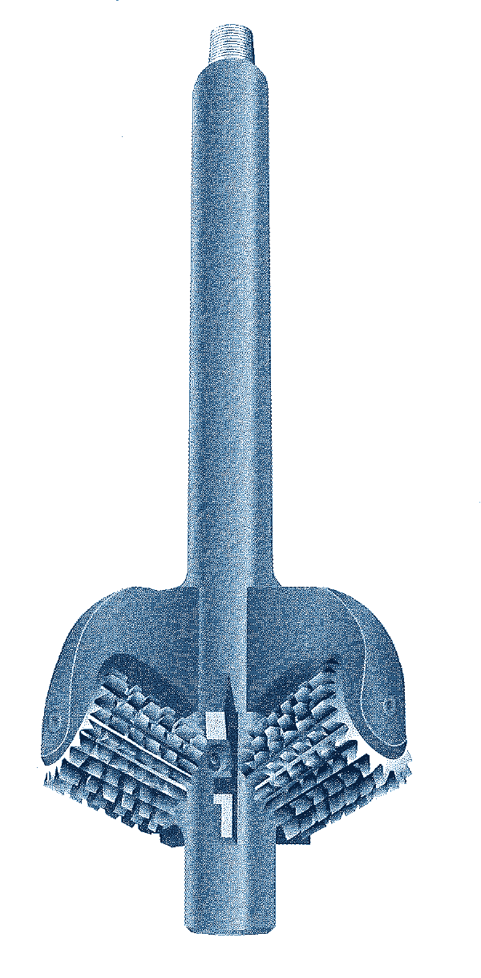



HOLE OPENER
ENLARGEMENT
FIXED-DIAMETER HOLE OPENER
GENERAL DESCRIPTION
FIXED-DIAMETER HOLE OPENER THAT ENLARGES A PREVIOUSLY DRILLED PILOT HOLE FROM THE SURFACE. THE CUTTERS ARE RIGIDLY ATTACHED TO THE BODY: THERE IS NO HYDRAULIC ACTUATION, AND THE TOOL ALWAYS CUTS AT ITS FULL GAUGE. USED MAINLY FOR SURFACE HOLES AND CONDUCTOR CASING, WHERE A BIGGER HOLE GIVES ENOUGH CLEARANCE TO RUN AND CEMENT THE CASING (FOR EXAMPLE, A 17-1/2 IN. HOLE OPENED TO RUN 13-3/8 IN. CASING). THE CHOICE OF CUTTERS LETS IT HANDLE SOFT TO HARD-ABRASIVE FORMATIONS. CUTTER SIZES FROM 26 TO 42 IN.
TECHNICAL CHARACTERISTICS
Std. opening Ø | Min. pilot hole Ø | Fishing neck length | Fishing neck Ø | Top pin API Reg. | Bottom neck length | Bottom neck Ø | Bottom box API Reg. | Body length | Min. bore Ø
26 | 14 | 60 | 9-1/2 | 6-5/8 - 7-5/8 | 12 | 9-1/2 | 7-5/8 | 96 | 1
28 | 16 | 60 | 9-7/8 | 6-5/8 - 7-5/8 | 12 | 9-1/2 | 7-5/8 | 96 | 1
30 | 18 | 60 | 9-7/8 | 6-5/8 - 7-5/8 | 12 | 9-1/2 | 7-5/8 | 100 | 2
32 | 20 | 60 | 10 | 7-5/8 - 8-5/8 | 15 | 9-1/2 | 8-5/8 | 100 | 2
34 | 22 | 60 | 10 | 7-5/8 - 8-5/8 | 15 | 9-1/2 | 8-5/8 | 101 | 2
36 | 24 | 60 | 10 | 7-5/8 - 8-5/8 | 15 | 9-1/2 | 8-5/8 | 103 | 3
38 | 26 | 60 | 10 | 8-5/8 | 15 | 9-1/2 | 8-5/8 | 106 | 3
40 | 28 | 60 | 10 | 8-5/8 | 15 | 9-1/2 | 8-5/8 | 106 | 3
42 | 30 | 60 | 10 | 8-5/8 | 15 | 9-1/2 | 7-5/8 | 106 | 3
Dimensions in inches, approximate. Intermediate sizes or sizes larger than 42 in. available on request.
DESIGN FEATURES
OPERATING PARAMETERS
■ Fixed gauge: cutters rigidly mounted; no hydraulic actuation.
■ Demountable cutters: easily replaced on the rig floor.
■ Cutters: sealed-bearing milled tooth or tungsten carbide insert.
■ Long fishing necks: can be made up below the rotary table despite the large size.
■ Replaceable nozzles: effective hole cleaning.
■ Wide formation range: soft to hard-abrasive.
Formation | Cutter | Weight (lb) | rpm
Soft | Milled tooth | 15,000 - 25,000 | 125 - 150
Medium | Milled tooth | 20,000 - 35,000 | 75 - 85
Hard | Button type | 35,000 - 45,000 | 50 - 60
Extr. hard | TCI button | 30,000 - 45,000 | 30 - 40
Guideline for 19-3/4 - 26 in. holes; smaller sizes need less weight.
GAUGE TOLERANCE (ARMS OPEN)
Size (in) | Plus | Minus
18 - 26 | +1/8 | - 1/16
27 - 42 | +5/32 | - 1/16
43 and larger | +3/16 | - 1/16
NOZZLES AND CUTTERS
Gauge as dressed, not ground; milled tooth and TCI.
■ Nozzles: threaded retainer holds the jet nozzle in its sleeve; O-ring seal.
■ Cutter sets: replacement sets include all parts needed.
■ Rebuild kits: cutter bearing rebuild kits on special order.
MASTER DRILLER (CONE ARM VERSION)
Cone-arm hole opener, up to 36 in.; one body takes several arm sizes. Bottom box for bit or bullnose. Milled tooth, TCI or PDC cones; soft to medium-hard formations.
Series | Std. opening Ø | Min. pilot Ø | Body Ø | Wt (lb)
8200 | 12-1/4 | 8-1/2 | 8-1/4 | 640
9500 | 12-1/4, 14-3/4 | 8-1/2, 9-1/2 | 9-1/2 | 915
11000 | 17-1/2, 22-5/8 | 9-1/2 | 11-5/8 | 1,100
15000 | 17-1/2, 26-5/8, 36-5/8 | 9-1/2, 12-1/4, 24-5/8 | 15-5/8 | 1,900
HOW TO ORDER
Please specify: 1. pilot hole size 2. hole opening size 3. top and bottom connections if not standard 4. fishing neck diameter if not standard 5. cutter type (milled tooth or tungsten carbide insert) and formation (soft or medium).

