Slide 1


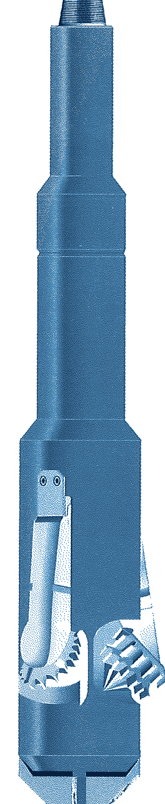



RTU
ENLARGEMENT
ROCK-TYPE UNDERREAMER
GENERAL DESCRIPTION
RUGGED THREE-CONE UNDERREAMER THAT ENLARGES A HOLE TO NEARLY TWICE ITS OWN BODY DIAMETER. A WIDE RANGE OF CONE TYPES MATCHES THE CUTTER TO THE FORMATION, AND A CHOICE OF ORIFICE SIZES TAILORS PERFORMANCE TO THE RIG HYDRAULICS. THE TOOL CAN BE SERVICED ON LOCATION, THE CUTTER ARMS ARE CHANGED QUICKLY ON THE RIG FLOOR, AND FULL CIRCULATION IS KEPT AT ALL TIMES WITH WATER, MUD, AIR, AERATED MUD OR FOAM.
TECHNICAL CHARACTERISTICS
Tool series | Std. opening Ø | Optional opening Ø | Body Ø | Collapsed Ø | Through casing Ø x lb/ft | Fishing neck length | Fishing neck Ø | Overall length | Top pin API Reg. | Wt (lb)
3600 | 6 | 4-3/4 - 6-1/2 | 3-5/8 | 3-3/4 | 4-1/2 x 15 | 8 | 3-3/8 | 26-1/2 | 2-3/8 | 175
4500 | 6-1/2, 8-1/2 | 6 - 9 | 4-1/2 | 4-5/8 | 5-1/2 x 20 | 18 | 4-1/8 | 67 | 2-7/8 | 235
5700 | 11 | 8 - 11 | 5-3/4 | 5-7/8 | 7 x 38 | 18 | 4-3/4 | 76-1/2 | 3-1/2 | 380
5800 | 11 | 8 - 11 | 5-7/8 | 5-7/8 | 6-5/8 x 20 | 18 | 4-3/4 | 76-1/2 | 3-1/2 | 380
6000 | 12 | 11 - 12 | 6 | 6-1/8 | 7 x 26 | 18 | 4-3/4 | 78-1/2 | 3-1/2 | 380
6100 | 12 | 11 - 12 | 6-1/8 | 6-1/8 | 7 x 20 | 18 | 4-3/4 | 78-1/2 | 3-1/2 | 380
6200 | 12 | 11 - 13 | 6-1/4 | 6-1/4 | 7 x 17 | 18 | 4-3/4 | 78-1/2 | 3-1/2 | 380
7200* | 14 | 9 - 14 | 7-1/4 | 7-3/8 | 8-5/8 x 40 | 18 | 5-3/4 | 86 | 4-1/2 | 775
8200* | 16 | 10 - 16 | 8-1/4 | 8-3/8 | 9-5/8 x 47 | 18 | 5-3/4 or 8 | 89 | 4-1/2 or 6-5/8 | 920
9500* | 17-1/2 | 13 - 18 | 9-1/2 | 9-3/4 | 10-3/4 x 45 | 18 | 8 | 91 | 6-5/8 | 1,160
11700* | 17-1/2 | 14-3/4 - 22 | 11-3/4 | 12-1/4 | 13-3/8 x 68 | 20 | 8 | 91 | 6-5/8 | 1,670
15000 LP* | 26 | 17-1/2 - 30 | 14-3/4 | 14-3/4 | 16 x 75 | 20 | 8 or 9 | 97 | 6-5/8 or 7-5/8 | 2,800
22000 | 32 - 40 | 32 - 40 | 22 | 22 | 24-1/2 x 113 | 20 | 9 or 10 | 124-1/4 | 7-5/8 or 8-5/8 | 5,900
* Available with PDC Bearclaw cutters. Dimensions in inches, weights in lb (approximate). Optional opening diameters on request.
DESIGN FEATURES
PERFORMANCE PARAMETERS
■ Three-cone cutters: enlarges to almost twice the body diameter.
■ Cutter options: milled tooth, TCI or PDC Bearclaw cutting structures.
■ Tailored hydraulics: orifice sizes selected to suit the rig conditions.
■ Full circulation: constant flow volume through the tool.
■ Field serviceable: serviced on location; arms swapped on the rig floor.
■ Optional Flo-Tel: pump pressure drops 200 - 250 psi once the arms are fully extended, confirming full gauge and avoiding second trips.
Rpm to shoulder depth | 30 - 50 rpm
Rpm, cutting shoulder | 80 - 150 rpm max.
Rpm, underreaming | 80 rpm
Weight on tool | 1,000 lb per in. of body Ø
With Flo-Tel | 80 - 150 rpm, max. pump pressure
Circulating medium | Water, mud, air, foam
CUTTING THE SHOULDER
■ Start: establish flow, rotate at 80 - 150 rpm and drill off slowly for 5 - 10 minutes.
■ Open the arms: lift off with the pump on and repeat to be sure they are fully open.
■ Shoulder reached: weight starts to register, then add weight to underream.
OPERATING NOTES
■ Running in: go slowly at the top of the section; surge pressure can open the arms and damage casing.
■ Rate of penetration: keep below 100 ft/hr or the hole may not reach drift gauge.
■ Dull cutters: pull at the first sign of dulling.
HOW TO ORDER
Please specify: 1. tool series 2. top and bottom connections 3. fishing neck Ø 4. opening Ø 5. size and weight of casing to run through, if known 6. bullnose or bits (ordered separately) 7. cutting structure (milled tooth, TCI or PDC).

