Slide 1
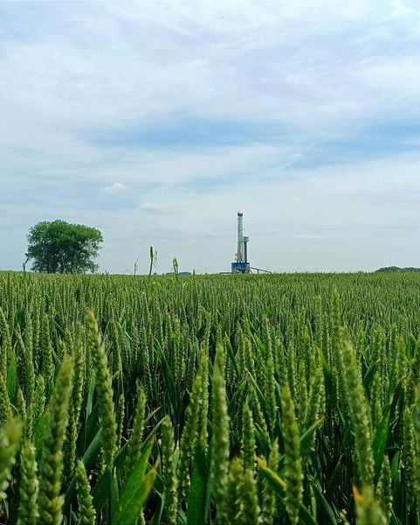
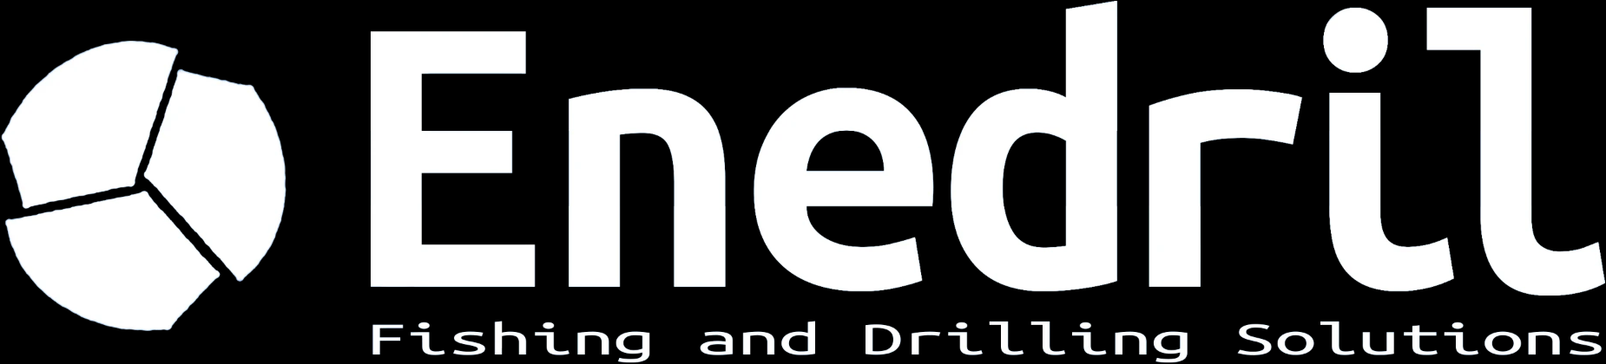
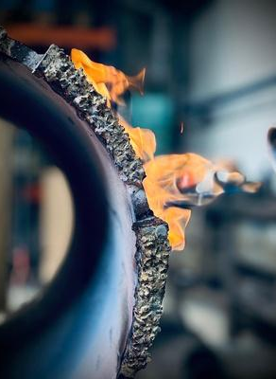
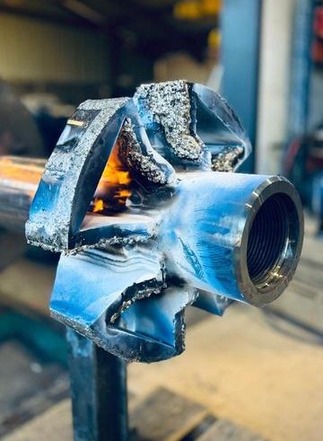
DRILLING SERVICES
& DOWNHOLE TOOLS
From shallow to deep wells
Directional drilling, fishing, workover and plug & abandonment for geothermal, oil & gas, underground gas storage and water wells.
Independent French company, founded in 2013 and based in Lons, near Pau. ISO 9001 certified.
WATER WELLS TOO
Cut & pull, reaming, milling
98,500 m
60
142
2,500
drilled
wells, up to 3,000 m TVD
fishing, workover and P&A jobs
tools in stock
OUR SERVICES
DIRECTIONAL DRILLING & MWD
PDM motors 3-1/8" to 9-5/8", push and point-the-bit RSS, high-temperature MWD up to 200°C, in-house well planning.
FISHING
Recovery of rods, strings and stuck tools. Jars, overshots, spears, magnets, mills. Response within 24/48h.
WORKOVER
Well restoration: section milling, wash over, casing repair, reaming and enlargement.
PLUG & ABANDONMENT
Safe abandonment of wells with cutters, whipstocks, packers, bridge plugs and liner hangers.
OWN WORKSHOP, CUSTOM TOOLS
Two workshops of more than 1,000 m² with a 5 t overhead crane, break-out unit, jar tester, lathe, milling and welding. Tools are inspected, repaired and redressed in-house. Custom tools are designed with an API 5 & 7 certified machine shop, within tight deadlines.
3,500 m² outdoor yard for tubulars, stabilizers and on-site containers.
"When you need us, it is already too late to look for us."
Stock of 2,500 tools and teams ready to mobilise: fewer days of costly standby for your rig.
Enedril · Fishing and Drilling Solutions · 3 avenue des lacs, 64140 Lons (France) · info@enedril.fr · +33 (0)5 59 04 50 45

Slide 2
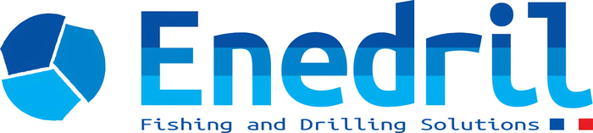
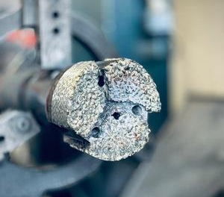
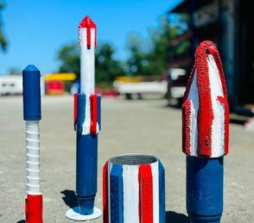
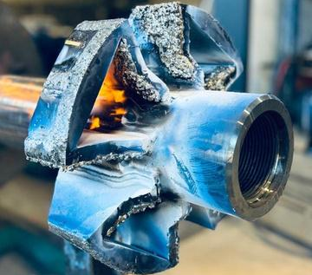
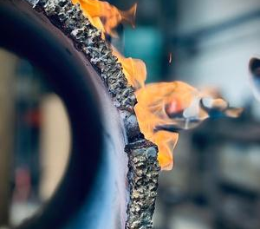
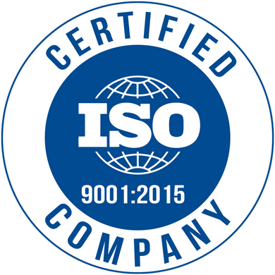
WHY ENEDRIL
DEEP EXPERTISE, LIGHT WELLS TOO
Used to 3,000 m wells in oil & gas and geothermal, we master shallow wells between 300 and 1,000 m just as well.
EMERGENCY RESPONSE 24/48H
Stuck tool, blocked string: our stock and our teams save you days of costly downtime.
TAILORED INTERVENTIONS
Every well is unique. We adapt BHA and procedures to your geology and your equipment.
ONE CONTACT, START TO FINISH
From diagnosis to resolution, a dedicated team follows your job. ISO 9001 certified.
WATER WELLS: CUT & PULL, REAMING, MILLING
Our solutions are fully suited to water wells, typically between 300 and 1,000 m. We support drilling contractors when a job goes wrong or when a well must be restored or enlarged.
CUT & PULL
Hydraulic and external pipe cutters, spears and overshots to cut and recover casing, tubing or stuck strings.
REAMING
Rotary and directional underreamers, hole openers, roller reamers and SPX drag-type underreamers.
MILLING
Junk mills, pilot and taper mills, section mills and washover shoes.
Mobilisation within 24/48h across metropolitan France · 2,500 tools in stock · BHA and procedures adapted to your geology.
A TEAM OF 33
Directional Drillers, MWD Engineers, fishing engineers, mechanics and welders, working from Lons and on your site. We are known for being fast, flexible and easy to work with.
2013
2 × 1,000 m²
~15
+200
founded as Mustang Services
equipped workshops
clients supported each year
operations completed
CONTACT
Enedril, Fishing and Drilling Solutions
3, avenue des lacs, 64140 Lons (France)
+33 (0)5 59 04 50 45
info@enedril.fr · www.enedril.com
EMERGENCY
Fishing response within 24/48h
Interventions across France, Europe and North Africa
Enedril · Fishing and Drilling Solutions · 3 avenue des lacs, 64140 Lons (France) · info@enedril.fr · +33 (0)5 59 04 50 45

