Slide 1

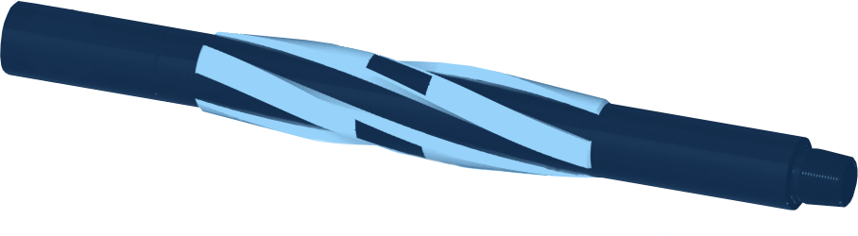




STRING MILL
MILLING
SPIRAL BLADE STRING MILL
GENERAL DESCRIPTION
THE STRING MILL IS A SPIRAL-BLADED MILLING TOOL RUN IN THE STRING TO REMOVE DEBRIS, PERFORATION BURRS AND OTHER FOREIGN MATERIAL LEFT IN THE CASING ID AFTER DRILLING, WELLBORE CLEAN-UP AND PRE-COMPLETION RUNNING OPERATIONS. ITS ALIGNED FLUID CHANNELS GIVE MAXIMUM FLUID BY-PASS AND 360 DEGREE COVER FOR BETTER RECOVERY. IT IS PARTICULARLY SUITED TO PREPARING CASING WINDOWS BEFORE RUNNING LINERS OR COMPLETIONS. IT IS RUN ALONGSIDE A NON-ROTATING CASING SCRAPER AHEAD OF THE DRIFT SUB, REMOVING DRILLING FLUID RESIDUE, SCALE AND CEMENT WHILE RUNNING IN HOLE AND RECIPROCATING THE STRING. THE BLADES CAN BE FACED WITH A CHOICE OF HARDFACING, DEPENDING ON OPERATIONAL REQUIREMENTS.
TECHNICAL CHARACTERISTICS
Casing (in) | Weight (lb/ft) | Drift (in) | Max hard OD (in) | Body ID (in) | Overall length (in) | Neck length (in) | Neck OD (in) | Rig connection | Torsional yield (ft-lb) | Make-up torque (ft-lb) | Tensile (lb)
4-1/2 | 9.5 - 16.5 | 3.965 - 3.629 | 3.965 - 3.629 | 1.50 | 57 | 18 | 3.125 | 2-7/8 HT PAC | 8,500 | 5,100 | 214,200
5-1/2 | 23 - 28.4 | 4.545 - 4.315 | 4.545 - 4.315 | 1.50 | 57 | 18 | 3.125 | 2-7/8 HT PAC | 8,500 | 5,100 | 214,200
7 | 26 | 6.151 | 6.151 | 2.69 | 64 | 18 | 4.750 | NC38 | 11,800 | 9,100 | 580,000
7 | 29 | 6.059 | 6.059 | 2.250 | 76 | 27.5 | 4.750 | NC38 | 11,800 | 9,100 | 580,000
7 | 32 | 5.969 | 5.969 | 2.250 | 76 | 27.5 | 4.750 | NC38 | 11,800 | 9,100 | 580,000
9-5/8 | 43.5 | 8.599 | 8.599 | 3.500 | 76.5 | 18 | 6.500 | NC50 | 51,700 | 27,000 | 944,000
9-5/8 | 47 | 8.525 | 8.525 | 3.500 | 76.5 | 18 | 6.500 | NC50 | 51,700 | 27,000 | 944,000
9-5/8 | 53.5 | 8.379 | 8.379 | 3.500 | 76.5 | 18 | 6.500 | NC50 | 51,700 | 27,000 | 944,000
9-5/8 | 58.4 | 8.279 | 8.279 | 3.500 | 76.5 | 18 | 6.500 | NC50 | 51,700 | 27,000 | 944,000
9-5/8 | 59.4 | 8.250 | 8.250 | 3.500 | 76.5 | 18 | 6.500 | NC50 | 51,700 | 27,000 | 944,000
Other sizes, bespoke ODs and blade lengths on request. Dimensions in inches, loads in lb and ft-lb.
OPERATING LIMITS
Casing (in) | Max run speed (ft/min) | Max rotating speed (rpm) | Max compression when rotating (lb) | Max pressure test (psi)
4-1/2, 5-1/2 | 60 | 30 | 5,000 | 10,000
7 | 60 | 120 | 30,000 | 10,000
9-5/8 | 60 | 120 | 40,000 | 10,000
BENEFITS
HOW TO ORDER
■ High fluid by-pass: fluid and debris flow past the tool body.
■ Compatible: large inner bore, works with all standard clean-up tools and prevents surge and swab.
■ Robust: no internal or external screws or bolts.
■ Flexible: API and non-standard casing sizes, bespoke ODs and blade lengths.
Please specify: 1. casing size and weight 2. rig connection 3. blade length and hardfacing 4. other tools run in the string (scraper, drift sub).

