Slide 1


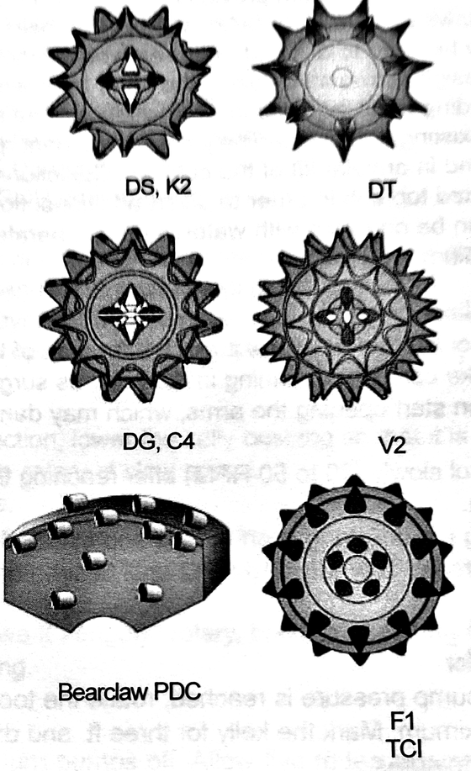



DTU
ENLARGEMENT
DRILLING-TYPE UNDERREAMER
GENERAL DESCRIPTION
DRILLING-TYPE UNDERREAMER THAT ENLARGES PREVIOUSLY DRILLED PILOT HOLES. A BOTTOM BOX CONNECTION LETS A BIT OR A BULLNOSE RUN BELOW THE TOOL, SO THE DTU CAN DRILL AND UNDERREAM AT THE SAME TIME. MUD FLOW CAN BE SPLIT BETWEEN THE CUTTER ARMS AND THE BIT OR BULLNOSE. IT RUNS WITH WATER, MUD, AIR, AERATED MUD OR ANY OTHER CIRCULATING MEDIUM.
TECHNICAL CHARACTERISTICS
Tool series | Std. opening Ø | Optional opening Ø | Body Ø | Collapsed Ø | Through casing Ø x lb/ft | Fishing neck length | Fishing neck Ø | Overall length | Top pin API Reg. | Wt (lb)
3600 | 6 | 5-1/2 - 6 | 3-5/8 | 3-5/8 | 4-1/2 x 15 | 8 | 3-3/8 | 35 | 2-3/8 | 170
5700 | 8-3/4 | 7 - 8-3/4 | 5-3/4 | 6 | 7 x 38 | 18 | 4-3/4 | 70 | 3-1/2 | 360
7200* | 11 | 9 - 11 | 7-1/4 | 7-1/2 | 8-5/8 x 40 | 18 | 5-3/4 | 74 | 4-1/2 | 770
8200* | 14 | 10 - 14 | 8-1/4 | 8-1/4 | 9-5/8 x 53 | 18 | 5-3/4 or 8 | 79 | 4-1/2 or 6-5/8 | 900
9500* | 15 | 12 - 15 | 9-1/2 | 10-1/4 | 11-3/4 x 71 | 18 | 8 | 82 | 6-5/8 | 1,150
11700* | 17-1/2 | 14-3/4 - 20 | 11-3/4 | 11-3/4 | 13-3/8 x 92 | 20 | 8 | 96 | 6-5/8 | 1,670
15000* | 17-1/2 - 26 | 17-1/2 - 26 | 14-3/4 | 14-3/4 | 16 x 75 | 20 | 8 or 9 | 97 | 6-5/8 or 7-5/8 | 2,800
17000* | 32 | 24 - 32 | 17 | 17 | 18-5/8 x 78 | 20 | 9 or 10 | 87 | 7-5/8 or 8-5/8 | 3,000
22000 | 36 | 28 - 36 | 22 | 22 | 24-1/2 x 113 | 20 | 9 or 10 | 100 | 7-5/8 or 8-5/8 | 4,400
* Available with PDC Bearclaw cutters. Dimensions in inches, weights in lb (approximate). Optional opening diameters on request.
DESIGN FEATURES
CUTTER OPTIONS
■ Drill and underream in one run: bottom box connection for a bit or bullnose.
■ Flexible hydraulics: flow can be divided between the arms and the bit or bullnose; orifice jets are selected to suit the available hydraulics.
■ Cooling and cleaning: jet placement keeps the cutters cool and aids annular lift of cuttings.
■ Extra flow options: jetted bullnose and jetted top sub to divert more flow when needed.
■ Cutting structures: open-bearing milled tooth (standard), TCI or PDC Bearclaw.
Gauge diameter tolerances, arms open
Size (in) | Tolerance
6 - 9 | +1/16 - 0
9-1/2 - 13 | +3/32 - 0
14 - 18 | +1/8 - 0
20 - 30 | +3/16 - 0
Applies to arm sets of RTU, DTU, drag and XTU underreamers, all cutting structures.
PERFORMANCE PARAMETERS
Rotary speed, reaching shoulder depth | 30 - 50 rpm
Rotary speed, cutting the shoulder | 80 - 150 rpm max.
Rotary speed, underreaming | 80 rpm
Weight on tool | 1,000 lb per inch of body Ø
Stabilization | Full-gauge stabilizer 60 - 90 ft above and below
Position in the BHA | Middle of the drill collars
HOW TO ORDER
Please specify: 1. tool series 2. top and bottom connections 3. fishing neck Ø 4. opening Ø 5. size and weight of casing to run through, if known 6. bullnose or bits (ordered separately) 7. cutting structure (milled tooth, TCI or PDC).

