Slide 1


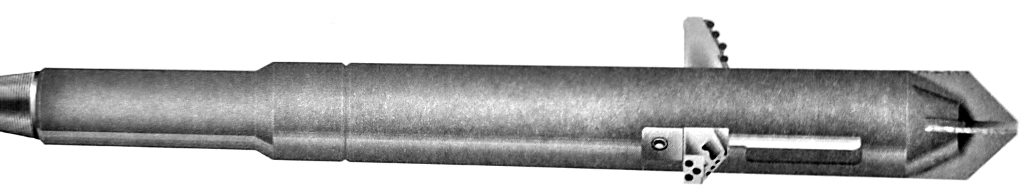



SPX
ENLARGEMENT
DRAG-TYPE UNDERREAMER, PDC CUTTERS
GENERAL DESCRIPTION
DRAG-TYPE UNDERREAMER WITH SPX PDC CUTTERS ON THE CUTTING EDGE: THE HARDNESS AND WEAR RESISTANCE OF POLYCRYSTALLINE DIAMOND, BACKED BY THE STRENGTH OF CEMENTED TUNGSTEN CARBIDE. THE CUTTERS SHEAR THROUGH SOFT TO MEDIUM-HARD FORMATIONS FASTER THAN CONVENTIONAL TOOLS AND NEED LESS TOOL WEIGHT. USED IN POORLY CONSOLIDATED SOFT TO MEDIUM FORMATIONS WHERE LARGER DIAMETERS ARE REQUIRED FOR GRAVEL PACKING OR CEMENTING. A PILOT HOLE CAN BE ENLARGED UP TO THREE TIMES THE BODY DIAMETER IN A SINGLE TRIP.
TECHNICAL CHARACTERISTICS
Tool series | Body Ø | Min. pilot hole Ø | Std. expanded Ø, SPX (PDC) | Std. expanded Ø, tungsten carbide | Fishing neck length | Fishing neck Ø | Overall length | Top pin API | Wt (lb)
3600 | 3-3/8 | 3-3/4 | N/A | 9 | 8 | 3-3/8 | 26-1/2 | 2-3/8 Reg. | tbc
4500 | 4-1/2 | 4-3/4 | 6-1/2, 6-3/4, 8-1/2 | Upon request | 18 | 4-1/4 | 69 | 3-1/2 IF | 230
4700 | 4-3/4 | 5 | Upon request | 12 | 18 | 4-1/8 | 67 | 2-7/8 Reg. | tbc
5700 | 5-3/4 | 6 | 7-1/2, 8, 8-1/2, 12, 13 | 16 | 18 | 4-3/4 | 70 | 3-1/2 Reg. | 350
7200 | 7-1/4 | 7-5/8 | 10, 12-1/4, 13, 14, 15, 16 | 22 | 18 | 5-3/4 | 78 | 4-1/2 Reg. | 750
8200 | 8-1/4 | 8-1/2 | 10, 12-1/4, 14, 15, 16, 17 | 23 | 18 | 5-3/4 or 8 | 78 | 4-1/2 or 6-5/8 Reg. | tbc
9500 | 9-1/2 | 9-7/8 | 12-1/4, 17-1/2 | 28 | 18 | 8 | 78 | 6-5/8 Reg. | tbc
11700 | 11-3/4 | 12-1/4 | Upon request | 36 | 18 | 8 or 9 | 86 | 6-5/8 or 7-5/8 Reg. | tbc
All dimensions in inches, weights in lb (approximate). Other expanded diameters, orifices and connections available on request. tbc: to be confirmed.
DESIGN FEATURES
PERFORMANCE PARAMETERS
■ Self-cleaning arms: a circulation jet nozzle sends part of the flow out of each arm pocket, cleaning the cutting surfaces, improving cuttings removal and dissipating frictional heat.
■ Durable arms: dressed with long-wearing cutting-grade tungsten carbide.
■ Field serviceable: low-cost cutter arms and orifices can be replaced in the field.
■ Optional Flo-Tel: pump pressure drops by 200 - 250 psi when the arms are fully extended, confirming full-gauge underreaming.
Rotary speed, cutting the shoulder | 40 - 60 rpm
Flow rate | Increase gradually, 250 - 450 gpm
Weight on tool | Start at 3,000 lb, up to 10,000 lb
With Flo-Tel | 80 - 150 rpm at max. pump pressure
Circulating medium | Water, mud, air, aerated mud, foam
Max. enlargement | 3 x body Ø in a single trip
ADVANTAGES
HOW TO ORDER
■ Faster penetration and more time on bottom
■ Less rig time and lower total cost per foot
■ Quick drilling through producing zones limits formation damage and hole-stability problems
Please specify: 1. tool series 2. top and bottom connections 3. fishing neck Ø 4. opening Ø 5. size and weight of casing to run through, if known 6. bullnose or bits (ordered separately) 7. cutting structure (milled tooth, TCI or PDC).

