Slide 1


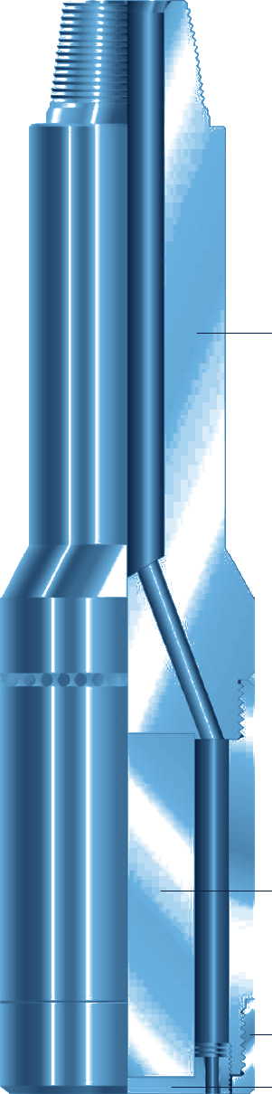



Fishing Magnet
FISHING
PERMANENT MAGNET FOR JUNK RETRIEVAL
GENERAL DESCRIPTION
PERMANENT-MAGNET TOOL THAT RETRIEVES UNDRILLABLE OBJECTS WITH MAGNETIC ATTRACTION: BIT CONES, BEARINGS, SLIPS, MILL CUTTINGS, TONG PINS AND HAMMERS. IT PICKS UP SMALL, ODD-SHAPED ITEMS THAT INSIDE OR OUTSIDE CATCH TOOLS CANNOT HOLD. AVAILABLE FROM 1 IN. TO 20 IN. O.D., ON PIPE OR WIRELINE, WITH PULLS FROM 5 LB TO 5,000 LB DEPENDING ON SIZE. IT IS ALSO USED TO CLEAR THE HOLE BEFORE DIAMOND CORING.
TECHNICAL CHARACTERISTICS
O.D. | Hole size | Top pin | Approx. pull (lb) | Wt (lb)
1 | 1-1/4 to 2 | 5/8 11-N.C. | 5 - 7 | 1
1-1/4 | 1-5/8 to 2-1/2 | 5/8 S.R. | 8 - 10 | 1-1/2
1-1/2 | 2 to 2-3/4 | 5/8 S.R. | 11 - 14 | 3-1/4
1-3/4 | 2-3/8 to 3-1/4 | 3/4 S.R. | 15 - 20 | 5
2-1/4 | 2-3/4 to 3-5/8 | 3/4 S.R. | 25 - 50 | 16
2-1/2 | 3 to 3-3/4 | 3/4 S.R. | 50 - 85 | 18
3 | 3-1/4 to 4-1/8 | 2-3/8 Tbg | 85 - 190 | 20
3-1/4 | 4 to 4-1/4 | 2-3/8 Tbg | 85 - 190 | 25
3-1/2 | 4-1/4 to 4-1/2 | 2-3/8 API Reg. | 150 - 250 | 27-1/2
4 | 4-1/2 to 5 | 2-3/8 API Reg. | 175 - 250 | 43
4-1/2 | 5-1/8 to 5-1/2 | 2-7/8 API Reg. | 250 - 320 | 67
5 | 5-5/8 to 6 | 2-7/8 API Reg. | 320 - 385 | 80
O.D. | Hole size | Top pin | Approx. pull (lb) | Wt (lb)
5-1/2 | 6-1/8 to 6-1/2 | 3-1/2 API Reg. | 385 - 425 | 95
5-3/4 | 6-1/8 to 6-1/2 | 3-1/2 API Reg. | 385 - 425 | 106
6 | 6-5/8 to 7-1/2 | 3-1/2 API Reg. | 425 - 500 | 120
7 | 7-5/8 to 8-1/2 | 4-1/2 API Reg. | 550 - 700 | 162
8 | 8-5/8 to 9-3/4 | 4-1/2 API Reg. | 700 - 850 | 205
9 | 9-7/8 to 11-5/8 | 4-1/2 API Reg. | 850 - 1,000 | 335
10 | 10-1/2 to 11-7/8 | 6-5/8 API Reg. | 1,000 - 1,125 | 390
10-1/2 | 11-3/4 to 13 | 6-5/8 API Reg. | 1,125 - 1,260 | 431
11-1/2 | 12-1/4 to 14 | 6-5/8 API Reg. | 1,260 - 1,550 | 512
14 | 15 | 6-5/8 API Reg. | 1,700 - 2,100 | 770
16 | 17 | 6-5/8 API Reg. | 3,200 - 4,000 | 1,200
19 | 20 | 13-3/8 V-4 thd | 4,200 - 5,000 | 1,700
Dimensions in inches, weights in lb (complete assembly, approximate). S.R.: sucker rod pin; Tbg: tubing pin. Pulls assume the magnet face fully covers a flat surface; pick-up capacity drops considerably on smaller contact areas.
DESIGN FEATURES
OPERATING PARAMETERS
■ Focused field: flux is concentrated at the bottom pole plate; the outer case is not magnetised, so the tool works inside cased hole.
■ Circulation: ports through the body exit inside the guide and keep the pole plate clean.
■ Guides: flush (standard) for large or flat objects; lipped for 3 or more cones or leaning objects; mill guide for tong dies, 1 - 2 cones and safety runs before diamond coring.
■ Run on pipe or wireline: wireline needs adaptors and gives no circulation.
Approach | Stop 6 in. to 1 ft above the fish; circulate to wash
Contact | Reduce flow, lower onto fish, rotate lightly, stop pumps
Max. weight, rotating | 5,000 lb
Max. weight, no rotation | 10,000 lb
Proper charge | 2,500 gauss or more
Excess weight or rotation can damage the pole plate and magnetic element. Never store two magnets face to face: the smaller loses charge. Clean ports after each run.
HOW TO ORDER
Please specify: 1. tool name and assembly number 2. O.D. 3. top connection if other than standard. Recommended accessories: 1 lipped guide and 1 mill guide.

