Slide 1


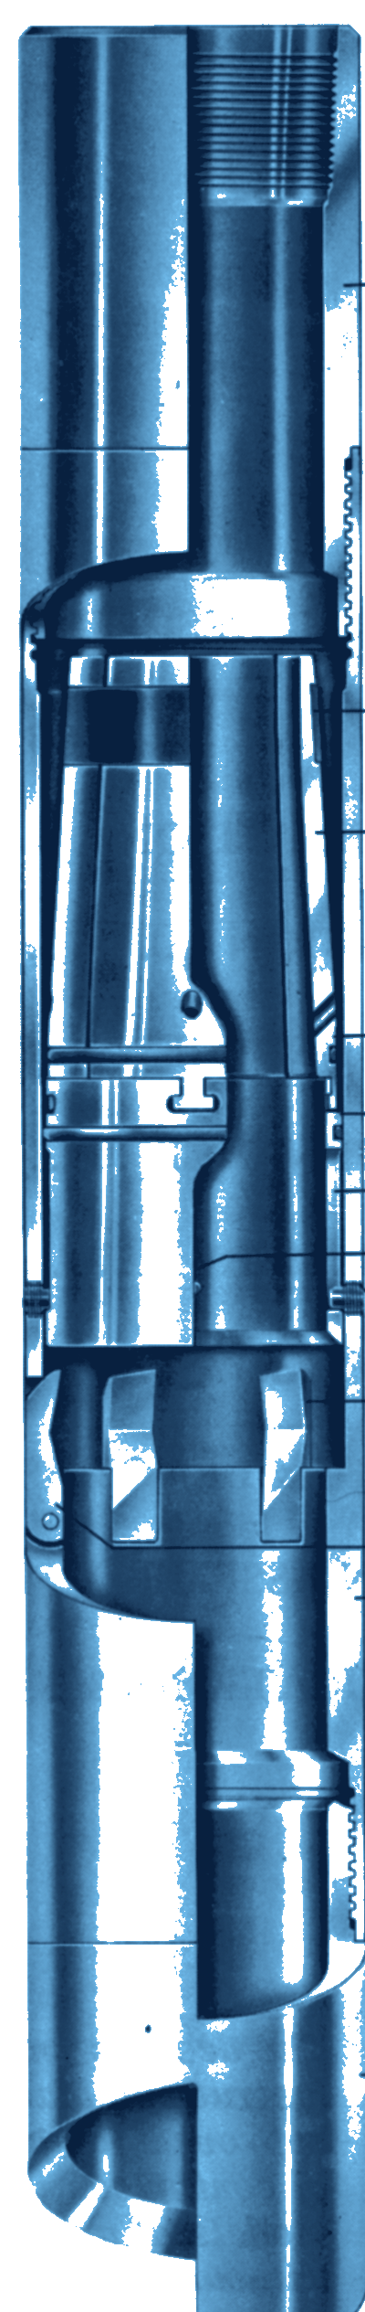



HEC
FISHING
HYDRAULIC EXTERNAL CUTTER
GENERAL DESCRIPTION
HYDRAULICALLY ACTUATED EXTERNAL CUTTER THAT CUTS AND RECOVERS TUBING OR DRILL PIPE IN A SINGLE TRIP. RUN ON A WASHOVER STRING, IT CUTS STUCK PIPE FROM THE OUTSIDE: THE KNIVES ARE FED BY PUMP PRESSURE, GIVING FAST, SMOOTH AND CLEAN CUTS UNDER SENSITIVE OPERATOR CONTROL. IT CUTS ALL TYPES OF DRILL PIPE AND TUBING, REGARDLESS OF TOOL-JOINT STYLE.
TECHNICAL CHARACTERISTICS
Cutter ref. | Pipe to cut | Cutter O.D. | Cutter I.D. | Max. size passed over* | Min. hole to run in | Wt (lb)
70086 | 1.315 - 2-1/16 | 3-3/4 | 2-7/8 | 2-3/4 | 4 | 55
34415 | 1.315 - 2-3/8 | 4-1/16 | 3-3/16 | 3-1/16 | 4-5/16 | 60
70209 | 1.900 - 2-7/8 | 4-7/16 | 3-5/8 | 3-7/16 | 4-11/16 | 73
41727 | 1.900 - 2-7/8 | 4-11/16 | 3-7/8 | 3-3/4 | 4-15/16 | 85
34551 | 2-1/16 - 4 | 5-5/8 | 4-5/16 | 4-3/16 | 5-7/8 | 95
51148 | 2-3/8 - 4 | 6-1/16 | 4-7/8 | 4-13/16 | 6-1/4 | 105
35957 | 3-1/2 - 5 | 8 | 6-1/2 | 6-3/8 | 8-1/2 | 230
* Maximum pipe O.D. the cutter will pass over, dressed with the largest piston segment. Dimensions in inches, weights in lb (approximate).
DESIGN FEATURES
PERFORMANCE PARAMETERS
■ Cuts and recovers: tubing or drill pipe in one trip, inside a washover string.
■ Hydraulic feed: pump pressure drives the knives; sensitive control of the cut.
■ Run-in protection: shear pins hold the piston until the cut starts (about 145 psi).
■ Interchangeable piston segments: one cutter covers several pipe sizes; threaded-edge segments pass collars.
■ Cool, flushed cut: each segment has a fluid passage for flushing and cooling.
■ Hardened knives: tempered tool steel, replaceable in the field.
■ Guide options: standard cut-lip, extra long wall hook or mill-toothed.
Rotary speed while cutting | 15 - 25 rpm
Shear pins | 1 pin: about 377 lb; 2 pins: 754 lb
Proving the cut | Torque drop, weight rise
Cut position | 1 joint above washover shoe
PULL CAPACITY AND HYDRAULICS
Cutter ref. | Max. load (lb) | psi | gpm
70086 | 2,530 - 7,910 | 20 - 40 | 120 - 220
34415 | 1,860 - 3,340 | 20 - 45 | 120 - 220
70209 | 1,550 - 3,570 | 10 - 25 | 120 - 145
41727 | 1,128 - 1,780 | 10 - 30 | 100 - 200
34551 | 6,100 - 16,800 | 15 - 55 | 180 - 230
51148 | 2,350 - 4,800 | 15 - 40 | 125 - 200
35957 | 5,160 - 9,040 | 10 - 20 | 140 - 180
OPERATING NOTES
■ Before the run: wash over the stuck pipe to centralise it at the cut point.
■ Avoid surging: pressure surges can break a knife tip.
■ After the cut: torque drops and the weight indicator rises; raise the string slowly to confirm.
Approximate values, depending on pipe size. Static loads: if shock loaded, reduce by 50%.
HOW TO ORDER
Please specify: 1. cutter ref. and size of pipe to cut 2. piston segment size 3. connection (top and bottom) 4. guide type (standard, wall hook or mill-toothed) 5. recommended spares: knives, knife pins, shear pins, piston and rubber rings.

