Slide 1


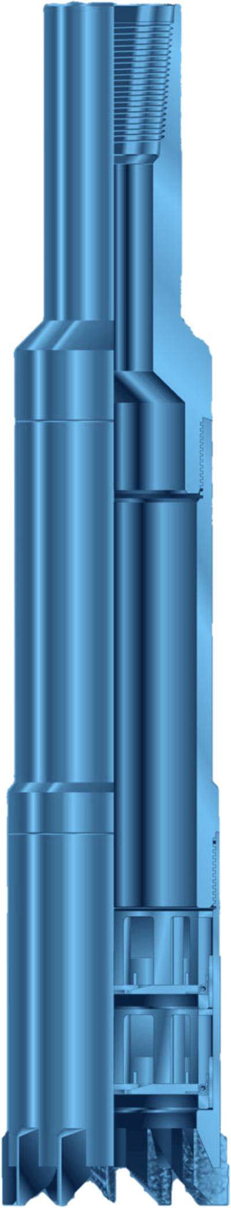



JUNK BASKET
FISHING
JUNK BASKET WITH DOUBLE CATCHERS
GENERAL DESCRIPTION
SIMPLE, DEPENDABLE FISHING TOOL FOR RETRIEVING LOOSE JUNK FROM THE BOTTOM OF THE HOLE: BIT CONES, BEARINGS, BROKEN SLIPS, WIRELINE, HAND TOOLS, DEBRIS FROM TWISTED-OFF STRINGS AND MILLING CUTTINGS. TWO FREE-REVOLVING CATCHERS SIT INSIDE A MILL SHOE, SO THE BASKET CUTS A SHORT CORE THAT LOCKS THE JUNK IN THE BARREL. IT CAN ALSO TAKE A CORE SAMPLE, DRILL A FULL-GAUGE HOLE OR REAM. MAGNET INSERTS AND ACCESSORY SHOES ADAPT IT TO THE JOB.
TECHNICAL CHARACTERISTICS
Hole size | Barrel OD | Shoe OD | Max. fish Ø | Teeth | Wt (lb)
3-3/4 - 4-1/8 | 3-5/8 | 3-5/8 | 2-11/16 | 8 | 55
4-1/4 - 4-1/2 | 3-3/4 | 4-1/16 | 2-15/16 | 8 | 60
4-5/8 - 5 | 3-7/8 | 4-1/2 | 3-9/32 | 8 | 65
4-5/8 - 5 | 3-7/8 | 4-1/2 | 3-3/8 | 8 | 65
5-1/8 - 5-1/2 | 4-1/4 | 4-7/8 | 3-23/32 | 8 | 80
5-3/8 - 6 | 5-1/8 | 5-1/8 | 3-25/32 | 8 | 80
5-5/8 - 6 | 4-3/4 | 5-3/8 | 4-1/16 | 8 | 100
6-1/8 - 6-1/2 | 5-3/4 | 5-3/4 | 4-13/32 | 8 | 200
6-1/8 - 6-1/2 | 5-1/8 | 5-7/8 | 4-5/16 | 8 | 110
Hole size | Barrel OD | Shoe OD | Max. fish Ø | Teeth | Wt (lb)
6-1/8 - 6-1/2 | 5-1/4 | 5-7/8 | 4-1/2 | 8 | 110
6-5/8 - 7 | 5-3/4 | 6-1/4 | 4-13/16 | 8 | 125
7-1/4 - 8 | 6-1/2 | 7-1/8 | 5-7/16 | 8 | 160
8-1/4 - 9 | 7-1/2 | 8-1/8 | 6-3/16 | 8 | 205
9-1/4 - 10-1/8 | 8-1/2 | 9-1/8 | 7-3/16 | 10 | 255
10-1/4 - 11-5/8 | 9-3/8 | 10-1/8 | 8-1/16 | 12 | 290
11-3/4 - 12-1/2 | 10-3/8 | 11-1/4 | 9-1/16 | 12 | 360
12-5/8 - 15 | 11-3/8 | 12-1/4 | 10-1/16 | 12 | 450
15 - 20 | 13-3/4 | 14-1/2 | 12-1/16 | 16 | 655
Dimensions in inches, weights in lb (approximate). Shoes should be at least 1/8 in. over the barrel size.
DESIGN FEATURES
OPERATING PARAMETERS
■ Double catchers: the upper fingers reach half way to the centre and break the core on pull; the lower catcher has alternating long and short fingers forming a close-fitting basket.
■ Free-revolving catchers: spin inside the shoe, which prevents finger breakage.
■ Rivet-free catchers: manganese bronze or steel fingers, redressed easily on location.
■ Magnet insert: replaces the two catchers and turns the basket into a fishing magnet, useful in hard formations or to clean the hole before diamond drilling.
Approach | Start circulation at reduced pressure just before bottom, rotate and lower slowly onto the fish
Mill shoes | 1 ton on bottom, 50 - 150 rpm
Finger shoes | Rotate and lower slowly to about 2 tons on bottom
Breaking the core | Stop rotation and circulation, release torque, take an upward pull; a hydraulic jar above helps
SHOE SELECTION
After use, disassemble, clean and lubricate all internal parts, inspect catcher fingers and springs, and paint or grease the outside.
■ Type A mill shoe: side wings, hard metal facing; standard, for soft formations and loose fish.
■ Type B mill shoe: hard-faced with sintered tungsten carbide, for hard formations.
■ Type C mill shoe: flat bottom, hard-faced on bottom, inner and outer faces; cuts cores and burns metal.
■ Finger shoe: for large, loose junk or junk too big for the catchers.
HOW TO ORDER
Please specify: 1. tool name and size 2. OD and type of shoe 3. top connection, if other than standard 4. recommended spares: 2 upper catchers, 2 lower catchers, 3 mill shoes, 2 finger shoes, 4 finger shoe replacements.

