Slide 1


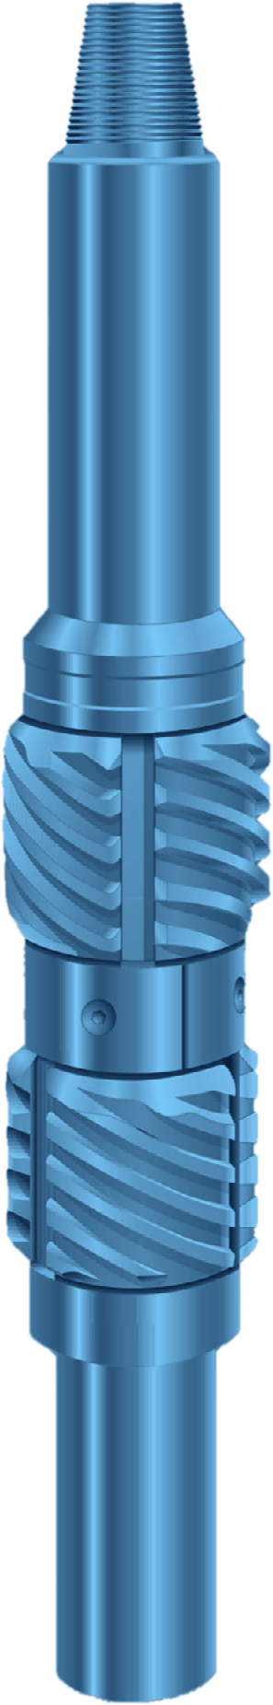



SCRAPER
CLEANING
FULL-CIRCLE CASING SCRAPER
GENERAL DESCRIPTION
CASING SCRAPER THAT REMOVES MUD, CEMENT, BULLETS, RUST, SCALE, PARAFFIN AND PERFORATION BURRS FROM THE INSIDE WALL OF CASING. THE BLADES ARE SPACED TO CONTACT 600 DEGREES OF THE CASING SURFACE AT ONCE, SO EVERY PART OF THE WALL IS SCRAPED WHETHER THE TOOL IS ROTATED OR SPUDDED. SHORT AND COMPACT, WITH A LONG TAPER ON THE BLADES, IT PASSES THROUGH CASING JOINTS WITHOUT HANGING. IT WORKS IN VERTICAL OR ROTARY OPERATIONS AND CAN BE RUN ON DRILL PIPE, PIN UP OR PIN DOWN.
TECHNICAL CHARACTERISTICS
Scraper for casing OD | Casing weight (lb/ft) | Casing ID min. | Casing ID max. | Top connection API Reg. | Fishing neck Ø | Tool ID | Tool OD
4-1/2 | 9.5 - 13.5 | 3.886 | 4.622 | 2-3/8 | 3-1/8 | 13/16 | 3-5/8
5-1/2 | 14.0 - 23.0 | 4.662 | 5.250 | 2-7/8 | 3-3/4 | 1-1/4 | 4-3/8
5-1/2, dressed for 6-5/8 | 20.0 - 33.0 | 5.600 | 6.188 | 2-7/8 | 3-3/4 | 1-1/4 | 4-3/8
7 | 17.0 - 38.0 | 5.850 | 6.688 | 3-1/2 | 4-1/4 | 1-1/2 | 5-1/2
7, dressed for 7-5/8 | 24.0 - 47.1 | 6.308 | 7.188 | 3-1/2 | 4-1/4 | 1-1/2 | 5-1/2
9-5/8 | 32.3 - 64.9 | 8.224 | 9.188 | 4-1/2 | 5-1/2 | 2-1/4 | 8-1/8
10-3/4 | 32.75 - 79.2 | 9.22 | 10.412 | 6-5/8 | 7-3/4 | 3-1/2 | 9-3/16
13-3/8 | 48.0 - 98.0 | 11.911 | 13.238 | 6-5/8 | 7-3/4 | 3-1/2 | 11
Dimensions in inches. One blade size covers a full range of casing weights for each casing OD. Casing ID range = recommended minimum and maximum.
DESIGN FEATURES
APPLICATIONS
■ Full-circle scraping: two rows of blades overlap, covering 600 degrees of casing wall.
■ Spring-loaded blades: move in or out with gradual ID changes and stay on the clean wall without cutting the metal.
■ Abrupt obstructions: a burr or cement fragment is held by the close-fitting blade slot, the mandrel and the split retainer ring.
■ Wear-resistant blades: precision-cast tool steel, tough, slightly work-hardening in service.
■ Secure construction: springs fully enclosed, blades fit closely over the spring housing, so loss downhole is virtually impossible.
■ One-piece mandrel: heat-treated alloy steel, pin by box, with a fishing neck at both ends.
■ Clean out cement, hardened mud and paraffin.
■ Remove perforation burrs and embedded bullets.
■ Dress burrs, nicks and tight spots left by bits, fishing tools or dents.
■ Prepare a clean casing ID before running packers, patches, spears, swabs and wireline tools.
OPERATION AND MAINTENANCE
■ Run: usually pin up, with a bit installed below; scrape by rotating or spudding.
■ After each run: disassemble, clean, inspect and replace worn parts; blades and springs are removed after taking out the four retainer-ring screws.
■ Re-dressing: a blade installation tool (required accessory) compresses the blades during assembly.
HOW TO ORDER
Please specify: 1. tool or part name 2. size and weight of casing 3. tool joint connection 4. recommended spares: one set of blades and one set of springs.

